Slide 1
CMS – Bari 1st meeting 2021 G. Pugliese 19 gennaio 2021

Slide 2
Welcome!!
Filippo Errico RTDA - REFIN
Adriano Di Florio RTDA – REFIN
Raffaella Radogna RTDa
Complimenti ad Alexis che ha vinto il CERN S.A.

Slide 3
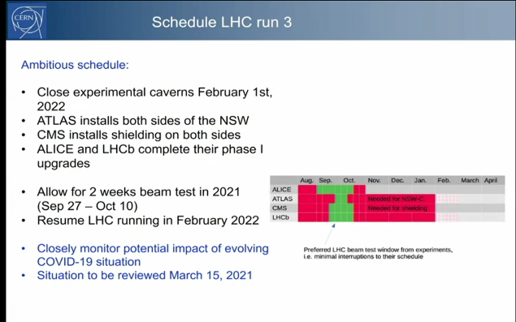
CERN news
New Year presentation to personnel 18th Jan
https://indico.cern.ch/event/988916/

Slide 4
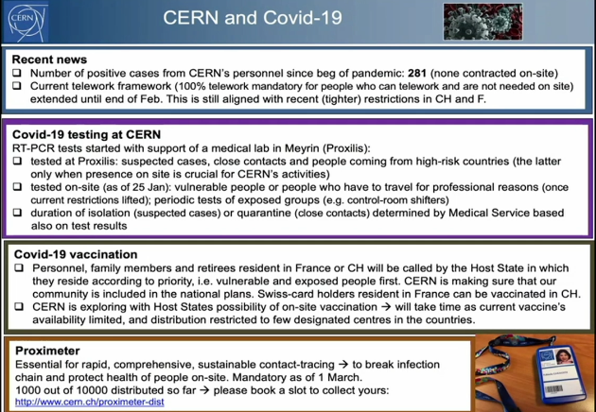
CERN news

Slide 5
Chair of CMS CB
Hanno accettato la nomination:
Elisabetta Gallo (DESY, Germany)
Panja Luukka (LUT, Finland)
Chiara Mariotti (INFN-Torino, Italy)
Niki Saoulidou (Athens, Greece)
Claudia-Elisabeth Wulz (HEPHY, Austria)
This list will be presented by the Chair of the Election Committee at the CB meeting on Friday, 2 February 2021.
The CVs and statements will be distributed on Friday, 18 March 2021.
The election will take place starting Wednesday 21 April 2021 by e-voting.

Slide 6
LV1 nominations
1) Physics Co-Coordinator
The candidate should have a broad view of the LHC physics potential and of the CMS physics program, from object definitions to final analysis. The candidate should be familiar with existing CMS Run3 physics plans, have a vision towards new scientific directions and innovative analysis techniques, and have demonstrated leadership capabilities in physics analysis and experience in the CMS analysis workflows. Prior experience in other coordination areas, while not required, is considered an asset.
2) Trigger Co-Coordinator
The candidate should have a broad view of the Run3 physics analysis needs in terms of trigger performance and algorithms. The candidate should be familiar with trigger algorithm workflows. In particular, technical experience in the implementation of the algorithms and/or in the recent development of the HLT workflows for Run3 is highly desirable. Prior experience in Level-1 trigger activities, while not required, is considered an asset.
3) Offline & Computing Co-Coordinator
The candidate should have demonstrated experience in offline and computing workflows for large, distributed, projects. In particular, experience in cutting edge software development and deployment on a large scale is highly desirable as is familiarity with plans and technologies targeting computing upgrades for HL-LHC, in particular in view of the coming TDR.
4) Physics Performance and Dataset Co-Coordinator
The candidate should be familiar with PPD activities: alignment and calibration workflows, data quality monitoring, data and Monte Carlo production validation and Particle Flow-based reconstruction. In particular, technical knowledge of Monte Carlo and data production as well as of alignment and calibration workflows is highly desirable. The candidate’s degree of familiarity with production constraints and plans for Run3 will also be taken into account. Prior experience in Offline and Computing and/or in DPG/POG activities, while not required, is considered an asset.
The co-coordinator terms begin September 1, 2021 and end August 31, 2023.
The nomination deadline is Friday midnight (CERN time) February 5th, 2021.
A final list of nominees, prepared by the SC and SP, will tentatively be presented to the Management Board on April 12th for endorsement, and for approval by the CB during CMS Week the following week.

Slide 7
L2 nominations
Physics Office: 1 communication officer
For this position the candidates should be familiar with CMS communication and outreach activities, and possibly be engaged on social platforms. The candidates should also have a broad view of the CMS physics program, possibly having carried out analyses in multiple groups and having also actively participated in detector construction, computing, software development, trigger, data taking or dataset preparation.
Physics Object Groups : 1 convener in EGM, JME, TAU, LUM, MUO, BTV, TRK, and 2 for PRO Shared groups: 1 GEN (shared with Offline and Computing coordination area), 2 PF (shared with PPD coordination area)
For the POG, GEN and PF positions we expect the candidates to be familiar with the group activities, to have knowledge of the software maintained and developed by the group, to know the procedures for calibrations and with trigger development. Having served as L3 or L2 convener in the POG, in related detector projects, or in PAGs or other coordination areas (PPD, O&C, TSG) is considered an added value.
Physics Analysis Groups: 1 convener in BPH, EXO, HIG, HIN, SUS, SMP, TOP, and 2 conveners for B2G
For the PAG positions the candidates should have experience with the analyses performed in the group and with the tools needed to perform analyses. The conveners are expected to be familiar with the CMS editorial processing, for example having successfully served as ARC members or as editors of ANs, PASes and papers. Having served as L2 or
L3 convener in a POG, in a detector project or PPD, O&C or TSG will be highly considered in the evaluation process.
The appointments will start on September 1st 2021 and end on August 31st, 2023.
The selection timeline, which is designed to give nominees sufficient time to prepare for their appointments, is as follows:
• 18 Jan 2020 - call for nominations
• 8 Feb 2021 - close nominations, send mail to all candidates.
• 22 Feb 2021 - deadline for candidates to accept/reject nomination • 12 Apr 2021 - proposed list of nominations to MB • 23 Apr 2021 - CB meeting

Slide 8
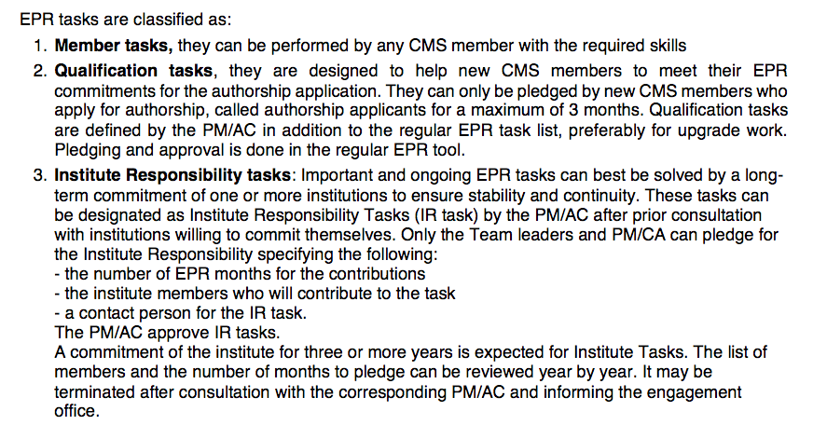
New EPR: definizioni e regole
Special Meeting of the CMS Collaboration Board, today
https://indico.cern.ch/event/993529/ to approve the new rules for Experimental Physics Responsibilities (EPR) in CMS:

Slide 9
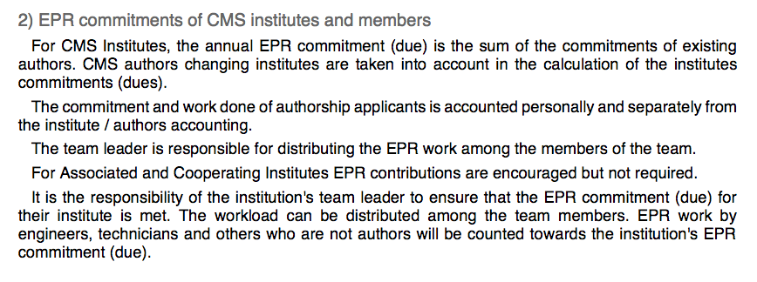
New EPR: definizioni e regole

Slide 10
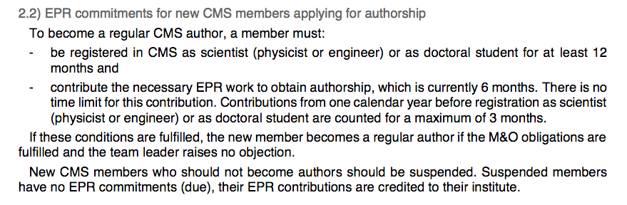
New EPR: definizioni e regole
Tolto il “bonus per gli instituti che coprono il 100% del duty.
2.3) Possible EPR reductions for institutes (see in the doc)

Slide 11
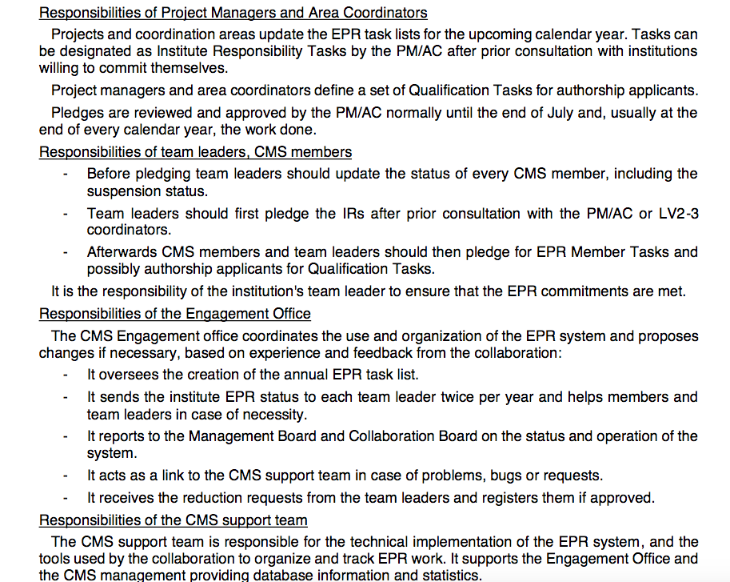
New EPR: definizioni e regole
..

Slide 12
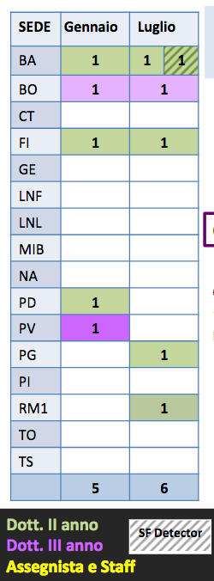
CERN- Semil - Fellow
3 posizioni richieste ed ottenute da Bari
Inizio previsto a Marzo (?).
https://agenda.infn.it/event/23790/contributions/120123/attachments/75815/97484/CMS_pres_referee_Sett2020_v1.pdf

Slide 13
Stato Finanziario Bari
VOCE | 2020 (in Euro) | 2021 (in Euro)*
Missioni | 135k (restituito 48k) | 179,5 k
Consumi (CMS) | 55k | 46,5k
Consumi (phase 2) | 11 k | 3.5 k
CORE (phase2) | 175 k (41k Tracker) (134k GEM) | 120,5k + 18 SJ
Missioni:
Il direttore intende approvare solo missioni motivate da attività non rinviabili svolte da personale già presente al CERN.
Preventivi https://www.ac.infn.it/preventivi/2021/ e presentazione Ref. https://agenda.infn.it/event/23790/contributions/120123/attachments/75815/97484/CMS_pres_referee_Sett2020_v1.pdf in back-up

Slide 14
SPARES

Slide 15
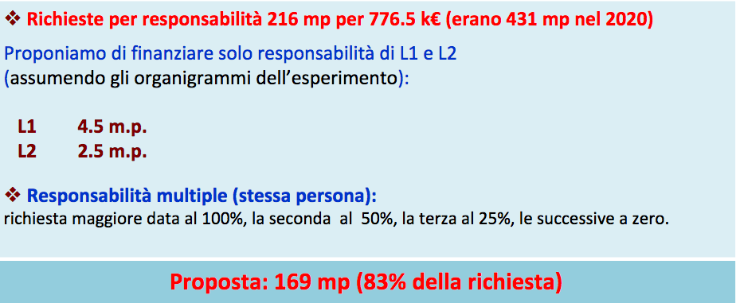
Missioni

Slide 16
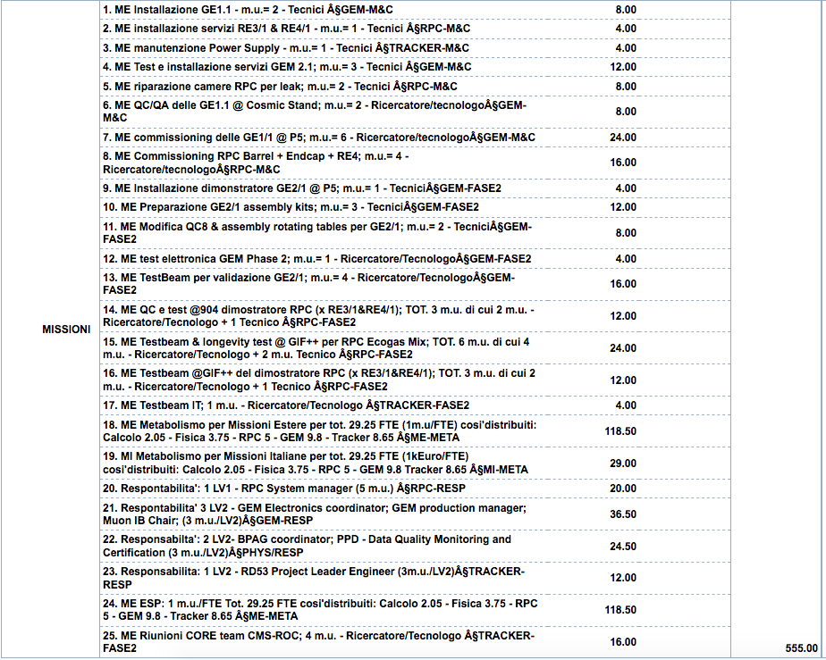
Richieste: CMS

Slide 17
CMS Restarting
Il CERN entra nella fase 3. Per poter entrare al CERN non è più necessario essere inserito nella lista di accessi ma è sempre necessario avere il corso COVID CERN (sono sempre esclusi i soggetti a rischio).
CERN HSE COVID-19 info | Main Page
HSE CERN COVID-19 FAQ | FAQ COVID-19
Memorandum COVID-19-related health and safety measures | EDMS 2370902
CERN Instruction on COVID-19 Health and Safety Measures | EDMS 2370903
CERN Instruction on COVID-19 Health and Safety Measures for contractors | EDMS 2373120
CERN instructions on COVID-19 related health and safety measures - addendum to Annex 1 (HVAC) | EDMS 2389839
COVID-19 related instructions on office work places | EDMS 2398834
CMS Safety Website | FAQ
CMS Work Safety procedure - Interventions in the context of Covid-19 | EDMS 2366490
CMS Work Safety procedure - Covid-19 briefing check-list and signs | EDMS 2366534
TRAINING: COVID-19 - Health & Safety Measures at CERN | LMS
CMS Training pills vs Covid-19 | EDMS 2376368 – INDICO
SMB Services availability | Link

Slide 18
Restarting activity
Our INFN director created a working group for the re-starting of activity. Actions:
Start planning the re-starting of activity on the following bases:
Access to Offices and laboratories alone or in VERY small team
Reduce moving to workers not residence in Bari
Reduce the incoming of international students and colleagues.
Document to be filled for CMS (before Monday): https://docs.google.com/document/d/1fNfPhuzIDtX61YyKQiUH6uEs3AskcFXqtsz-4rC5H4Q/edit
INFN Meeting is planned for April 27, 11.30
Similar policy will be followed by MIUR (Alexis’s email):
Phase 2: May-August
Phase 3: Sept – Jan 2021!!

