Slide 1
SRIM SIMULATIONS OF DLC IRRADIATION AT CEDAD
DLC layer (100 nm)
Kapton (50 µm)
Copper (5 µm)
BEAM

Slide 2
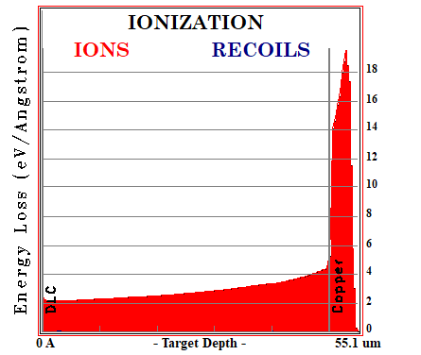
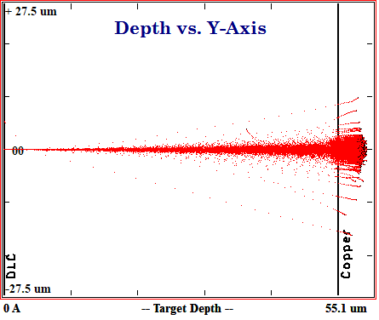
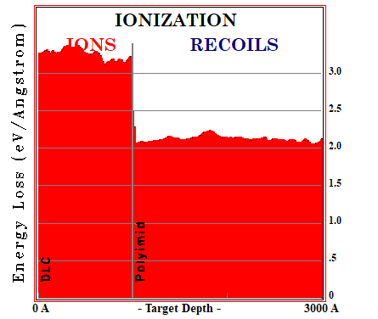
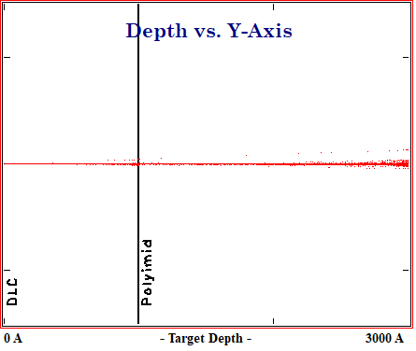
SIMULATION 1
Ion: ¹H¹⁺
Energy: 2 MeV
The stopping power
in the DLC layer is:
Protons are implanted in Cu
~ 30 keV/µm

Slide 3
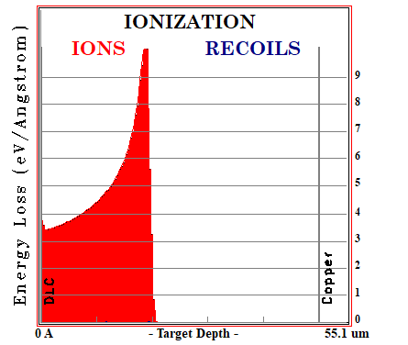
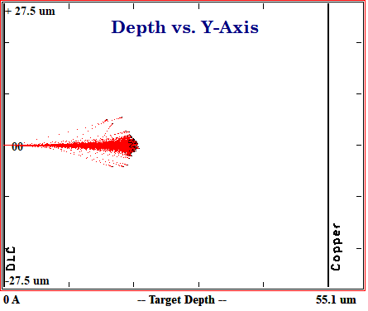
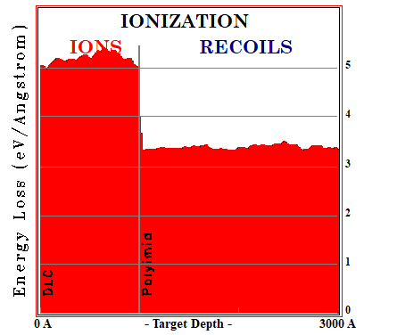
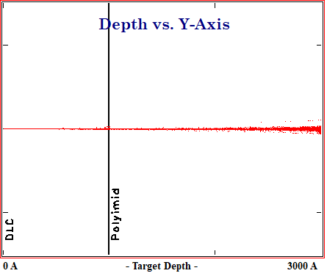
SIMULATION 2
Ion: ¹H¹⁺
Energy: 1 MeV
The stopping power
in the DLC layer is:
Protons are implanted in Kapton
~ 50 keV/µm

Slide 4
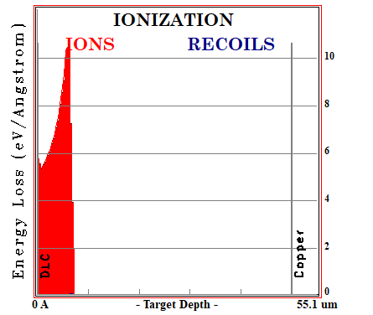
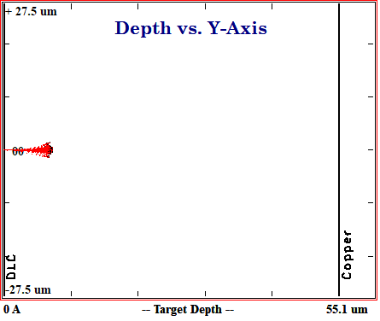
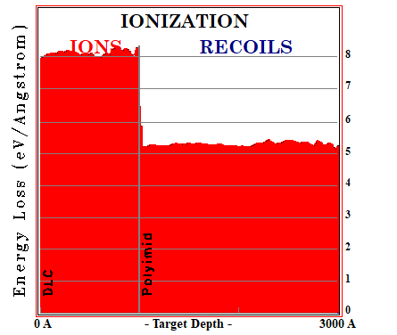
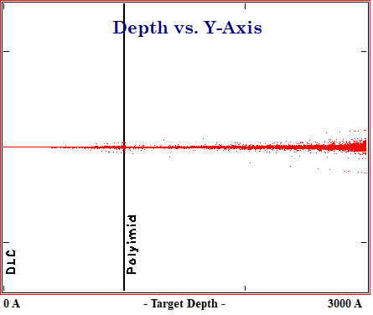
SIMULATION 3
Ion: ¹H¹⁺
Energy: 0.5 MeV
The stopping power
in the DLC layer is:
Protons are implanted in Kapton
~ 80 keV/µm

Slide 5
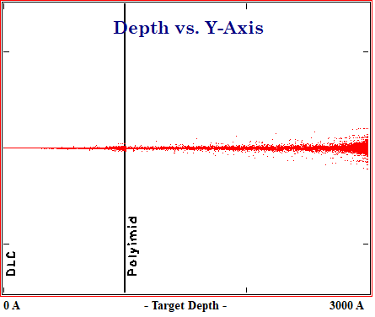
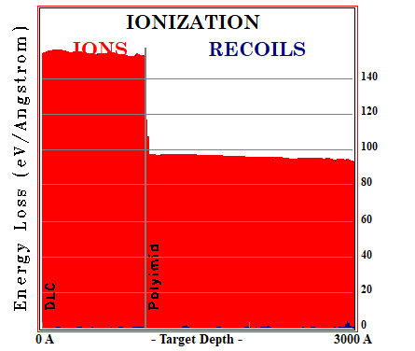
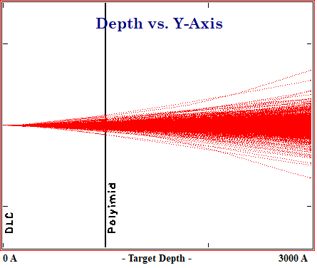
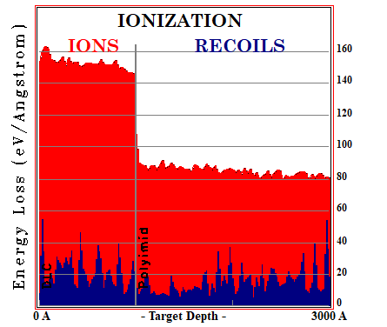
SIMULATION 4
Ion: ¹²C³⁺
Energy: 2 MeV
Carbon is implanted in Kapton
The stopping power
in the DLC layer is:
~ 150 keV/µm
SIMULATION 5
Ion: ⁶³Cu³⁺
Energy: 2 MeV
Copper is implanted in Kapton
The stopping power
in the DLC layer is:
~ 170 keV/µm
(ions+recoils)

Slide 6
DLC layer (100 nm)
Cr (5 nm)
Copper (5 µm)
Kapton (50 µm)
Copper (5 µm)
BEAM

Slide 7
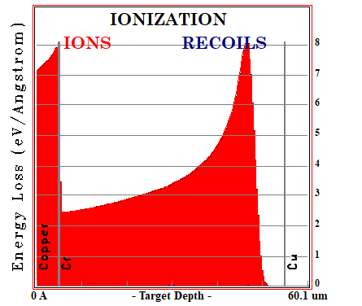
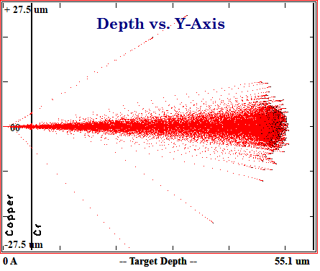
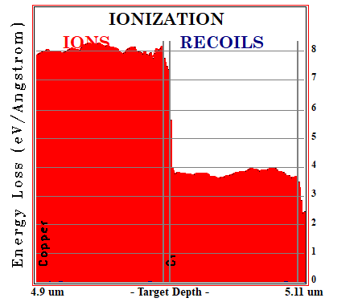
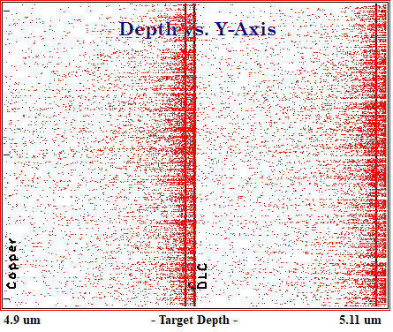
SIMULATION 6
Ion: ¹H¹⁺
Energy: 2 MeV
The stopping power
in the DLC layer is:
Protons are implanted in the Kapton
~ 35 keV/µm

Slide 8
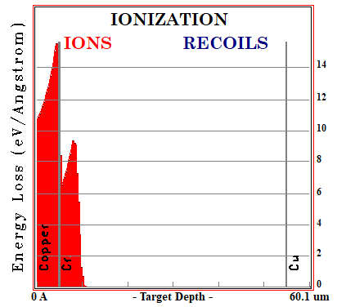
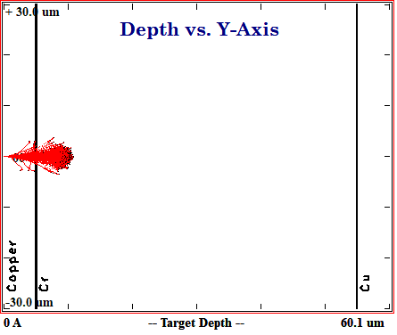
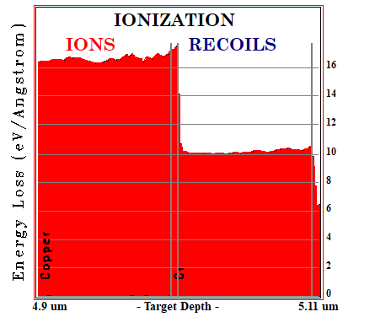
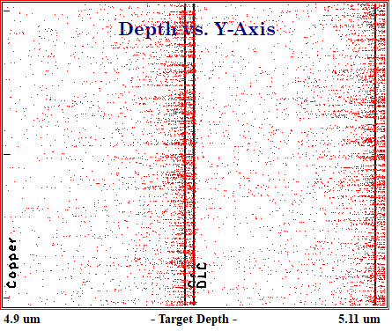
SIMULATION 7
Ion: ¹H¹⁺
Energy: 1 MeV
The stopping power
in the DLC layer is:
Protons are implanted in the Kapton
~ 100 keV/µm

Slide 9
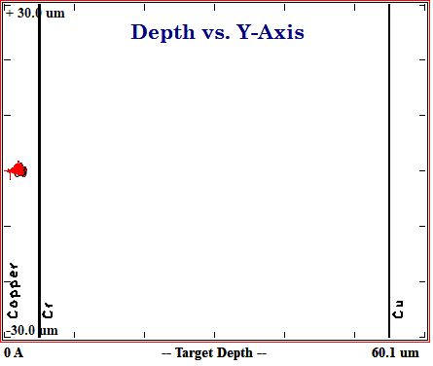
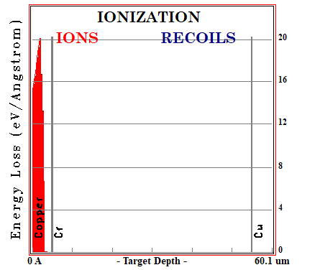
SIMULATION 8
Ion: ¹H¹⁺
Energy: 0.5 MeV
Protons are implanted in the first Cu layer

