Slide 1
Fermipy tutorial - hands on session...
Principe Giacomo*^{1,2,3}
¹Dipartimento di Fisica, Università di Trieste, Trieste, Italy
²Istituto Nazionale di Fisica Nucleare, Trieste, Italy
³INAF - Istituto di Radioastronomia, Bologna, Italy

Slide 2
Fermipy Step by Step: LAT data download
Target: 3C454.3
https://fermi.gsfc.nasa.gov/cgi-bin/ssc/LAT/LATDataQuery.cgi
Alternative command (instead of wget) for data-download with Mac:
curl –o ft1.fits ....

Slide 3
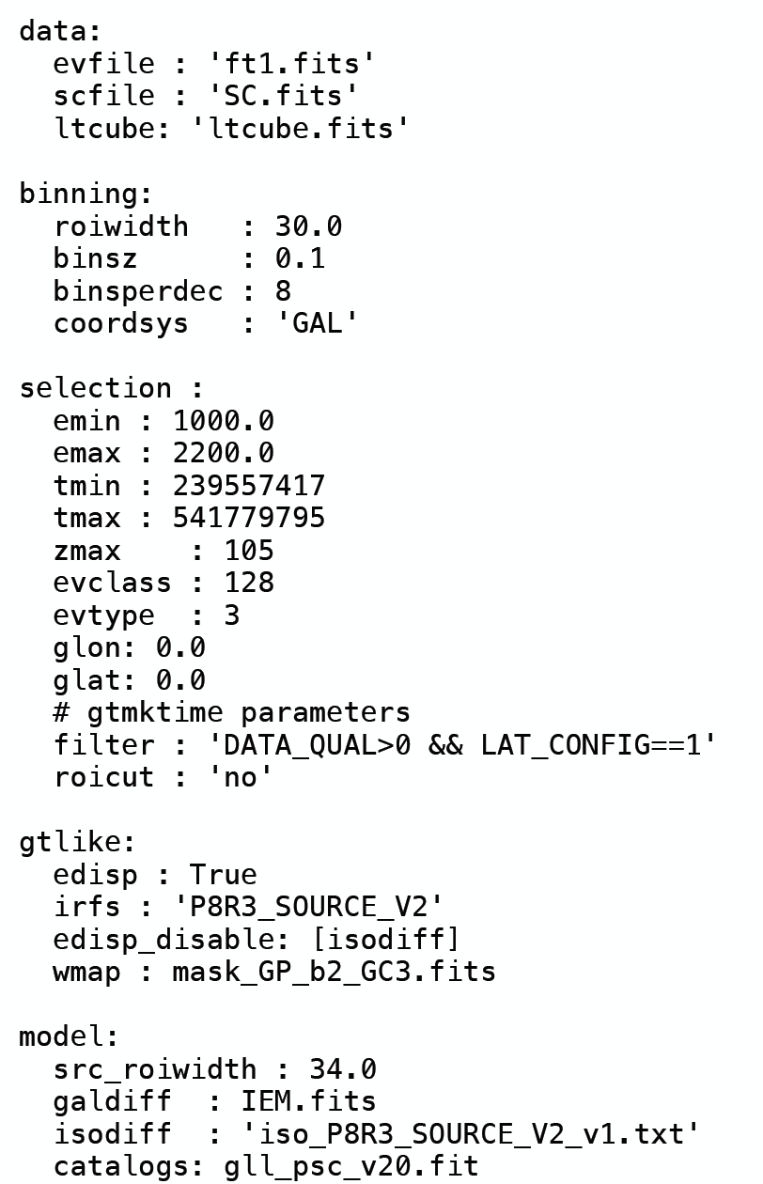
Remind - Configuration file
The data section contains the path to the ft1, ft2 and ltcube
The binning part specifies the pixel size, energy bins and ROI width
The selection part report the energy range, time interval, zmax, center of the ROI and cuts for gtmktime.
gtlike part includes the irfs, energy dispersion and weight map
Model: catalog, IEM and ISO
template

Slide 4
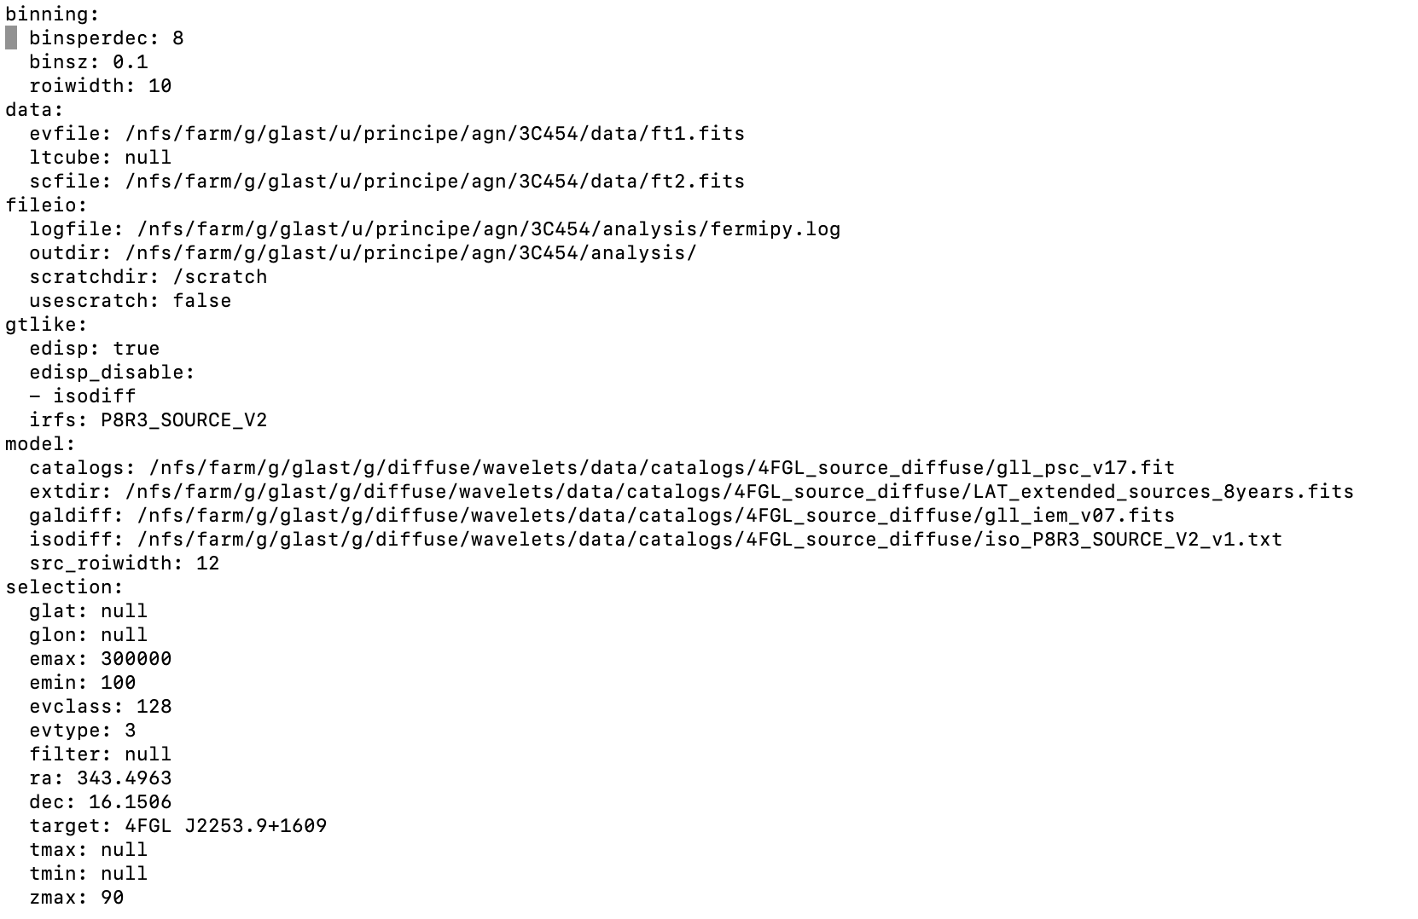
Config file preparation

Slide 5
Remind - Preliminary steps of the analysis
gta.setup() runs the gt-tools (gtselect, gtmktime, gtbin, gtcountsmap, gtexposure,..) for selecting the data, creating counts and exposure maps, etc..
Then gta.print_model():
gta.free_sources(), gta.free_shape(), gta.set_norm() ….
gta.write_roi() print different control plots: count spectrum, count map,….

Slide 6
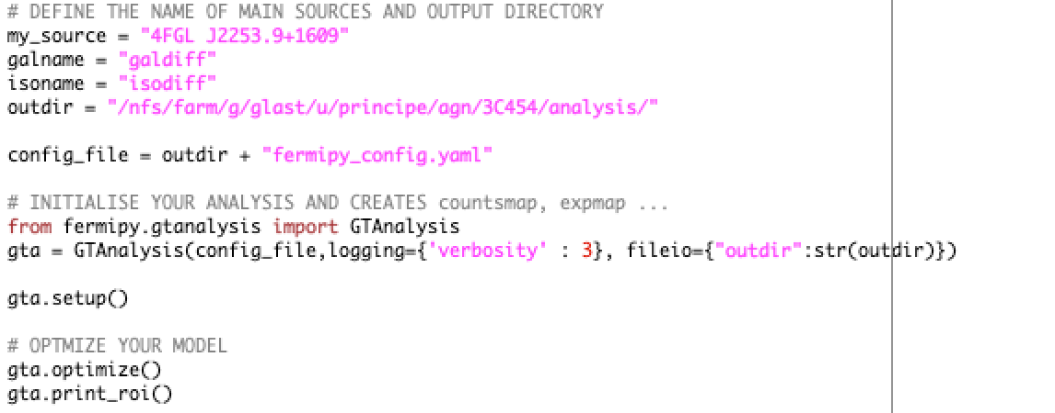
Run gta.setup()

Slide 7
Remind : Performing a preliminary fit - gta.optimize()

Slide 8
gta.optimize()

Slide 9
Remind– free sources

Slide 10
free sources

Slide 11
Remind: Performing a fit: gta.fit()
gta.fit() is a wrapper on the pyLikelihood fit.
By default gta.fit() will repeat the fit until a fit quality of 3 is obtained. After the fit returns all sources with free parameters will have their properties (flux, TS, NPred, etc.) updated in the ROIModel instance. The return value of the method is a dictionary containing the following diagnostic information about the fit:

Slide 12
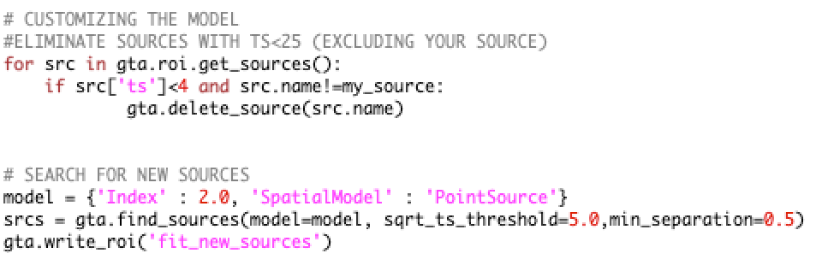
gta.fit()
Preliminary fit
Customize your model: remove undetected sources - add new sources
Second fit

Slide 13
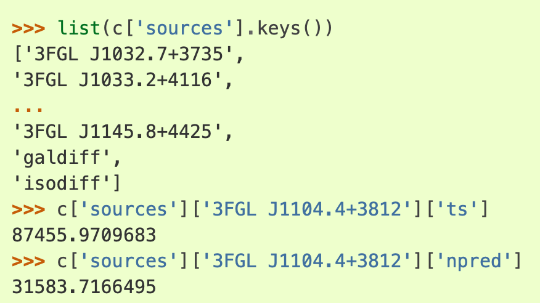
Remind: printing or saving the output model
We can check the results of the optimization step by calling print_roi():
After the fitting is complete we can write the current state of the model with write_roi():
Using FitsView (or Topcat, or python libraries) for exploring the output file, or numpy - astropy
import numpy as np

Slide 14
Checks on the fit

Slide 15
Remind: performing a fit: gta.sed()
The sed() method computes a spectral energy distribution (SED) by performing independent fits for the flux normalization of a source in bins of energy. The normalization in each bin is fit using a power-law spectral parameterization with a fixed index.
Use option: make_plots=True !!!

Slide 16
gta.lightcurve()
(Eventual localization) and SED fit

Slide 17
Remind: Lightcurve analysis

Slide 18
gta.lightcurve() -

Slide 19
Summary
In the hands on session we have performed a complete analysis of a flaring source.
Note that the fitting results are still preliminary since usually an iterative fitting procedure (improving the model at each step) is needed to obtain an accurate model for describing our data.
More information on the Fermipy analysis can be found in:
https://fermipy.readthedocs.io/en/latest/
In case of problems with the use of the fermipy library you can also have a look and create a new issue in:
https://github.com/fermiPy/fermipy/issues
Enjoy your Fermipy analysis!

