Slide 1
Analysis of neutrons data collected at GSI:
first steps
Sofia Colombi, Cristian Massimi, Roberto Zarrella, Riccardo Ridolfi
FOOT Physics Meeting
06/10/2021
1

Slide 2
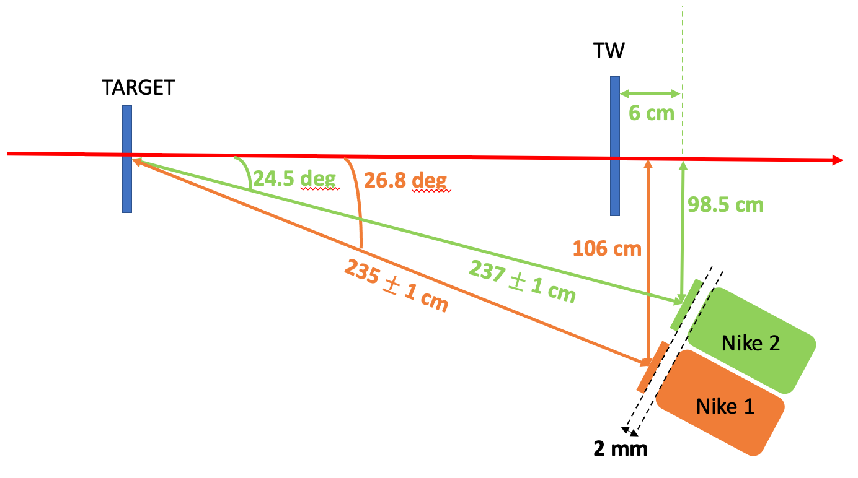
Setup
Veto 2
ch 13 WD, HV: 1200 V
Nike 2
ch 15 WD, HV: 1150 – 1200 V
Veto 1
ch 11 WD, HV: 1200 V
Nike 1
ch 14 WD, HV: 1150 – 1200 V
Notes:
198 cm from the floor
2 deg lower than the beam line
06/10/2021
S. Colombi
FOOT physics meeting
2

Slide 3
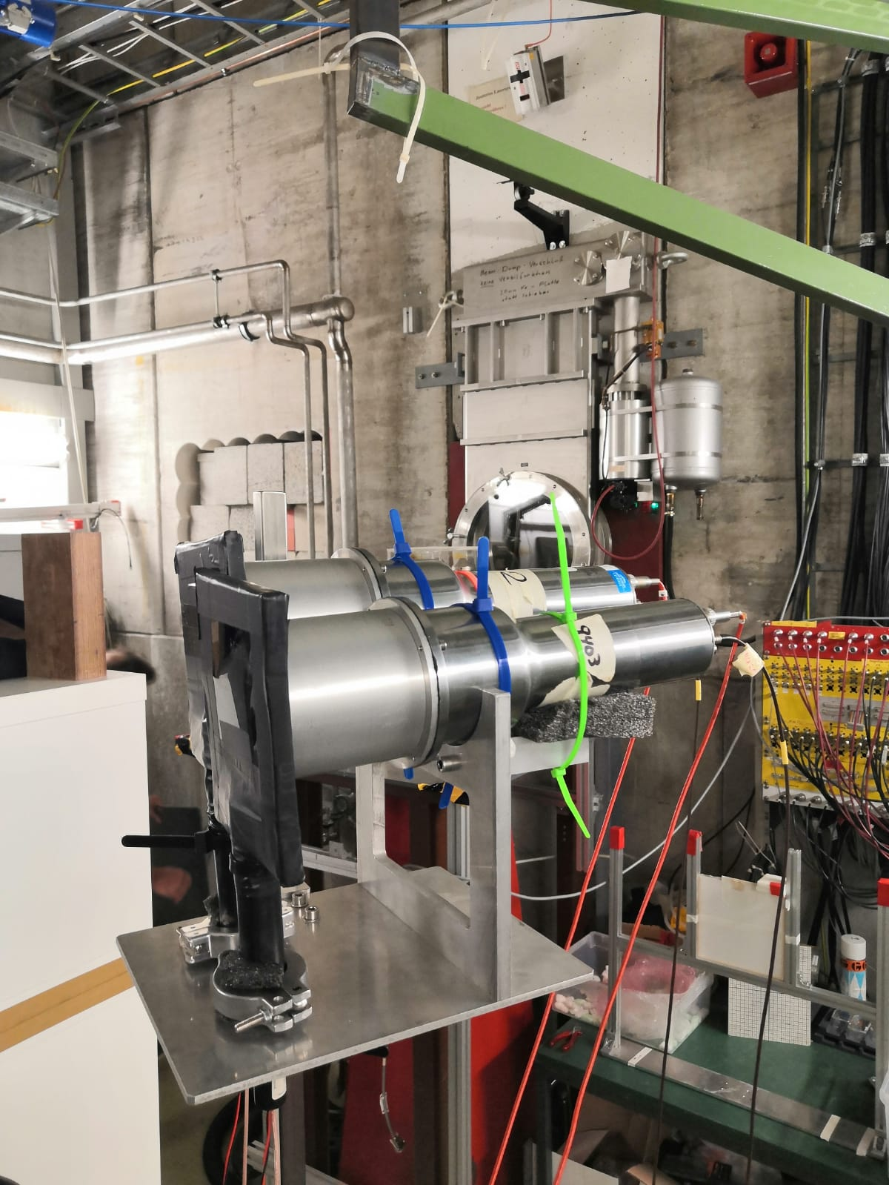
Setup
Veto 2
ch 13 WD, HV: 1200 V
Nike 2
ch 15 WD, HV: 1150 – 1200 V
Veto 1
ch 11 WD, HV: 1200 V
Nike 1
ch 14 WD, HV: 1150 – 1200 V
Notes:
198 cm from the floor
2 deg lowet than the beam line
06/10/2021
S. Colombi
FOOT physics meeting
3

Slide 4
Data collected
All the collected files : /gpfs_data/local/foot/NeutronsGSI2021
MargMaj_16O_200AMeV_5mmC2H4.root
MargMaj_16O_200AMeV_5mmC.
MargMaj_16O_200AMeV_5mmC_TWmoved.root
MargMaj_16O_200AMeV_notarget.root
MargMaj_16O_200AMeV_notarget_TWmoving.root
MargMaj_16O_400AMeV_10mmC2H4.root
MargMaj_16O_400AMeV_5mmC2H4.root
MargMaj_16O_400AMeV_5mmC2H4_TWscan.root
MargMaj_16O_400AMeV_5mmC.root
MargMaj_16O_400AMeV_notarget.root
Frag_16O_200AMeV_5mmC_calo2deg_MBprescale7.root
Frag_16O_200AMeV_5mmC_calo4deg_MBprescale7.root
Frag_16O_200AMeV_5mmC_MBprescale10.root
Frag_16O_200AMeV_5mmC_MBprescale2.root
Frag_16O_200AMeV_5mmC_MBprescale7.root
Frag_16O_400AMeV_10mmC2H4_MBprescale10.root
Frag_16O_400AMeV_5mmC_MBprescale10.root
Lucia Salvi: new master student that is going to work with us
06/10/2021
S. Colombi
FOOT physics meeting
4

Slide 5
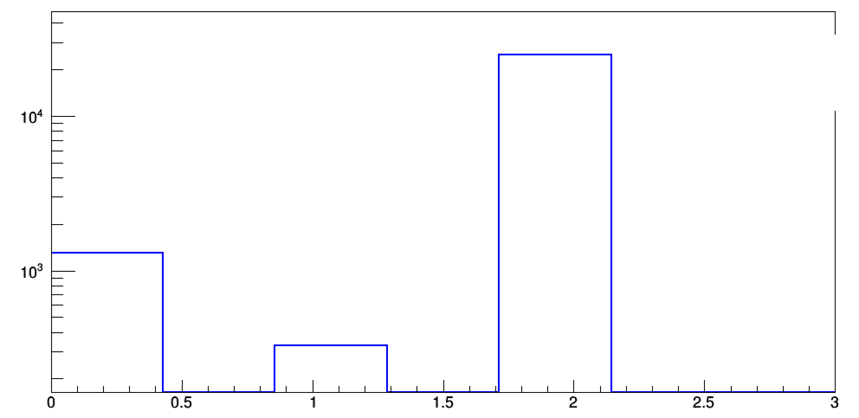
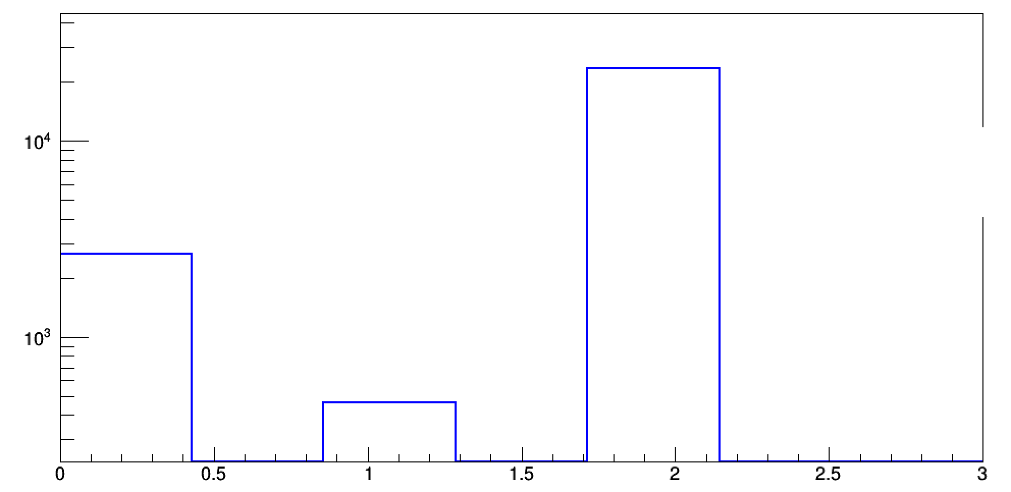
Occurrence di anticoincidence
DET 1
DET 2
8 %
5 %
Coincidence
VETO1 – DET1
Coincidence
VETO2 – DET2
Anticoincidence
VETO1 – DET1
Anticoincidence
VETO2 – DET2
06/10/2021
S. Colombi
FOOT physics meeting
5

Slide 6
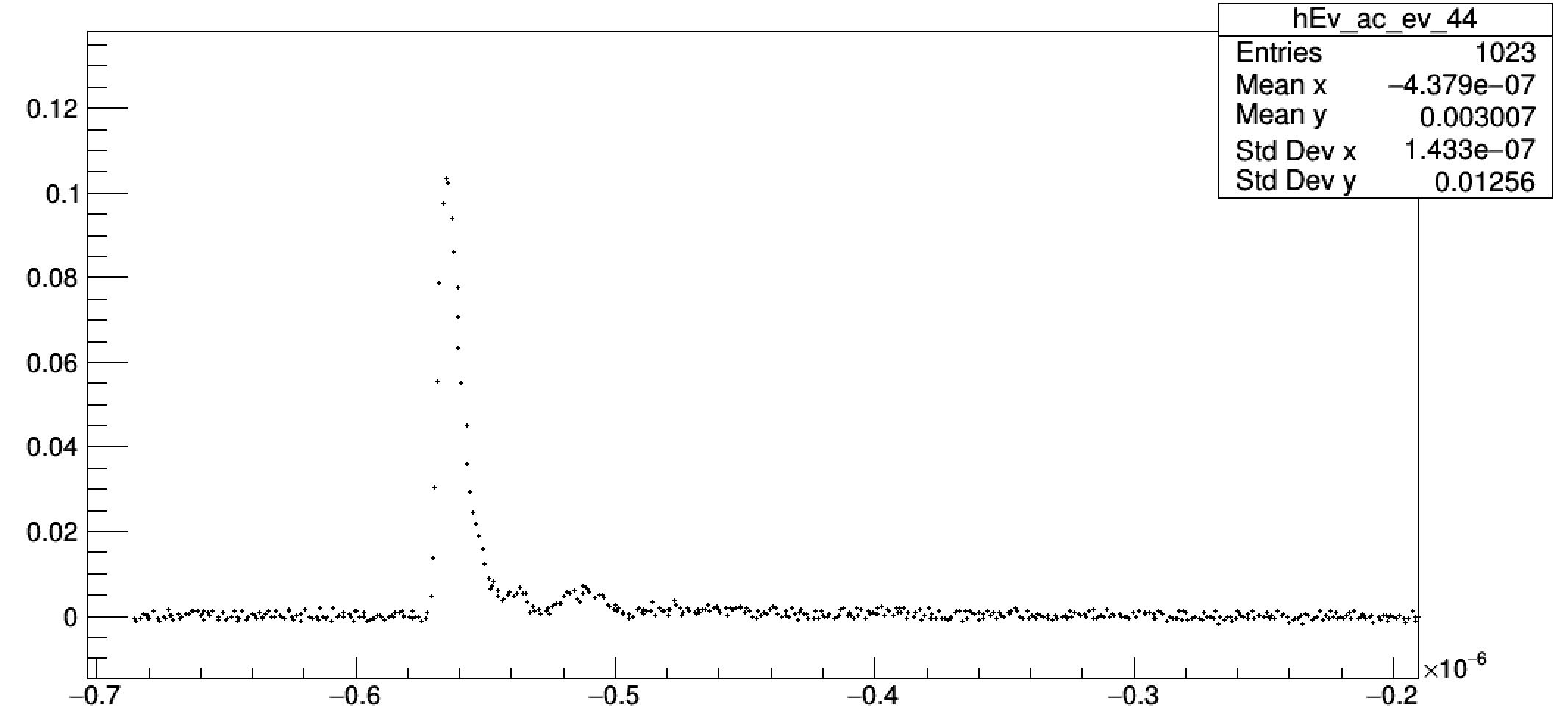
Waveform and time selection
30% peak
Seconds
Time - $T_{SC}$
06/10/2021
S. Colombi
FOOT physics meeting
6

Slide 7
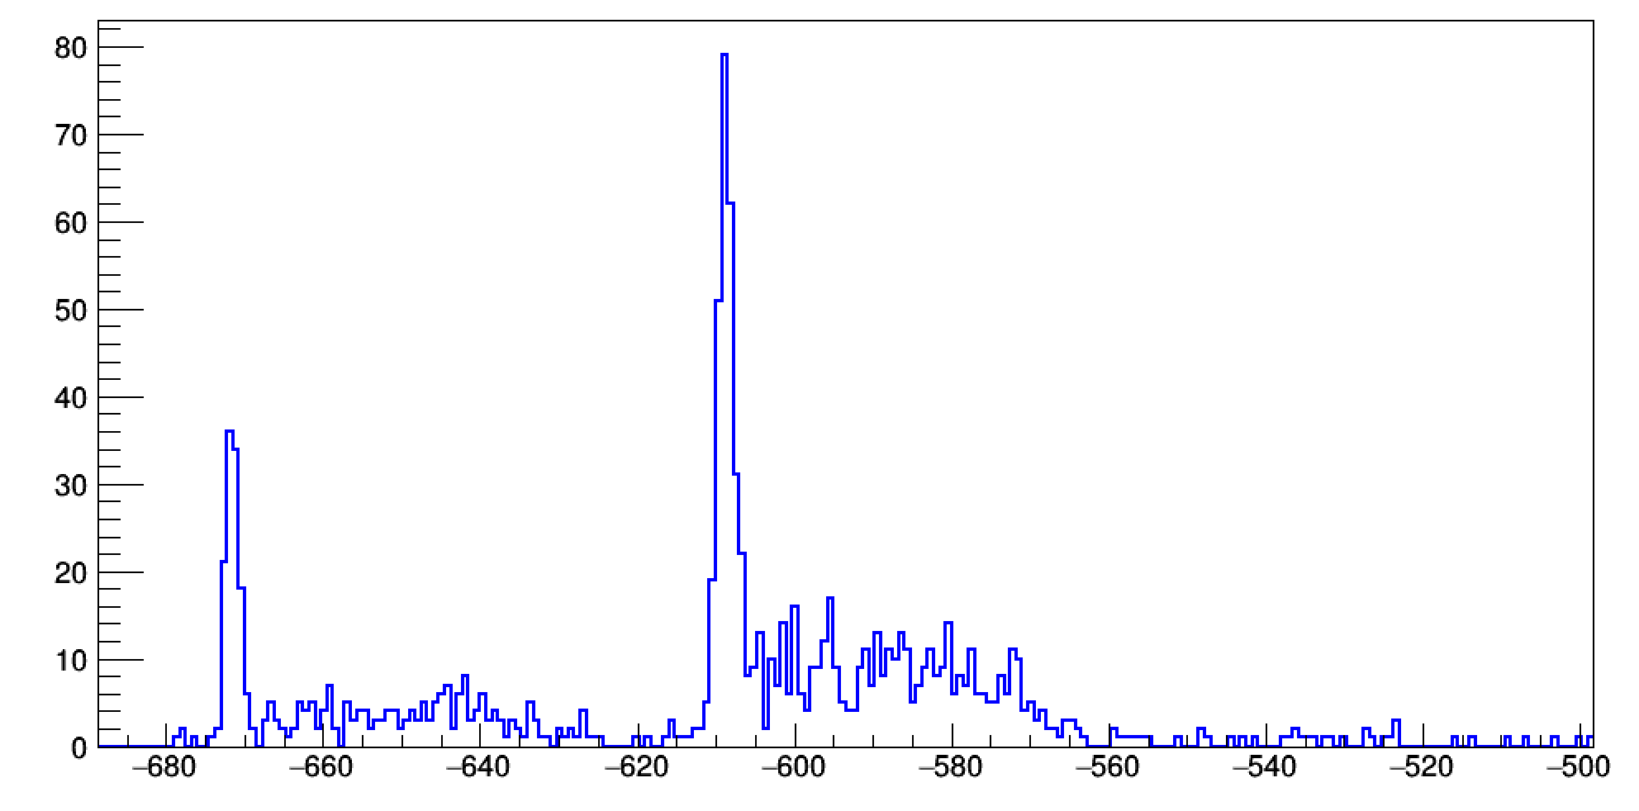
TOF raw
Run number > 4290 -> Delay = 593.75 ns
Run number < 4290 -> Delay = 656.25 ns
(see LogBook)
Nanoseconds
06/10/2021
S. Colombi
FOOT physics meeting
8

Slide 8
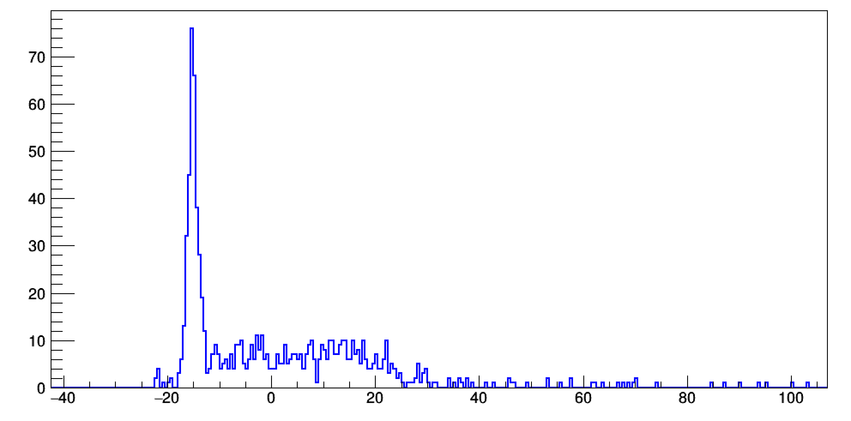
TOF raw: delay correction
06/10/2021
S. Colombi
FOOT physics meeting
9

Slide 9
TOF raw: delay correction
Prompt gamma peak
Neutrons + delay gammas
06/10/2021
S. Colombi
FOOT physics meeting
9

Slide 10
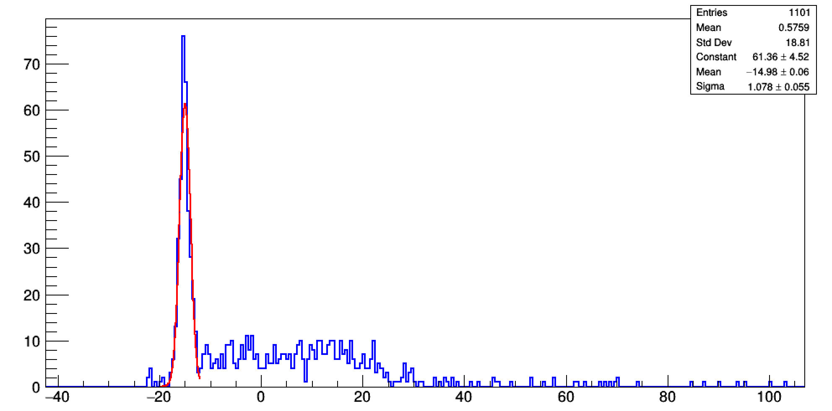
TOF raw: delay correction
Prompt gamma peak
Time resolution -> 1 ns
TOF gamma (target - DET) -> 7.9 ns
Neutrons + delay gammas
Nanoseconds
06/10/2021
S. Colombi
FOOT physics meeting
10

Slide 11
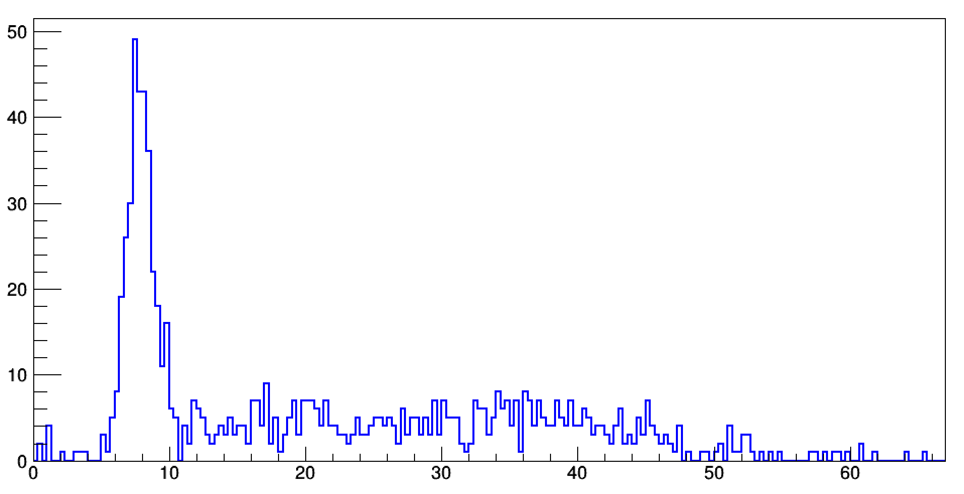
TOF
Next steps:
Pulse Shape Discrimination to identify fast and slow components
Calibrate in energy
Repeat for all data samples
Nanoseconds
06/10/2021
S. Colombi
FOOT physics meeting
9

