Slide 1
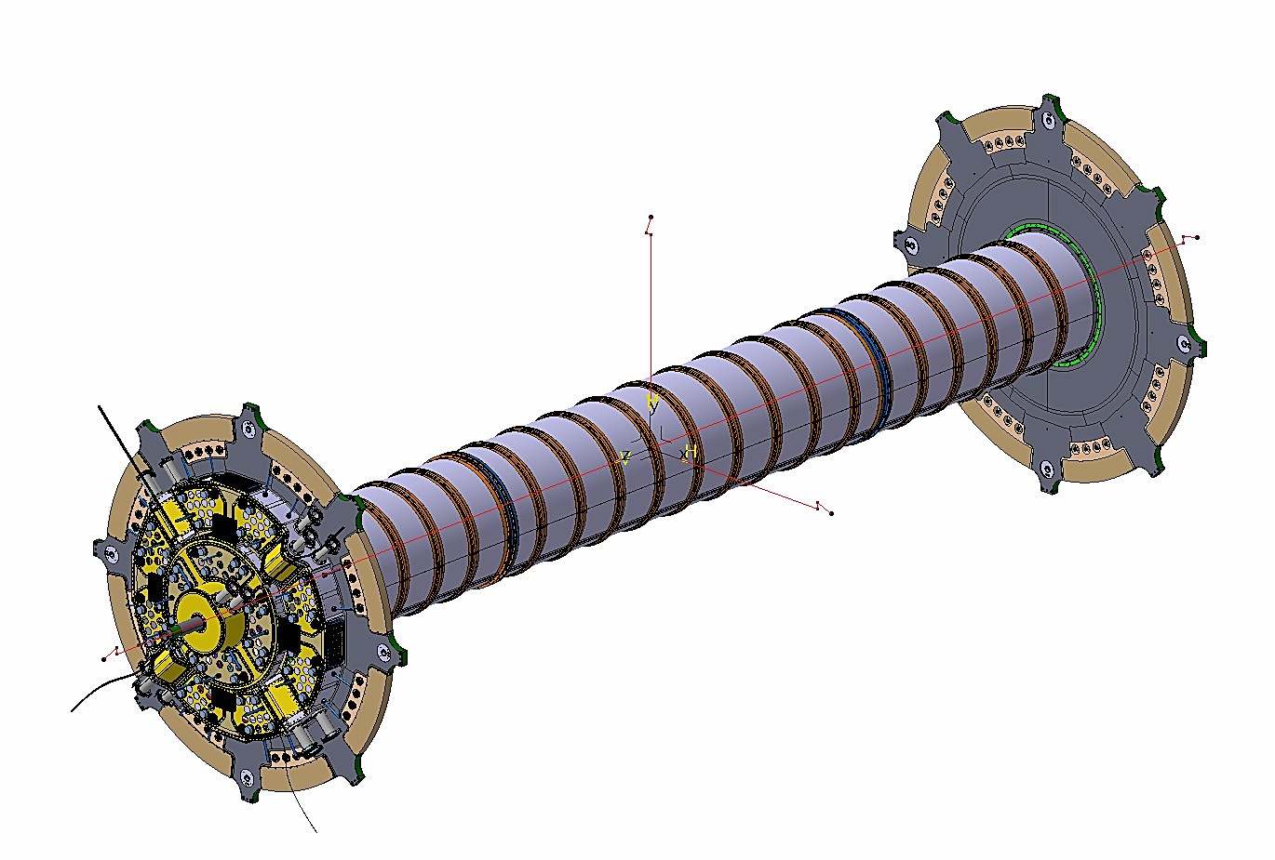
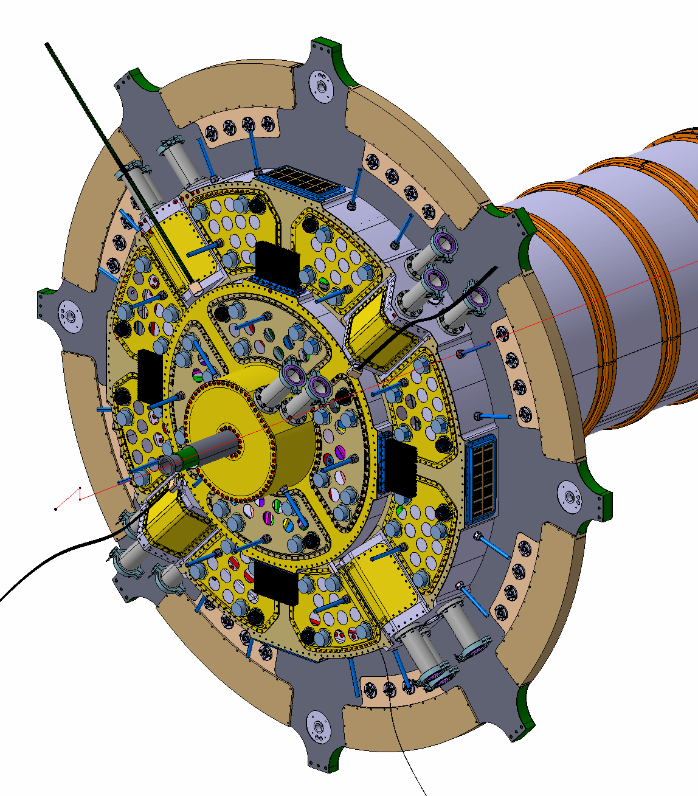
INFN LNF – 1° SEMESTER 2021-CIF
ITk - PP1 DESIGN OVERVIEW
PP1 A_Side
PP1 Outer Diameter: 1400mm
Itk Lenght Dimension: 6800mm
PP1 C_Side
2020 December 2020 - D. Orecchini - 1/6

Slide 2
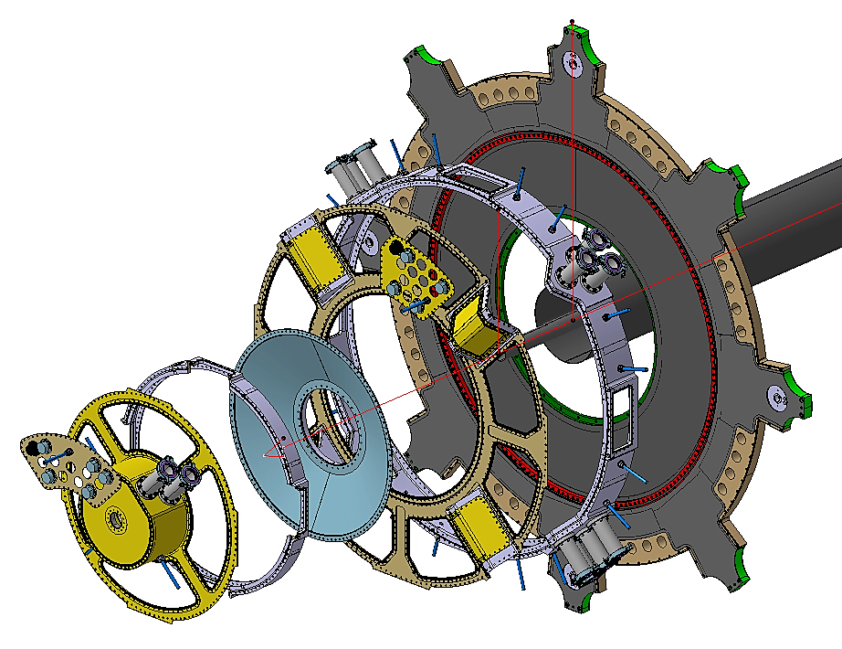
INFN LNF – 1° SEMESTER 2021-CIF
PP1 MAIN COMPONENTS OVERVIEW
1)- Outer Flange
BULKHEAD
2)- Outer Wall
3)- Outer P_Panels
4)- Conical Flange
5)- Inner Flange
6)- Inner Wall
7)- Outer P_Panels
8)- Closing Flange
2020 December 2020 - D. Orecchini - 1/6

Slide 3
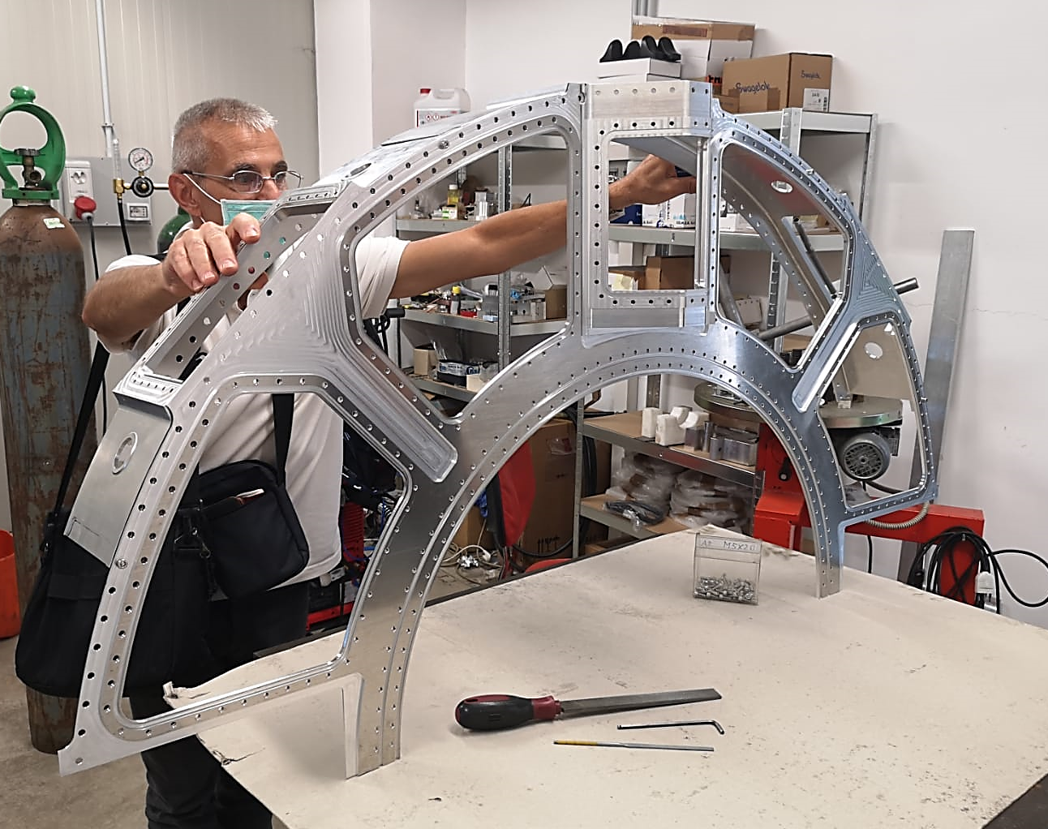
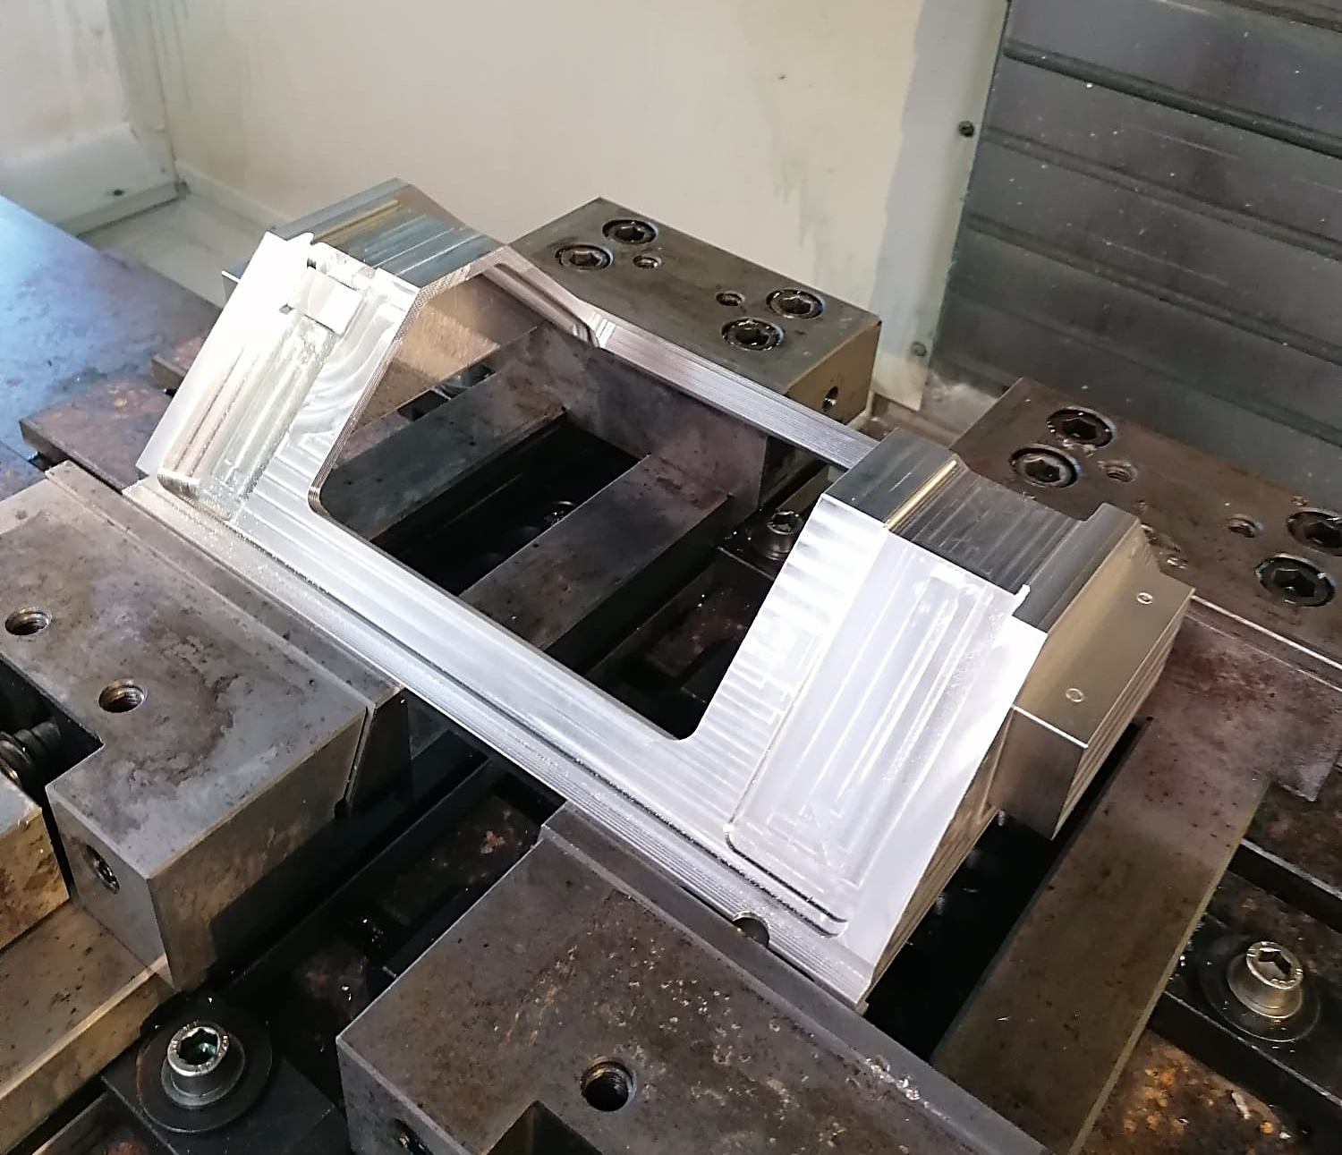
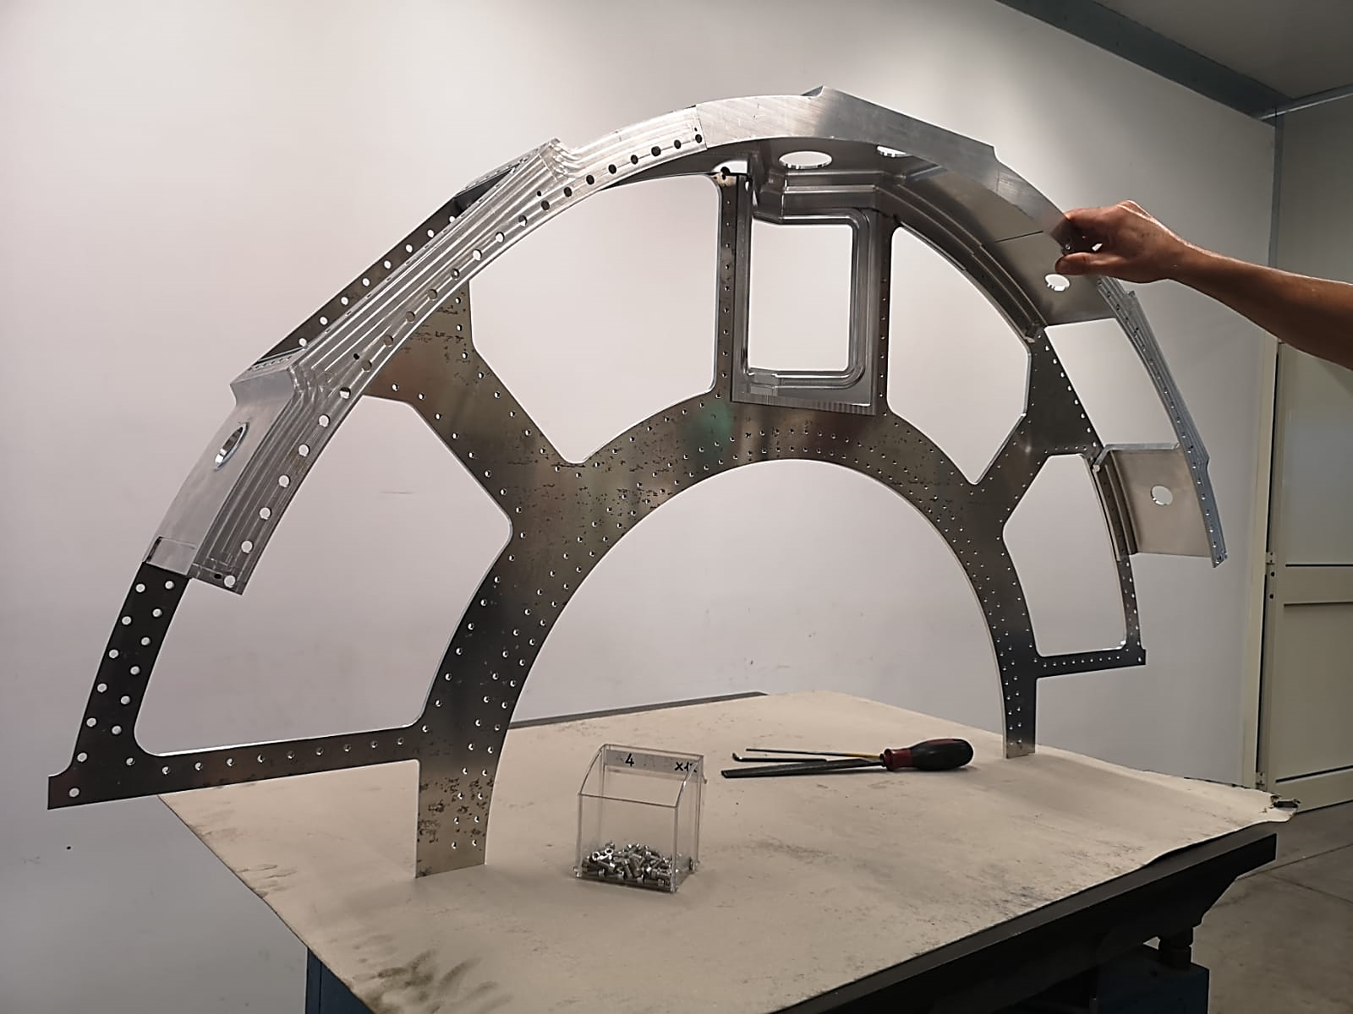
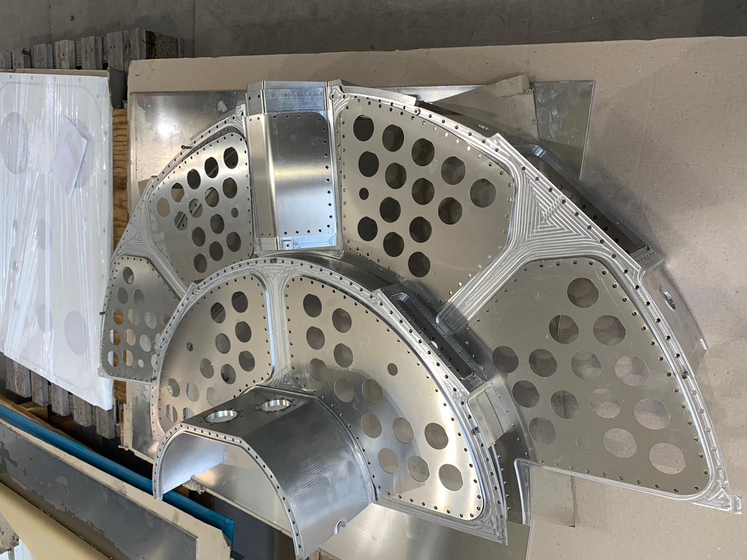
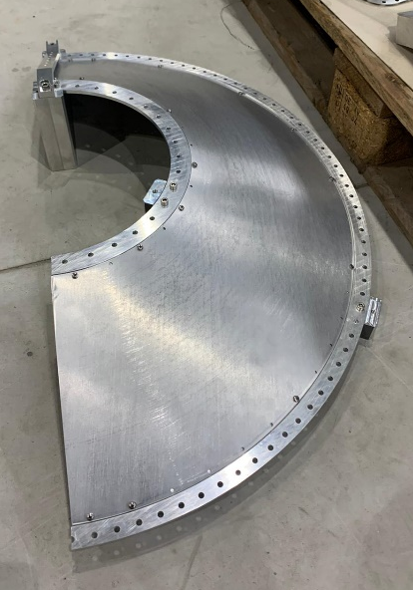
INFN LNF – 1° SEMESTER 2021-CIF
PP1 PROTOTYPE OVERVIEW
2020 December 2020 - D. Orecchini - 1/6

Slide 4
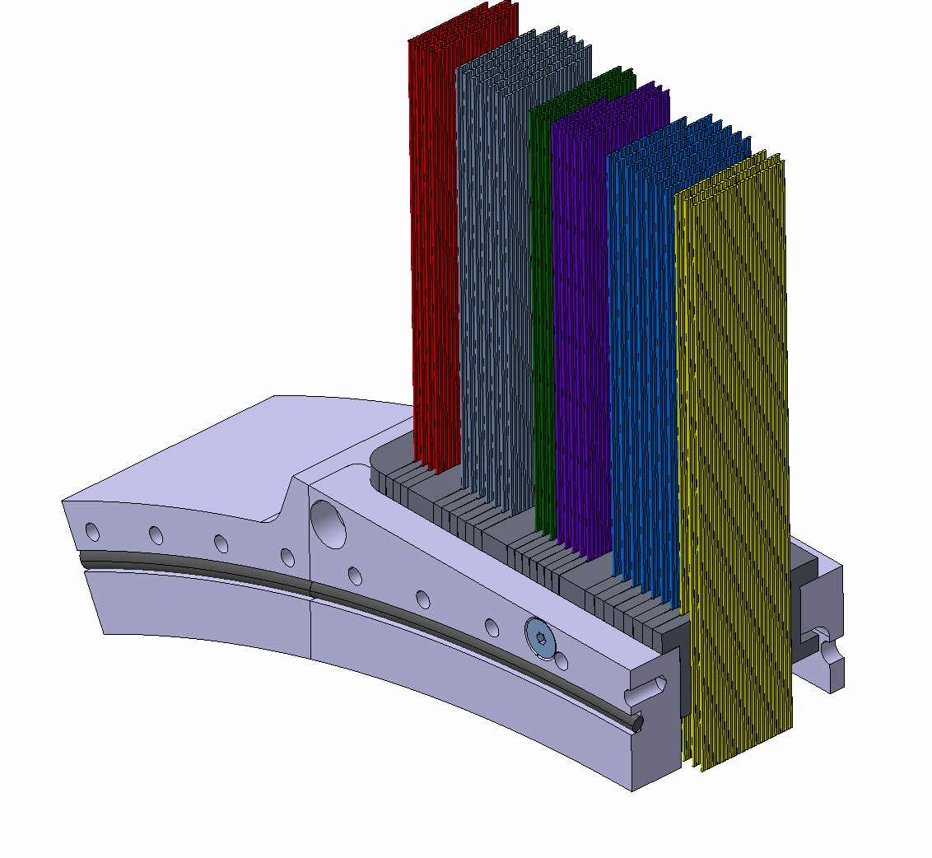
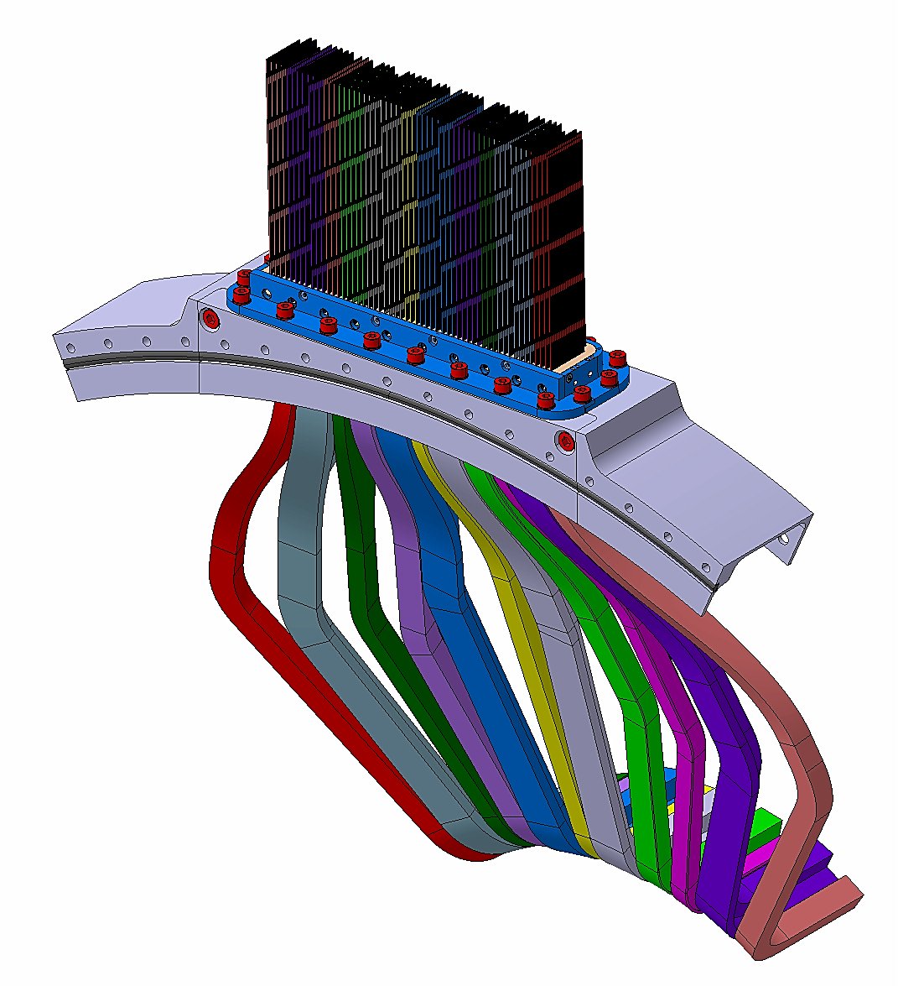
INFN LNF – 1° SEMESTER 2021-CIF
PP1 Signal Cables Feedthrough development
RUBBER SEALING SOLUTION
GLUED SEALING SOLUTION
Development in sharing with F. Rosatelli (Sealing test)
2020 December 2020 - D. Orecchini - 1/6

Slide 5
INFN LNF – 1° SEMESTER 2021-CIF
ITk - PP1 Upcoming Activities
Design activity time committment proposed for next six mounths: 60%
1)- DEVELOPMENT OF PP1 DESIGN IN ACCORDING TO Itk COLLABORATION INCOMING UPDATES
2)- PP1 PROTOYPE ASSEMBLY AND DEVELOPMENT
3)- DEVELOPMENT OF PP1 FEEDTHROUGH DESIGN, PROTYPING AND TEST
2020 December 2020 - D. Orecchini - 1/6

Slide 6
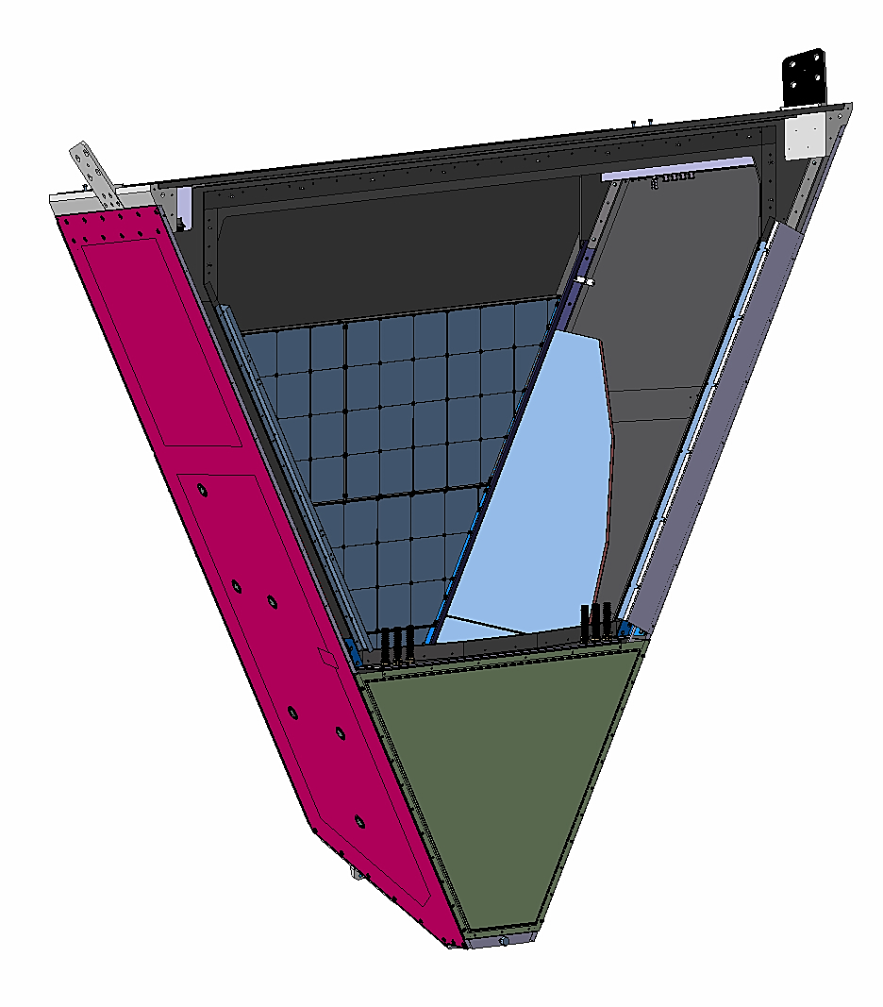
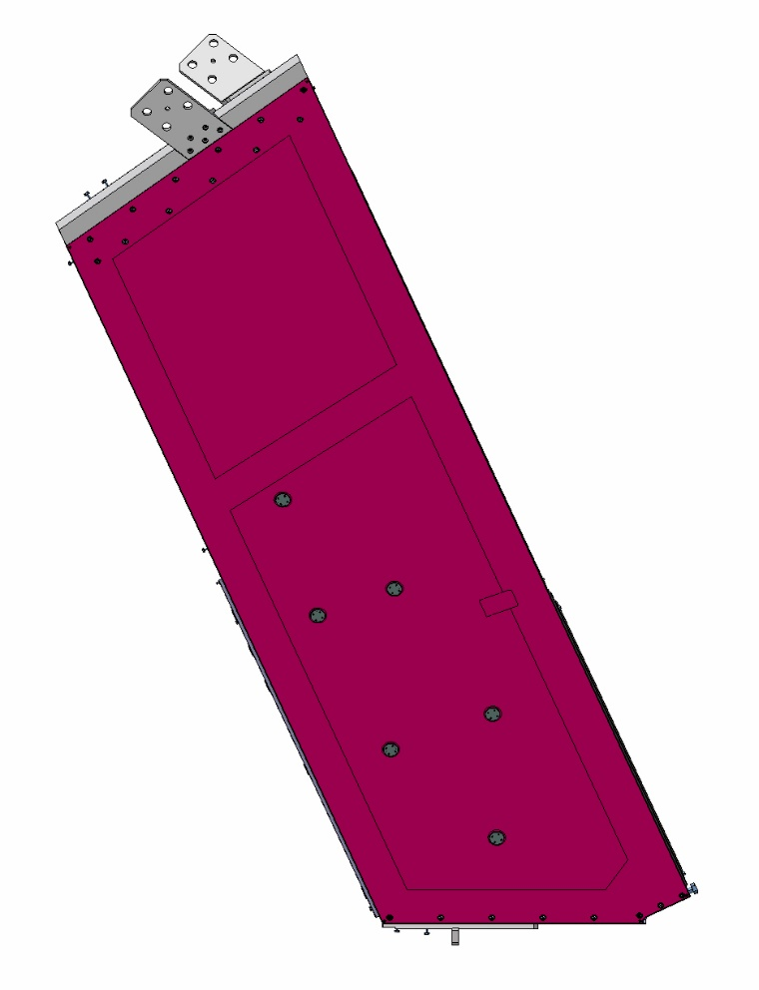
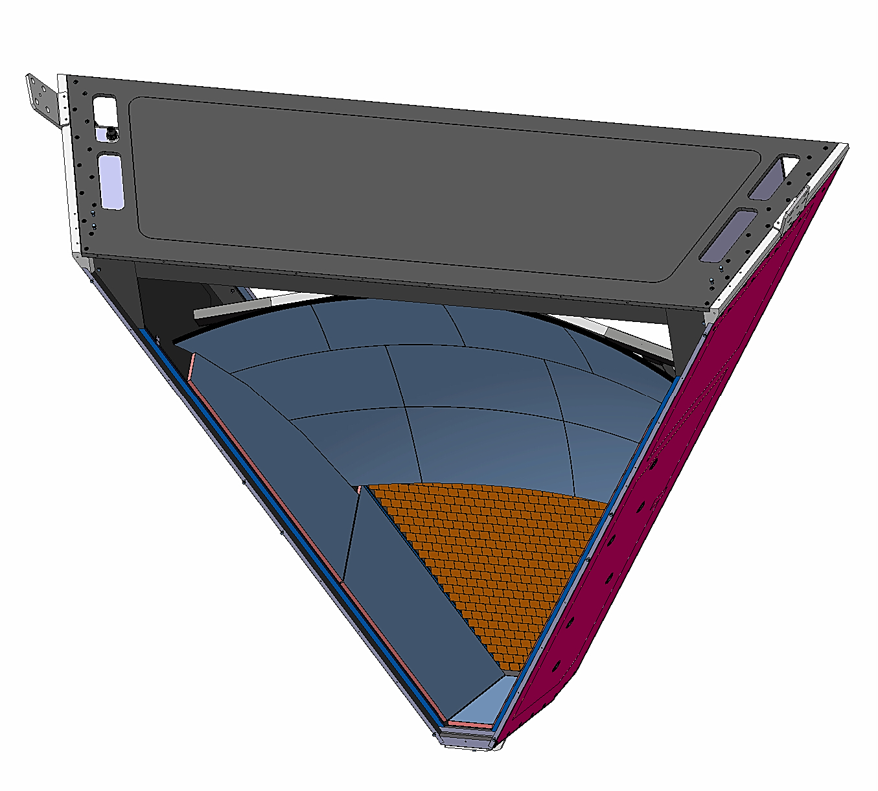
INFN LNF – 1° SEMESTER 2021-CIF
CLAS 12_RICH DESIGN OVERVIEW
Aerogel System
Spherical Mirror
4200mm
3500mm
4200mm
1200mm
Lateral Mirrors
PMTs System
2020 December 2020 - D. Orecchini - 1/6

Slide 7
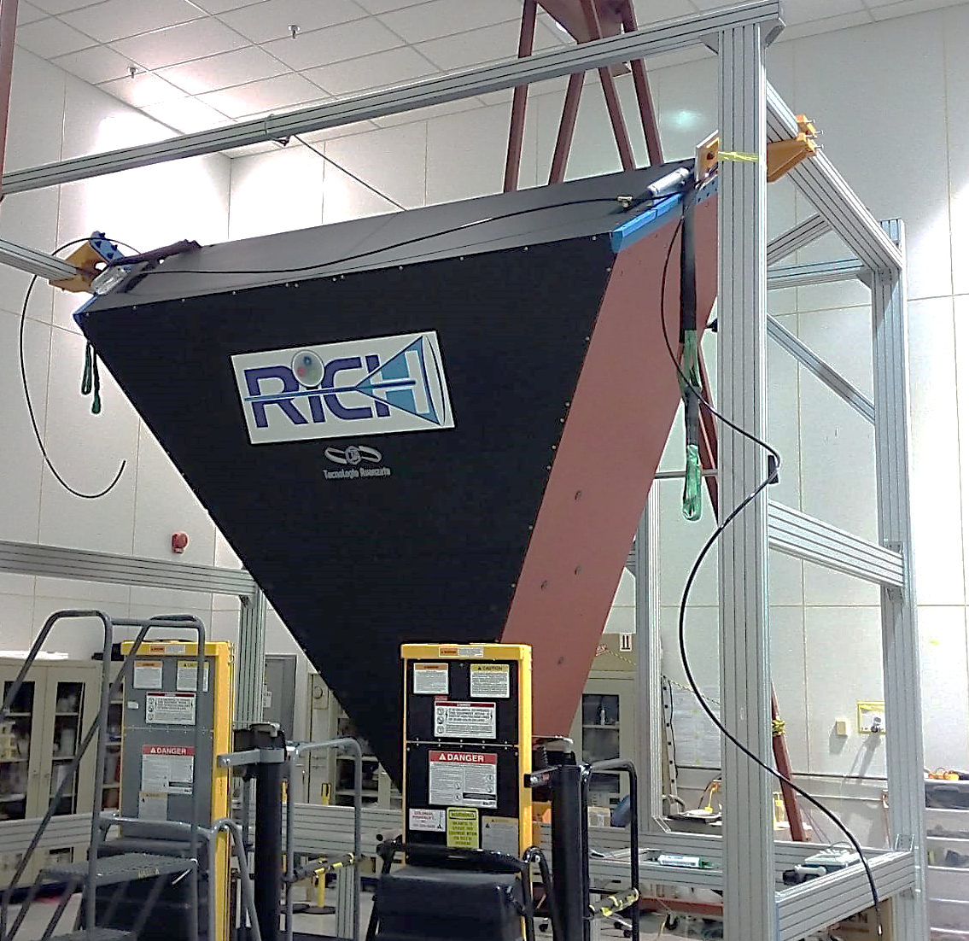
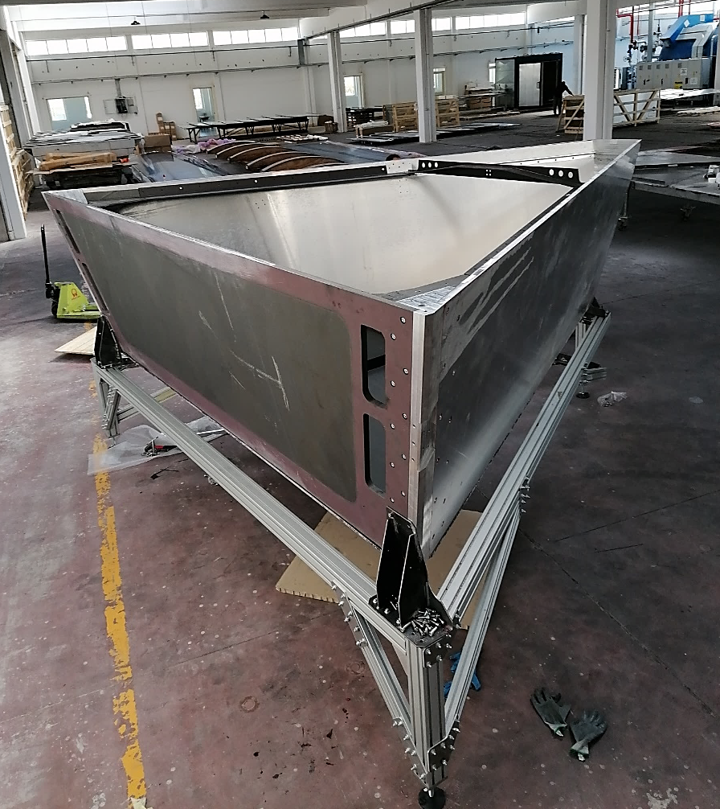
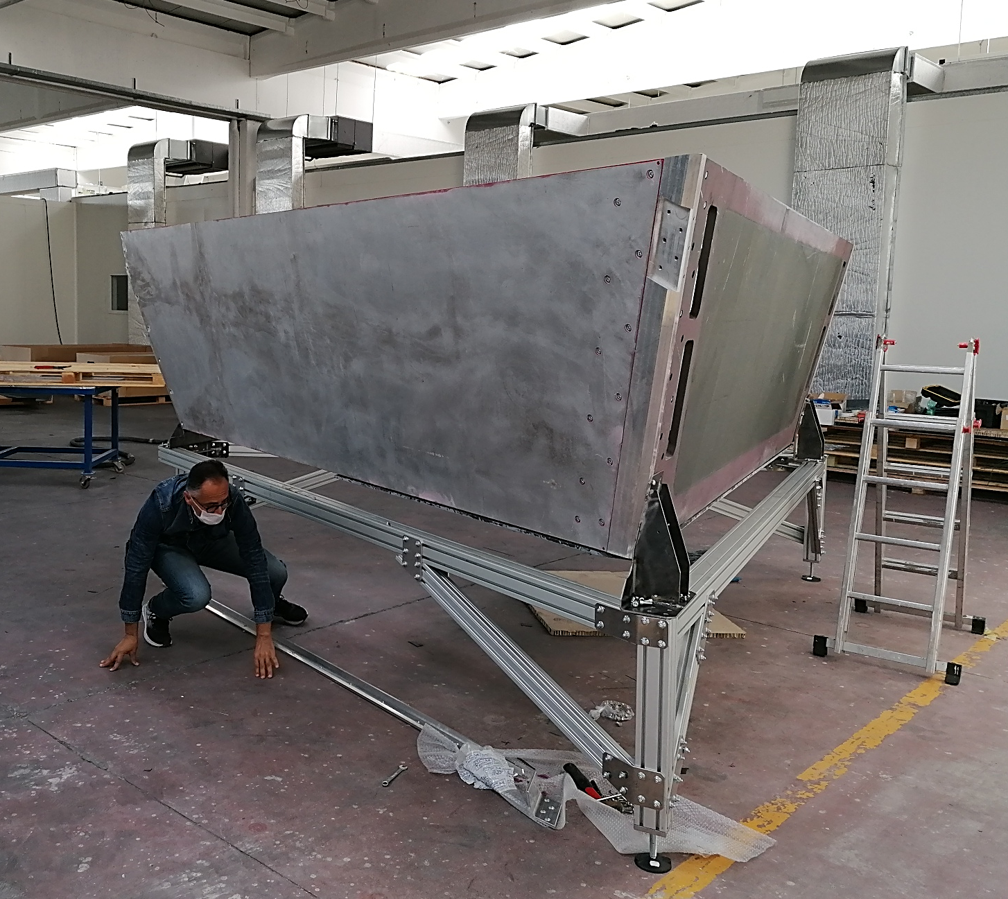
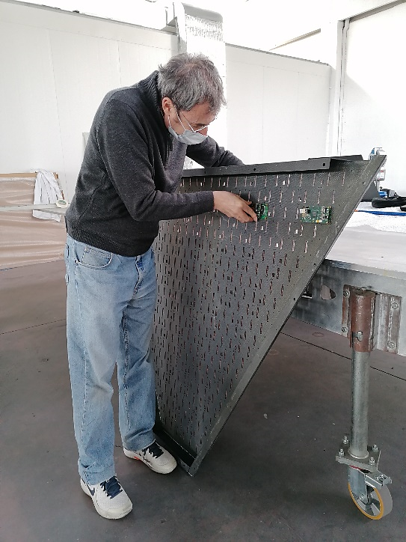
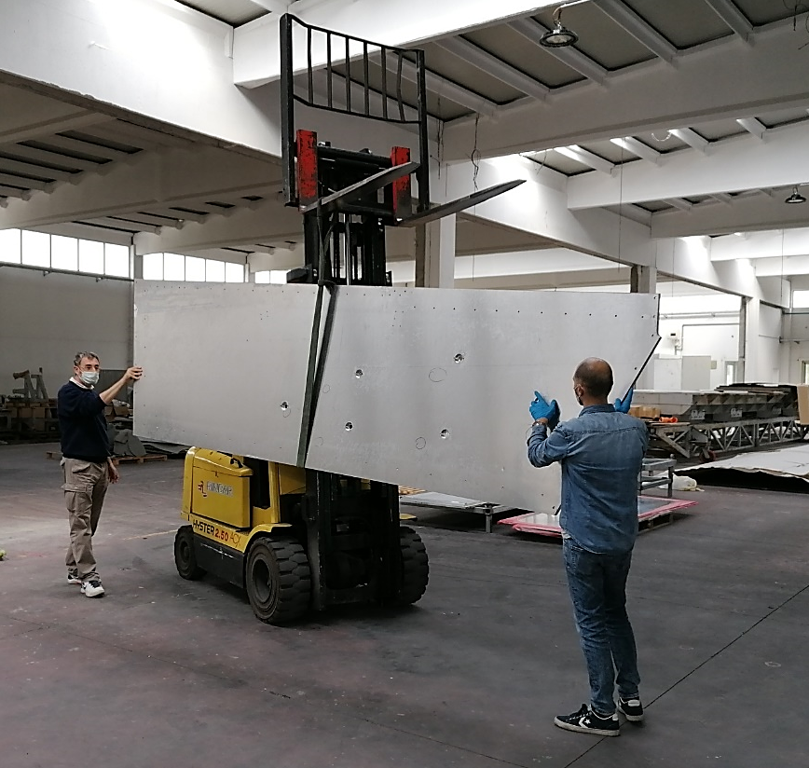
INFN LNF – 1° SEMESTER 2021-CIF
CLAS 12_RICH ASSEMBLY OVERVIEW
2020 December 2020 - D. Orecchini - 1/6

Slide 8
INFN LNF – 1° SEMESTER 2021-CIF
CLAS 12_RICH Upcoming Activities
Design activity time committment proposed for next six mounths: 30%
1)- UPDATE OF THE E_PANEL TRANSLATION AND INSERTION TOOLS DESIGN
2)- UPDATE OF THE SPHERICAL MIRROR SUPPORT FRAME DESIGN
3)- CONTACTS AND OVERVIEW ABOUT TecnAvan ACTIVITY OF PAINTING, PACKAGING AND
SHIPPING OF RICH COMPONENTS (Operative aspects)
2020 December 2020 - D. Orecchini - 1/6

Slide 9
INFN LNF – 1° SEMESTER 2021-CIF
LNF Mechanical Workshop requested activity
1)- UPDATE OF THE E_PANEL TRANSLATION AND INSERTION TOOLS DESIGN
2)- CONTACTS AND OVERVIEW ABOUT TecnAvan ACTIVITY OF PAINTING, PACKAGING AND
SHIPPING OF RICH COMPONENTS (Not administrative but operative aspects)
LNF 3D Printing requested activity
2020 December 2020 - D. Orecchini - 1/6

