Slide 1
SEM Meeting
INFN-LNF
F. Rosatelli,
4/12/2020

Slide 2
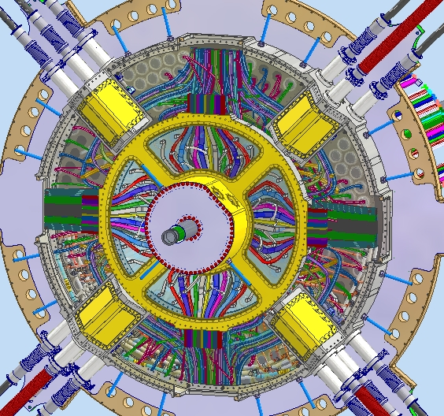
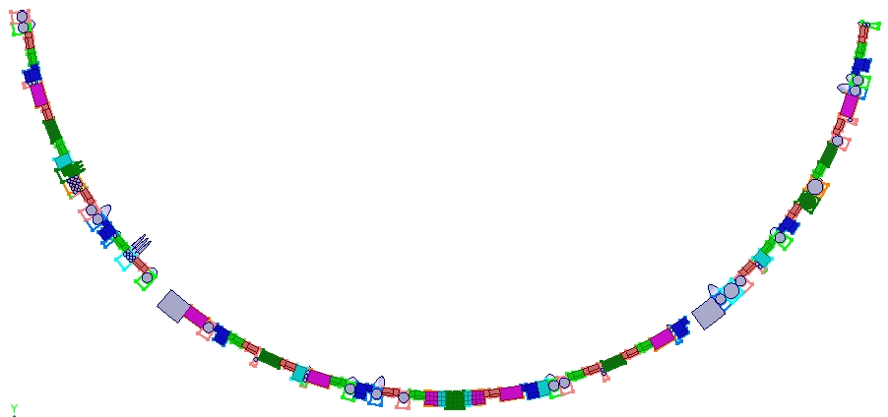
ATLAS ITk – Cabling design
INNER SYSTEM ROUTING
2D OF ENDCAP
Y
X
Activities:
From 2D mapping and allocation tables, I designed the preliminary routing of data cables and High/Low voltage cables in the PP1 regions: Inner system, Endcap and Outer Barrel.

Slide 3
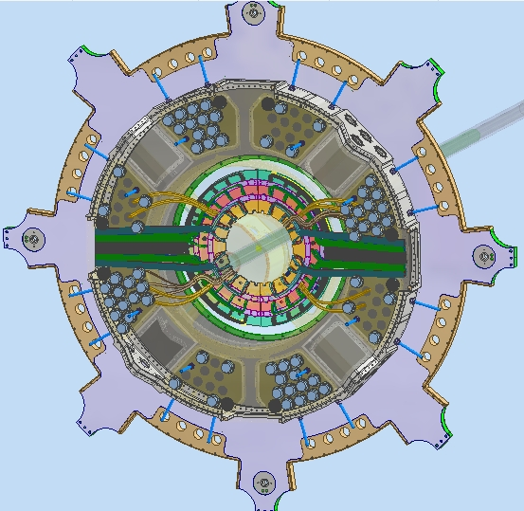
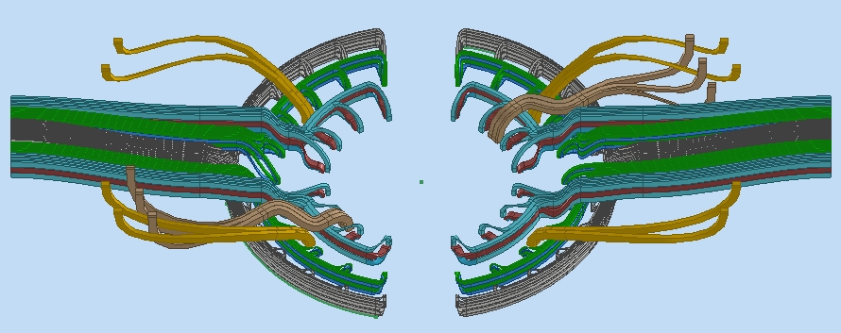
ATLAS ITk – Cabling design
PP1 VIEW
Data link
ENDCAP CABLES ROUTING
HV-LV to ACT connectors
Activities:
Synergic work with Sandro, Dario and Emiliano for integration of the different elements in PP1 (mechanics, piping, cabling, assembly integration sequences, etc..)

Slide 4
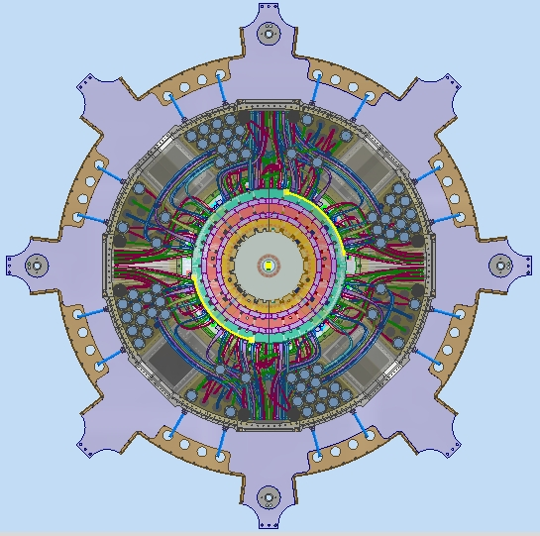
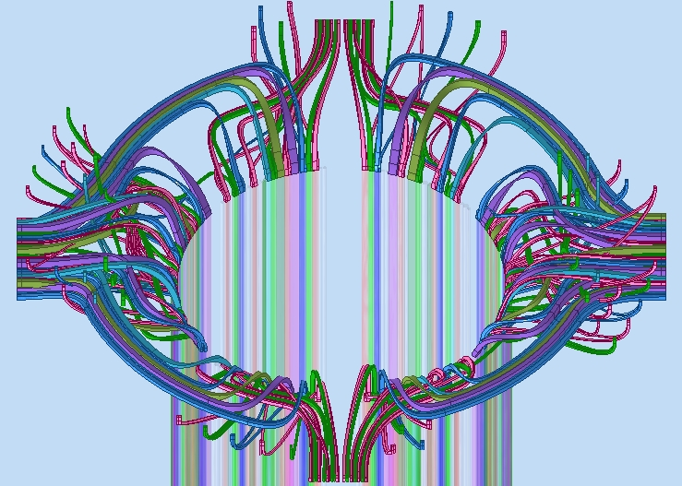
ATLAS ITk – Cabling design
PP1 TOP VIEW
OUTER BARREL CABLES ROUTING
Data link
HV-LV to ACT connectors
Activities:
Contribution to PDR document for the ATLAS ITk pixel Global Mechanics and Integration.

Slide 5
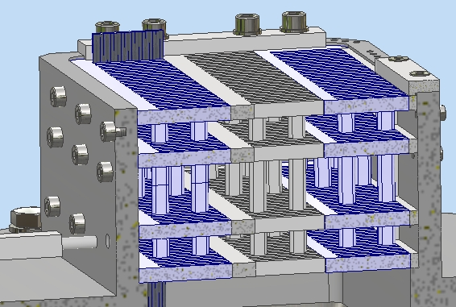
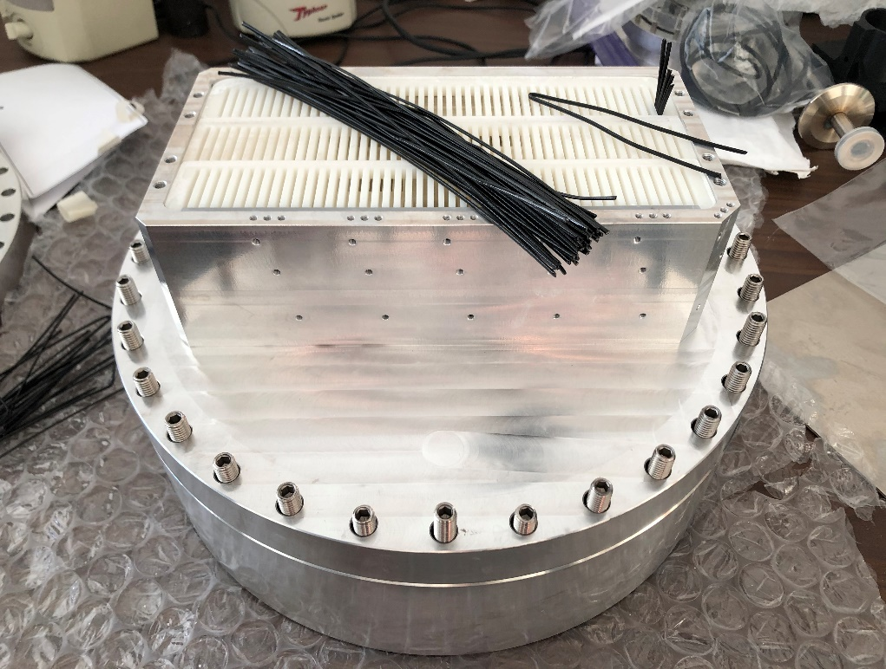
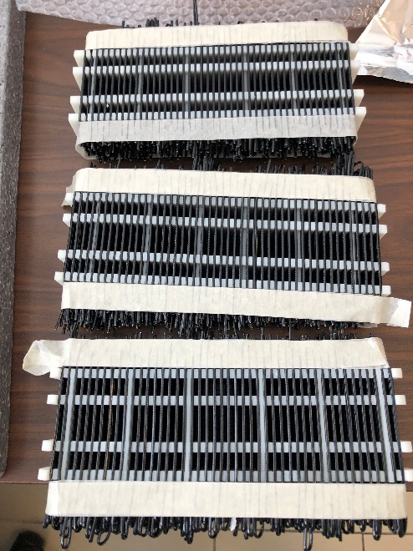
PP1 OUTER SYSTEM DATA CABLES FEEDTHROUGH
1:1 SCALE FEEDTHROUGH
PREPARATION OF COMBS
DP490
ARALDITE 2011
VENT HOLES
VESSEL
FLANGE
U-BENDED CABLES (INSIDE)
Activities:
This prototype will be used to measure the comb’s leakage only.
We will test the resins filling process in horizontal and vertical position with to flanges. This, to simulate the integration process in PP1.
Delays due 3D printing process and Covid-19 emergency.

Slide 6
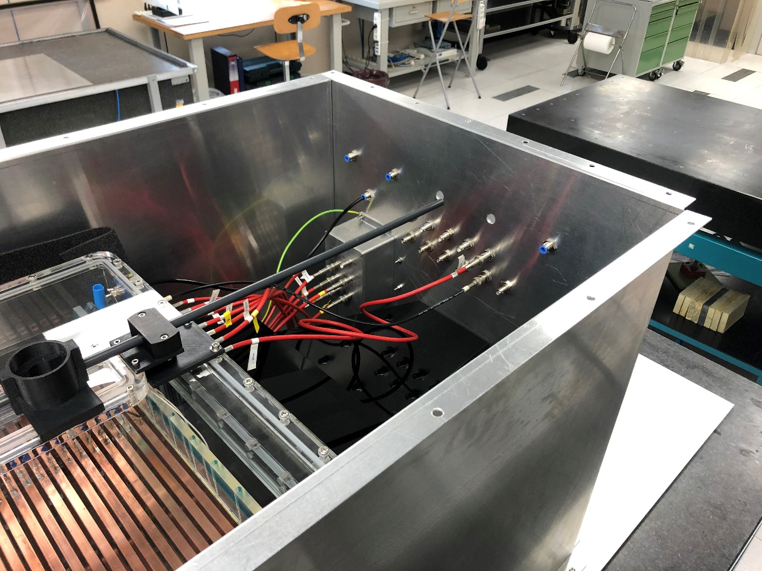
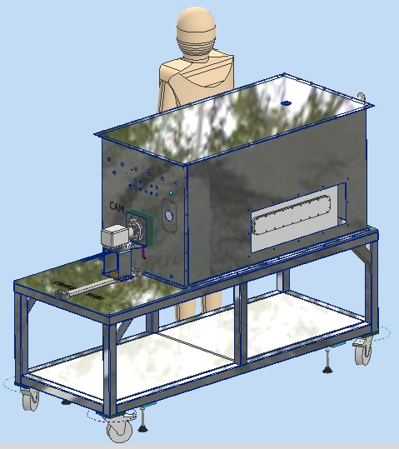
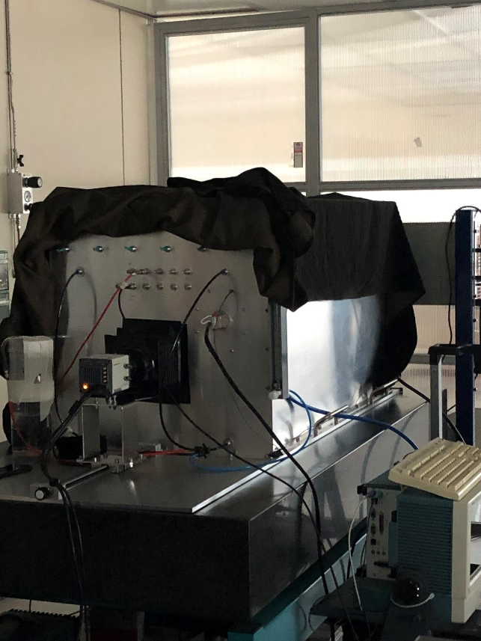
CYGNO-LIME
LIME
LIME 2
Activities:
Completion of parts in workshop of Faraday cage of LIME2 (with Cesidio), similar to LIME. Construction delayed due to Covid-19. Now ended.
Order parts to complete the assembly of Faraday cage .

