Slide 1

Tuning and matching of 1 and 2 loops antenna
Our aim is to match Zin of our circuit to 50Ω at the resonance frequency of 14.8 MHz.

Slide 2
Procedure
Calculate the impedance of our circuit, modelized as a series of R and L in parallel with C;
Work at low frequency to calculate L, R(0) and R(f0);
Calculate C from the initial formula of the impedance;
Calculate Q;
Calculate the matching and tuning capacitors Cm and Ct and include these capacitors in our circuit in order to tune and match it;
Vary a little the value of the capacitors in order to find the precise values which tune and match perfectly the circuit.

Slide 3
1 loop antenna
Project_Alice_1loop_simulation

Slide 4
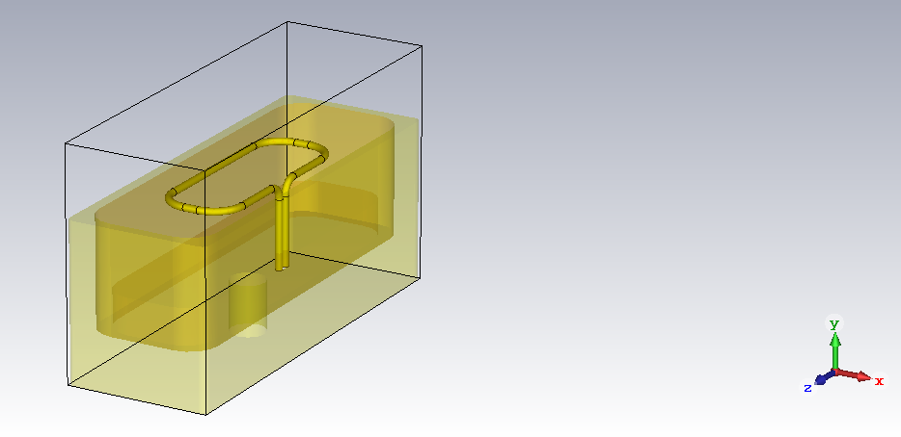

Slide 5
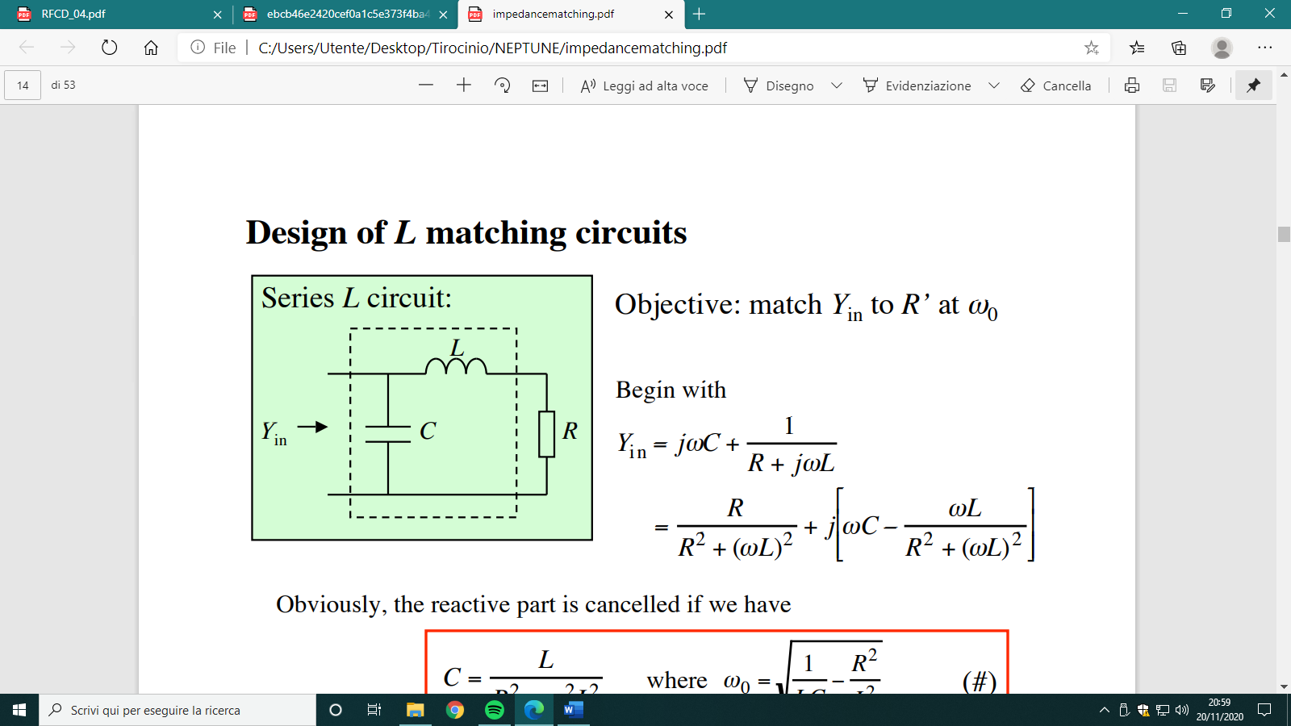
Step 1
The circuit we are referring is schematized as follows:
The admittance of our circuit is the following one:

Slide 6
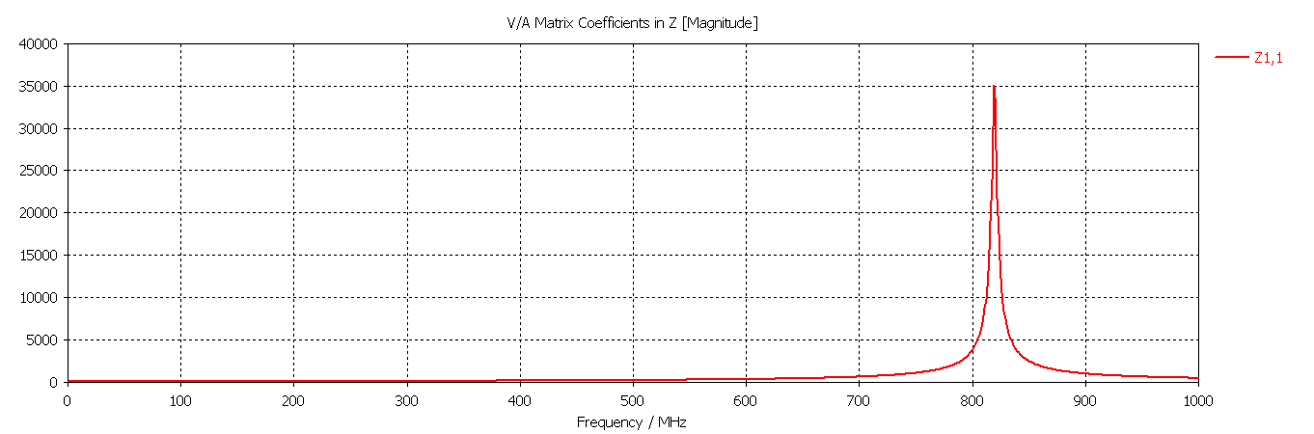
Natural frequency fn=819,5 MHz and relative impedance Z(fn)=35000 Ω

Slide 7

Step 2
Working at low frequency the formula for the impedance becomes:
Z(ω) = R(ω) + jωL (for ω → 0, $\frac{1}{jωC}$ →∞) |Z| = |ωL|
and so
L = $\frac{∆Z}{∆ω}$ = $\frac{\left(4.85−2.43\right)Ω}{2π\left(10 MHz\right)}$ = 38.6 nH
where ∆Z is calculated from the simulation of the imaginary part of Z in a frequency range of 10 MHz near the origin.
Then, we get the value of the resistance R(0) from the simulation of the real part of Z at 0 Hz:
R(0) = 0.0033 Ω
We also estimate R at the resonance frequency f0=14.8 MHz:
R(f0) = 0.033 Ω

Slide 8
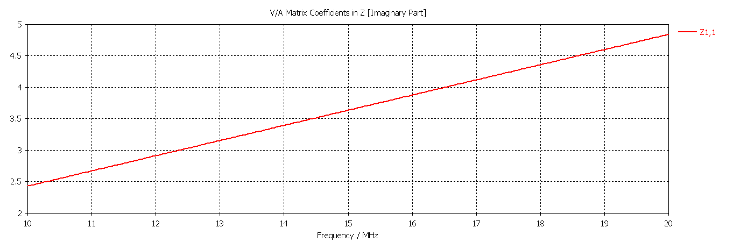

Slide 9
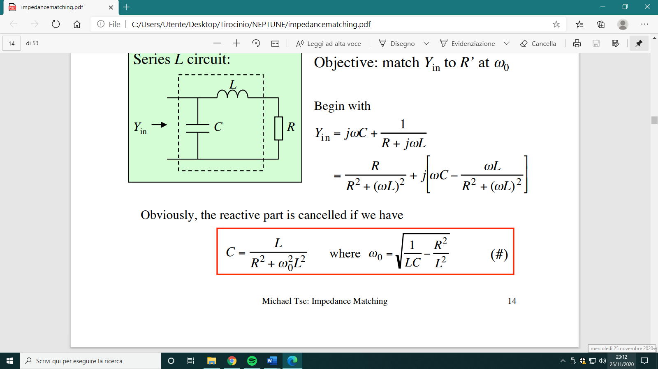
Step 3
Calculate C using the forumla:
C= =2,99 nF
where R=R(f0)

Slide 10

Step 4
Determine Q measuring the resonance frequency and the bandwidth of lower and upper frequencies at 70% down from the maximum amplitude; the corresponding formula is:
Q = $\frac{f0}{∆f}$ = $\frac{14.45 MHz}{0.131 MHz}$ = 110.3
where ∆f = f_{upper} - f_{low} = bandwidth.

Slide 11
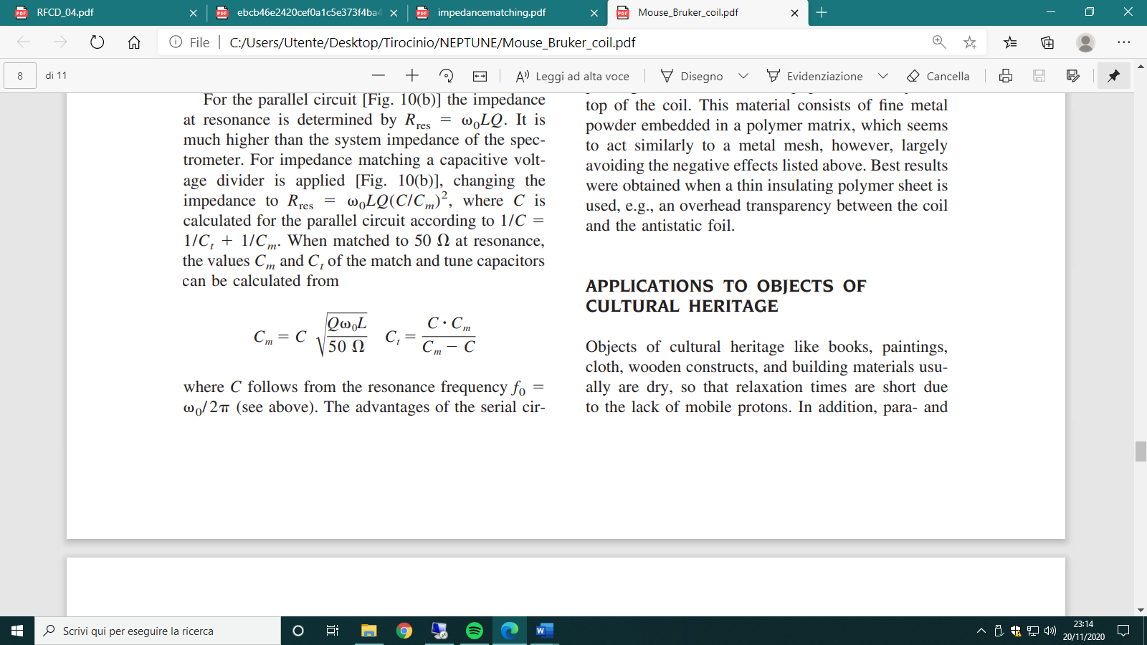
Step 5
Calculation of the tuning and matching capacitors, that can be obtained using the following formulas:
Cm= =8,41 nF
Ct= =4,63 nF

Slide 12
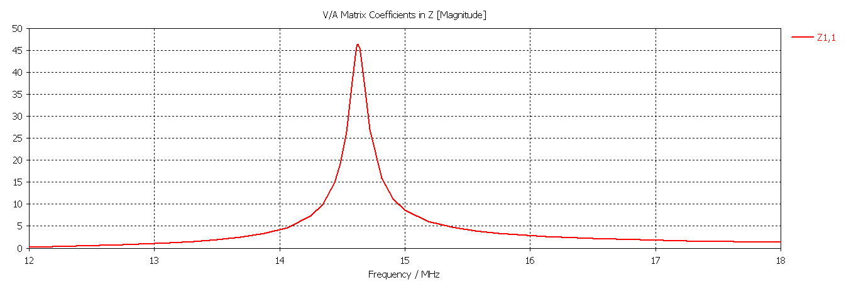
Resonance frequency f0=14.62 MHz
Matching resistance Z(f0)=46.4 Ω

Slide 13
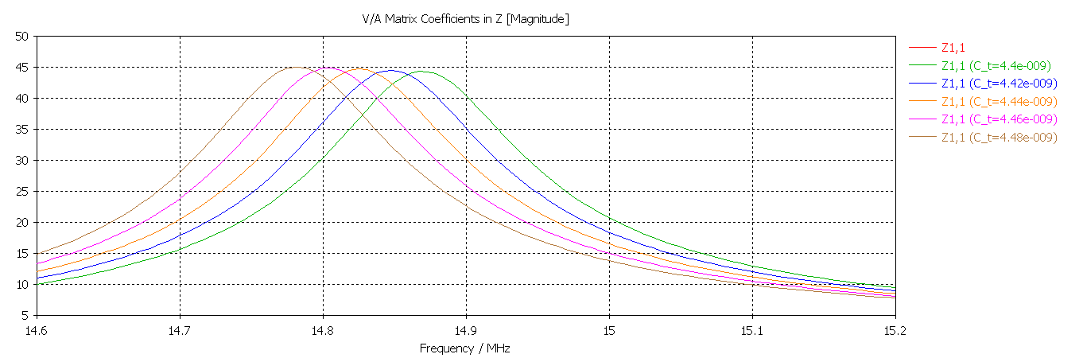
Step 6
Since we want a perfect tuning and matching, we vary a little bit the value of Cm and Ct one by one and we find the precise values of the two capacitors that fully tune and match the circuit. In order to do that, we do two simulations:
Tuning simulation: the value of Ct has been varied by a step width of 2∙10⁻¹¹ F from 4.4 nF to 4.48 nF and, simulating using 100 discrete points in a frequency range if 14.6 – 15.2 Mhz, it is found that the capacity that tunes our circuit at 14.8 MHz is Ct=4.46 nF:

Slide 14
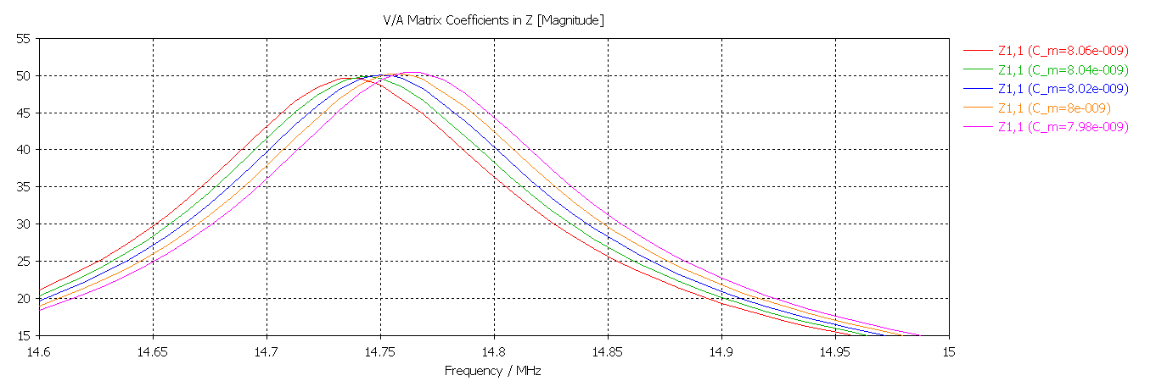
Matching simulation: : the value of Cm has been varied by a step width of 2∙10⁻¹¹ F from 7.98 nF to 8.06 nF and, simulating using 100 discrete points in a frequency range if 14.6 – 15.2 Mhz, it is found that the capacity that matches our circuit at 50 Ω is Cm=8.02 nF:

Slide 15
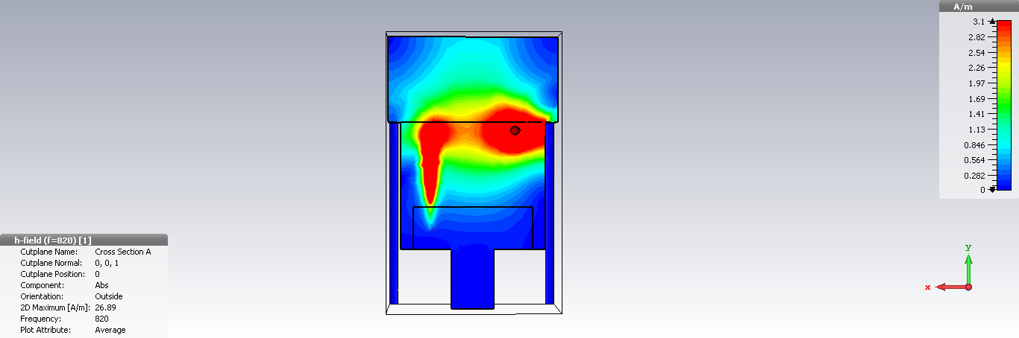
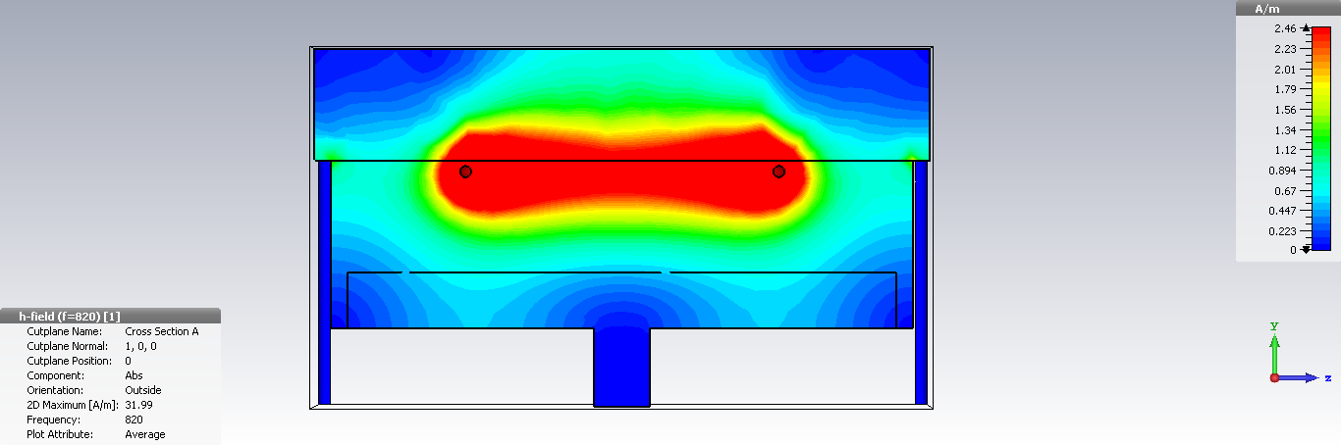
H field

Slide 16
2 loops antenna
Project_Alice_2loop_simulation

Slide 17
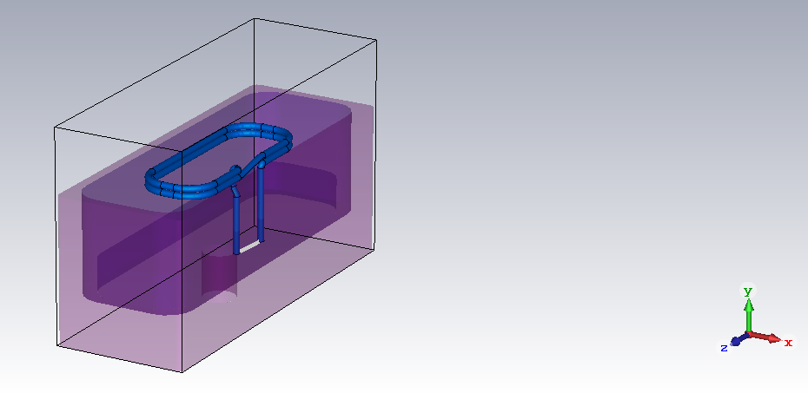

Slide 18
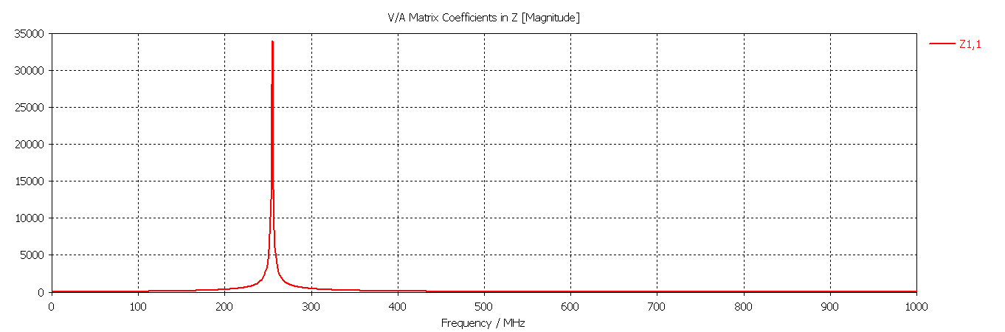
Step 1
Natural frequency fn=255 MHz and relative impedance Z(fn)=33961 Ω

Slide 19
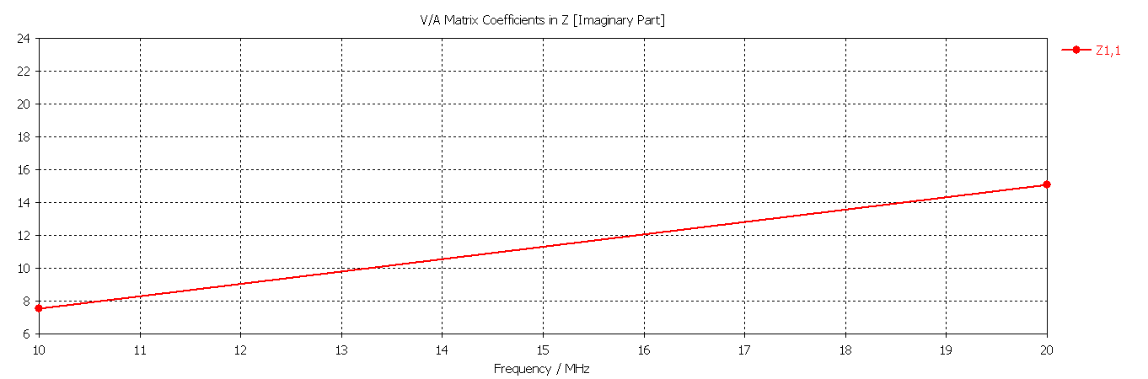

Step 2
L = $\frac{∆Z}{∆ω}$ = $\frac{\left(15.1−7.53\right)Ω}{2π\left(10 MHz\right)}$ = 0.12 μH
R(0)=0,06 Ω R(f0)=0.073 Ω

Slide 20

Step 3
Step 4
C=0,96 nF
Q= $\frac{f0}{∆f}$ = $\frac{14.75 MHz}{0.2 MHz}$ = 73.75
Step 5
Cm=3,89 nF
Ct=1,27 nF

Slide 21
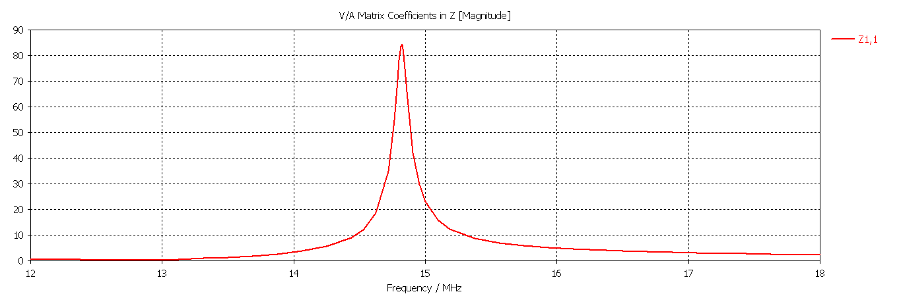
Resonance frequency f0=14,82 MHz
Z(f0)=84,35

Slide 22
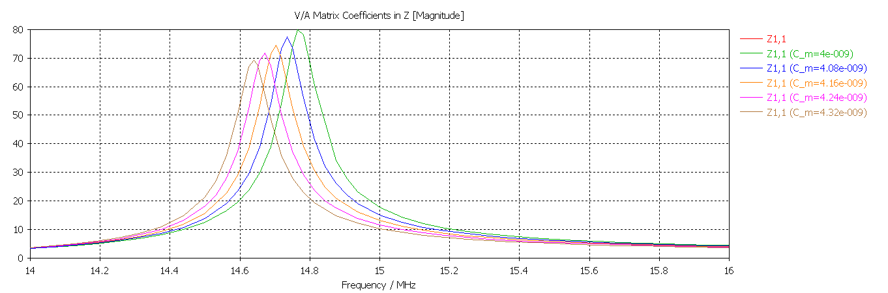
Step 6
Tuning simulation: the value of Ct gives a perfect tuning at f0=14,82 MHz
Matching simulation: the value of Cm has been varied by a step width of 8∙10⁻¹¹ F from 4 nF to 4,32 nF (the simulation is done using 40 discrete points in a frequency range if 14 – 16 Mhz):

Slide 23
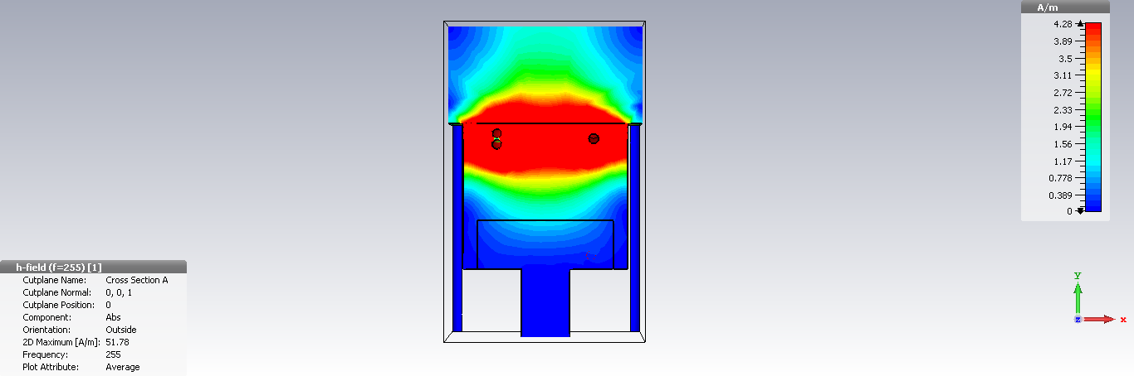
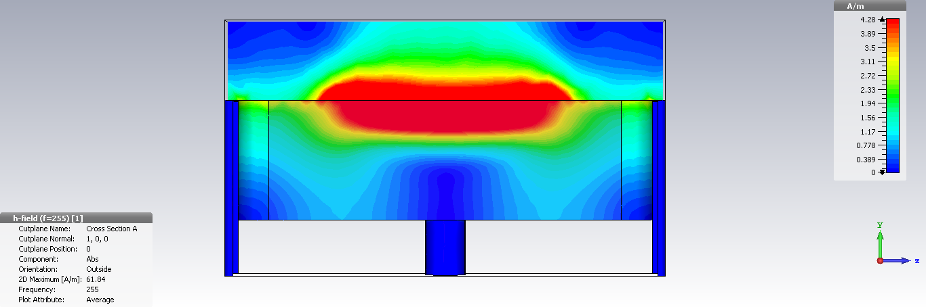
H field

Slide 24
3 loops antenna
Project_Alice_2loop_simulation

Slide 25


