Slide 1
Virtual Machines on BiG Grid
INFN Annual Meeting
May 2010
Sander Klous, Nikhef

Slide 2
Contents
Introduction
Who are we? What do we do?
Motivation
Why, What and How with VMs?
Status
Challenges
Conclusions

Slide 3
Introduction
Collaboration between
NCF: national computing facilities
Nikhef: national institute for subatomic physics
NBIC: national bioinformatics center
Participation from Philips, SARA, etc.
Goal:
“Enable access to grid infrastructures for scientific research in the Netherlands”

Slide 4
BiG Grid VM Working Group
https://wiki.nbic.nl/index.php/BigGrid_virtualisatie
Representatives from:
User Communities/Support, Operations and Security, Management, “Independent Chair”
Recipe for disaster
Charge for phase 1:
“Provide a design and Proof-of-Concept for virtualized worker nodes that fulfill requirements of different user communities.”
Preliminary result:
Extensive report on all aspects that need to be addressed before BiG Grid accepts VMs.

Slide 5
Motivation: Why Virtual Machines?
Site perspective
Resource flexibility (e.g. SL4 / SL5)
Resource management
Scheduling / multi-core / sandboxing
User perspective
Isolation from environment
Identical environment on multiple sites
Identical environment on local machine

Slide 6
Different VM classes
Class 1: Site generated Virtual Machines
No additional trust issues
Benefits for system administration
Class 2: Certified Virtual Machines
Inspection and certification to establish trust
Requirements for monitoring / integration
Class 3: User generated Virtual Machines
No trust relation
Requires appropriate security measures

Slide 7
Status
Different VM Classes

Slide 8
Typical use case Class 1 VM
Resource management
Torque/PBS
Virtual Machine Manager
Job queue
VM
queue
Site infrastructure
Box 1
“Normal WN”
Box 3
“8 Virtual SL5 WNs”
Box 2
“8 Virtual SL4 WNs”

Slide 9
Typical use case Class 2 VM
Analysis on Virtual Machines
Run minimal analysis on desktop/laptop
Access to grid services
Run full analysis on the grid
Identical environment
Identical access to grid services
No interest to become system administrator
Standard experiment software is sufficient

Slide 10
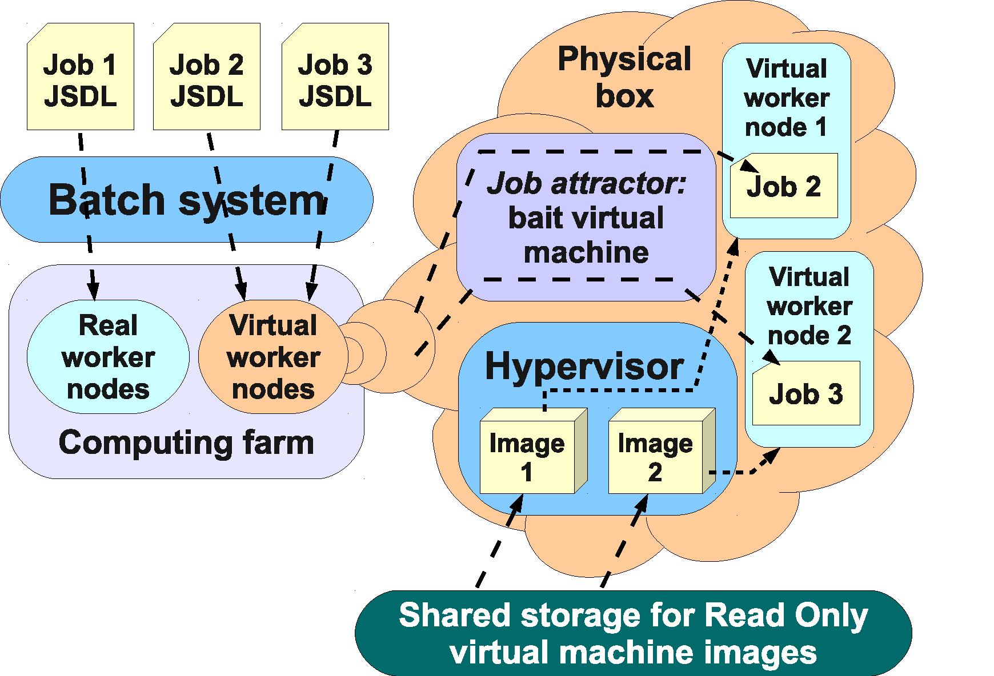
Between Class 1 and 2/3: WNoDeS

Slide 11
HEPiX VM working group
Chaired by Tony Cass (CERN)
Representatives from site operations
Charge:
“Enable virtual machine images created at one site to be used at other HEPiX (and WLGC) sites.”
Preliminary results:
Draft security policy
VM Image Catalog
(straw man model and interface definition)

Slide 12
Draft Security Policy
http://www.jspg.org/wiki/Policy_Trusted_Virtual_Machines
“The aim is to enable Grid Sites to trust and instantiate endorsed VM images that have been generated elsewhere.”
Main points:
VM combined image split in base image (root install) , VO environment (user install)
Complete image is endorsed by an individual to confirm that it respects the policy requirements
Extendible with a site local policy

Slide 13
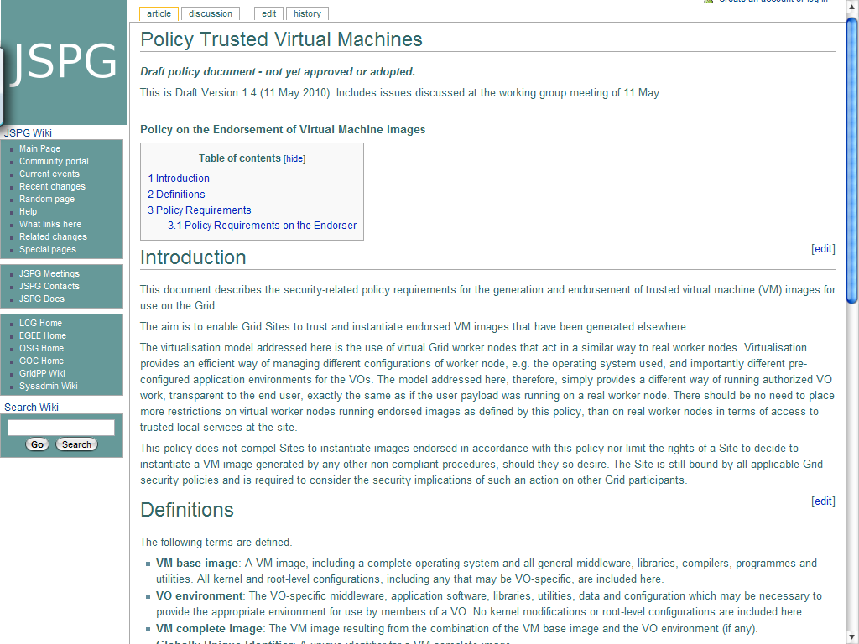

Slide 14
BiG Grid Policy Addendum
VO environment endorsed by VO person
Complete image endorsed by non-VO person
Nikhef endorsers will defer responsibilities and liabilities for VO environment to VO person.
Written and signed deferral of all responsibilities and liabilities of VO environment, including:
Consequences of possible security leaks
Consequences of possible license violations

Slide 15
Other applicable policies
Grid Security Policy, version 5.7a
VO Portal Policy, version 1.0 (draft)
Big Grid Security Policy, version 2009-025
Grid Acceptable Use Policy, version 3.1
Grid Site Operations Policy, version 1.4a
LCG/EGEE Incident Handling and Response Guide, version 2.1
Grid Security Traceability and Logging Policy, version 2.0
VO-Box Security Recommendations and Questionnaire, version 0.6 (draft, not ratified)

Slide 16
Relevant policy statements
Network security is covered by site local security policies and practices
A VO Box is part of the trusted network fabric. Privileged access is limited to resource administrators
Software deployed in the grid must include sufficient and relevant site central logging.

Slide 17
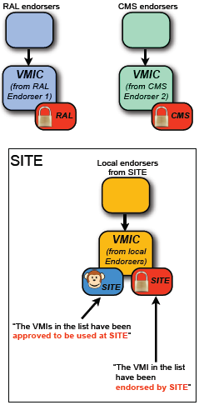
VM Image Catalog
Endorsed means:
Image created according to HEPiX policy requirements
Endorser responsible/liable
Approved means:
Site will run this image
Acceptable endorser
Acceptable Meta Data

Slide 18
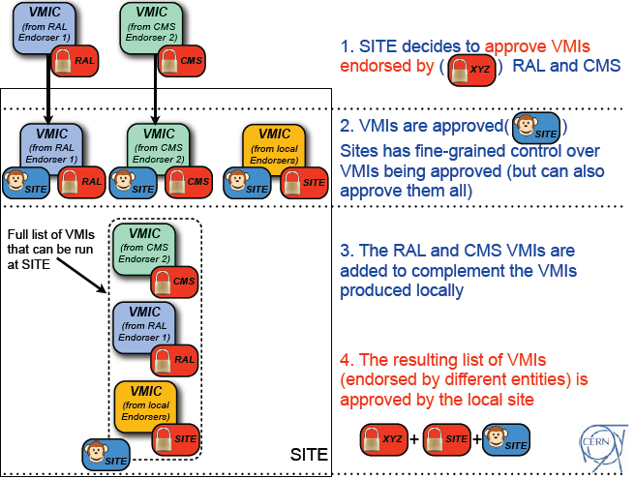

Slide 19
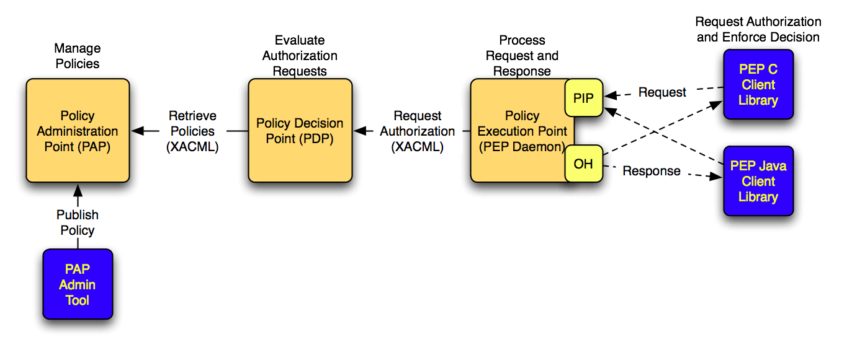
How does this fit in the gLite middleware?
Argus Authorization framework

Slide 20
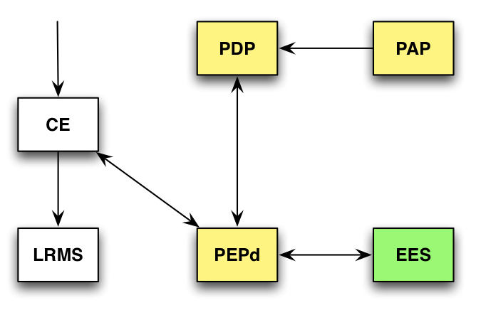
Local Policy Enforcement
= Argus framework

Slide 21
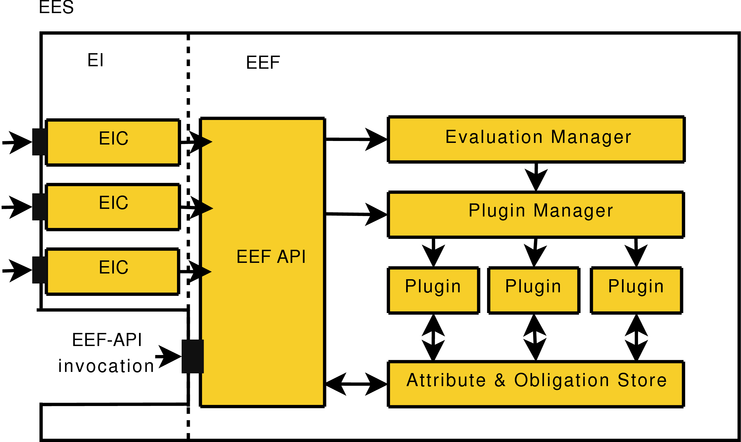
Execution Environment Service
https://edms.cern.ch/document/1018216/1

Slide 22
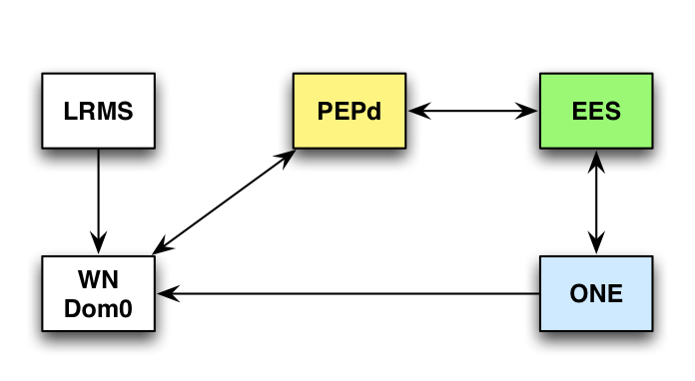
Deployment
A lot of similarities with WNoDeS, Nimbus
Additional benefits compared to WNoDeS
Policy enforcement with standard middleware
Modular: EES middleware sets environment
OpenNebula is a standard VM Manager
Disadvantages
Not operational yet, scalability unproven

Slide 23
Typical use case Class 3 VM
Identification and classification of GPCRs
Requires very specific software set
Blast 2.2.16
HMMER 2.3.2
BioPython1.50
Even non-x86 (binary) applications!
Specific software for a single user
No common experiment software

Slide 24
Cloudia project, SARA
Make separate DMZ for Class 3 VMs
SSH accessible (Amazon like, OpenNebula based)
Comparable to “Guest networks”
Only outbound connectivity
Detection of compromised guests
Extended security monitoring
Packet inspection, netflows, hypervisor monitoring
Small, but upgrade expected (500 kEuro)
Floris Sluiter: floris@sara.nl

Slide 25
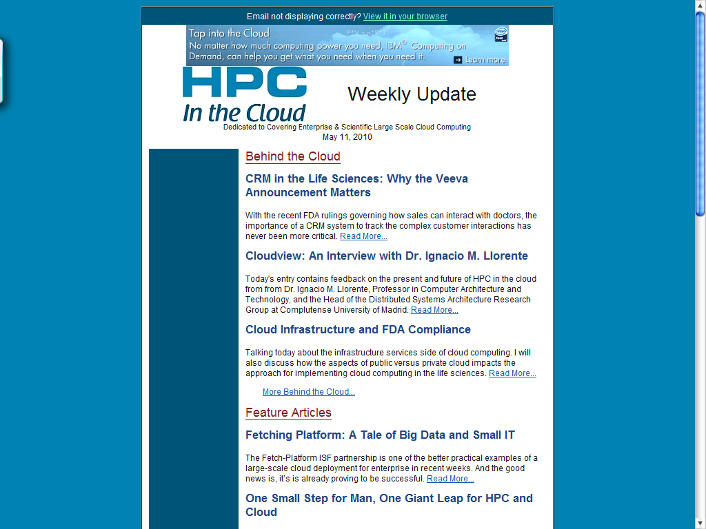
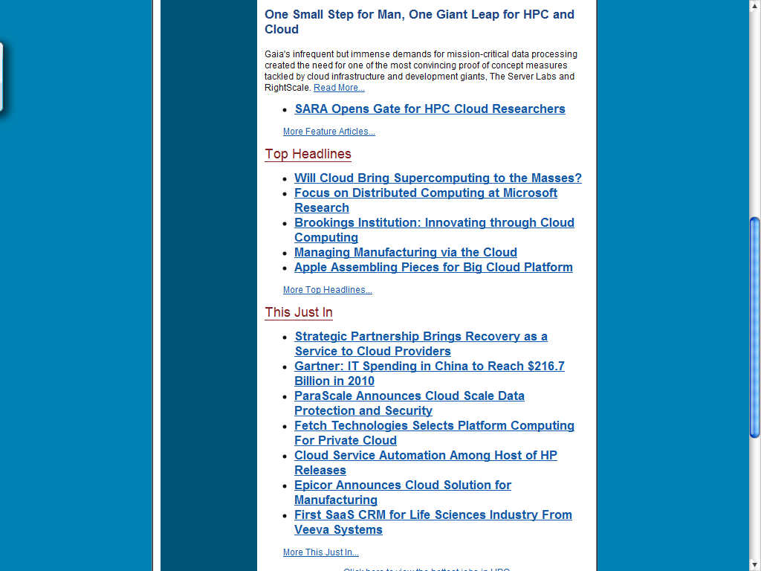
Already made HPC weekly

Slide 26
Challenges
Scalability, Reliability, Maintainability, Usability, *bilities

Slide 27
Distributing VM images
Repository (SAN)
iSCSI/LVM
Image
Image
Image
Class 2/3 upload solution
Image
Image
Box 1
“Normal WN”
Box 2
“8 Virtual WNs”
Box 3
“8 Class 2/3 VMs”

Slide 28
Cached copy-on-write
Repository
Image
Box 1
Cache
COW
Image
Box 2
Cache
VM
COW
COW
VM
Image
VM
COW
VM

Slide 29
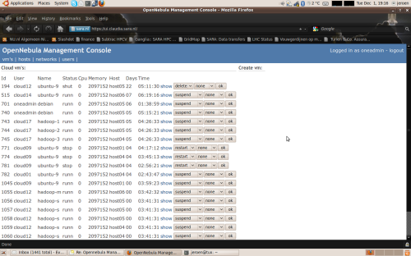
Hybrid solution: integration
Cloudia Interface
Class 3 VMs
Class 2 VMs

Slide 30
Reliability / Usability
Experiences from WNoDeS and Cloudia
EGI focus point
See position paper on CloudScape II, 2010
http://www.ogfeurope.eu/Repository/FileScaricati/Cloudscape_II_Position_Papers_and_Professional_Profiles.pdf
Industry developments
Grid was so far a purely scientific endeavor
Keep a close eye on industry for all the *bilities

Slide 31
Conclusions
Integration of Grids and VMs is a hot topic
WNoDeS, HEPiX, BiG Grid, OpenNebula, etc.
Many different approaches
Trusted/Untrusted, Grid like/Cloud like
Scalability, reliability, maintainability, usability remain issues of primary concern.
Cloud like solutions: do they scale?
Grid like solutions: are they user friendly?

