Slide 1
Dynamical casimir effect (?)
twjpa

Slide 2
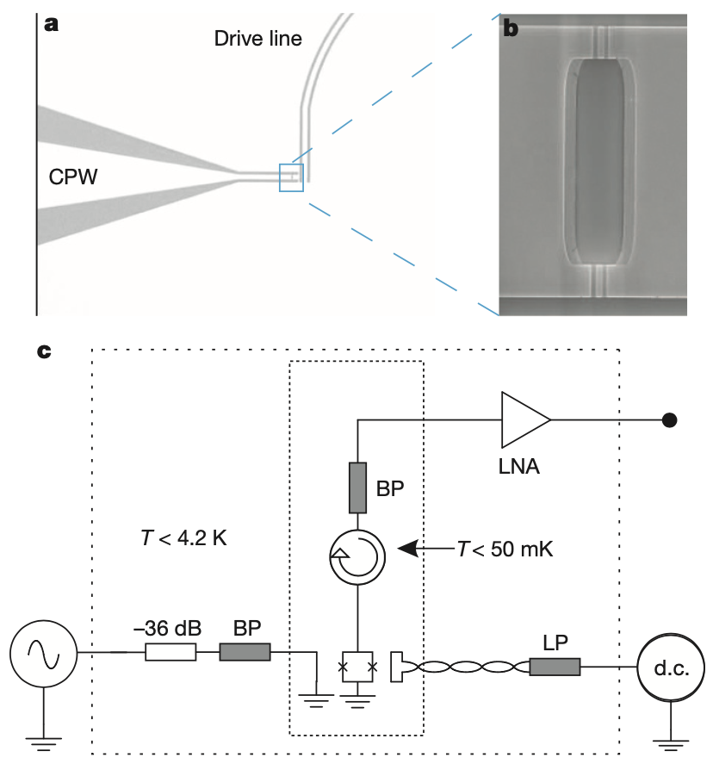
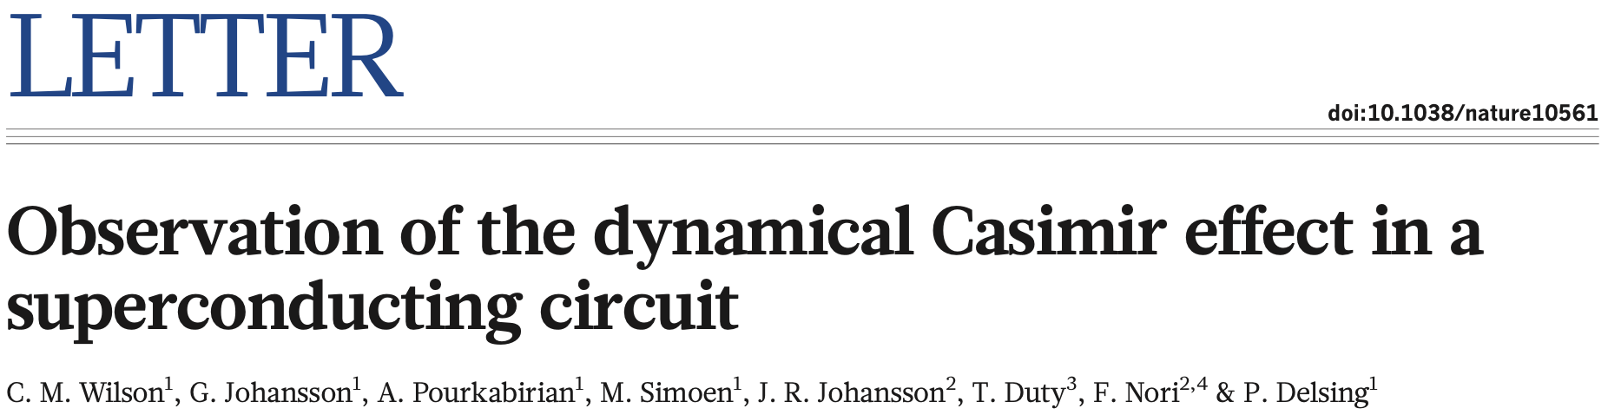
Nature 479, 376–379 (2011). https://doi.org/10.1038/nature10561

Slide 3
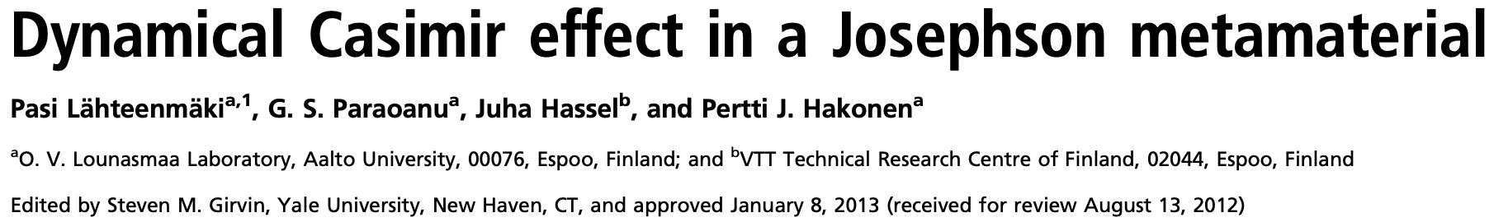
PNAS March 12, 2013 110 (11) 4234-4238; https://doi.org/10.1073/pnas.1212705110

Slide 4
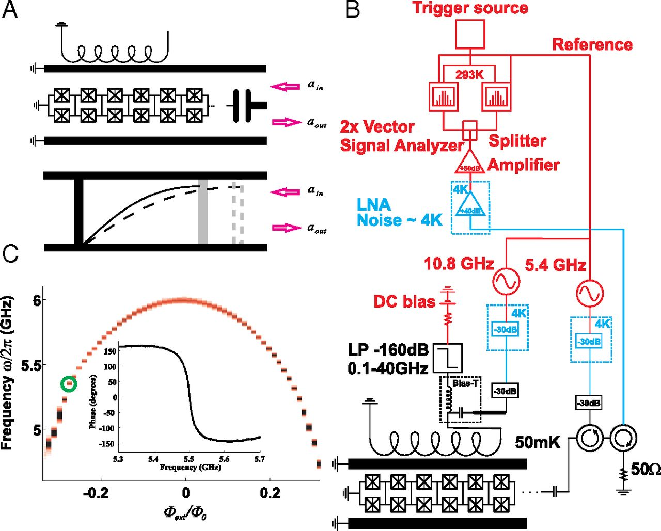
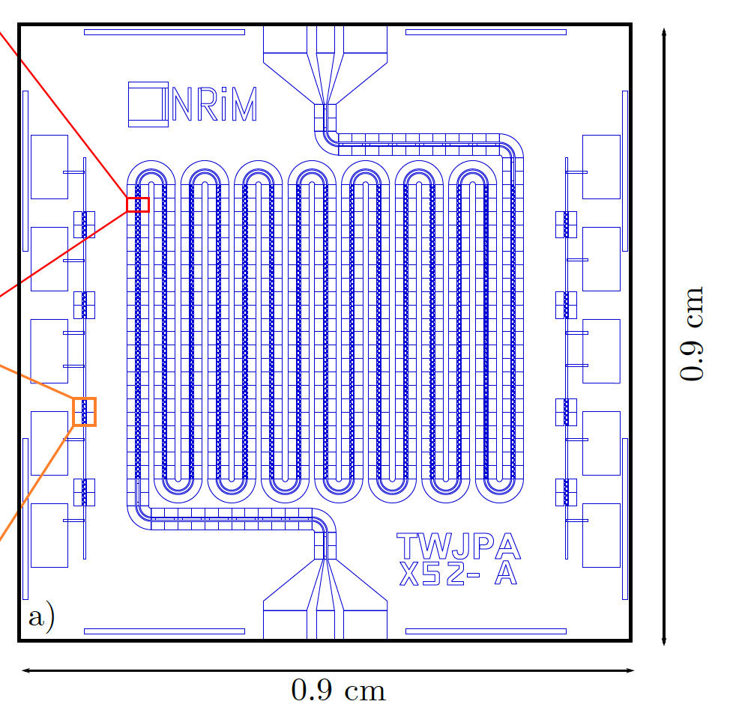
Pnas 2012
Our setup
Coplanar waveguide with 250 embedded SQUIDs
Resonator

Slide 5


‘sparrow-tail’ structures
$$ν=ω_{res}−ω_{d}/2$$
$$Δ=ω−ω_{d}/2$$

Slide 6
Bias current scan
Fixed pump parameters
f = 17.994 GHz
P = 2 dBm

Slide 7
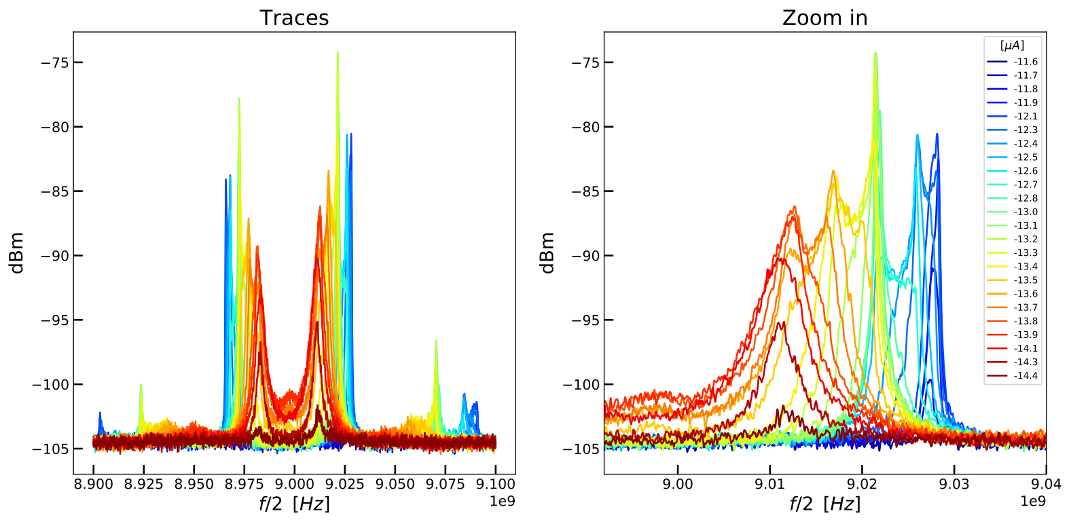

P = 2 dBm, f = 17.994 GHz - scan $I$

Slide 8

P = 2 dBm, f = 17.994 GHz - scan $I$
Blue: peaks to the right
Rosso: peaks to the left
Energy conservation and correlation:
Peaks on the left always smaller than peaks on the right
$$ω_{d}=ω_{+}+ω_{−}$$

Slide 9
Bias current scan
Fixed pump parameters
f = 6.006 GHz
P = 2.85 dBm

Slide 10
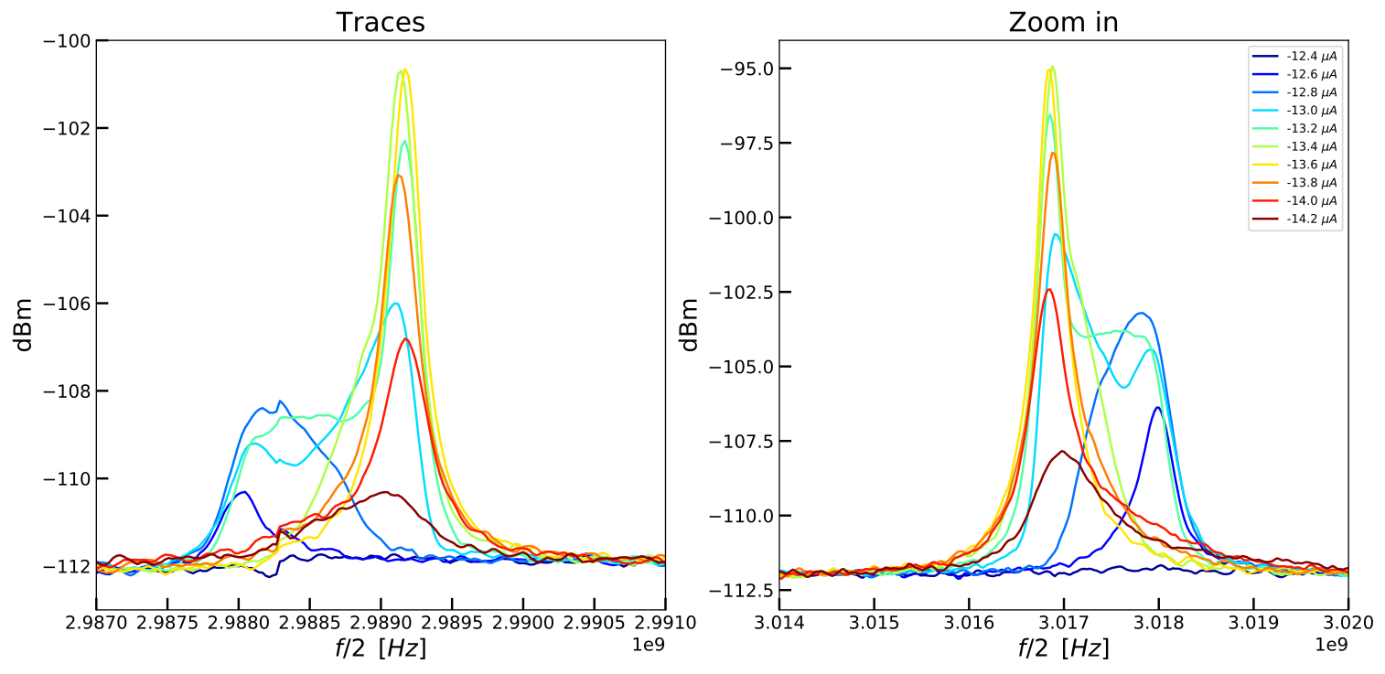

P = 2.85 dBm, f = 6.006 GHz - scan $I$
Peaks on the left
Peaks on the right

Slide 11
P = 2.85 dBm, f = 6.006 GHz - scan $I$
Blue: peaks to the right
Rosso: peaks to the left
(double ‘horn’ on each peak)

Slide 12

pump power scan
Fixed parameters
f = 17.994 GHz (pump)
I = -13.4 $μ$A

Slide 13
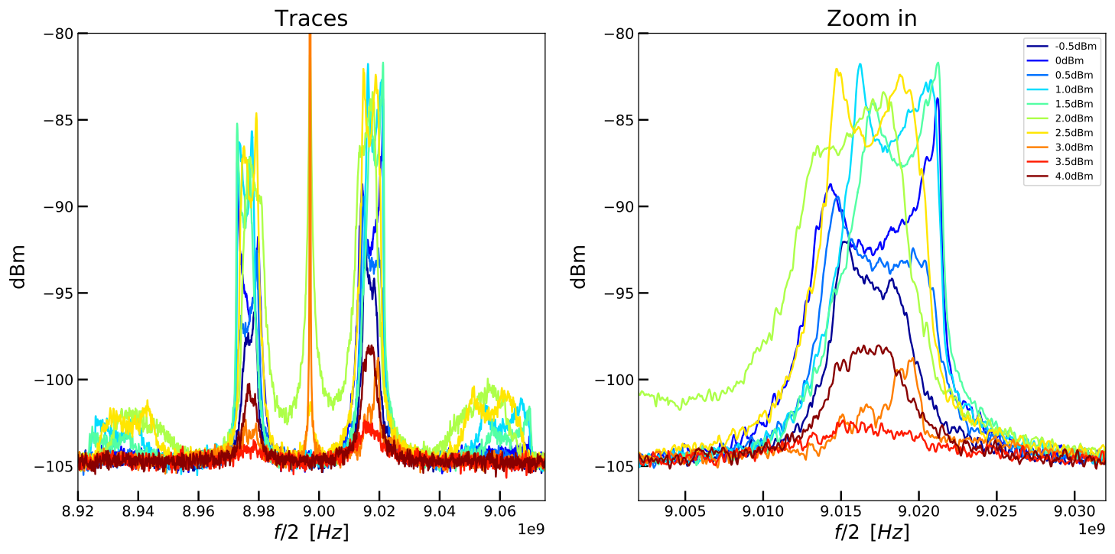

I = -13.4 $μ$A, f = 17.994 GHz - scan P

Slide 14
I = -13.4 $μ$A, f = 17.994 GHz - scan P
Blue: peaks to the right
Rosso: peaks to the left
There seems to be oscillations, due to the double ‘horn’ structures. But the mean seems to be constant.
Blue and red oscillations are opposite → energy conservation

Slide 15

pump power scan
Fixed parameters
f = 6.007 GHz (pump)
I = -13.4 $μ$A

Slide 16

I = -13.4 $μ$A, f = 6.007 GHz - scan P

Slide 17
I = -13.4 $μ$A, f = 6.007 GHz - scan P
Blue: peaks to the right
Rosso: peaks to the left
Peaks get closer with increasing power

Slide 18

pump frequency scan
Fixed parameters
P = 2.9 dBm (pump)
I = -13.4 $μ$A

Slide 19

I = -13.4 $μ$A, P = 2.9 dBm - scan f

Slide 20
I = -13.4 $μ$A, P = 2.9 dBm - scan f
Blue: peaks to the right
Rosso: peaks to the left
The two peaks move in the same direction.

Slide 21

pump frequency scan
Fixed parameters
P = 2 dBm (pump)
I = -13.4 $μ$A

Slide 22
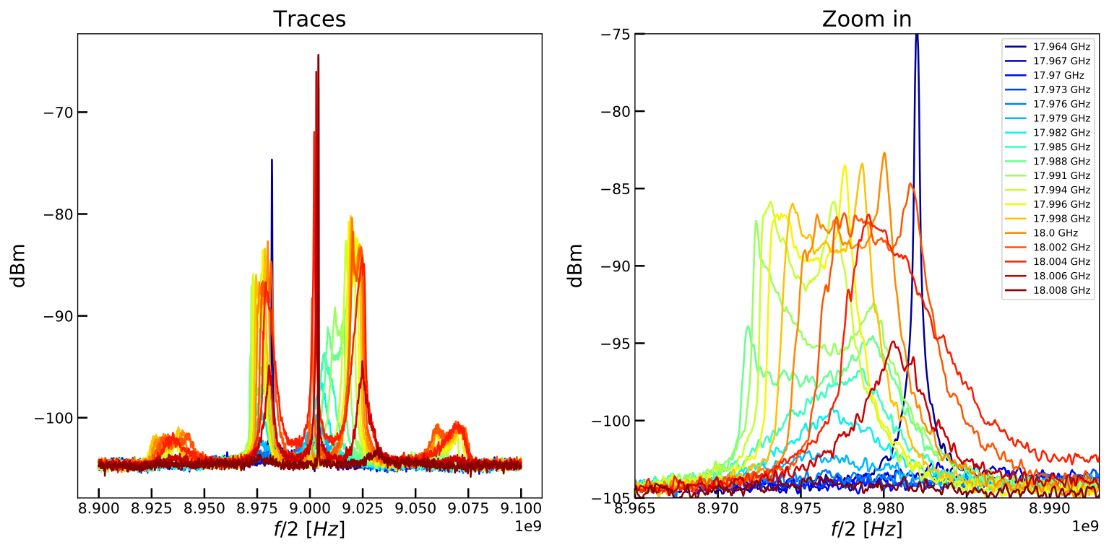

I = -13.4 $μ$A, P = 2 dBm - scan f

Slide 23
I = -13.4 $μ$A, P = 2 dBm - scan f
Blue: peaks to the right
Rosso: peaks to the left

