Slide 1
EUCARD Emittance discussion
EUCARD – ANAC WP11.4 : Instrumentation for novel accelerator
First Collaboration Meeting
Frascati 8-9 March 2010

Slide 2
Plasma photoinjector Electron beam parameters
Transverse dimensions =1-2 μm
Divergences =2-3 mrad
Bunch duration =1.5 fsec
Bunch charge =10-100 pC
Energy =50-200 MeV
Energy spread > 1%

Slide 4
Palaiseau - FRANCE
On the Control of e-Beam Parameters
with Laser Plasma Accelerators
victor.malka@ensta.fr
V. Malka, J. Faure, C. Rechatin, O. Lundh, A. Ben Ismail, J. Lim,
Laboratoire d’Optique Appliquée, ENSTA-Ecole Polytechnique, CNRS, 91761 Palaiseau, France
E. Lefebvre, X. Davoine
CEA/DAM Ile-de-France, France
A. Lifschitz
LPGP, CNRS- University of Orsay, France
Partially supported by CARE/FP6-Euroleap/FP6-Accel1/ANR-PARIS/ERC contracts
Frontiers in Intense Laser-Matter Interactions Theory, Garching, Germany – March 1-3 (2010)
http://loa.ensta.fr/
UMR 7639

Slide 5
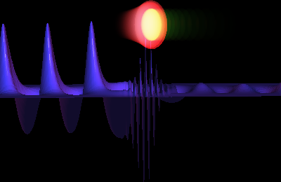
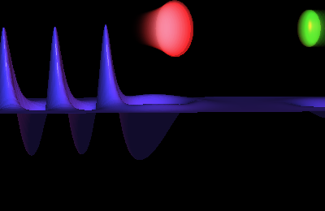
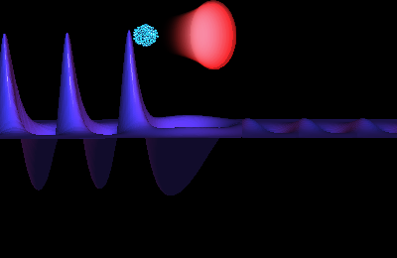
Controlling the injection
A second laser beam is used to heat electrons
Pump beam
Injection
beam
Trapped electrons
Beatwave
Wakefield
Acceleration phase
Acceleration phase
Injection phase
Ponderomotive force of beatwave: F_{p} ~ 2a₀a₁/λ₀ (a₀ et a₁ can be “weak”)
Boost electrons locally and injects them INJECTION IS LOCAL and IN FIRST BUCKET
E. Esarey et al., PRL 79, 2682 (1997), G. Fubiani et al., PRE 70, 016402 (2004),
H. Kotaki et al., PoP 11 3296 (2004), J. Faure et al., Nature (2006)

Slide 6
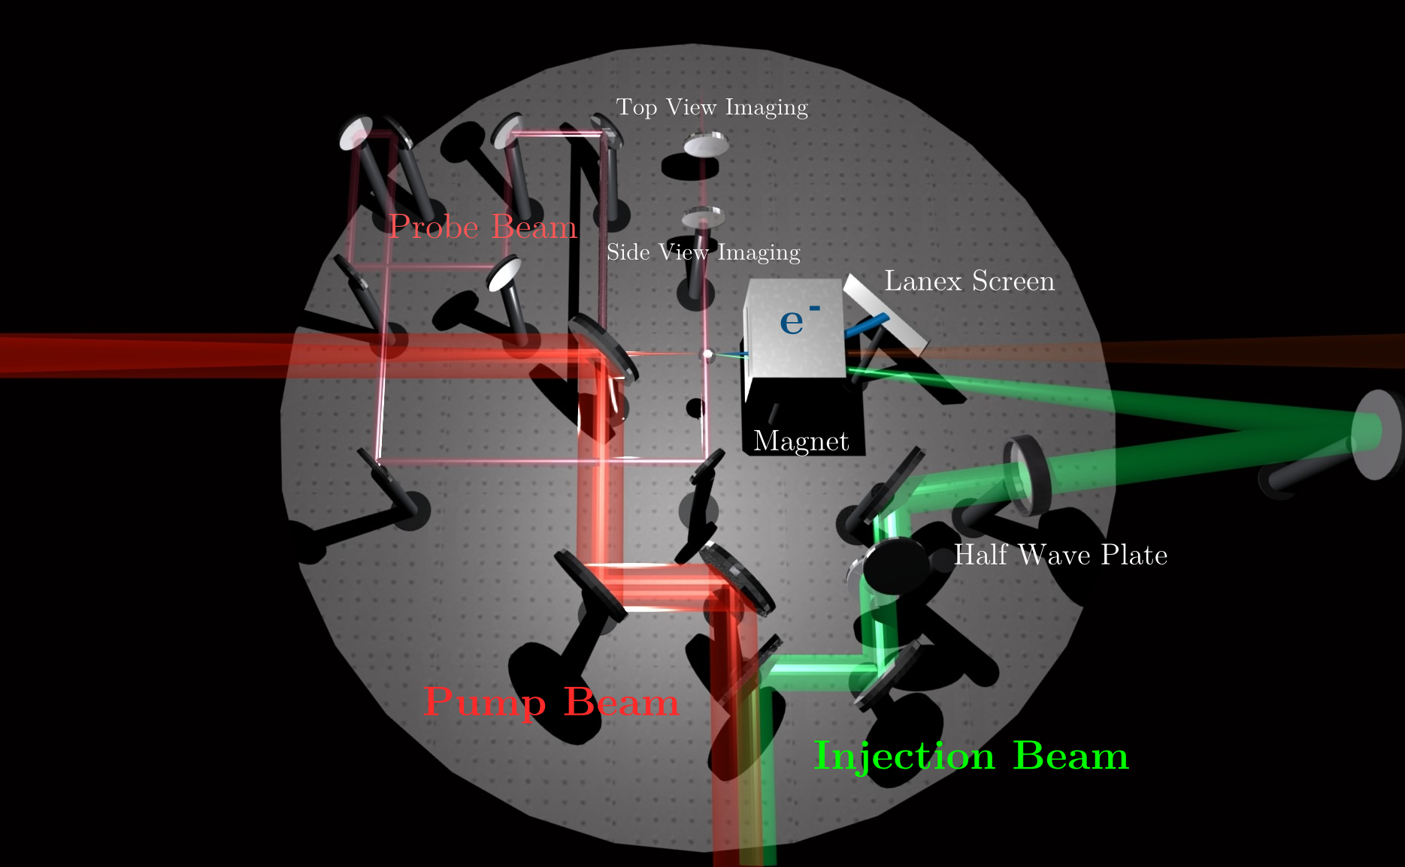
Experimental set up

Slide 7
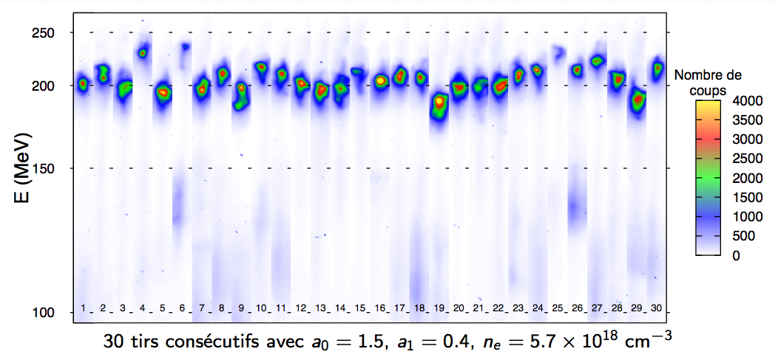
Very stable quasi-mono energetic electron beam
Nb: very few electrons at low energy
δE/E=5% limited by the spectrometer
http://loa.ensta.fr/
UMR 7639

Slide 8
1% energy spread beams
C. Rechatin et al., PRL, 102, 164801 (2009)

Slide 9
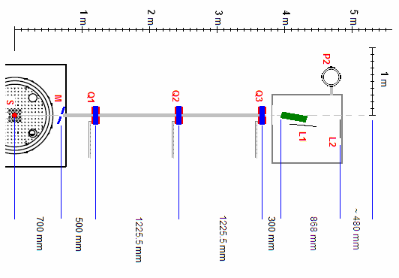
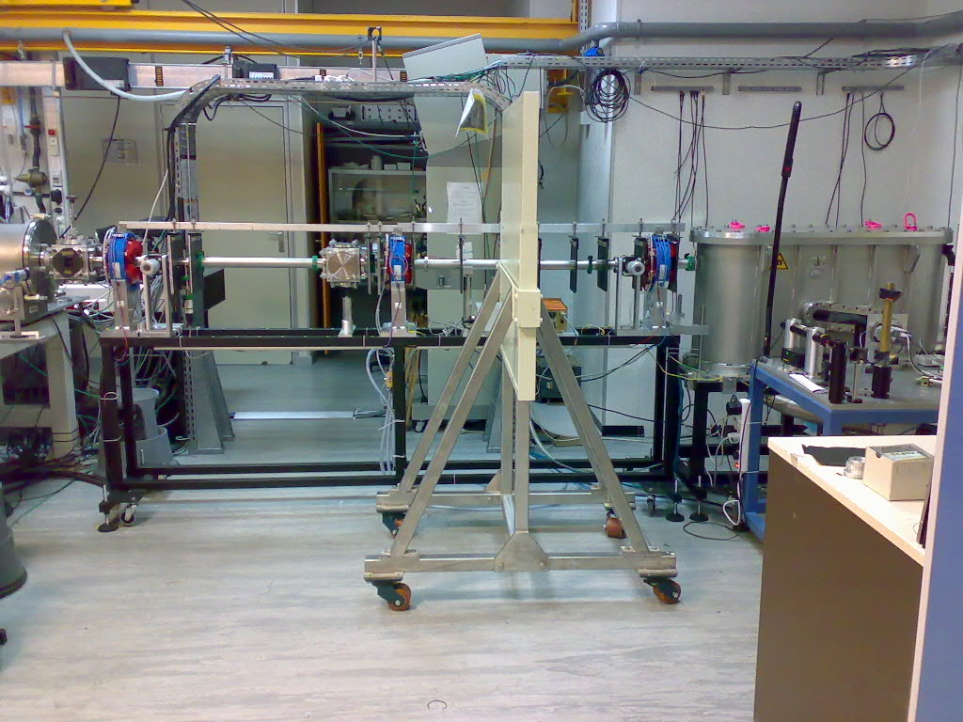
High resolution electron spectrometer
Gas jet
quadripoles
Permanent dipole
LANEX screens
transport / focusing
dispersion / imaging
Resolution < 1 % expected
In collaboration with A. Specka, H. Videau
LLR, CNRS, Ecole Polytechnique
Frontiers in Intense Laser-Matter Interactions Theory, Garching, Germany – March 1-3 (2010)
http://loa.ensta.fr/
UMR 7639

Slide 10
Low energy emittance measurements @SPARC

Slide 11
Low energy emittance measurements @SPARC

Slide 16
LIFE Temporary Spectrometer (2010)
Will discuss these points, showing studies for the 2010 preliminary spectrometer for PlasmonX
➔ Dedicated detector under design
Magnet
Mostly recycled material:
Magnet spare of SPARC
Scintillating fibers from NA62
electronic board borrowed from ISS
Beam line
detector

Slide 17
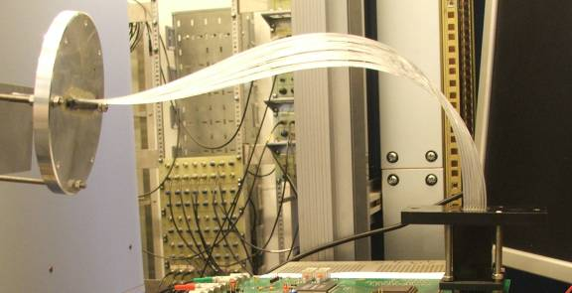
Lanex vs Scintillating fibers
Fibers detector
LANEX
PMT
Pros
Easy to deploy
Extremely small position resolution
Two dimensional
Works in vacuum
Cons
Difficult to read for large areas
Frequent alignment needed
Sensitive to radiation
Linearity in charge for high energy particles?
Pros
Insensitive to radiation
Easy to integrate in a DAQ
Flexible in shape
Works in vacuum
Calibration required only once
Cons
Lot of electronic channels (expensive)
Low space resolution

Slide 18
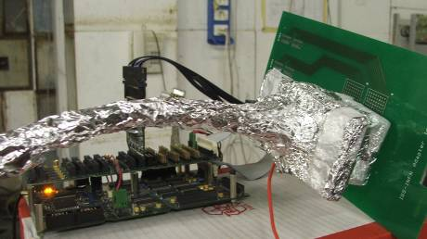
64 channels Prototype

Slide 19
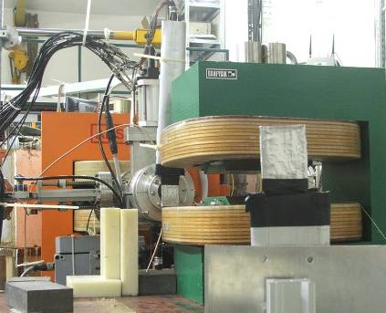
Test Beam @ Frascati BTF
UPSTREAM position monitor
DHSTB02
DANFYSIK
DOWNSTREAM
Position monitor
(or prototype)

Slide 20
Projected Emittance Measurement with QSCAN

Slide 21
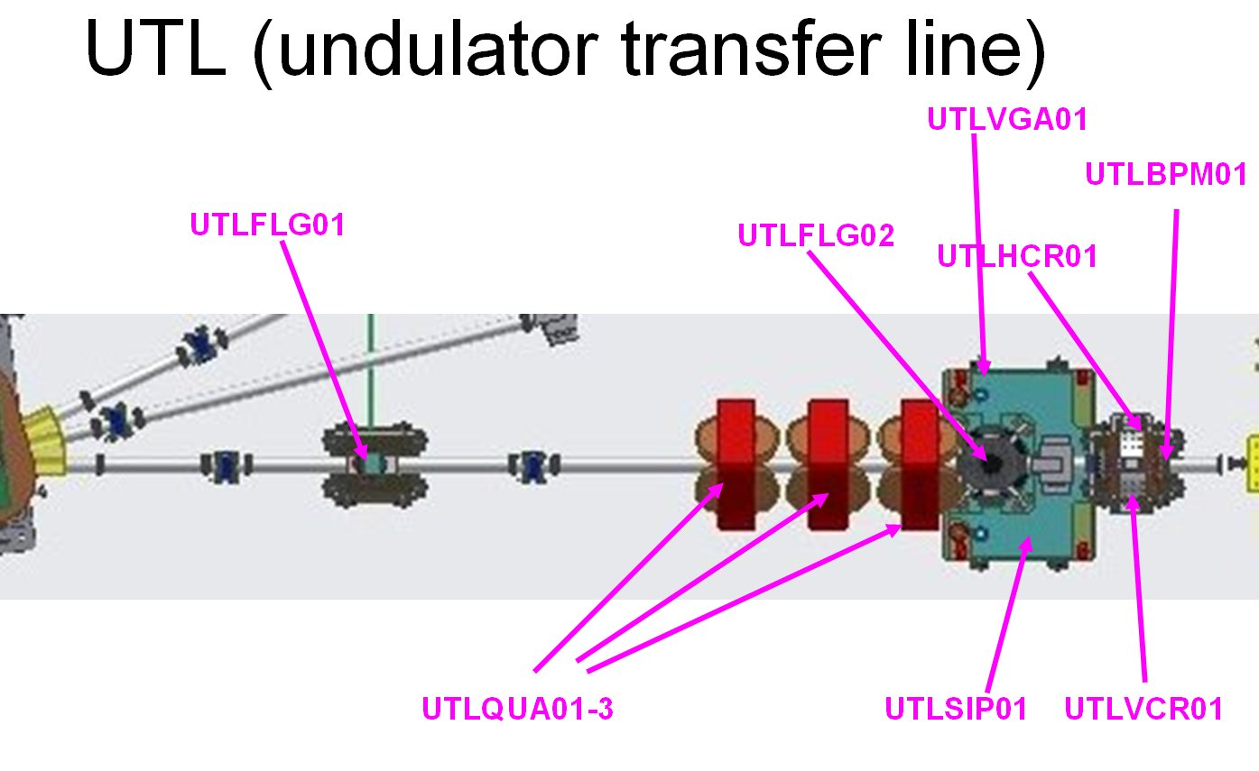
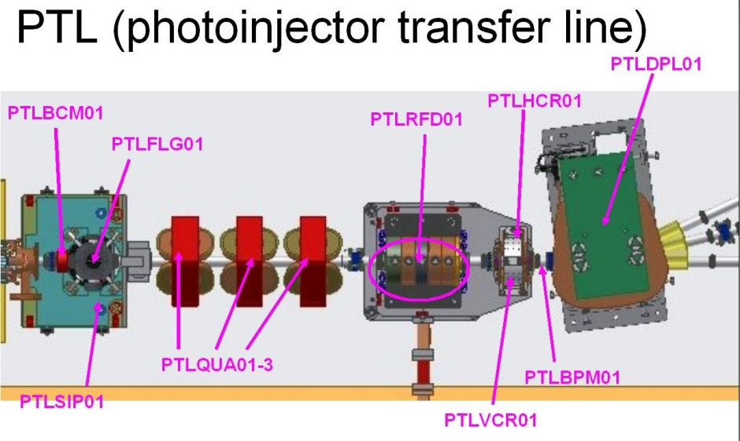
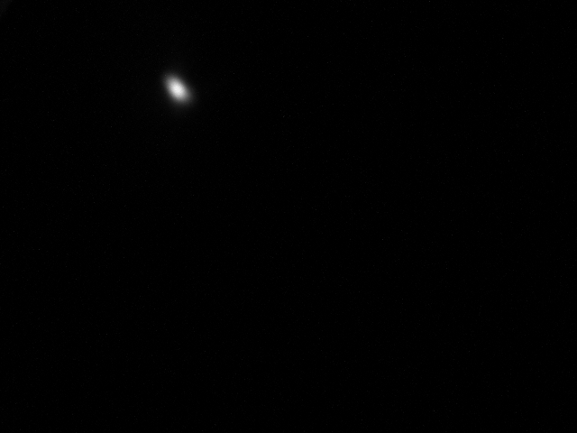
Projected Emittance Measurement with QSCAN
Evaluation
flag
Measurement
flag
PTLQUA01-03
vary as a doublet
(|I_{QUA02}|= |I_{QUA03}|)
or
Single quad meas.
Usually set at 0 A

Slide 22
Quadrupole Scan Technique
Principle
with a well-centered beam, the beam size is measured as a function of the quadrupole field strength
L_{drift0}
L_{q2q1}
L_{q3q2}
L_{drift1}
Each raw corresponds
to a different current
M. Minty, F. Zimmermann
Measurement and Control of Charged Particle Beams

Slide 23
Typical Beam Parameters
E = 170 MeV
σ_{γ} = 0.1% (non compressed beam)
σ_{γ} = 1% (compressed beam)
σ ~ 10² μm
σ’ ~ 10 μrad

Slide 24
Limitations
The machine optics changes
Well-centered beam (⬄ alignment of quads)
Overlapping of quadrupole fields
Chromatic effects

Slide 25
Analysis of Chromatic Effects
In quadrupole scan measurements a monochromatic electron beam,
is assumed to evaluate the projected emittance. However, for a real beam, particles have an energy spread, σ_{γ}, different from zero.
Being ε₀, x₀, x′₀, the emittance, the position and the divergence just before
the first quadrupole, the geometrical emittance after the quadrupole is
from single quad
σ_{x} is the transverse dimension at the entrance at quadrupole.

Slide 26
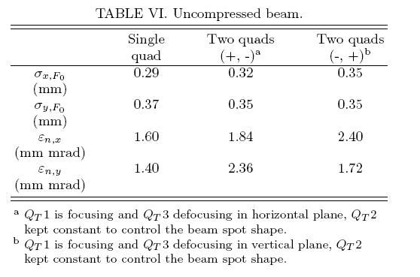
Comparison with Measurements
The measured emittance values for the two quadrupoles configuration are systematically higher than those measured in single quadrupole one.
They show the same asymmetry highlighted by simulations, i.e. the emittance results higher in the plane where the first quadrupole is defocusing.
This means that also for uncompressed beams second order effects might affect the measurement.

Slide 27
Is it possible to cancel ε_{chr}?
In the two quadrupole emittance measurement, a possibility is to choose the quadrupole setting to cancel the contribution to the emittance increase. In particular assuming that the σ_{x}⁴ term is dominant, one can choose K₁=k₁l₁ and K₂=k₂l₂ such that
Condition for achromatic doublet.

Slide 28
Second order effects can affect the quad-scan emittance measurement at SPARC especially in case of large energy spread and and large spot size
Is it possible to realize experimentally an achromatic doublet for emittance measurement?
Could the large spot size and divergence affect the two quad measurement (when the first quad is defocusing) giving a non-linear transport?

Slide 29
Conclusions
We need new emittance measurement set up for plasma generated beam
Possible solution is the use of quads to change the starting condition and measure with multiscreen or pepper pot technique
Or Multislits with long propagation drift

