Slide 1


SICURA
Gamma and X ray detectors

Slide 2

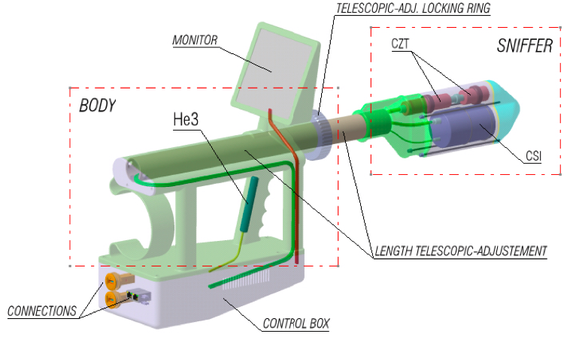
Probe design
Multi-detector probe:
Gamma detectors:
Neutron detector:
Dedicated electronics
User interface - monitor
One hand and telescopic
All the mechanical structure is 3D printed
                Alarm detector CsI(Tl)
  Isotope identification CdZnTe -> CZT
  ³He
?
?

Slide 3
CONTENTS OF THIS CONTRIBUTION
Two Gamma and X detectors
Alert stage
  Choice of the light output reading
Identification stage
Simulations
  MCNP6
Conclusions

Slide 4
Two detectors
We chose the Technical and Functional Specifications for Border Monitoring Equipment of IAEA as reference. The requirements are
Energy resolution < 8 % at 662 keV
Fast response – able to detect a ¹³⁷Cs source with activity of 1 MBq at 30 cm in 1 s
We decided to mount two different detectors, one with good efficiency and the second with great energy resolution
Alert Stage
Alert Stage
Identification Stage
Notes:
Faccio finta di spiegare perché due rivelatori sono una buona idea

Slide 5
Detectors Choice
The choice of the optimal Gamma and X detector for the SICURA device was based on two different types of parameters:
Physical
Project-related
Material | Germanium | CdZnTe | CsI(Tl) | NaI(Tl) | LaBr
Efficiency | 3 | 3 | 4 | 5 | 4
Resolving power | 5 | 5 | 3 | 3 | 4
Hygroscopicity | 3 | 5 | 5 | 1 | 2
Sensitivity to Temperature | 1 | 5 | 4 | 3 | 3
Cost at fixed efficiency | 1 | 3 | 4 | 4 | 3
Dimensions and weight at fixed efficiency | 1 | 4 | 5 | 5 | 5
Conformity to international standards [1] | ✘ | ✔ | ✔ | ✔ | ✔
TOTAL | 14 | 25 | 26 | 21 | 21
Such as efficiency, resolving power, hygroscopicity and sensitivity to temperature.
Cost, dimensions and weight, impact resistance and conformity to relevant international standards.

Slide 6
Detectors Choice
The choice of the optimal Gamma and X detector for the SICURA device was based on two different types of parameters:
Physical
Project-related
Material | Germanium | CdZnTe | CsI(Tl) | NaI(Tl) | LaBr
Efficiency | 3 | 3 | 4 | 5 | 4
Resolving power | 5 | 5 | 3 | 3 | 4
Hygroscopicity | 3 | 5 | 5 | 1 | 2
Sensitivity to Temperature | 1 | 5 | 4 | 3 | 3
Cost at fixed efficiency | 1 | 3 | 4 | 4 | 3
Dimensions and weight at fixed efficiency | 1 | 4 | 5 | 5 | 5
Conformity to international standards [1] | ✘ | ✔ | ✔ | ✔ | ✔
TOTAL | 14 | 25 | 26 | 21 | 21
Such as efficiency, resolving power, hygroscopicity and sensitivity to temperature.
Cost, dimensions and weight, impact resistance and conformity to relevant international standards.

Slide 7
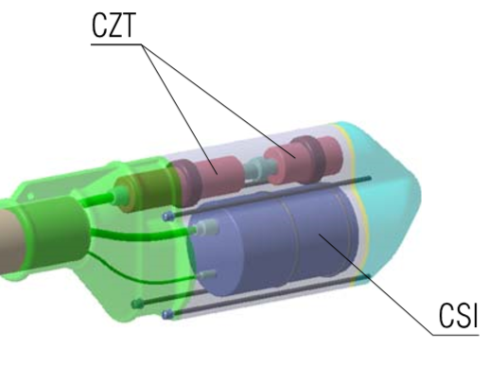
Gamma Detectors
?
Alert Stage
Identification
High detection efficiency
Low sensitivity to background
Fast response
High resolving power
Large sensitive volume
?
Non hygroscopic and insensitive to temperature variations
Portable
Low cost
Compliant to International Standards

Slide 8
Gamma Detectors
Alert Stage
Identification
High detection efficiency
Low sensitivity to background
Fast response
High resolving power
Large sensitive volume
Non hygroscopic and insensitive to temperature variations
Portable
Low cost
Compliant to International Standards
CsI(Tl)
CZT

Slide 9
Alert Stage - CsI(Tl)
It was chosen a cylindrical CsI(Tl) crystal 51 mm h x 51 mm Ø
We tested and compared three different light reading systems:
  Photodiode
  SiPM
  Phototube
All detectors were calibrated employing point-like sources. Their efficiency and energy resolution were measured and evaluated.

Slide 10
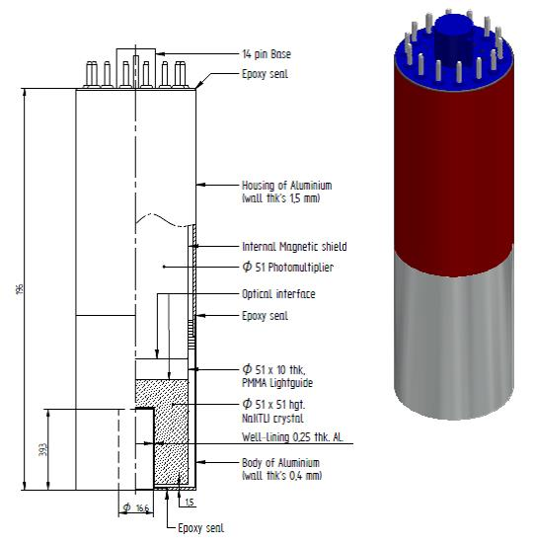
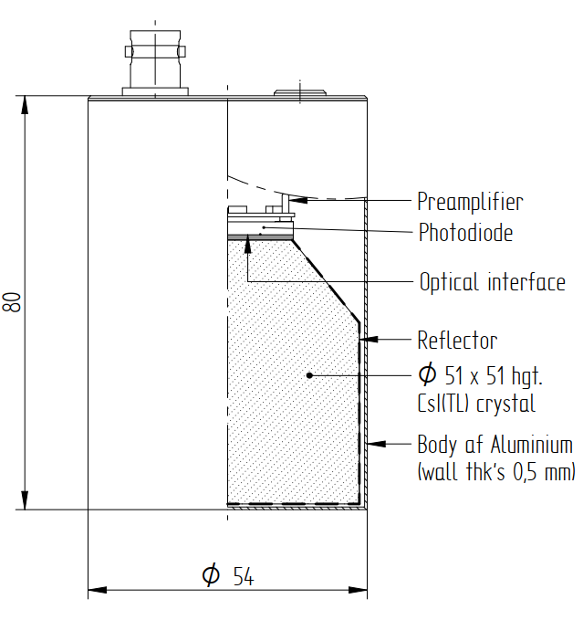
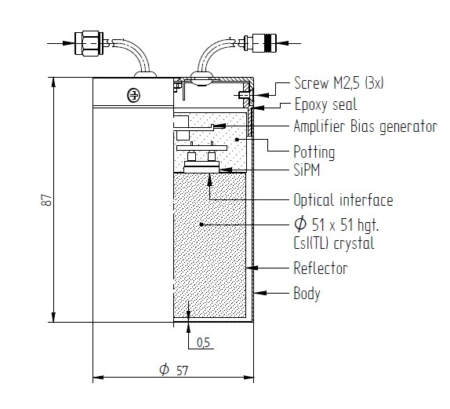
All produced and assembled by Scionix [4]
Photodiode
SiPM
Phototube

Slide 11
Measurements
Amplitude, efficiency and energy resolution as functions of energy of the impinging particles were measured employing point like sources.
Efficiency extracted as integral in the 3 interval under the photopeak.
Resolving power was estimated as FWHM/centroid of the photopeak.
Readout | Photodiode | SiPM | Phototube
Efficiency @ 662 keV | 21.3 % | 12.4 % | 25.1 %
Resolving power @662 keV | 13.8 % | 10.7 % | 5.7 %
Amplification needed | Yes | No | No
Cost | 1545 € | 1495 € | 1495 €
Weight | 750 g | 800 g | 1.2 kg
Power supply or bias | No | 6-12 V | -1000 V
Seen these characteristics, we opted for the SiPM readout

Slide 12
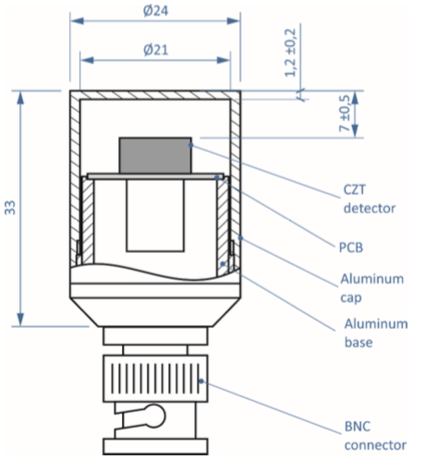
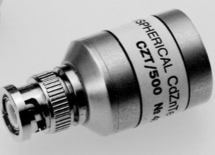
Identification Stage - CZT
From marked analysis emerged the CZT 500 built by RITEC [5] was the best choice given the fixed budget (4 k€)
Large sensitive volume – 500 mm³
Excellent energy resolution – 2 % @ 662 keV (measured)
  In compliance with the IAEA Technical Guide
Same power supply voltage as He³ and electronics
Pre-amplifier provided by the constructor
Small and light

Slide 13
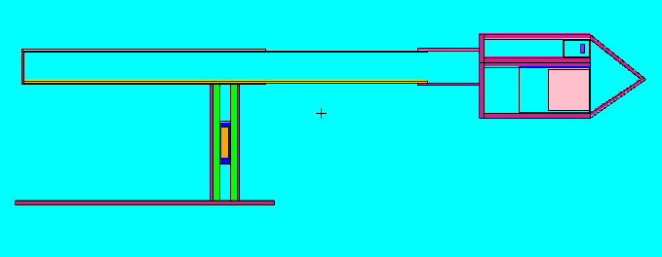
Simulations
In parallel we simulated the whole device using the Monte Carlo N-Particles transport code MCNP6[6] and verified that the experimental and simulated results are in agreement.
CsI
CZT
Poimt-like source
He-3

Slide 14
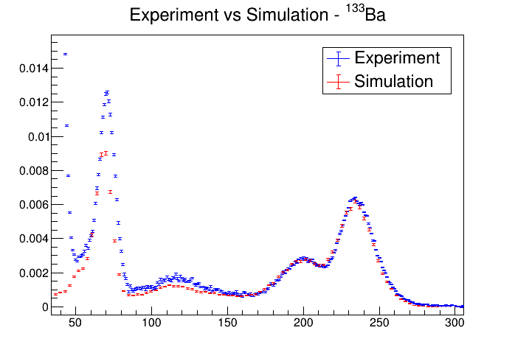
MCNP6: ¹³³Ba – CsI(Tl)
E [keV] | Yield (%)
383,85 | 8,94
356,02 | 62,05
302,85 | 18,33
276,40 | 7,16
# counts normalized to unity
Channel (AU)

Slide 15
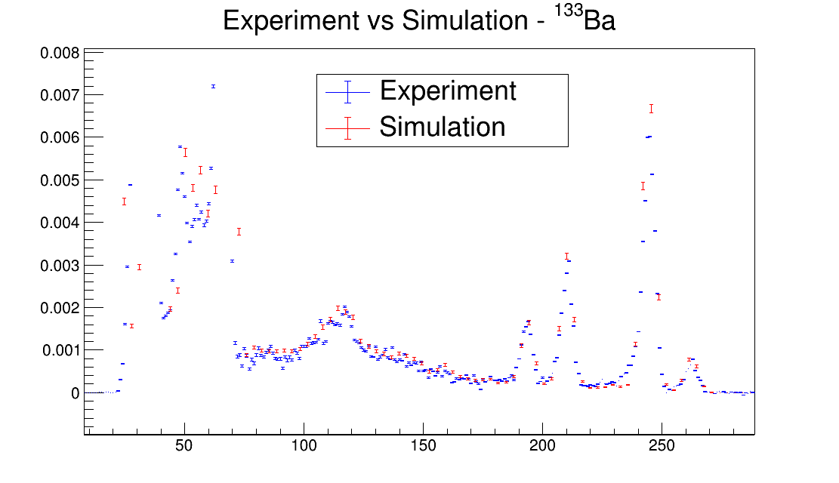
MCNP6: ¹³³Ba – CZT
E [keV] | Yield (%)
383,85 | 8,94
356,02 | 62,05
302,85 | 18,33
276,40 | 7,16
# counts normalized to unity
Channel (AU)

Slide 16
Conclusions
Conclusions

Slide 17
References
[1] Technical and Functional Specifications for Border Monitoring Equipment, Technical Guidance – Reference Manual, IAEA Nuclear Security Series no. 1
[2] Monitoring for inadvertent movement and illicit trafficking of radioactive material, ISO, Geneve, 2004.
[3] Radiation Detection and Measurement, Glenn F. Knoll, 4a edizione, Wiley.
[4] https://scionix.nl/scintillation-crystals/
[5] http://www.ritec.lv/html/czt500.html
[6] C.J. Werner(editor), "MCNP Users Manual - Code Version 6.2", Los Alamos National Laboratory, report LA-UR-17-29981 (2017).

Slide 18
Thanks for your attention!!

Slide 19
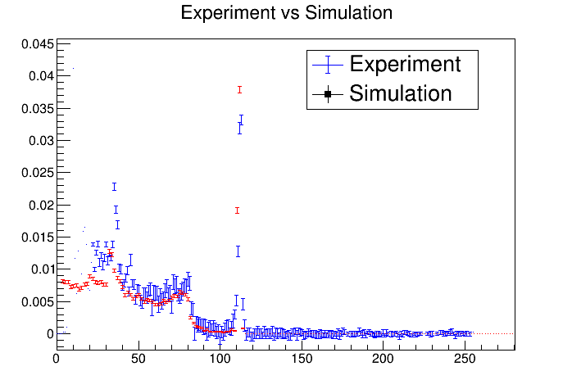
MCNP6: 137Cs - CZT
counts
chn

Slide 20
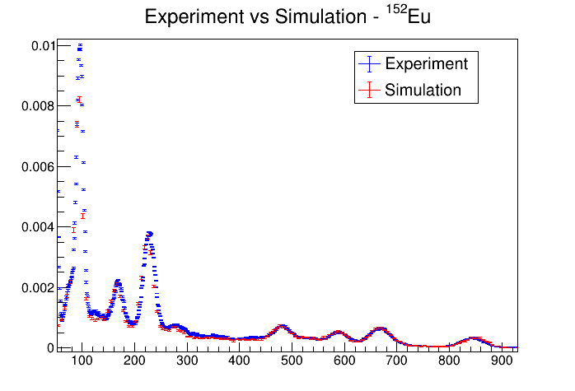
MCNP6: 152Eu – CsI(Tl)
counts
chn

Slide 21
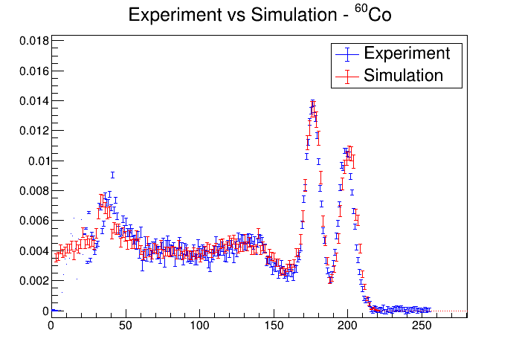
MCNP6: 60Co – CsI(Tl)
counts
chn

Slide 22

GEB: gaussian energy broadening
Fwhm [MeV]
Fwhm [MeV]
E [MeV]
E [MeV]
$$FWHM\left(E[MeV]\right)=p0+p1∙\sqrt{E+p2∙E^{2}}$$

