Slide 1
A Metastable Positronium Inertial Sensor
Ruggero Caravita
INFN TIFPA
H2020 MSCA COFUND
G.A. 754496

Slide 2
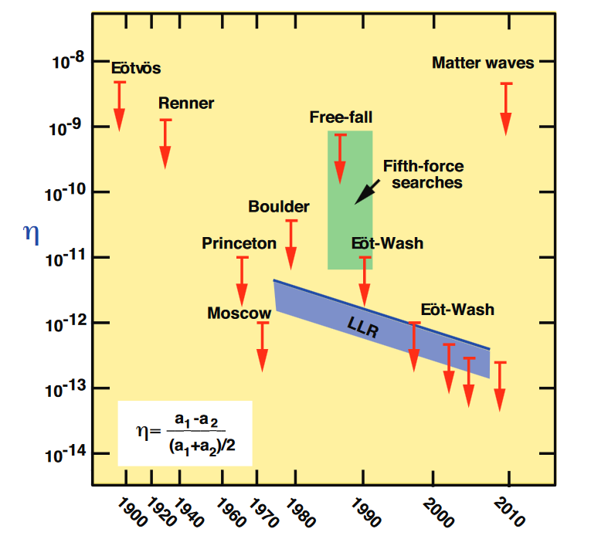
Gravity and Standard Model – the state of the art
Galileo’s Pisa leaning tower thought experiment
parmi che ben potremo con molto probabil coniettura credere che nel vacuo sarebbero le velocità loro del tutto eguali
... also known as the Universality of the Free-Fall (UFF), a cornerstone beyond Einstein’s Equivalence Principle and General Relativity.
Searches for violations of the Universality of the Free-Fall
Very accurate tests were done with matter
Attempts with charged positrons ~ 1967, failed
Attempts with charged antiprotons ~ 1985, failed
Some indirect limits ~ 1987-2000, unconclusive
Only one limited attempt with antihydrogen by ALPHA (2014)
any deviation from g would be an indication of new physics!

Slide 3
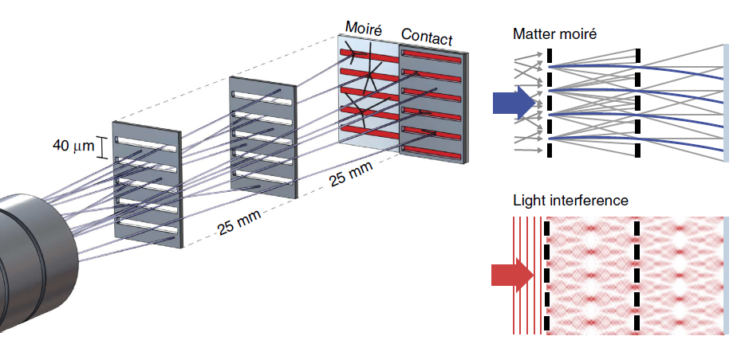
Universality of the Free-Fall with antimatter atoms
The experiment goal and concept
Detect the vertical displacement of a free-falling beam of antiatoms
... either with antihydrogen or positronium atoms ...
... by comparing their annihilation positions to a light reference

Slide 4
Universality of the Free-Fall with antimatter atoms
One needs
a suitable source of cold antiatoms
a very high-resolution imaging detector for antiparticles
a classical deflectometer/light interferometer
patience (i.e. beam time ☺)
the real bottleneck
AMPIS
AEgIS
$e$⁺
Positronium (Ps)
$e$⁺
Antihydrogen ($\overline{H}$)
electron + positron
short-lived (only 142 ns!)
table-top experiments
antiproton + positron
only «stable» atom
small amounts only @
$\overline{p}$⁻
$e$⁻
Two joint ventures with one single goal – developing the first source of cold antiatoms for a test of the Universality of the Free-Fall
Published results so far with FELLINI acknowledgment
Antonello M. et al. (The AEgIS collaboration), Phys. Rev. A 100 (2019) 063414
Mariazzi S., Caravita R. et al., Eur. Phys. Jour. D 74 (2020) 78
Amsler M. et al. (The AEgIS collaboration), Nat. Comm. Phys. (2020), accepted

Slide 5
Research skills and techniques
Research skills and techniques acquired or planned to be improved
Experimental skills in gamma-ray spectroscopy with state-of-the-art fast scintillation calorimeters (PbWO₄, LaBr₃) – achieved
Experimental skills with low-energy positron beams and cold positronium production techniques – achieved
Experience with ultra-high-resolution position-sensitive and imaging detectors for low-energy charged particles (MCP with phosphor/pixel readout) – in progress
Experience with ultra-high-resolution laser spectrum diagnostics in the vacuum ultraviolet domain – in progress
Theoretical insights of the impact of positronium gravitational measurements to general physics – planned
Atom interferometry with cold atoms – planned

Slide 6
Management of research funds
Funds availability and management
FELLINI (for AMPIS) – 18 k€/year available to each Fellow for new develoments
ATTRACT – 100 k€ for the laser cooling laser development
INFN-CSN3 (for AEgIS) – support for mantainance of existing infrastructure
FELLINI funds allocation | Year 1 | Year 2 | Year 3
Funds income | +18 k€ | +18 k€ | +18 k€
Missions budget | 5 k€ | 5 k€ | 5 k€
Total funds available | 13 k€ | 26 k€ | 39 k€
Expenditure plan | Year 1 | Year 2 | Year 3
Missions | 4 k€ | 6 k€ (est) | 5 k€ (est)
Laser and optics | 1.4 k€ | 15 k€ (est) | 3 k€ (est)
Interferometer |  |  | 10 k€ (est)
Vacuum technology |  | 5 k€ (est)
Detectors |  | 6 k€ (est)

Slide 7
Management of research teams
Coordination of the AEgIS experiment scientific activity
Acting AEgIS physics coordinator since October 15, 2019
Drafting and planning of AEgIS phase2 scientific activities
Planning and execution of FELLINI Ps physics experiments
Experimental fieldworks coordination
On-site coordination of AEgIS Ps physics working group for experimental activities (3 post.doc, 2 Ph.D.)
Remote coordination of AEgIS non-neutral plasma working group (1 post.doc, 2 Ph.D.)
Collaborating with TIFPA/CERN polarized Ps working group (2 post.doc, 1 Ph.D.)
Collaboration with INFN-GE LAr calorimetry group (4 post.doc)

Slide 8
Research network and connections
INFN
Europe
INFN-Ge
Universtität Innsbruck
INFN-Mi
University of Oslo
Laboratoire Aimé-Cotton
INFN-Pd
Jagiellonian University
Uni. Heidelberg
LNGS
TIFPA
UCL
PSI
Uni. Wien
Interdisciplinary secondment?
CERN
Università di Napoli
EP-SME (AEgIS)
Università di Milano
EP-DT
(Medipix)
Politecnico di Milano
Università di Brescia
EP-SME
(Totem)
Università dell’Insubria
Italy
RRI
UCSC
Coworker
Strong bound
Ohio State
Weak bound
World

Slide 9
Professional training and communication skills
Professional Training
Lecturing at a Ph.D. advanced course
Ph.D. theses being followed/mentored
«high resolution position-sensitive detector for slow positronium» (L.G.)
«first inertial measurements with neutral antimatter systems» (M.V.)
«ballistic production of a beam of antihydrogen» (S.H.)
Communication skills and outreach
Wish-to participate to the Festival of Science in Genova, 2021, with a guided experiment
Wish-to participate to Pint of Science events after the COVID-19 crisis is over

