Slide 1
HQL2010
Frascati
11-15 October 2010
Unitarity Triangle Analysis (UTA) within and beyond the SM:
(on behalf of the Collaboration)
www.utfit.org
A.Bevan, M.Bona, M.Ciuchini, D.Derkach, E.Franco, V.Lubicz, G.Martinelli,
F.Parodi, M.Pierini, C.Schiavi, L.Silvestrini, A.Stocchi, V.Sordini, C.T., V.Vagnoni
Cecilia Tarantino
Università Roma Tre and INFN

Slide 2
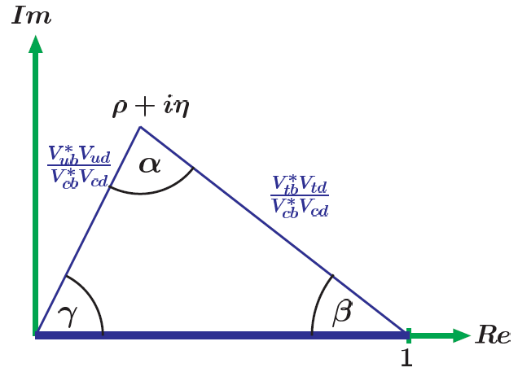
The Unitarity Triangle Analysis (UTA): an introductory slide
Wolfenstein parameterization (up to O(λ³))
(η≠0↔CP-violation)
†
Unitarity ( )
provides 9 conditions
on the CKM parameters
Among these it is of great
phenomenological interest
Accurately measured: - λ=0.225(1)
- A=0.81(1)
Unitarity Triangle (UT)
It defines a triangle
in the (ρ,η)-plane
(with sides of similar size,
so that CP-violation is visible)
Some O(λ⁵) corrections are required
by the present accuracy and are
included by replacing ρ and η by

Slide 3
I will present Summer 2010 Results (pre-ICHEP)
The Standard Model Fit:
the SM is assumed, all available experimental constraints are used
The Tree-level Fit:
Generic New Physics (NP) is allowed in all loop processes,
only tree-level constraints are used
The Universal Unitarity Triangle (UUT) Fit:
NP is assumed to be Minimal Flavour Violating (MFV) (i.e. ruled by the CKM couplings),
only the constraints unaffected by MFV NP are included
The New Physics Fit:
Generic NP is allowed and parametrized in DF=2 in processes,
CP-asymmetry constraints are also included as constraints
see Luca Silvestrini’s talk
The indirect determination of the hadronic parameters:
Lattice parameters are excluded one by one and predicted from the SM UTA
see Vittorio Lubicz’s talk

Slide 4
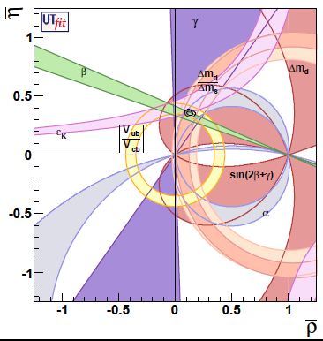
The Standard Model Fit
The experimental constraints:
relying on theoretical calculations
of hadronic matrix elements
SM analysis
independent from theoretical
calculations of hadronic parameters
overconstrain the CKM parameters consistently
~16%
~ 3%
The UTA has established that
the CKM matrix is the dominant source
of flavour mixing and CP violation

Slide 5
From a closer look
From the UTA
(excluding its exp. constraint)
 | Prediction | Measurement | Pull
sin2β | 0.771±0.036 | 0.654±0.026 | 2.6
γ | 69.6°±3.1° | 74°±11° | <1
α | 85.4°±3.7° | 91.4°±6.1° | <1
|V_{cb}|·10³ | 42.69±0.99 | 40.83±0.45 | +1.6
|V_{ub}|·10³ | 3.55±0.14 | 3.76±0.20 | <1
ε_{K}·10³ | 1.92±0.18 | 2.230±0.010 | -1.7
BR(B→ τ ν)·10⁴ | 0.805±0.071 | 1.72±0.28 | -3.2

Slide 6

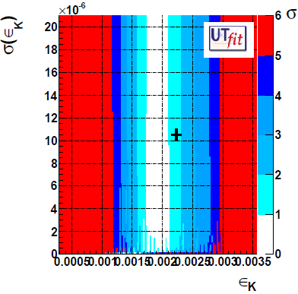
ε_{K}
Buras&Guadagnoli (0805.3887)+Buras&Guadagnoli&Isidori (1002.3612):
decrease of the SM prediction of ε_{K} by ~6%
Long-distance

Slide 7

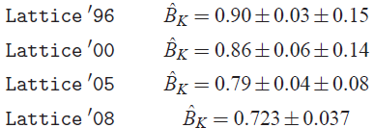
ε_{K}
Improved accuracy in B_{K} from Lattice QCD,
thanks to the continuum limit in unquenched studies
(smaller though compatible values w.r.t few years ago)
Average by V.Lubicz in PoS Lattice09
(1004.3473)
NEWS:
Brod&Gorbahn (1007.0684): NNLO QCD analysis of the charm-top contribution in box diagrams
(3% enhancement of ε_{K})
NEXT FUTURE:
Further few percents could come from dimension-8 operators: ~m_{K}²/m_{c}² corrections (calculation in progress)

Slide 8
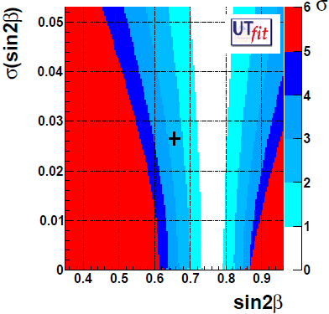
sin2β
The indirect determination of sin(2β)
turns out to be at ~2.6 σ
from the experimental measurement
(the theory error in the extraction
from B→ J_{ψ} K_{S} is well under control)

Slide 9
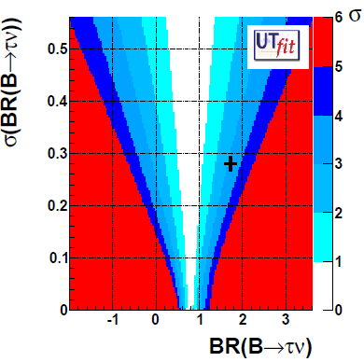
B→ τ ν
BR(B→ τ ν)_{SM} = (0.805±0.071)•10⁻⁴
[UTfit, update of 0908.3470]
turns out to be smaller by ~3.2 σ
than the experimental value
BR(B→ τ ν)_{exp} = (1.72±0.28)•10⁻⁴
The experimental state of the art
BaBar Semileptonic tag (0912.2453)
BaBar Hadronic tag (0708.2260)
[new result is available since ICHEP10 (already included)]
Belle Semileptonic tag (1006.4201)
Belle Hadronic tag (hep-ex/0604018)
[full data set analysis is on the way]

Slide 10

B→ τ ν
BR(B→ τ ν)_{exp} prefers a large value for |V_{ub}|
(f_{B} under control and improved by the UTA)
But a shift in the central value of |V_{ub}|
would not solve the β tension
the debate on V_{ub} (excl. vs incl, various models…)
is not enough to explain all
N.B. a charged Higgs cannot explain it,
it would modify the BR by the muliplicative factor
which becomes >1 for (excluded by B→ X_{s} γ)

Slide 11
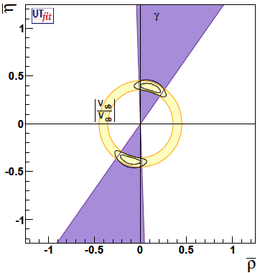
The Tree-Level Fit
Generic New Physics (NP) is allowed in all loop processes
Only tree-level constraints are used
Tree-level Fit
The (TREE-LEVEL) experimental constraints:
from semileptonic B decays
from B→ D^{(*)} K
~60%
~ 8%
The results of the Tree-Level Fit are in agreement,
with larger uncertainties, with the results from the SM Fit

Slide 12
The Universal Unitarity Triangle(UUT) Fit
NP is assumed to be Minimal Flavour Violating (MFV) (i.e. ruled by the CKM couplings)
Master Formula
for Weak Decays
(General) Minimal Flavour Violation
(MFV)
G.D´Ambrosio et al., hep-ph/0207036
Constrained Minimal Flavour Violation
(CMFV)
A.J.Buras et al., hep-ph/0007085
Most General NP
(beyond MFV)
F^{i}´s: short-distance Loop Functions (Penguins, Boxes) [from perturbation theory]
(η^{i}_{QCD})´s: QCD corrections [from RG improved perturbation theory]
B_{i}´s: long-distance Parameters [the most uncertain: from experiments, Lattice, …]
CMFV: (pragmatic approach) a CMFV Model has to satisfy two constraints:
the only source of flavour-violation is the CKM, the only operators are the SM ones
[A.J. Buras et al., hep-ph/0007085]
MFV: (top-down approach) in building a MFV Model the SM Yukawa couplings
are the only building-blocks of flavour violation [G.D´Ambrosio et al., hep-ph/0207036]
General NP beyond MFV: new sources of flavour violation (V^{i}_{NEW}) can appear

Slide 13
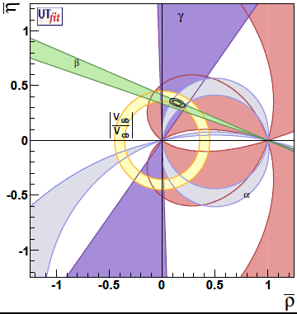
Within MFV the following observables are not affected by NP:
The constraints excluded from the analysis are:
The results of the UUT Fit are in agreement,
with similar accuracy, with the results from the SM Fit
~20%
~ 4%

Slide 14
B→ τ ν
from the UUT Fit
BR(B→ τ ν)_{UUT} = (0.83±0.10)•10⁻⁴
[UTfit, update of 0908.3470]
turns out to be smaller by ~3 σ
than the experimental value
BR(B→ τ ν)_{exp} = (1.72±0.28)•10⁻⁴
The tension is still present in MFV models

Slide 15
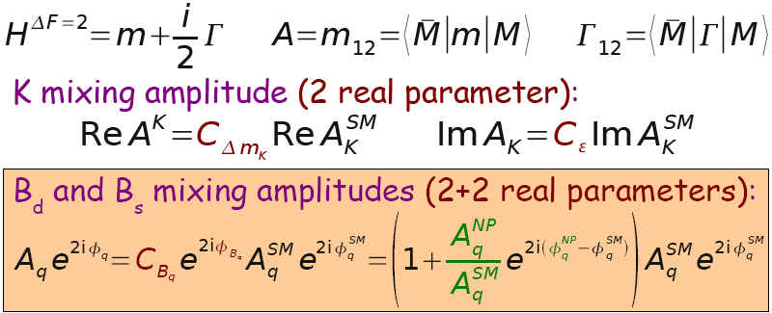
The UTA beyond the Standard Model
Update of UTfit 0909.5065
Model-independent UTA: bounds on deviations from the SM (+CKM)
Parametrize generic NP in ΔF=2 processes, in all sectors
Use all available experimental info
Fit simultaneously the CKM and NP parameters
NP contributions in the mixing amplitudes:

Slide 16
From this (NP) analysis:
In good agreement,
within doubled uncertainties,
with the results
from the SM analysis
See Luca Silvestrini’s talk for the results of the NP parameters

Slide 17
The Indirect Determination of the Hadronic Parameters
Some hadronic quantities can be
extracted from the (overcostraint) UTA
and compared to Lattice calculations *
* assuming the SM validity!!!
Parameter | Input value | Full fit | SM Prediction
|V_{ub}|·10⁴ | 37.6(2.0) | 36.4(1.1) | 35.5(1.4)
|V_{cb}|·10³ | 40.8(0.5) | 41.2(0.4) | 42.7(1.0)
f_{Bs} [MeV] | 239(10) | 236(6) | 235(7)
f_{Bs}/f_{B} | 1.23(3) | 1.23(3) | 1.21(4)
B_{Bs} | 0.87(4) | 0.85(4) | 0.77(7)
B_{Bs}/B_{Bd} | 1.06(4) | 1.07(4) | 1.11(9)
B_{K} | 0.73(4) | 0.76(3) | 0.85(7)
Remarkable agreement:
Additional evidence of the SM success
in describing flavour physics
Reliability of Lattice QCD
See Vittorio Lubicz’s talk

Slide 18
Some information and propaganda:
Renovated UTfit website is available at
www.utfit.org
Thanks!

Slide 19
BACKUP

Slide 20
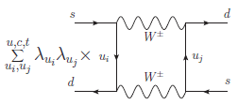
The UTA beyond the Standard Model
NP contributions in the mixing amplitudes:
s
K

Slide 21
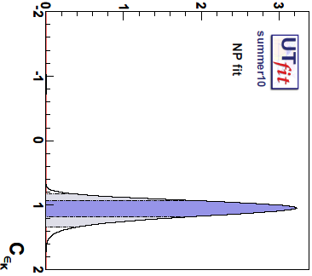
Results for the K mixing amplitude
For K-K mixing,
the NP parameters are found
in agreement with
the SM expectations

Slide 22
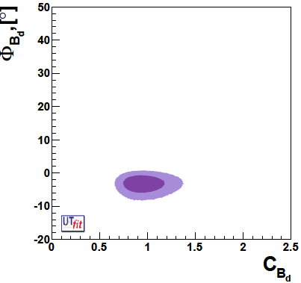
Results for the B_{d} mixing amplitudes
For B_{d}-B_{d} mixing,
the mixing phase φ_{Bd} is found
1.8 σ away from the SM expectation
(reflecting the tension in sin2β)

Slide 23
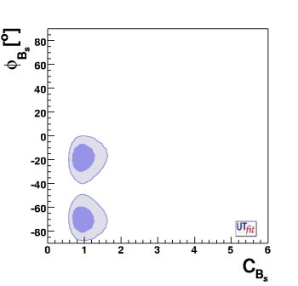
Results for the B_{s} mixing amplitude:
INTERESTING NEWS NEW QUESTION MARKS
In 2009, by combining CDF and DØ results for φ_{Bs}:
UTfit: 2.9σ (update of 0803.0659)
HFAG: 2.2σ (0808.1297)
CKMfitter: 2.5σ (0810.3139)
Tevatron B w.g.: 2.1σ (http://tevbwg.fnal.gov)
More than 2σ deviation for
every statistical approach!

Slide 24
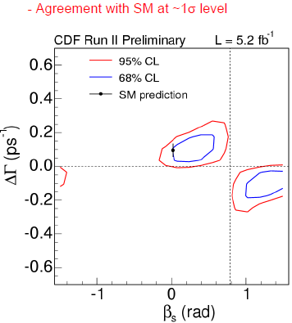
In 2010, two surprising news:
The new CDF measurement reduces the significance of the deviation.
The likelihood is not yet available, a CDF Bayesian study is underway
Before it was
1.8 σ
The new DØ measurement of a_{μμ} points to large β_{s} but
also to large ΔΓ_{s} requiring a non-standard Γ₁₂ ?!?!?
If confirmed, two (UNLIKELY) explantions:
Huge (tree-level-like) NP contributions in Γ₁₂
(a factor 2.5: why only in Γ₁₂??)
Bad failure of the OPE in Γ₁₂
(while in Γ₁₁ (b-hadron lifetimes) works well)

Slide 25
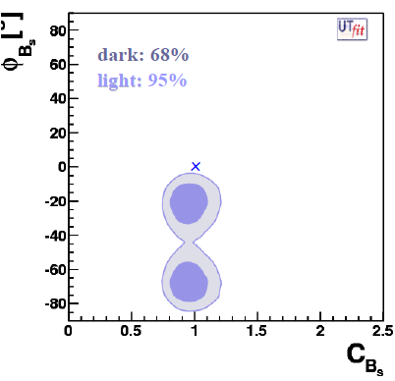
Updated Results including NEW DØ results
(new CDF results are not yet available)
Deviation from the SM at 3.1σ

Slide 26
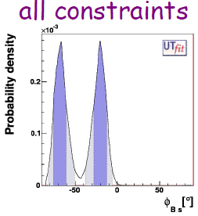
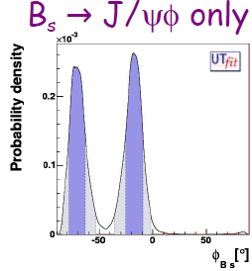
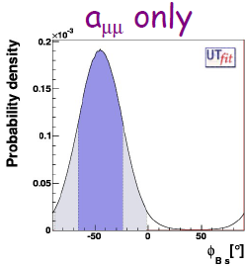
Updated Results including NEW DØ results
(new CDF results are not yet available)
a_{μμ} and B_{s} →J/Ψ φ point to large
but different values of φ_{Bs}
(N.B. the UTA beyond the SM
allows for NP in loops only,
i.e. tree-level NP in Γ₁₂ is not allowed)
Further confirmations
from experiments
are looked forward!

Slide 27
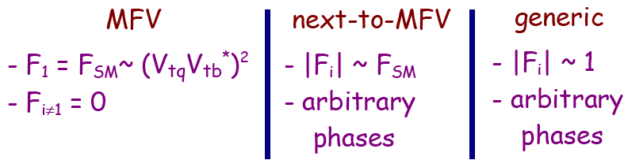
Flavour Physics is highly sensitive to NP:
The Effective Field Theory (EFT) analysis
The high scale coefficients
C_{i}(Λ) can be extracted
from the data
(switching on one operator per time)
α
α
α
Tree/strong inter. NP: L~1
Perturbative NP: L ~α_{s}², α_{W}²

Slide 28
Main contribution to present lower bound on NP scale comes from
ΔF=2 chirality-flipping operators which are RG enhanced
From Kaon sector @ 95% [TeV]
Scenario | Strong/tree | α_{s} loop | α_{W} loop
MFV (low tanβ) | 8 | 0.8 | 0.24
MFV (high tanβ) | 4.5 | 0.45 | 0.15
NMFV | 107 | 11 | 3.2
Generic | ~470000 | ~47000 | ~14000
Preliminary
From Bd&Bs sector @ 95% [TeV]
Scenario | Strong/tree | α_{s} loop | α_{W} loop
MFV(high tanβ) | 6.4 | 0.6 | 0.2
NMFV | 8 | 0.8 | 0.25
Generic | 3300 | 330 | 100
Effective Theory analysis
quantifies the known
“flavor problem”

