Slide 1





Precision measurements
of
Kaon radiative decays in NA48/2
Monica Pepe
INFN Perugia
on behalf of the NA48/2 Collaboration
(Cambridge, CERN, Chicago, Dubna, Edimburgh, Ferrara, Firenze, Mainz, Northwestern, Perugia, Pisa, Saclay, Siegen, Torino, Vienna )

Slide 2
OUTLINE
NA48/2 experiment @ CERN SPS
Study of the K±→π±π⁰γ decay
[Eur. Phys. J. C68 (2010), 75]
  Measurement of DE and INT term fractions
  Limit on CPV parameters (A_{N} , A_{W})
Measurement of the K±→π±γγ (preliminary)
Measurement of the K±→π±e⁺e⁻γ
[Phys. Lett. B659 (2008), 493]
Conclusions

Slide 3
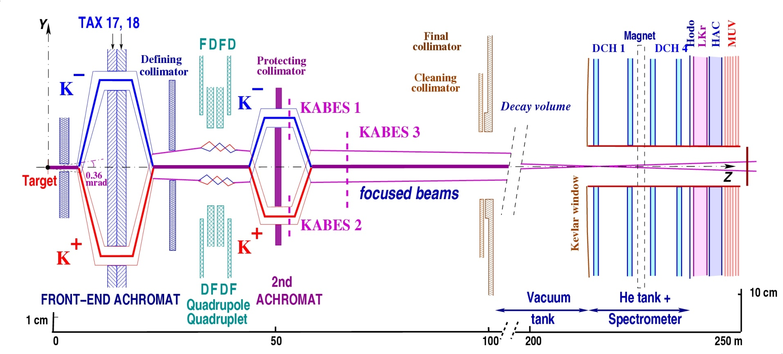
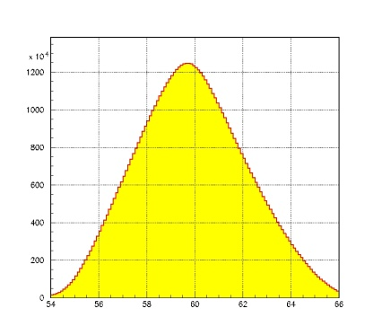
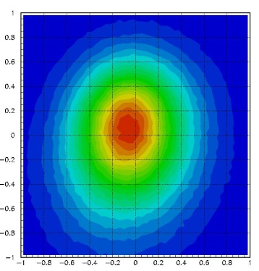
Simultaneous K± Beam in NA48/2
(2003 – 2004)
~7⋅10¹¹
p/spill
400 GeV/c
5-6% K±
P_{K} = 60±3 GeV/c
Simultaneous K⁺ and K⁻ beams:
Flux ratio: K⁺/K– ~ 1.8
large charge symmetrization of experimental conditions
Width ~ 5 mm
K⁺/K⁻ ~ 1 mm
54 60 66

Slide 4
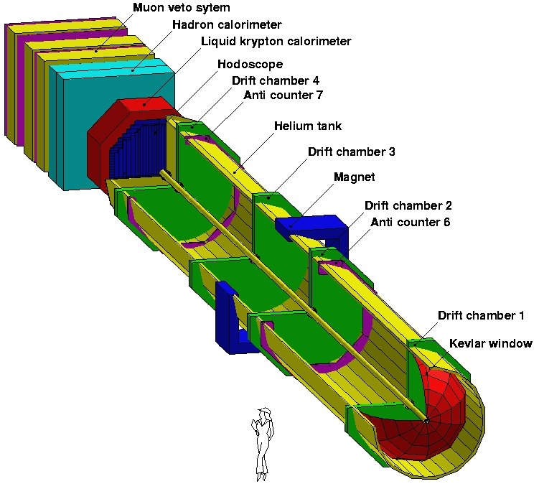
The NA48 detector
Magnetic spectrometer (4 DCHs):
Δp/p = 1.02% ⊕ 0.044%*p [GeV/c]
Liquid Krypton EM calorimeter (LKr)
High granularity, quasi-homogeneous
ΔE/E = 3.2%/√E ⊕ 9%/E ⊕ 0.42% [GeV]
σ_{x}=σ_{y}=0.42/E^{1/2} ⊕ 0.06cm (1.5mm@10GeV)
Hodoscope
Fast trigger
Precise time measurement (150 ps)
Hadron calorimeter, muon veto counters,
photon vetoes
=> PT KICK = 120 MeV
Beam pipe
LV1 trigger: hodoscope , DCH multiplicity, LKr E deposition
LV2 trigger: software algorithm on fast on-line data processing
(~1MHz → ~10kHz)

Slide 5
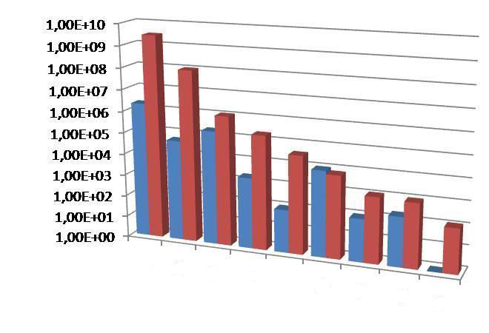
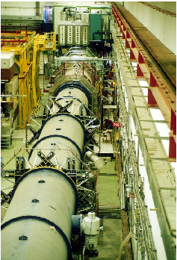
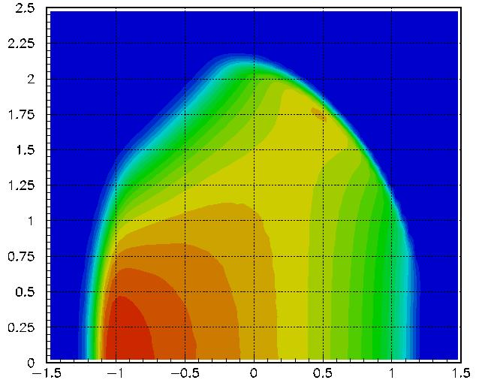
NA48/2 Data taking
Before NA48/2
NA48/2
π± π⁺ π⁻
π± π⁰ π⁰
Κe4
π± π⁰ γ
Κe4η
π± e⁺ e⁻
π± γ γ
π± μ⁺ μ⁻
π± e⁺e⁻ γ
Unprecedented statistics in many channels
Two years of data taking (2003 and 2004)
Main purpose was to measure direct CP violation in
charged kaon decays, through asymmetry in Dalitz plot distribution
New limits on CP violation in charged kaon decays
NA48 Experimental hall
A_{g}^{ch}= (-1.5 ± 2.1) × 10⁻⁴
A_{g}⁰ = (1.8 ± 1.8) x 10⁻⁴

Slide 6
K± → π± π⁰ γ rare decay
Test for low energy QCD (ChPT theory)
[Eur. Phys. J. C68 (2010), 75]

Slide 7
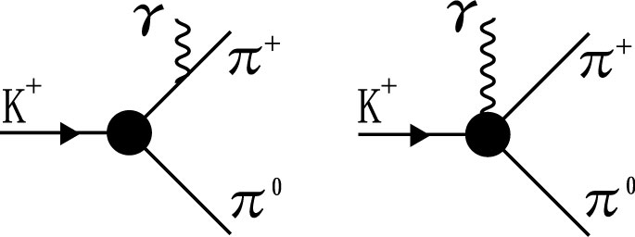
Theoretical framework
Lorentz invariant
P*_{K} = 4-mom of the K±
P*_{π} = 4-mom of the π±
P*_{γ} = 4-mom of the radiative γ
IB
DE
Differential rate:
IB
INT
DE
IB can be predicted from BR(π ± π⁰) + QED corrections
DE O(p⁴) contribution terms (cannot be predicted in model independent way in ChPT)
  X_{M} magnetic: two contributions by chiral anomaly
    Reducible: calculated using WZW functional (X_{M}~270 GeV⁻⁴)
    Direct: small contribution, not model independent
  X_{E} electric: no prediction in ChPT (depends on unknown constants)
INT arises from interference of IB and DE X_{E}

Slide 8
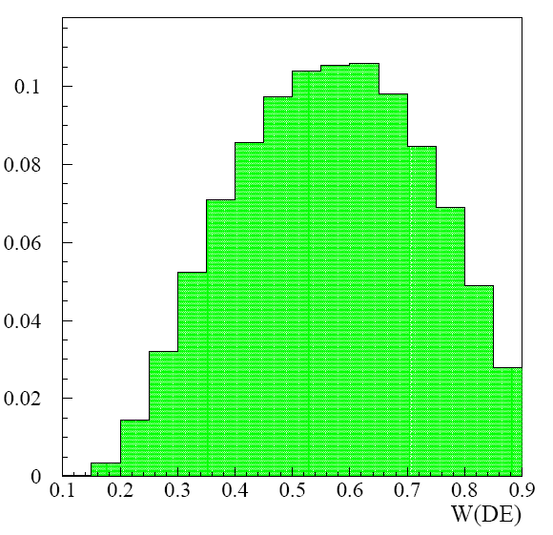
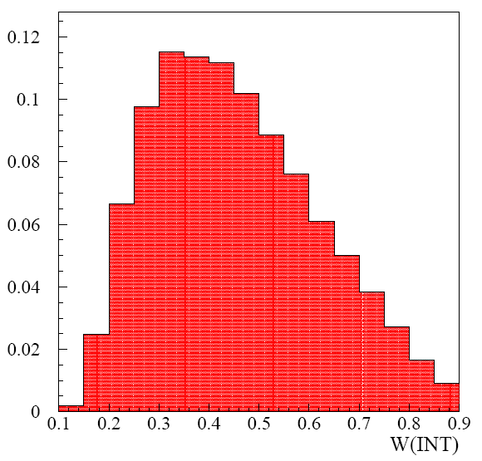
W distributions for IB, DE, INT
Very different distributions!
IB
30xDE
30xINT
Inner Bremsstrahlung(IB) : BR = (2.75±0.15)·10⁻⁴ PDG (55<T*_{π}<90 MeV)
Direct Emission (DE) : BR = (4.3±0.7)·10⁻⁶ PDG (55<T*_{π}<90 MeV)
Interference (INT) : not yet measured
T∗ _{π} : kinetic energy of the charged Pion in the Kaon cms

Slide 9
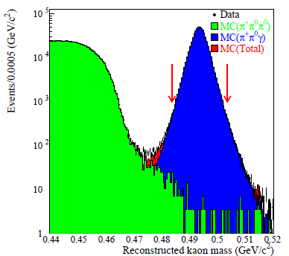
NA48/2 measurement of K± → π± π⁰ γ decay
Simultaneous K⁺ and K⁻ beams:
possibility to study CP violating effects
Larger T*_{π} region in the low energy part (0 < T*_{π} < 80 MeV)
Background contribution <1% wrt DE
mainly K± → π±π⁰π⁰ (accidentals < 5x10⁻³ wrt DE, mistagged < 10⁻³ )
Order <‰ γ mistagging probability for IB, DE and INT
W resolution better than 1%
Fit performed with both likelihood and polynomial techniques

Slide 10
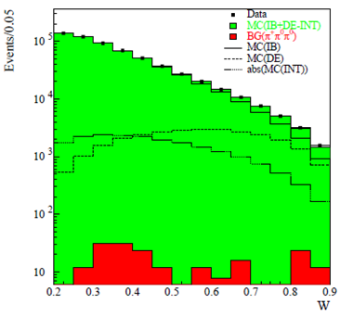
NA48/2 Measurement technique
HIGH STATISTICS
~ 1 Million reconstructed events
(the full number is used for the CPV
measurements)
after a cut on W [0.2, 0.9] and on
E_{γ} > 5GeV, still 600 k events left
in the region M_{K} ± 10 MeV for the
measurement of DE and INT fraction
FIT TECHNIQUE
Fitting conditions
  0.2 < W < 0.9 & T*_{π} < 80 MeV
  E_{γmin} > 5 GeV
  14 bins in the fit to enhance sensitivity to INT
Extended maximum Likelihood
  main method
  correct for different acceptances using MC
Polynomial fit
  used only as a cross-check
  assumes equal IB, DE, INT acceptance

Slide 11
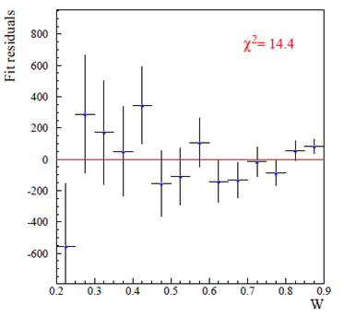
Fit results
Extended maximum Likelihood
Data(i) = N₀[(1−α−β)·MC_{IB}(i) + α·MC_{INT}(i) + β·MC_{DE}(i)]
NA48/2
Likelihood residuals
The algorithm assigns weights to MC W distributions of the 3 components to reproduce data
The method relies on the very different
W distributions
χ² = 14.4/13
prob = 0.35
Final result ( 2003+2004 data):
Frac(DE)_{T*π(0-80)MeV} = BR(DE) / BR(IB) = (3.32 ± 0.15_{stat} ± 0.14_{sys}) · 10⁻²
Frac(INT)_{T*π(0-80)MeV} = BR(INT) / BR(IB) = (-2.35 ± 0.35_{stat} ± 0.39_{sys}) · 10⁻²

Slide 12
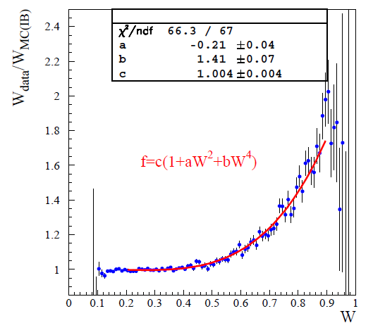
Fit results (cross-check)
Polynomial fit
F = c · (1+aW²+bW⁴)
Fit the ratio W(Data)/W(MC_{IB})
Assume equal acceptances
Use proper integrals of DE/IB & INT/IB
Frac(DE) = b · 2.27·10⁻²
Frac(INT)= a · 0.105
Final result ( 2003+2004 data):
Frac(DE)_{T*π(0-80)MeV} = BR(DE) / BR(IB) = (3.19 ± 0.16_{stat} )·10⁻²
Frac(INT)_{T*π(0-80)MeV} = BR(INT) / BR(IB) = (-2.21 ± 0.41_{stat}) · 10⁻²

Slide 13
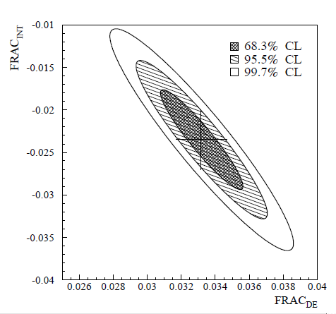
DE and INT fraction: final results
Final result ( 2003+2004 data):
Frac(DE)_{T*π(0-80)MeV} = (3.32 ± 0.15_{stat} ± 0.14_{sys})·10⁻²
Frac(INT)_{T*π(0-80)MeV} = (-2.35 ± 0.35_{stat} ± 0.39_{sys})·10⁻²
Systematics | DE (x 10⁻²) | INT (x 10⁻²)
Acceptance L1trigger L2 trigger LKr Energy scale | <0.10 0.01 0.05 0.09 | <0.15 0.03 0.30 0.21
Total | 0.14 | 0.39
ρ = - 0.93
INT has never been
observed before!
K±→π± π⁰ γ : first extraction of X_{E} and X_{M}
Under the approximations:
φ = 0 and cos(δ₁¹-δ₀²) = cos(6.5°) ~ 1
X_{E} and X_{M} can be extracted using the formulae:
Electric and Magnetic components
X_{E}=(-24 ± 4_{stat} ± 4_{sys}) GeV⁻⁴
X_{M} = (254 ± 6_{stat} ± 6_{sys}) GeV⁻⁴
(WZW reducible anomaly
prediction for X_{M} ~ 270 Gev⁻⁴)

Slide 14
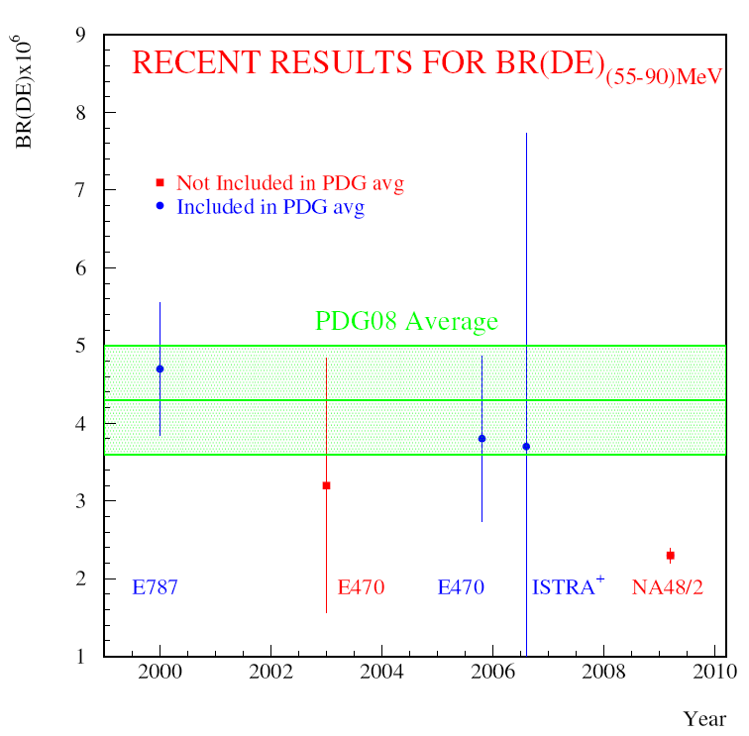
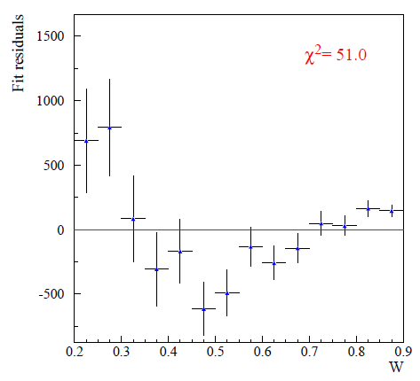
Fit to data with INT=0 (T*_{π} in 55 – 90 MeV)
NA48/2
Likelihood residuals
Bad χ²=51/13
prob=2·10⁻⁶
BR(DE)_{INT=0} 55 MeV < T*_{π}< 90 MeV
BR(DE)_{T*π(55-90)MeV}= (2.32±0.05_{stat}±0.08_{sys})·10⁻⁶
Measured in 0<T*_{π}<80 MeV extrap. to 55< T*_{π}< 90 MeV using MC. BR(IB)₅₅₋₉₀=2.61·10⁻⁴
Clear disagreement with INT=0 hypothesis!
Need a fit with non vanishing interference

Slide 15
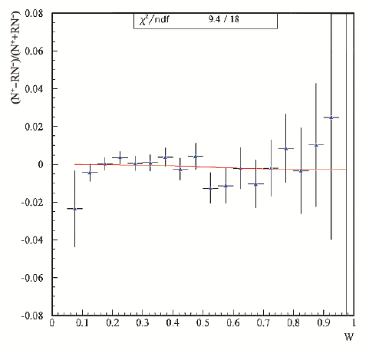
CPV in K± → π± π⁰ γ
K± →π±π⁰γ with direct photon emission is not suppressed by ΔI = 1/2 rule
good channel to search for CP violation (NA48/2 sample ~1 M events)
Theoretical range 2·10⁻⁶ - 1·10⁻⁵ (50 < E_{γ} < 170 MeV) but Susy contribution can push A~10⁻⁴
PDG08 value : (0.9 ± 3.3)%
Asymmetry in the decay rate :
R = N_{beam}(K⁺)/N_{beam}(K⁻) = 1.7998 ± 0.0004 , δR/R ~ 2·10 ⁻⁴ from K± → π± π⁰ π⁰ decay used as normalization.
A_{N} = (N₊ - RN–) / (N₊ + RN–) = (0.0 ± 1.0_{stat} ± 0.6_{sys}) × 10⁻³
χ² /ndf =9.4/18
|A_{N}| < 1.5 × 10⁻³ @ 90% CL
First limit on sinΦ = -0.01 ± 0.43
|sin Φ| < 0.56 @ 90% CL
Asymmetry in the Dalitz plot:
N⁺ = 695k K⁺
N⁻ = 386k K⁻
A_{W} = e ʃINT / IB = (−0.6 ± 1.0_{stat}) × 10⁻³
NO CP asymmetry observed in K± → π± π⁰ γ

Slide 16
K± → π± γγ rare decay

Slide 17
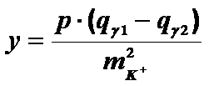
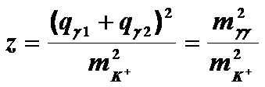
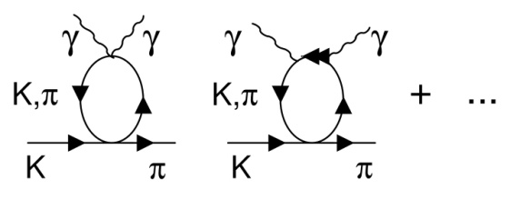
K± → π±γγ theory
In the ChPT framework the differential rate of the K±(p) → π±(p₃) γ(q₁) γ(q₂) process (no O(p²) contribution) is:
relevant only at low m_{γγ}
(only z is dynamically relevant)
O(p⁴)
[G. Ecker, A. Pich and E. de Rafael, Nucl., Phys. B303 (1988), 665]
A(z, ĉ)→ dominant loop diagram contribution responsible for a cusp at m_{γγ} = m_{2π}
C → contains poles and tadpoles diagrams
[J.M. Gerard, C. Smith, S. Trine, Nucl. Phys. B 730 (2005) 1]
B = D = 0
O(p⁶)
[G. D’Ambrosio and J. Portoles, Nucl., Phys. B386 (1996), 403]
Unitarity corrections effects can increase the BR by 30-40 %

Slide 18
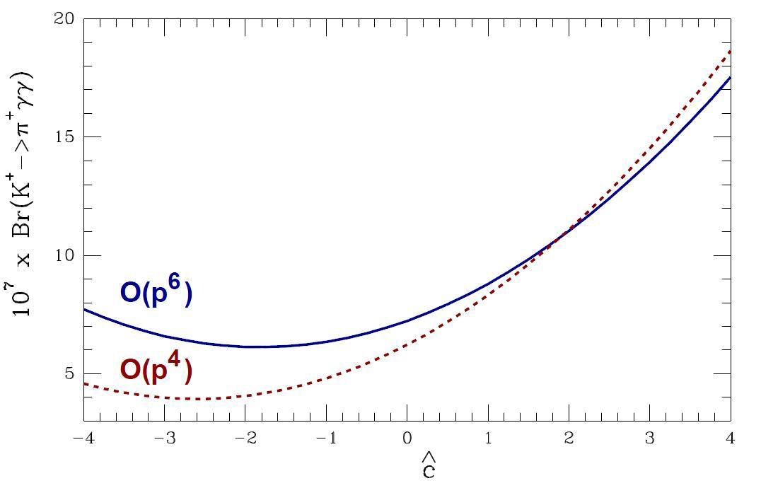
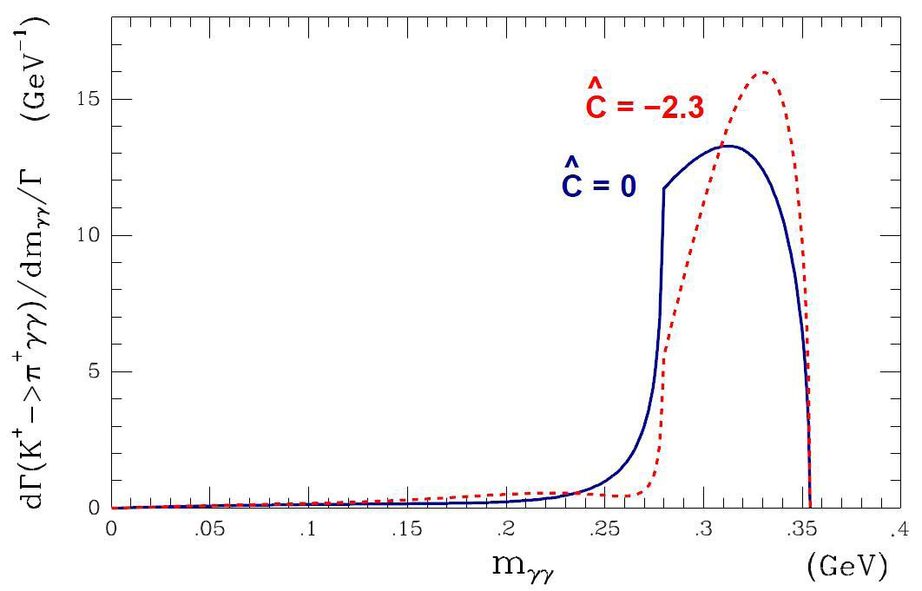
K± → π±γγ theory: dependence on ĉ
Both BR and M_{γγ} spectrum shape strongly depend on the ĉ parameter (O(1))
The M_{γγ} spectrum has a pronounced cusp-like behaviour at 2π threshold.
BR(K±→ π ±γγ) = (5.26 + 1.64·ĉ + 0.32·ĉ² + 0.49)·10⁻⁷ ≥ 4·10⁻⁷
BR(K±→π±γγ) vs ĉ
M_{γγ} spectra for ĉ=–2.3, ĉ=0
unitarity corrections
O(p⁴)
m_{2π}
The spectrum dependence will be used to extract the ĉ value

Slide 19
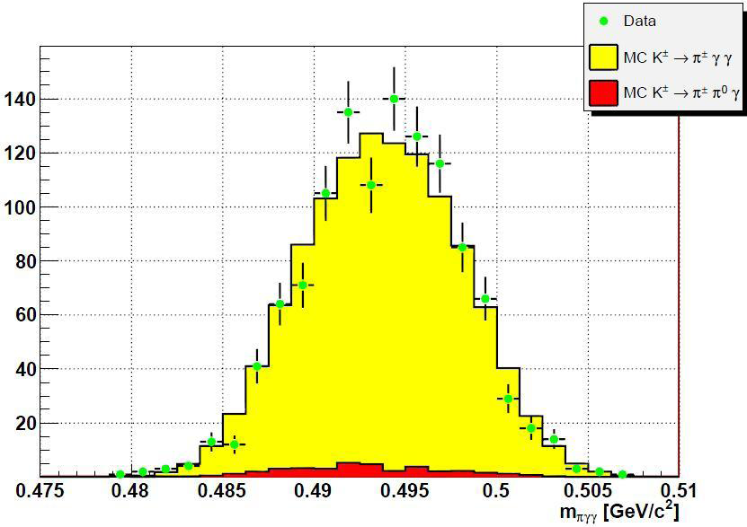
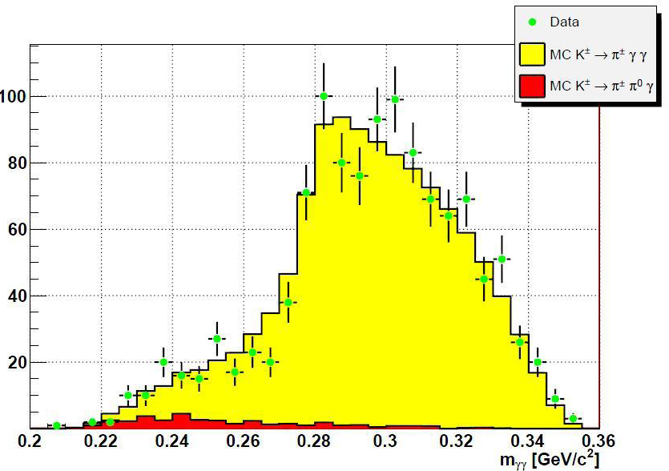
K± → π±γγ : NA48/2 result
Previous measurement by E787 based on 31 events (5 BG events) [PRL79 (1997) 4079]
BR(π±γγ) = (1.10 ± 0.32)·10^{–6}
m_{πγγ}
NA48/2 measurement
Data sample
K± → π±π⁰ as normalization
1164 events in 40% of the full 2003+2004 data (~40 times previous world sample)
Background: mainly from π±π⁰γ (IB) (3.3%)
Systematic: mainly from trigger efficiency
Shape analysis
Assume MC O(p⁶) and ĉ = 2 for comparison
Data shape follows ChPT description
Possibility for precise ĉ measurement, but not quantitative result yet
m_{γγ}
First observation
of the cusp at 2π threshold!
PRELIMINARY
Our model dependent BR determination is
m_{2π}
BR(K±→ π ±γγ) = (1.07 ± 0.04_{stat} ± 0.08_{sys})·10^{–6}
model independent BR and ĉ extraction in preparation

Slide 20
K± → π±e⁺e– γ
First Observation
[Phys. Lett. B659 (2008), 493]

Slide 21
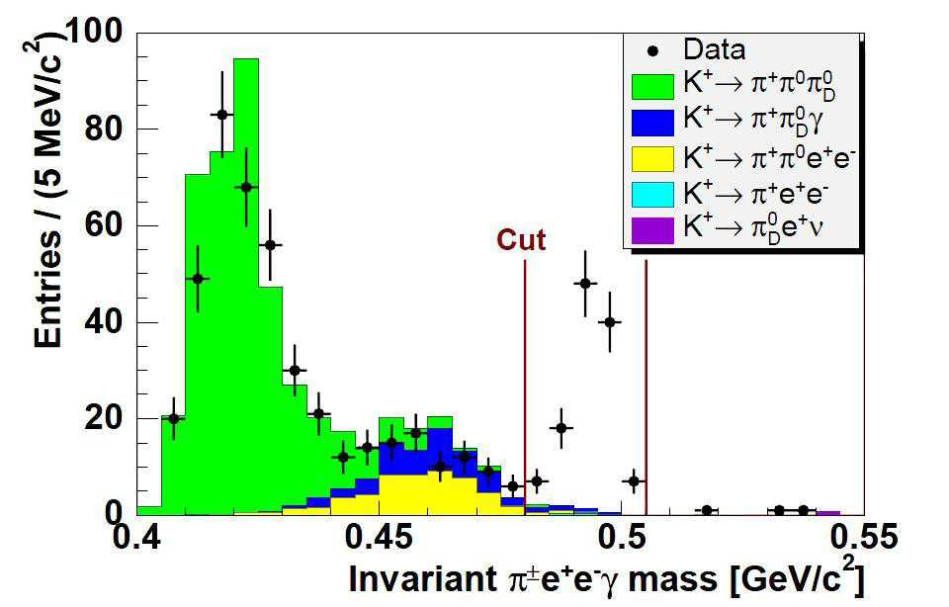
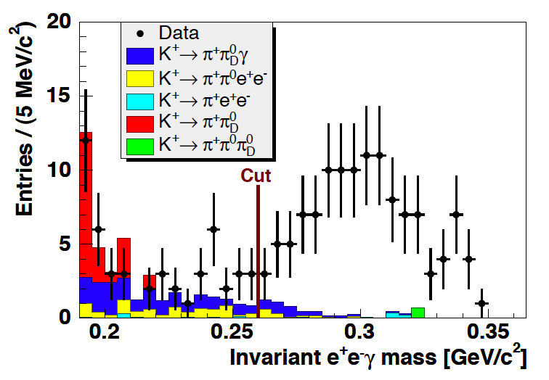
K±→ π±e⁺e⁻ γ : BR measurement
K±→π±e⁺e–γ similar to K±→π±γ γ with internal γ-conversion
O(p⁶) ChPT prediction BR(π± e⁺e⁻ γ) = (0.9÷1.7)·10⁻⁸
Never observed before!
[F. Gabbiani, Phys. Rev. Lett. D59 (1999), 094022]
Data sample (NA48/2 full statistics)
120 candidate events
K± → π±π⁰_{D} → π±e⁺e– γ as normalization
( 18.7M events , Φ_{K}=(1.48 ± 0.04)·10¹¹ )
Background mainly from π±π⁰_{D}γ (IB) (7.3%)
Systematic mainly from Normalization and Background
BR computed in bins of m_{eeγ}
no assumption on m_{eeγ} (model independent measurement)
cut on m_{eeγ} > 260 MeV/c²
Model-independent BR (m_{eeγ} > 260 MeV/c²)
BR(K± → π± e⁺e⁻ γ)_{meeγ>260 MeV} =
(1.19 ± 0.12_{stat} ± 0.04_{syst})·10⁻⁸

Slide 22
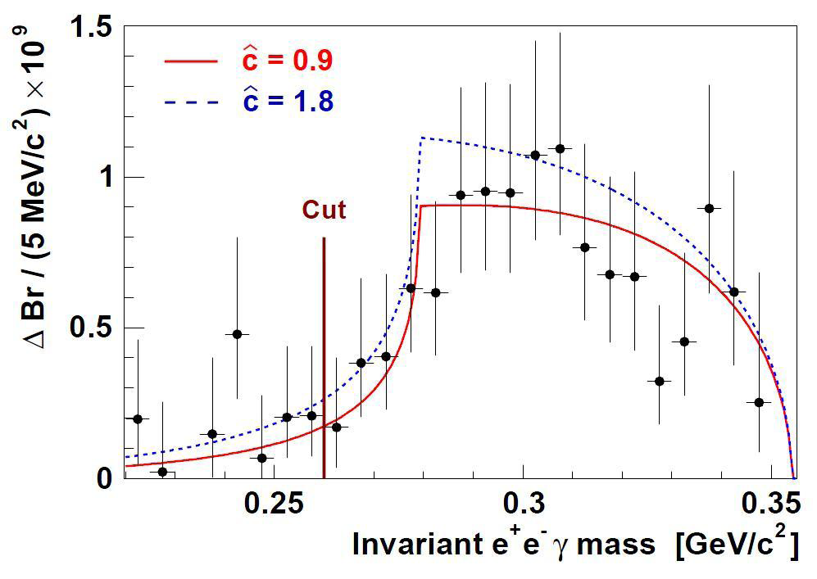
K±→ π±e⁺e⁻ γ : shape analysis
The ĉ value is extracted by fitting data to the absolute O(p⁶) ChPT prediction [F. Gabbiani, Phys. Rev. Lett. D59 (1999), 094022]
ĉ = (0.90 ± 0.45)
χ²/ndf=8.1/17; prob=96.4%
1.2 σ away from BNL E787 value in K⁺ → π⁺γγ : ĉ =1.8 ± 0.6
Using NA48/2 measured ĉ and O(p⁶) ChPT prediction we compute BR (m_{eeγ} < 260 MeV/c²) to obtain the total model dependent BR:
BR(K± → π± e⁺e⁻ γ) = (1.29 ± 0.13_{exp} ± 0.03_{ĉ} )·10⁻⁸
[Batley et al. Phys.Lett.B659:493, 2008]

Slide 23
CONCLUSIONS
NA48-2 exp: K± → π± π⁰ γ
Precise measurement of DE contribution and first measurement of INT term
Frac(DE)_{T*π(0-80)MeV} = BR(DE) / BR(IB) = (3.32 ± 0.15_{stat} ± 0.14_{sys}) · 10⁻²
Frac(INT)_{T*π(0-80)MeV} = BR(INT) / BR(IB) = (-2.35 ± 0.35_{stat} ± 0.39_{sys}) · 10⁻²
Incompatibility of data with INT=0 hypotesis established
Extraction of Magnetic and Electric components
X_{E}=(-24 ± 4_{stat} ± 4_{sys}) GeV⁻⁴
X_{M} = (254 ± 6_{stat} ± 6_{sys}) GeV⁻⁴
No evidence for CPV asymmetry in both rates and Dalitz plot
NA48-2 exp: K± → π± γ γ
Preliminary measurement of BR at O(p⁶) and ĉ = 2
BR(K± → π ±γγ) = (1.07 ± 0.04_{stat} ± 0.08_{sys})·10^{–6}
Model independent measurement and ĉ extraction in preparation
NA48-2 exp: K± → π± e⁺e⁻ γ
  First observation and measurement of BR and shape
BR(K± → π± e⁺e⁻ γ) = (1.19 ± 0.12_{stat} ± 0.04_{syst})·10⁻⁸
ĉ = (0.90 ± 0.45)

Slide 24
Spare Slides

Slide 25
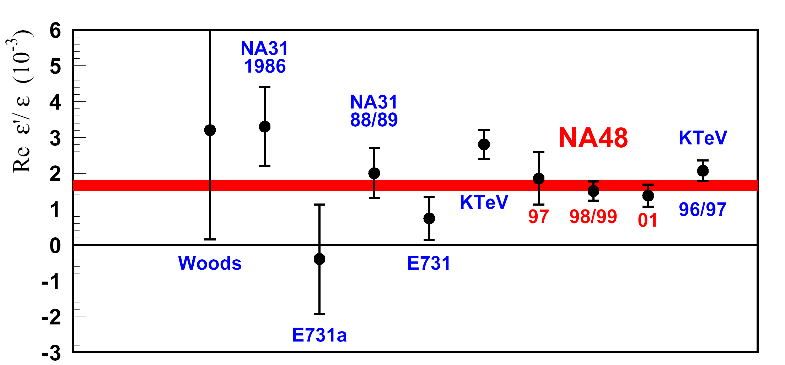
The NA48/NA62 experiment
NA48 (1997-2001):
Direct CP-Violation in neutral K
  Re(ε’/ε) = (14.7 ± 2.2)·10⁻⁴
NA48/1 (2002):
Rare K_{S} decays and hyperons
NA48/2 (2003-2004):
Direct CP-Violation in charged K
NA62 (2007-2008) and P326 (2008…): R(K_{e2}/K_{μ2}), and new experiment K⁺→ π⁺νν
KTeV (2008) 19.2 ± 2.1 × 10⁻⁴
NA62
2007 K±_{e2}/K±_{μ2} run

Slide 26
Experimental status of BR(DE)
 | DE±err | stat
E787 | (4.7±0.9)·10⁻⁶ | 20K
E470 | (3.8 ± 1)·10⁻⁶ | 10K
ISTRA⁺ | (3.7 ± 4)·10⁻⁶ | 930
PDG 08 | (4.3±0.7)·10⁻⁶ | //
Assumption INT=0 in the DE measurement
Measurements performed in the range 55MeV<T*_{π}<90MeV
No Interference and no CPV observed
  INT(E787) = (-0.4 ± 1.6)% T*_{π} (55-90) MeV
Rare Kaon Decay K±→ π±π⁰γ

Slide 27
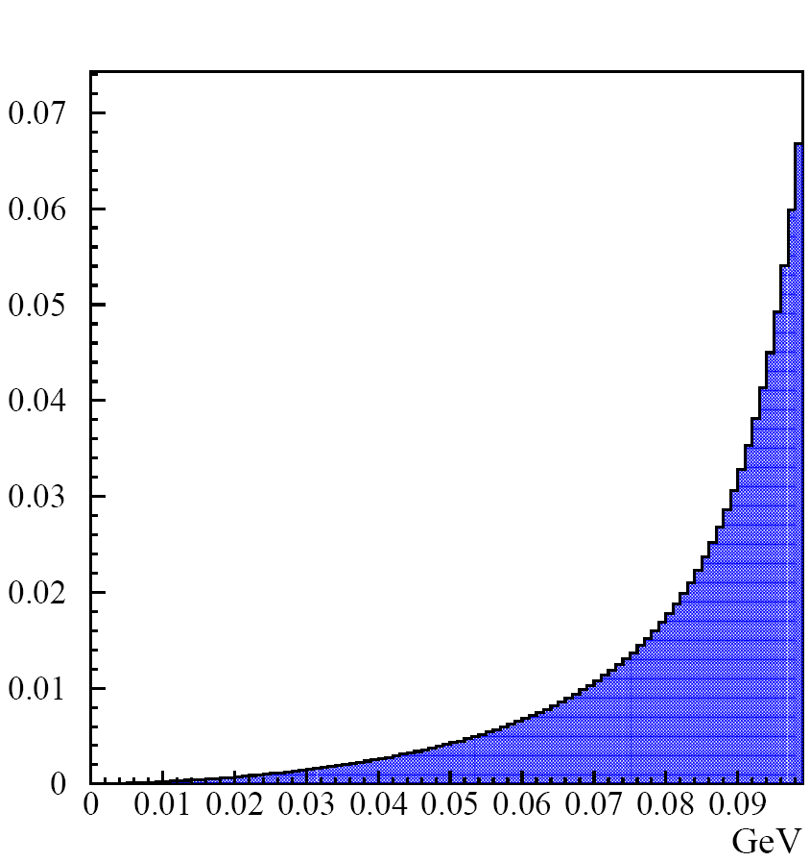
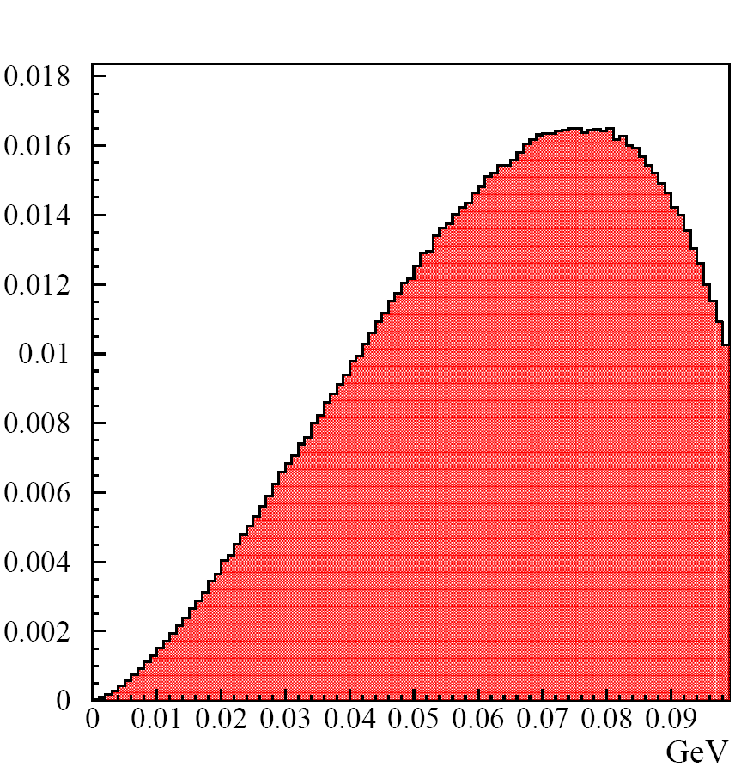
Enlarged T*_{π} region
T*_{π}(ΙΒ)
T*_{π}(DE)
T*_{π}(INT)
Standard region
Standard region
Standard region
Use standard region 55<T*_{π}<90 MeV as safe choice for BG rejection
But…. region <55 MeV is the most interesting to measure DE and INT
This measurement is performed in the region
0 < T*_{π}< 80 MeV
to improve statistics and sensitivity to DE
Rare Kaon Decay K±→ π±π⁰γ

Slide 28
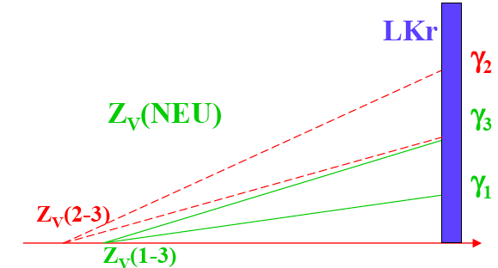
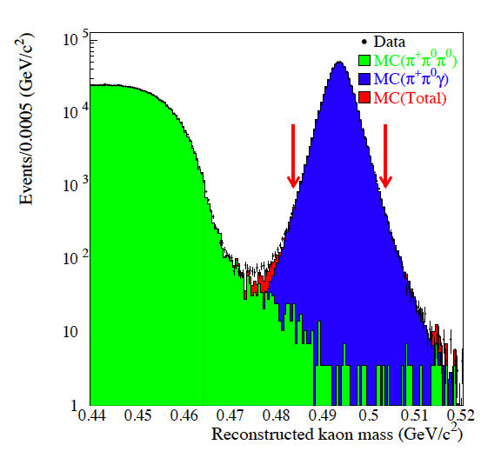
Reconstruction and backgrounds
γ₂ radiative γ
γ₁ γ₃ π⁰ decay γ’s
Reconstruction aims to identify the radiative γ
Fitting conditions:
0.2 < W < 0.9 & T*_{π} < 80 MeV
E_{γmin} > 5 GeV
BG <1% of DE due to π±π⁰π⁰
Accidentals <5·10⁻³ wrt DE
γ mistagged events <10⁻³
Data sample: 600K events
in the region M_{K}± 10MeV
Rare Kaon Decay K±→ π±π⁰γ

Slide 29
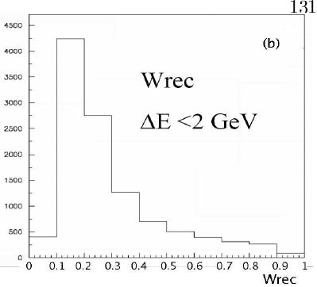
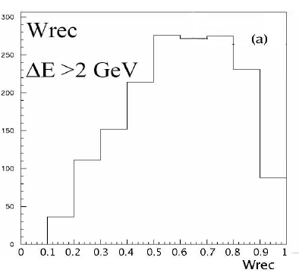
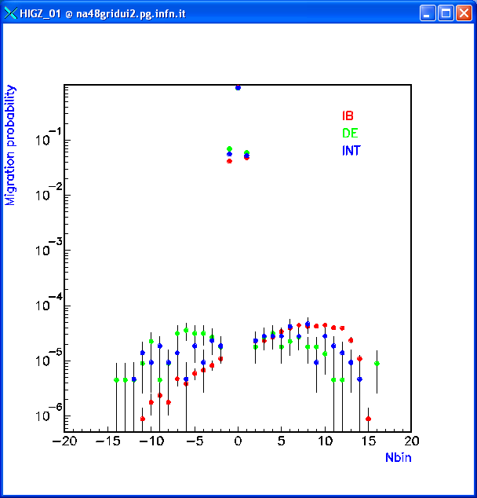
Mistagging self background to DE
Generated W distribution
IB
Reconstruction
Wrong γ in W
Reconstructed IB events using a γ from the π⁰ look like DE!!!
Mistagging lead to overestimated DE
NA48/2 mistag
Mistag(IB) =(0.52±0.06)·10⁻³
Mistag(DE) =(0.48±0.23)·10⁻³ Mistag(INT)=(0.49±0.24)·10⁻³
Rare Kaon Decay K±→ π±π⁰γ

Slide 30
Fitting techniques and fit results
- Extended Maximum Likelihood Fit (main method)
An algorithm assigns weights to MC W distributions of the 3 components to reproduce data
This algorithm relies on the very different W distributions
- Polynominal Fit (used as cross-check)
The ratio W(Data)/W(IBMC) is fitted
with polynomial function: F = c · (1 + aW² + bW⁴)
Systematics | DE x 10⁻² | INT x 10⁻²
Acceptance L1trigger L2 trigger Energy scale | <0.10 0.01 -- 0.09 | <0.15 0.03 0.30 0.21
Total | 0.14 | 0.39
IB
DE
INT
INT has never been
observed before!
BG
Final result ( 2003+2004 ):
Frac(DE)_{T*π(0-80)MeV} = %DE / %IB = (3.32 ± 0.15_{stat} ± 0.14_{sys})*10⁻²
Frac(INT)_{T*π(0-80)MeV}= %INT / %IB =(-2.35 ± 0.35_{stat} ± 0.39_{sys})*10⁻²
Rare Kaon Decay K±→ π±π⁰γ
Notes:
30

Slide 31
CPV table of systematic
Effect | Value
P_{K} distribution correction | 3·10⁻⁴
+ - Acceptance difference | < 4·10⁻⁵
LVL1 trigger | 3·10⁻⁴
LVL2 trigger | 4·10⁻⁴
π⁺ π⁻ cross section difference | ~ 4·10⁻⁵
R max variation | 3.5·10⁻⁴
Total Systematic | 6.1·10⁻⁴
CPV in K±→ π±π⁰γ

Slide 32
Systematic on BR(K±→ π±e⁺e⁻γ)
Effect | ΔBR ·10⁻⁸
Background subtraction | ±0.107
Electron/Pion ID | ±0.005
Detector acceptance | ±0.005
Trigger efficiency | ±0.007
MC statistics | ±0.011
Normalization | ±0.032
Total Systematic | ±0.04
Total Statistical uncertainty | ±0.12
K±→ π±e+e−γ

