Slide 1
INFN contributions to EIC machine construction
Alessandro Gallo - LNF
Giornata nazionale EIC_NET 2020
03-04/12/2020

Slide 2
SUMMARY
Introduction (contacts)
Workshop – “Promoting Collaboration on the EIC”
The Machine
Organization, Budget, Schedule
INFN Collaboration: next steps

Slide 3
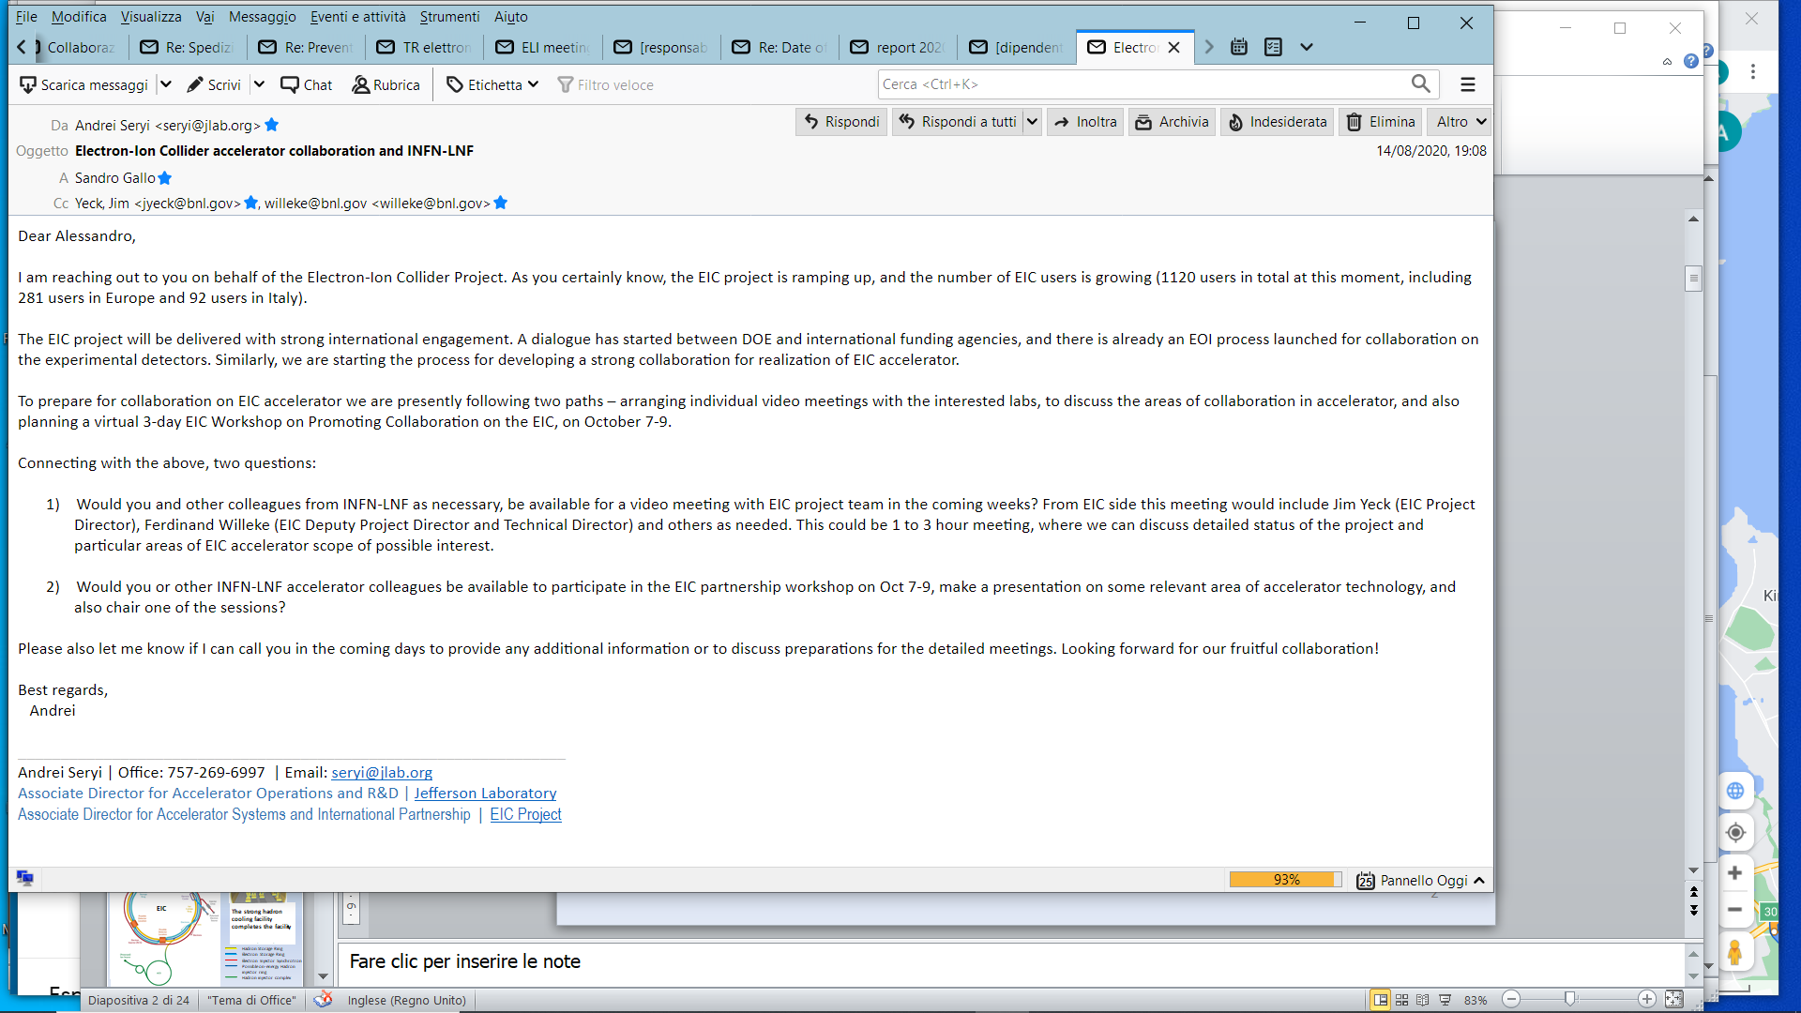
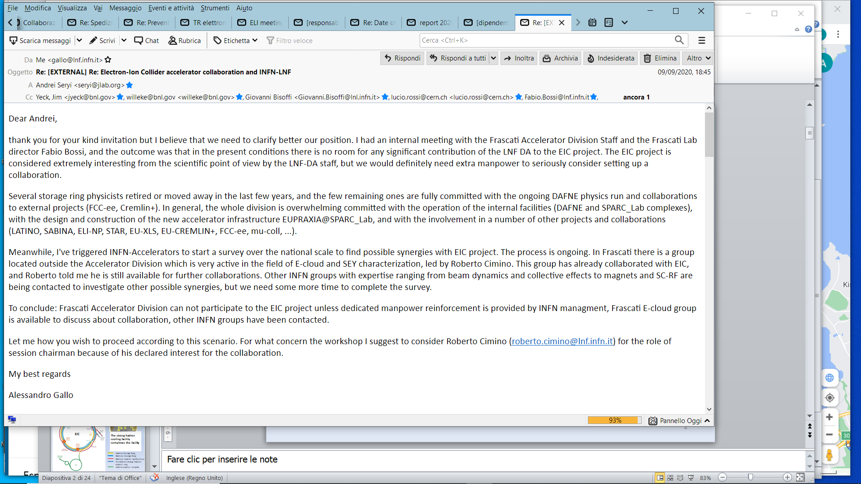
Original contact message from
Andrei Seryi,
Associate Director for Accelerator Systems and International Partnership
my reply after few iterations

Slide 4
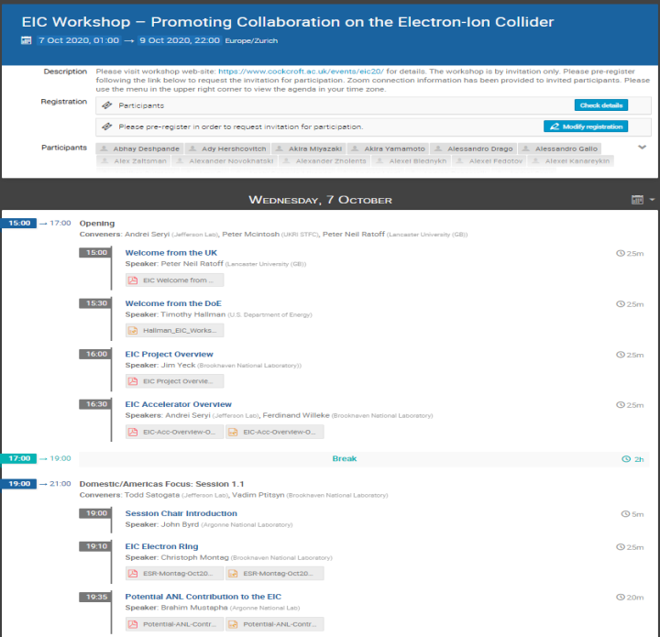



≈ 80 presentations + various open-mic sessions
About 33 hrs of presentations over 50 hrs of total duration!
Almost all-around-the-clock schedule with regional areas focus sessions

Slide 5
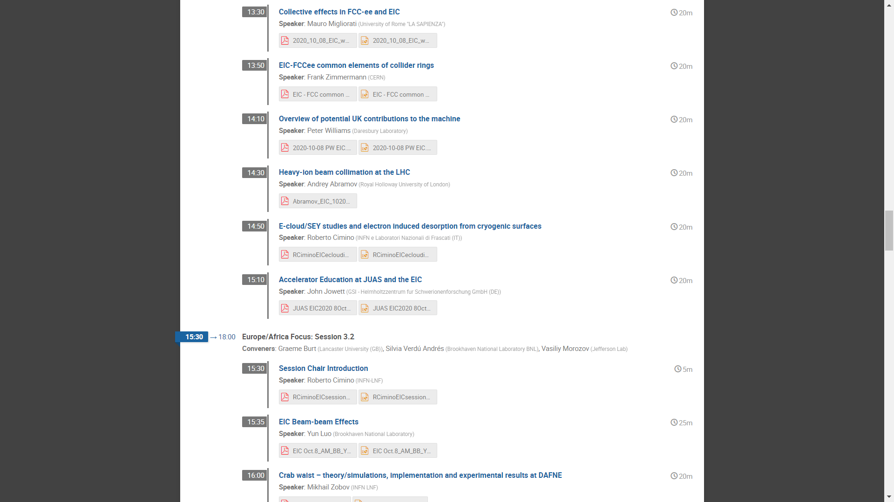
INFN contribution to the workshop
INFN Participants
1 | Angelucci Marco | LNF
2 | Biagini Maria Enrica | LNF
3 | Bisoffi Giovanni | LNL
4 | Blanco Garcia Oscar | LNF
5 | Boscolo Manuela | LNF
6 | Carideo Emanuela | RM1
7 | Cimino Roberto | LNF
8 | Drago Alessandro | LNF
9 | Ficcadenti Luca | RM1
10 | Gallo Alessandro | LNF
11 | Guiducci Susanna | LNF
12 | La Cognata Marco | LNS
13 | Liedl Andrea | LNF
14 | Mascali David | LNS
15 | Masullo Maria Rosaria | Na
16 | Migliorati Mauro | RM1
17 | Mikhail Zobov | LNF
18 | Milardi Catia | LNF
19 | Passarelli Andrea | Na
20 | Pastrone Nadia | To
21 | Pira Cristian | LNL
22 | Quartullo Danilo | LNF
23 | Rossi Lucio | Mi
24 | Santopinto Elena | Ge
25 | Tessarotto Fulvio | Ts
26 | Turrisi Rosario | Pd
27 | Vaccaro Vittorio | Na

Slide 6
EIC designed to meet NSAC and NAS Requirements
The Machine
Center of Mass Energies 20 GeV – 140 GeV
Maximum Luminosity 10³⁴ cm⁻²s⁻¹
Hadron Beam Polarization >70%
Electron Beam Polarization >70%
Ion Species Range p to Uranium
Number of interaction regions up to two
NSAC - Department of Energy Nuclear Science Advisory Committee
NAS - National Academies of Sciences, Engineering, and Medicine

Slide 7
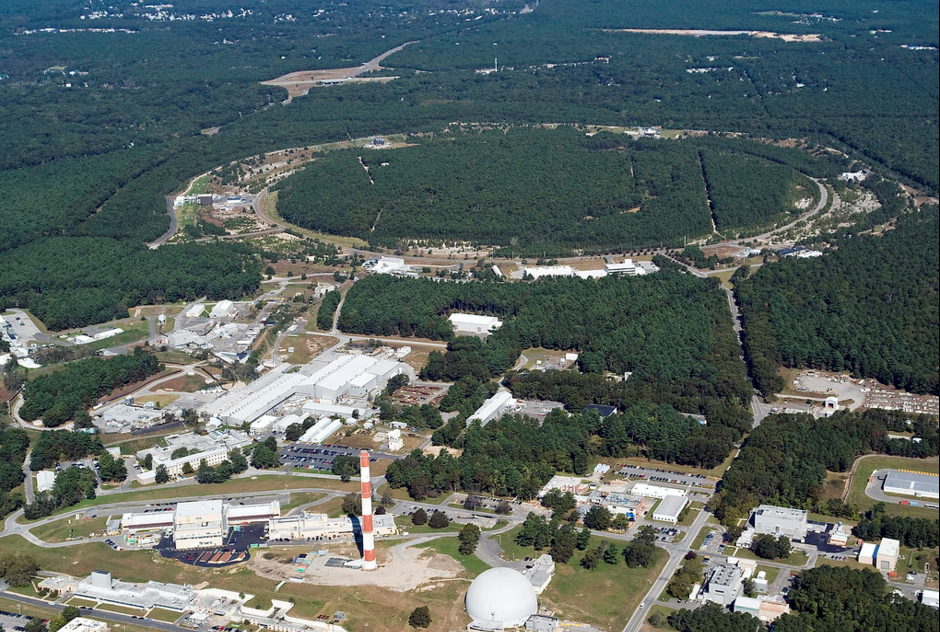

EIC Collider Concept
Design based on existing RHIC,
RHIC is well maintained, operating at its peak
Hadron storage ring 40-275 GeV (existing)
  Many bunches
  Bright beam emittance
  Need strong cooling or frequent injections
Electron storage ring (2.5–18 GeV (new))
  Many bunches,
  Large beam current (2.5 A) ➔ 10 MW S.R. power
Electron rapid cycling synchrotron (new)
  1-2 Hz
  Spin transparent due to high periodicity
High luminosity interaction region(s) (new)
  L = 10³⁴cm⁻²s⁻¹
  Superconducting magnets
  25 mrad Crossing angle with crab cavities
  Spin Rotators (longitudinal spin)
  Forward hadron instrumentation
EIC

Slide 8
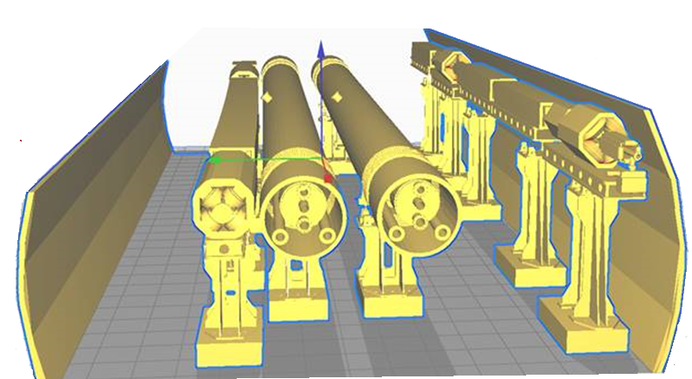
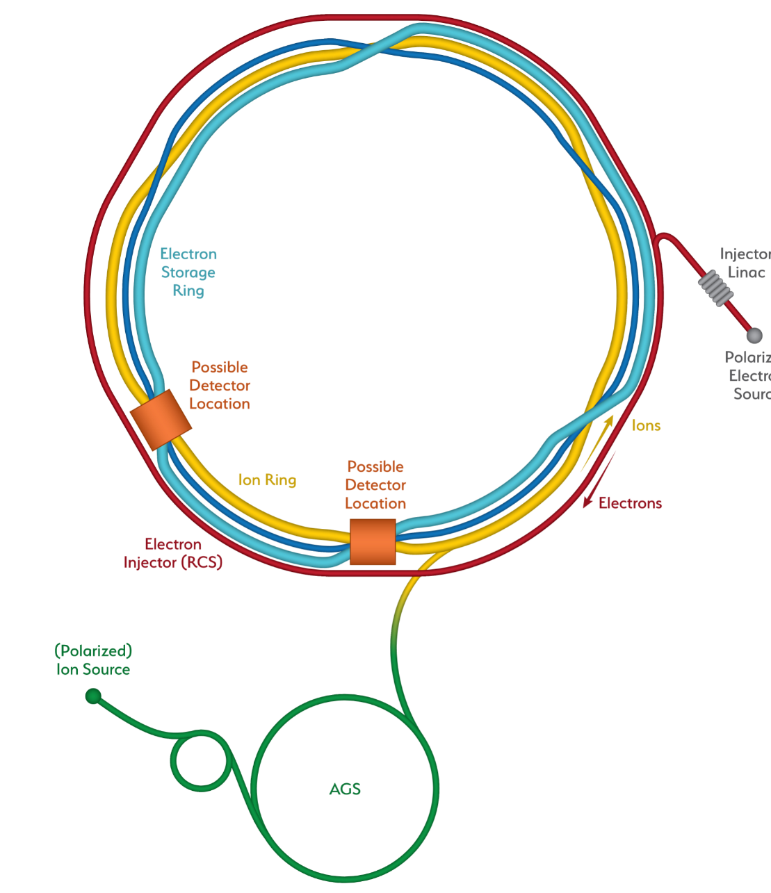

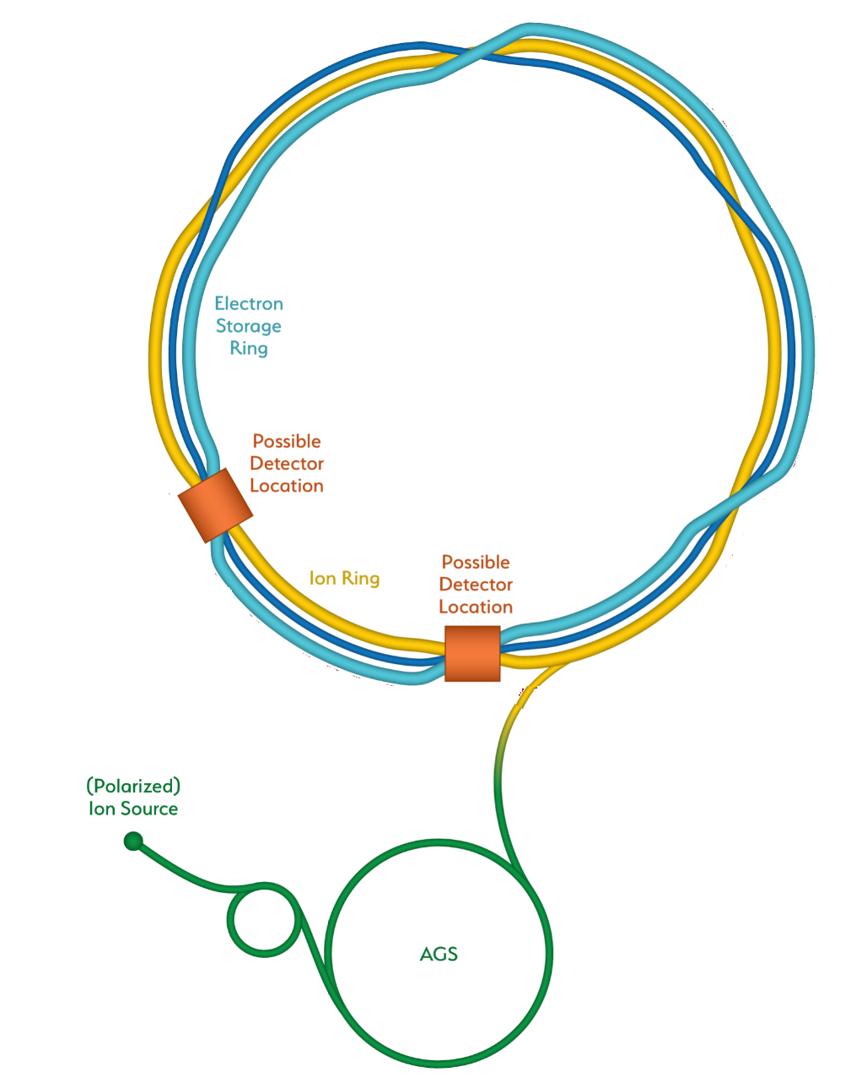
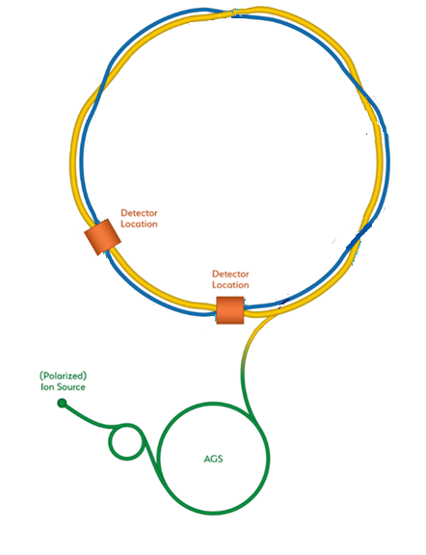
From RHIC to the EIC
Add electron storage ring
Which holds the electrons which collide with hadrons
We add an electron
Injector complex which delivers full energy electrons to the storage ring
EIC
The strong hadron cooling facility completes the facility
Existing RHIC with
Blue and Yellow ring
Hadron Storage Ring
Electron Storage Ring
Electron Injector Synchrotron
Possible on-energy Hadron
injector ring
Hadron injector complex

Slide 9
EIC covers full center of mass energy range of 20 – 140 GeV
Protons up to 275 GeV:
  Existing RHIC with superconducting magnets allow up to E_{p} = 275 GeV and down to E_{p} = 41 GeV
  RHIC beam parameters are close to what is required for EIC
Electrons up to 18 GeV:
Electron storage ring with up to 18 GeV installed RHIC tunnel,
readily achievable with
    large circumference of 3870 m and
    available superconducting RF technology ➔ U_{rf} = 62 MV
low electron energy of 2.5 GeV is easily obtainable

Slide 10
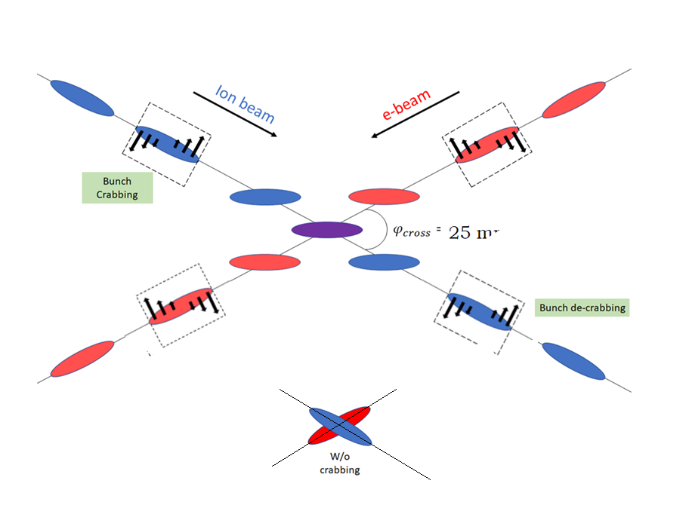
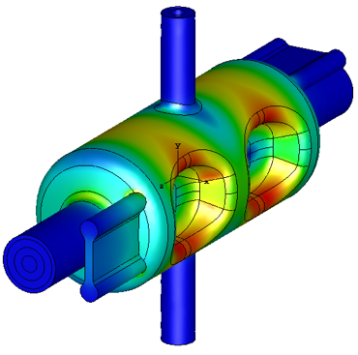
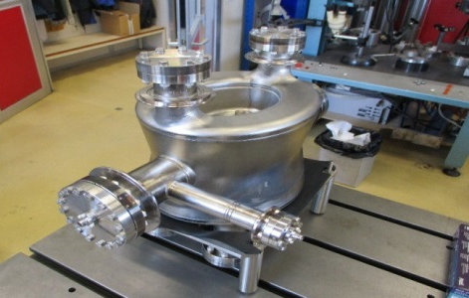
EIC High Luminosity with a Crossing Angle
Modest crossing angle of 25 mrad
  Avoid parasitic collisions due to short bunch spacing
  For machine elements, to improve detection
  Reduce detector background
However, crossing angle causes
  Low luminosity
  Beam dynamics issues
25 mrad
avoided by Crab Crossing
Then :
  Effective head-on collision restored
  Beam dynamic issues resolved
RF resonator (crab-cavity) prototypes built
and tested with proton beam in the CERN-SPS

Slide 11
Luminosity versus E_{CM} center of mass energy
10³⁴
10³³
10³²
EIC
Optimization for low E_{cm}
EIC
Optimization for high E_{cm}
Annual Integrated Luminosity [fb⁻¹]
Peak Luminosity [cm⁻²s⁻¹]
100
10
1
Tomography (p/A)
Spin and Flavor Structure of
the Nucleon and Nuclei
Internal
Landscape of the Nucleus
QCD at Extreme Parton Densities-
Saturation
150
Center of Mass Energy E_{cm} [GeV]

Slide 12
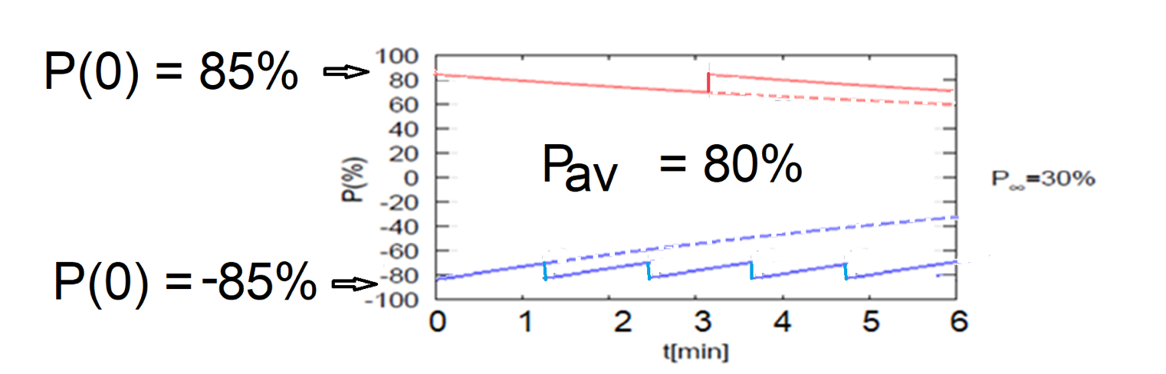
High average polarization at electron storage ring of 80% by:
Frequent injection of bunches on energy with high initial polarization of 85%
Initial polarization decays towards P∞ < ~50% (equilibrium of self-polarization and stochastic excitation)
At 18 GeV, every bunch is refreshed within minutes with RCS cycling rate of 2Hz
Need both polarization directions present at the same time
B P
Refilled every 1.2 minutes
B P
Refilled every 3.2 minutes
Re-injection
P_{av}=80%
P∞= 30%
(conservative)
P_{av}=80%
Re-injections

Slide 13
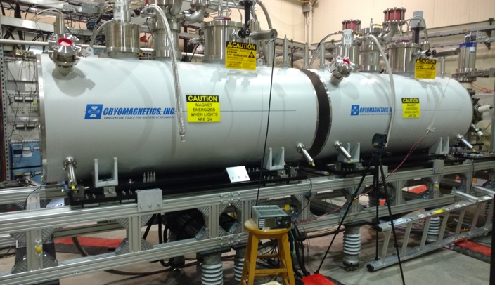
EIC Hadron Polarization
Existing p Polarization in RHIC achieved with “Siberian snakes”
Near term improvements will increase proton polarization in RHIC from 60% to 80%
³He polarization of >80% measured in source
80% polarized ³He in EIC will be achieved with six “snakes”,
Acceleration of polarized Deuterons in EIC 100% spin transparent
Need tune jumps in the hadron booster synchrotron
Electron beam ion source EBIS with polarized ³He extension

Slide 14
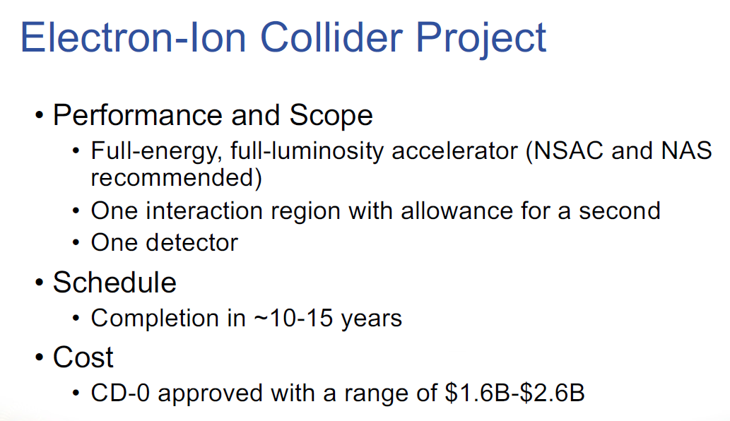

Slide 15
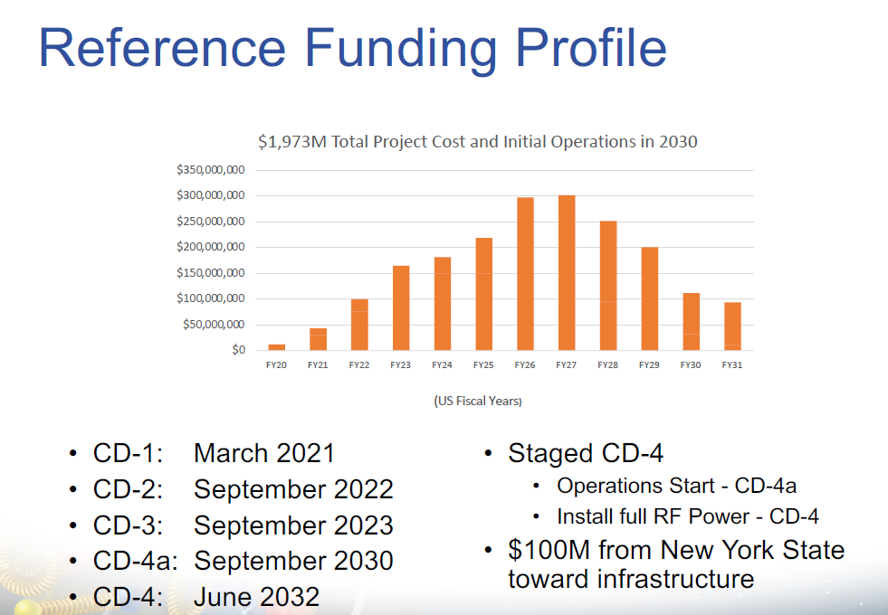

Slide 16
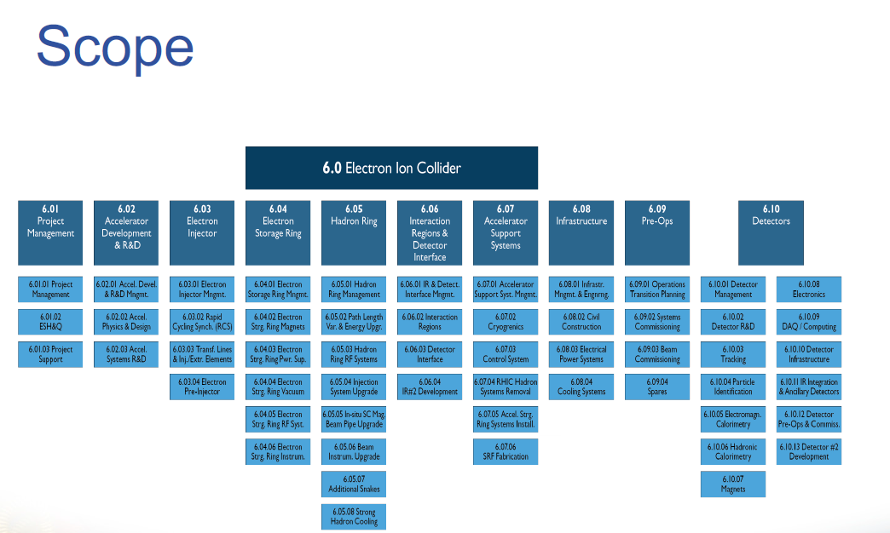

Slide 17
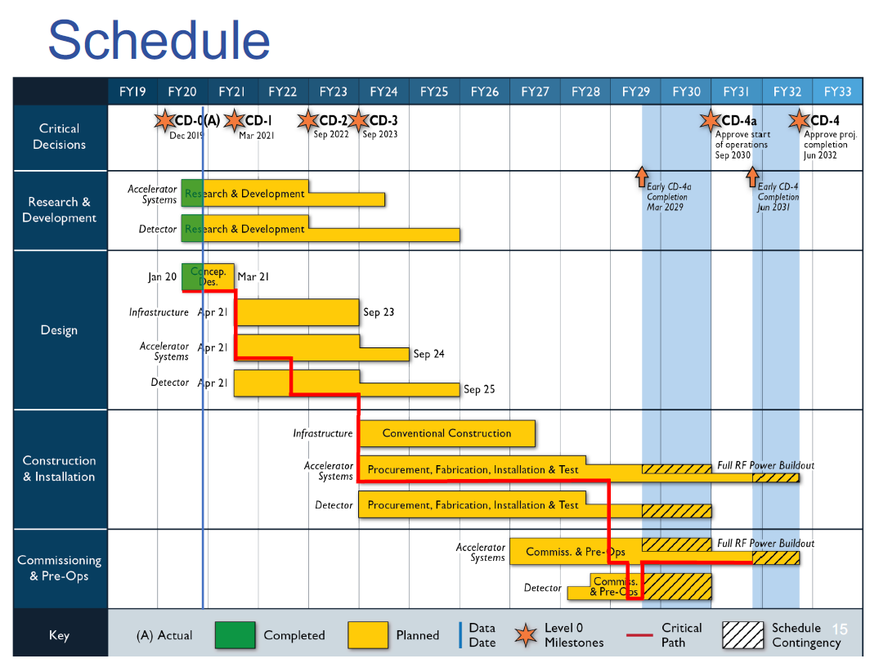

Slide 18
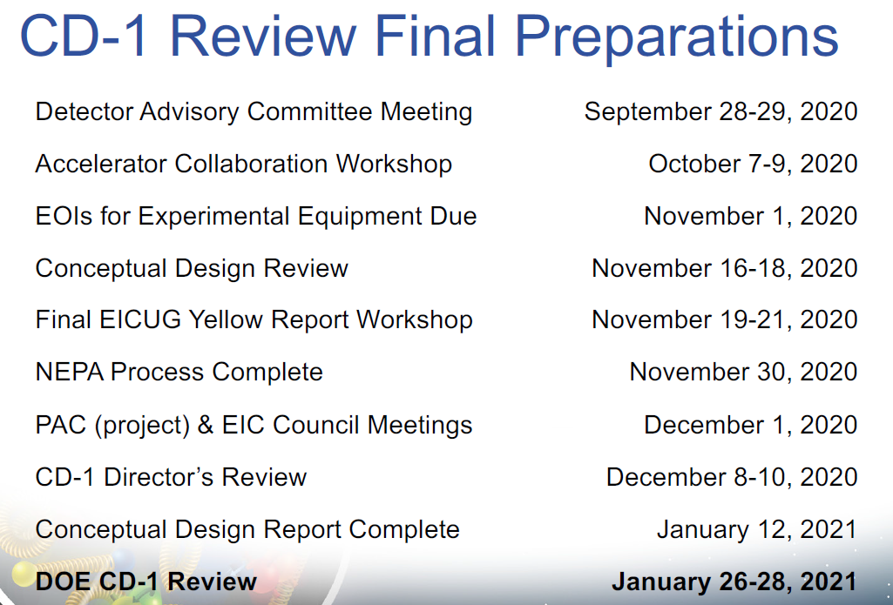

Slide 19
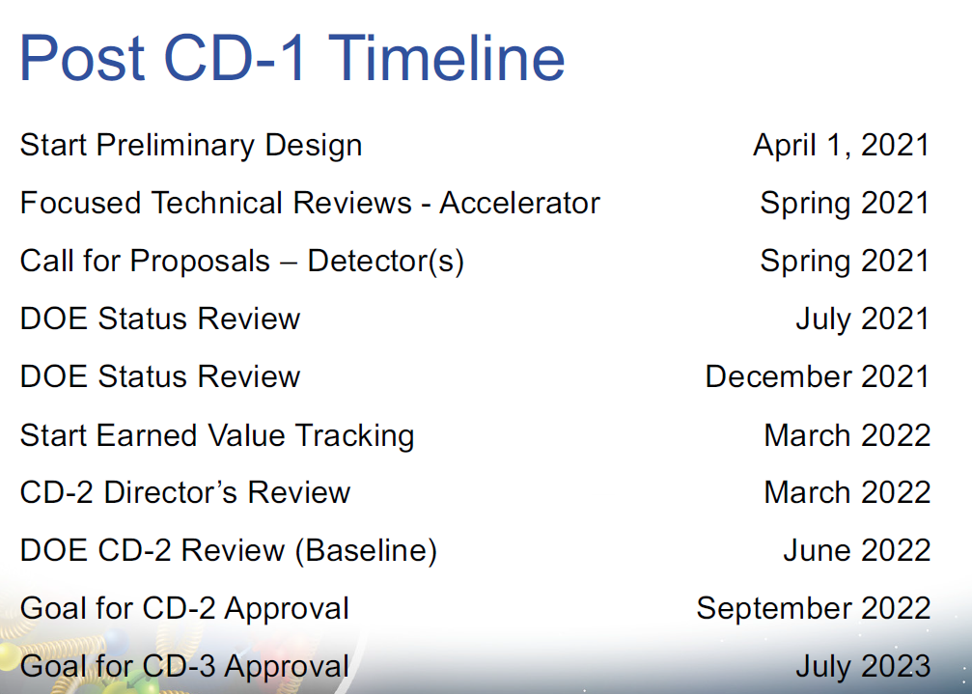

Slide 20
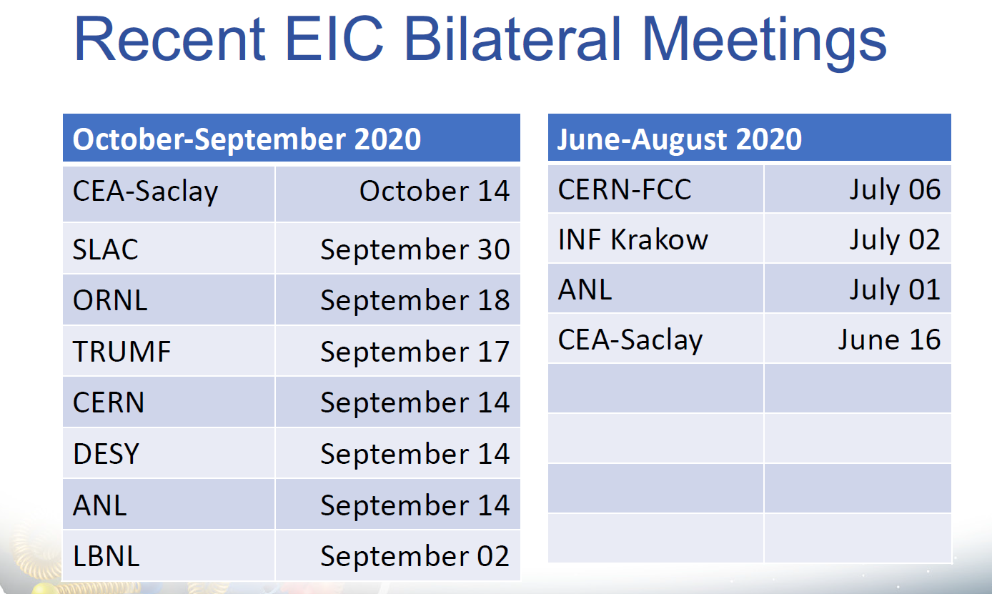

Slide 21
EIC Accelerator Collaboration Opportunities
EIC is international from its conception
Collaboration on EIC design and construction –mutually beneficial, providing a gateway to EIC science, advancing accelerator science and technology
Possible contributions to the EIC accelerator could include the full range of accelerator design and hardware
  E.g. IR magnet design and construction, luminosity monitoring, RF R&D and construction, normal conducting magnets, critical vacuum components, feedback systems, polarimetry, contributions to the 2nd IR, beam-dynamics calculations, etc.

Slide 22

Collaboration – path forward
The EIC team making efforts to stay as close as possible to technically driven schedule
With anticipated CD1 in 2021, CD2 in 2022 the time to engage is now
Mechanisms for collaboration developing
  1) Partnership workshops like the one we attend allow to see the broad picture and indicate the areas where project needs and the interests and expertise match
  2) Meetings between the institutional team and EIC project team allow for focused discussion on specific collaboration scope
  many such meetings already happened and
  we expect many more after this workshop
Andrei Seryi,
Associate Director for
Accelerator Systems and International Partnership

Slide 23
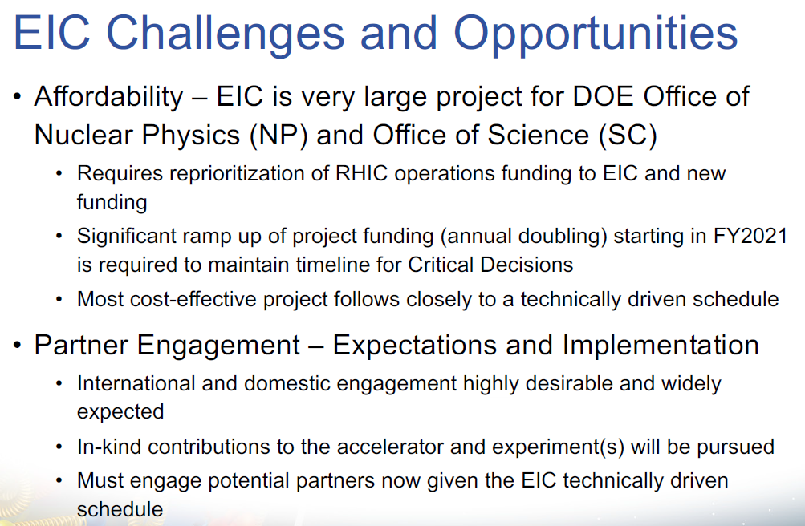

Jim Yeck, Project Director

Slide 24
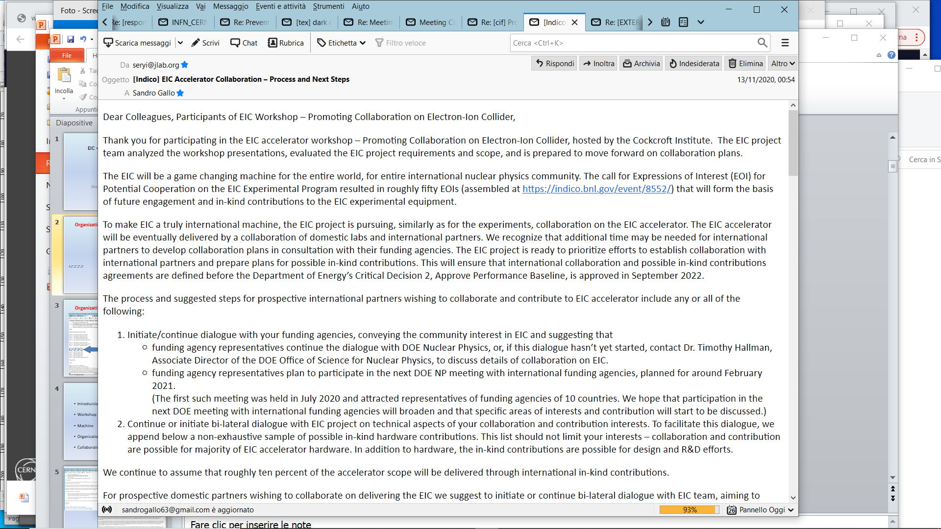
Workshop follow-up from Andrei Seryi
INFN?

Slide 25
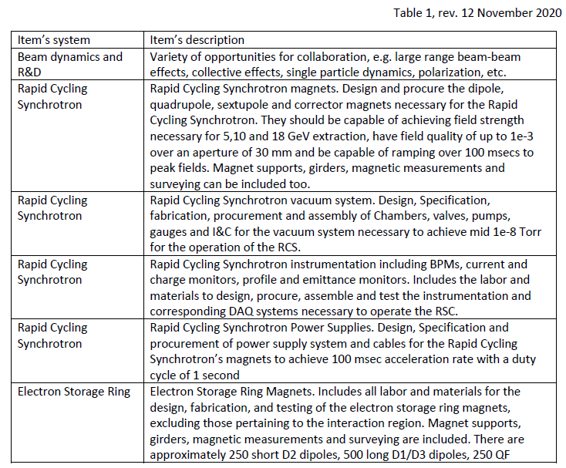
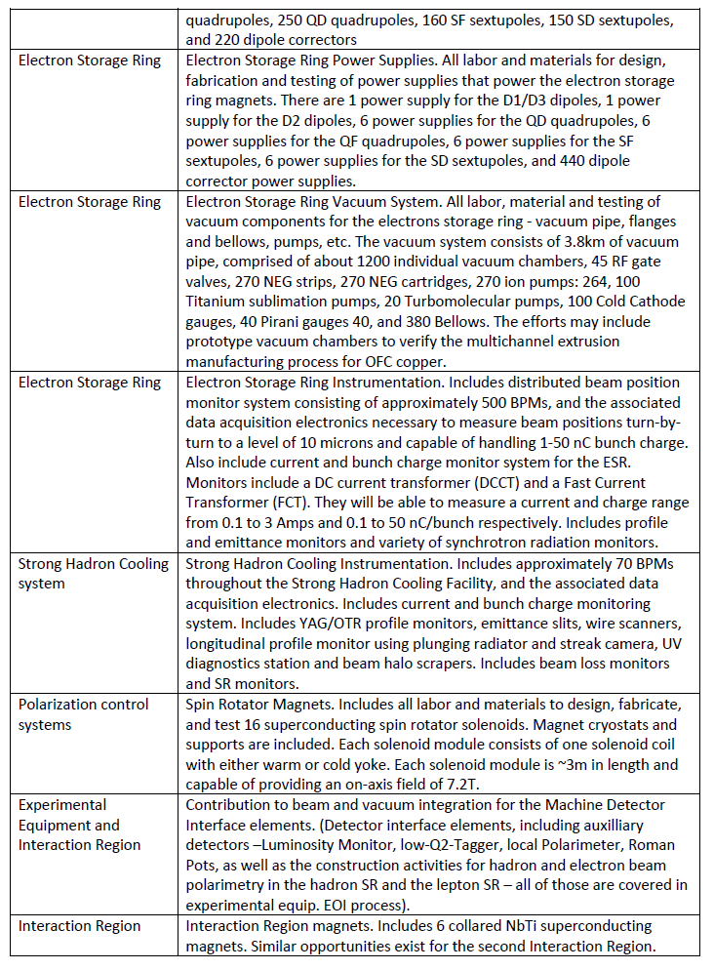
Workshop follow-up from Andrei Seryi

Slide 26
Workshop follow-up from Andrei Seryi

Slide 27
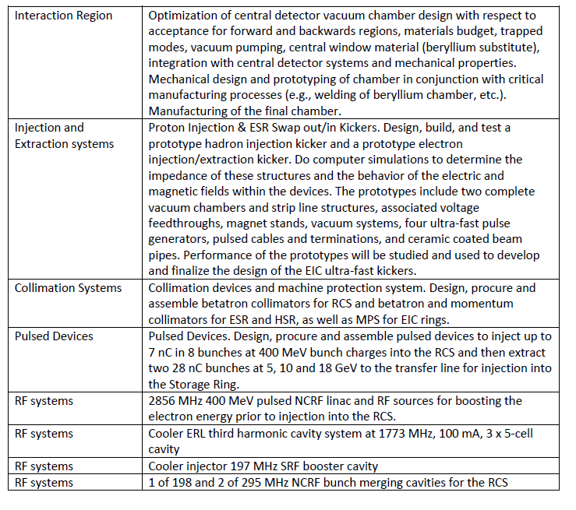
Workshop follow-up from Andrei Seryi

Slide 28
INFN Collaboration
INFN management is interested in maintaining a contact with the EIC project especially for the benefit of the internal nuclear physics community. However, at the moment the INFN accelerator community has not been committed to that extent.
Original contacts have been taken to LNF, probably on the base of the lepton storage ring expertise. LNF declared its difficulty in answering the call, and INFN-Accelerators has been involved.
Limited territory for a collaboration has been identified, mainly on:
E-cloud studies and mitigation, material studies and characterization (R. Cimino; LNF, INFN-Na, …)
Collective effects, instability, fbks (M. Migliorati; INFN-RM1, INFN-Na, LNF, …)
Possibility to expand the collaboration on other topics:
Fast ramping magnets for the full energy electron injector synchrotron
SC RF for the electron rings
…
Possible in-kind contributions related to conventional systems (not in this phase)
Bi-lateral meeting (INFN Acceleratori vs. EIC team) is being organized in January 7, 2021

Slide 29
e—cloud, SEY studies and electron induced desorption
(R. Cimino et al., INFN-LNF)
The performance reach of accelerators crucially depends on the vacuum system
1. The beam interacts with the rest gas in the vacuum chamber causing:
  reduced beam lifetime - and/or emittance growth - trigger avalanche multiplication processes
2. The vacuum system plays an important role for beam stability:
  Its material(s) conductivity, shape, coating mainly determine resistive wall impedance of a machine
  Transitions between pipes, bellows, etc. significantly contribute to the global machine impedance
  Total impedance needs to be kept below a certain budget to allow operation at the desired intensity.
3. The vacuum chamber also affects beam stability and lifetime otherwise
  Its inner wall surface properties in particular desorption and electron yields, are critical
  High desorption yields can lead to pressure runaway
  High electron yields can lead to electron cloud formation
  Distributed pumping from surface/design (e.g. NEG coating, pumping holes)
  Shape optimization for photon absorption (antechambers, slits)
RM1
NA
LNF
NA
29

Slide 30
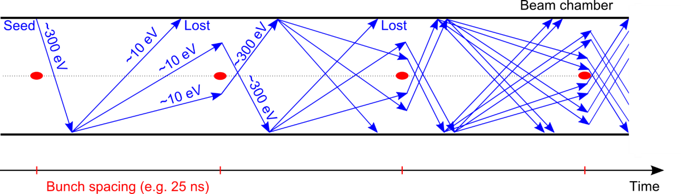
e⁻ cloud formation
Generation of electrons inside the vacuum chamber
(primary, or seed, electrons)
R. Cimino and T. Demma “Electron cloud in Accelerators” Int. J. Mod. Phys. A 29 (2014) 1430023.
Acceleration of primary electrons in the beam field
Secondary electron production when hitting the wall
Avalanche electron multiplication
Tx to F. Ruggiero
30
e—cloud, SEY studies and electron induced desorption (R. Cimino et al., INFN-LNF)

Slide 31
LNF group approach
Mitigation Strategies
Issues:
External solenoid field
Costly and not always applicable
Electrodes in the lattice
Costly, not always applicable, impedance?
e⁻ and/or Ph. Scrubbing
Time consuming, not stable and “asymptotic”
Run with low e⁻ cloud
filling partners
Costs machine performance (reduced n. of bunches)
Geometrical modifications
Impedance, dust, vacuum behavior.
Intrinsically low SEY material
Impedance, stability, adhesion, etc
31
e—cloud, SEY studies and electron induced desorption (R. Cimino et al., INFN-LNF)

Slide 32
Collective effects in FCC-ee and EIC
(M. Migliorati et al., univ. La Sapienza and INFN-RM1)
Parameter list | FCC-ee Z pole (W) | EIC
Circumference (m) | 97756 | 3834
Beam energy (GeV) | 45.6 | 10 (18)
Beam current (A) | 1.39 | 2.5 (0.27)
Bunch population [10¹¹] | 1.7 | 1.7
Bunch length [mm](SR/BS) | 3.5/12.1 | 20
Energy spread(SR/BS) [10⁻³] | 0.38/1.32 | 0.58
Synchrotron tune | 0.025 | 0.0815
Bunches/beam | 16640 | 1174
Mom compaction [10⁻⁶] | 14.8 | 1450
Energy loss/turn (MeV) | 36 | 9.1
RF Voltage (MV) | 100 | 41
Effects of:
Resistive wall
Impedance (vacuum chamber, BPMs, …)
Turbulent Mode Coupling
Transverse Coupled Bunch
under evaluation for FCC-ee can be extended to EIC using same approach and tools

Slide 33
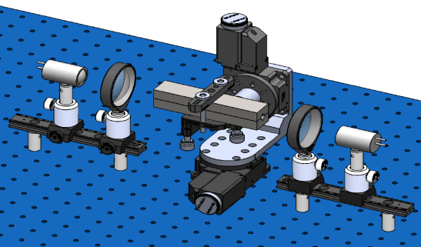
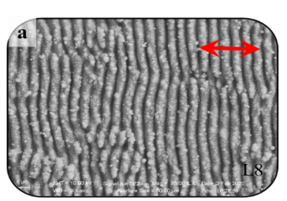
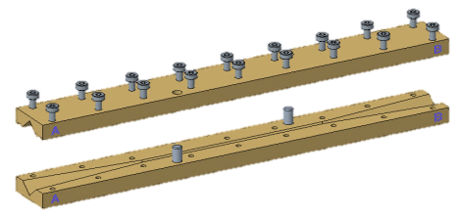
Electromagnetic characterization of coated surfaces for broadband impedance evaluation (M.R. Masullo et al., INFN Naples)
Different range of frequencies and material thickness require different approaches
THz Time domain spectrometer
A new waveguide methodology
Example of dielectric
resonator
NEG
Laser ablated structure
5
20
100
300
f [GHz]
𝝀 [mm]
60
15
3
1
33

Slide 34
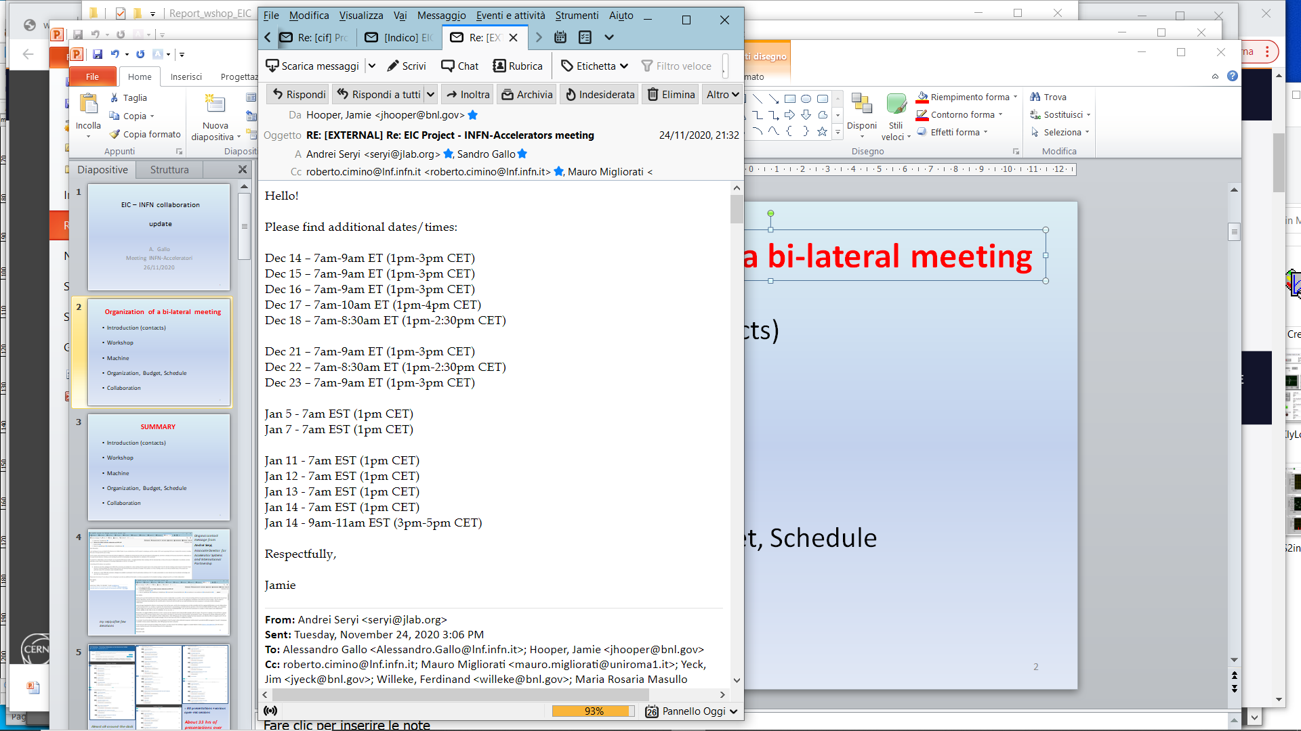
Organization of a bi-lateral meeting
Goals of the meeting:
Better definition of a collaboration program on the items where INFN groups have already expressed their interest;
Through INFN-Acceleratori reach the whole community to explore other possible fields of collaboration
2021
January 7th
1 pm CET
Pending questions:
What channels could be activated to give resources to the groups willing to collaborate?
Do we need to ask special funds from management?
Can this activity become just an additional work package within the INFN CSN3 general collaboration on the EIC physics? Something similar has happened in the past in CSN1 (PEP-II and SuperKEKB, RD_FA, …)

Slide 35
Thanks
for the attention …

