Slide 1
Collider Study Case and Intermediate Steps to Particle Physics Experiments
5th European Advanced Accelerator Concepts Workshop,
20 – 23 September 2021, Italy, Frascati and the World
Edda Gschwendtner, Ralph Assmann
for the Expert Panel ‘High Gradient – Plasma and Laser Accelerators’

Slide 2
Motivation
Perform a feasibility and pre-CDR study for high gradient plasma and laser accelerators and their particle physics reach.
  Understand the promise of a plasma collider, key parameters and performance estimate
  Guide future feasibility demonstrations
  Estimate realistic benefits in cost and size
Study Intermediate Steps towards Particle Physics Experiments
  Potential for lower energy Particle Physics applications.
  Parameter regime that could be realized in the nearer future.
Compare different technologies with the same target parameters relevant for particle physics.
  PWFA (e- and p), LWFA, DLA, THz
  Understand strengths and weaknesses of different technologies at quantitative level.
  Provide sound basis for selection of best technology

Slide 3
Parameters for a Linear Collider with Advanced Acceleration Technology
➔ Many challenges

Slide 4
High-Energy Common Study Case
Previous roadmaps specified collider as a whole, we propose to look at the feasiblity of an accelerator module.
Assess the feasibility in the high-energy collider regime.
CLIC has already established an optimized set of parameters.
Use CLIC parameters of the final 15 GeV of the CLIC 380 GeV main linac
Relevant study case:
  Design of an advanced accelerator module (2 or more acceleration stages) accelerating electron or positron beams from 175 GeV to 190 GeV.
  Collider based on plasma or dielectric accelerator technology is not expected to reproduce exactly the same parameters as used in CLIC. → parameters shall be adapted.
Even if plasma wakefield acceleration works at low energy, does it also work at high energies of 175 GeV?
  More challenging for in-out coupling of beam drivers, manipulating phase space, focussing, Length of magnetic chicanes gets longer
  Tolerances are much tighter, geometric emittance is much smaller for same normalized emittance
Crucial to look at 175 GeV (10-100 times higher than studied so far).

Slide 5
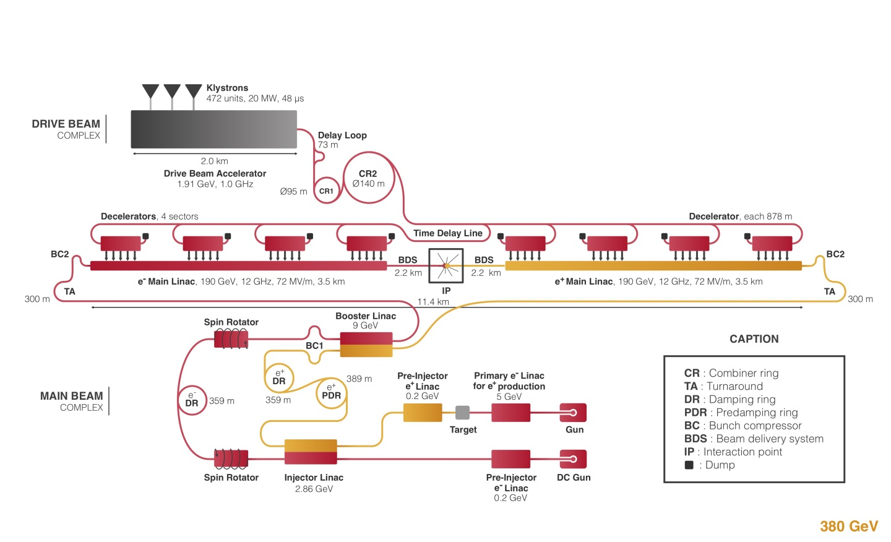
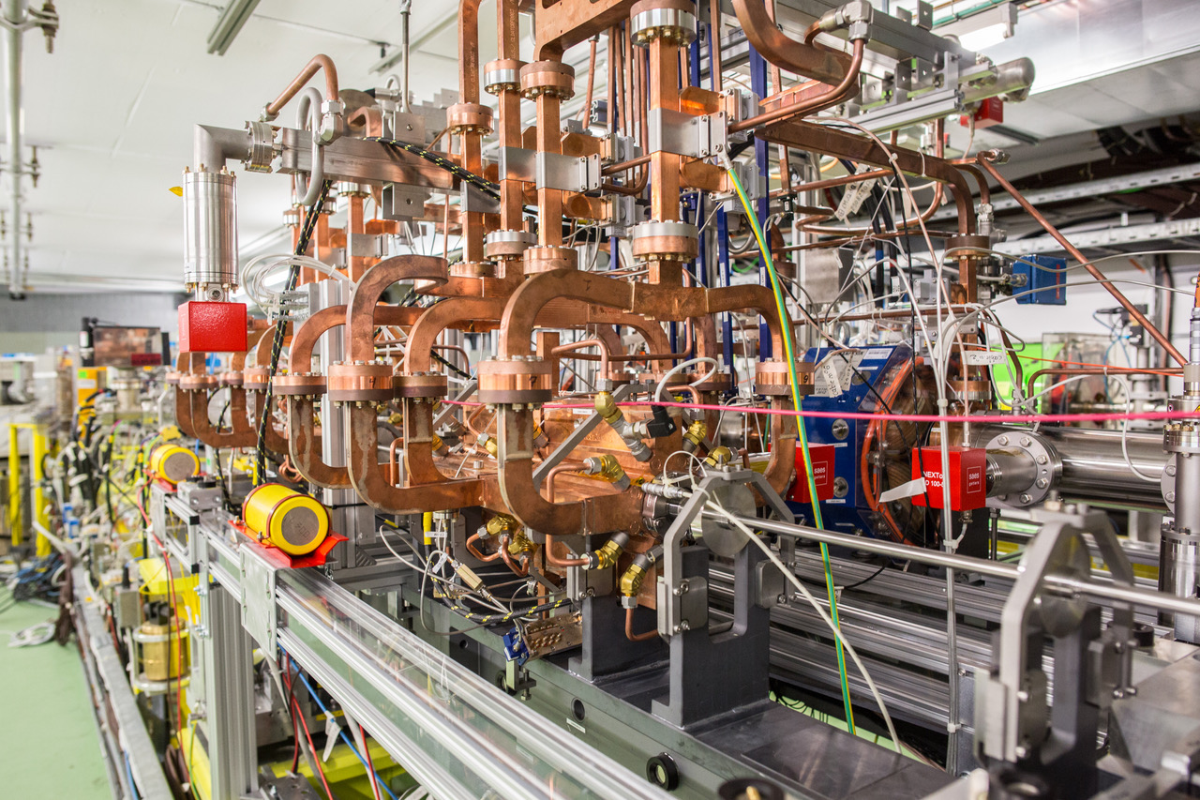
CLIC
CLIC parameters (380 GeV)
Our idea:
replace last 15 GeV with advanced accelerator modules.
Assess feasibility and study the single bunch performance

Slide 6
Parameters for High Energy Study Case
Study multi-stage electron (positron) accelerator from 175 GeV to 190 GeV:
Full lattice
In/out coupling
All magnetic elements
Correctors
Diagnostics
Collective effects
Emittance, efficiency
Include realistic imperfections
Betatron radiation
Estimate of realistic performance
Estimate realistic footprint
Estimate realistic benefits in cost and size
Understand scaling with beam energy for different technologies (laser, e⁻, p driven, DLA/THz)

Slide 7
Low-Energy Common Study Case
Assess the potential for lower energy Particle Physics applications by considering a parameter regime for fixed-target experiments.
Could be realized in the nearer future with more relaxed beam parameters compared to colliders.
Aim at more compact and more cost-effective particle physics experiments
Relevant study cases:
  The design of an advanced accelerator (that can include the injector) to accelerate electrons to a final beam energy in the regime of 15 GeV to 50 GeV to be used for HEP experiments.

Slide 8
Laser-Electron Experiment – LUXE
Strong-field regime of QED: Electron enters an electric field, which is strong enough to accelerate an electron over the distance of the electron Compton wavelength to an energy comparable to its rest energy. Field strength called ‘Schwinger field’.
Reach the Schwinger field by using a high energy electron beam (from the European XFEL, with E=17 GeV) and a high-power laser to create the electric field, and to study then the interactions of the high energy electrons or photons with the laser photons.
  Enter into non-perturbative regime of QED in electron and photon induced interactions
  Study transition from perturbative to non-perturbative regime
  Use Compton process to create “photon factory” for BSM physics, study axion-like particles
➔ Parameters similar to plasma wakefield acceleration and dielectric laser accelerators
➔ Study the energy reach, emittance and requirements for stable e-laser collisions
B. Heinemann, talk at Townhall meeting, 30.3.2021

Slide 9
Beam-Dump/Fixed-Target Experiments
Search for dark photons, deep inelastic scattering, non-linear QED
M. Wing, talk at Townhall meeting, 30.3.2021
Require less challenging beam
  Energy and flux is important
  Relaxed parameters for emittance
Use bunches or single electrons
  Single electrons: tagging → invisible channel
  Bunches: only visible channel possible

Slide 10
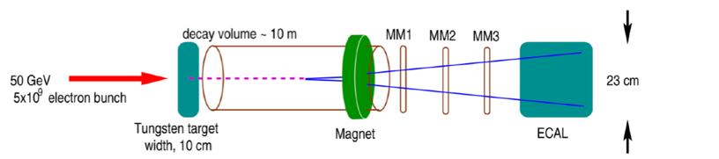
Electron Bunches – Beam Dump Experiments
Experimental conditions modeled on NA64 experiment.
AWAKE example:
Beam dump experiment: 50 GeV electrons, 5x10⁹ electrons, 10¹⁶ electrons on target in 3 months with existing SPS cycle, emittance O (10µm)
Study increase of electron intensity (duty cycle, extraction mechanism, repetition rate, …)
Study scalable plasma sources (proton-driven)
In general, other novel accelerator technologies should study the possibility to provide such high energy bunched electron beams, ideally with higher intensity and rate

Slide 11
Single Electrons – Fixed Target Experiments
→ Invisible Channel
M. Wing, talk at Townhall meeting, 30.3.2021
Dielectric laser accelerator: capable of generating such beams in principle, when are we at 5-20GeV?
➔ Need to reach proposed particle energy – an experiment for the 2030’s ?!

Slide 12
Other Applications
gg–collider, with centre-of-mass energy of 12 GeV: Study known and search for new resonances up to bb-bar.
  Current design based on European XFEL electron beam.
  Polarisation comes from laser
  Low energy electrons
  No positrons needed.
V. Telnov
  LHeC: Precision deep inelastic scattering, strong force, electroweek physics, searches for BSM, electron-ion collision.
  E_{e}=60GeV, √s = 1.3 TeV, L=10³³cm⁻²s⁻¹.
Physics with an electron-proton or electron-ion collider
  Emittance requirements: Less challenging electron beam parameters than CLIC.
Using plasma wakefield acceleration technology – some case studies:
  LHeC: → Low-luminosity version of LHeC (50 GeV electrons, PEPIC)
  EIC → use the RHIC-EIC proton beam to accelerate electron
  3 TeV VHEeP → use the LHC protons to accelerate electrons: New energy regime means new physics sensitivity even at low luminosities.
Optimize luminosity
Consider different novel acceleration schemes
Study electron polarisation
M. Wing, A. Caldwell, talks at Townhall meeting, 30.3.2021, 31.5.2021

Slide 13
Parameters for Low-Energy Physics Case
Assess the low energy regime around 15-50 GeV:
achievable performance
Estimate realistic footprint andbenefits in cost and size
schemes and designs for first particle physics experiments with novel accelerators
needed R&D demonstration topics for low energy design
needed test facilities.

Slide 14
Summary
We have established a proposal for a first high energy, detailed study case for particle physics.
We have collected a number of highly interesting proposals for intermediate particle physics experiments.
Now we need a coordinated study for a self-consistent design (theory and simulations, involving particle physicists)
Study is complemented by technical milestones as presented by Ralph.
This will allow an informed assessment in 2027.
Comments and suggestions of advanced accelerator community for finalizing this approach is very welcome!

Slide 15
Links
Townhall meetings:
1st Townhall meeting 30 March 2021: https://indico.cern.ch/event/1017117/
2nd Townhall meeting 21 May 2021: https://indico.cern.ch/event/1040116/
3rd Townhall meeting 31 May 2021: https://indico.cern.ch/event/1041900/

