Slide 1
IFAST = Innovation Fostering in Accelerator Science and Technology
EU Project May 2021 – April 2025, Coordinator M. Vretenar
WP6: Novel Particle Accelerators Concepts and Technologies – Coordinator R. Assmann
Contains European Network for Novel Accelerators (EuroNNAc4) = Sponsor of EAAC

Slide 2
Agenda EuroNNAc meeting on Thursday SEP 23 (9:00 - 11:30):
09:00 - 09:20 The next four years of EuroNNAC and EAAC: Support from I-FAST and NPACT (R. Assmann, DESY)
09:20 - 09:40 LASPLA: A European roadmap on lasers for plasma acceleration (L. Gizzi, CNR)
09:40 - 09:50 Specialized Elba meeting in 2022 (M. Ferrario, INFN)
09:50 - 10:15 Round-Table, News, Plans
10:15 - 10:30 Coffee Break
10:30 - 11:30 Round-Table, News, Plans
11:30 Adjourn

Slide 3
Agenda EuroNNAc meeting on Thursday SEP 23 (9:00 - 11:30):
09:00 - 09:20 The next four years of EuroNNAC and EAAC: Support from I-FAST and NPACT (R. Assmann, DESY)
09:20 - 09:40 LASPLA: A European roadmap on lasers for plasma acceleration (L. Gizzi, CNR)
09:40 - 09:50 Specialized Elba meeting in 2022 (M. Ferrario, INFN)
09:50 - 10:15 Round-Table, News, Plans
10:15 - 10:30 Coffee Break
10:30 - 11:30 Round-Table, News, Plans
11:30 Adjourn

Slide 4
Tasks of WP6 – Novel Particle Accelerators Concepts and Technologies
Task 1 (RA + M. Ferrario): Novel Particle Accelerators Concepts and Technologies (NPACT – EuroNNAc4) M1 – M48 Sub-task leaders: B. Holzer (CERN), P. Nghie (CEA), A. Specka (CNRS), R. Walczak (Oxford)
Task 2 (Leo Gizzi): Lasers for Plasma Acceleration (LASPLA) M1 – M48
Task 3 (Cedric Thaury): Multi-scale Innovative targets for laser-plasma accelerators (MILPAT) M1 – M32
Task 4 (Francois Mathieu): Laser focal Spot Stabilization Systems (L3S) M1 – M36
WP6.1

Slide 5
The Theme of WP6
This is the iFAST WP on high gradient accelerators (> 1 GV/m), involving mainly plasma-based technology but also dielectric accelerators.
This includes the development of laser features required for driving accelerators and targets.
This WP: Promote and support the development of very high gradient, compact accelerators as a viable technology option!
Towards HEP but also near-term applications.

Slide 6
WP6.1 (EuroNNAc) Sub-Tasks
Strategic forum novel accelerator landscape in Europe (= EuroNNAc4 and EAAC)
Strategy High Gradient RF Accelerators in Lower Energy Applications;
Strategy Plasma Accelerators towards Applications and HEP
Strategy Defining and Exploiting the Potential of Dielectric Accelerators.

Slide 7
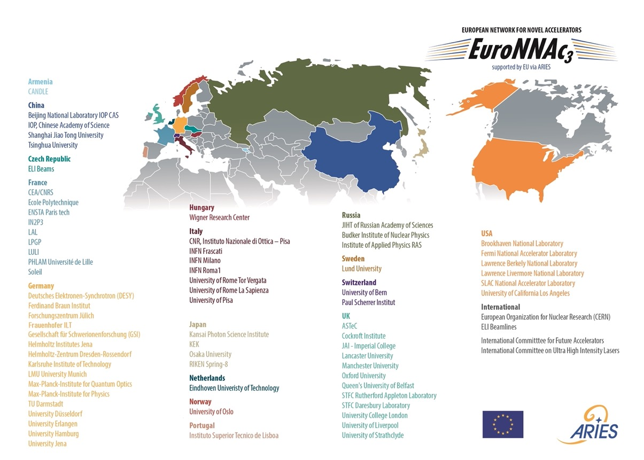

Slide 8
WP6.1 (EuroNNAc) To Do‘s
The Task partners will jointly organise and support workshops, in particular the EAAC, set up dedicated schools, and award a prize for young scientists in the field.
Proposed strategies will be published in open access reports.
Reports on the European novel accelerator landscape and strategic proposals will be made available to interested parties in research, industry and funding bodies.
The Industry Advisory Board will contribute to the definition of the strategy.

Slide 9
WP6 Milestones
May 2023
MS21: Report on the novel accelerator landscape in Europe, facilities, projects and capabilities at the beginning of the 2020’s. Lead – DESY, M24, Publication, website (task 6.1)
MS22: LASPLA Workshop/School. Lead – CNR, M30, Report (task 6.2)
MS23 Target manufacturing and characterization. Lead – CNRS, M12 Report (task 6.3)
MS24: Hypothesis on the causes of the instabilities of the focal spot profile. Lead – CNRS, M24 Publication (task 6.4)

Slide 10
WP6 Deliverables
November 2024

Slide 11
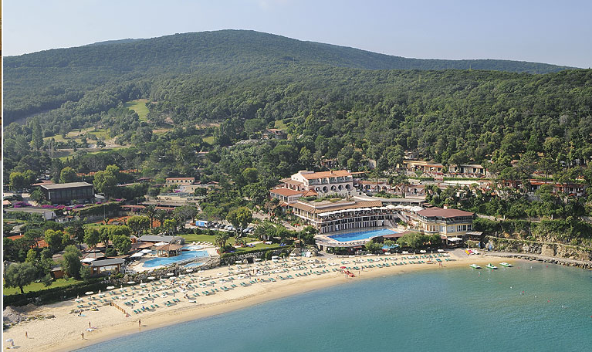
Next Meetings
-EuroNNAc Special Topics Workshop: 18-24 September 2022
It will be discussed in the EuroNNAc Yearly Meeting
It will include the Simon van der Meer Early Career Award in Novel Accelerators
and the Poster Prize
-AAC will take place in 2022 in the US (to be announced) –
we hope to be able travelling there
-EAAC 2023, 17-23 September 2023

Slide 12
Agenda EuroNNAc meeting on Thursday SEP 23 (9:00 - 11:30):
09:00 - 09:20 The next four years of EuroNNAC and EAAC: Support from I-FAST and NPACT (R. Assmann, DESY)
09:20 - 09:40 LASPLA: A European roadmap on lasers for plasma acceleration (L. Gizzi, CNR)
09:40 - 09:50 Specialized Elba meeting in 2022 (M. Ferrario, INFN)
09:50 - 10:15 Round-Table, News, Plans
10:15 - 10:30 Coffee Break
10:30 - 11:30 Round-Table, News, Plans
11:30 Adjourn

Slide 13
Agenda EuroNNAc meeting on Thursday SEP 23 (9:00 - 11:30):
09:00 - 09:20 The next four years of EuroNNAC and EAAC: Support from I-FAST and NPACT (R. Assmann, DESY)
09:20 - 09:40 LASPLA: A European roadmap on lasers for plasma acceleration (L. Gizzi, CNR)
09:40 - 09:50 Specialized Elba meeting in 2022 (M. Ferrario, INFN)
09:50 - 10:15 Round-Table, News, Plans
10:15 - 10:30 Coffee Break
10:30 - 11:30 Round-Table, News, Plans
11:30 Adjourn

Slide 14
EuroNNAc Special Topics Workshop: 18-24 September 2022 in Elba, Italy
Prepare milestone report MS21 to be delivered in May 2023:
Report on the novel accelerator landscape in Europe, facilities, projects and capabilities at the beginning of the 2020’s.
Topics EuroNNAc special topics workshop:
Facilities.
Projects.
Capabilities.
High Gradient RF Acc. in Lower Energy Applications;
Plasma Acc. towards Applications and HEP;
Defining and Exploiting the Potential of Dielectric Acc.
Possible program
5 days = 10 sessions
6 sessions see left
ask session coordinators to draft report from presentations
1 session opening
1 session summaries
2 poster sessions

Slide 15
EuroNNAc Special Topics Workshop: 18-24 September 2022 in Elba, Italy
Prepare milestone report MS21 to be delivered in May 2023:
Report on the novel accelerator landscape in Europe, facilities, projects and capabilities at the beginning of the 2020’s.
Topics EuroNNAc special topics workshop:
Facilities.
Projects.
Capabilities.
High Gradient RF Acc. in Lower Energy Applications;
Plasma Acc. towards Applications and HEP;
Defining and Exploiting the Potential of Dielectric Acc.
Possible program
5 days = 10 sessions
6 sessions see left
ask session coordinators to draft report from presentations
1 session opening
1 session summaries
2 poster sessions
Collecting other proposals…

Slide 16
6th EAAC: 17-23 September 2023 in Elba, Italy
EAAC with traditional setup: plenary and parallel sessions, covering our full scope
Proceedings in journal after peer review

Slide 17
Agenda EuroNNAc meeting on Thursday SEP 23 (9:00 - 11:30):
09:00 - 09:20 The next four years of EuroNNAC and EAAC: Support from I-FAST and NPACT (R. Assmann, DESY)
09:20 - 09:40 LASPLA: A European roadmap on lasers for plasma acceleration (L. Gizzi, CNR)
09:40 - 09:50 Specialized Elba meeting in 2022 (M. Ferrario, INFN)
09:50 - 10:15 Round-Table, News, Plans
10:15 - 10:30 Coffee Break
10:30 - 11:30 Round-Table, News, Plans
11:30 Adjourn

Slide 18
AOB?

