Slide 1
Methodologies and diagnostics of advanced time-of flight ion spectrometry for high-repetition-rate high-intensity laser-matter experiments
M. Salvadori^{1,2,3}, F. Consoli¹, C. Verona⁴, M. Cipriani¹, M. P. Anania⁵, P. L. Andreoli¹, P. Antici², F. Bisesto⁵, G. Costa⁵,
G. Cristofari¹, R. De Angelis⁶, G. Di Giorgio¹, M. Ferrario⁵, M. Galletti⁵, D. Giulietti^{6,7}, M. Migliorati^{3,8}, R. Pompili⁵,
O. Rosmej^{9,10} M. Scisciò¹, S. Zähter^{9,10} , A. Zigler¹¹
¹ ENEA Fusion and technologies for nuclear safety department, C. R. Frascati, Rome, Italy ²INRS-EMT, Varennes, Quebec, Canada ³ Università di Roma La Sapienza, Italy ⁴Industrial Engineering department, University of Rome Tor Vergata, Italy ⁵INFN-LNF Frascati, Rome Italy ⁶Department of Physics, University of Pisa, Italy ⁷INFN of Pisa, Italy ⁸ INFN Sezione di Roma, Italy, ^{. 9}GSI Helmotzzentrum für Schwerionenforschung GmbH, Darmstadt, Germany ¹⁰ Goethe University Frankfurt, Frankfurt am Main, Germany ¹¹Racah Institute of Physics, Hebrew University, Jerusalem, Israel
martina.salvadori@uniroma1.it
EAAC 2021, 20th-24^{h} September, Frascati
This work has been carried out within the framework of the EUROfusion Consortium and has received funding from the Euratom research and training program 2014-2018 and 2019-2020 under agreement No 633053. The views and opinions expressed herein do not necessarily reflect those of the European Commission

Slide 2
OVERVIEW
01
LASER PLASMA ACCELERATION
a simple introduction
02
TIME OF FLIGHT (TOF)
the basics of the technique
03
ADVANCED TOF
EMP robustness and enhanced dynamic range
04
THE SPECTRUM RECONSTRUCTION
from the raw signal to a calibrated spectrum
05
THE TECHNIQUE APPLIED
some results from the PHELIX experimental campaign

Slide 3
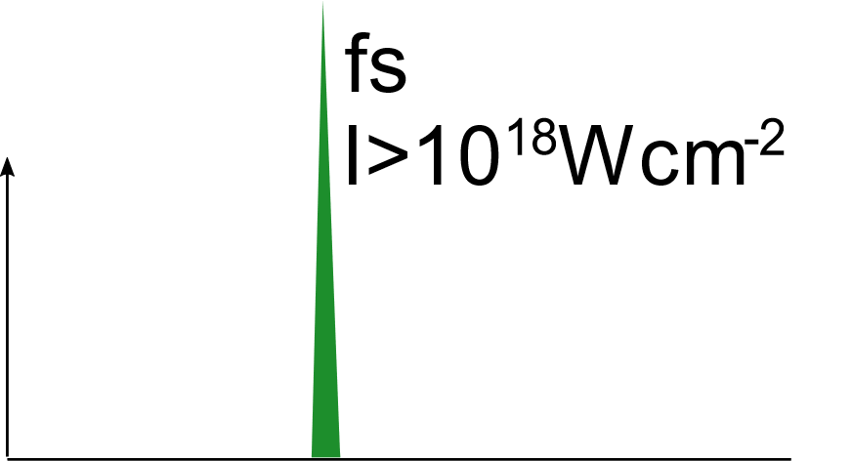
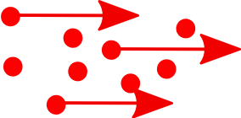
Laser-plasma acceleration: a simple introduction
, ps
Ions⁺
Ions⁺
Suprathermal electrons
1. Plasma generation
2. Laser energy absorption by plasma electrons
Collisional processes (I < 10¹⁵ W cm⁻²)
Collisionless processes (resonance absorption, vacuum heating, J$×$B heating)
2.1. electrons transport through the dense target
A. Macchi et al., Rev. Mod. Phys. 85 (2013) 751, H. Daido et al., Reports Prog. Phys. 75 (2012) 056401 and references there in

Slide 4
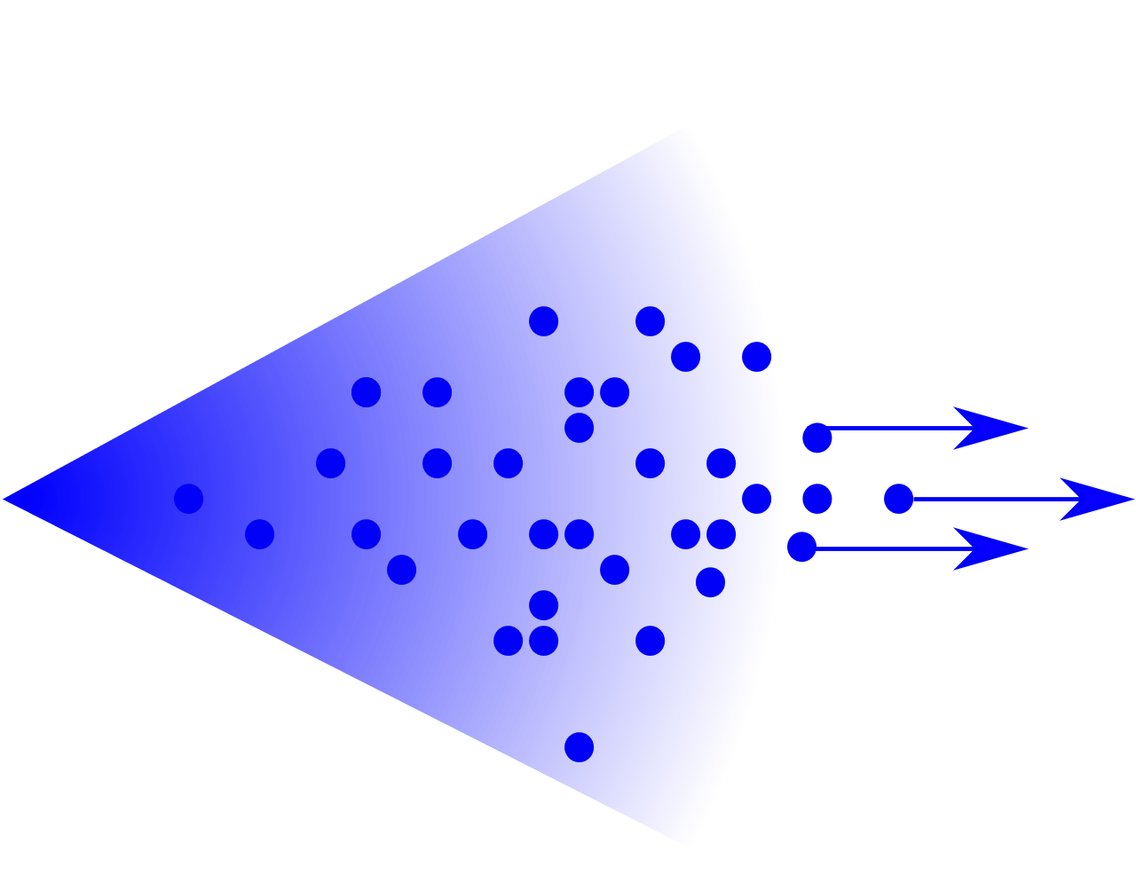
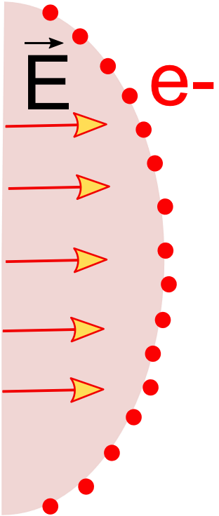
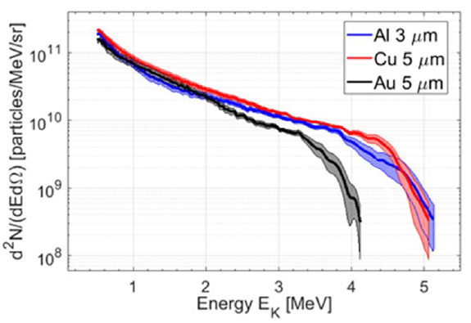
Laser-plasma acceleration: a simple introduction
3. The escaping electrons will give rise to an electrostatic potential derived by the charge-separation between themselves and the positively charged target.
4. The oncoming electrons are thus going to be confined under Coulombic forces to a Sheath field, directed as the Target Normal, that extends for a distance $λ_{D}$ and reaches an intensity of the order of TV/m.
+
5. The intensity of this electric field is high enough to ionize the atoms present at the rear surface of the target.
$$λ_{D}≃1 μm$$
$$E∼TV/m$$
6. These ions, which are subjected to an intense electric field, will be then accelerated to the order of MeV energies. Protons, having the highest charge to mass ratio, are in the most favorable condition for Acceleration
Proton energy up to a few tens of MeV
Short proton bunch duration at the source (fs-ps)
Charge of a few nC
Conical beam of tens of degrees ($≃$ 20°)
The spectrum can be approximated with a Maxwellian
Highest energy → lower flux
We need a suitable
diagnostic system!
P. Puyuelo-Valdes et al.
Sci. Rep. 11:9998 (2021)
A. Macchi et al., Rev. Mod. Phys. 85 (2013) 751, H. Daido et al., Reports Prog. Phys. 75 (2012) 056401 and references there in

Slide 5
Diagnostic system requirements
The ideal diagnostic system should have:
High sensitivity
High energy resolution
and should allow to retrieve:
Spectrum of accelerated ions
Angular distribution of accelerated ions
but it also has to provide:
Electro Magnetic Pulses (EMPs) robustness
Real-time detection and characterization of ions
Layered Imaging systems (RCF, Imaging plates…)
Solid state nuclear track detectors
Thomson spectrometers
Electrostatic-magnetostatic spectrometers
Time Of Flight technique

Slide 6
Diagnostic system requirements
The ideal diagnostic system should have:
High sensitivity
High energy resolution
and should allow to retrieve:
Spectrum of accelerated ions
Angular distribution of accelerated ions
but it also has to provide:
Electro Magnetic Pulses (EMPs) robustness
Real-time detection and characterization of ions
Layered Imaging systems (RCF, Imaging plates…)
Solid state nuclear track detectors
Thomson spectrometers
Electrostatic-magnetostatic spectrometers
Time Of Flight technique

Slide 7
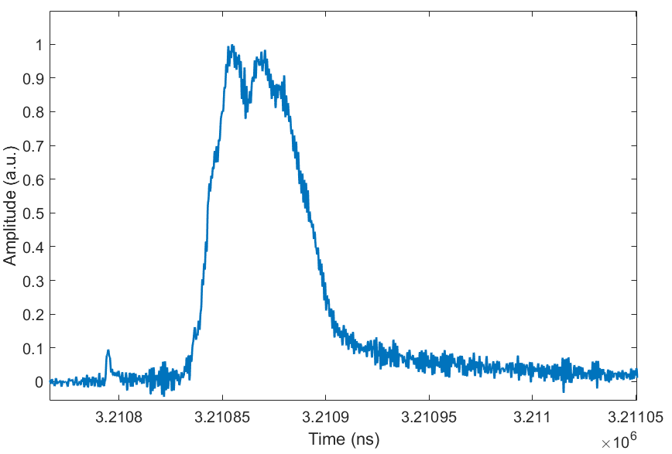
The Basics of Time-Of-Flight (TOF)
TOF technique relies on the measurement of the time needed by a particle to travel for a known distance
The temporal position T₀ of the photopeak provides a reliable signature of the laser-matter interaction instant
$$t_{bang}=T_{0}−\frac{d}{c}$$
Photons, c
Ions
Ion, v₁
Ion, v₂ < v₁
Particle energies are computed evaluating the delay between the signal detection time and $t_{bang}$
Photopeak
time
$v=\frac{d}{t_{i}−t_{bang}}$
$$E_{i}=\left(γ_{i}−1\right)m_{i}c^{2}$$
Accelerating potential: temporal window with pure proton contribution
$∆t_{i}= t_{pM}\left(\sqrt{\frac{A_{i }}{Z_{i}}}−1\right)$ $≥{ t}_{pM}\left(\sqrt{2}−1\right)$
T₀
Or in terms of proton energy: $∆E_{p}≥ E_{pM}/2$

Slide 8
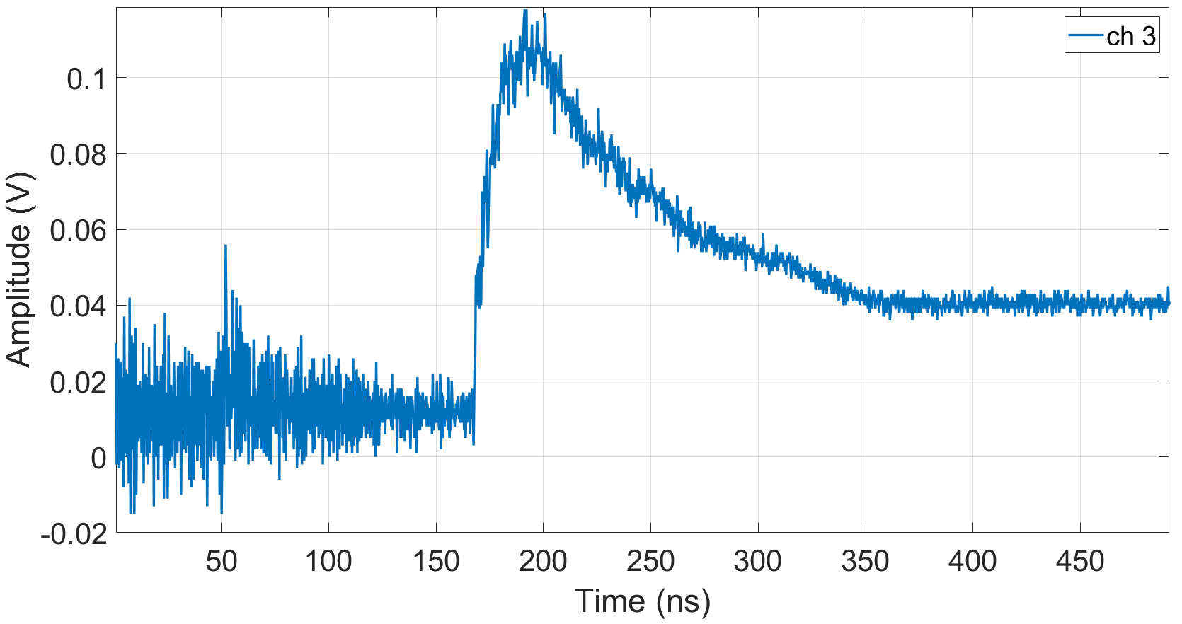
Challenges in TOF: EMP and Dynamic Range
Typical signal from Time Of Flight in Laser-Plasma environment
TOF signals have an intrinsic high dynamic range.
X-rays peak
Ion signal
It is necessary to develop a technique able to appreciate the full dynamic range
EMP pollution hinders the employment of TOF in high energies facilities
It is necessary to optimize the system to work in these environments
Low precision in defining T₀
Poor energy resolution
Poor Signal to Noise Ratio

Slide 9
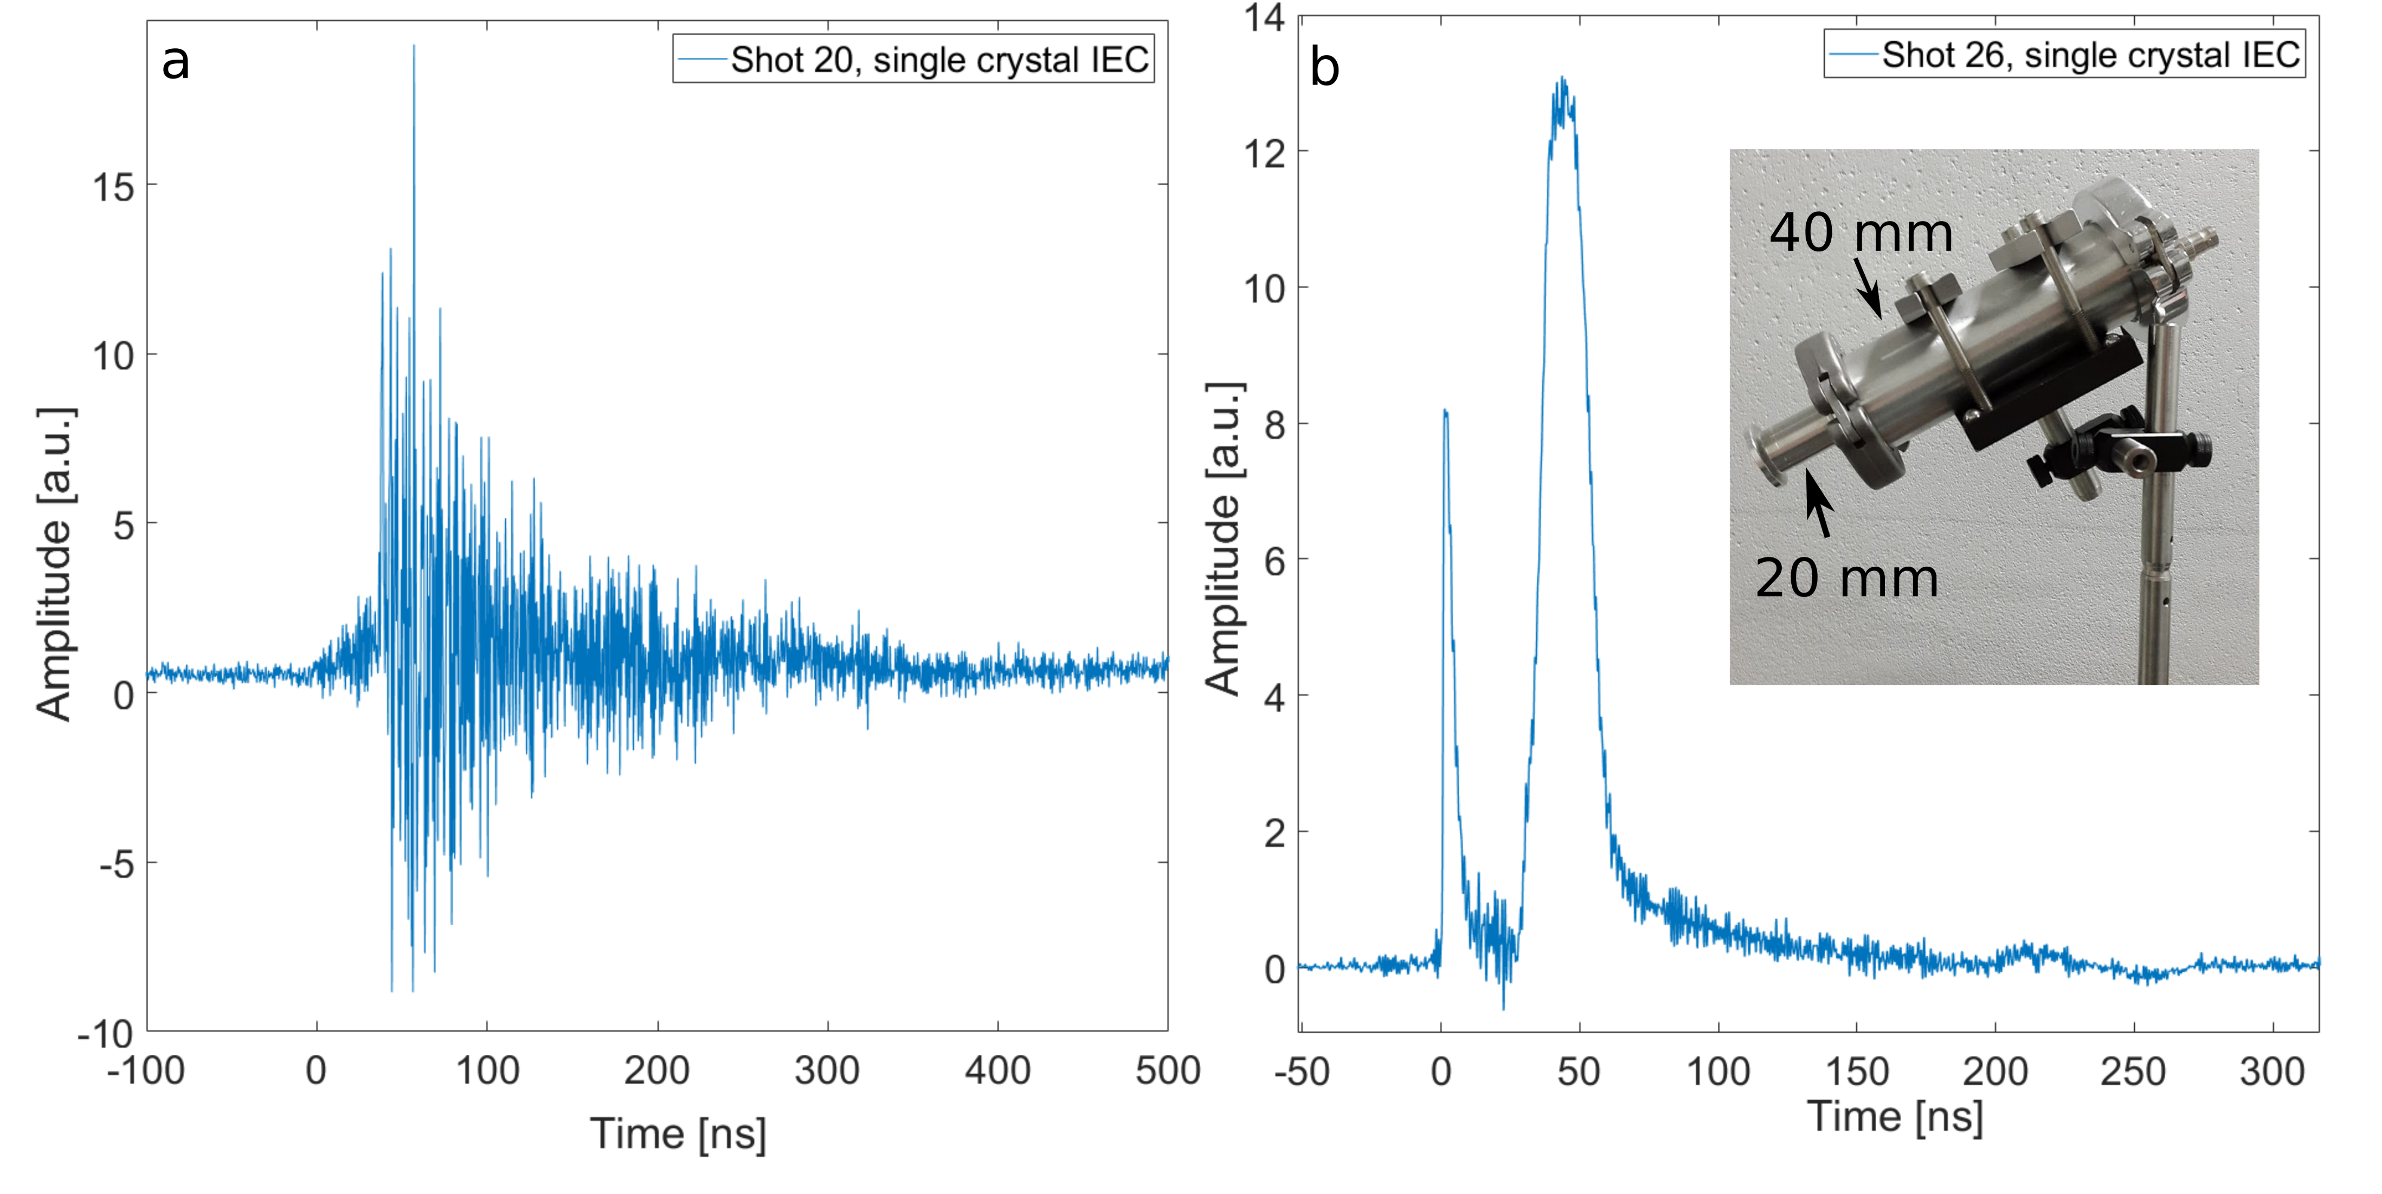
Challenges in TOF: EMP and Dynamic Range
FLAME
E = 2.5 J
$I= 1.7×{10}^{19}$ W ${cm}^{−2}$
PHELIX
E = 88 J
$I=2.5×{10}^{19}$ W ${cm}^{−2}$
τ = 25 fs
Target : 10 µm Al
τ = 750 fs
Target: 10 µm Titanium

Slide 10
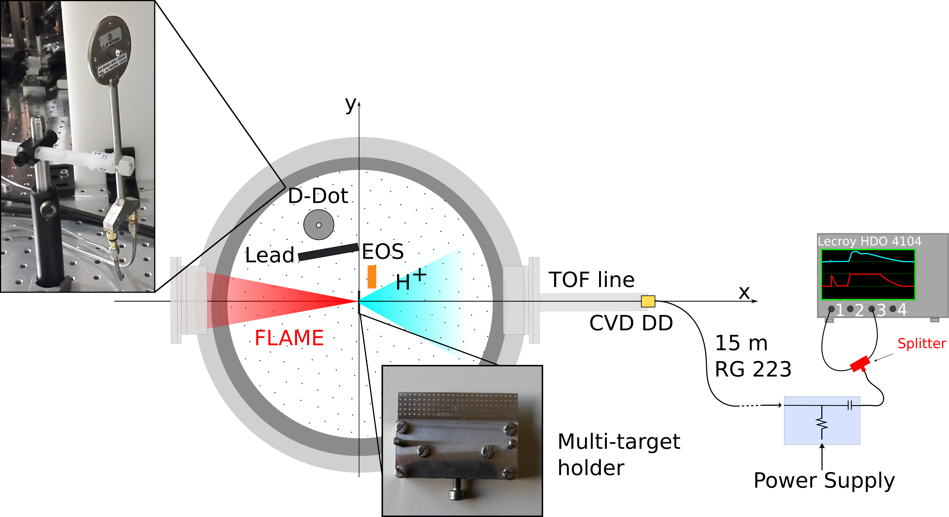
Challenges in TOF: EMP and Dynamic Range
Broadband EMP spectra
Associated electric field at 30 cm: 25 kV/m
Coupling with the detection system
Coupling with the acquisition system
FLAME
E = 2.5 J
$I= 1.7×{10}^{19}$ W ${cm}^{−2}$
τ = 25 fs
Target : 10 µm Al
M. Salvadori et al., JINST 15, C10002 (2020)
F. Consoli et al., Scientific Reports 9, 8551 (2019)
F.Consoli et al. High-Power Laser Science and Engineering 8, e22 2020)

Slide 11
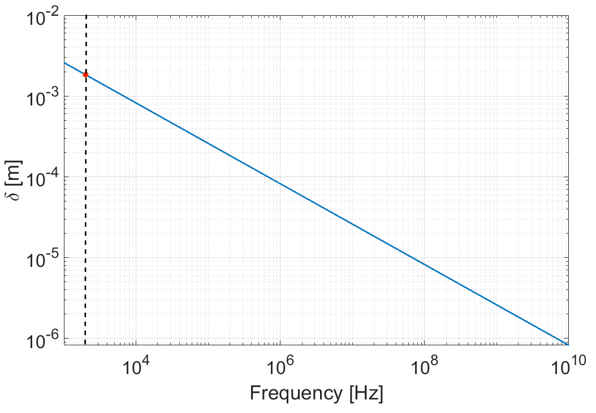
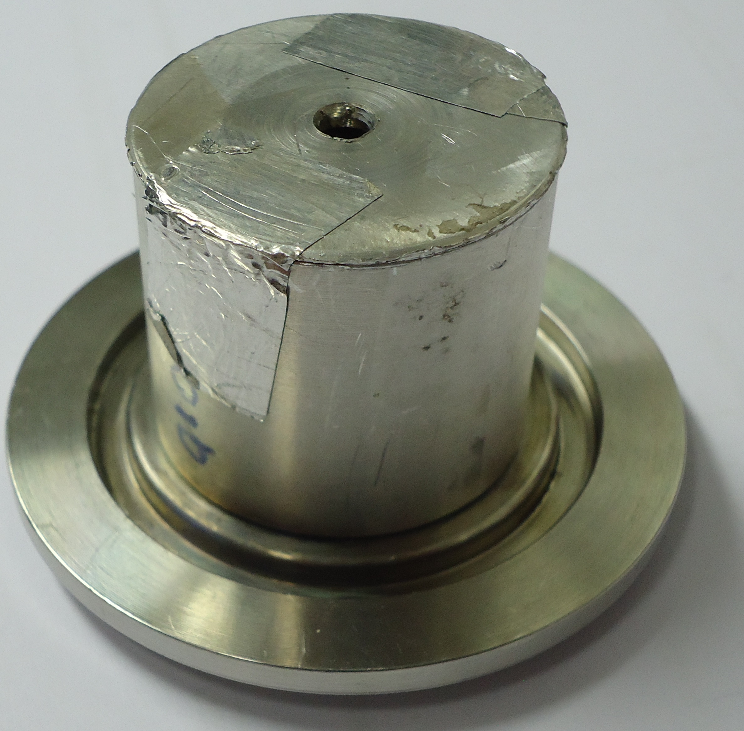
Detection system optimization
Skin depth for aluminum
Developing a proper shielding
Compact metallic enclosure: exploting skin effect
$$δ=\sqrt{\frac{ρ}{πfμ_{r}μ_{0}}}$$
$$E\left(z\right)∝E_{0}e^{−\frac{z}{δ}}$$
$ρ$ resistivity; $μ_{r}$permeability
The 2 mm Al enclosure attenuate EM waves with frequencies down to 2 KHz
M. Salvadori et al. Scientific Reports 11, 3071 (2021)

Slide 12
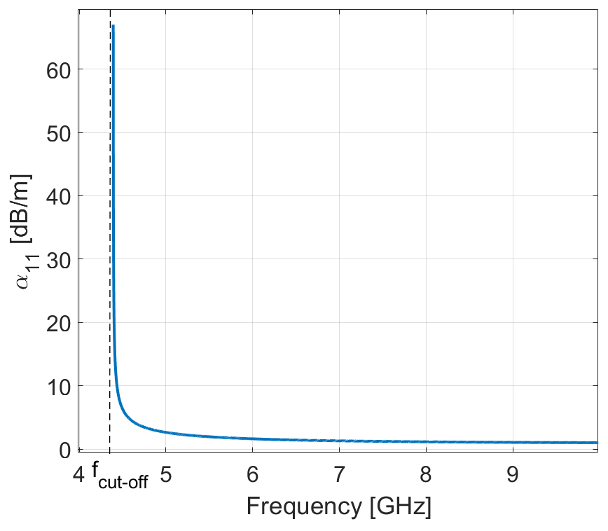
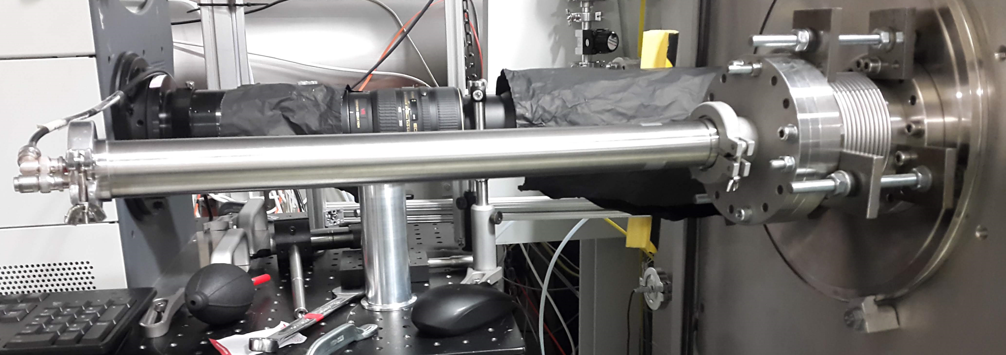
Detection system optimization
Exploiting the attenuation provided by waveguides
1. Cutoff frequency
2. Attenuation of the propagating EM waves:
$$E\left(z\right)∝E_{0}e^{−α_{m,n}z}$$
40 mm Aluminum pipe
Skin depth
Geometrical parameters
Material conductivity
M. Salvadori et al. Scientific Reports 11, 3071 (2021)

Slide 13
Acquisition system optimization
Scattering parameter S₂₁ Transmission coefficient
Long double shielded coaxial cables
Provide high frequency attenuation,
Introduce a temporal delay between the TOF signal and the EMP contribution,
Allow to place the scope far from the experimental chamber.
Scope with minimal bandwidth to reduce coupling with high frequency electromagnetic pulses.
M. Salvadori et al. Scientific Reports 11, 3071 (2021)

Slide 14
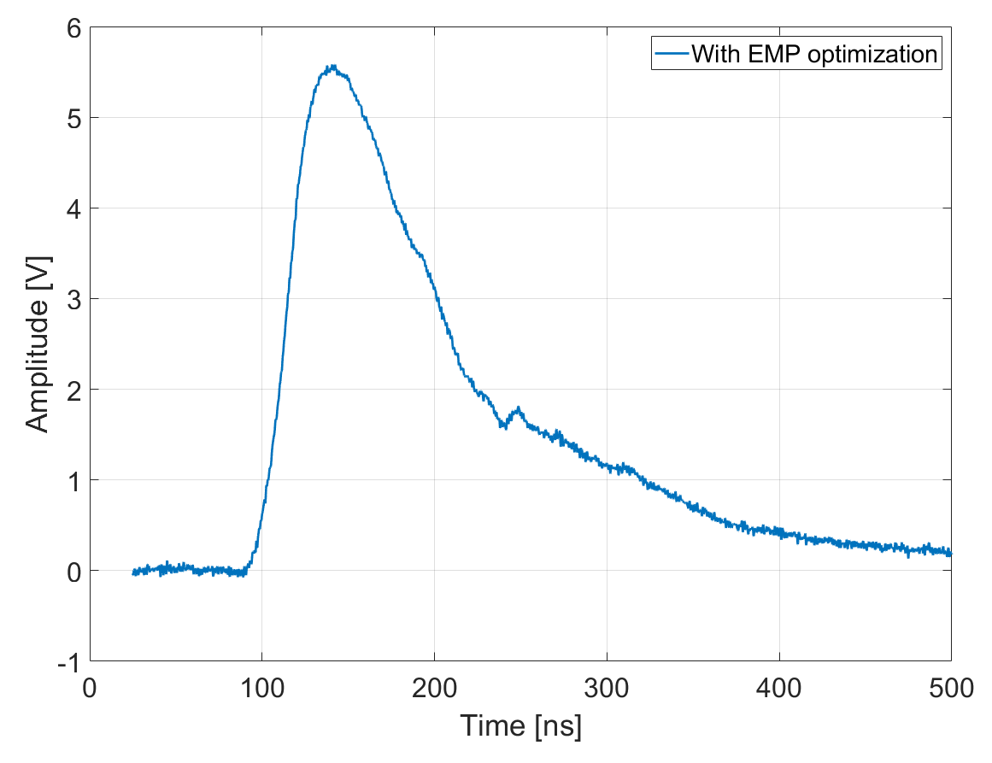
Dynamic range enhancement
Raw signal: no numerical filtering technique is used!
Where is the photopeak?
Need a higher dynamic range of the acquisition system

Slide 15
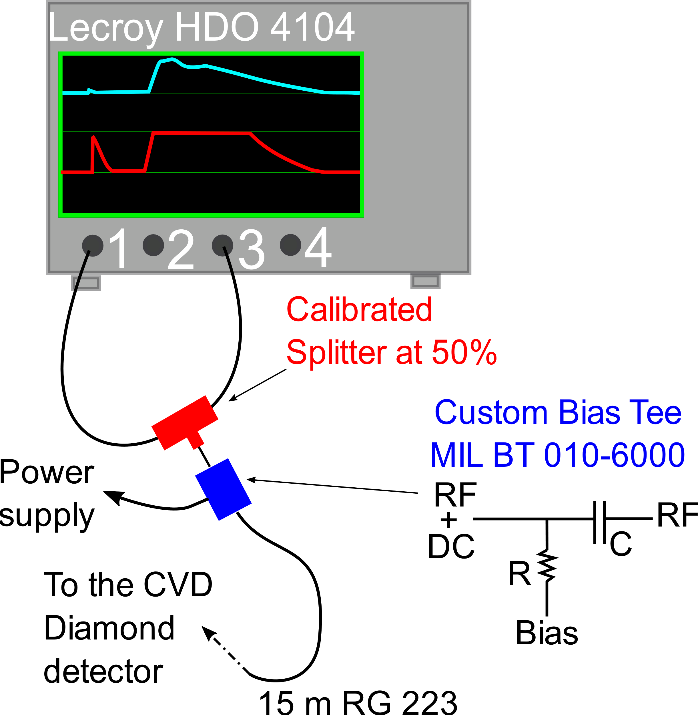
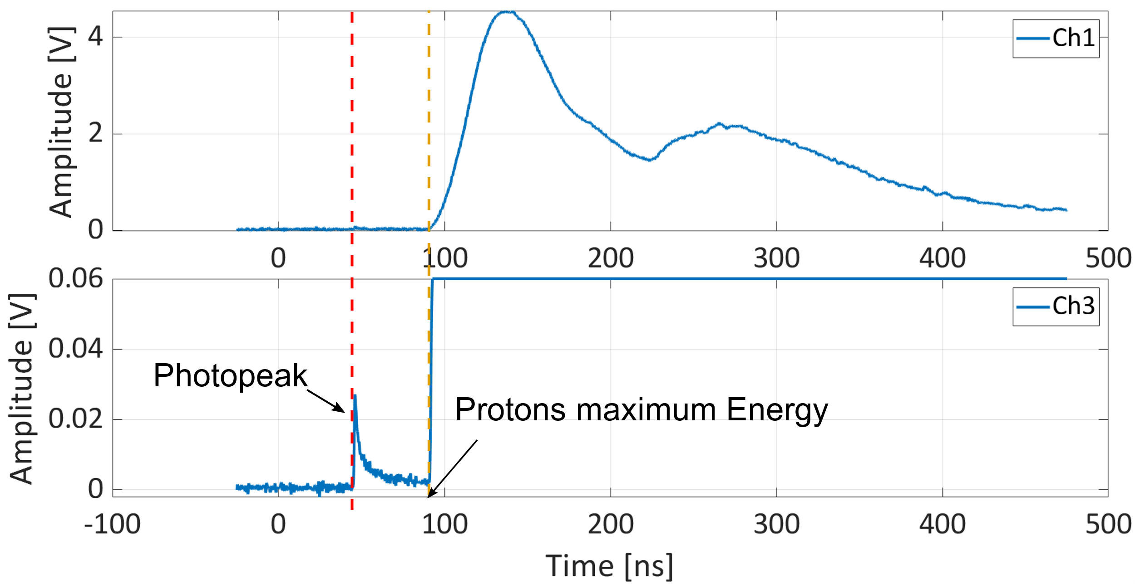
Dynamic range enhancement
M. Salvadori et al. Scientific Reports 11, 3071 (2021)

Slide 16
The spectrum reconstruction
01
SIGNAL
ACQUISITION
Acquisition and diagnostic system optimization for EMP robustness
Enhanced dynamic range
Enabling high-repetition rate measurements
02
ENERGY
PARTICLE
SPECTRUM
ESTIMATION
Measure the Time-Of-Flight of particles
Compute their velocity
Retrieve their energy
03
NUMBER
COMPUTATION
De-embedding procedure to retrieve the amplitude at the source
Characterization of the Detector used for TOF measurements
Particle number estimation from the signal amplitude
M. Salvadori et al. Scientific Reports 11, 3071 (2021)

Slide 17
1. De-embedding: signal at source
What we need
What we have
Obtained characterizing the transmission line by means of a Network Analyzer
M. Salvadori et al. Scientific Reports 11, 3071 (2021)

Slide 18
Detector characterization
The detectors that can be used in the time-of-flight scheme can be grouped in three categories:
Electrostatic detectors (i.e. Faraday Cups)
Scintillators coupled to vacuum phototubes
Semiconductor detectors
Wide bandgap (5.5 eV)
High charge carrier mobility
High breakdown field
Diamond Detectors
Not sensible to visible and IR light High radiation hardness
Fast time response
Low leakage current

Slide 19
2. Detector characterization: Diamond detectors
Carriers drift velocity
mobility, Electric field
E
(> 1 MV/m)
$$∝$$
1. Production of free electron-hole pairs ($ε_{g}$ = 13.1 eV).
2. Charge collection at the electrodes
$$Q_{i,c}= N_{i}\frac{E_{i}q_{e}}{ε_{g}CCE(E_{i})}$$
3. Signal Generation according to the collected charge
Charge Collection Efficiency
C. Verona et al. , J. Appl. Phys. 118 (2015) 184503,
R. Sussmann CVD diamond for electronic devices and sensors, Wiley and Sons (2009)

Slide 20
2. Detector characterization: Diamond detectors
Carriers drift velocity
mobility, Electric field
E
(> 1 MV/m)
$$∝$$
1. Production of free electron-hole pairs ($ε_{g}$ = 13.1 eV).
2. Charge collection at the electrodes
$$Q_{i,c}= N_{i}\frac{E_{i}q_{e}}{ε_{g}CCE(E_{i})}$$
3. Signal Generation according to the collected charge
Charge Collection Efficiency
C. Verona et al. , J. Appl. Phys. 118 (2015) 184503,
R. Sussmann CVD diamond for electronic devices and sensors, Wiley and Sons (2009)

Slide 21
2. Detector characterization: Diamond detectors
Single crystal structure: 1. Allow to have high CCE 2. Allow to have fast temporal response 3.Small area detectors
50 µm thickness: Protons up to 3 MeV are completely stopped inside the detector, higher energies require a correction factor.
Different electrodes layout for different needs!
C. Verona et al., JINST 15, C09066 (2020)

Slide 22
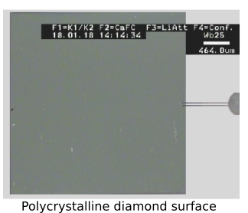
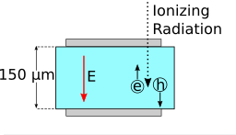
2. Detector characterization: Diamond detectors
Type: IIa-Electronic grade
15 mm
Polycristyalline structure:
Allow to have large area detectors
CCE lower than single crystal structures
Lower temporal response than single crystal structures
15 mm
Wide active surface:
Enhanced sensitivity
More susceptible to direct EMP coupling
150 µm thicnkess:
Suitable for protons up to 6 MeV
For higher energies a correction factor must be introduced

Slide 23
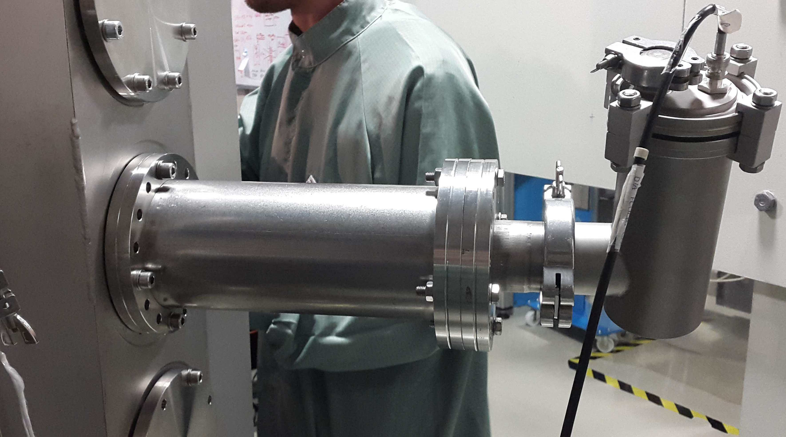
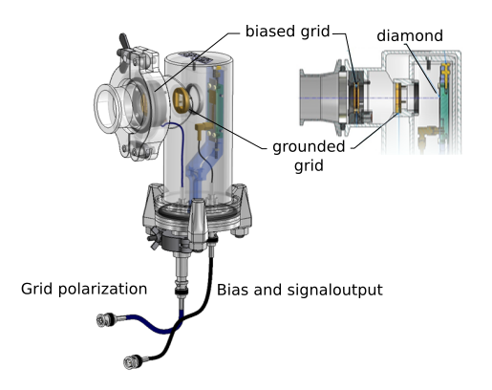
2. Detector characterization: Diamond detectors
The detector assembly mounted on the PHELIX chamber
ions
Diamond
detector

Slide 24
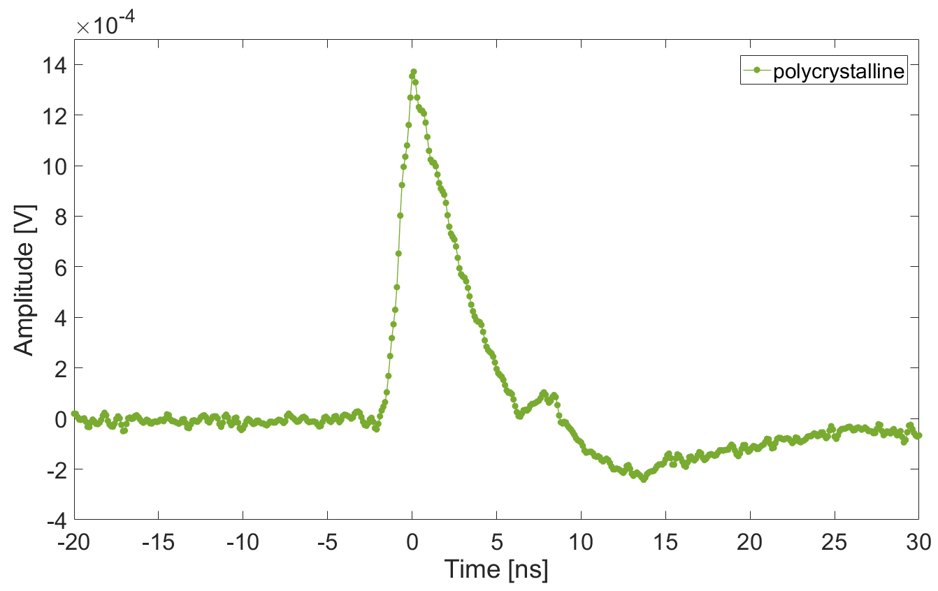
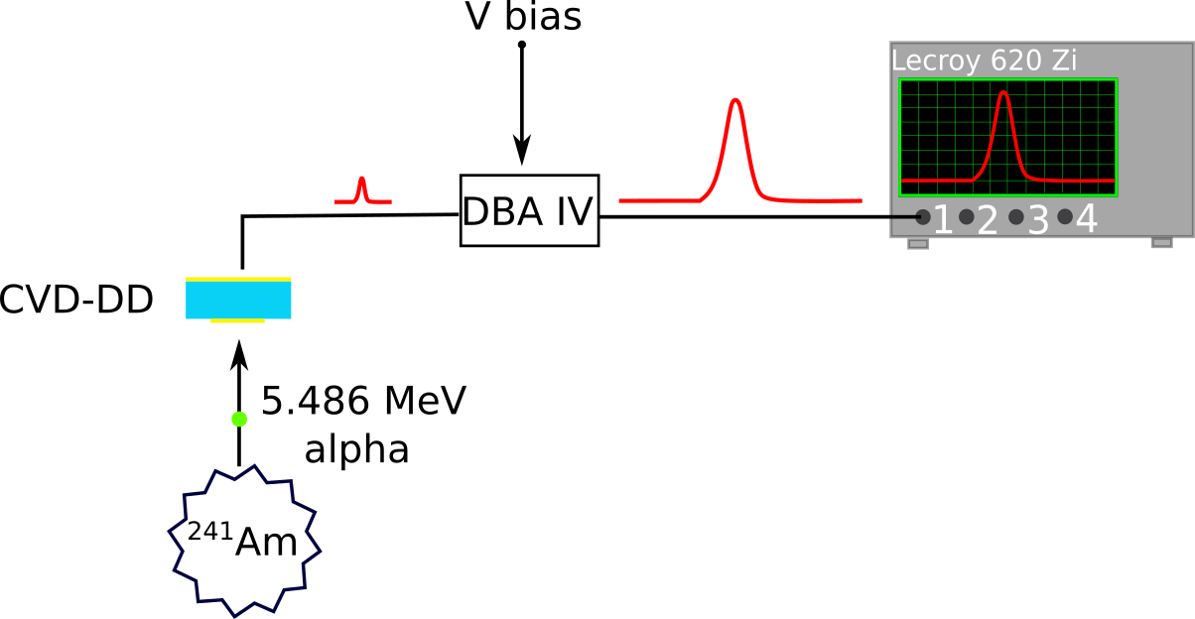
2. Detector characterization: Diamond detectors
FWHM = 3.4 ns
CCE ≈ 30 %
$$Q_{α,g}= N_{i}\frac{E_{i}q_{e}}{ε_{g}}$$
$=\frac{{5.486×{10}^{6}q}_{e}}{13.1}$ $≃$ $6.75×{10}^{−14}C$
$$Q_{α,c}= N_{i}\frac{E_{i}q_{e}}{ε_{g}CCE(E_{i})}$$
$$C$$
$≃2.06×{10}^{−14}$

Slide 25
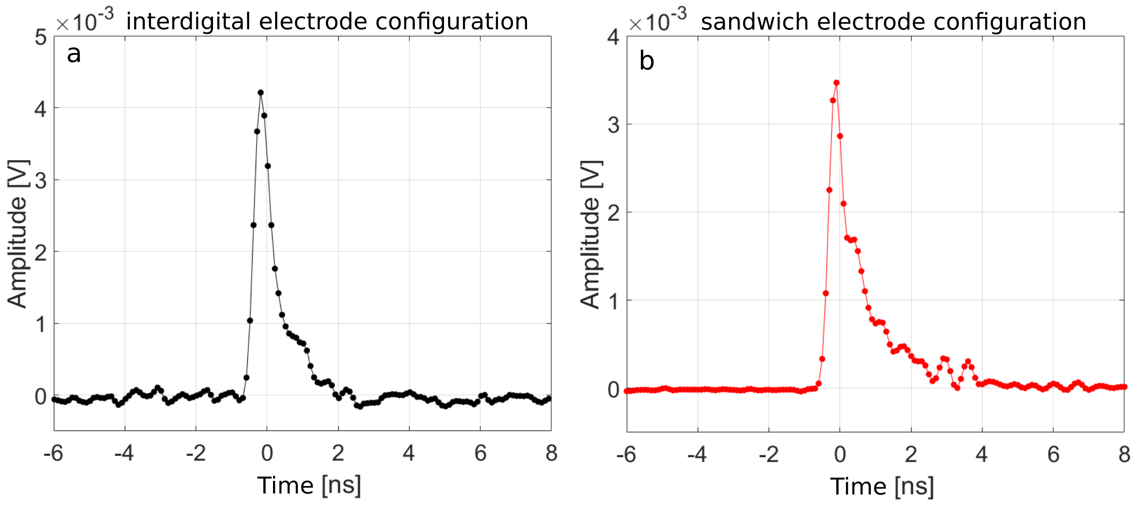
2. Detector characterization: Diamond detectors
FWHM = 520 ps
FWHM = 460 ps
CCE = 70 %
CCE = 98 %
C. Verona et al., JINST 15, C09066 (2020)

Slide 26
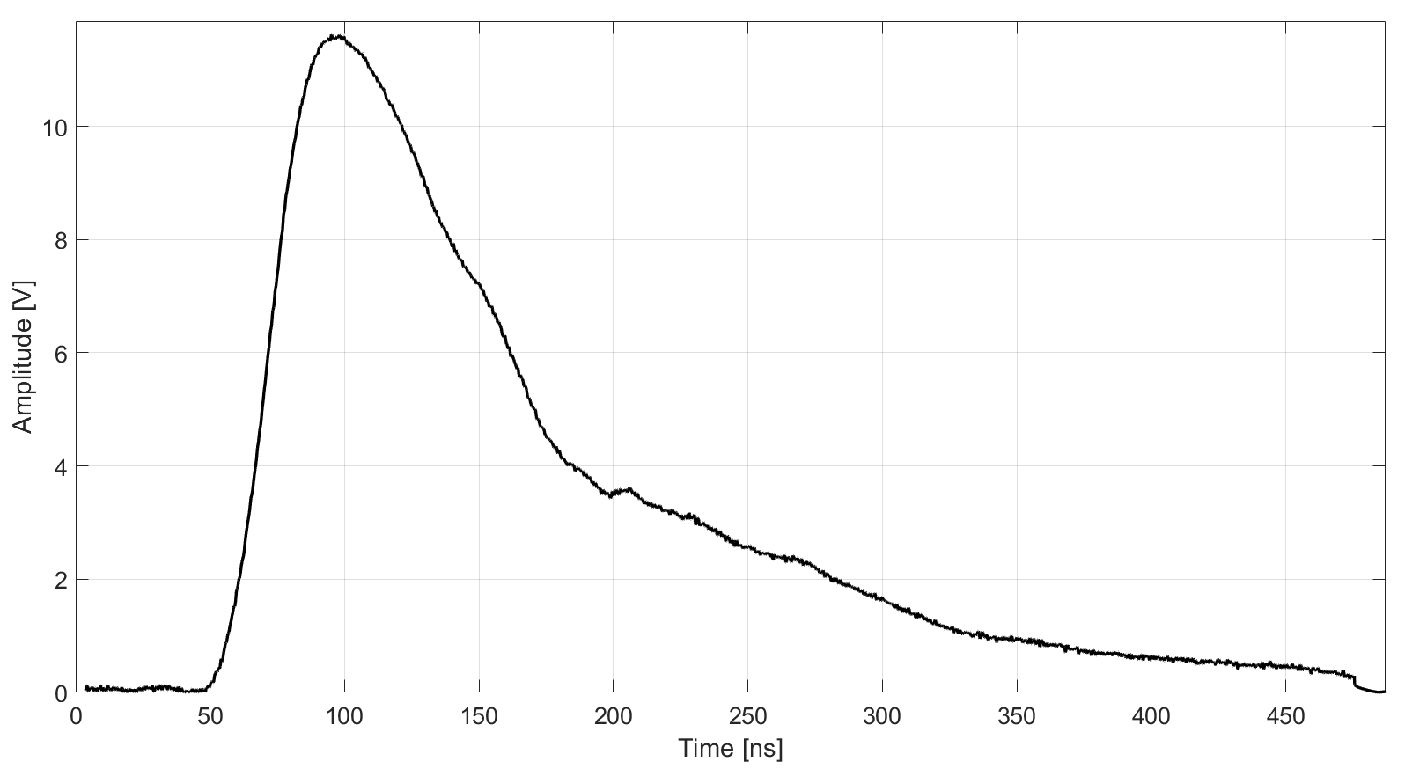
3. Particle number: the final spectrum
$E_{i}=\left(γ−1\right)m_{i}c^{2}$.
$$\frac{ΔE_{i}}{E_{i}}=\frac{m_{i}c^{2}}{E_{i}}\left(\frac{cΔt}{d}\right){\left[{\left(\frac{E_{i}}{mc^{2}}+1\right)}^{2}−1\right]}^{3/2}$$
FWHM
$Q_{i,c}=\frac{1}{R}\int_{t^{i}}^{t^{f}}{𝒮_{𝒟}\left(V\left(t\right)\right)dt}$
$$N_{i}= \frac{Q_{i,c}ε_{g}}{CCE\left(E_{i}\right)E_{i}q_{e}}$$
$\frac{ΔN_{i}}{N_{i}}=\frac{N_{i}\left(E_{i}^{f}\right)−N_{i}\left(E_{i}^{s}\right)}{N_{i}}$

Slide 27
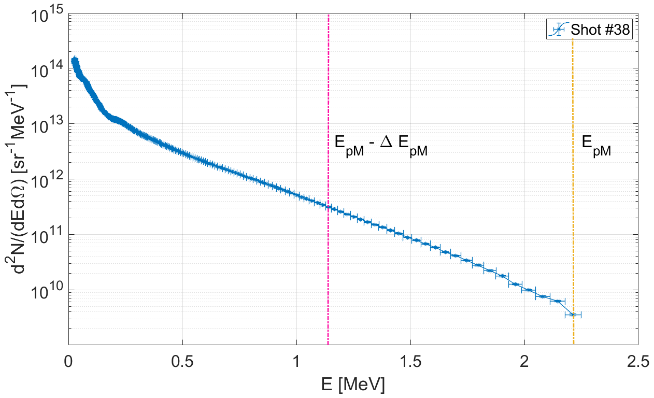
3. Particle number: the final spectrum
Proton spectrum
Ions accelerated by a potential
Energy range with pure proton contribution:
$$∆E_{p}≥ E_{pM}/2$$
Pure proton contribution
Application of suitable filters helps to down extend the region of pure proton contribution
FLAME
E = 2.5 J
$I= 1.7×{10}^{19}$ W ${cm}^{−2}$
τ = 25 fs
Target : 10 µm Al

Slide 28
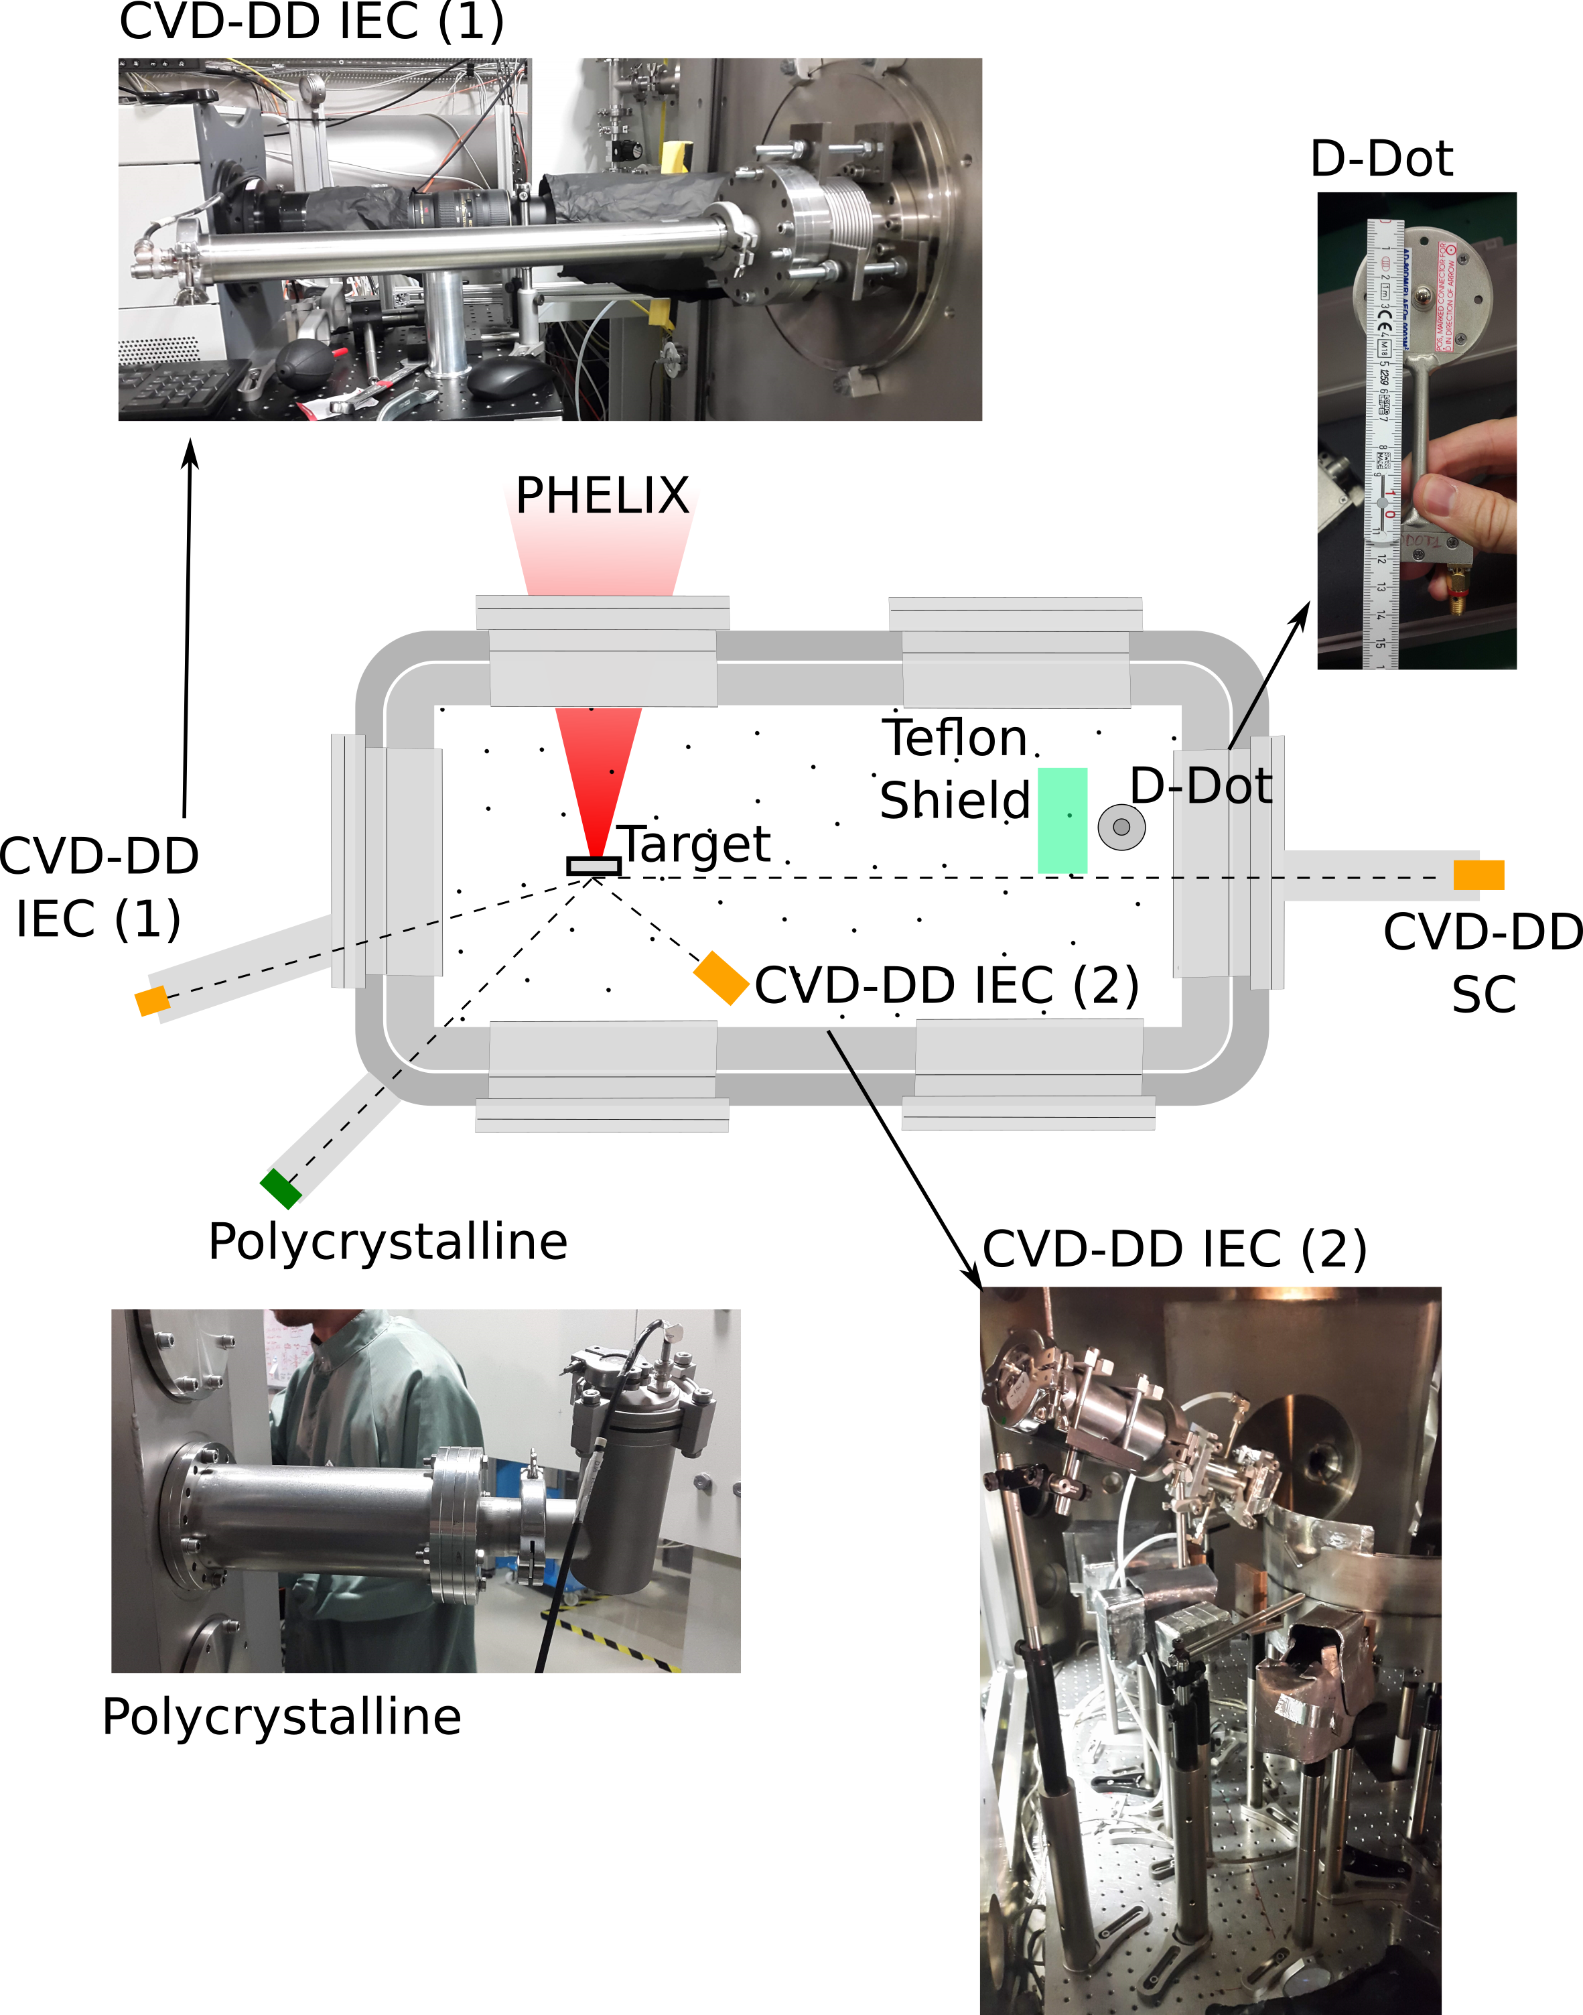
Experiment at PHELIX
10 µm Al filter
2 × 2 mm² area
FWHM = 520 ps
CCE ≈ 70 %
Provide information on
the EMP level
PHELIX
E = 88 J
$I=2.5×{10}^{19}$ W ${cm}^{−2}$
τ = 750 fs
Target: 300 µm TAC Foam 2 mg/cm³
20 µm Al filter
10 µm Al filter
15 × 15 mm² area
2 × 2 mm² area
FWHM = 3.4 ns
FWHM = 520 ps
CCE ≈ 30 %
CCE ≈ 70 %

Slide 29
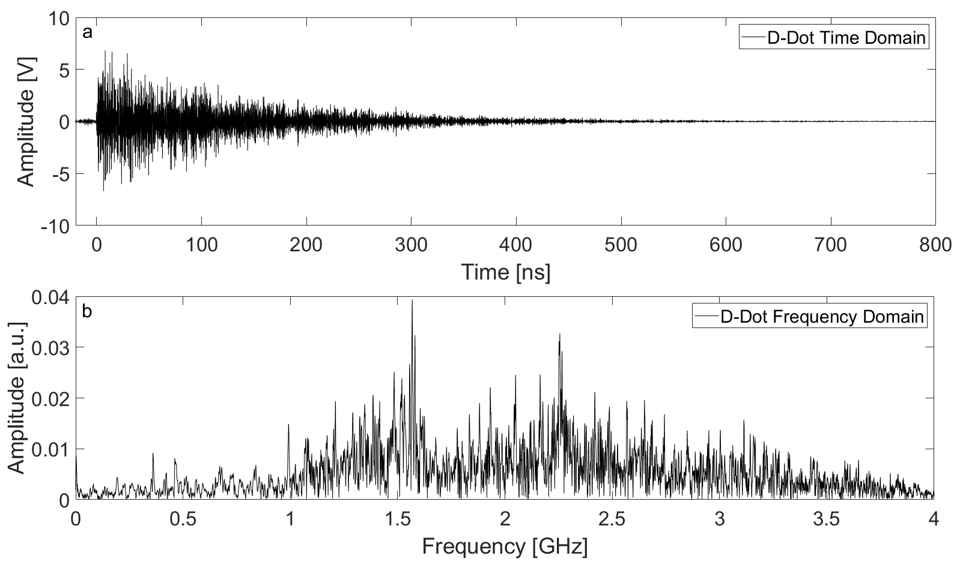
Experiment at PHELIX
Broadband spectra
Associated estimated electric field at ≈30 cm : 250 kV/m

Slide 30
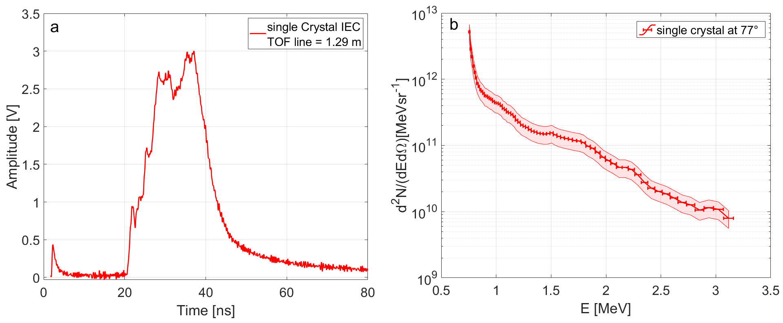
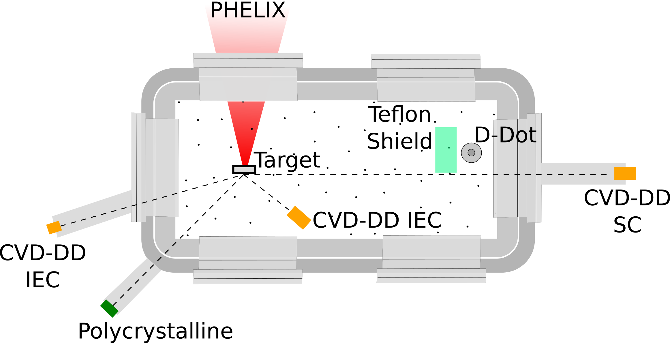
Experiment at PHELIX

Slide 31
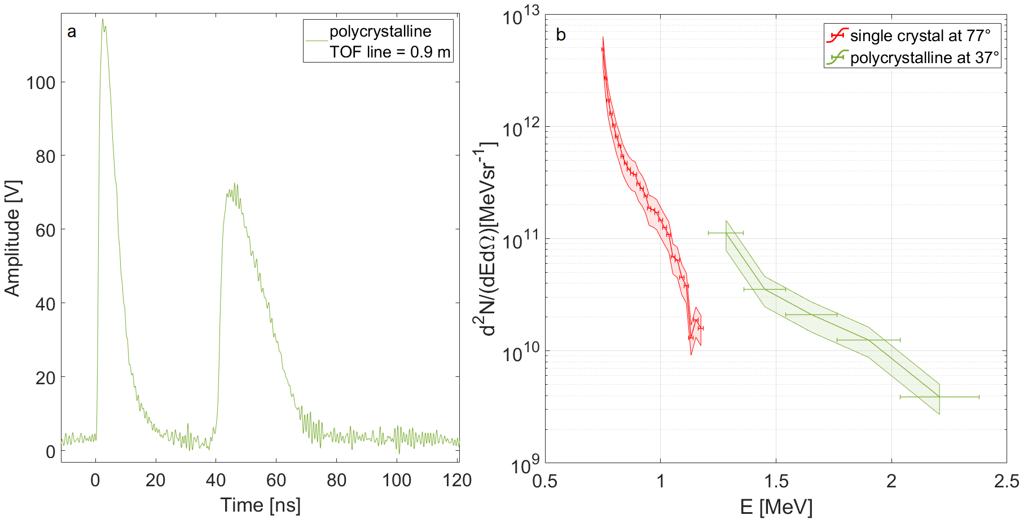
Experiment at PHELIX

Slide 32
Experiment at PHELIX
Detector inside the experimental chamber 60 cm from target

Slide 33
Talk summary
An advanced TOF diagnostic methodology was developed to cope with the high level of EMPs typically produced during laser-plasma interaction enabling the possibility to work at high repetition rate
The enhanced dynamic range of the methodology allow to appreciate the whole dynamic range of the signal resulting in an optimal identification of the minimum TOF delay
The technique was coupled with diamond detectors characterized by a wide band gap, a high charge carrier mobility and a fast temporal response resulting in measurement with a high energy resolution
Knowing the detector characteristics and the type of accelerated particles, the methodology allows for the reconstruction of a calibrated spectrum.
It has been shown how the advanced technique has been employed during an experiment performed at the PHELIX laser facility (GSI). Successful tests were also carried out in other environments strongly affected by EMPs :
PALS laser facility (up to 600 J, hundreds of ps pulse) High fluxes moderate energy ions
CLPU – Vega 3 (up to 25 J, tens of fs pulse) High energy ions with low fluxes

Slide 34
Thank you for your attention
Any questions?
Martina.salvadori@uniroma1.it
This work has been carried out within the framework of the EUROfusion Consortium and has received funding from the Euratom research and training programme 2014-2018 and 2019-2020 under agreement No 633053. The views and opinions expressed herein do not necessarily reflect those of the European Commission

Slide 35
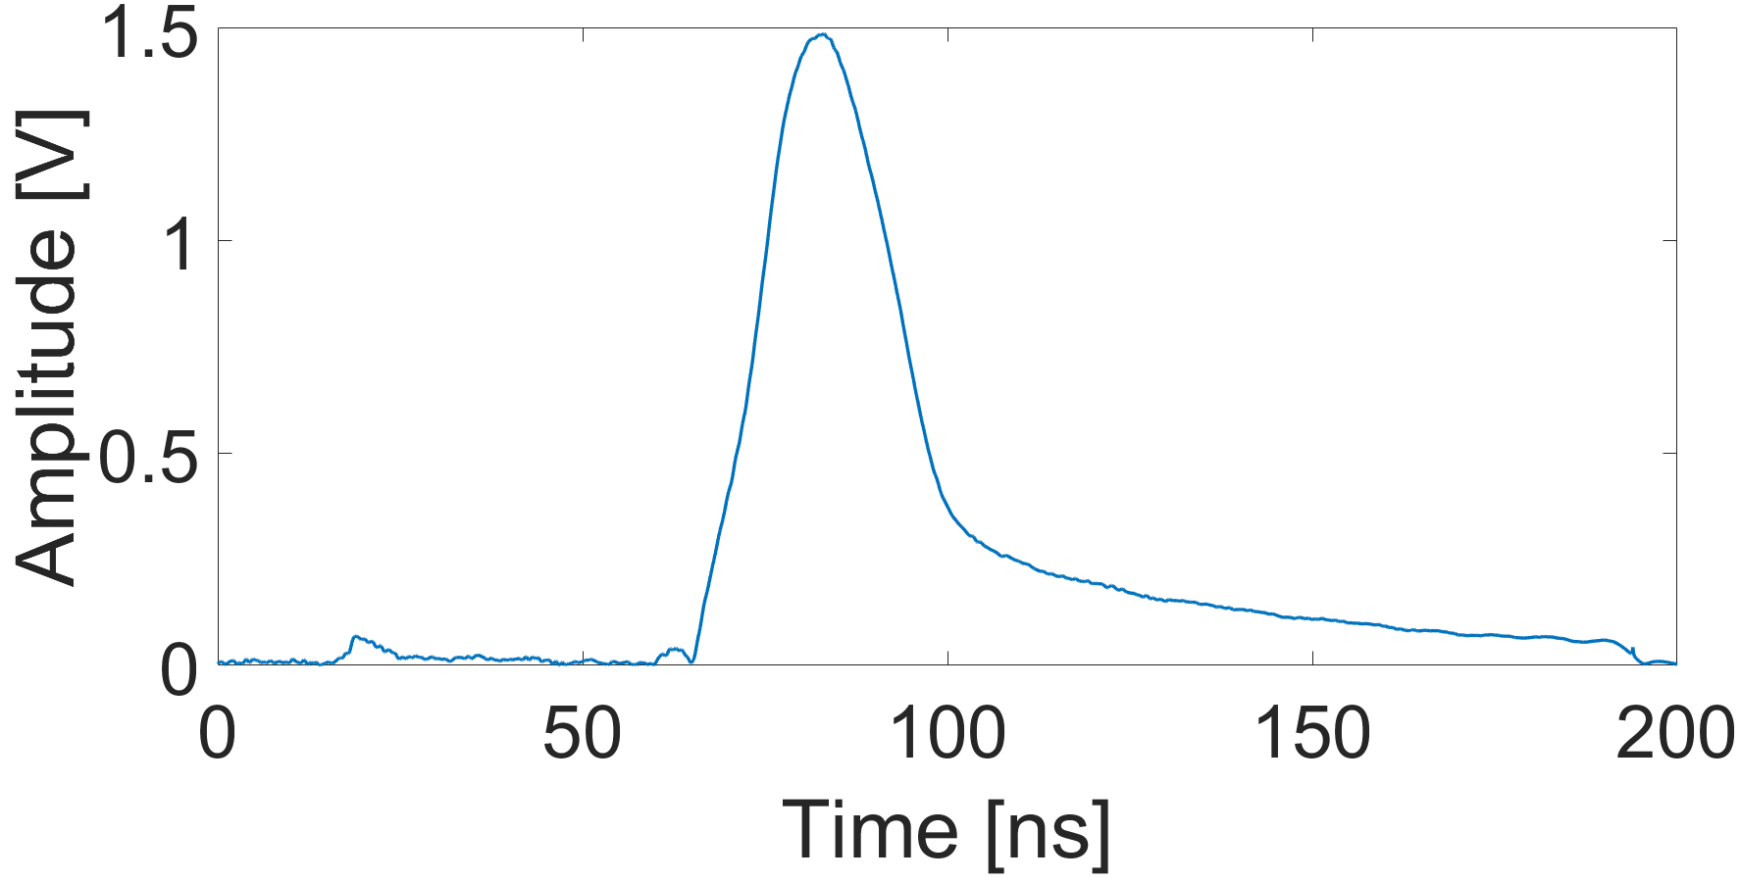
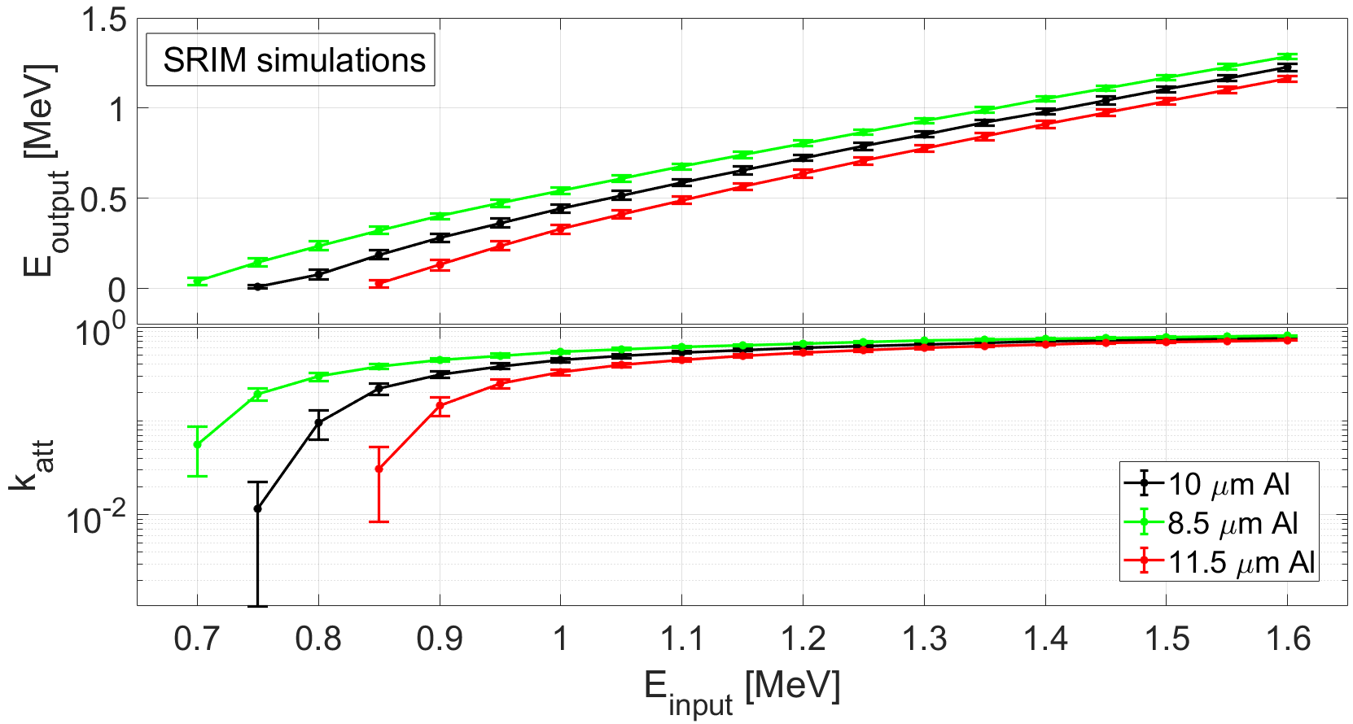
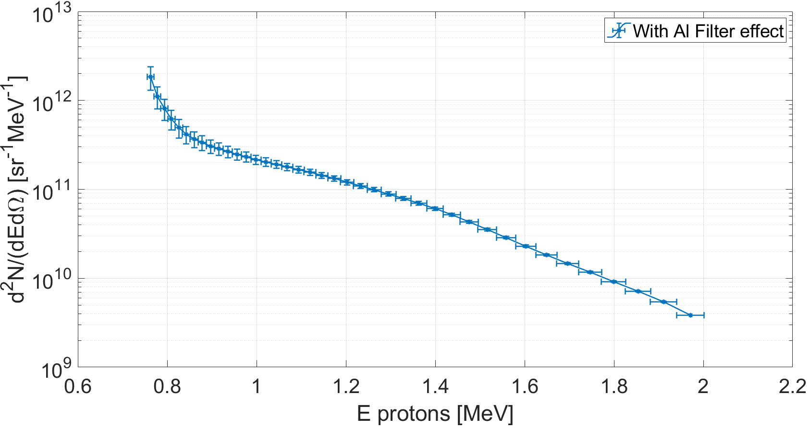
Back up – filter application
Al filter cut
Al filter cut
According to the performed SRIM simulations, (10±1.5) µm aluminium filter stops protons up to 750 keV and heavier ions.
SHOT #5
E_{L} on Target = 2.65 J

Slide 36
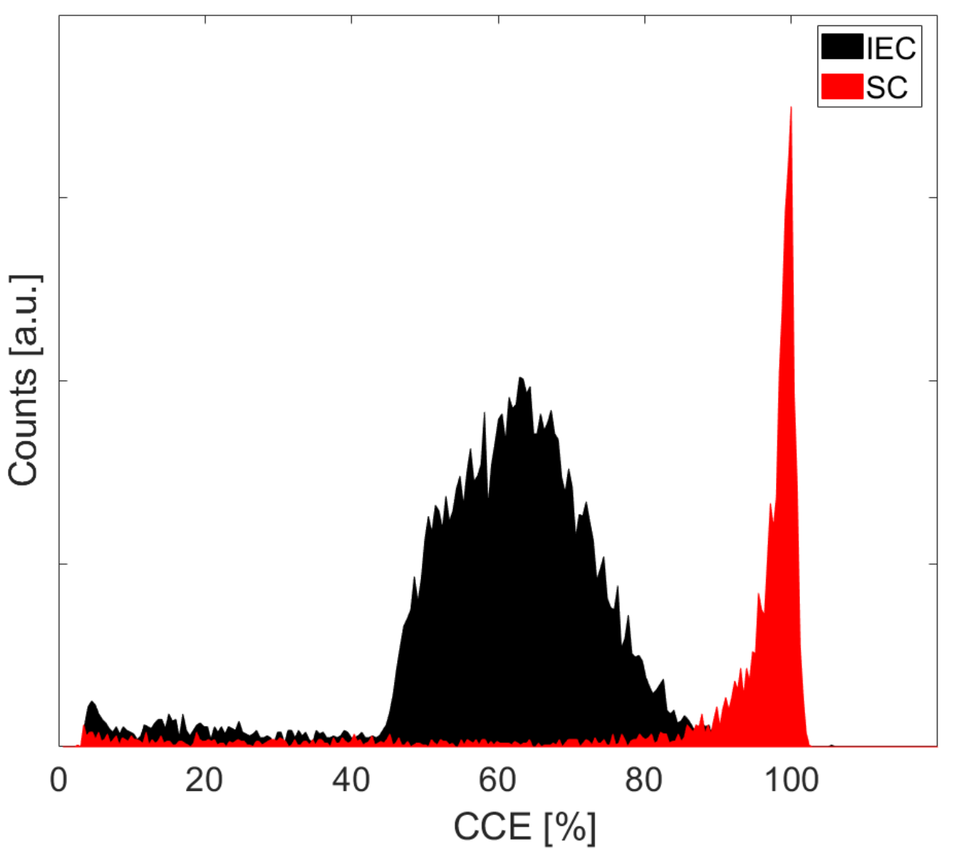
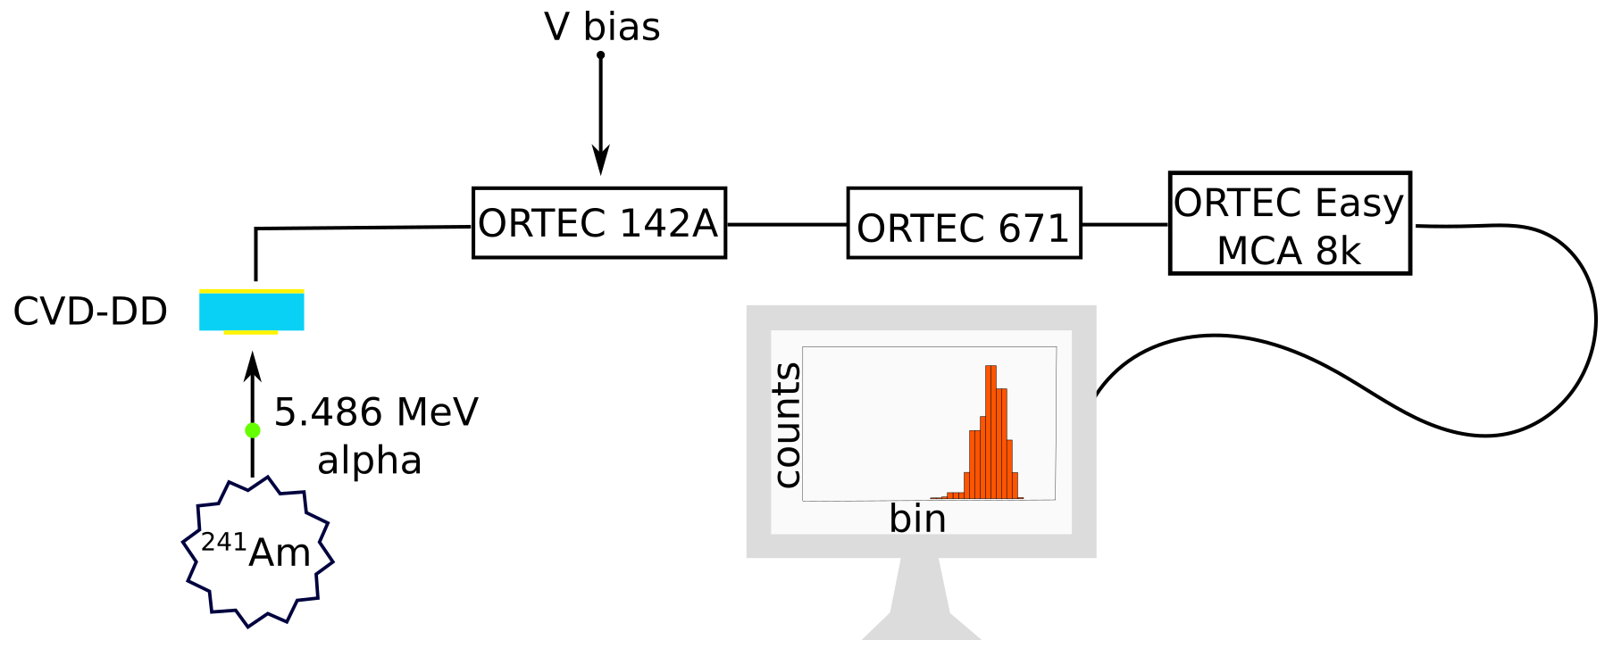
Back up – CCE calibration
Effect of a thickness-dependent electric field on CCE

Slide 37
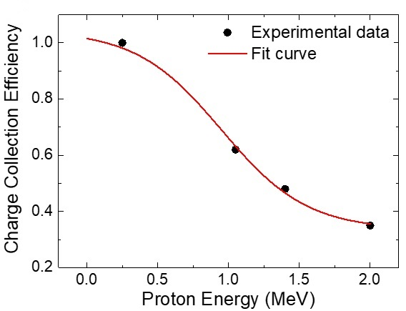
Back up – IEC calibration
Effect of a thickness-dependent electric field on CCE

Slide 38
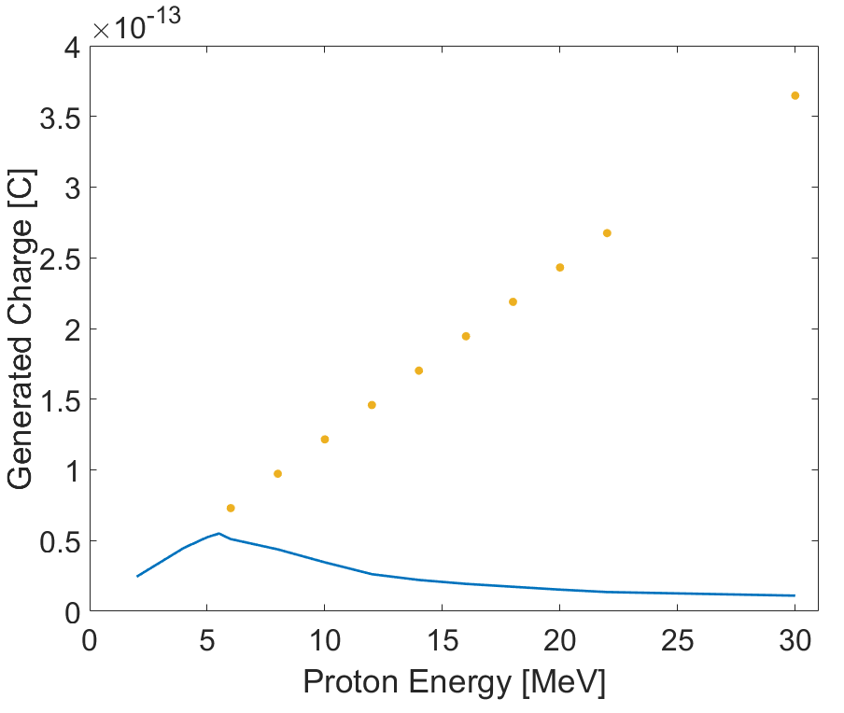
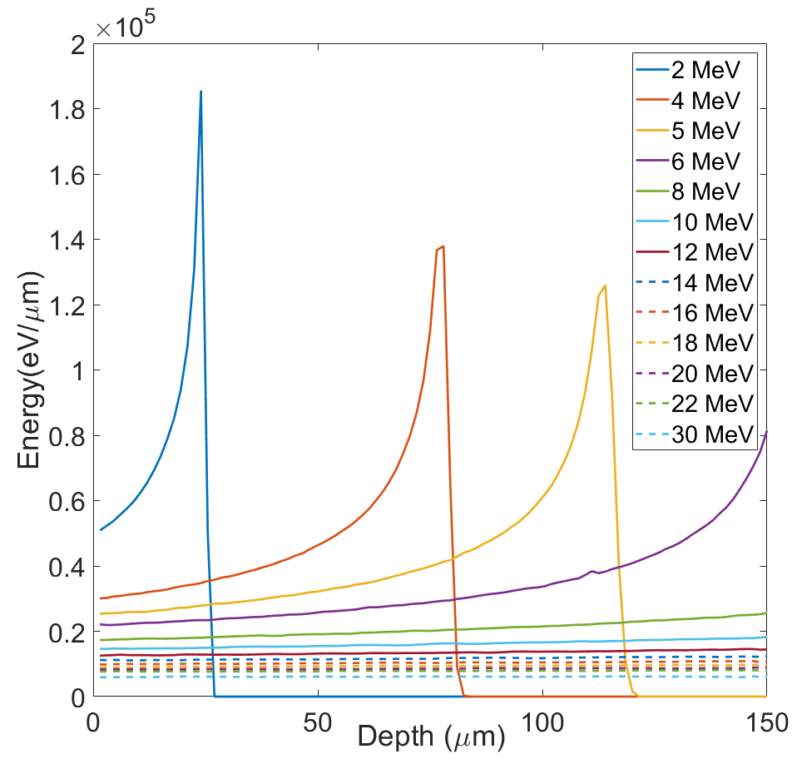
Back up – Correction factor (1)
Without thickness limit:
The whole energy is deposited in the detector
This amount of charge is generated
2 MeV
5 MeV
6 MeV
150 thick diamond layer:
Only a portion of the energy is deposited
This amount of charge is generated

Slide 39
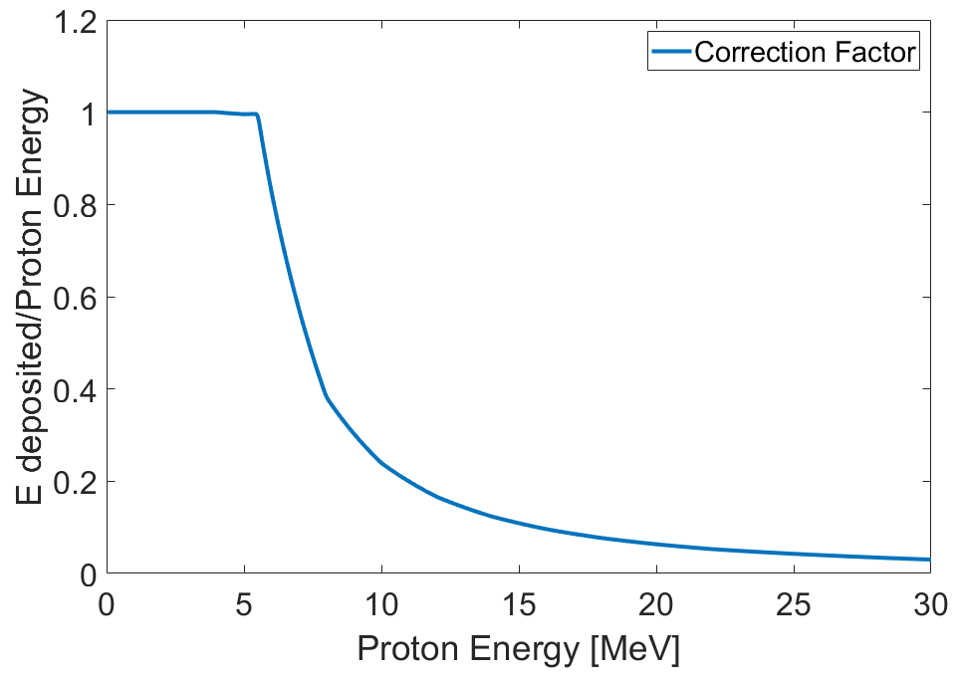
Back up – Correction factor (2)
The whole energy is deposited in the detector
Only a portion of the energy is deposited in the detector
$$N_{i}=Q_{i,c}\frac{ε_{g}CCE(E_{i})E_{i}q_{e}}{E_{i}{∗Correction Factor∗q}_{e}}$$

