Slide 1
Introduction to EAAC 2021
Ralph Assmann and Massimo Ferrario
20.9.2021

Slide 2
2021: Good News (some are EAAC helped outcomes)
Start of I-FAST project (European Network for Novel Accelerators and EAAC into 2025) → Yearly Meeting Thursday morning
Setup of expert panel for „High Gradient: Plasma and Laser Accelerators“ – one of 5 panels for European accelerator R&D → Special session on roadmap Tue PM/Wed AM.
Snowmass effort with advanced accelerators in Accelerator Frontier 6 (AF6). → Talk in special session on expert panel.
Placement of EuPRAXIA (only new accelerator project in EU) on ESFRI roadmap, >110 M€ funding obtained (next phase being prepared)
Plenty of new and exciting achievements in novel accelerator R&D → see talks

Slide 3
2021: Good News (some are EAAC helped outcomes)
Start of I-FAST project (European Network for Novel Accelerators and EAAC into 2025) → Yearly Meeting Thursday morning
Setup of expert panel for „High Gradient: Plasma and Laser Accelerators“ – one of 5 panels for European accelerator R&D → Special session on roadmap Tue PM/Wed AM.
Snowmass effort with advanced accelerators in Accelerator Frontier 6 (AF6). → Talk in special session on expert panel.
Placement of EuPRAXIA (only new accelerator project in EU) on ESFRI roadmap, >110 M€ funding obtained (next phase being prepared)
Plenty of new and exciting achievements in novel accelerator R&D → see talks

Slide 4
IFAST = Innovation Fostering in Accelerator Science and Technology
EU Project May 2021 – April 2025, Coordinator M. Vretenar
WP6: Novel Particle Accelerators Concepts and Technologies
Contains European Network for Novel Accelerators (EuroNNAc4) = Sponsor of EAAC

Slide 5
Tasks of WP6 – Novel Particle Accelerators Concepts and Technologies
Task 1 (RA + M. Ferrario): Novel Particle Accelerators Concepts and Technologies (NPACT – EuroNNAc4) M1 – M48 Sub-task leaders: B. Holzer (CERN), P. Nghie (CEA), A. Specka (CNRS), R. Walczak (Oxford)
Task 2 (Leo Gizzi): Lasers for Plasma Acceleration (LASPLA) M1 – M48
Task 3 (Cedric Thaury): Multi-scale Innovative targets for laser-plasma accelerators (MILPAT) M1 – M32
Task 4 (Francois Mathieu): Laser focal Spot Stabilization Systems (L3S) M1 – M36

Slide 6
WP6 Deliverables

Slide 7
2021: Good News (some are EAAC helped outcomes)
Start of I-FAST project (European Network for Novel Accelerators and EAAC into 2025) → Yearly Meeting Thursday morning
Setup of expert panel for „High Gradient: Plasma and Laser Accelerators“ – one of 5 panels for European accelerator R&D → Special session on roadmap Tue PM/Wed AM.
Snowmass effort with advanced accelerators in Accelerator Frontier 6 (AF6). → Talk in special session on expert panel.
Placement of EuPRAXIA (only new accelerator project in EU) on ESFRI roadmap, >110 M€ funding obtained (next phase being prepared)
Plenty of new and exciting achievements in novel accelerator R&D → see talks

Slide 8
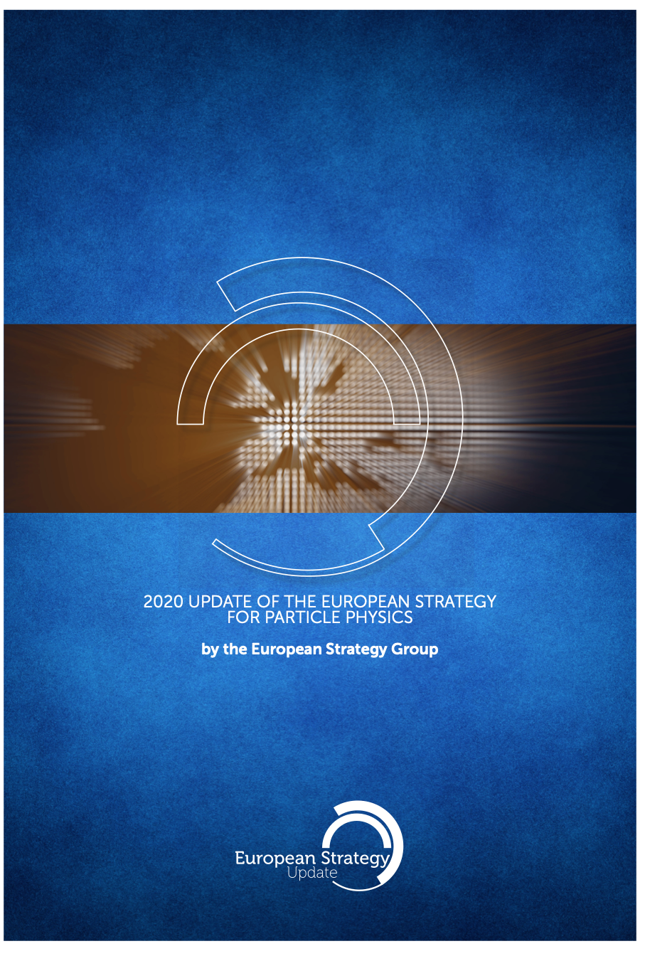
European Strategy for Particle Physics
The European Strategy for Particle Physics is updated every 5 years in a procedure based on wide community input.
Many of us provided input to this process:
Written statements from European Network for Novel Accelerators (EuroNNAc), AWAKE, ALEGRO and EuPRAXIA.
Several talks at meetings.
Strategy defines future directions and priorities for particle physics in Europe and for CERN. Last update: 2020.
Outcome a great success for advanced accelerators:
Importance of accelerator R&D in general.
Explicit mentioning of plasma and laser high gradient acceleration.
Request for accelerator R&D roadmap, adequate resources, priorities, deliverables for next decade, synergy with other science fields, …

Slide 9
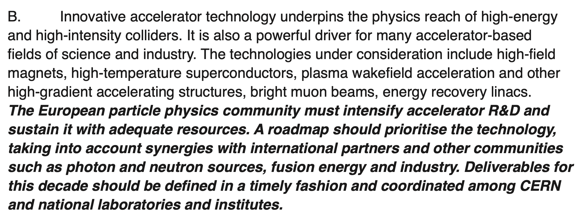

Slide 10
Expert Panel HGPL “High Gradient Acceleration (Plasma/Laser)”
OPEN CONSULTATION PROCESS – WORK FLOW
Expert Panel
Chair: Ralph Assmann (DESY/INFN)
Deputy Chair: Edda Gschwendtner (CERN)
Expert Panel: 18 experts - 4 associated - 13 meetings Retreat 23/6
Panel members:
Kevin Cassou (IN2P3/IJCLab), Sebastien Corde (IP Paris), Laura Corner ( Liverpool), Brigitte Cros (CNRS UPSay), Massimo Ferarrio (INFN), Simon Hooker (Oxford), Rasmus Ischebeck (PSI), Andrea Latina (CERN), Olle Lundh (Lund), Patric Muggli (MPI Munich), Phi Nghiem (CEA/IRFU), Jens Osterhoff (DESY), Tor Raubenheimer (SLAC), Arnd Specka (IN2PR/LLR), Jorge Vieira (IST), Matthew Wing (UCL).
Panel associated members:
Cameron Geddes (LBNL), Mark Hogan (SLAC)), Wei Lu (Tsinghua U.) , Pietro Musumeci (UCLA)
Email list
231 scientists registered to roadmap process
Townhall 30/3
Setting the scene,
explaining the process, HEP goals and targets
Parameters
Parameters of interest, proposal of 2 common study cases
Townhall Meetings 21/5 and 31/5
Input presented by 48 SPEAKERS FROM COMMUNITY
Up to 130 simultaneous participants
➔ EAAC Tue PM/Wed AM
Draft R&D Roadmap, de-liverables: 16 July, HEP talk, Priorization: 30 Sep
FINAL REPORT October
EAAC 2021 feedback
LDG, SPC, … feedback

Slide 11
2021: Good News (some are EAAC helped outcomes)
Start of I-FAST project (European Network for Novel Accelerators and EAAC into 2025) → Yearly Meeting Thursday morning
Setup of expert panel for „High Gradient: Plasma and Laser Accelerators“ – one of 5 panels for European accelerator R&D → Special session on roadmap Tue PM/Wed AM.
Snowmass effort with advanced accelerators in Accelerator Frontier 6 (AF6). → Talk in special session on expert panel.
Placement of EuPRAXIA (only new accelerator project in EU) on ESFRI roadmap, >110 M€ funding obtained (next phase being prepared)
Plenty of new and exciting achievements in novel accelerator R&D → see talks

Slide 12
Great News 30.6.2021
About the ESFRI Roadmap ESFRI has established a European Roadmap for Research Infrastructures (new and major upgrades, pan-European interest) for the next 10-20 years, stimulates the implementation of these facilities, and updates the roadmap as needed. The ESFRI Roadmap arguably contains the best European science facilities based on a thorough evaluation and selection procedure. It combines ESFRI Projects, which are new Research Infrastructures in progress towards implementation, and ESFRI Landmarks successfully implemented Research Infrastructures enabling excellent science.
Building the first plasma accelerator facility

Slide 13
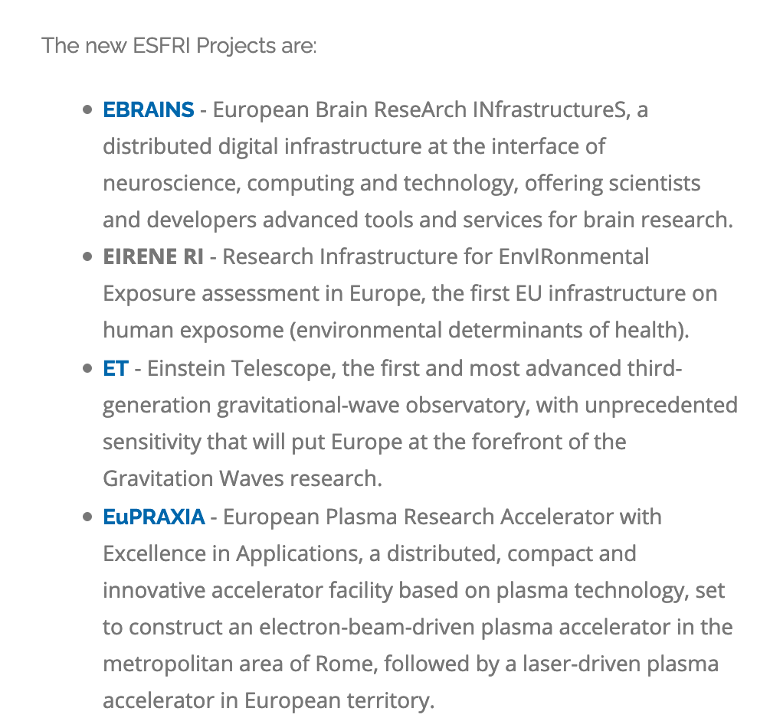
Great News 30.6.2021
Building the first plasma accelerator facility

Slide 14
Great News 30.6.2021
Building the first plasma accelerator facility

Slide 15
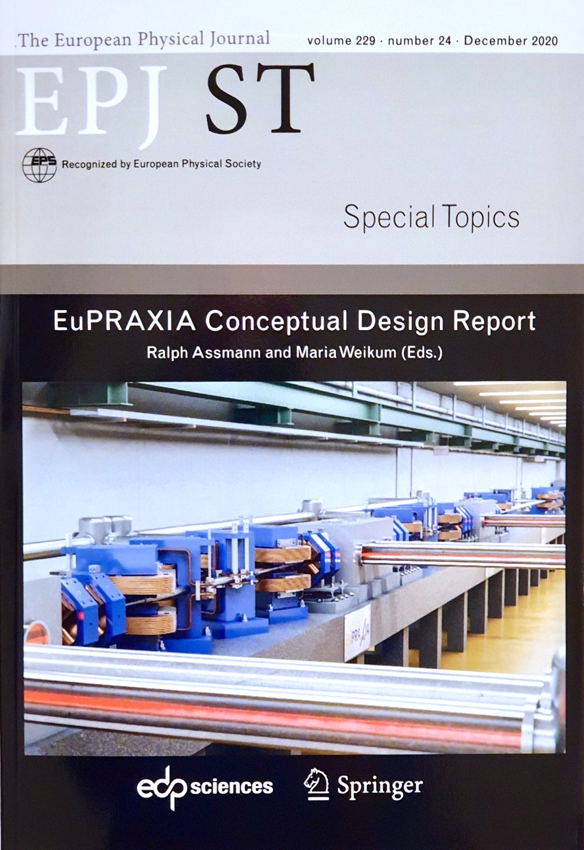
The EuPRAXIA Project
http://www.eupraxia-project.eu/
First ever international design of a plasma accelerator facility.
Challenges addressed by EuPRAXIA since 2015:
How can plasma accelerators produce usable electron beams?
For what can we use those beams while we increase the beam energy towards HEP and collider usages?
CDR for a distributed research infrastructure funded by EU Horizon2020 program. Completed by 16+25 institutes.
Next phase consortium with 40 partners, 10 observers.
Applied to ESFRI roadmap update 2021 with government support in Sep 2020.
Successful and and placed on ESFRI roadma.
653 page CDR, 240 scientists contributed

Slide 16
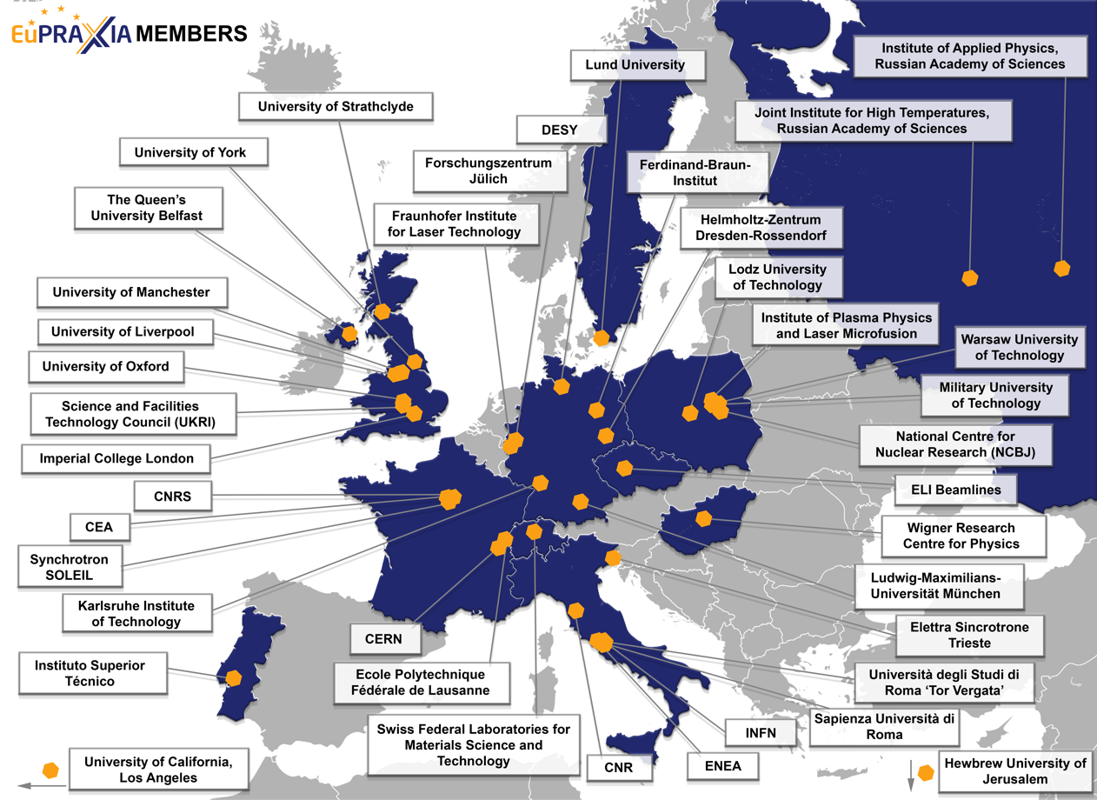
The Consortium Members for the Next Phase (from 16 to 40)
40 Member institutions in:
Italy (INFN, CNR, Elettra, ENEA, Sapienza Università di Roma, Università degli Studi di Roma “Tor Vergata”)
France (CEA, SOLEIL, CNRS)
Switzerland (EMPA, Ecole Polytechnique Fédérale de Lausanne)
Germany (DESY, Ferdinand-Braun-Institut, Fraunhofer Institute for Laser Technology, Forschungszentrum Jülich, HZDR, KIT, LMU München)
United Kingdom (Imperial College London, Queen’s University of Belfast, STFC, University of Liverpool, University of Manchester, University of Oxford, University of Strathclyde, University of York)
Poland (Institute of Plasma Physics and Laser Microfusion, Lodz University of Technology, Military University of Technology, NCBJ, Warsaw University of Technology)
Portugal (IST)
Hungary (Wigner Research Centre for Physics)
Sweden (Lund University)
Israel (Hebrew University of Jerusalem)
Russia (Institute of Applied Physics, Joint Institute for High Temperatures)
United States (UCLA)
CERN
ELI Beamlines

Slide 17
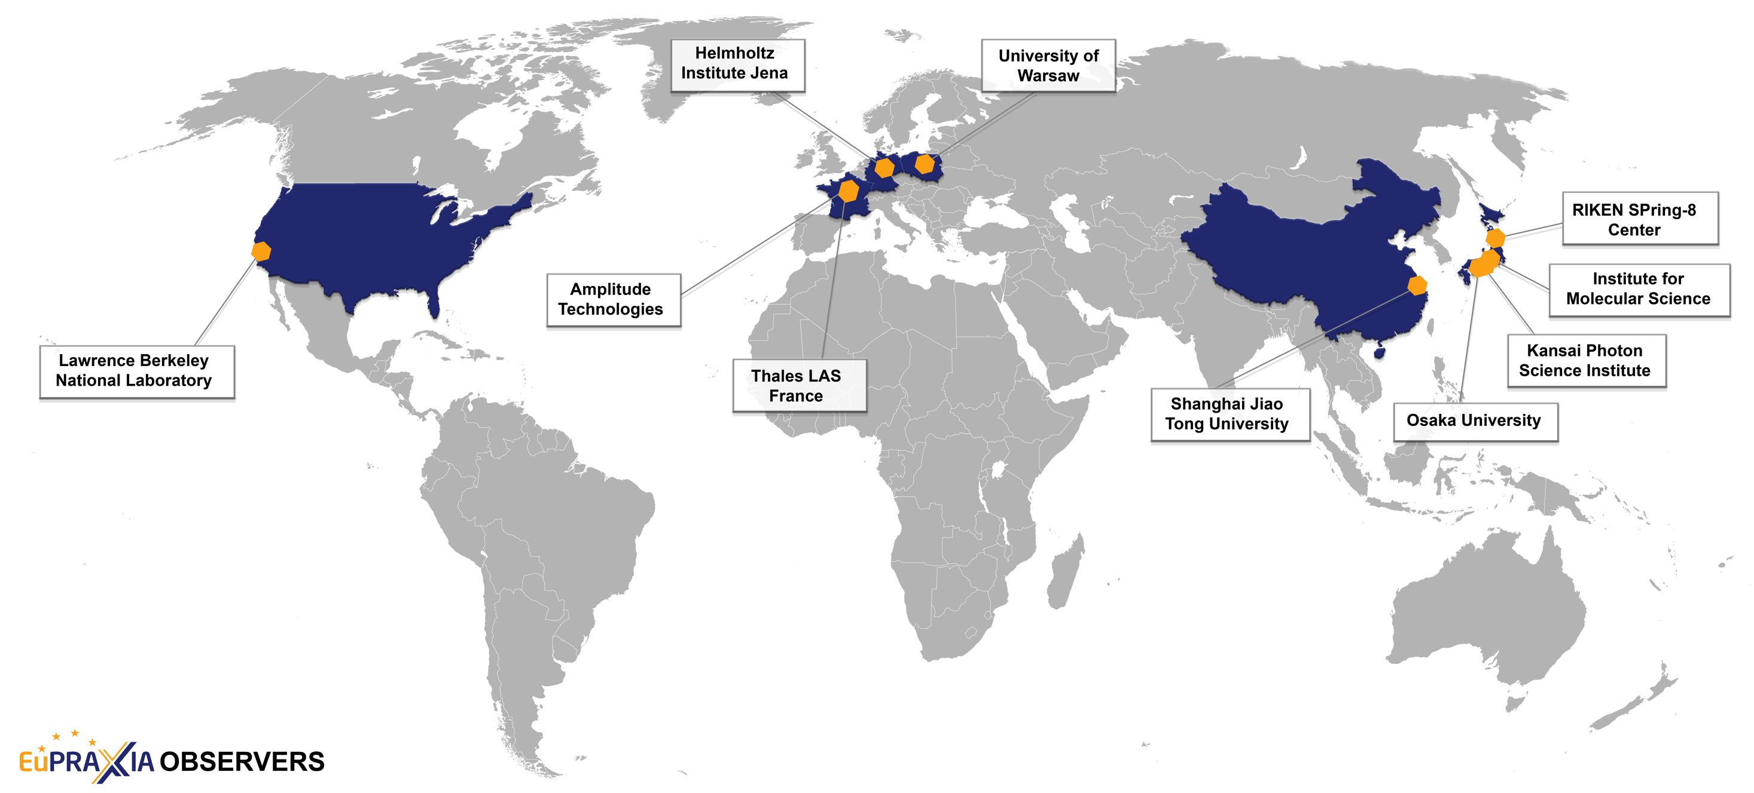
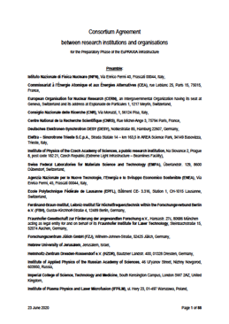
The Consortium Observers for the Next Phase (from 25 to 10, Consortium Agreement signed)
10 Observer institutions in:
France (Amplitude Technologies, Thales LAS France SAS)
Germany (Helmholtz-Institut Jena)
Poland (University of Warsaw)
United States (LBNL)
China (Shanghai Jiao Tong University)
Japan (Institute for Molecular Science, Osaka University, Kansai Photon Science Institute, RIKEN SPring-8 Center)

Slide 18
2021: Good News (some are EAAC helped outcomes)
Start of I-FAST project (European Network for Novel Accelerators and EAAC into 2025) → Yearly Meeting Thursday morning
Setup of expert panel for „High Gradient: Plasma and Laser Accelerators“ – one of 5 panels for European accelerator R&D → Special session on roadmap Tue PM/Wed AM.
Snowmass effort with advanced accelerators in Accelerator Frontier 6 (AF6). → Talk in special session on expert panel.
Placement of EuPRAXIA (only new accelerator project in EU) on ESFRI roadmap, >110 M€ funding obtained (next phase being prepared)
Plenty of new and exciting achievements in novel accelerator R&D → see talks

Slide 19
EAAC 2021 – Hybrid
Some of us (40) can be in Frascati/Rome in person, having direct discussions
Connected to the world (>200 remote participants have registered).
Many thanks to the LOC team who made it work: Gemma Costa (INFN - LNF, Italy), Martina Del Giorno (INFN - LNF, Italy), Massimo Ferrario (INFN - LNF, Italy), chair, Maria Rita Ferrazza (INFN - LNF, Italy), Alessandro Gallo (INFN - LNF, Italy), Fabio Villa (INFN - LNF, Italy), Giulia Vinicola (INFN - LNF, Italy)
Many thanks to Laura Corner (SPC chair) and our other co-organizers: Bernhard Holzer, (CERN, Switzerland), Phi Nghiem (CEA, France), Arnd Specka, (Ecole Polytechnique, France), Roman Walczak, (JAI, United Kingdom)
Some EAAC features delayed to a special meeting next year in Sep 2022 at Elba (e.g. posters, student prizes, Simon van der Meer award).
This year: no proceedings. Slides from talks on the web…

Slide 20
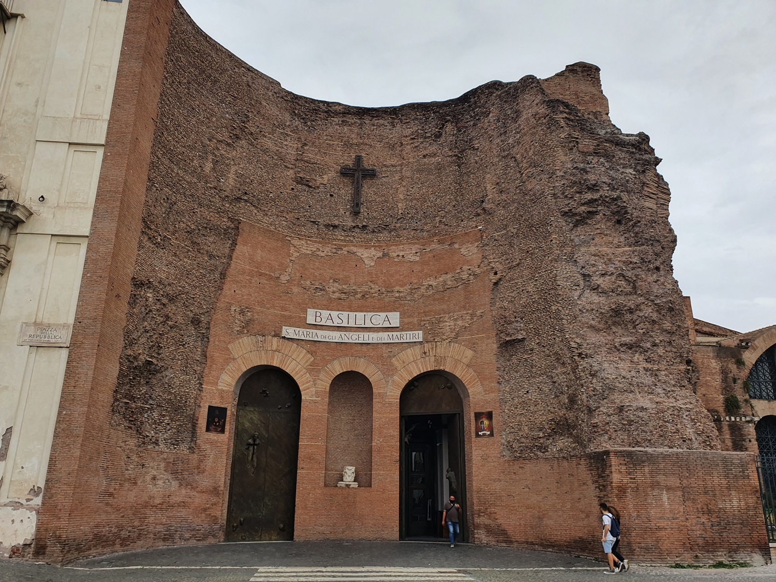
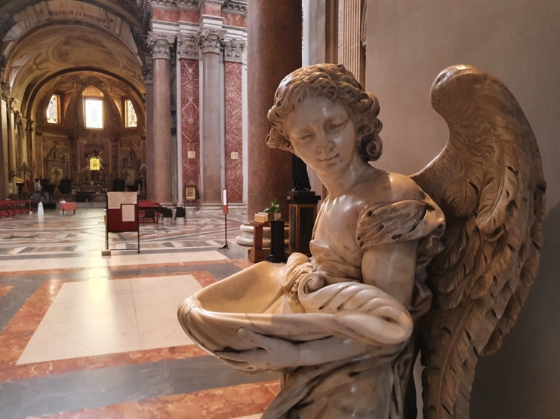
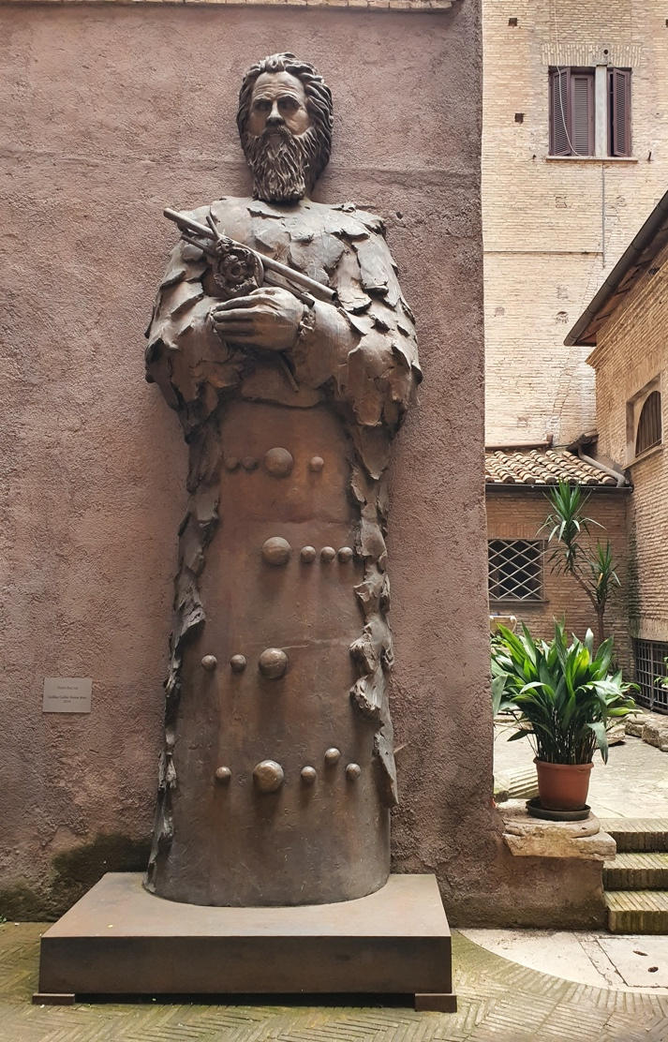
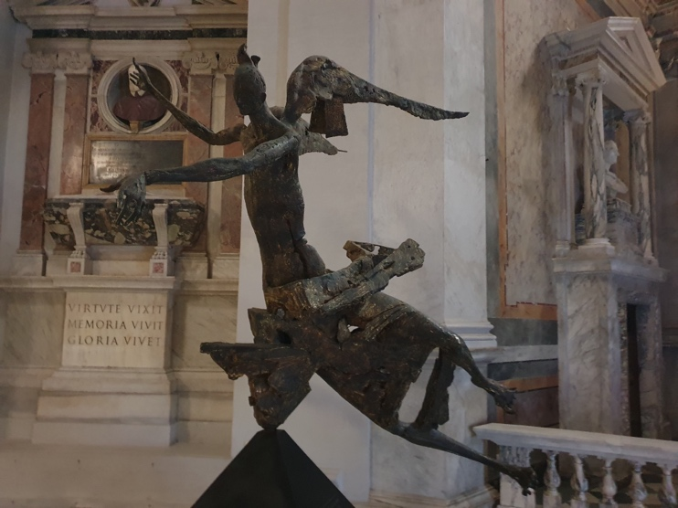
Forza EAAC 2021 in Frascati/Rome
Who is this guy?
Santa Maria of the Angels and the Martyrs.
Church in the ruins of the Dioclethian baths, next to the main station Termini. Designed by Michelangelo.

Slide 21
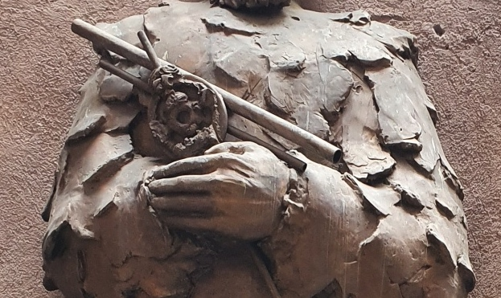
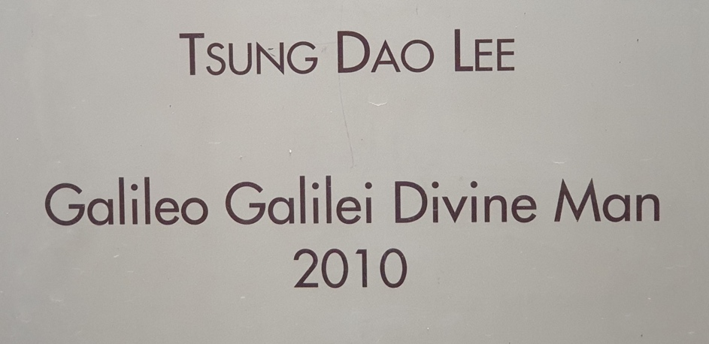
Forza EAAC 2021 in Frascati/Rome
Santa Maria of the Angels and the Martyrs.
Church in the ruins of the Dioclethian baths, next to the main station Termini. Designed by Michelangelo.

Slide 22
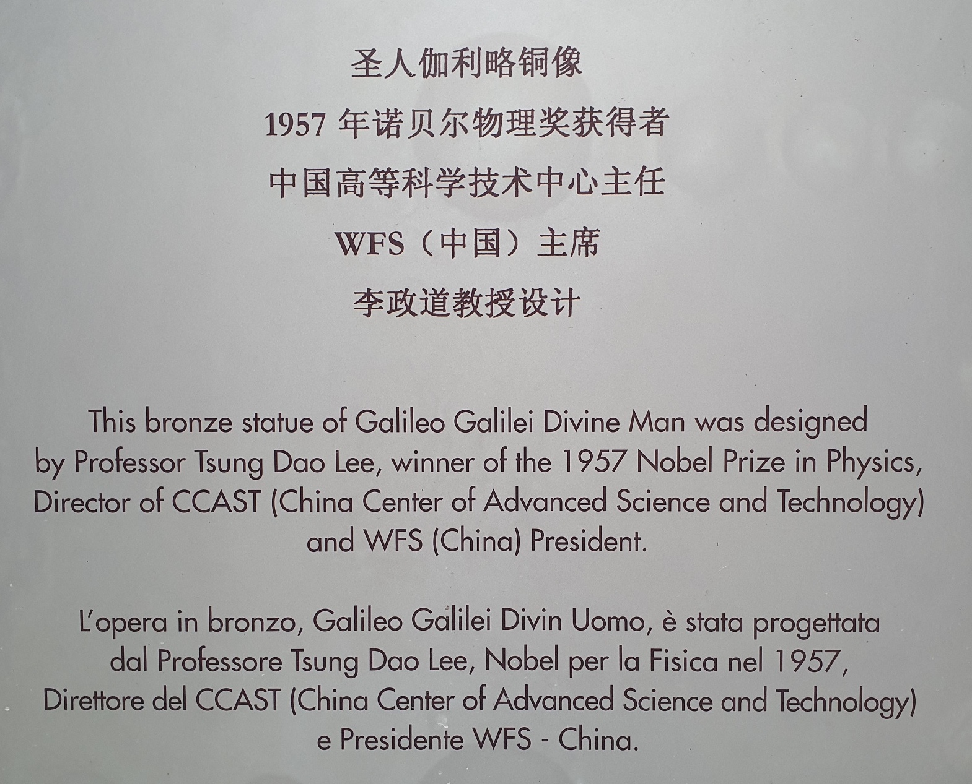
Forza EAAC 2021 in Frascati/Rome

Slide 23
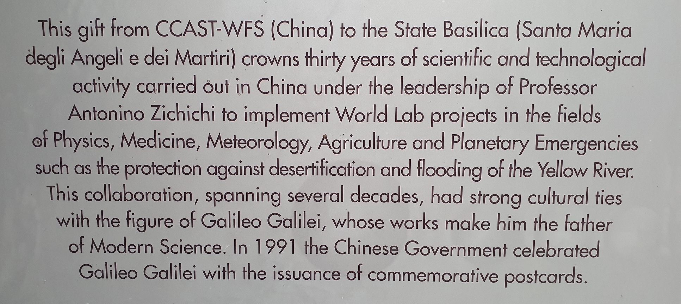
Forza EAAC 2021 in Frascati/Rome
Galileo, the hero of our acceleration law, a story of physics, of the church, of physics prevailing, of friendship, of collaboration!

Slide 24
Forza EAAC 2021 (and Accelerators, Science, New Ideas, World-Wide Collaboration)

