Slide 1



Study of Wakefield Monitors in Accelerating Structures as Beam Diagnostics
21.10.2020
Hikmet Bursali
Supervisors:
Prof. Mauro Migliorati (Sapienza University of Rome)
Prof. Andrea Mostacci (Sapienza University of Rome)
Dr. Nuria Catalan Lasheras (CERN)

Slide 2
Outline
Introduction
Compact Linear Collider Study (CLIC)
Super Accelerating Structure
Wakefield Monitors & WFM Data Acquisition Electronics
CERN Linear Electron Accelerator for Research (CLEAR) Facility
  Beam Measurements at CLEAR
  CST Wakefield Solver Simulations
X-Band High Gradient Test Facility
  Xbox2 Experiment Line
  Dark Current Simulations
  Dark Current Study on WFMs
Design and Construction of a 3D Printed Spiral Load

Slide 3
Introduction
CLIC Study accelerating structures are made of OFE copper (99.99% pure) and operating between 70-120 MV/m accelerating gradient at X-Band (11.9942 GHz). In order to reach these nominal gradients, the beam apertures of structures must be kept small and this generates transverse short and long range wakefields.
CLIC structures have an integrated wake-field monitor (WFM) meant to be used as beam positioning monitor in order to realign the structures to an average reference further minimizing the wakefields. The accuracy of this system is to be kept below 5-7 μm which is the combined effect of geometric imperfections of the WFM cell, misalignment errors during fabrication, cables and feedthroughs mismatch and errors coming for the acquisition electronics.
Recent studies have shown that a fully electromagnetic measurement using only RF transmission from the transverse ports of the WFM cell can determine the geometrical center of the WFM cell with microns accuracy [1]. Same results have been observed with beam in the CTF3 and CLEAR facilities and have shown a good reproducibility [2]. However, measurement chain at CLEAR showed the limitations of the system in real operational conditions when a large RF power is injected into the structure.
This research includes investigating the accuracy and reproducibility of wakefield monitors with measurements in the presence of RF, dark current (at X-Band HG Test Facility) and beam (CLEAR Facility) by using current structure prototypes.
1-Development of direct measurement techniques for the in-situ internal alignment of accelerating structures (PhD Thesis) Natalia Galindo Munoz, February 2018
2-Wakefield Monitor Experiments with X-Band Accelerating Structures, R. L. Lillestøl∗, E. Adli, J. Pﬁngstner, Department of Physics, University of Oslo, Norway, W. Farabolini, R. Corsini, S. Döbert, A. Grudiev, L. Malina, W. Wuench, CERN, Geneva, Switzerland. Proceedings of IPAC2015, Richmond, VA, USA

Slide 4
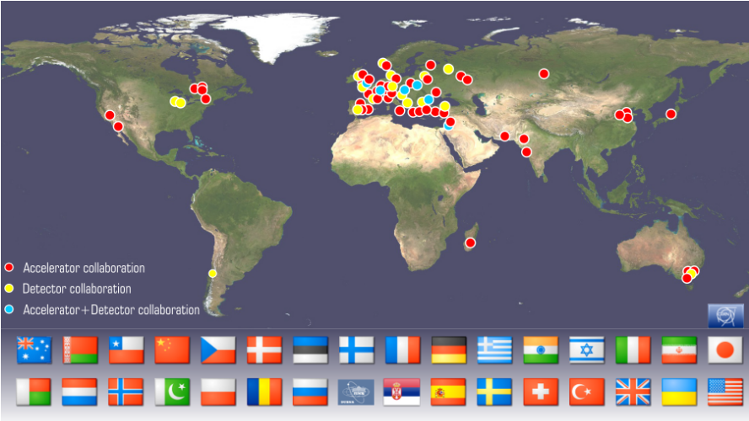
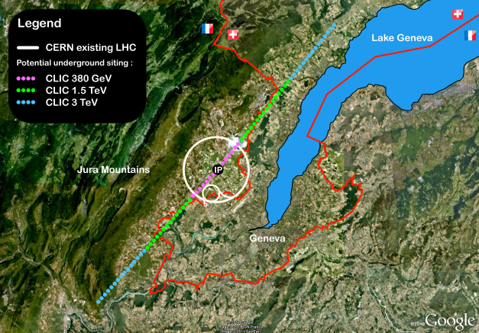
Compact Linear Collider (CLIC) Study
CLIC Collaboration Map
CLIC Planning Location
[1]
Compact Linear Collider (CLIC) is an internatinal collaboration (30 countries and more than 70 institutes) for building a linear accelerator to collide electrons and positrons within three energy stages.
[2]
Stage | Length (km) | Energy (TeV)
First | 11.4 | 0.38
Second | 29 | 1.5
Third | 50.1 | 3
1-http://clic-study.web.cern.ch/content/list-members
2-https://cds.cern.ch/record/2210892/files/arXiv:1608.07537.pdf
4

Slide 5
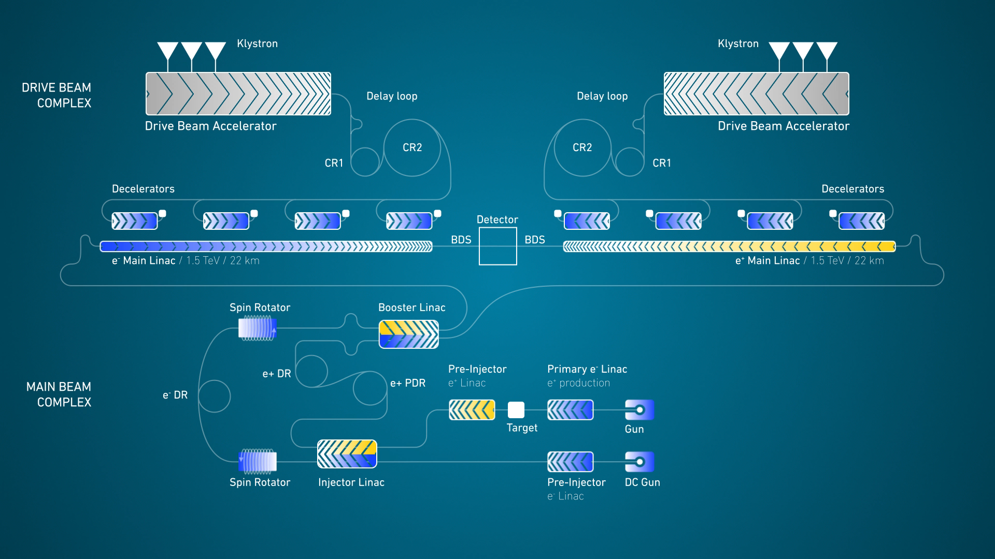

Slide 6
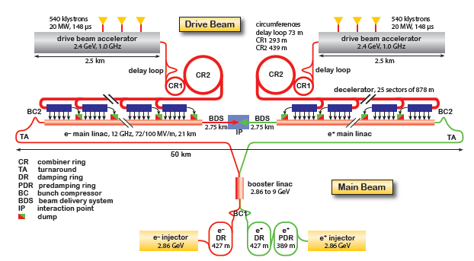
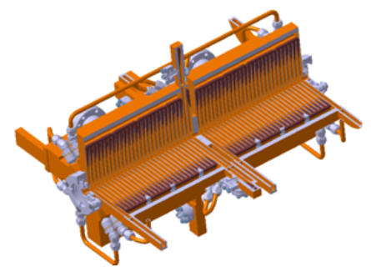
CLIC Study
CLIC Layout for 3 TeV
CLIC includes 142812 accelerating structures at final stage.
Alignment and diagnostics of this number of structures is one of the main challenges.
CLIC has superstructure as main accelerating structure equipped with wakefield monitors for beam positioning.
[1]
[2]
Engineering Model of Super-Accelerating Structure
1-Updated Baseline for a Staged CLIC, https://cds.cern.ch/record/2210892
2-The Compact Linear Collider (CLIC) – Project Implementation Plan (Vol. 4 (2018)-https://e-publishing.cern.ch/index.php/CYRM/issue/view/68
6

Slide 7
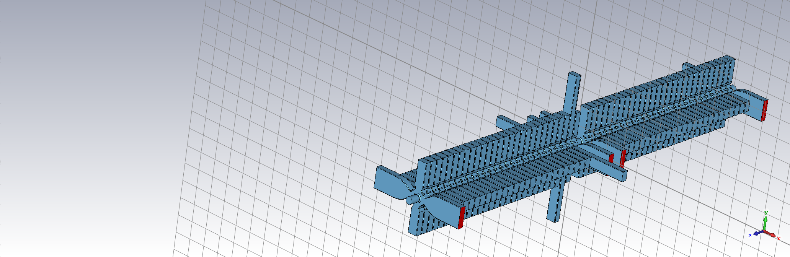
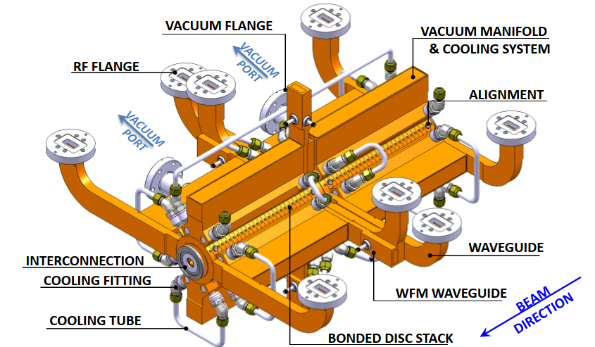
Super Accelerating Structure (SAS)
Beam Direction
1st structure
*
Wakefield Monitor Waveguides
2nd structure
2xTD26CCs (combination of two structures), Normal Cond., OFE copper
Operating Frequency: 11.9942 GHz (at 30ºC)
Operating Mode : TM₀₁ with 2π/3
Input Power : 43.7 MW
Filling Time : 66.98 ns
Group Velocity : 1.65%c-0.83%c
Quality Factor : 5657
Superstructure Vacuum Model
Two superstructure prototypes have been installed both CLEAR and X-Band High Gradient Test Facility for wakefield monitor studies.
*CLIC Engineering Design Meeting, Annex 1.1, 12.01.2012
**CERN EDMS No.1078698
**

Slide 8
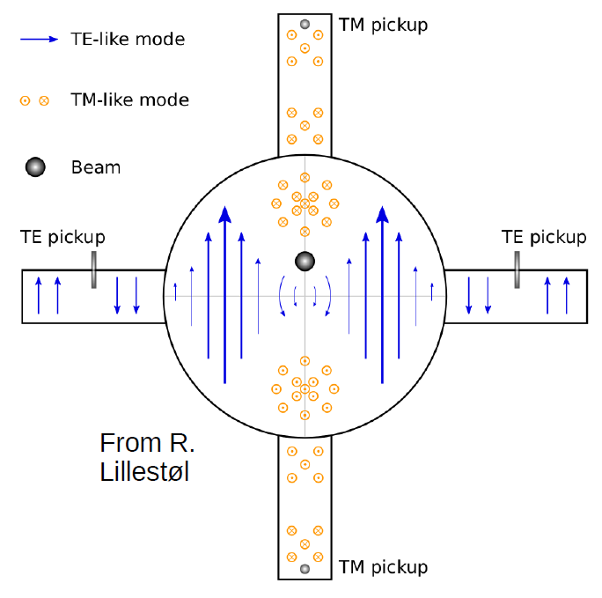
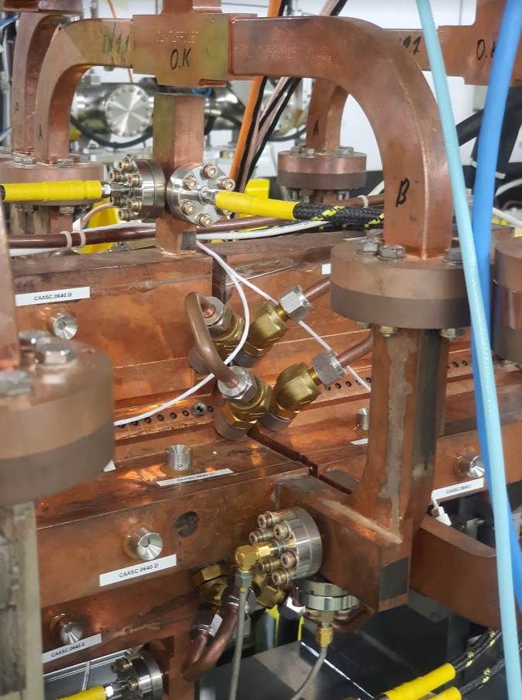
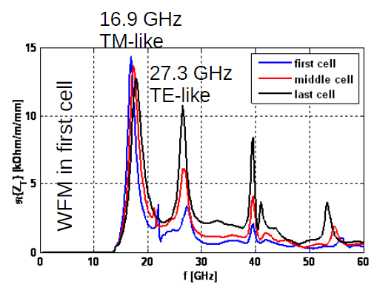
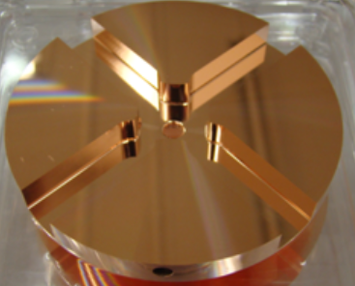
Wakefield Monitors
Wakefield monitors are the pickup antennas equipped with CF16 flange to take the signals belong to TM and TE like modes on the wakefield monitor waveguides. [1]
WFMs installed on the first cell of 2nd structure. (4 pairs, 8 in total.)
TM pickups
4 HOM waveguides per cell
TE pickups
[2]
1-Status of Wakefield Monitor Experiments at The CLIC Test Facility, CLIC-Note-1086
2-Description of CLEAR WFM acquisition system, K. Sjobak

Slide 9
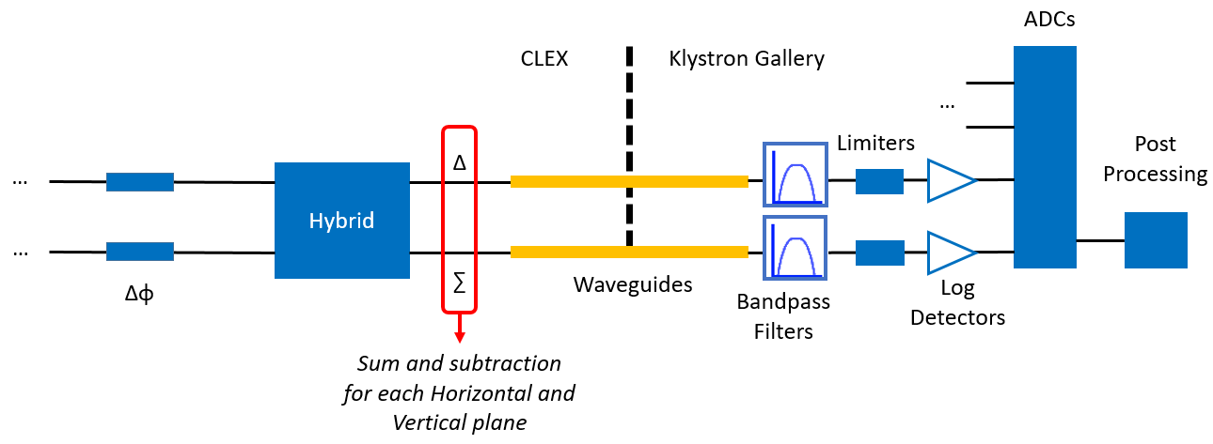
Wakefield Monitor Data Acquisition Electronics
WFM signals from pickup antennas
[1]
Superstructure has been equipped with WFM data acquisition electronics as shown above.
Hybrids make sum and subtraction process of signals for each plane (H/V).
After filtering (18/24 GHz), signals are sending to ADCs through limiters and log detectors for post processing.
1-Kyrre Sjobak, Tests of Wakefield Monitors (WFMs) at CLEAR, CLIC Workshop 2019

Slide 10

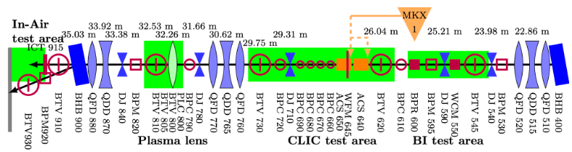
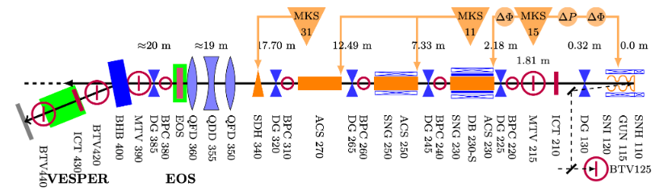
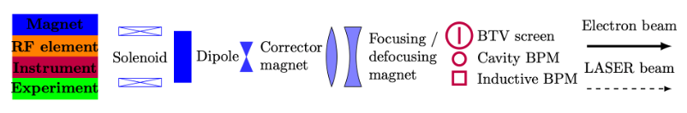
CLEAR Facility
CERN Linear Electron Accelerator for Research (CLEAR) is an R&D electron beam facility for existing and future accelerator studies.
Includes experimental areas for plasma technology, irradiation tests, characterisation of accelerator components, medical applications and one for CLIC WFM experiments also. [1]
[2]
Legend for Layout
1-https://cds.cern.ch/record/2665487/files/10.1016.j.nima.2017.11.080.pdf
2-https://clear.cern/content/beam-line-description

Slide 11
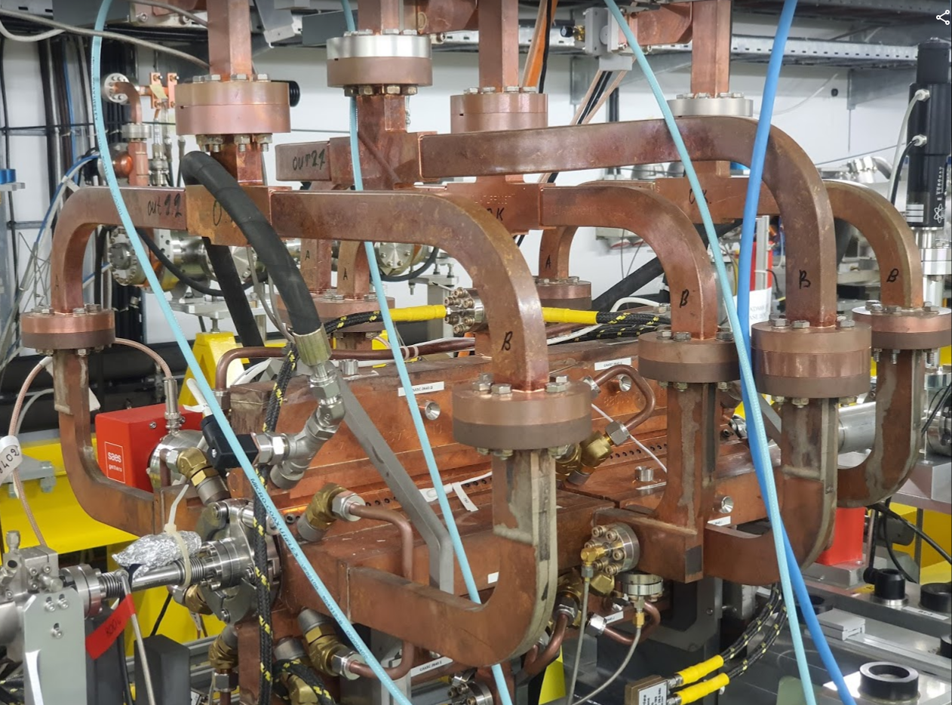
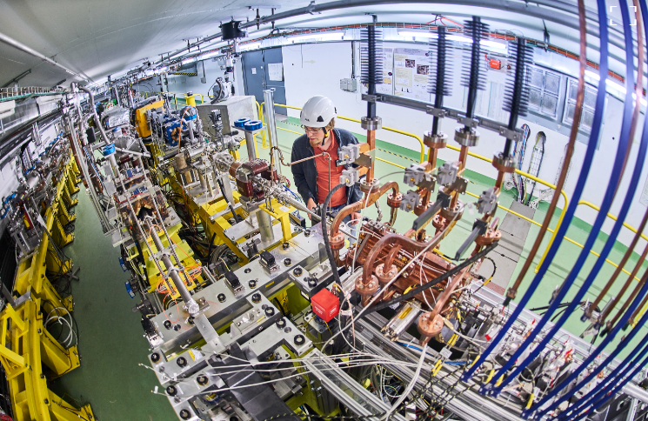
Superstructure in CLEAR
*
Superstructure prototype installed in CLEAR experimental area.
Equipped with WFM data acquisition electronics.
*https://clear.cern/about-clear/photo-gallery

Slide 12
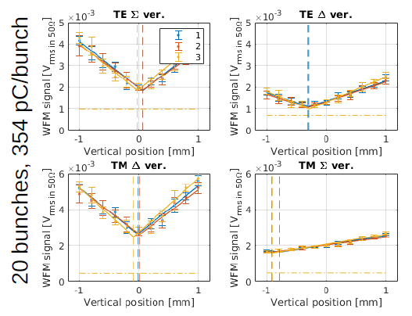
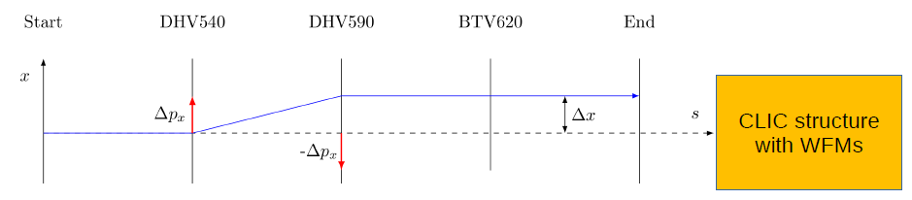
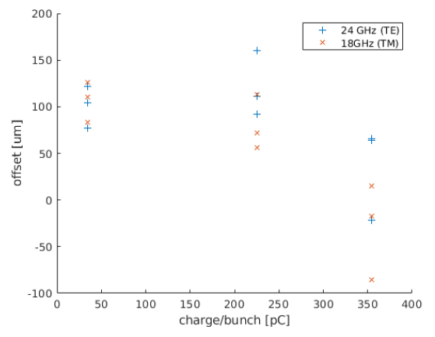
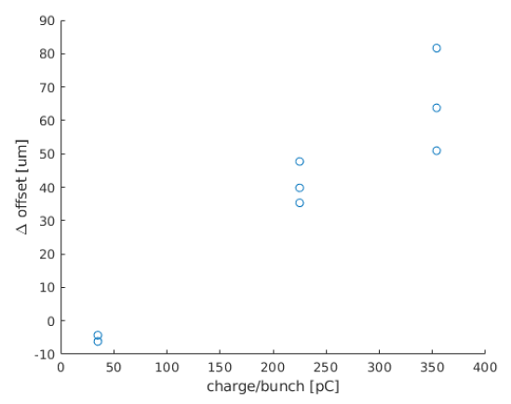
Beam Measurements in CLEAR
*
Wakefield monitor experiments are performed by using magnetic bump to scan the transverse space with keeping CLIC structure stable while WFM signals are observed from log detectors on a scope.
*
*
During these measurements, we saw a discrepancy between the offset measured using the two different modes read as WFM on the order of microns.
This behaviour is consistent when repeating the measurement and recent data suggests it could have a link to bunch train quality.
*Description of CLEAR WFM acquisition system, K. Sjobak

Slide 13
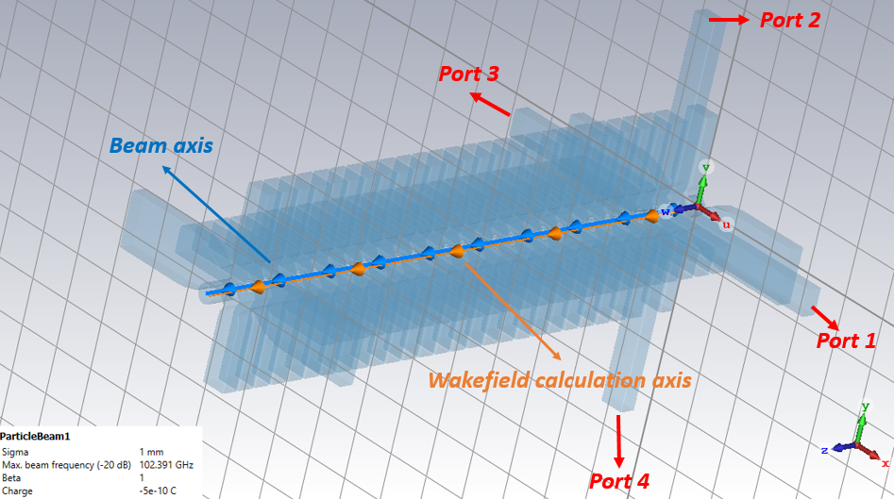
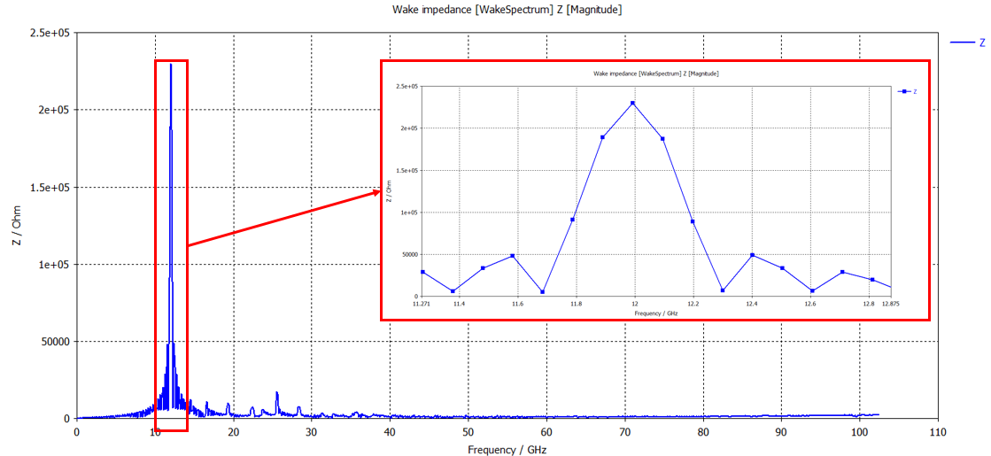
CST Wakefield Solver Simulations
In order to verify bunch train quality effect with making comparison on measurement, I have performed CST wakefield solver simulations with CLEAR beam parameters (0.5 nC bunch charge and 1mm bunch length) with scanning on x-axis to calculate the wake potentials for second structure.
Next workflow will include evaluation of wakefield monitor port signals.

Slide 14
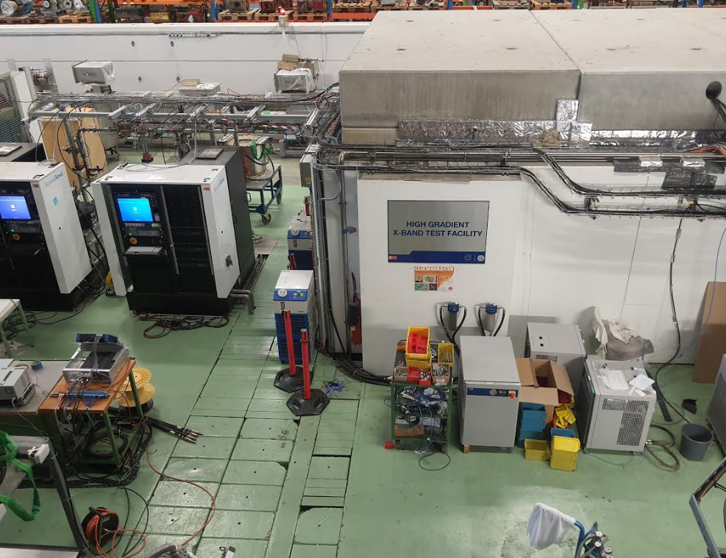
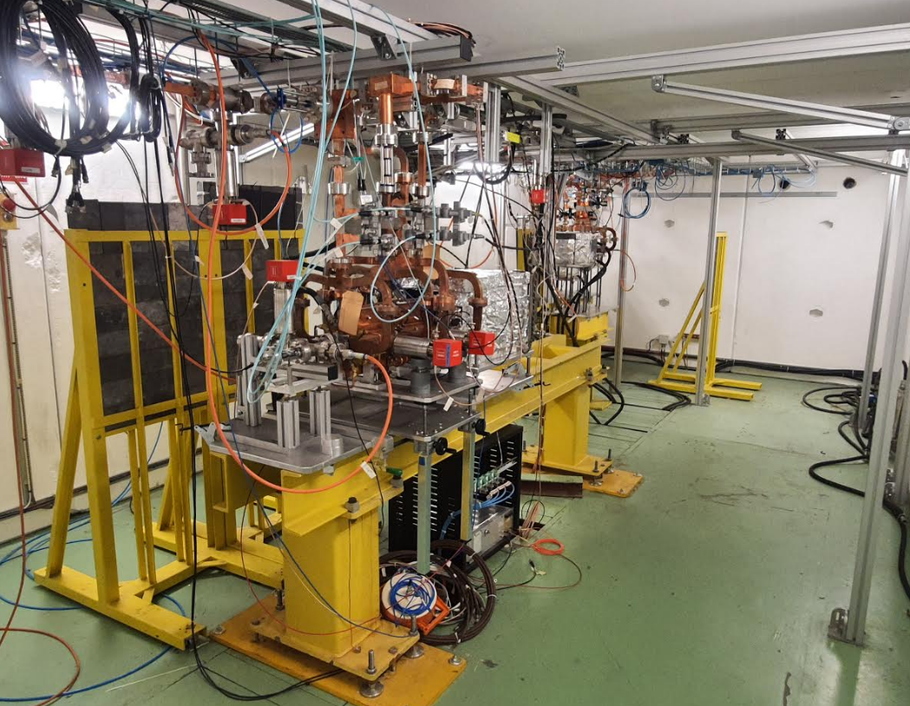
X-Band High Gradient Test Facility
In the X-band HG Test Facility at CERN we perform high power conditioning studies of the CLIC normal-conducting, high-gradient, accelerating structure prototypes.
Prototypes are tested at increased input power and pulse length while keeping the breakdown rate per pulse under control.
CLIC requires breakdown rate should be kept below 3x10⁻⁷ per pulse per meter of structure at nominal gradient of around 100 MV/m.
The facility uses a 50 MW klystron and a pulse compressor unit to reach peak powers up to 120 MW on a 250 ns pulse length.
Inside Bunker

Slide 15
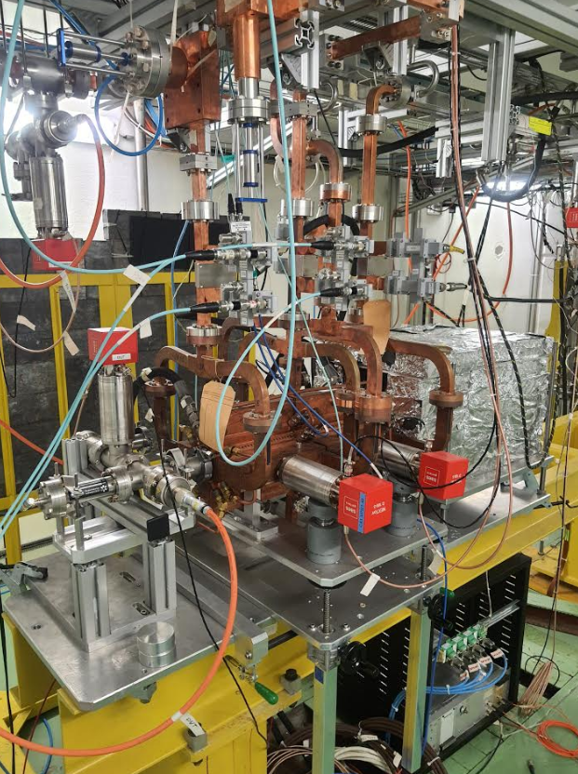
Superstructure installed in Xbox2
Xbox2 is one of the experiment lines in X-Band HG Test Facility and superstructure has been installed at that line.
It has variable power splitter to share the RF power to the structures and phase shifter to change the RF phase difference between structures.
There are directional couplers for measuring the transmitted and reflected power and high power loads to absorb the remaining RF power through the structures at the end of the network.
Experimental Arrangement of Superstructure in Xbox2
*
During conditioning of superstructure, we start to see dark current (which can cause damage to diagnostic elements and energy loss during normal operation**) on the Faraday Cups above 20 MW RF power.
In our experiment, we are using the dark current for generation of signals on WFMs.
Superstructure in Xbox2
*CLIC Project Meeting, 24.07.2020, L. Millar
** Dark current analysis at CERN’s X-band facility, 10th International Particle Accelerator Conference, Melbourne, Australia, 19 - 24 May 2019, pp.WEPRB059

Slide 16
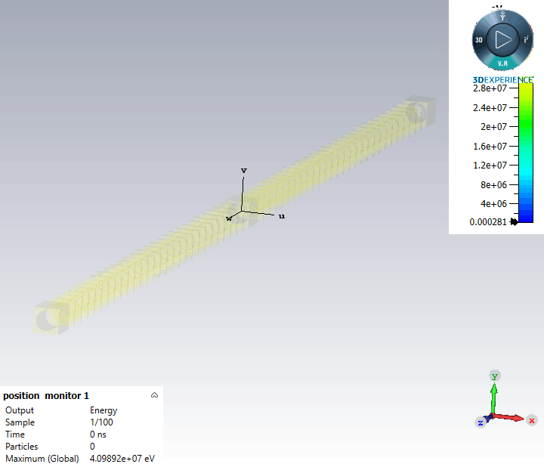
Dark Current Simulations
E-field Phase Difference ( º ) Between two Structures | 1st Pic 2D Monitor (MeV) | 2nd Pic 2D Monitor (MeV)
-150 | 19.27 | 25.7
-120 | 19.27 | 33.3
-60 | 19.27 | 41
0 | 19.27 | 28.2
+60 | 19.27 | 21.9
+120 | 19.27 | 22.2
+150 | 19.27 | 22.5
Beam direction
1st structure
2nd structure
Visible bunching of captured dark current.
In order to observe the captured and accelerated dark current from first structure to second one, I have created CST PIC solver simulation model for superstructure.
Different set of RF phase differences have been applied between structures to observe the change on captured energy level.
The energy of the accelerated dark current has been observed at 2D PIC monitors which are placed both between the structures and end of the second structure.

Slide 17
Dark Current Study on WFMs
On the experimental part, we have installed data acquisition electronics almost identical to that in CLEAR Facility. However, given the large current observed during breakdowns, we added attenuators to the acquisition cables in order to protect the electronics.
We have not observed signal above the noise in operating conditions. We expect to see WFM signals on wakefield monitors after removing the log detectors and other software updates foreseen on the coming weeks.
We plan to investigate the WFM signal dependencies on dark and breakdown current. We are preparing a simulation workflow to gauge the dependency of signals with the dark current energy and intensity at 2D PIC monitors depending on field emission intensity, gradient and RF phase between the two structures.

Slide 18
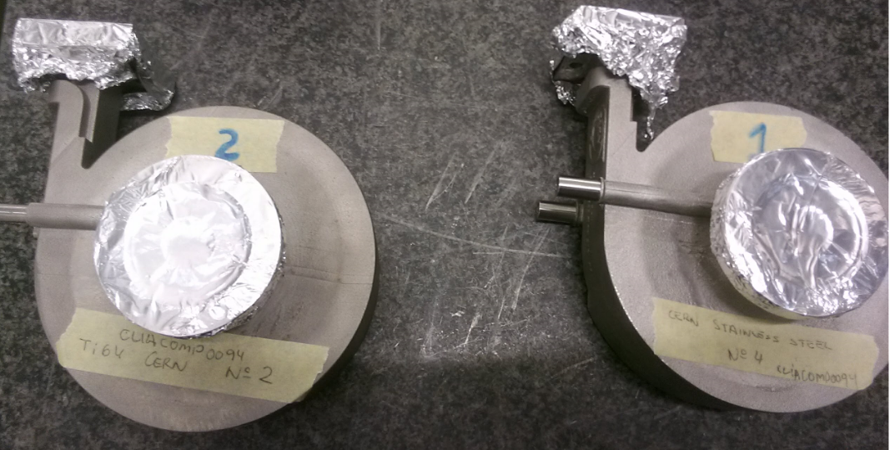
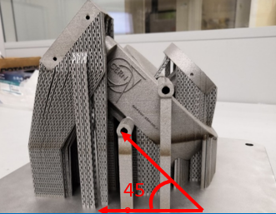
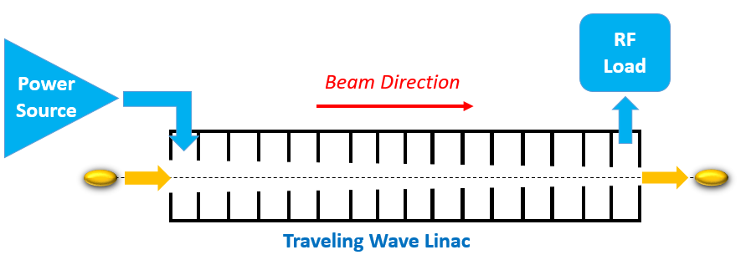
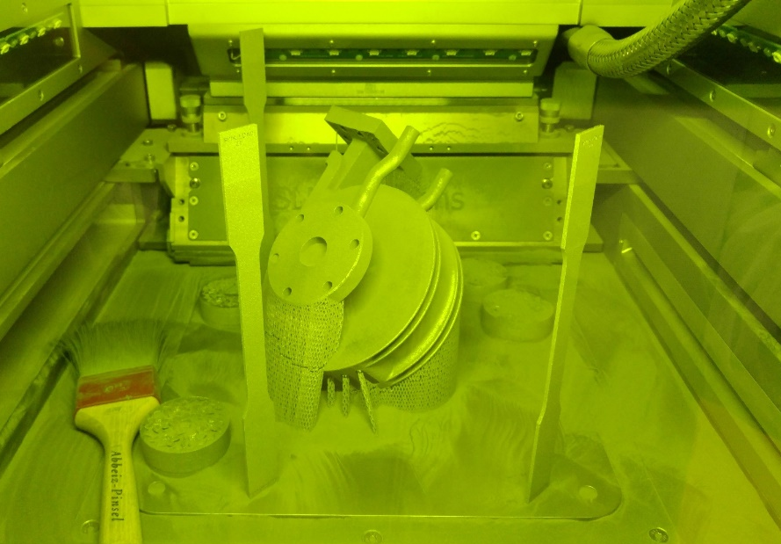
Design and Construction of a 3D Printed Spiral Load (1)
CLIC accelerating structures are constant gradient traveling wave type structures operating at X-Band (12 GHz), TM₀₁ mode with 2π/3 phase difference and require RF loads to absorb remaining RF power passing through structures.
We have several RF spiral loads which were designed (CLIACOMP0071, CLIACOMP0094), fabricated (at CERN or Vendor companies) and tested successfully. (Materials; Stainless-Steel “316L”, Titanium alloy “Ti6A14V”)
The current designs allow to produce only one load during an additive manufacturing cycle because of 45° oblique placing and 3D printing machine dimensions.
Spiral Load in 3D printing machine

Slide 19
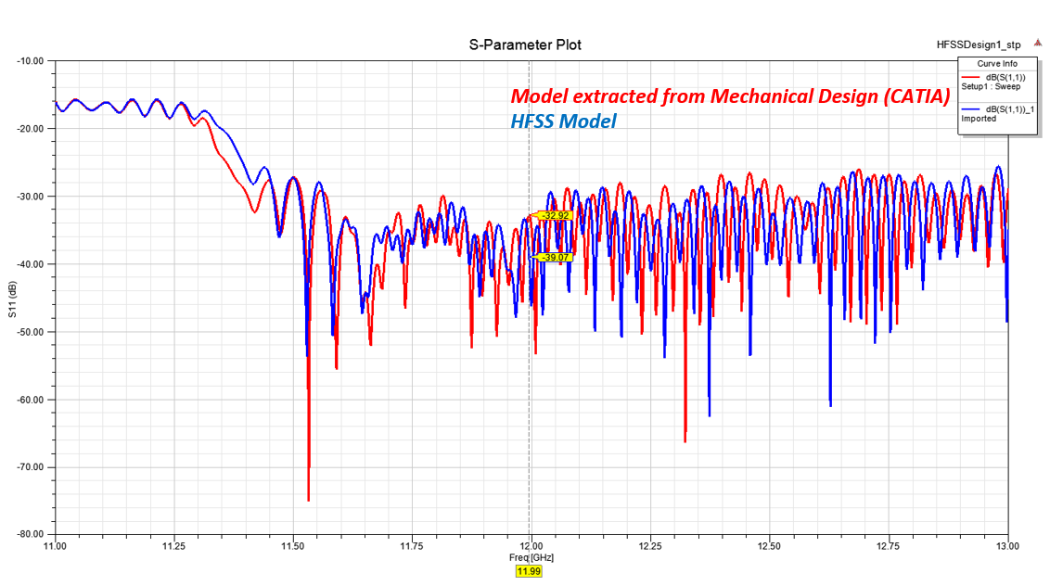
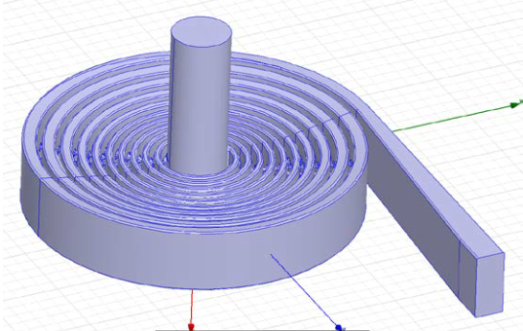
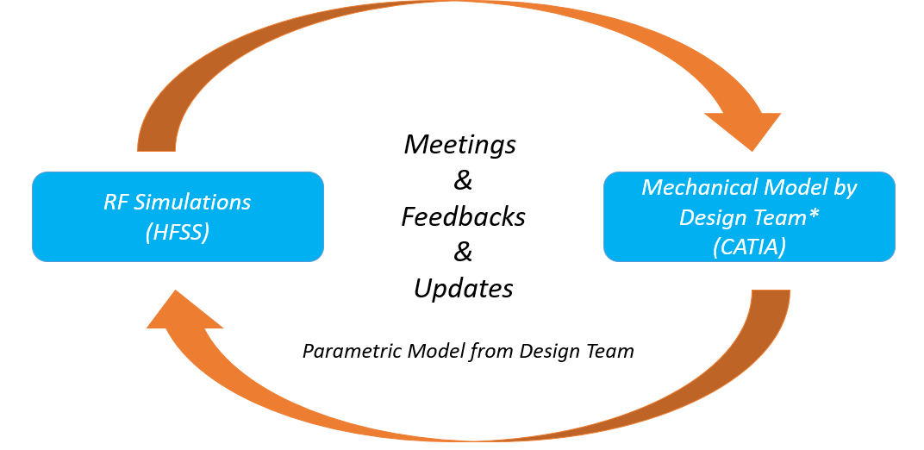
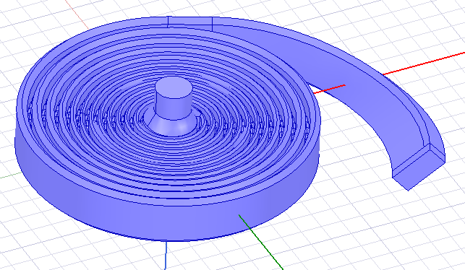
Design and Construction of a 3D Printed Spiral Load (2)
The aim of this study is to optimise the internal cross-section of RF loads in order to create a stackable design to increase number of products per additive manufacturing cycle and so decreasing the unit price.
I have performed several simulations on HFSS for optimizing the RF performance of load related to outcomes of meetings and feedbacks from mechanical design team.
The RF and mechanical design of the load has finished and the first prototypes will be printed in January 2021 and tested electrically afterwards.
Previous Design
New Design
*Oleg Gumenyuk, Benoit Riffaud, Romain Gerard

Slide 20
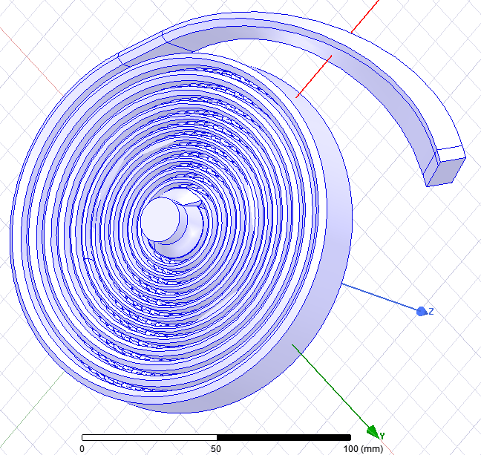
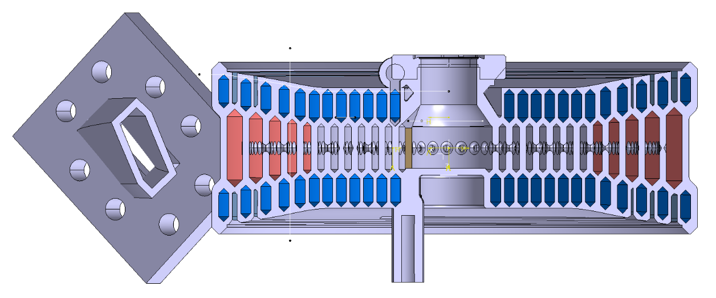
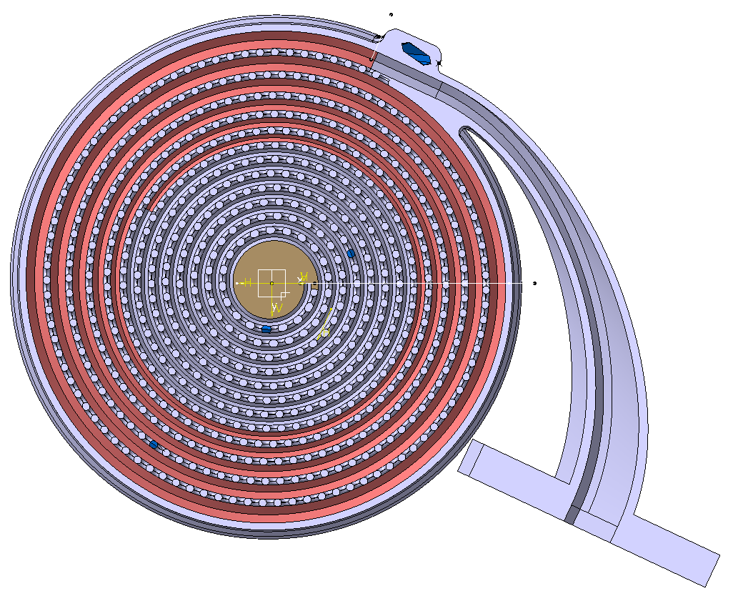
Spiral Load Final Model
Vacuum Model (RF design)-HFSS
Mechanical Design-CATIA
*
**
*X-Band Spiral Load RF Design (Optimized cross-section) H. Bursali, A. Grudiev, https://edms.cern.ch/document/2404437/1
**Pedro Morales Sanchez

Slide 21
Thank you for your attention!

Slide 22
Backup Slides

Slide 23
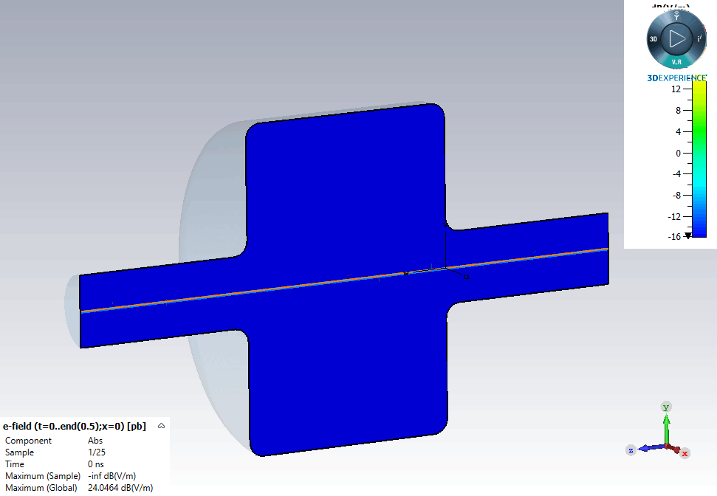
Wakefields and Impedances
The electromagnetic fields carried along with the particle bunch induce surface charges and currents on the wall of the surrounding structure and these become the sources of fields that act back on the particles in the bunch. These are called ‘wakefields’ in time domain and ‘impedances’ in frequency domain.[1]
1-RF Linear Accelerators, Thomas P. Wangler, 2nd Edition, Wiley
2-CST Workflow Example Pillbox Cavity
[2]

Slide 24

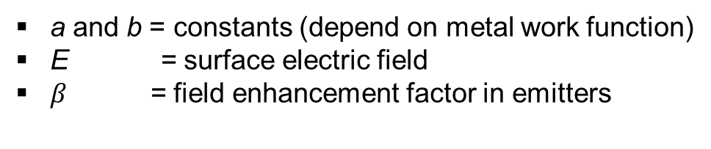
Dark Current
During high gradient operation of normal conducting linacs, electrons are emitted from inner surface of linacs, then captured and accelerated by RF fields. This is called ‘dark current’. [1]
Dark current can cause [2];
RF energy absorbtion in linac
Noise in beam position monitors
Ionasing radiation
Dark current follows the Fowler-Nordheim law [3];
$$J=aβ^{2}E^{2}e^{\frac{−b}{βE}}$$
a and b = constants (depend on metal work function)
E = surface electric field
$β$ = field enhancement factor in emitters
1-K. L. F. Bane, V. A. Dolgashev, T. Raubenheimer, G. V. Stupakov, and J. Wu, “Dark currents and their effect on the primary beam in an X-band linac,” Physical Review Accelerators and Beams, vol. 8, no. 064401, 2005.
2-Dark current analysis at CERN’s X-band facility, 10th International Particle Accelerator Conference, Melbourne, Australia, 19 - 24 May 2019, pp.WEPRB059
3- R. H. Fowler and L. Nordheim, “Electron emission in intense electric fields,” Proc. R. Soc. Lond. Ser. A Math. Phys. Eng. Sci., vol. 173, no. 119, 1928

Slide 25
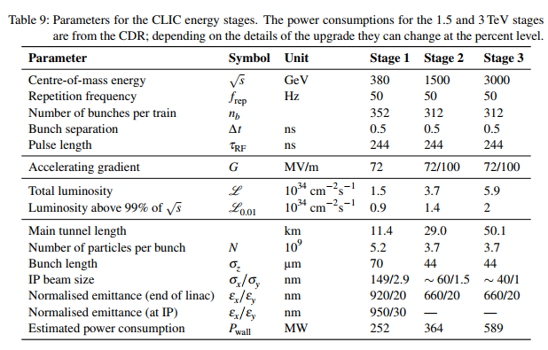
CLIC Study
CLIC Parameters
CLIC Layout for 3 TeV
[1]
[2]
CLIC final stage includes 142812 accelerating structures.
1-https://cds.cern.ch/record/2210892/files/arXiv:1608.07537.pdf
2-Updated Baseline for a Staged CLIC, https://cds.cern.ch/record/2210892
One of the main challenges,
optimisation process is ongoing.
25

Slide 26
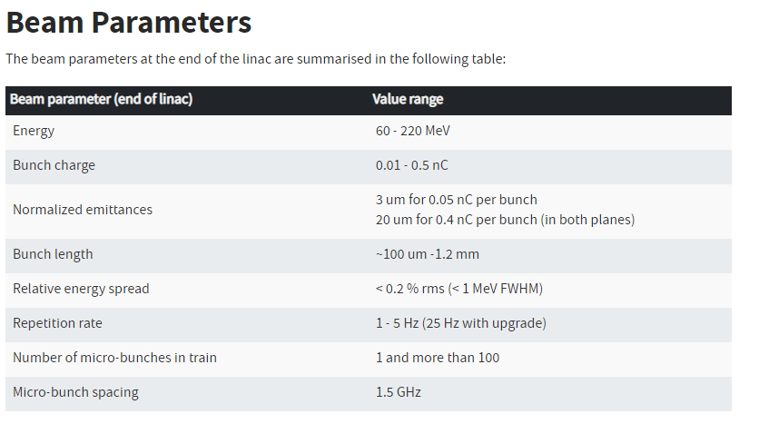
CLEAR Beam Parameters
Parameters used in this study;
Bunch charge - 0.5nC
Bunch Length - 1mm
https://clear.cern/content/beam-line-description

Slide 27
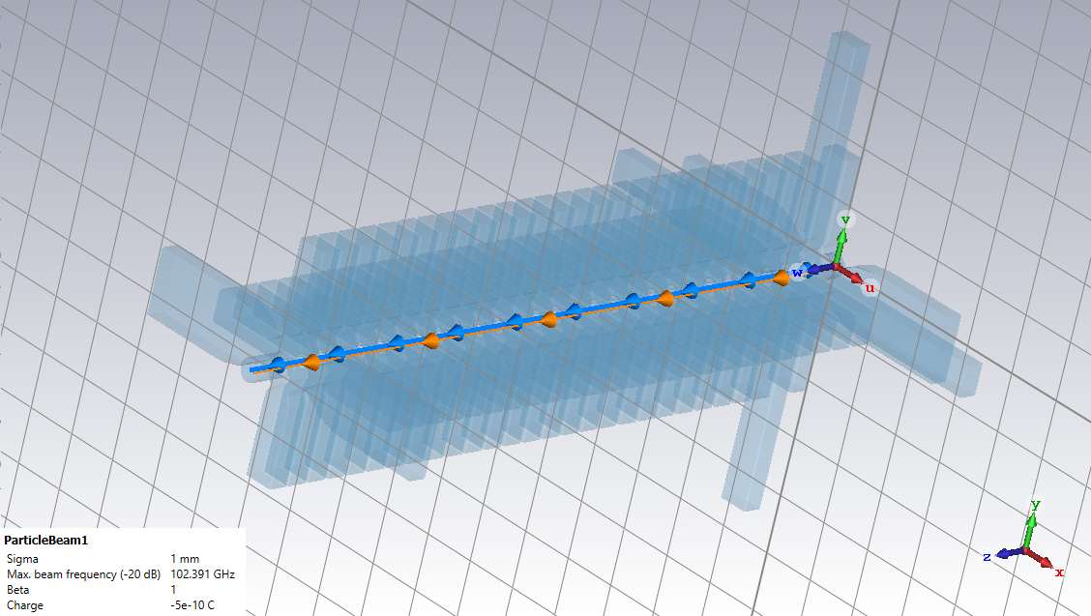
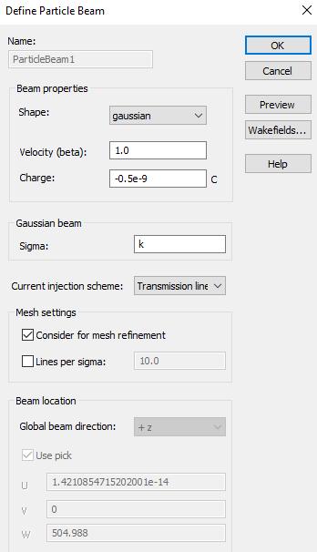
Particle Beam Properties on CST
Wakefield monitors defined as ports
Port 2
Port 3
Beam axis
Port 1
Wakefield calculation axis
Port 4

Slide 28
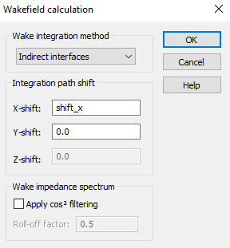
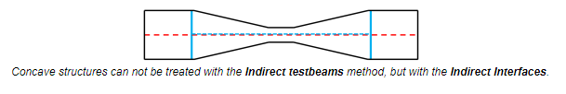
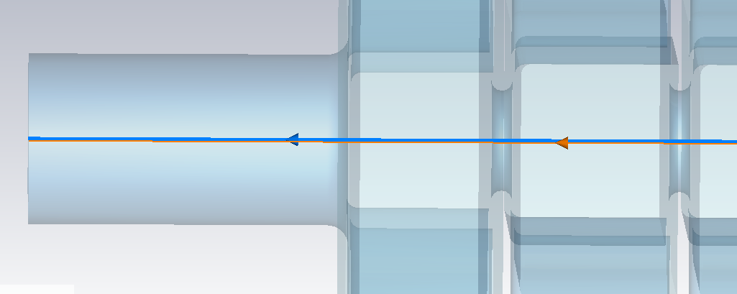
Particle Beam – Wakefield settings
*
Beam pipes are bigger than irises
*http://www.mweda.com/cst/cst2013/mergedProjects/CST_PARTICLE_STUDIO/special_beams/special_beams_wakefield_calculation_settings.htm

Slide 29
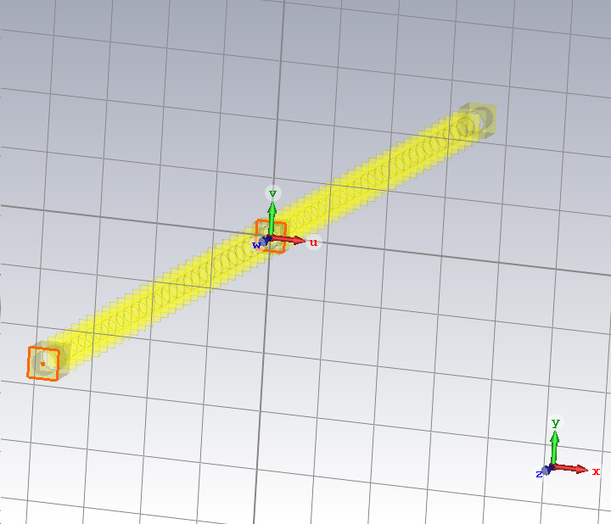
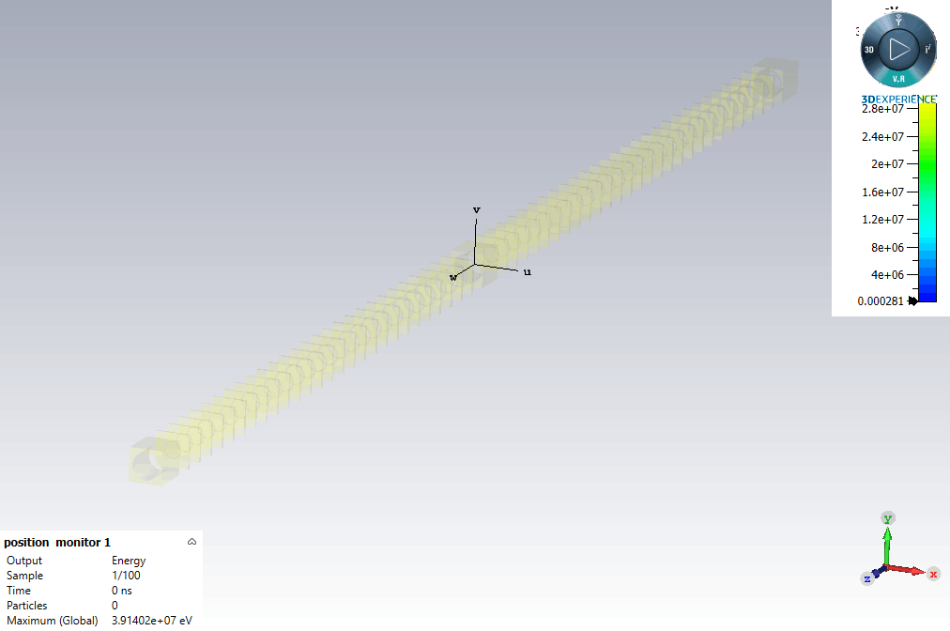
Dark Current Simulation Results (1)
1st structure
Beam direction
1st structure
1st Pic 2D Monitor
19.27 MeV
2nd structure
2nd structure
2nd Pic 2D Monitor
1st and 2nd accelerating structures are in phase.
Energy of the captured dark current at 1st pic monitor has reached nearly double at 2nd pic monitor.
39.1 MeV
29

Slide 30
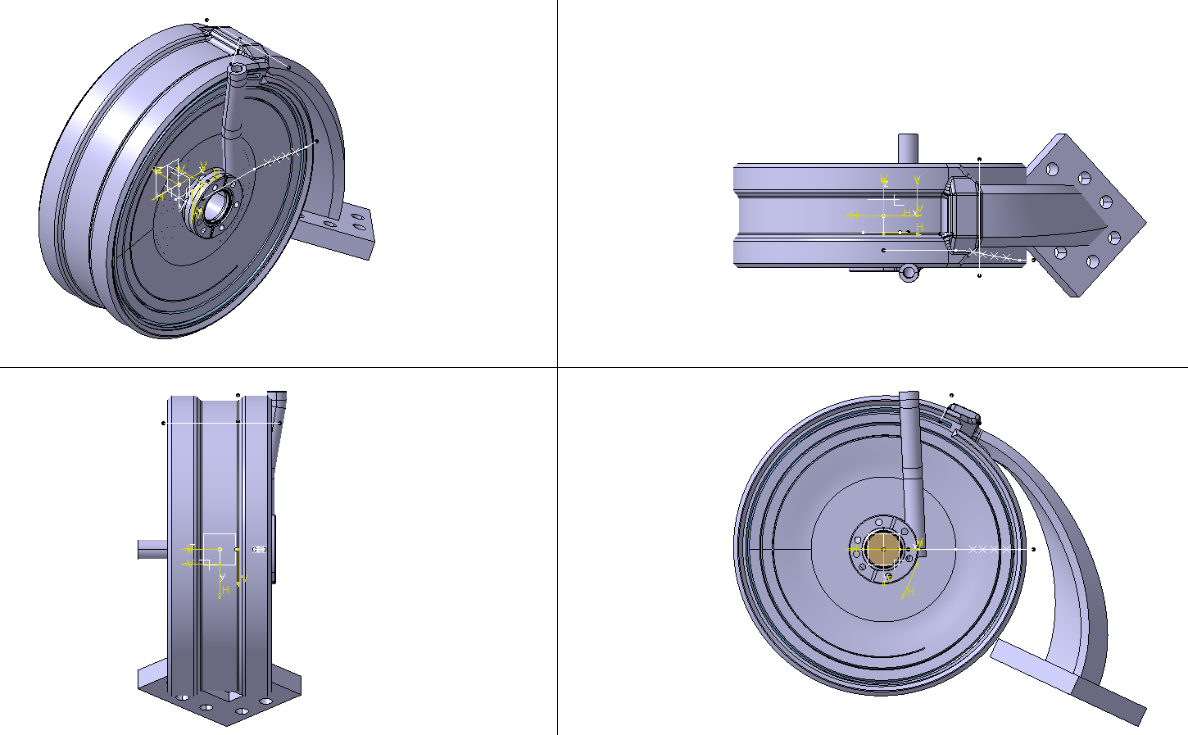
Final Model (in CATIA)
Internal Views
Side Views
Pedro Morales Sanchez

