Slide 1
Development and Characterization of Plasma Sources for Plasma-based Accelerators
Sahar. Arjmand
Prof. Massimo Ferrario
Dr. Angelo Biagioni
On behalf of SPARC_LAB
collaboration
Laboratori Nazionali di Frascati
INFN
Sahar.Arjmand@lnf.infn.it

Slide 2
Outline
Motivations:
Plasma Accelerators
Accleration Scheme
Importance of Plasma Properties
Plasma Module:
Experimental Setup
Plasma Sources
Plasma Diagnostics
Plasma Characterization Results:
Longitudinal Density Profiles
Plasma Ramps Study
Stability with Laser Trigger Technique
Future Frontiers
L = 30 mm
L = 30 mm
Electrode
Ø = 1 mm
H2 inlets
Plasma Capillary
Sahar.Arjmand@lnf.infn.it

Slide 3
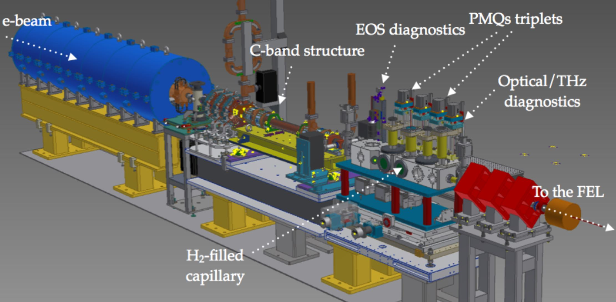
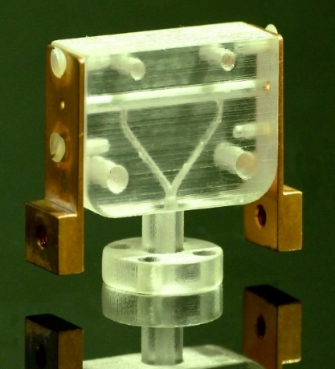
Motivations: Plasma Based Accelerators
High accelerating gradients ∼ 100GeV/m
Compactness
COMB Chamber
Sahar.Arjmand@lnf.infn.it

Slide 4
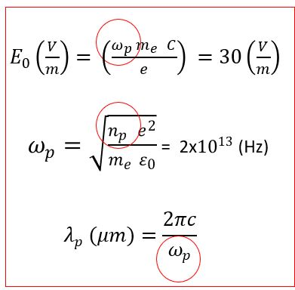
Motivations: Acceleration Scheme
PWFA and Importance of the Plasma Prameters
The plasma density regulates the accelerating field, thus is a crucial point to implement plasma based devices and has to be finely tuned.
Driver bunch
λp
Witness bunch
Sahar.Arjmand@lnf.infn.it

Slide 5
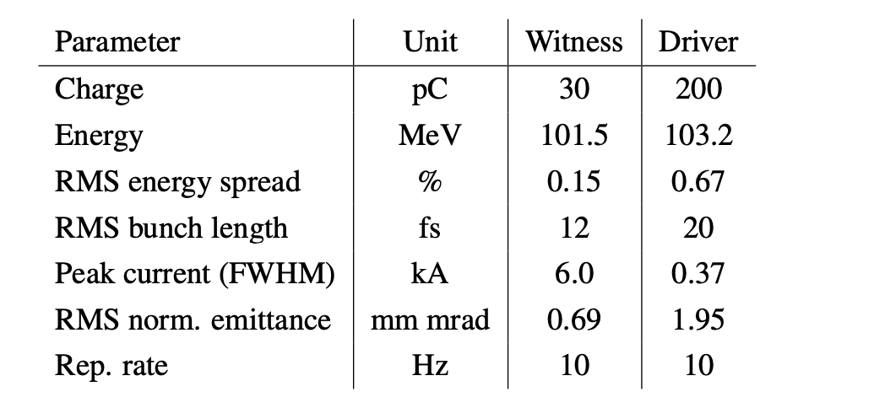
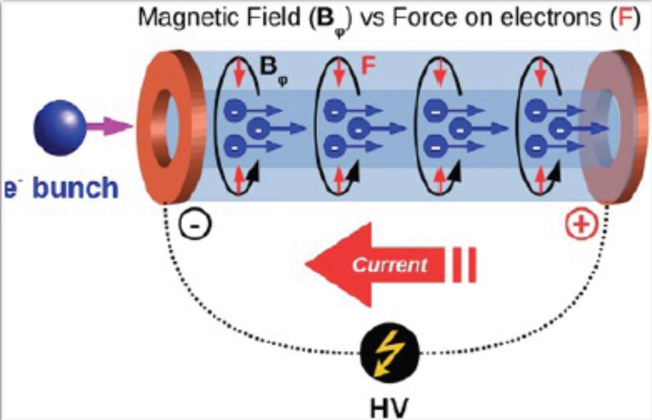
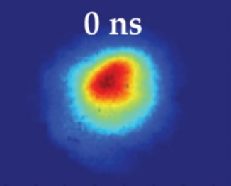
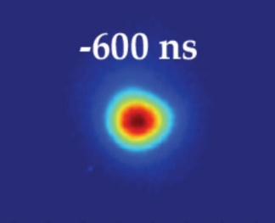
Motivations: Acceleration Scheme
High Accelerating Gradient
Witness bunch
Driver bunch
High Quality Beam
Active Plasma lens
Magnetic Field
To strongly focus an electron beam, squeezing its size down to few microns. The gas is ionized into a plasma by a current-discharge flowing through the capillary itself. The discharge induces an azimuthal magnetic field whose strength is directly proportional to the flowing current.
Focusing the beam
Replacing Solenoids/Quadrupoles
(Compactness)
B_{φ} > 500 T/m
90 μm
25 μm
Sahar.Arjmand@lnf.infn.it

Slide 6
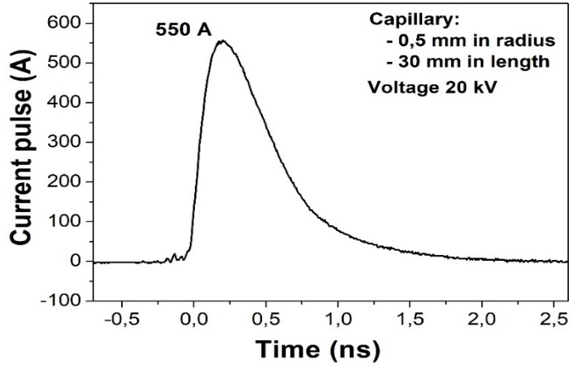
Plasma Module: Experimental Setup
Experimental Setup
Vacuum:
10⁻⁷ mbar
Gas injection system: 3 ms
H2 inlets
Ø = 1 mm
Gas injection frequency: 1-10Hz
Discharge circuit
Timing:
Valve opening time
Voltage delay time
Trigger of ICCD camera
Capillary shapes:
Length (Energy)
Radius (Density)
Capillary 30mmx1mm
Double inlets
Voltage 20kV
Current 550A
Spectrometer:
Grating
Optical alignment
Camera timing:
Delay time
Gate time
Sahar.Arjmand@lnf.infn.it

Slide 7
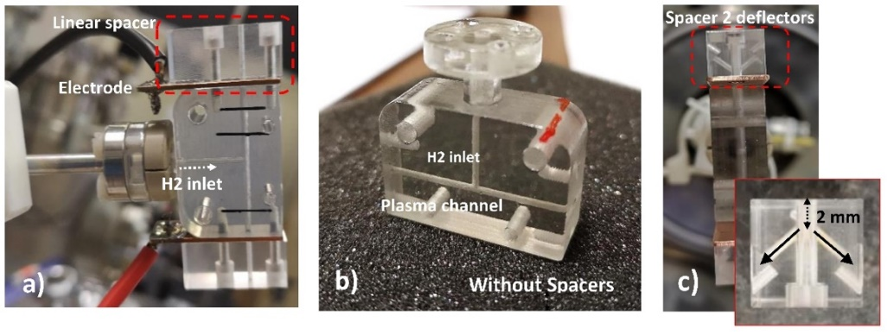
Plasma Module: Plasma Sources
Plasma Sources:
Linear Spacer/Standard Capillary/Spacer with deflectors
Spacer: A 10mm elongation located at the capillary’s exterimities, near the electrodes to stabilize the plasma ramps.
Table of all tested Sources
Capillary
Length | Diameter | Inlet
20 mm | 1 mm | Single
20 mm | 2 mm | Single
30 mm | 1 mm | Single
30 mm | 1 mm | Double
50 mm | 1 mm | Double
100 mm | 1 mm | Double
200 mm | 1 mm | Double
Sahar.Arjmand@lnf.infn.it

Slide 8
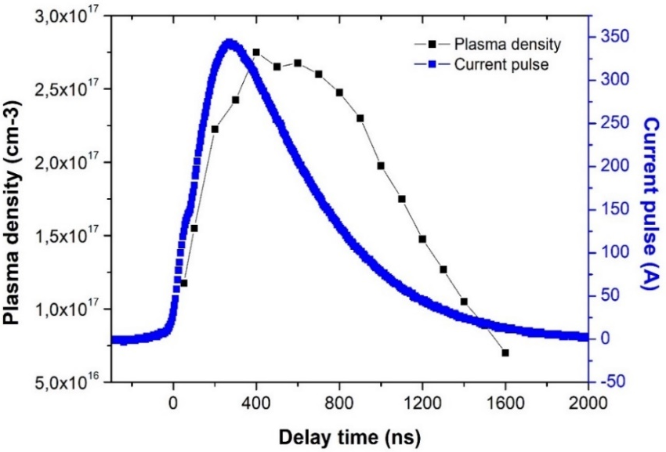
Plasma Module: Plasma Diagnostics
Stark Broadening Method
< Balmer Lines >
Alpha: n 3 2 656 nm
Beta: n 4 2 486 nm
By using the Stark Broadening method we measure the plasma densities as a function of the delay time from the zero-time of the current pulse. For each delay time we obtain a longitudinal profile of the density.
The results below have obtained:
The larger is the Balmer line (Δλ)
The higher is the plasma density.
Electrode shadow
Plasma channel
Plasma plume
Balmer beta line B_{β} due to transitions from the outer orbit n=4 to the orbit n=2
Plasma density depends on the enlargement of Balmer lines so the measuring Balmer lines are as following.
Sahar.Arjmand@lnf.infn.it

Slide 9
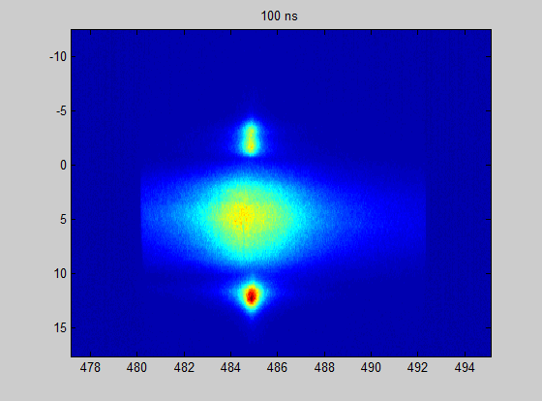
Plasma Module: Plasma Diagnostics
Plasma density inside and outside the capillary changes during the current pulse: such a behaviour it is essential for injecting the electron bunch at the right time.
Plasma Density
Position (mm)
Balmer β line
Δλ
Capillary 30mmx1mm
Double inlets
Voltage 20kV
Current 550A
Capillary
Electrode
Plasma
Channel
Plasma Plume
λ (nm)
Sahar.Arjmand@lnf.infn.it

Slide 10
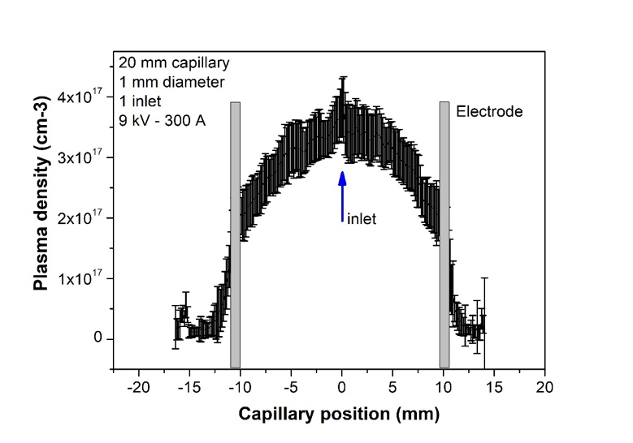
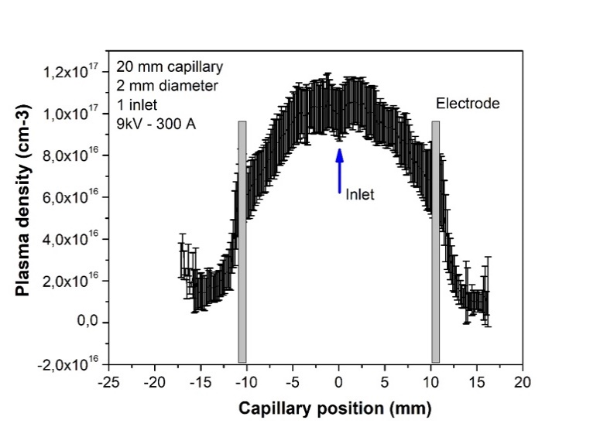
Plasma Charecterization Results: Density Measurement
Diameter Configuration
1
Capillary 20mmx1mm
Single inlet
NO SPACERS
Capillary 20mmx2mm
Single inlet
NO SPACERS
Voltage: 9 kV
Current: 300 A
Pressure: 300 mbar
Longitudinal Plasma Density Profile
3.5×10¹⁷
1×10¹⁷
2×10¹⁷
6×10¹⁶
Reduction of 75 %
Reduction of 65 %
Sahar.Arjmand@lnf.infn.it

Slide 11
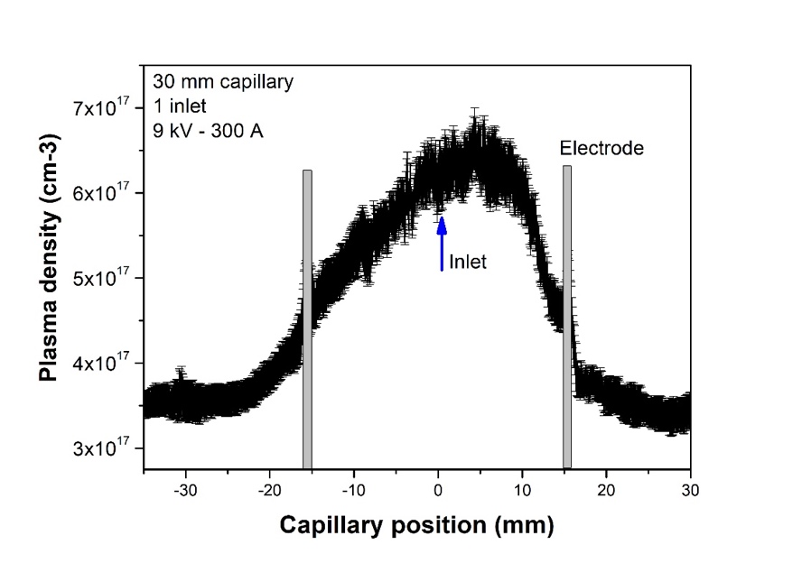
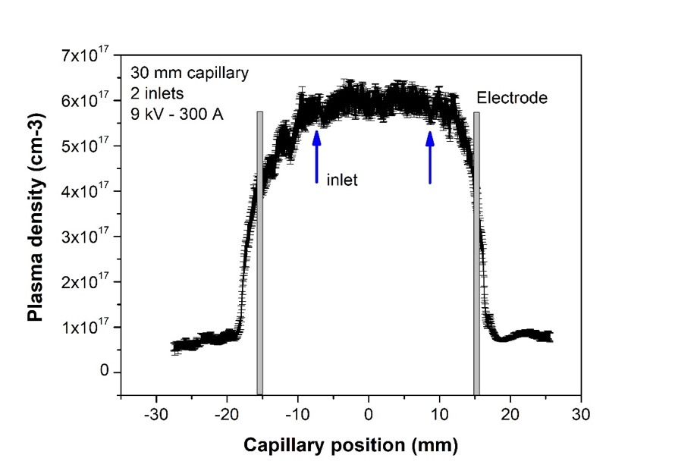
Plasma Charecterization Results: Density Measurement
Inlet Configuration
2
Capillary 30mmx1mm
Single inlet
NO SPACERS
Capillary 30mmx1mm
Double inlets
NO SPACERS
Voltage: 9 kV
Current: 300 A
Pressure: 300 mbar
Longitudinal Plasma Density Distribution
Sahar.Arjmand@lnf.infn.it

Slide 12
Plasma Charecterization Results: Plasma Ramps
3
Ramps Comparison of:
Capillary with Linear Spacer
Standard Geometry
Capillary with Spacer and deflector
Sahar.Arjmand@lnf.infn.it

Slide 13
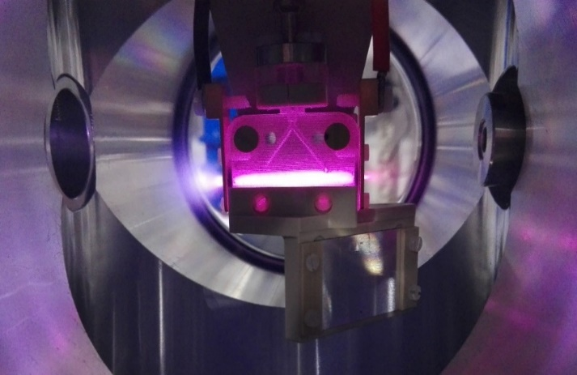
Plasma Charecterization Results: Plasma Ramps
Ramps Stabilization
No spacers _3ms_delay2000ns_Pressure -0.2
Plasma discharge
Plasma plume
Spacers _3ms_delay2000ns_Pressure -0.2
Sahar.Arjmand@lnf.infn.it

Slide 14
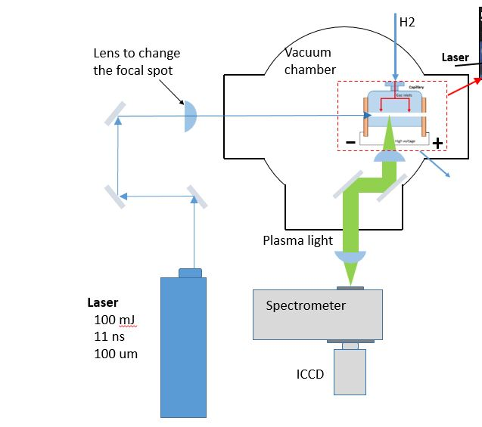
Plasma Charecterization Results: Laser Trigger Technique
Laser Trigger Setup
4
Lens to change the focal spot
Capillary
30mmx1mm
2 inlets
Voltage: 5.5 kV
Laser: 80 mJ
Current: 110 A
Density measures
Discharge Capillary
Plasma Light
Laser:
80 mJ
11 ns
100 um
By applying laser at the one entrance of
the capillary, it is possible to stabilize
the plasma formation, depending on:
Voltage
Pressure
Laser energy
Laser spot position along the capillary
Sahar.Arjmand@lnf.infn.it

Slide 15
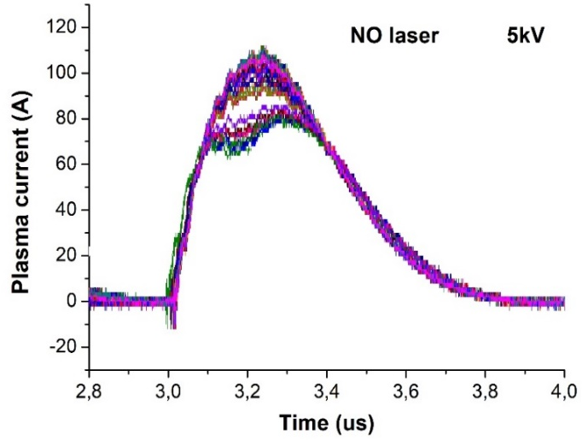
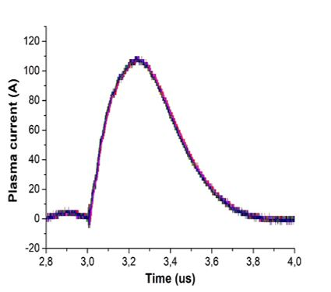
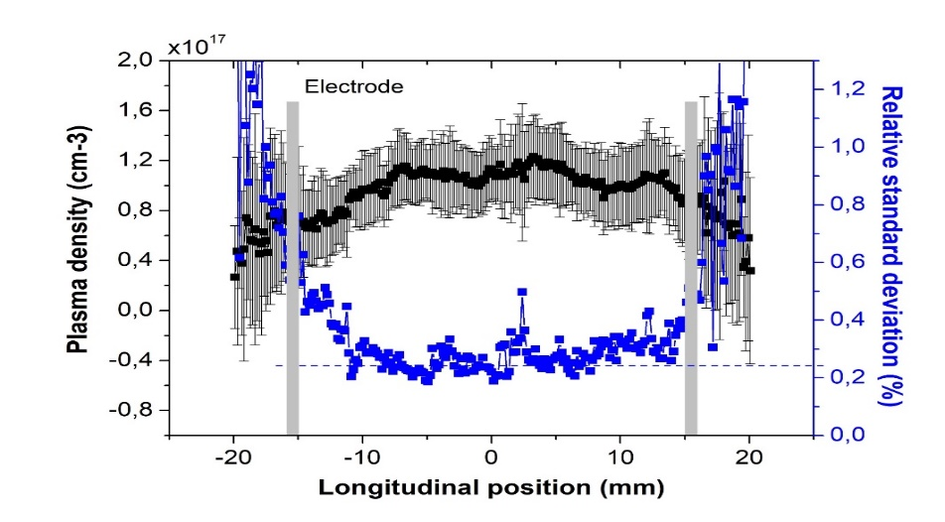
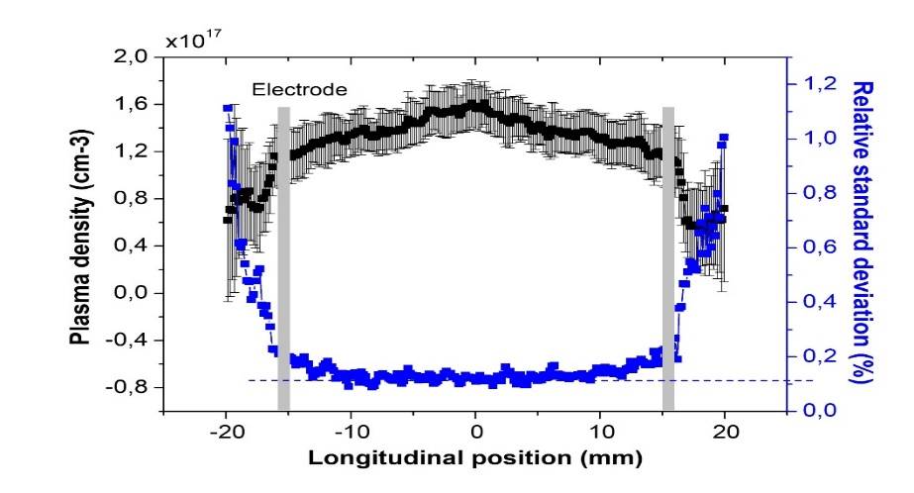
Plasma Charecterization Results: Laser Trigger Technique
Longitudinal Shot-to-shot Stability of the Plasma Formation
Capillary
30mmx1mm
2 inlets
Voltage: 5.5 kV
Laser: 80 mJ
Current: 110 A
The laser trigger technique used to reduce the plasma instabilities within the discharge capillaries, on the area close to the electrodes and has shown that could remove the current oscillations around the peak value.
Instability without laser (50 shots)
(relative standard deviation reaches 25%)
Stability with laser (50 shots)
(Relative standard deviation 10-12%)
Reduction of ∼ 15-13 %
Sahar.Arjmand@lnf.infn.it

Slide 16
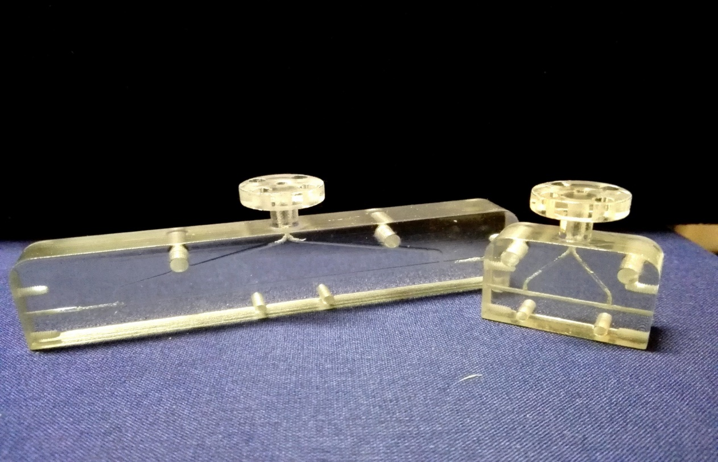
Future Frontier
200 mm - 1 mm
1. Shortly, an investigation of the new capillaries up to 400 mm that will be placed in the novel acceleration machine related to the EuPRAXIA project would be feasible.
To be Tested
The maximum accelerating filed is depend on the the plasma density, for this reasoan the length of capillary get increased to increase the accelerating energy while the gradient remains constant.
200 mm
2. For capillaries in higher lengths, the length will be segmented, and the voltage will be forced to each part separately to ionizing the gas inside the entire plasma tube.
400 mm
3. Characterization of the transverse plasma density distribution.
Sahar.Arjmand@lnf.infn.it

Slide 17
Do appreciate your attention!
Laboratori Nazionali di Frascati
INFN
Sahar.Arjmand@lnf.infn.it

