Slide 1
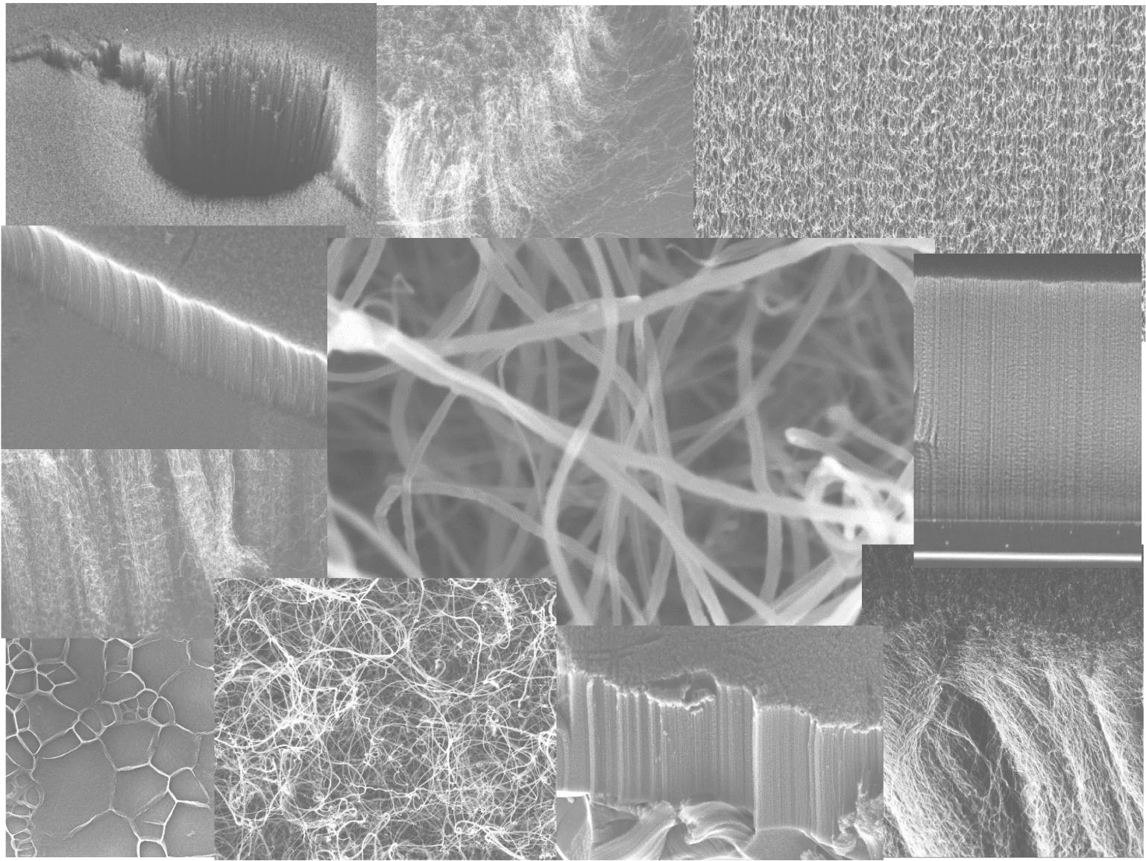

Vertically Aligned Carbon Nanotubes: Synthesis, Characterization and Applications
Ilaria Rago*, Francesco Pandolfi, Gianluca Cavoto
*ilaria.rago@uniroma1.it
Dipartimento di Fisica, Università di Roma “La Sapienza»
INFN Rome

Slide 2
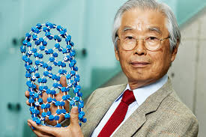
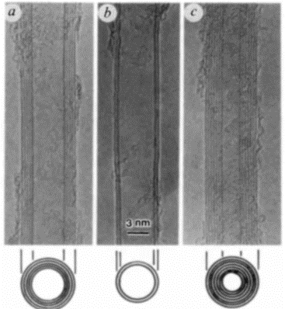
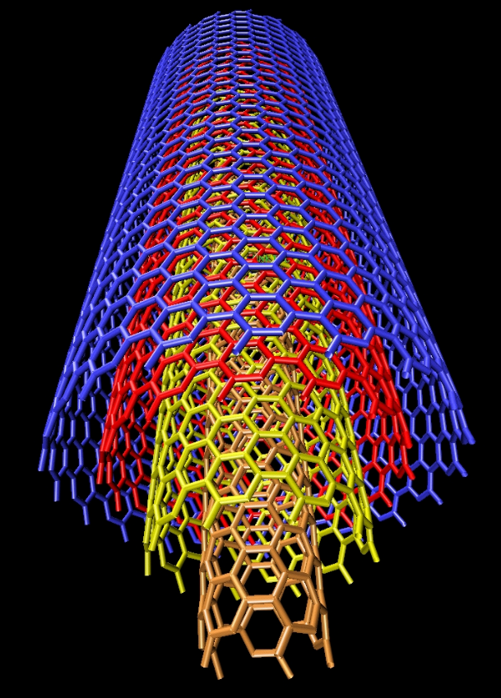
CNTs discovery
TEM images of different MWCNTs
Structure of a MWCNT
Sumio Iijima, the discoverer of carbon nanotubes
S. Iijima, Helical microtubules of graphitic carbon, Nature (London) 354 (1991) 56
Copyright Alain Rochefort Assistant Professor Engineering Physics Department,
Nanostructure Group, Center for Research on Computation and its Applications (CERCA).
2
2

Slide 3
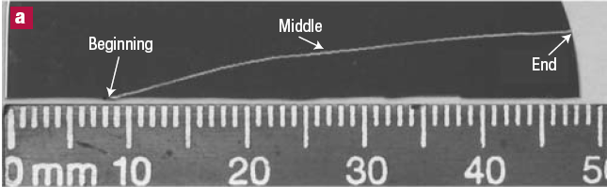
What are Carbon NanoTubes (CNTs)?
CNTs: hollow, cylindrical nanostructures composed of one or more separate layers of carbon bonded in a hexagonal lattice, are 1000x thinner than an average human hair, but can be 200x stronger than steel.
High aspect ratio:
Length:
μm to cm
→ quasi 1D solid
Diameter:
as low as 1 nm
SWCNT – 1.9 nm
Zheng et al. Nature Materials 3 (2004) 673.
3
3

Slide 4
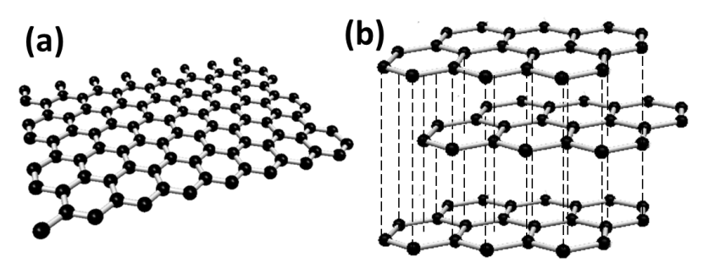

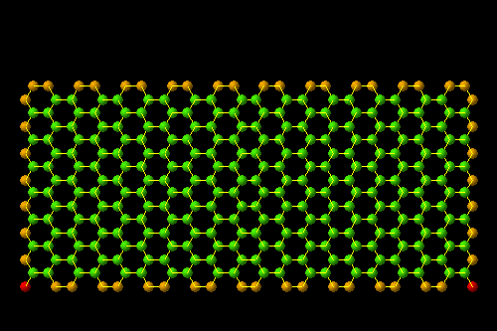
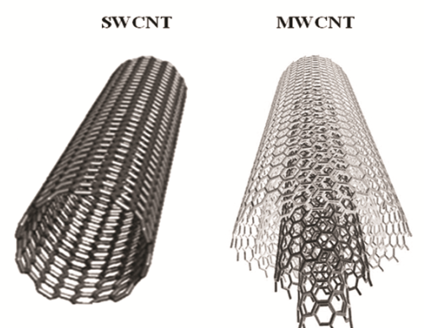
…wrapping a sheet of graphene into a tube
graphene
graphite
SWCNT
(observed in 1993)
MWCNT
(firstly observed in 1991)
4
S. Maruyama, Univ. Tokyo University
4

Slide 5
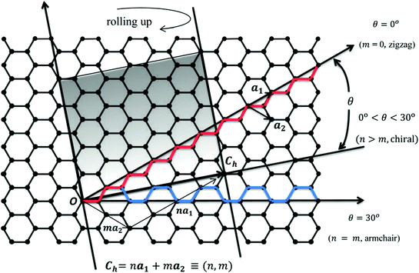
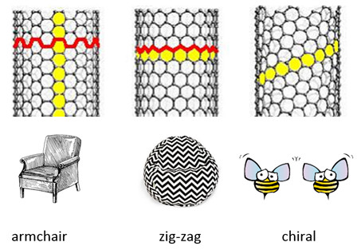
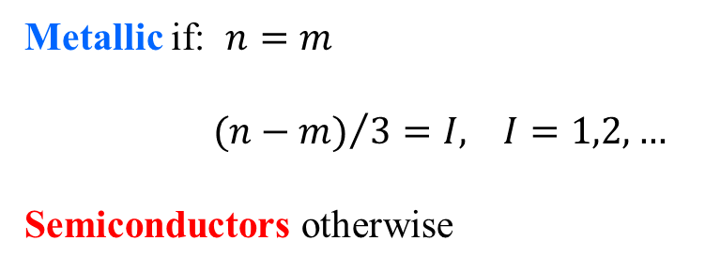
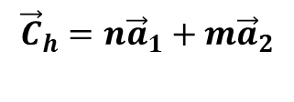
Single-Walled Carbon Nanotubes (SWCNTs) structure
CNT diameter and chirality are defined by a vector perpendicular to the tube axis.
All possible tubes are obtained by spanning the vector between the armchair and zigzag directions.
$${\vec{C}}_{h}=n{\vec{a}}_{1}+m{\vec{a}}_{2}$$
Metallic if: $n=m$
${ (n−m)}/{3=I, I=1,2,…}$
Semiconductors otherwise
K. Koziol, University of Cambridge
5
5

Slide 6

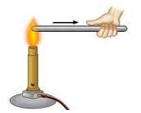

Some properties of CNTs
• The strongest and most flexible molecular
material because of C-C covalent bonding
and seamless hexagonal network architecture
• Young’s modulus of over 1 TPa vs 70 GPa for Aluminum, 700 GPA for C-fiber
• Maximum strain 10-30% much higher than any material
• Thermal conductivity > 3000 W/mK in the axial direction, greater than natural diamond and the basal plane of graphite (both 2000 W/mK)
Good thermal and chemical stability, normally being stable up to 650 °C in air
CNT can be metallic or semiconducting depending on chirality and diameter
Very high current carrying capacity (10⁹ A/cm²)
6
6

Slide 7
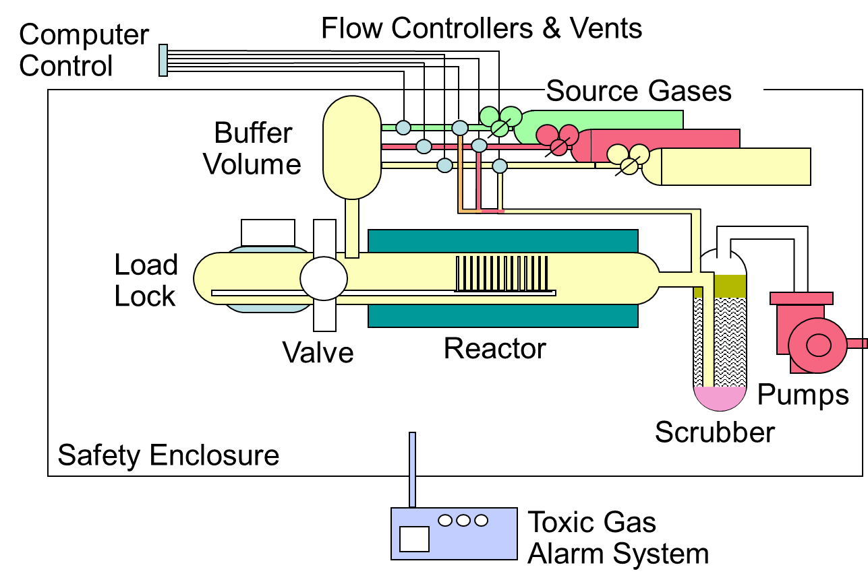
CNTs Synthesis via Chemical Vapor Deposition (CVD)
CVD is a simple, economic and versatile technique for synthesizing CNTs
harnessing plenty of hydrocarbons in any state (solid, liquid or gas)
use of various substrates (silicon, fused silica, aluminum, copper)
CNTs growth in a variety of forms (powder, thin or thick films, aligned or entangled, straight or coiled nanotubes, or a desired architecture of nanotubes on predefined sites of a patterned substrate)
Thermal decomposition of a hydrocarbon vapor on nanostructured transition metal catalyst at temperatures sufficiently high to decompose the hydrocarbon (600 °C-1200 °C) in a high-vacuum reaction chamber.
7
7

Slide 8
Vertically Aligned CNTs (VA-CNTs) growth via CVD
Thermal decomposition of a gaseous precursor on catalytic nanoparticles in a high-vacuum reaction chamber
C_{x}H_{y}
C_{x}H_{y}
Diameter ~ 15-25 nm
2-5 nm
Metal Catalyst
Buffer layer
Substrate
Diffusion of produced carbon atoms and formation of CNT
Formation a carbon layer on catalyst surface (red line) stopping the growth
process
Surface adsorption of CxHy feedstock molecules on catalyst and carbon production

Slide 9
VA-CNTs growth mechanism
Tip growth
The catalyst is lifted off from the supporting surface during nanotube’s growth
Base growth
CNT grows up
with the catalyst particle rooted on its base
M Kumar and Y. Ando, J. Nanosc. Nanotec. (2010)
9
9

Slide 10
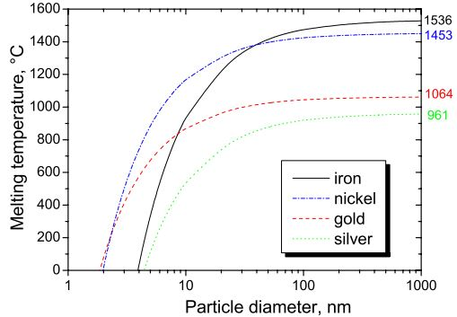
CNTs catalysts
Metallic nanoparticles are required to enable hydrocarbon decomposition.
The most widely employed metals are Fe, Co and Ni:
high carbon solubility in these metals at high temperatures;
high carbon diffusion rate.
The melting point of metals decreases with nanoparticle radius, falling to very low temperatures for nanoparticles below 10 nm in diameter
10
10

Slide 11
CNTs carbon precursors and growth substrates
The growth substrate plays several important roles in CNT synthesis:
formation of metal nanoparticles with a narrow size distribution
avoid excessive sintering of metal particles during CVD
definition of the macroscopic shape of the CNTs product
Some of the common substrates used in CVD are graphite, quartz, silicon, silicon carbide, silica, alumina, alumina silicate and magnesium oxide.
Recent research has focused on the synthesis of CNTs onto metallic substrates: copper, aluminum, Inconel, stainless steel, Si/SiO₂ substrates made conductive by the deposition of metallic thin films (Au (~100 nm, top)/Ti(~10 nm, adhesion layer).
11
11

Slide 12
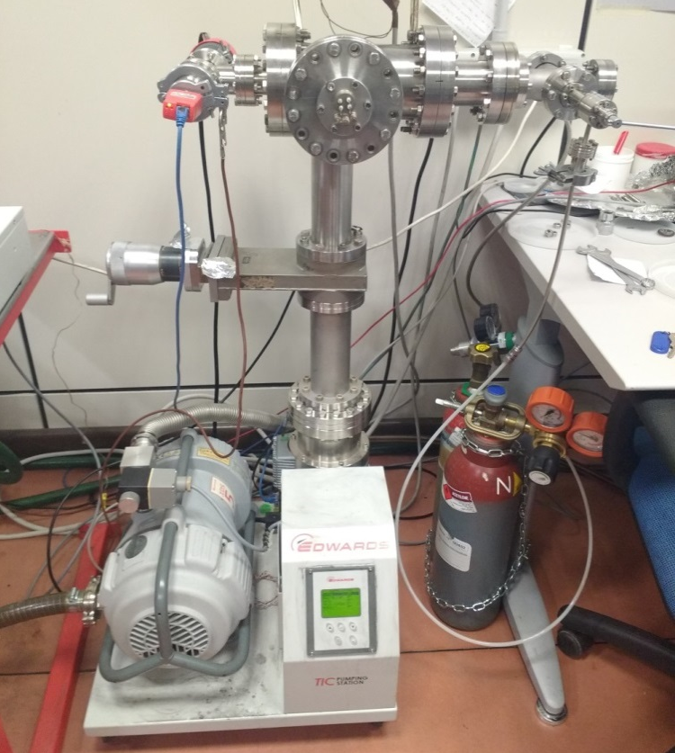
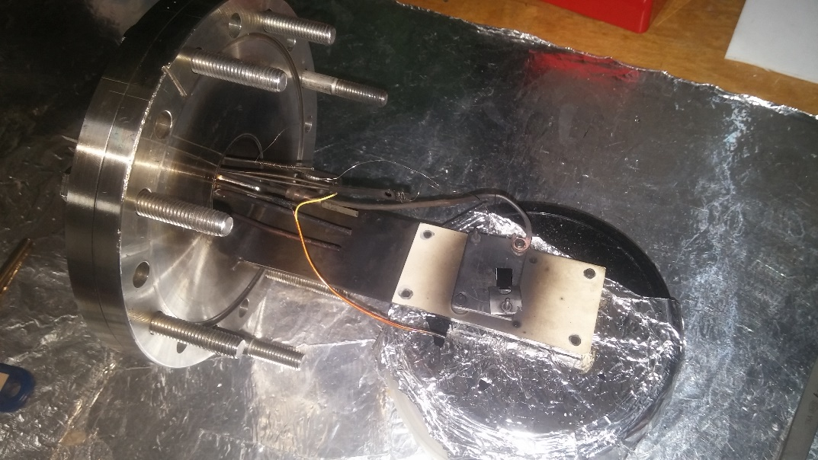
VA-CNTs synthesis via CVD*
Thermal decomposition of a gaseous precursor on catalytic nanoparticles in a high-vacuum reaction chamber
T ≈ 670 – 750 °C
Growth Catalyst: Fe nanoparticles
Annealing treatment: 670–700 °C in H₂ atmosphere for 4 minutes (up to a partial pressure of 3∙10⁻¹ mbar)
CNTs growth: C₂H₂ (up to a partial pressure of 10–20 mbar) for 10 minutes
Si and SiO₂ substrates
*In collaboration with Andrea Goldoni, Carbon Lab, ELETTRA, Trieste, Italy

Slide 13
VA-CNTs morphology and alignment: SEM characterization

Slide 14
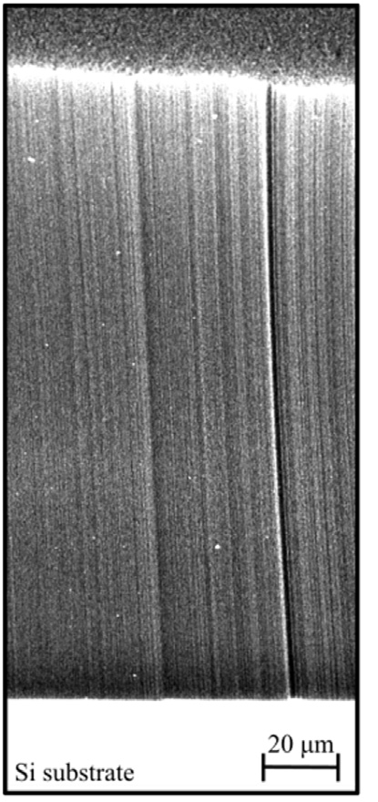
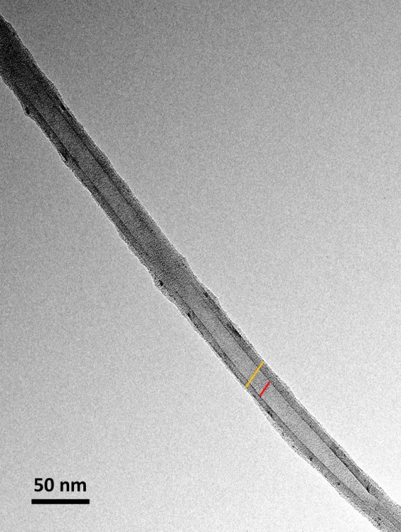
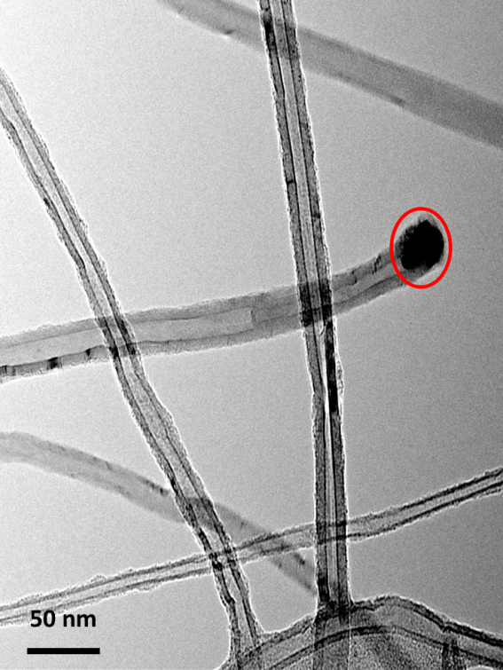

VA-CNTs dimensions, density and structure
HEIGHT 180 ± 8 μm
DIAMETER 20 ± 1 nm
~ 10⁴ aspect ratio
$$N=4x{10}^{10}\frac{MWCNTs}{{cm}^{2}}$$
TEM micrographs
180 µm
O.D.≈21.47 nm
I.D. ≈11.92 nm
Si substrate
20 µm

Slide 15
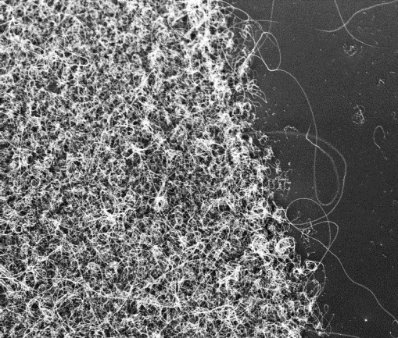
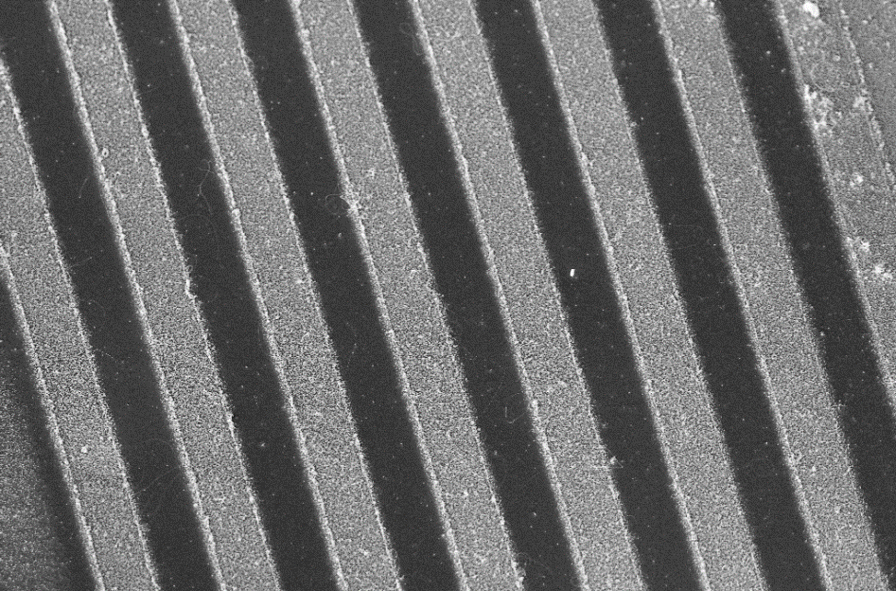
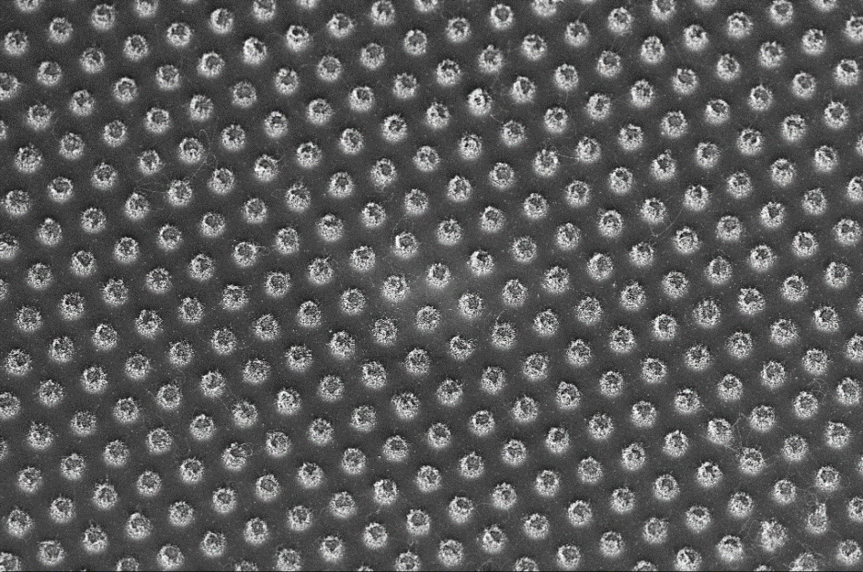
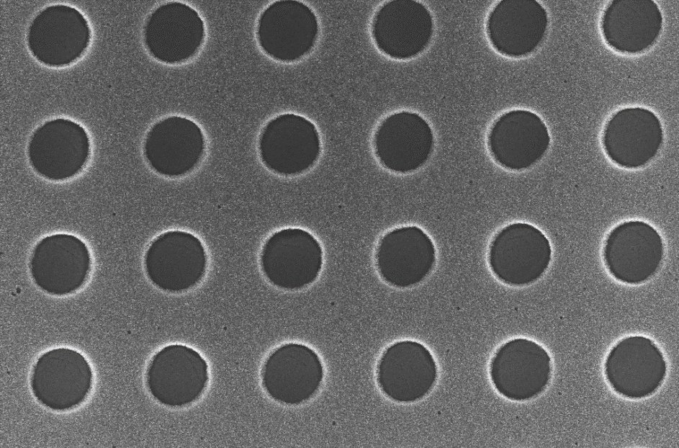
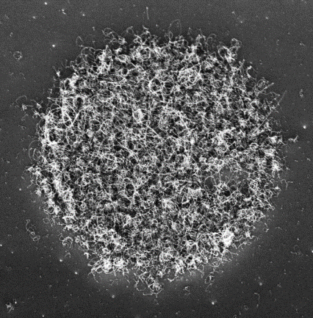
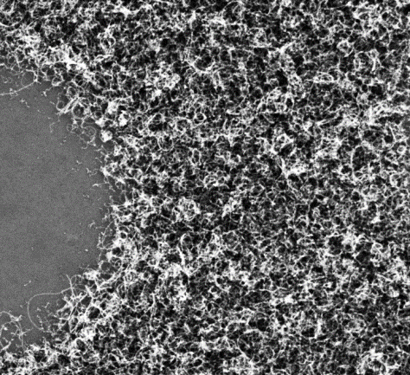
Patterned CVD grown VA-CNTs
1 µm
SiO₂
Si
10 µm
1 µm
1 µm
10 µm
10 µm
15

Slide 16
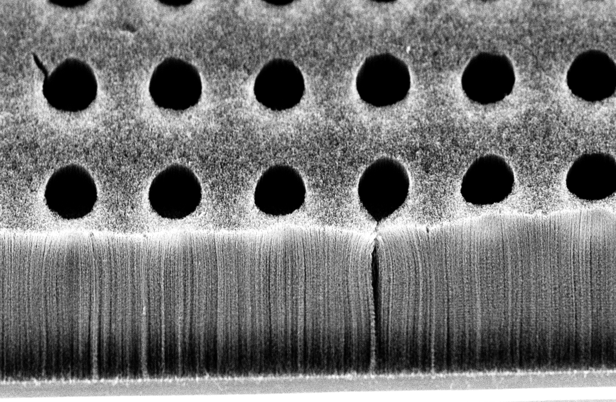

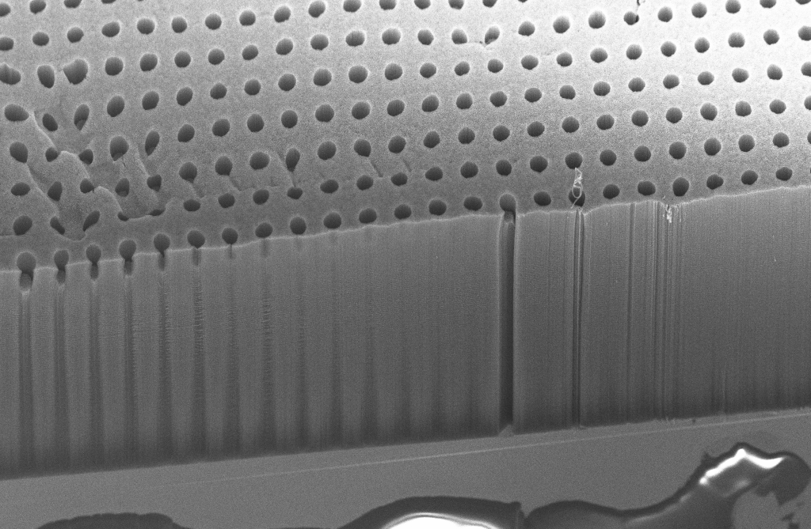
Patterned CVD grown VA-CNTs: controlling their length
Growth time ~ 4 min
45 µm
20 µm
20 µm
200 µm
Growth time ~ 10 min
100 µm

Slide 17
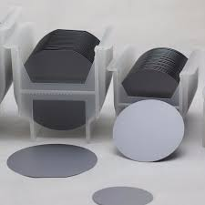
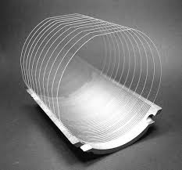
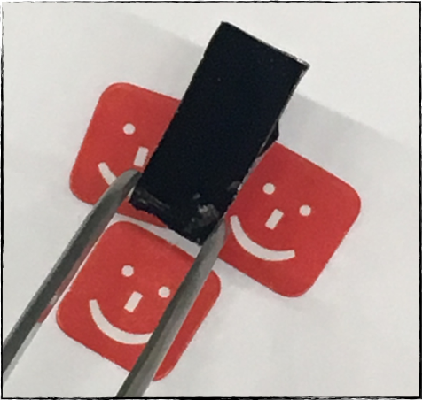
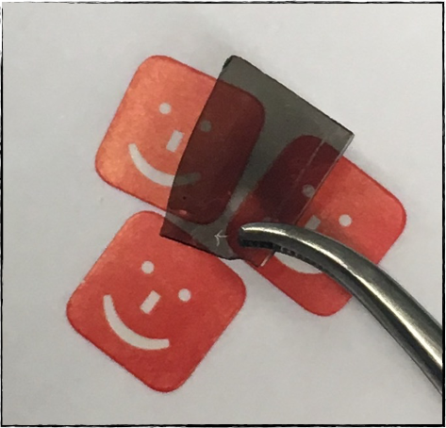
VA-CNTs growth on opaque and transparent substrates
Silicon wafers
Fused silica wafers
180 µm
After cleaving and CNTs synthesis
15 mm
Si substrate
20 µm

Slide 18
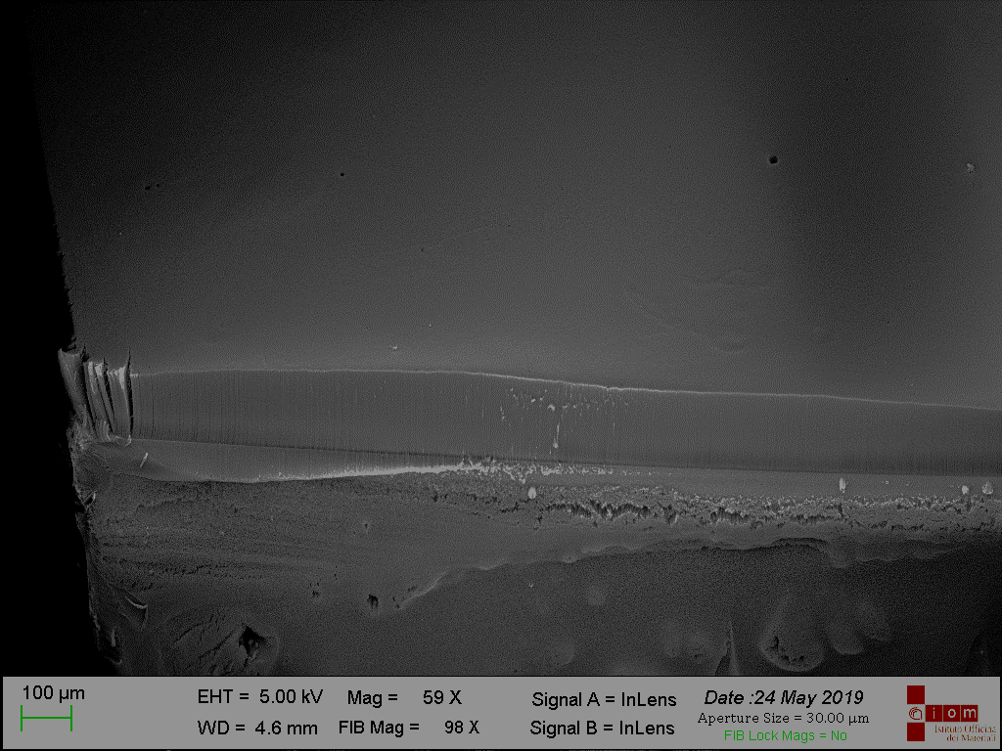
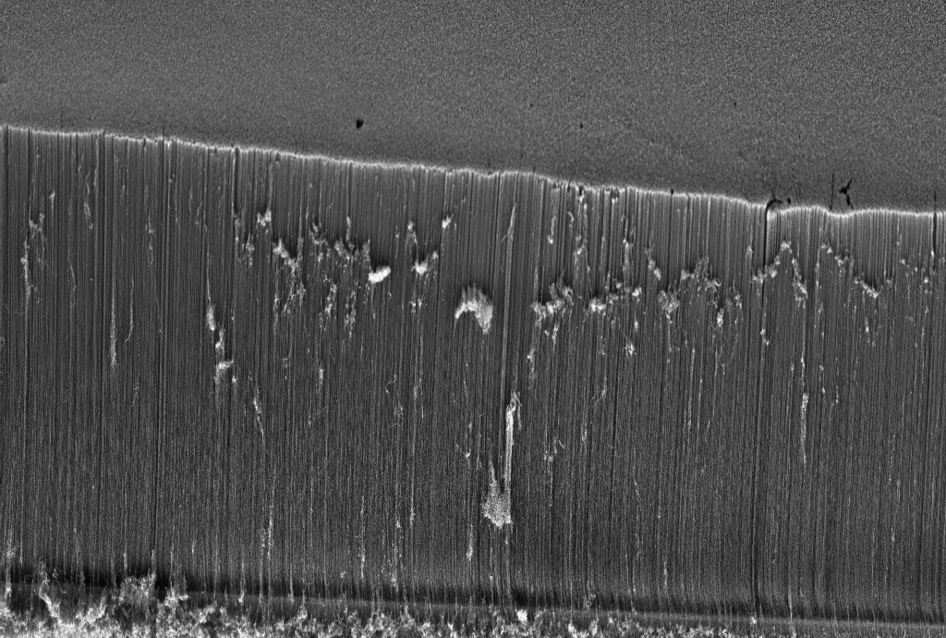
CVD assisted growth of VA-CNTs on transparent substrates (fused silica)
HEIGHT 160 ± 10 μm
DIAMETER 21 ± 3 nm
100 µm
~ 160 µm
10 µm

Slide 19

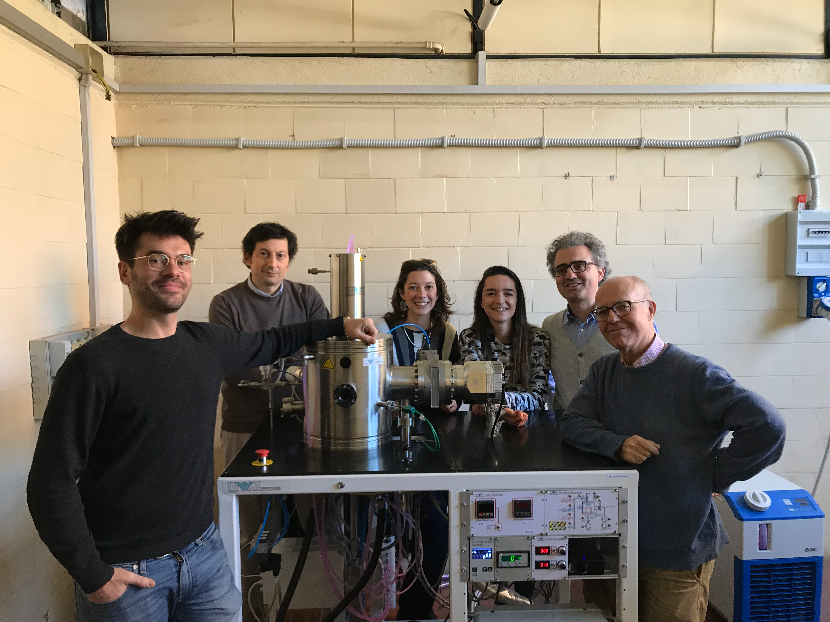
Growing VA-CNTs in NanoUV/PTOLEMY Lab
New CVD chamber installed in Rome Sapienza at the end of July 2020
Thanks to ATTRACT funding
Highly versatile CVD chamber with a large reaction zone enabling VA-CNTs growth on an entire wafer (2 inch) or on different samples simultaneously
Equipped with Plasma-Enhanced technology

Slide 20
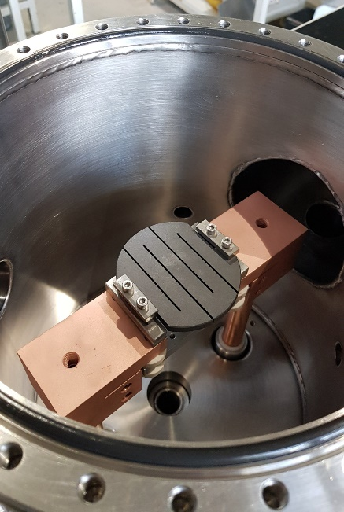
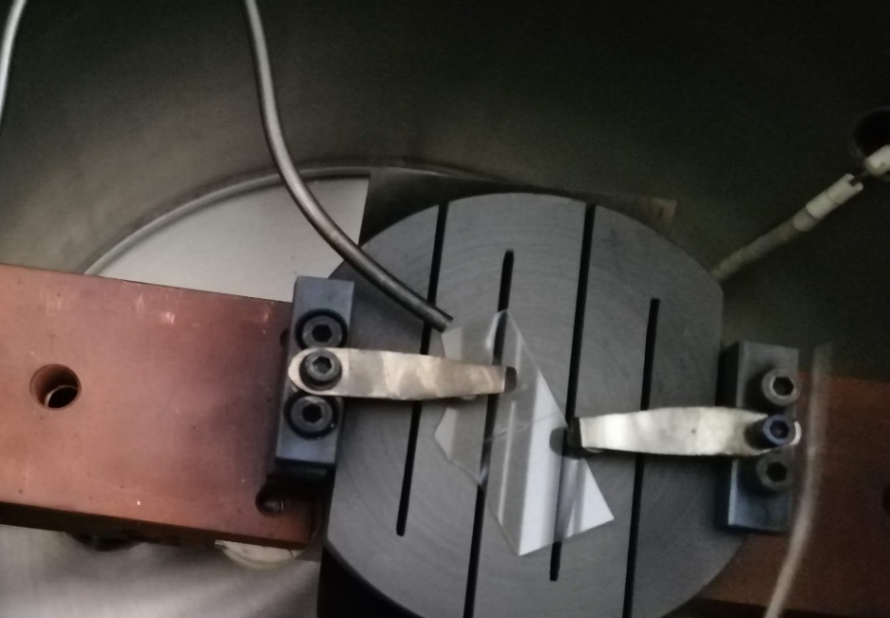
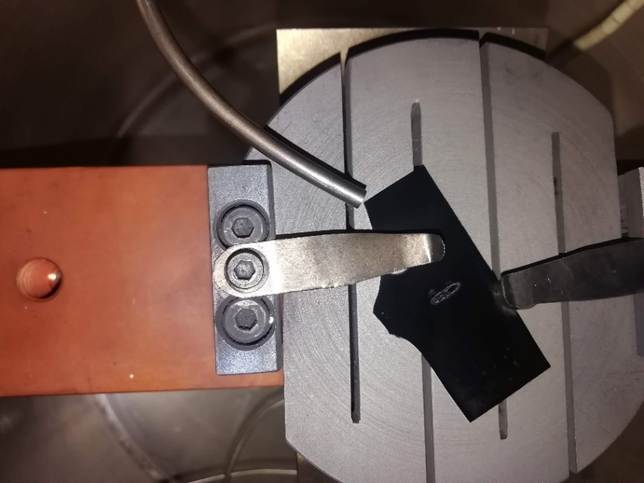
Growing VA-CNTs in NanoUV/PTOLEMY Lab
Optimized VA-CNTs Growth Parameters
T ≈ 720 – 750 °C
Growth Catalyst: Fe nanoparticles
Annealing treatment: 700–720 °C in H₂ atmosphere for 4 minutes (up to a partial pressure of 6∙10⁻¹ mbar)
CNTs growth: C₂H₂ (up to a partial pressure of 10–20 mbar) for 10 minutes
SiO₂ substrates (up to now!)
Before VA-CNTs Growth
After VA-CNTs Growth
4 cm

Slide 21
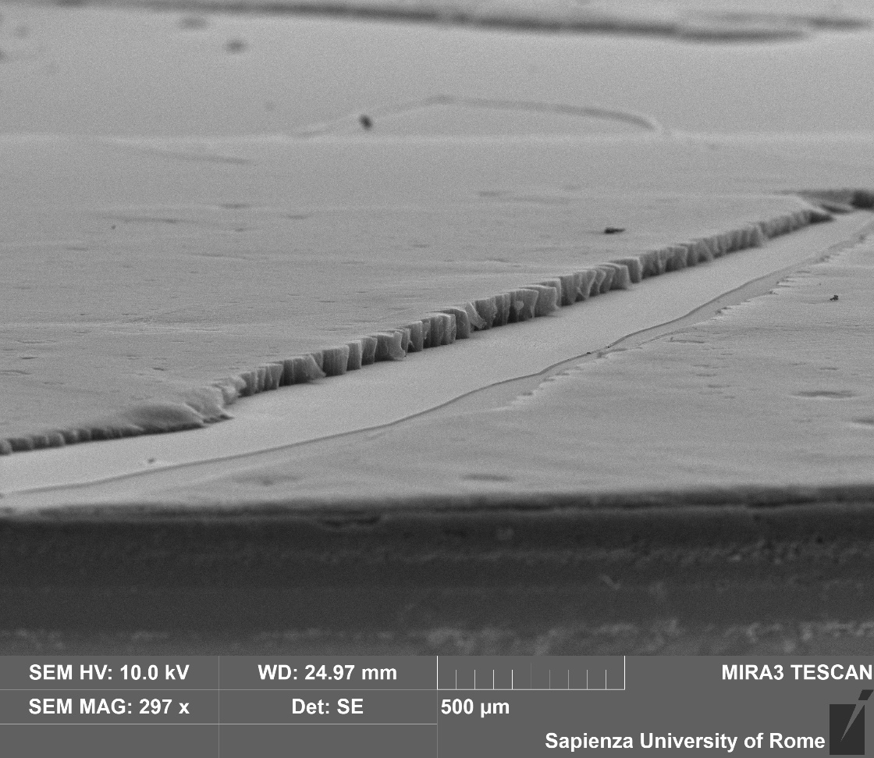
First Successful VA-CNTs Growths via our CVD chamber
Successfully synthetized VA-CNTs carpets having uniform distribution on the underneath SiO₂ substrate, typical diameter of around 20 nm and lengths up to 100 µm

Slide 22
Applications of VA-CNTs
Electronics
Electrochemical/chemical storage devices
Field-emission devices
High-intensity electron sources
Flat panel displays
Electrical interconnects
Transistors
Fuel cells
Supercapacitors
Lithium ion batteries
Hydrogen storage
Electromechanical devices
Actuators
Artificial muscles
Nanoelectrode-based sensors
Ion sensors
Gas sensors
Biosensors
Thermal devices
thermal interface materials
Mechanical devices
Challenges
Carbon nanotube ropes
TEM grids
Mechanical tapes
Control of VA-CNTs properties (diameter, length, density, quality of the tubes)
Large scale production
Application development

Slide 23
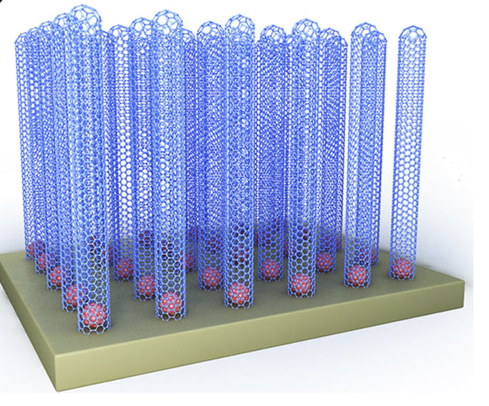
VA-CNTs: Thermal Interface Material (TIMs)
CNTs are considered as one of the most promising TIMs due to their good stability, high thermal conductivity and desirable mechanical properties.
The intrinsic thermal conductivity of a VACNT array is determined by both the thermal conductivity of individual CNTs and their packing density.
The thermal conductivity of VACNTs can be optimized by combining quality-controlled synthesis and post–growth treatment.
The thermal conductivity of VA-CNTs is of the order of 80 W m−1 K−1 which is better than most commercially available TIMs
L.Ping et al, APL Mater. 7, 020902 (2019)

Slide 24
Conclusions and perspectives
Highly aligned MWCNTs can be synthesized on both opaque (i.e silicon) and transparent (i.e. fused silica) substrates;
VA-CNTs show uniform distribution on the underneath catalyst support, typical diameter of around 20 nm and lengths up to 300 µm;
A desired CNTs-based architecture on predefined sites of a patterned substrate can be realized;
Precise tuning of VA-CNTs density, distribution, length and alignment;
Growth of VA-CNTs on conductive substrates (copper and Si/SiO₂ substrates made conductive by the deposition of metallic thin films (Au (~100 nm, top)/Ti(~10 nm, adhesion layer));
Realization of polymeric and metallic nano-composites.

