Slide 1


Progresses of the multi-PMT optical module for the Hyper-K experiment
Alan C. Ruggeri
on behalf of the
Hyper-Kamiokande Collaboration
XIX NeuTel, February 18-26th, 2021

Slide 2
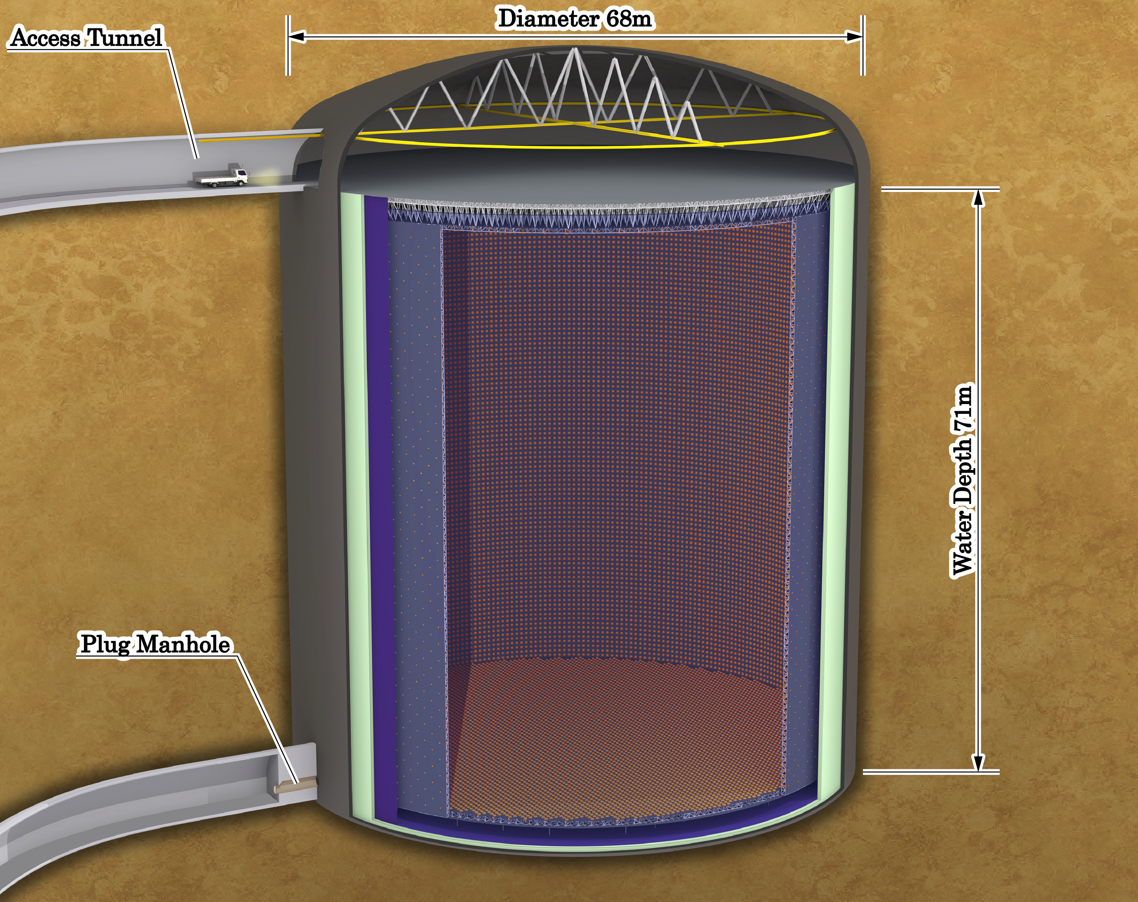
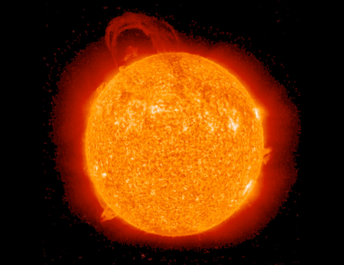
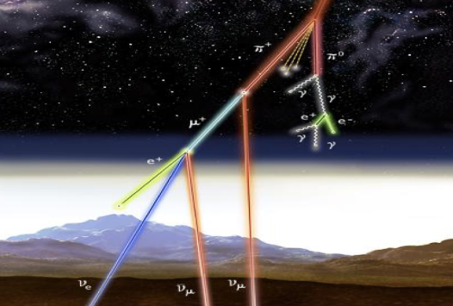
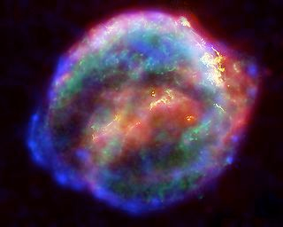
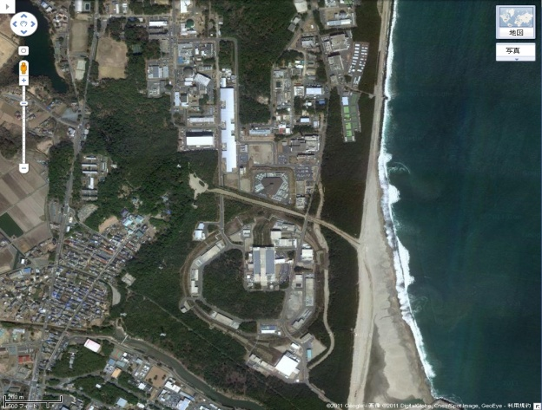
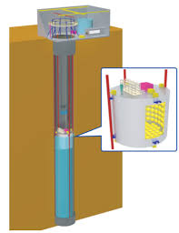
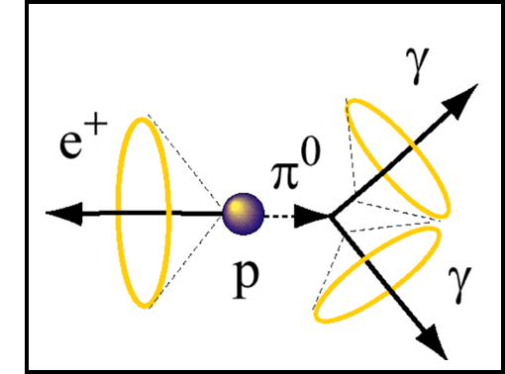
Hyper-K overview
Hyper-Kamiokande (Hyper-K) is a multi-purpose Water-Cherenkov detector with a variety of scientific goals:
Neutrino oscillations
(by atmospheric, accelerator and solar ν)
Neutrino astrophysics
Proton decay
Non-standard physics
Atmospheric ν
Solar ν
Accelerator ν
Today, Hyper-K is under construction and
its operation will begin in 2027
IWCD
Hyper-K Far Detector (HK-FD)
Cylindrical tank: Φ 68 m and H 71 m
Fiducial volume: 0.20Mtons (∼8 times SuperK)
Intermediate Water Cherenkov Detector (IWCD)
1 kilo-ton scale water Cherenkov detector located at ∼1 km from the neutrino beam source
Proton decay
Supernova ν

Slide 3
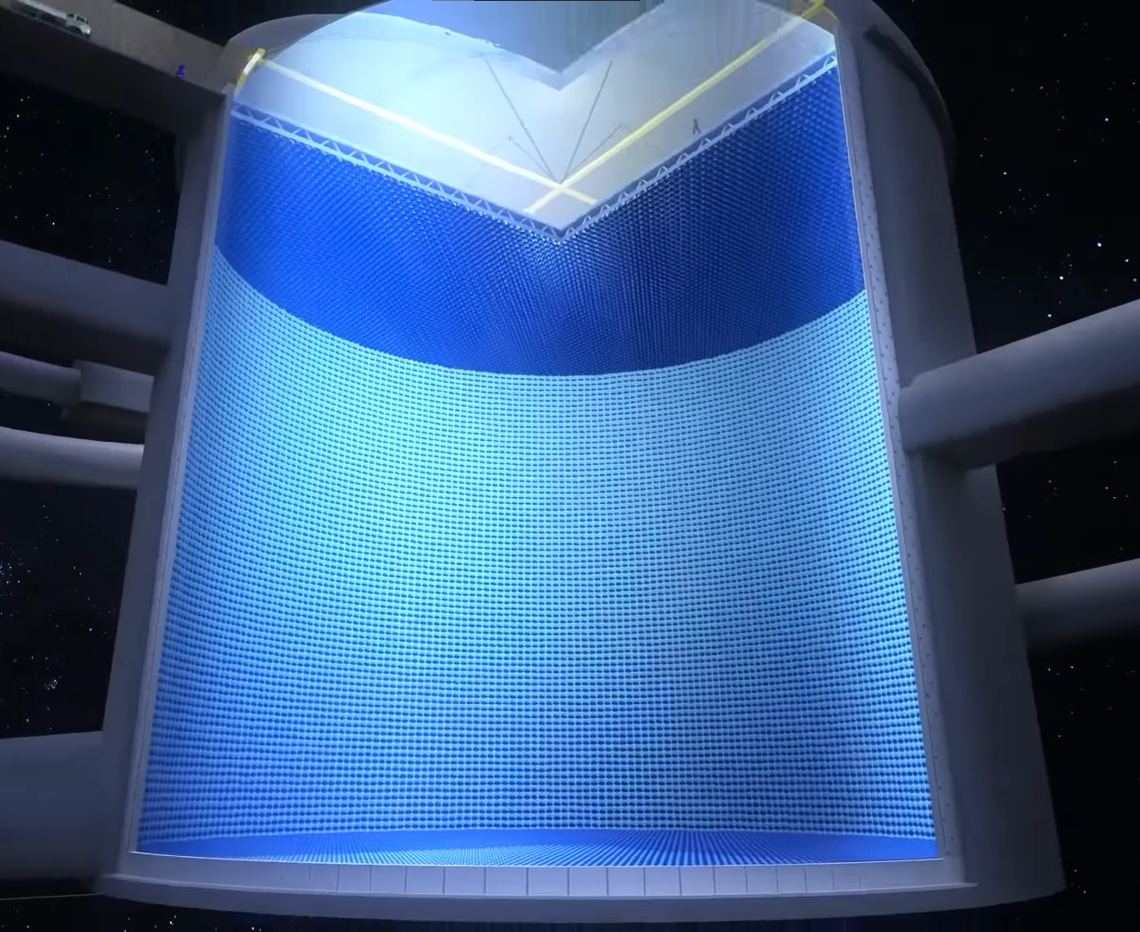
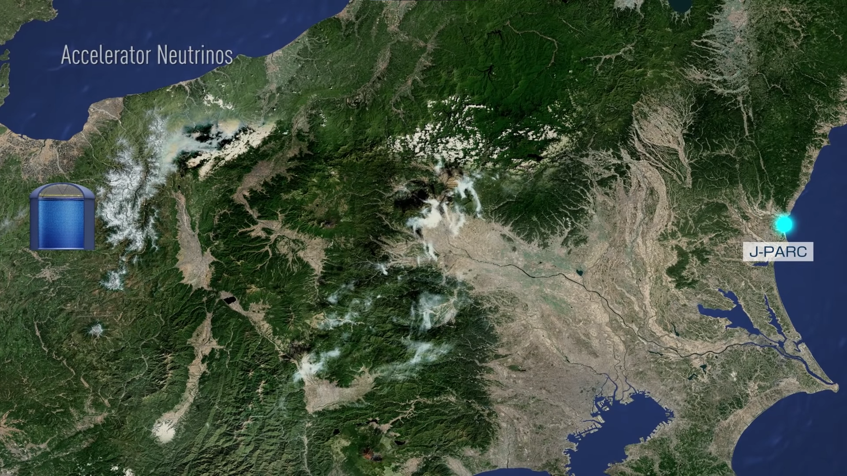
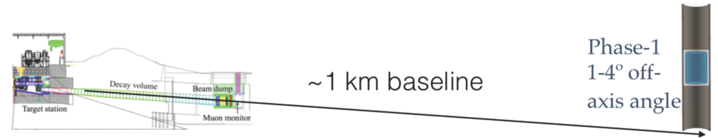
Hyper-K design
Hyper-K builds on the successful strategies used to study neutrino oscillations by Super-Kamiokande, K2K and T2K, but with some upgrades:
Larger detector for increased statistics
Improved photo-sensors for better efficiency
Higher intensity beam and updated/new near detector for accelerator neutrino part
Zoom of Japan
Credit by: https://youtu.be/JFOE3D2z7LM
Tokai
Position of the IWCD
∼300 km
Kamioka mine
Credit by: https://www.uvic.ca/science/physics/vispa/research/projects/neutrino/
Credit by: https://youtu.be/JFOE3D2z7LM

Slide 4
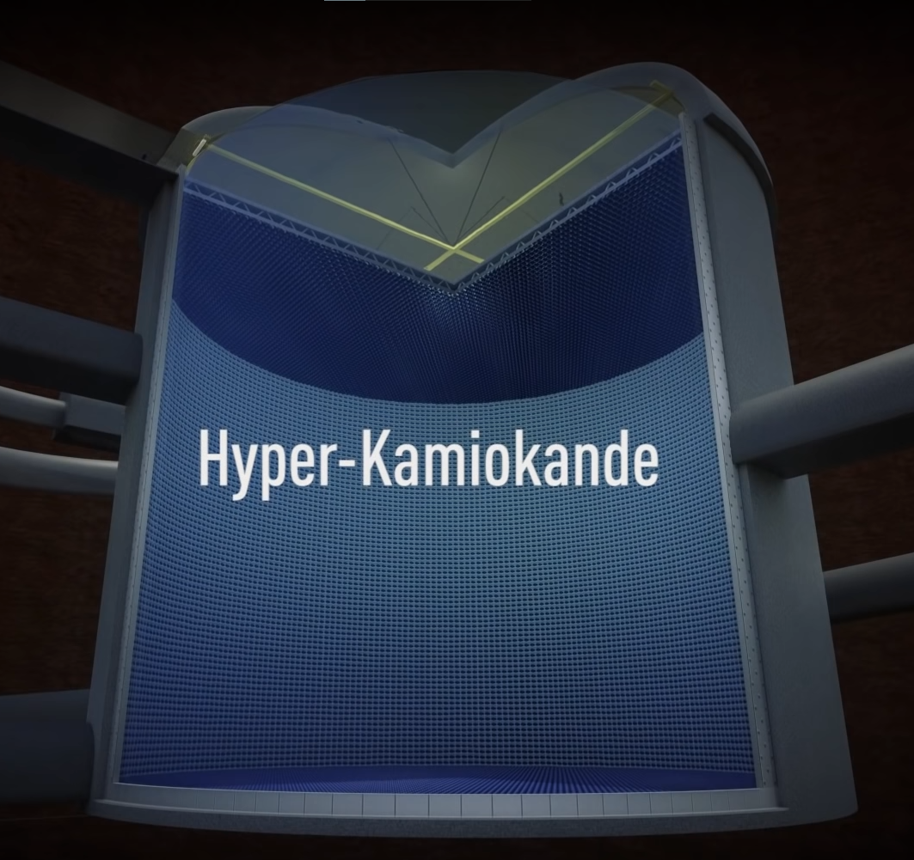
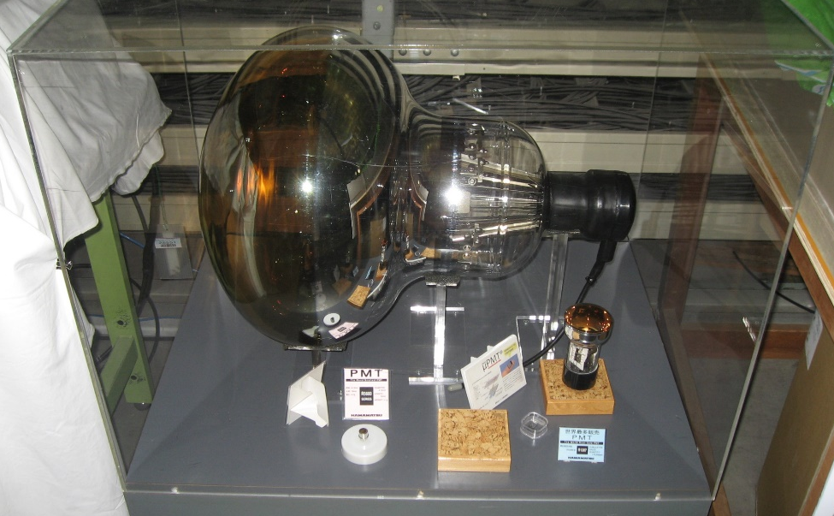
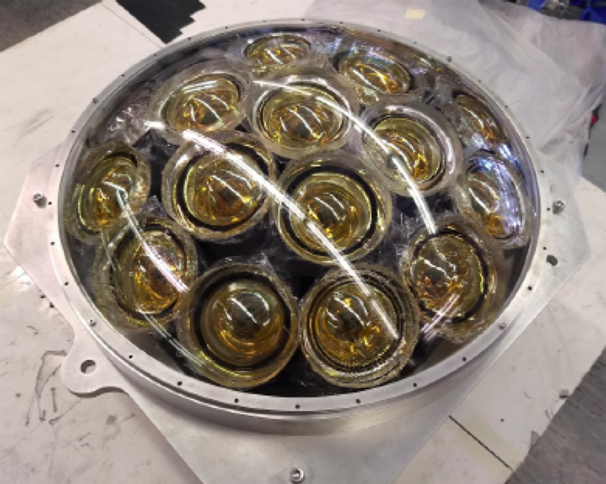
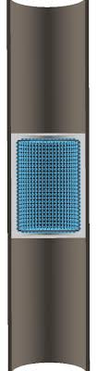
Hyper-K Far Detector and Intermediate Water Cherenkov Detector
The FD will consist of a hybrid configuration of detectors:
20’’ PMTs + 20’’ mPMTs for inner volume
3’’ PMTs for the outer volume
The IWCD will be like an elevator, placed at ∼ 1 km from the J-PARC accelerator and mPMTs will be installed only.
Credit by: https://youtu.be/JFOE3D2z7LM
20’’ PMT
3’’ PMT
Far Detector
New high-QE 50 cm Box&Line PMT
If compared to the Super-K PMT:
×2 higher pressure bearing for 60 m depth
×2 higher detection efficiency
and half time&charge resolutions
The Hyper-K IWCD
The instrumented portion will span a range of angles wrt the neutrino direction.
Inner detector:
8 m diameter and 6 m tall to contain up to 1 GeV muons
Planned to populate with ∼500 mPMT modules to provide photo coverage.
20’’ mPMT with 19 3’’ PMTs inside

Slide 5
The multi-PMT designs
The mPMT is a vessel which houses and protects an array of 19 3” PMTs.
WRT single 20’’ PMTs the mPMT configuration:
improves the granularity and timing response over larger number of photo-sensors
has got an additional intrinsic directional information.
This detector is a common effort from Italy, Canada and Poland.
Two mPMT designs are planned, but very similar each other Same assembly, similar components where possible.
Different constrains for the IWCD and FD mPMTs:
- in the FD a higher resistance to pressure is required (than IWCD)
- in the IWCD mPMT electronics needs to be able to distinguish between different hits in different bunches
The mPMT detector is confirmed for the IWCD!!
Currently, there are 1000, 3000 or 5000 mPMTs in discussion for the Hyper-K FD.
Principal mPMT componets | Characteristic for the FD | Caracteristic for the IWCD
Dome | UV-transmitting acrylic | UV-transmitting acrylic
3’’ PMT | 19 items | 19 items
Vessel cylinder | HDPE material (TBC) | PVC material (TBD)
Back plate | AISI-316 stainless steel (TBC) | PVC material (TBD)
Optical gel | For an optical connection between the acrylic dome and the PMT photo-cathode | For an optical connection between the acrylic dome and the PMT photo-cathode
Clamping ring | AISI-316 stainless steel (TBC) | PVC material (TBD)
Electronic board | Q/T digitization based on discrete components | FADC digitization, with on-board signal processing

Slide 6
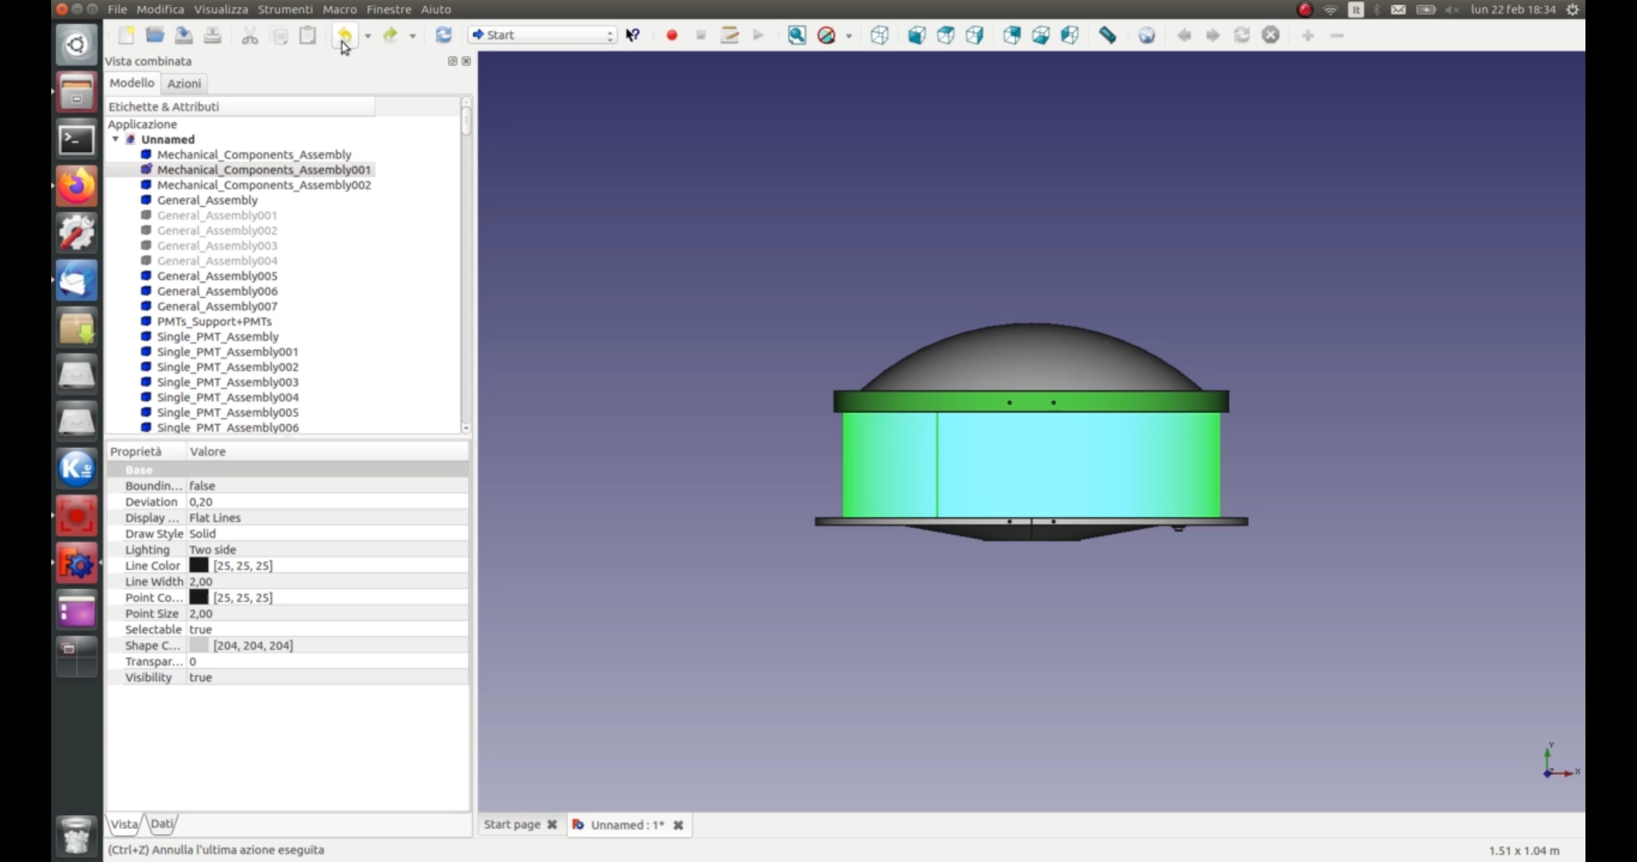
The FD multi-PMT – Last updated version (video)
Original design by TRIUMF and uploaded design by M. Mongelli (INFN – Bari)

Slide 7
Thank you!!!

