Slide 1
The NEXT experiment
Status and Prospects
Lior Arazi for the NEXT Collaboration
Ben-Gurion University
XIX International Workshop on Neutrino Telescopes, 18-26 February 2021

Slide 2




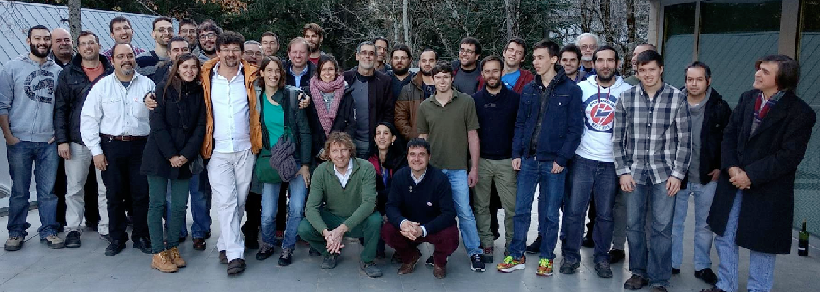








USA
Spain
Portugal, Israel, Colombia
LSC
Laboratorio Subterráneo de Canfranc
Co-spokespersons:
D. Nygren
J.J. Gomez-Cadenas
Funded by:

Slide 3
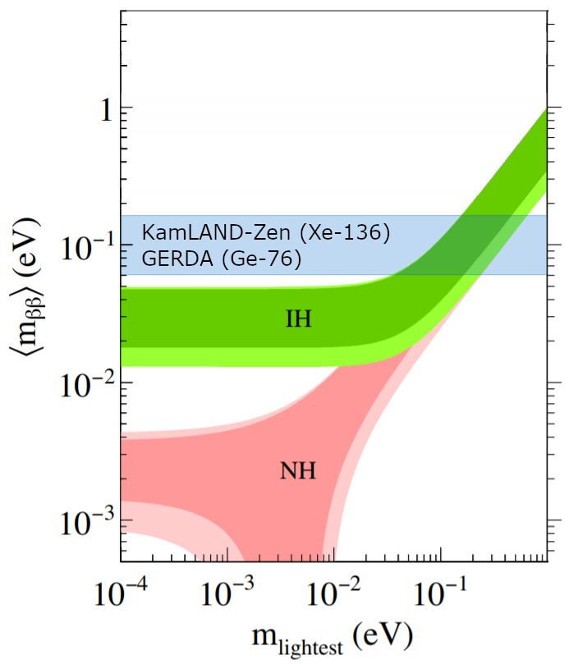
The challenge of next generation experiments
Next generation:
Lifetime ~10²⁷-10²⁸ years. For ¹³⁶Xe: 0.3-3 events/tonne/yr

Slide 4
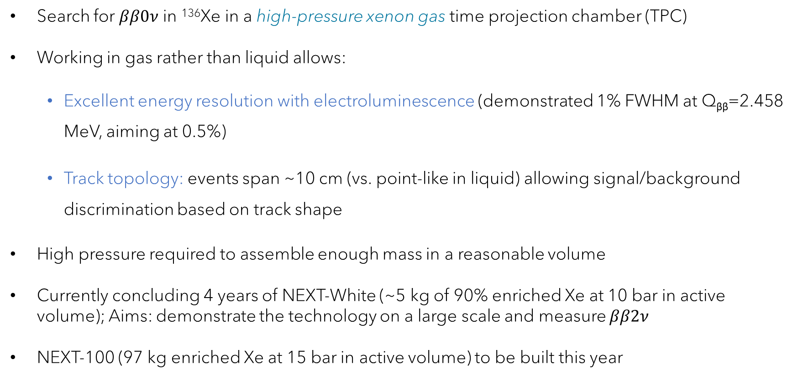
NEXT: Neutrino Experiment with a Xenon TPC
Search for $ββ0ν$ in ¹³⁶Xe in a high-pressure xenon gas time projection chamber (TPC)
Working in gas rather than liquid allows:
    Excellent energy resolution with electroluminescence (demonstrated 1% FWHM at Q_{ββ}=2.458 MeV, aiming at 0.5%)
    Track topology: events span ~10 cm (vs. point-like in liquid) allowing signal/background discrimination based on track shape
High pressure required to assemble enough mass in a reasonable volume
Currently concluding 4 years of NEXT-White (~5 kg of 90% enriched Xe at 10 bar in active volume); Aims: demonstrate the technology on a large scale and measure $ββ2ν$
NEXT-100 (97 kg enriched Xe at 15 bar in active volume) to be built this year

Slide 5
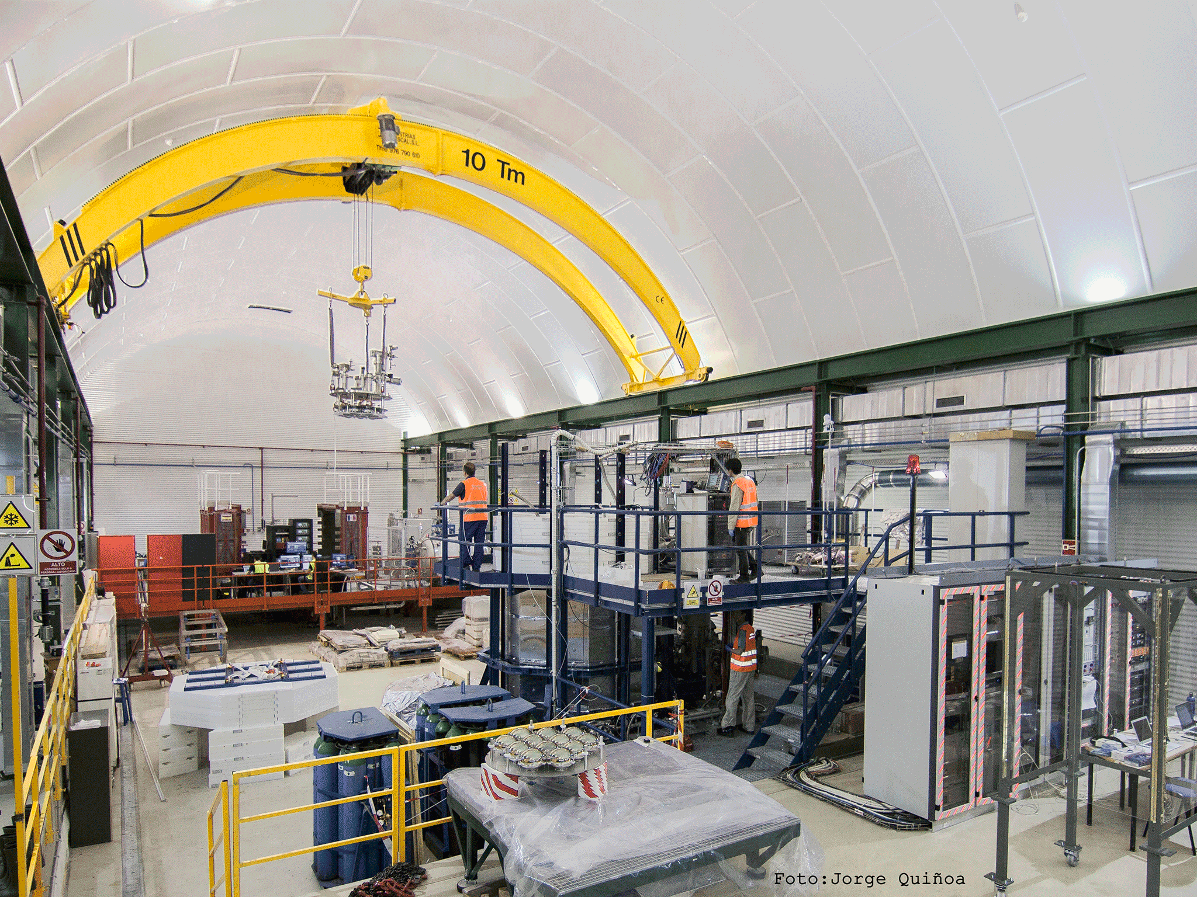
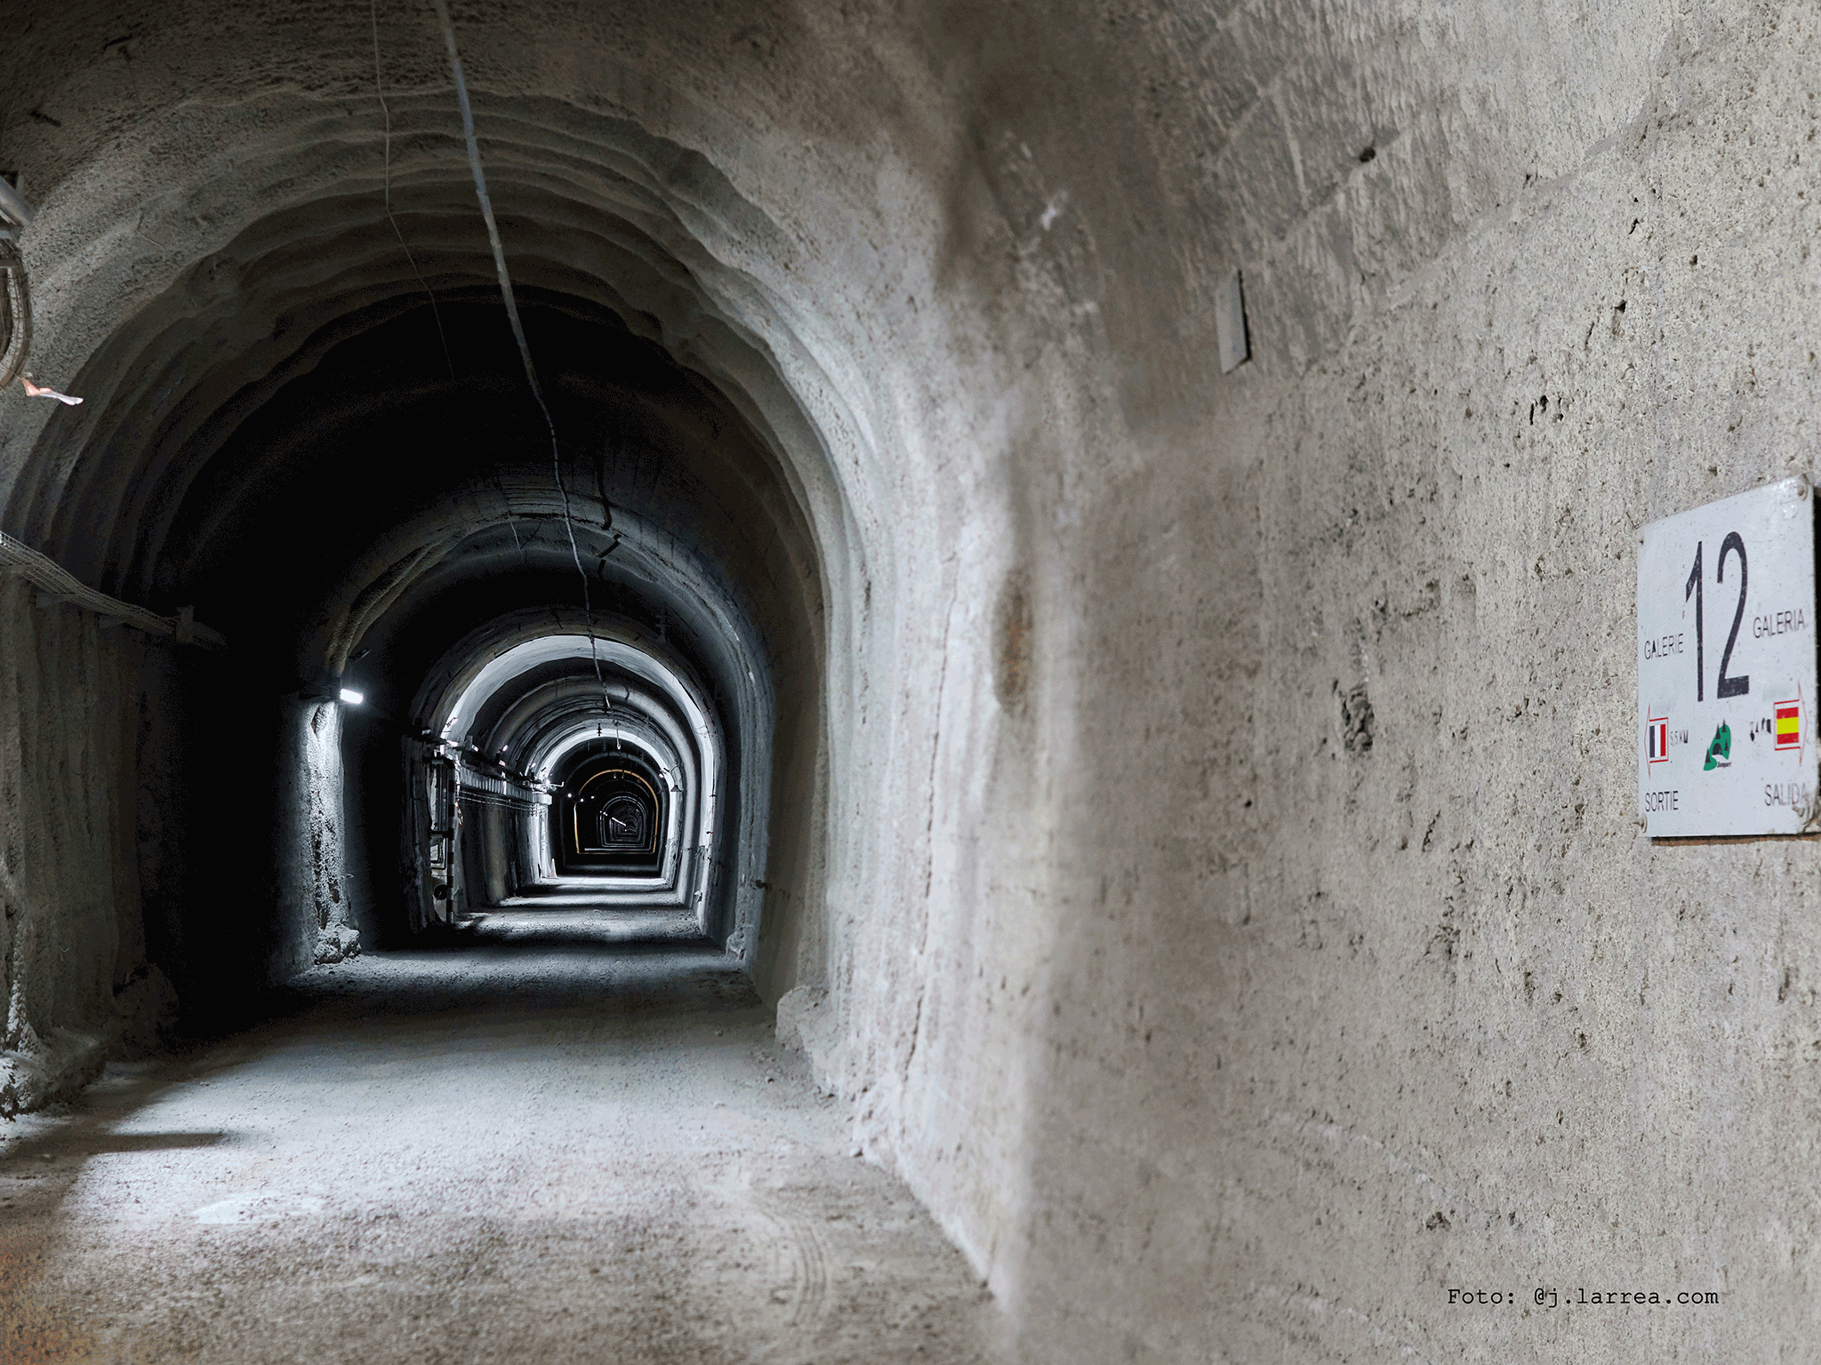
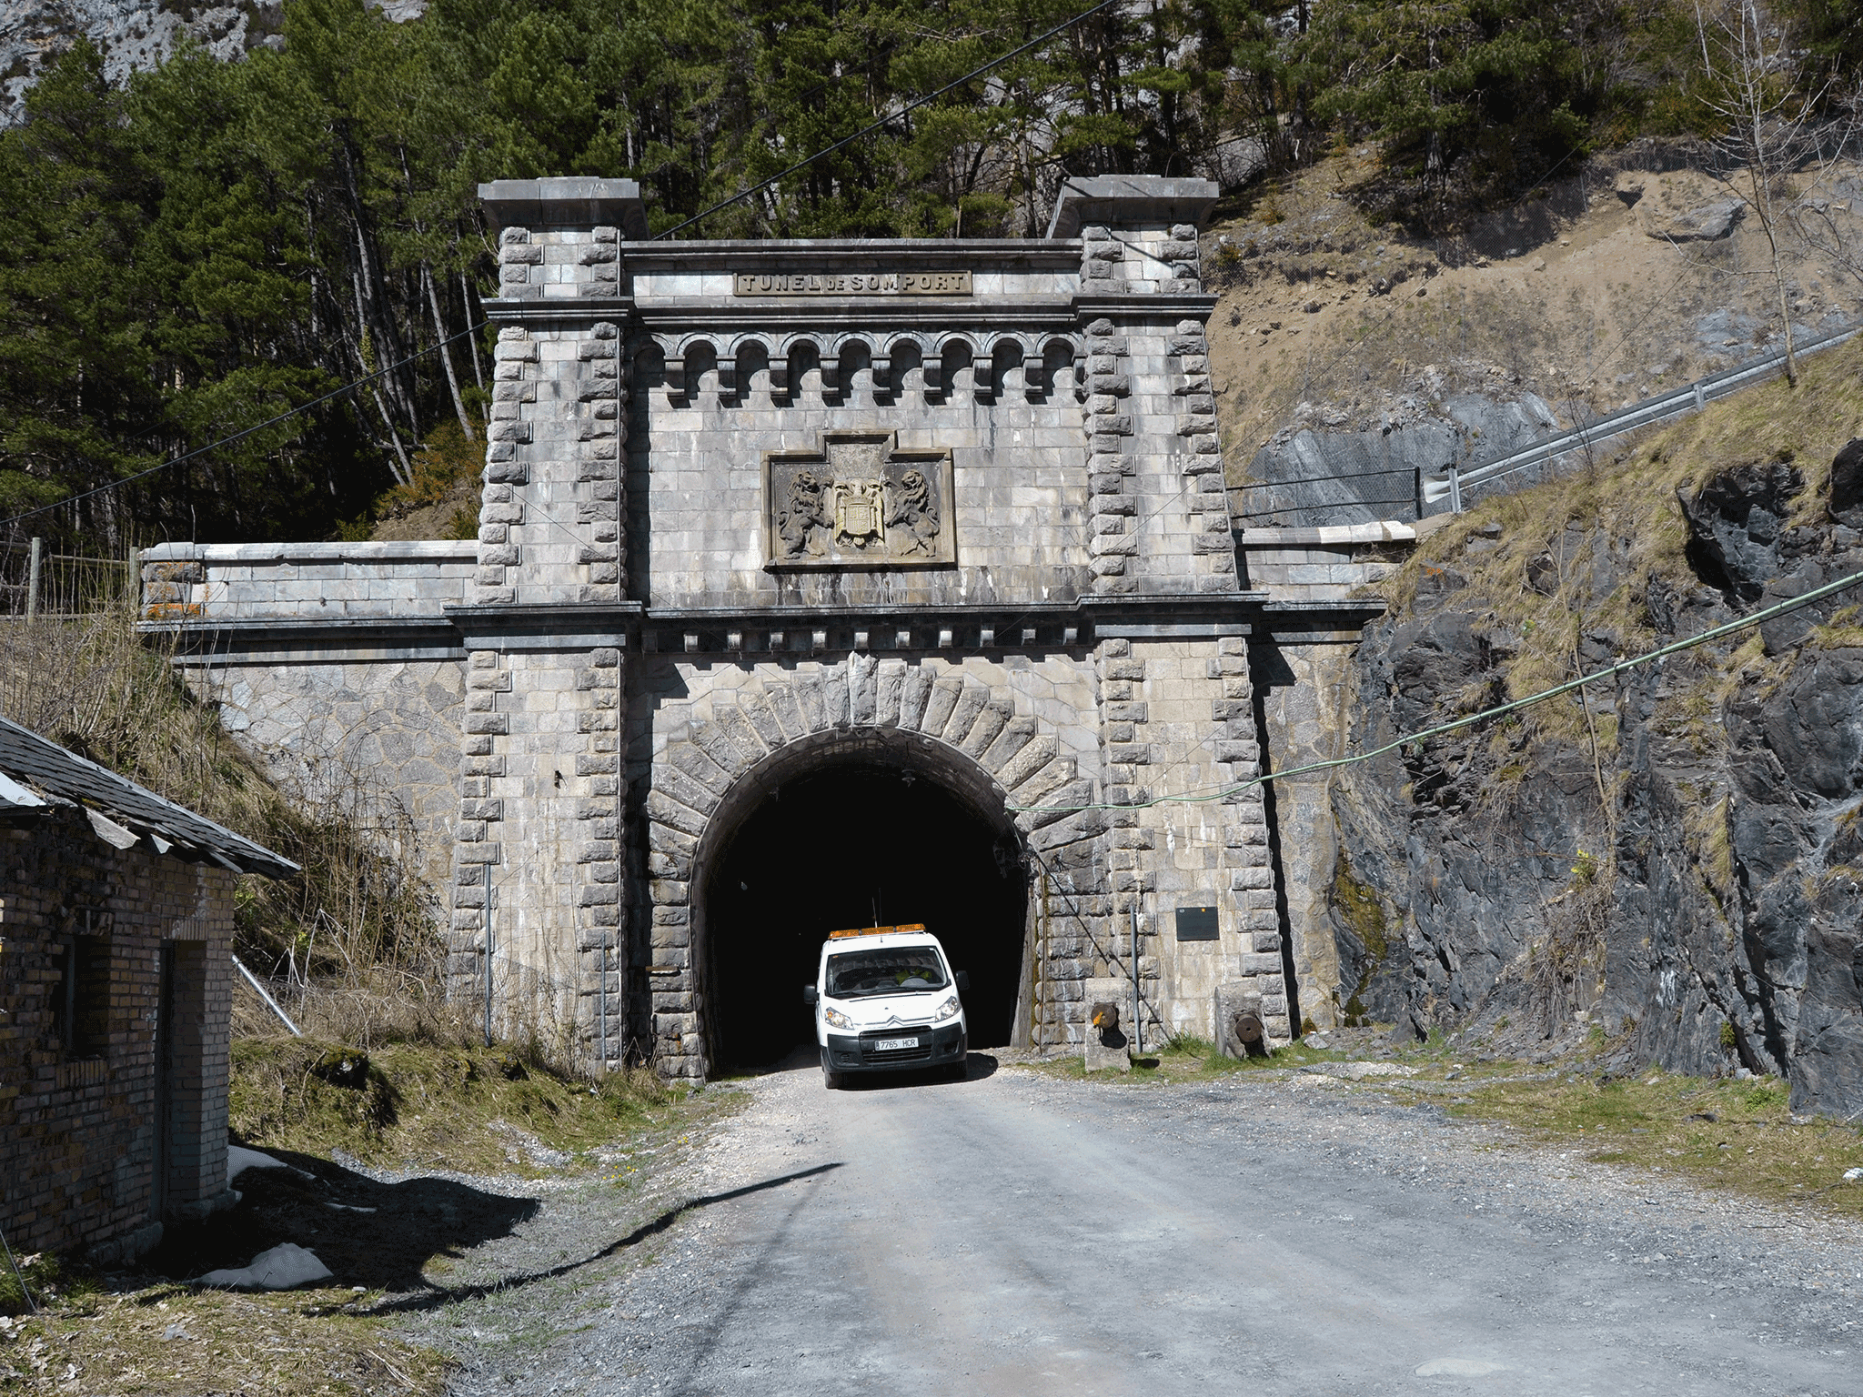
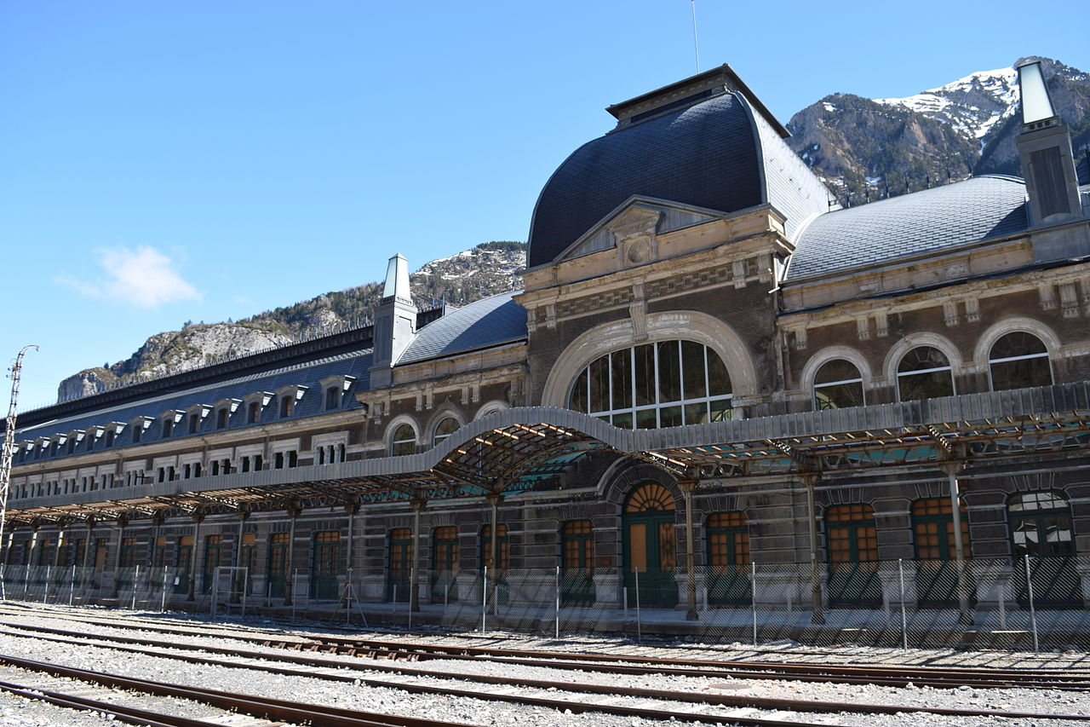
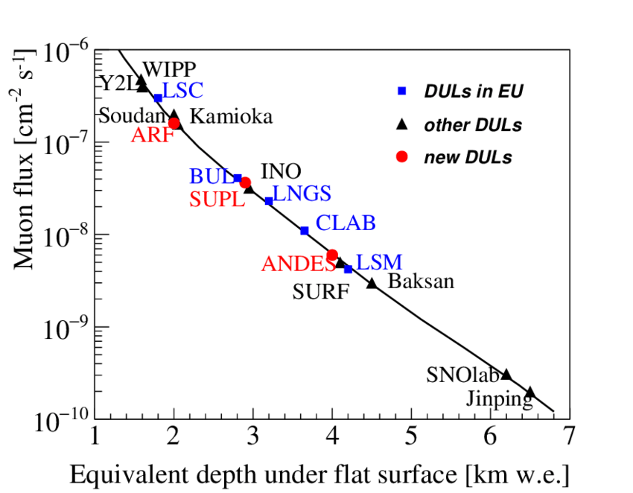
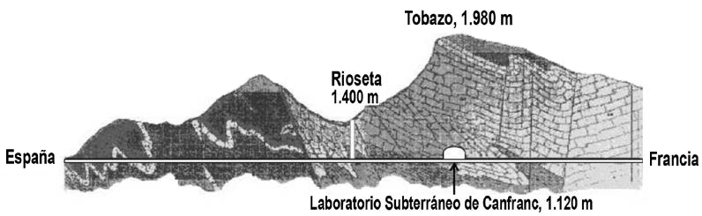
Canfranc underground laboratory (LSC)

Slide 6
NEXT-White outside view
Lead castle (shield)
Detector vessel
Data acquisition system
Gas system

Slide 7
NEXT-White outside view

Slide 8
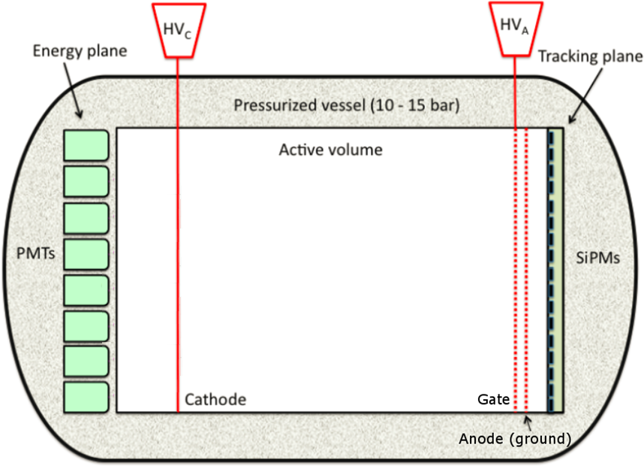


NEXT principle of operation (demonstrated in NEXT-White)
Horizontal Time Projection Chamber (TPC)
Full of high-purity xenon gas at 10 bar, contained in a high-pressure vessel
Three conductive planes + peripheral “field shaping rings” define two uniform field regions:
  The cathode and gate stainless steel grids (53 cm apart) define the drift field
  The gate grid and anode plate (6 mm apart) define the electroluminescence (EL) field
TPC diameter: 39.6 cm
12 PMTs behind the cathode form the “energy plane”
1792 SiPMs behind the anode define the “tracking plane”
-30kV
-8kV
G
Xe gas
Field cage
$$E_{drift}\sim 0.4 kV/cm$$
$$E_{EL}\sim 13 kV/cm$$

Slide 9
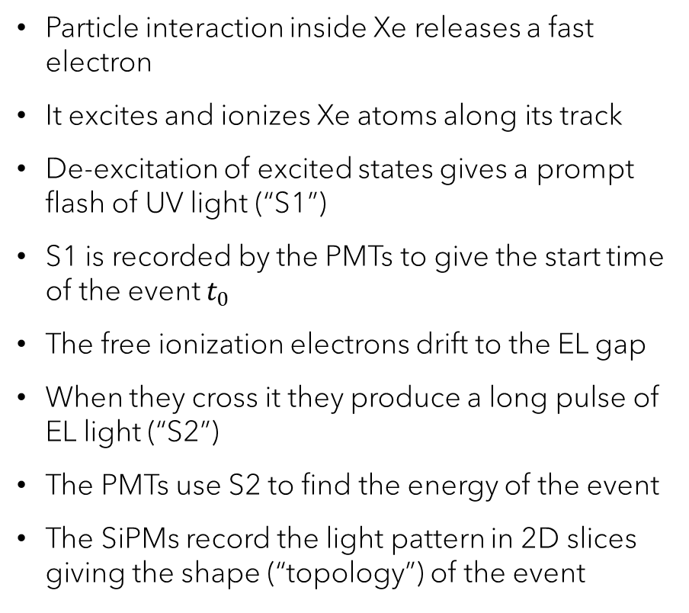
NEXT principle of operation (demonstrated in NEXT-White)
Particle interaction inside Xe releases a fast electron
It excites and ionizes Xe atoms along its track
De-excitation of excited states gives a prompt flash of UV light (“S1”)
S1 is recorded by the PMTs to give the start time of the event $t_{0}$
The free ionization electrons drift to the EL gap
When they cross it they produce a long pulse of EL light (“S2”)
The PMTs use S2 to find the energy of the event
The SiPMs record the light pattern in 2D slices giving the shape (“topology”) of the event
-30kV
-8kV
G
Xe gas
EL (S2)
e⁻
Primary scintillation (S1)
Field cage
$$E_{drift}\sim 0.4 kV/cm$$
$$E_{EL}\sim 13 kV/cm$$

Slide 10
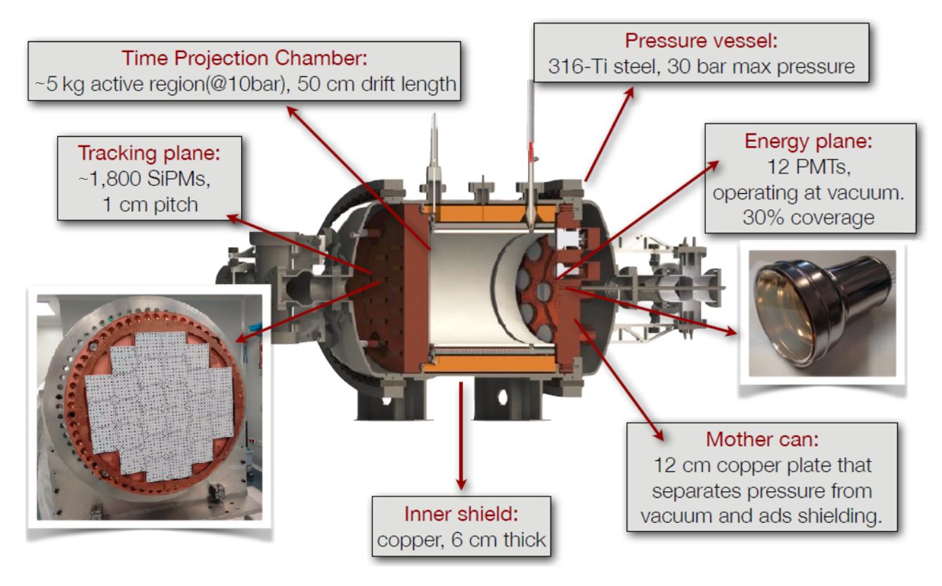
NEXT-White inner structure
F. Monrabal et al 2018 JINST 13 P12010

Slide 11
NEXT-White inner structure

Slide 12
Energy resolution
Energy resolution determined using ¹³⁷Cs (662 keV) and ²⁰⁸Tl (1593, 2615 keV).
Long tracks corrected voxel-by-voxel with ^{83m}Kr calibration maps
Demonstrated <1% FWHM at $Q_{ββ}$ (intrinsic statistical limit = 0.3%)
J. Renner et al JHEP 2019 230

Slide 13
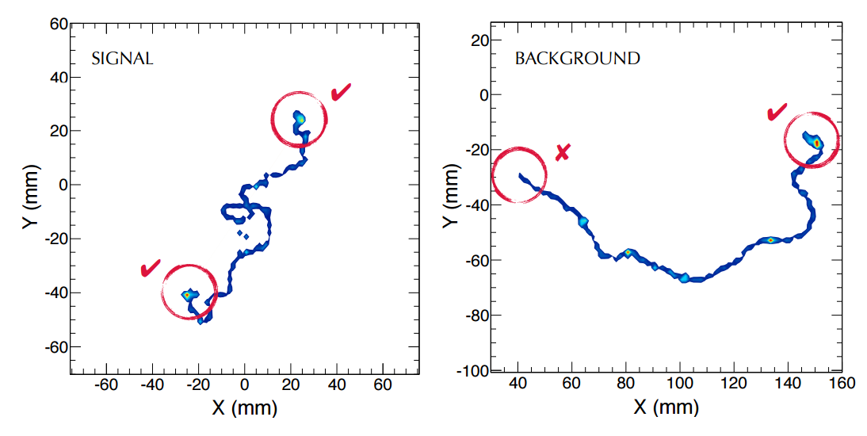
Topological background suppression
Background events more likely to have multiple tracks → require a single track
Remaining background events have a single electron, with one Bragg peak at the end
ββ events have two Bragg peaks
→ Signal/background discrimination by comparing the energy in spherical “blobs” at track ends

Slide 14
Topological background suppression (ideal MC)
Signal: both blobs have similar energy
Background: one blob has low energy

Slide 15
Recent progress in topological analysis
Ideally, we should have had this:

Slide 16
Recent progress in topological analysis
Until recently, we had this:
P. Ferrario et al JHEP 2019 52

Slide 17
Recent progress in topological analysis
This was considered ok because electron diffusion during drift smears out the track in any case:

Slide 18

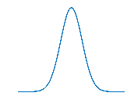

Can we deblur the image?
-1
Blur:
Convolve image with Point Spread Function (PSF)
Deblur:
Deconvolve blurred image with PSF (iteratively)
Need to know the PSF!

Slide 19
Idea: use ^{83m}Kr to find the PSF!
Blurring results from diffusion + optical smearing by EL gap
Use ^{83m}Kr point-like events at different drift distances to quantify blurring as PSF(z)
Apply image deblurring algorithm (Richardson-Lucy) to recover original track

Slide 20
Crossing muons
A. Simón et al 2102.11931

Slide 21
e⁻e⁺ pairs at 1.6 MeV (²⁰⁸Tl double escape peak)
Real e⁻e⁺ events recorded and processed by RL deconvolution in NEXT-White
A. Simón et al 2102.11931

Slide 22
Background events at 1.6 MeV
Real Compton electrons recorded and processed by RL deconvolution in NEXT-White
A. Simón et al 2102.11931

Slide 23
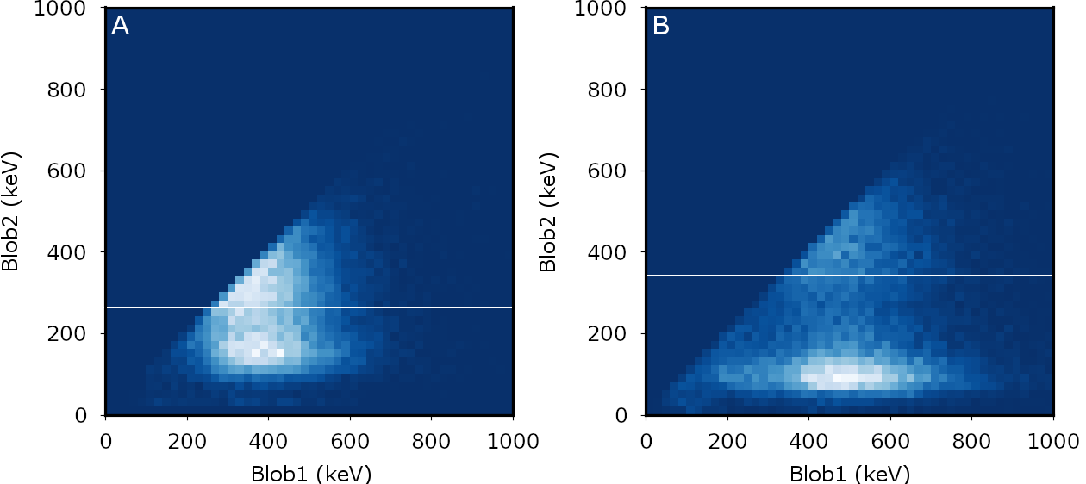
>5-fold improvement in background suppression!
Previous state-of-the-art
New method
Topological Background rejection factor = 4.9
72% signal efficiency
Topological Background rejection factor = 27
57% signal efficiency
signal
signal
bkg
bkg

Slide 24
$ββ2ν$ analysis in NEXT-White
Using event energy (different isotopes), event average z, and blob2 energy information to constrain background/signal yields

Slide 25
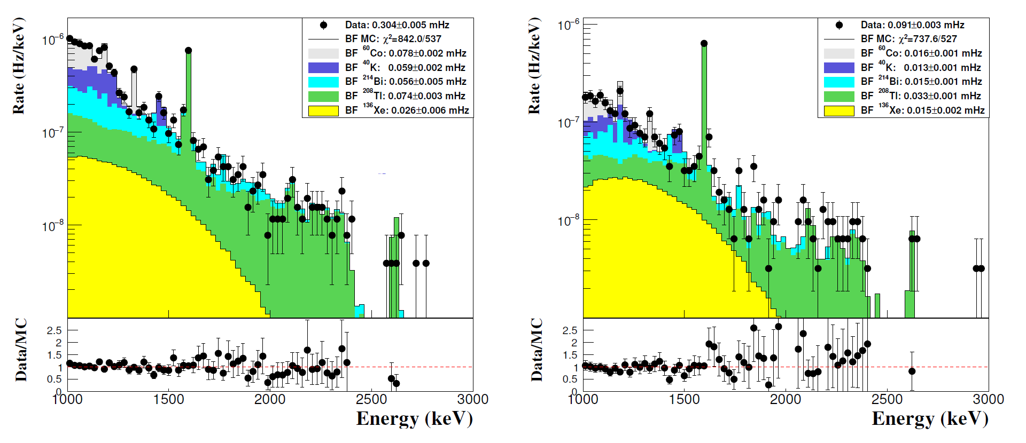
$ββ2ν$ analysis in NEXT-White
Without RL
With RL
Ongoing work: use RL deconvolution + depleted Xe run + improved background model + improved systematic error analysis
Adding RL deconvolution improves chi square and relative error on ¹³⁶Xe fit

Slide 26
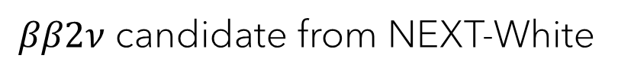
$ββ2ν$ analysis in NEXT-White
$ββ2ν$ candidate from NEXT-White

Slide 27
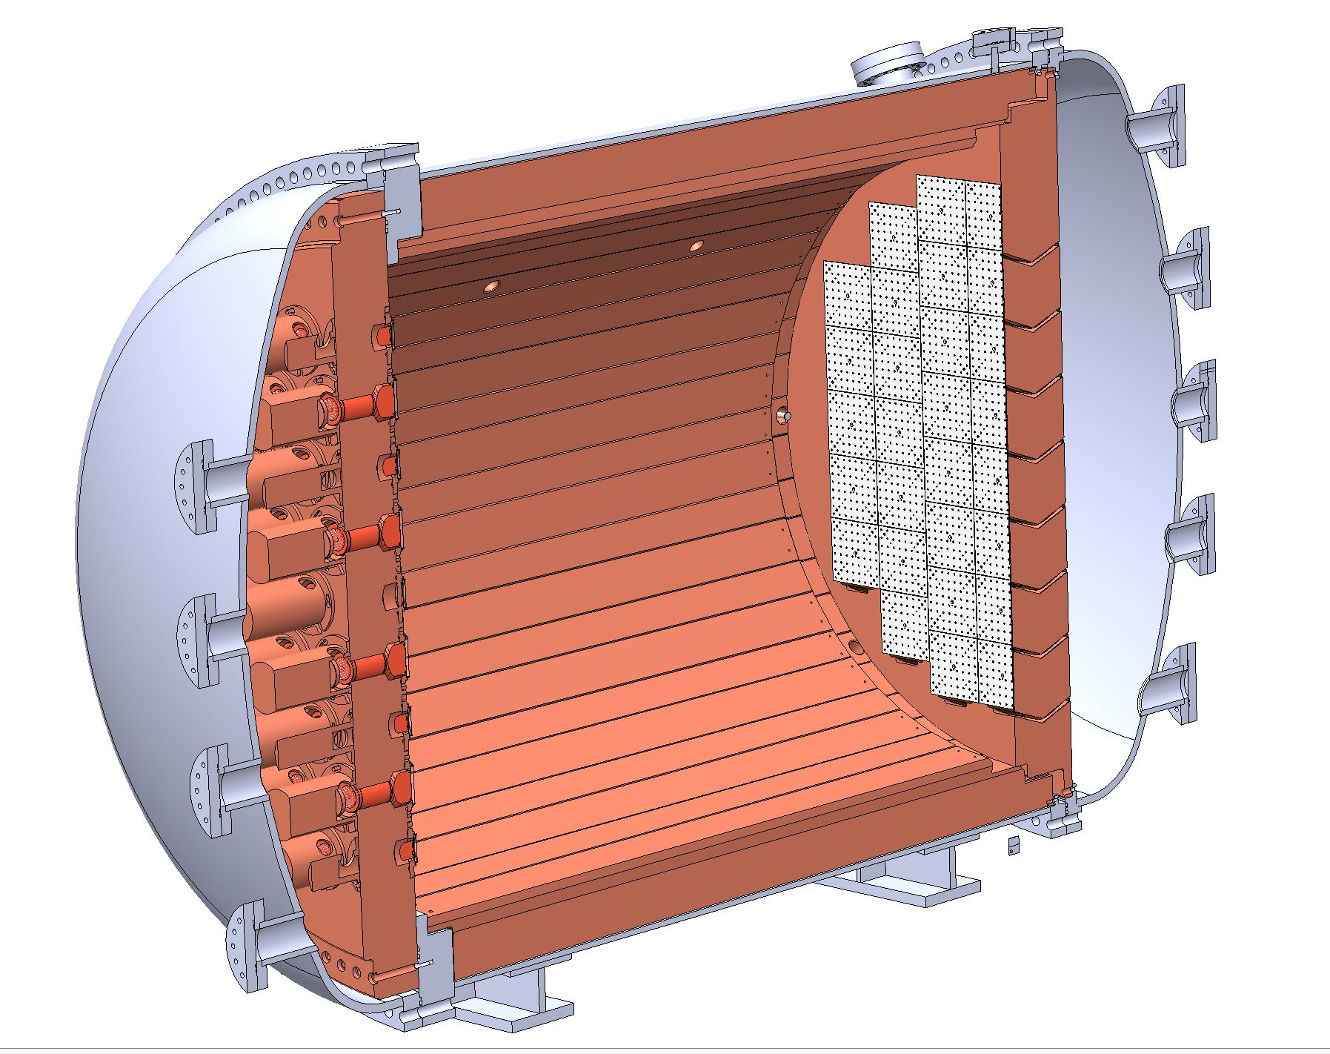
NEXT to come: NEXT-100
Main goal: demonstrate the technology at the 100 kg scale, expected sensitivity ~10²⁶ y
Background index $4×{10}^{−4}$ counts/keV/kg/yr. Construction planned for 2021
TPC: 97 kg active region, 113 cm drift length
Pressure vessel: St-St, rated for 15 bar
Tracking plane: ~3600 SiPMs at 1 cm pitch
Energy plane: 60 radio-pure PMTs, 30% coverage
Inner shield: 12 cm Cu
Outer shield: lead castle with Rn-free air

Slide 28
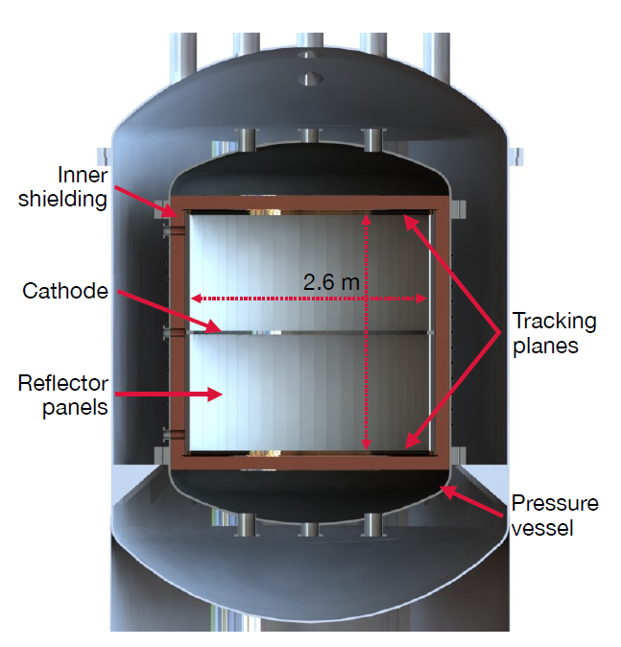
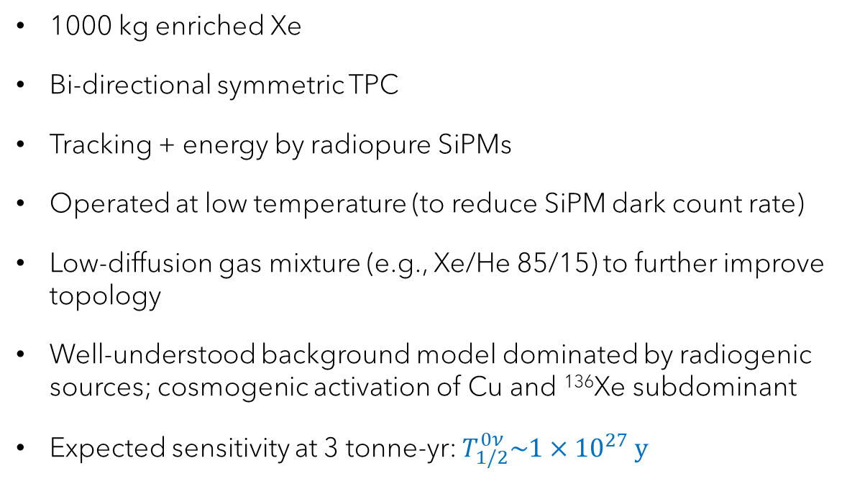
NEXT-Tonne simulation study
1000 kg enriched Xe
Bi-directional symmetric TPC
Tracking + energy by radiopure SiPMs
Operated at low temperature (to reduce SiPM dark count rate)
Low-diffusion gas mixture (e.g., Xe/He 85/15) to further improve topology
Well-understood background model dominated by radiogenic sources; cosmogenic activation of Cu and ¹³⁶Xe subdominant
Expected sensitivity at 3 tonne-yr: $T_{1/2}^{0ν}\sim {1×10}^{27} y$
2006.07320

Slide 29
The aggressive approach: barium tagging
For NEXT, $ββ2ν$ leakage to the Q_{ββ} ROI is negligible
Identification of ¹³⁶Ba in coincidence with a signal in the Q_{ββ} ROI → true background-free experiment

Slide 30
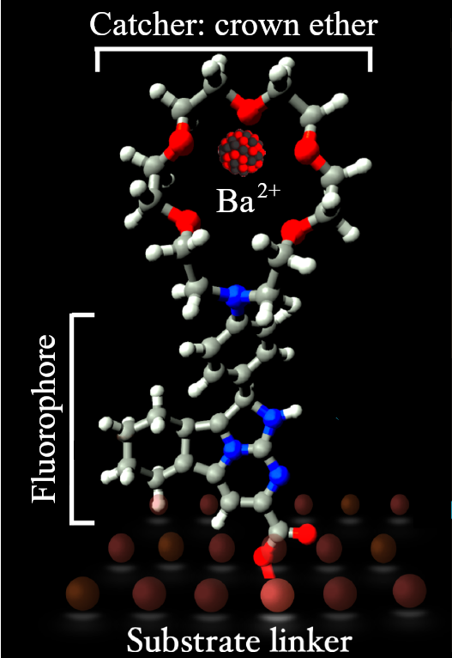
Ba²⁺ detection using molecular indicators
Idea (D. Nygren): use single molecule fluorescent imaging to visualize (“tag”) a single Ba²⁺ ion as it arrives at the TPC cathode
Ba²⁺ sensor: based on molecular indicators able to change luminous response after chelating Ba²⁺ cations; must operate in dry phase
Apparatus: must be able to detect in delayed coincidence the electron signal (at the anode) and the cation signal (at the cathode)
D. Nygren, J Phys Conf Ser 650 (2015) 012002
JINST 11 (2016) P12011
PRL 120 (2017) 132504
Sci Rep 9 (2019) 15097
Nature 583 (2020) 48-54
ACS Sens 6 (2021) 192-202

Slide 31
Ba²⁺ detection using molecular indicators
Extensive collaboration-wide R&D program
  Molecular indicators: bicolor, on/off, monolayers, tests with ions
  Microscopy: two-photon absorption, high-pressure epifluorescence
  Ion collection: RF carpets, tiled monolayers
  Energy and tracking: metalenses, camera readout
Goals: Prove barium tagging feasibility for a tonne-scale NEXT detector using small/medium/large-scale demonstrators in ~5 yr
D. Nygren, J Phys Conf Ser 650 (2015) 012002
JINST 11 (2016) P12011
PRL 120 (2017) 132504
Sci Rep 9 (2019) 15097
Nature 583 (2020) 48-54
ACS Sens 6 (2021) 192-202

Slide 32
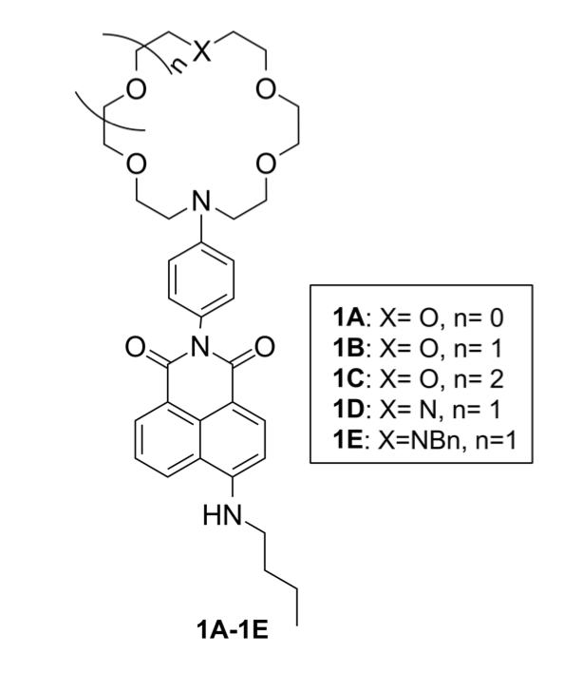
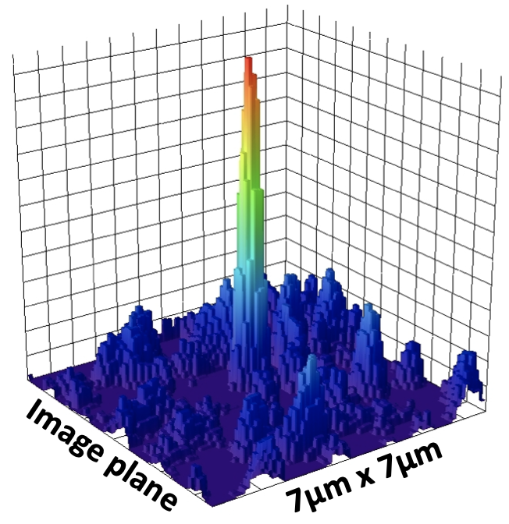
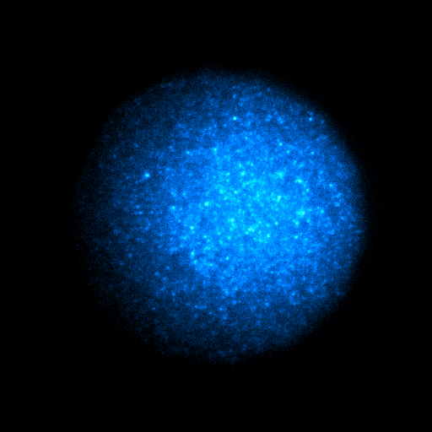
Enhanced fluorescence
100×100 µm²
Single barium ion imaging with SMFI
On/off molecules: dry single-molecule imaging with TPC-compatible microscopy
Sci Rep 9 (2019) 15097
ACS Sens 6 (2021) 192-202

Slide 33
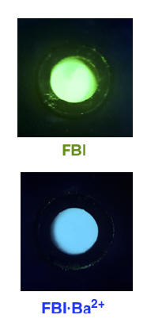
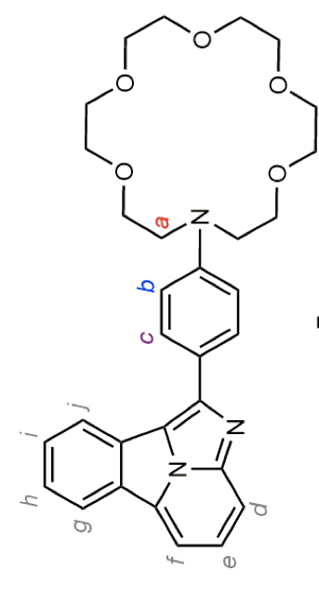
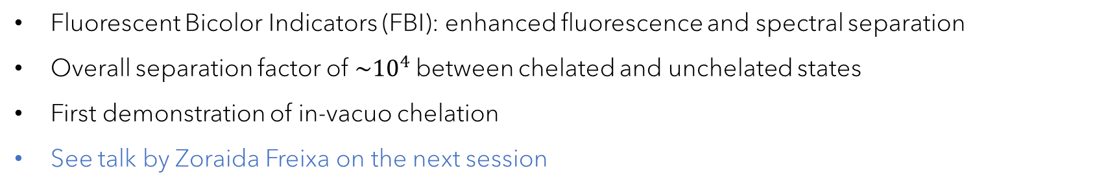
Bicolor enhanced fluorescence
Scaled by x300
Fluorescent Bicolor Indicators (FBI): enhanced fluorescence and spectral separation
Overall separation factor of $\sim {10}^{4}$between chelated and unchelated states
First demonstration of in-vacuo chelation
See talk by Zoraida Freixa on the next session
Nature 583 (2020) 48-54

Slide 34
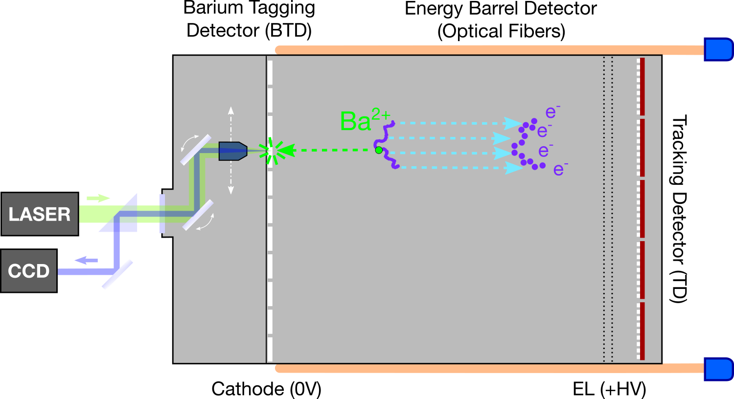
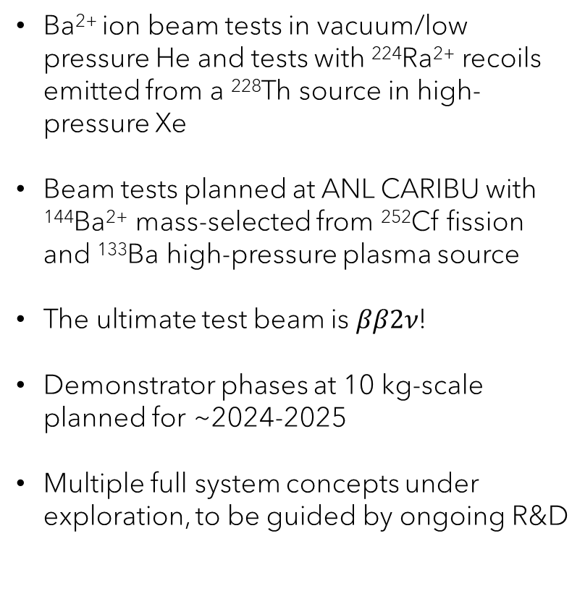
NEXT steps
Ba²⁺ ion beam tests in vacuum/low pressure He and tests with ²²⁴Ra²⁺ recoils emitted from a ²²⁸Th source in high-pressure Xe
Beam tests planned at ANL CARIBU with ¹⁴⁴Ba²⁺ mass-selected from ²⁵²Cf fission and ¹³³Ba high-pressure plasma source
The ultimate test beam is $ββ2ν$!
Demonstrator phases at 10 kg-scale planned for ~2024-2025
Multiple full system concepts under exploration, to be guided by ongoing R&D
BOLD concept with fully active cathode, SiPM-based tracking and Energy Barrel detector
Awarded 9.3 M€ ERC Synergy grant

Slide 35
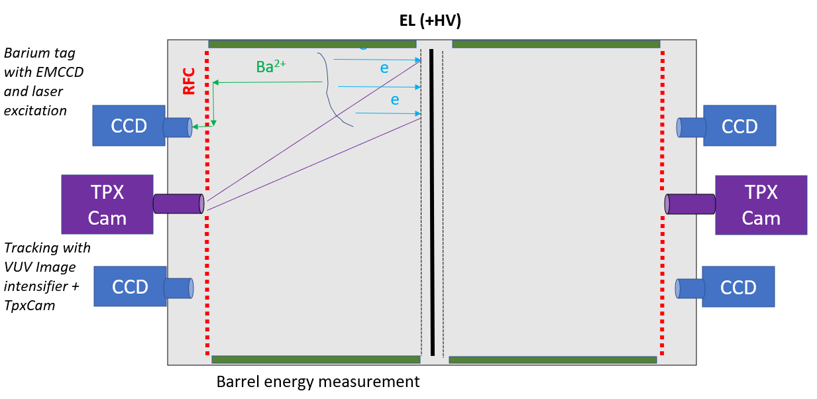
NEXT steps
Ba²⁺ ion beam tests in vacuum/low pressure He and tests with ²²⁴Ra²⁺ recoils emitted from a ²²⁸Th source in high-pressure Xe
Beam tests planned at ANL CARIBU with ¹⁴⁴Ba²⁺ mass-selected from ²⁵²Cf fission and ¹³³Ba high-pressure plasma source
The ultimate test beam is $ββ2ν$!
Demonstrator phases at 10 kg-scale planned for ~2024-2025
Multiple full system concepts under exploration, to be guided by ongoing R&D
CRAB concept with RF carpet concentrators and camera-based topology measurement
Well-funded ongoing DOE-supported program

Slide 36
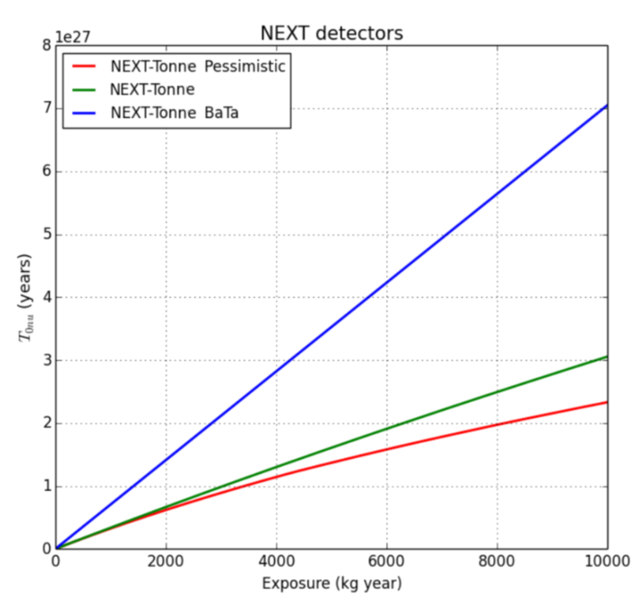
Projected sensitivities
NEXT forward-looking sensitivity estimates for a tonne-scale detector
Assumed background in ROI:
  NEXT-Tonne: 0.06 counts/yr
  NEXT-Tonne Pessimistic: 0.1 counts/yr
  NEXT-Tonne BaTa: real background free

Slide 37
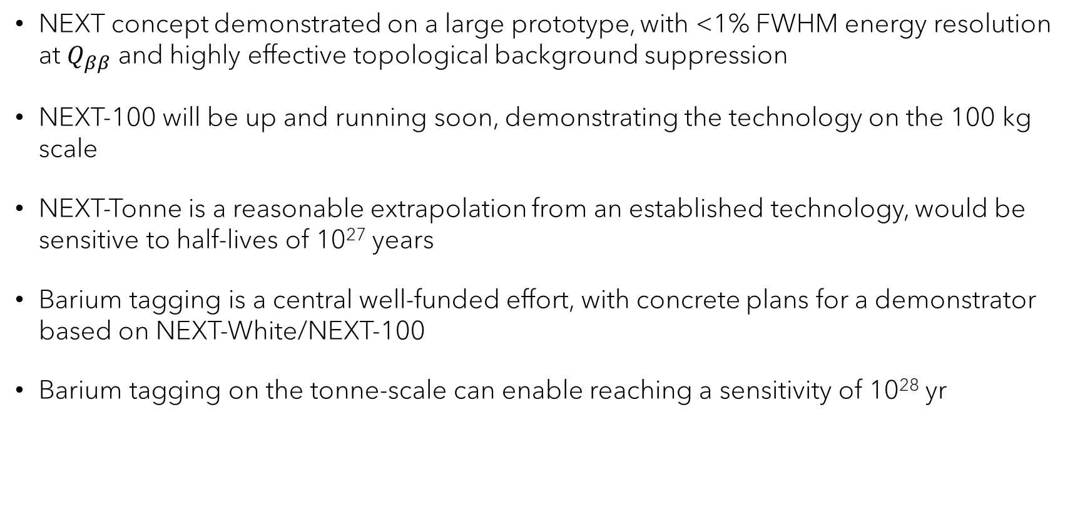
Summary and outlook
NEXT concept demonstrated on a large prototype, with <1% FWHM energy resolution at $Q_{ββ}$ and highly effective topological background suppression
NEXT-100 will be up and running soon, demonstrating the technology on the 100 kg scale
NEXT-Tonne is a reasonable extrapolation from an established technology, would be sensitive to half-lives of 10²⁷ years
Barium tagging is a central well-funded effort, with concrete plans for a demonstrator based on NEXT-White/NEXT-100
Barium tagging on the tonne-scale can enable reaching a sensitivity of 10²⁸ yr

Slide 38
Thank you!

