Slide 1
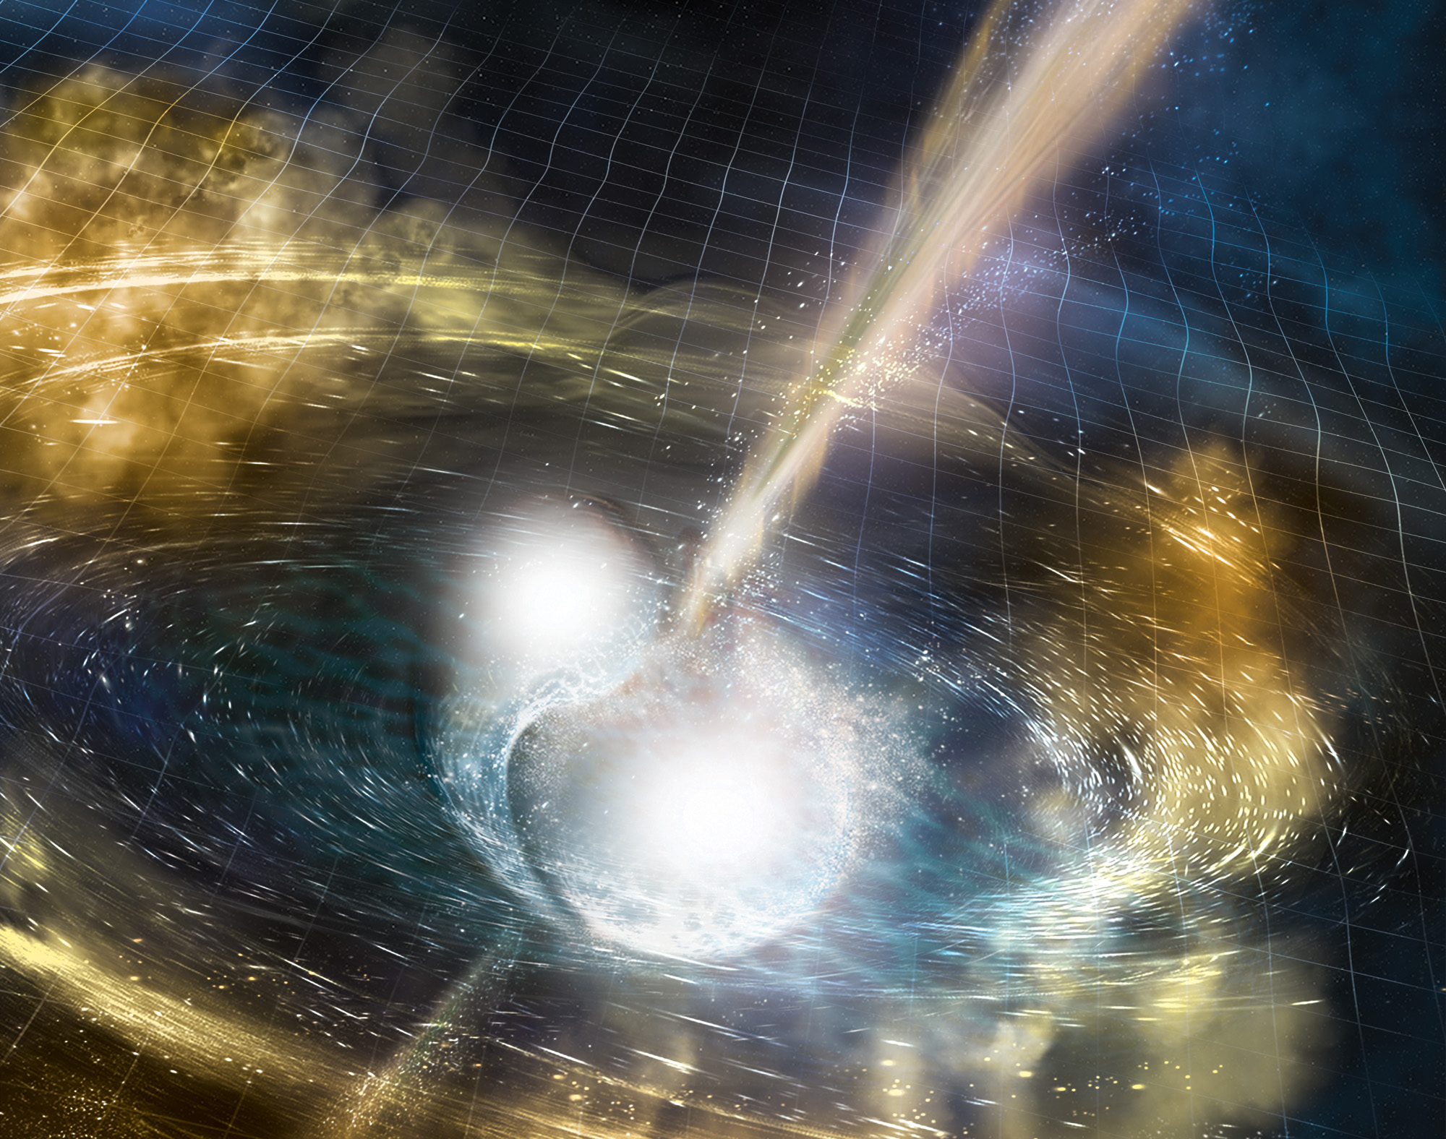




Multimessenger signatures for sources of
Gravitational Waves
M. Branchesi
Gran Sasso Science Institute
INFN/LNGS and INAF

Slide 2
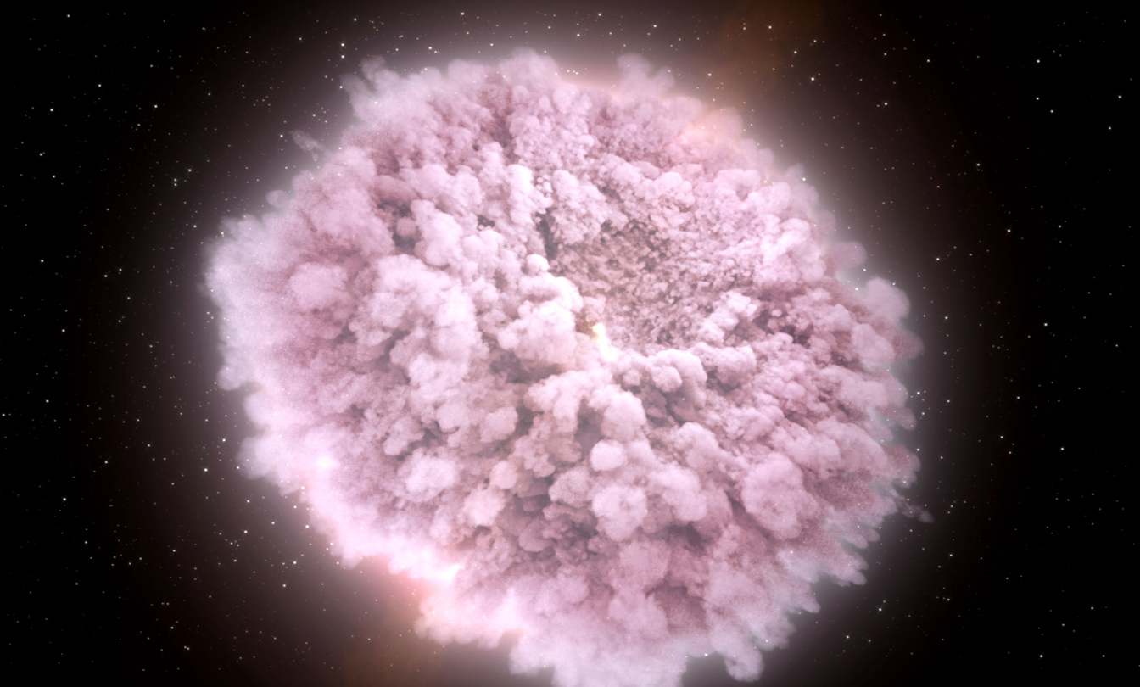
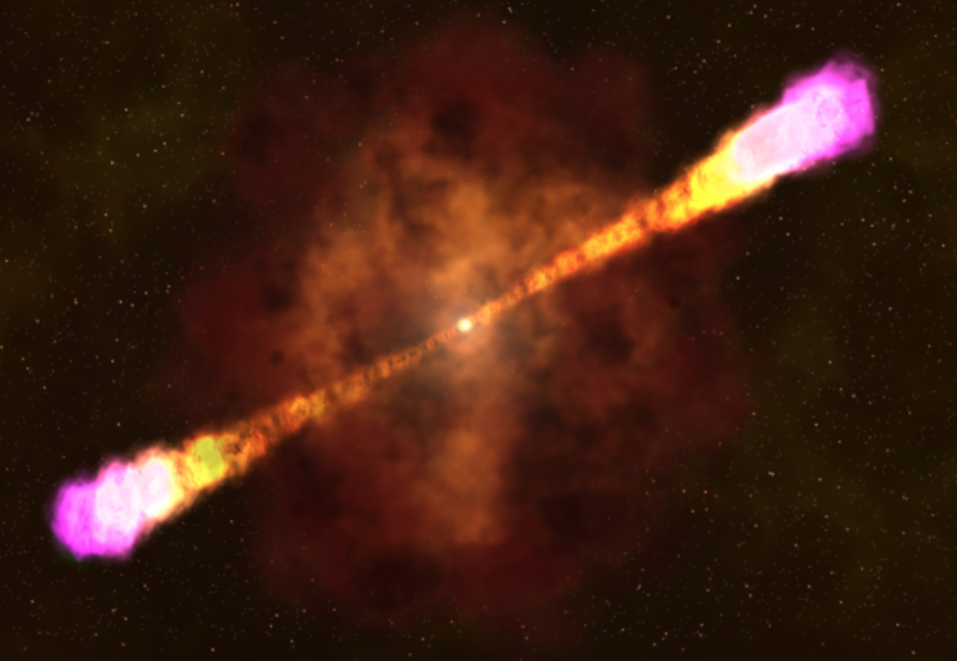
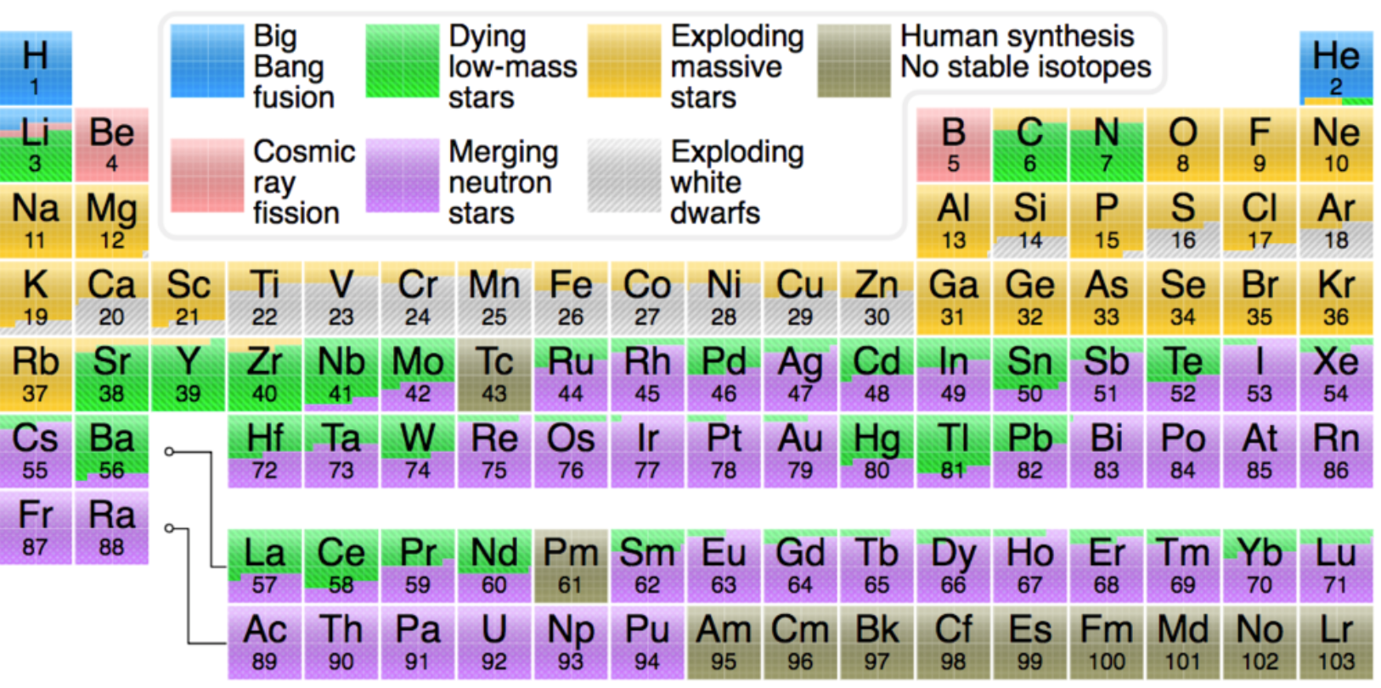
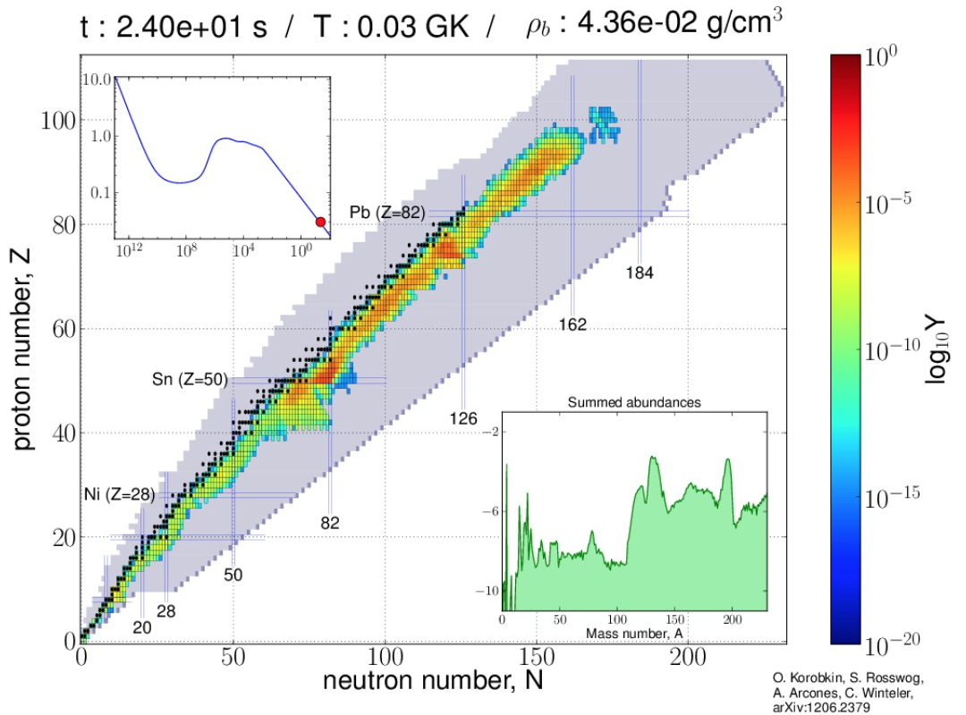
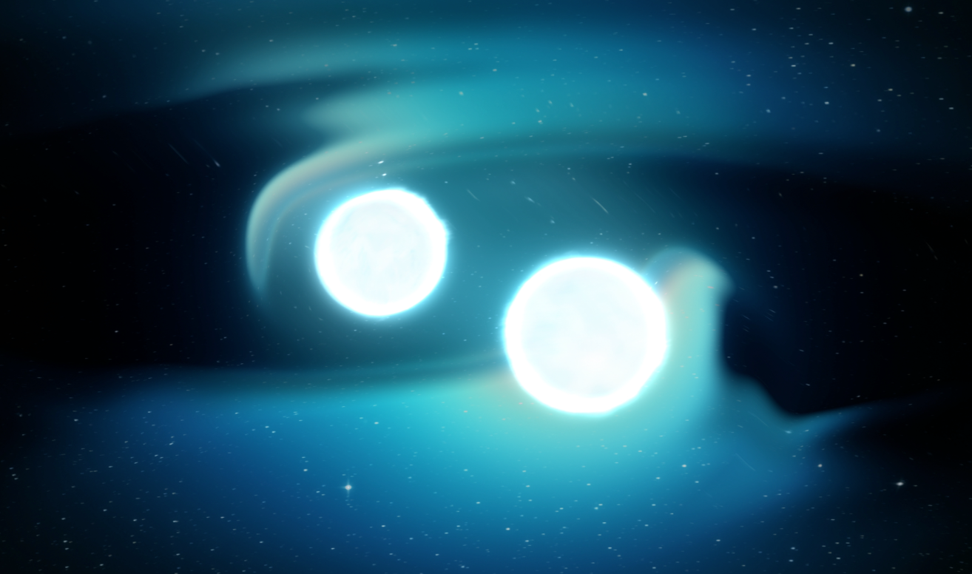
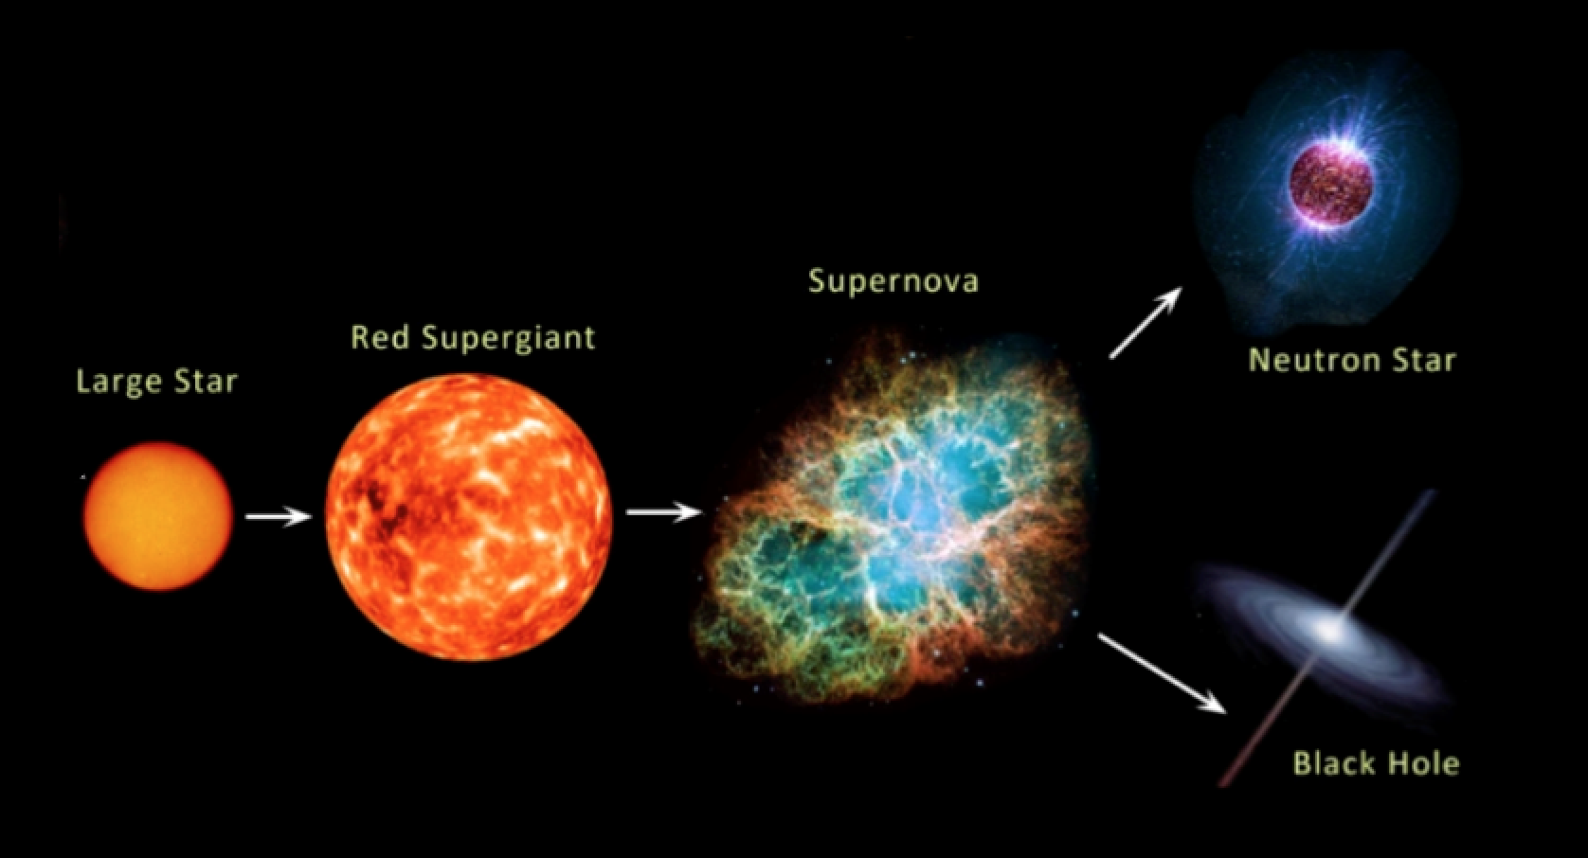
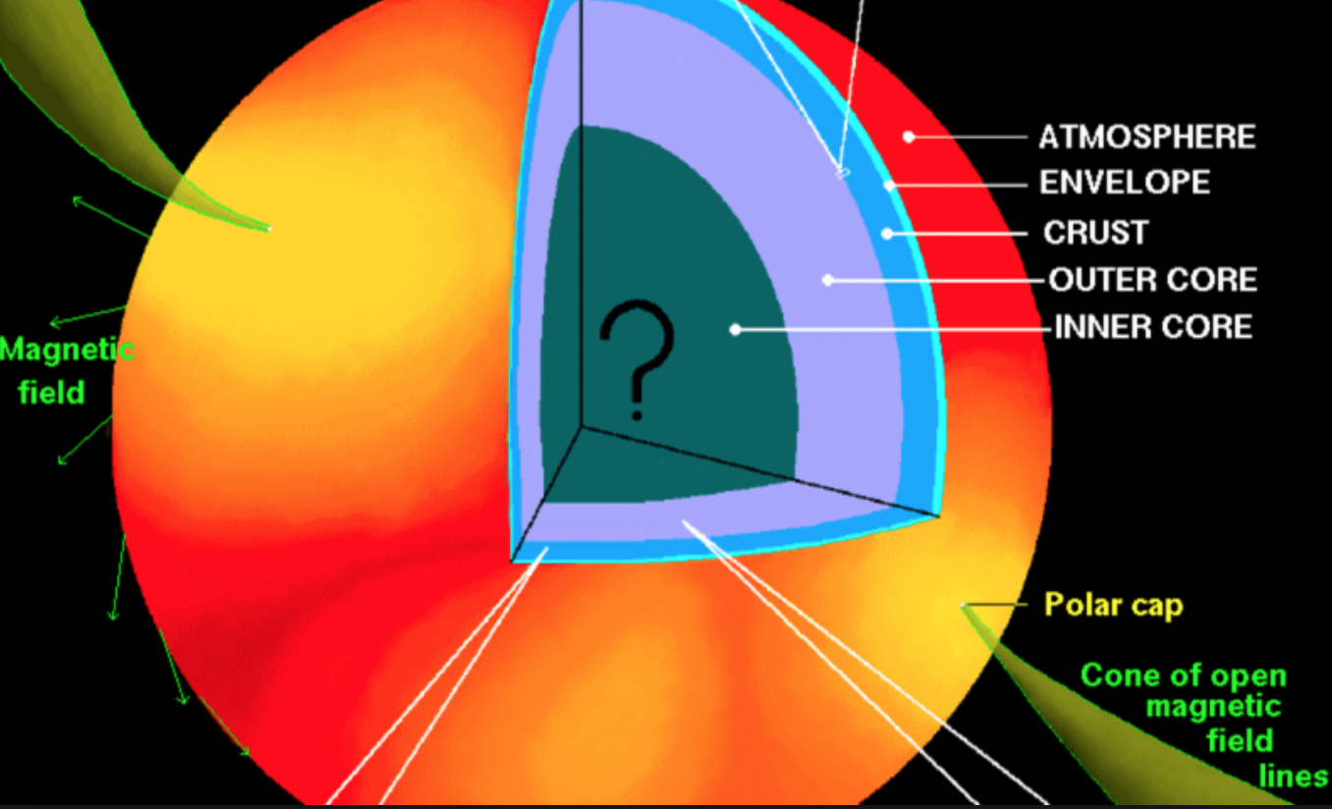
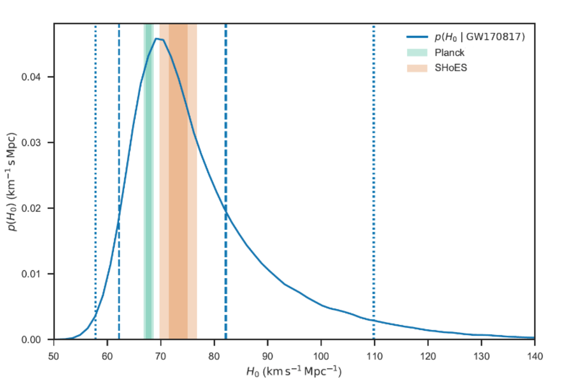
Radioactively powered transients
Relativistic astrophysics
Nucleosynthesis and
enrichment of the Universe
GW170817
Compact object
formation and evolution
Nuclear matter physics
Cosmology

Slide 3
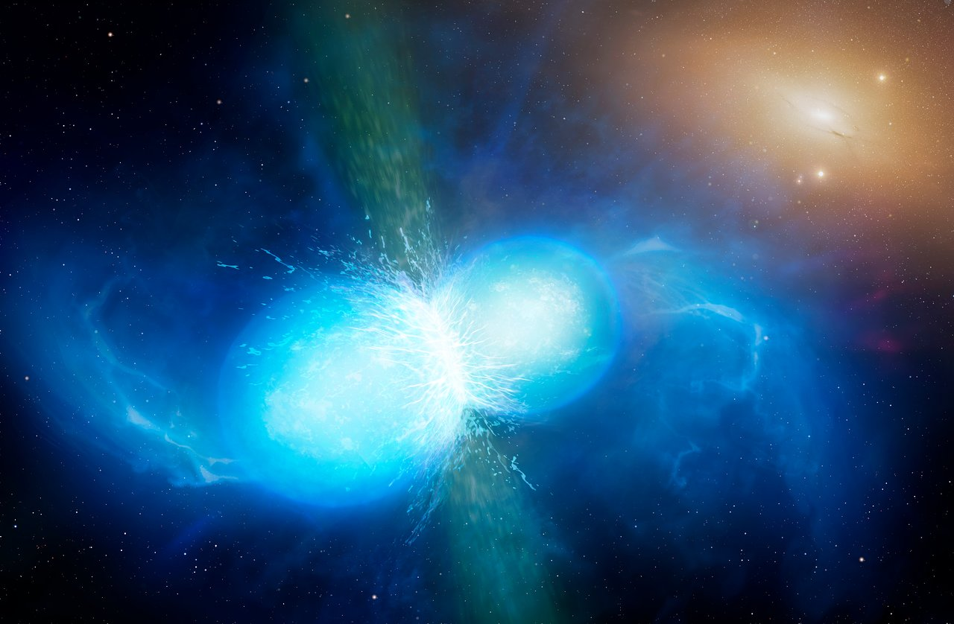
17 August 2017, 12:41:04 UT
Credit: NASA's Goddard Space Flight Center/CI Lab
Credit: University of Warwick/Mark Garlick

Slide 4
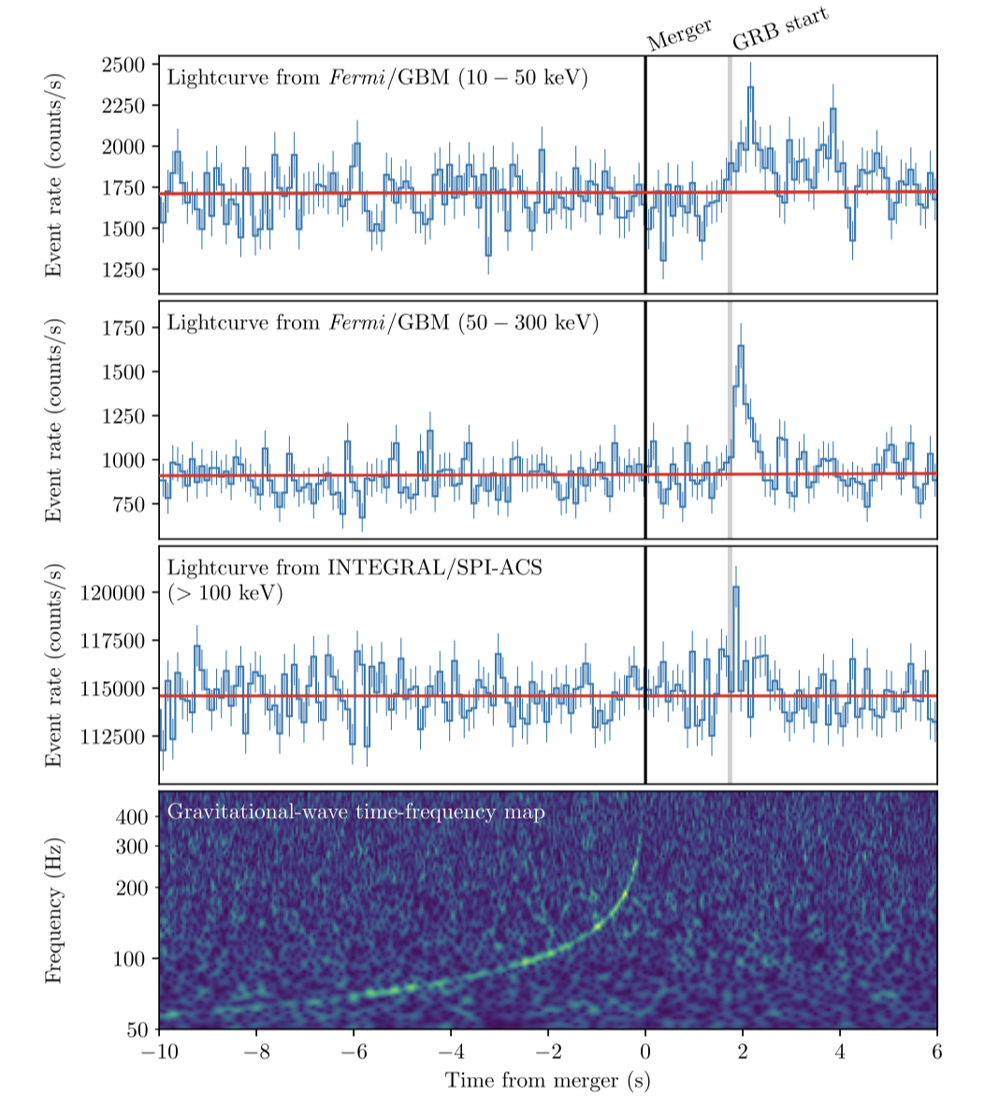
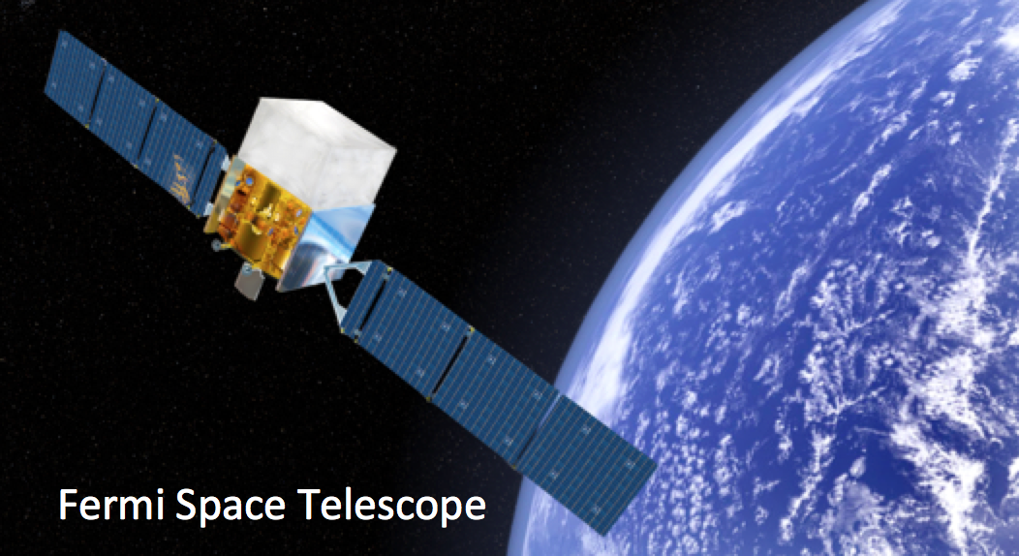
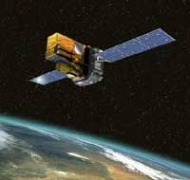
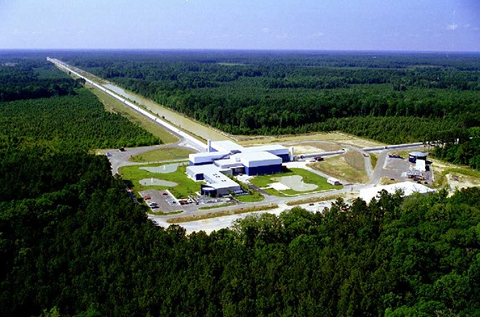
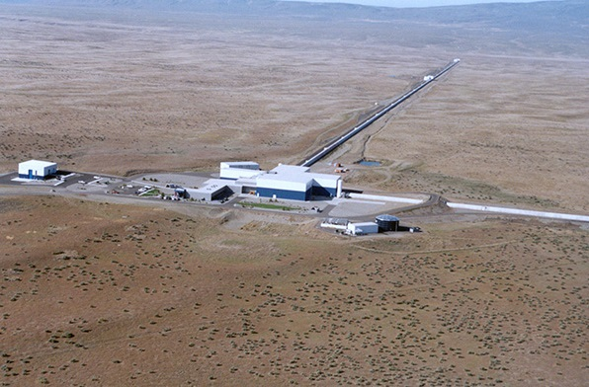
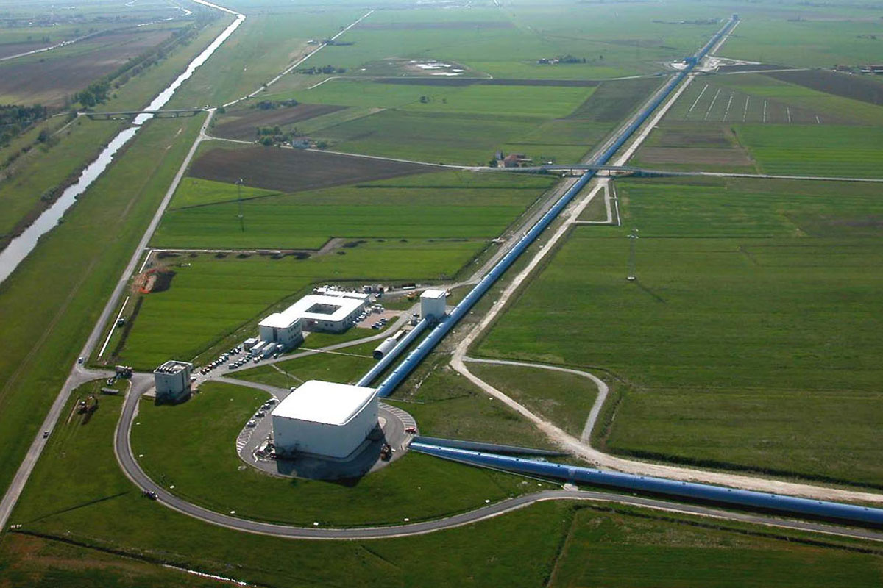
GW170817

Slide 5
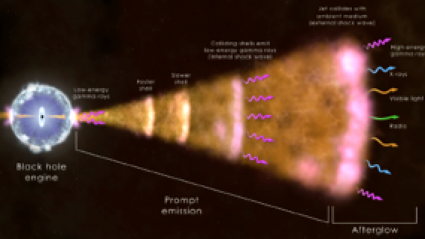
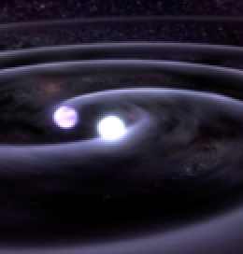

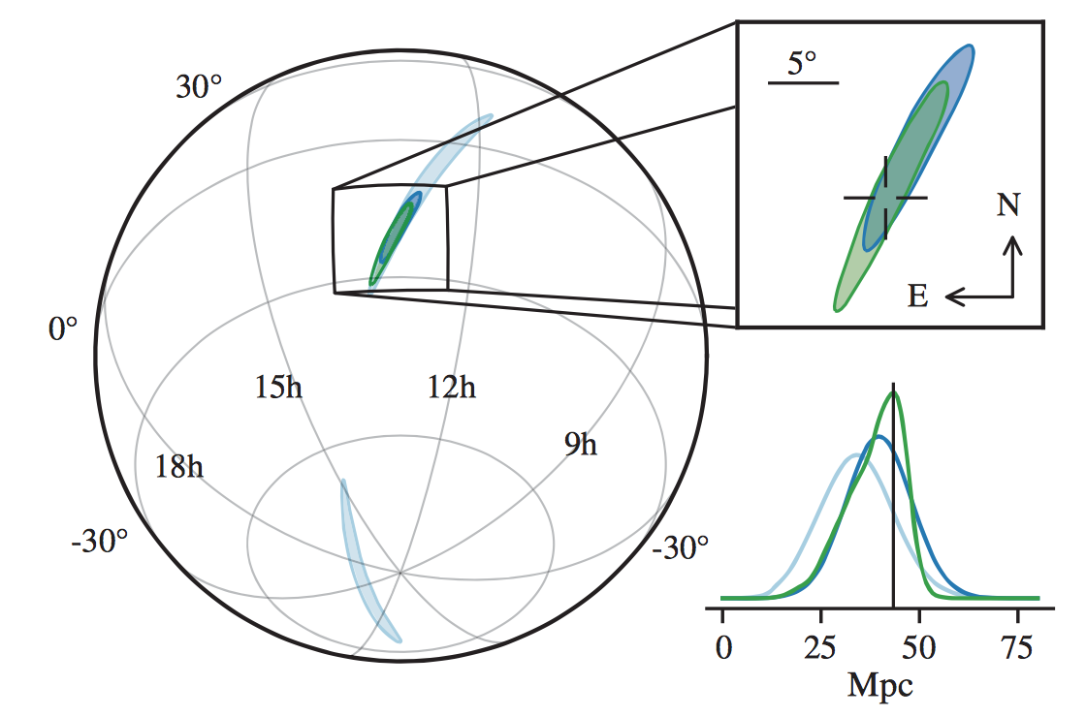
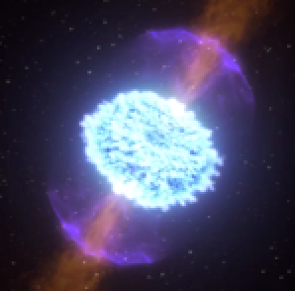
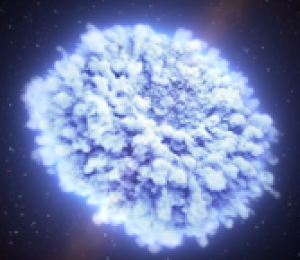
NS merger
Short GRB
X-ray Radio afterglow
t0 1.7s +5.23hrs +10.87 hrs +9 days +16 days
LHV sky localization
UV/Optical/NIR Kilonova
LVC + astronomers, ApJL, 848, L12
Notes:
Aggiungere skymap

Slide 6
GW observables

Slide 7
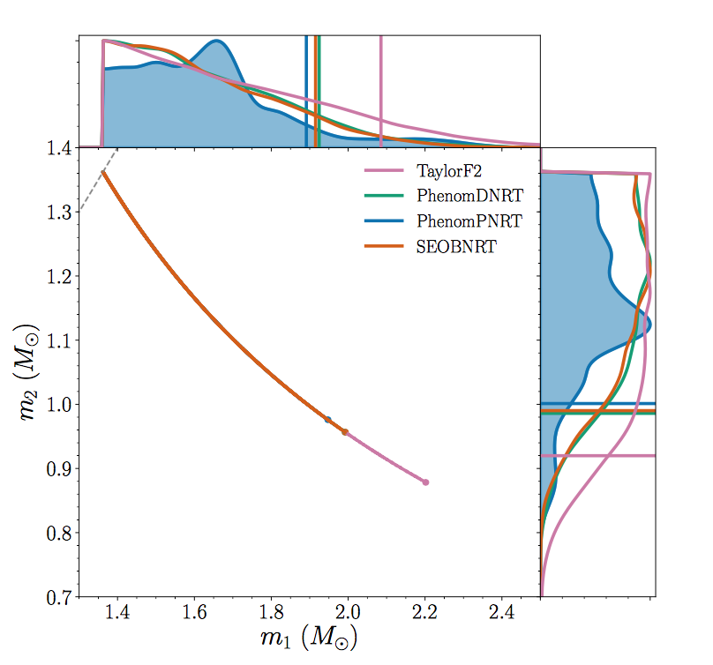
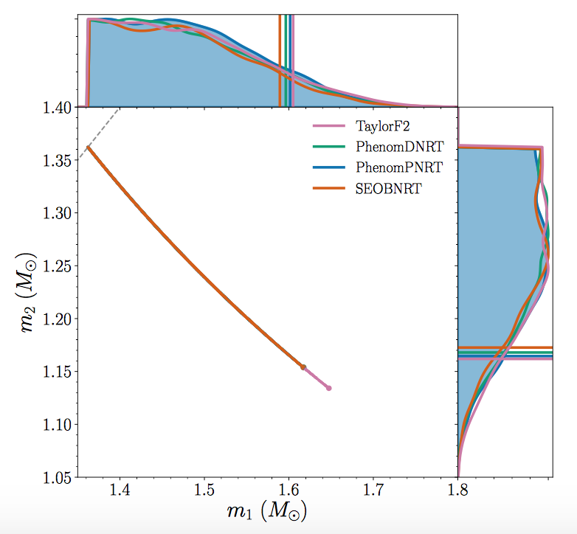


GW170817: PARAMETERS OF THE SOURCE
23 < f /Hz < 2048
Analysis uses source location from EM
Mass range 1.0 – 1.89 Mo
1.16 – 1.60 Mo low spin
Masses are consistent with the masses of all known neutron stars!
Abbott et al. 2018, arXiv1805.11579
Notes:
Better modelling
Virgo re-calibrated
Using the known localization

Slide 8
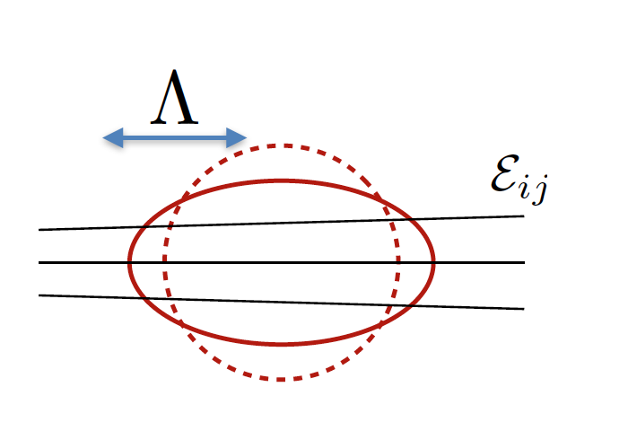

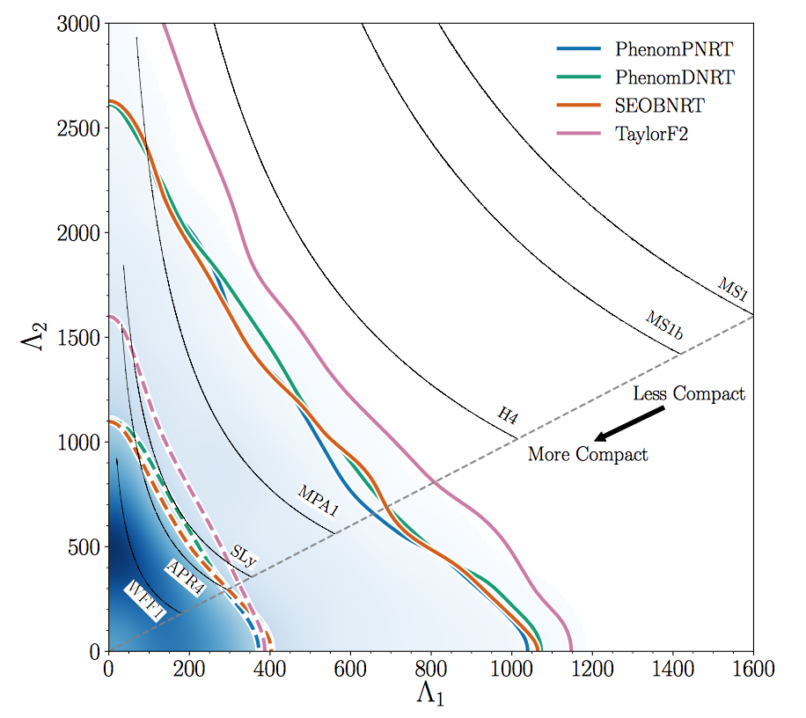
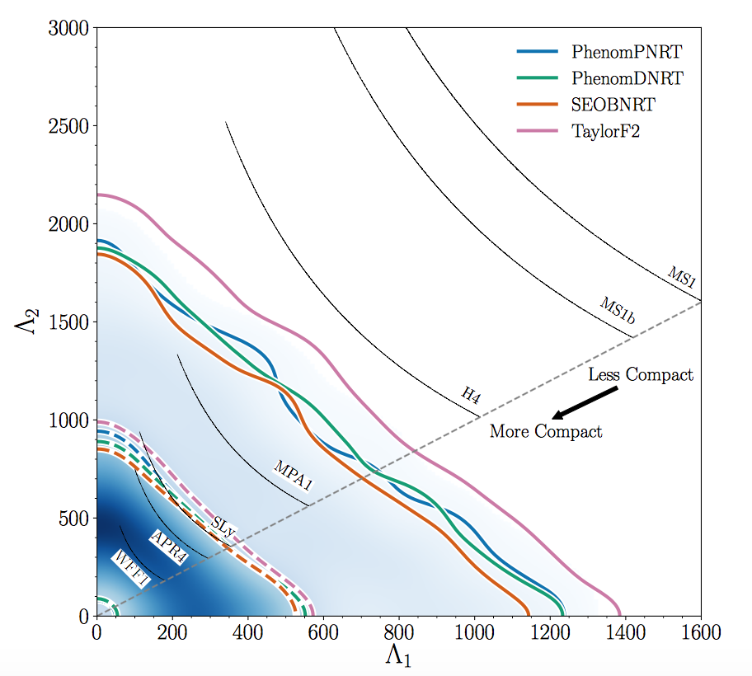
NS LABORATORY FOR STUDYING SUPER-DENSE MATTER
TIDAL DEFORMABILITY
~15 km
~14 km
~12 km
~11 km
From only GWs we cannot say both components of the binary were NS
Notes:
TIDAL DEFORMABILITY = how its gravitational potential changes when the star is squeezed by the gravity of the companion
mass-weighted linear combination of the two tidal parameters Λ ̃
Less compact, larger radius, difficult to compress, easier to disrupt STIFF EOS

Slide 9
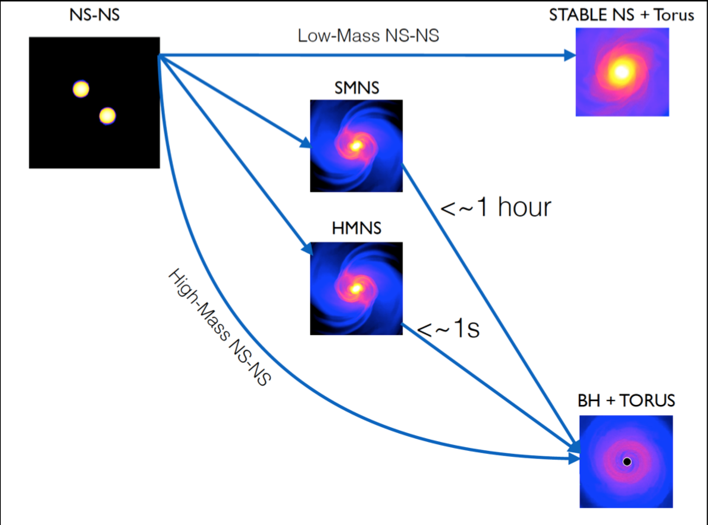
Post merger remnant?
Sim. & vis., W. Kastaun
Notes:
Supermassive neutron stars are those exceeding the TOV mass limit (cold, nonrotating neutron stars) of 2.1 M ☉
For each EOS we determine whether their merger will automatically lead to prompt collapse to a black hole, or whether the remnant can be supported against collapse by uniform rotation (possibly as a supramassive star) or differential rotation (possibly as a hypermassive star).
Mtot is less than the maximum (nonrotating) TOV mass MTOV → the remnant can be supported against gravitational collapse even without rotation.
If Mtot 0 is greater than MTOV but less than the maximum mass of uniformly rotating stars, then the merger could lead to SMNS supported by uniform rotation
If Mtot 0 is greater than MUNI but less than the maximum mass we find for differentially rotating stars MDIF, merger may lead to a HNS supported by differential rotation
If Mtot 0 is greater than MDIF 0 → the remnant will promply collapse to a black hole (“BH”).
HYPRAMSSIVE support higher mass but agnetic braking and viscosity combine to drive the star to uniform rotation (but since higher mass they collapse before) the mass threshold
To survive with uniform rotation is smaller

Slide 10
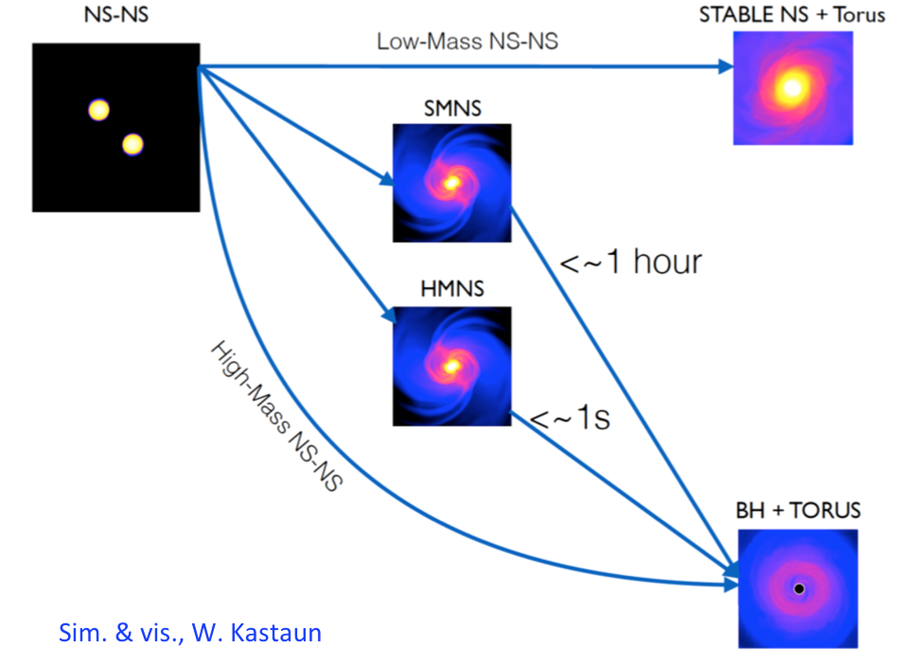
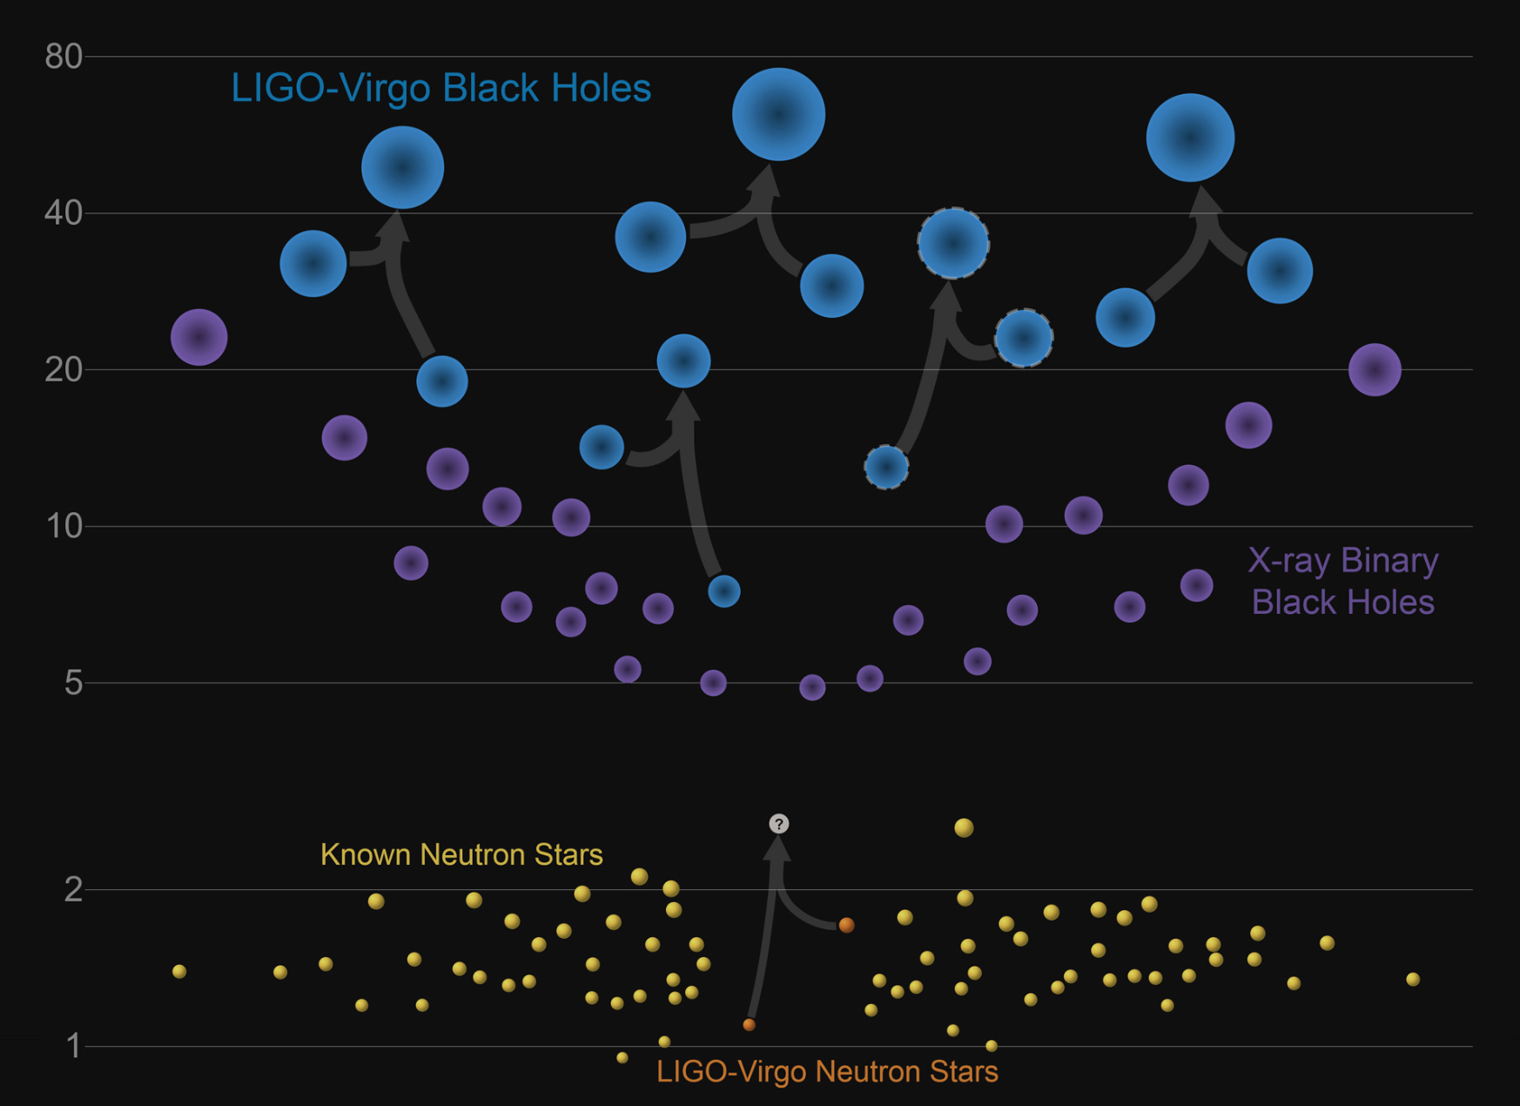
Post merger remnant?
Abbott et al. 2017, ApJL,851
GW search:
ringdown of BH around 6 kHz
→ LIGO/Virgo response strongly reduced
short (tens of ms) and intermediate duration
(≤ 500 s) GW signals up to 4 kHz
→ no evidence of postmerger signals, but it cannot rule out short- or long-lived NS
Heaviest NS
or lightest BH known?
Masses (in solar masses)
Notes:
Ejected mass

Slide 11
EM non-thermal emission

Slide 12
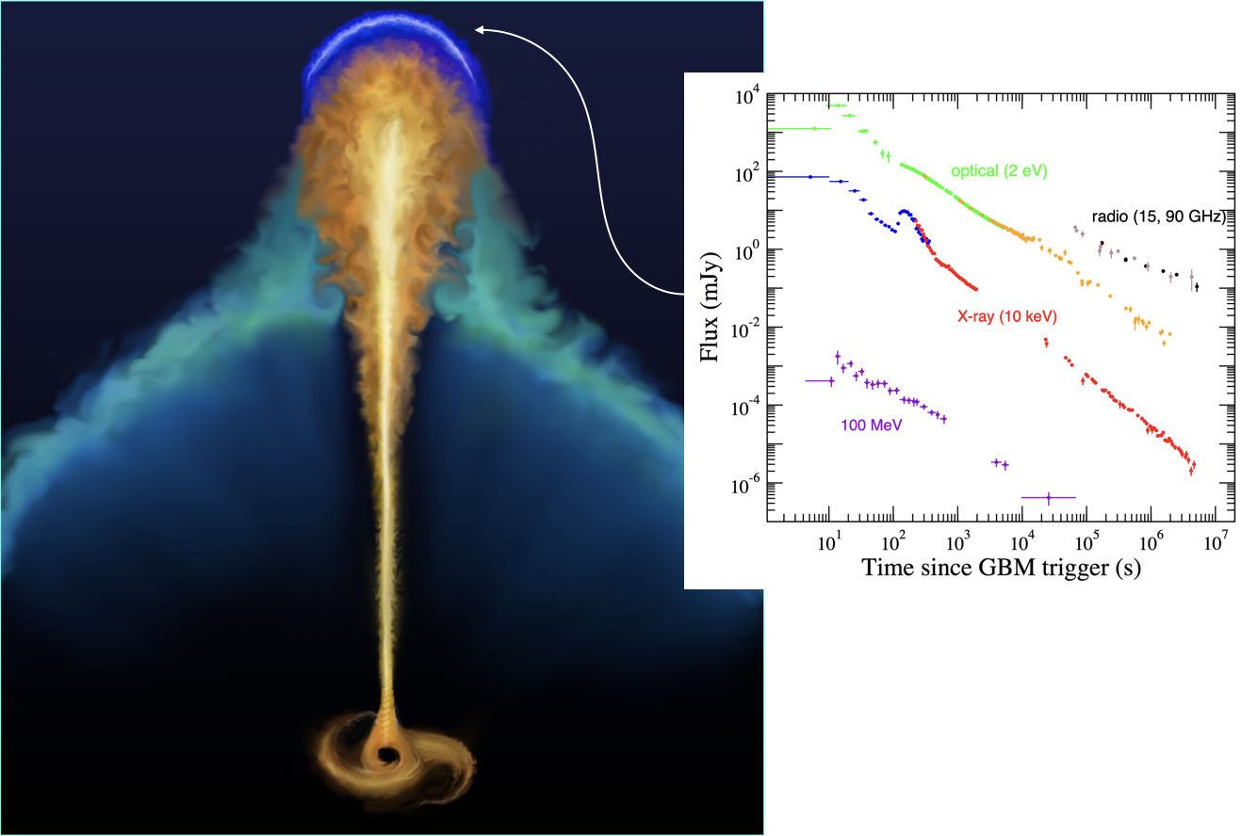

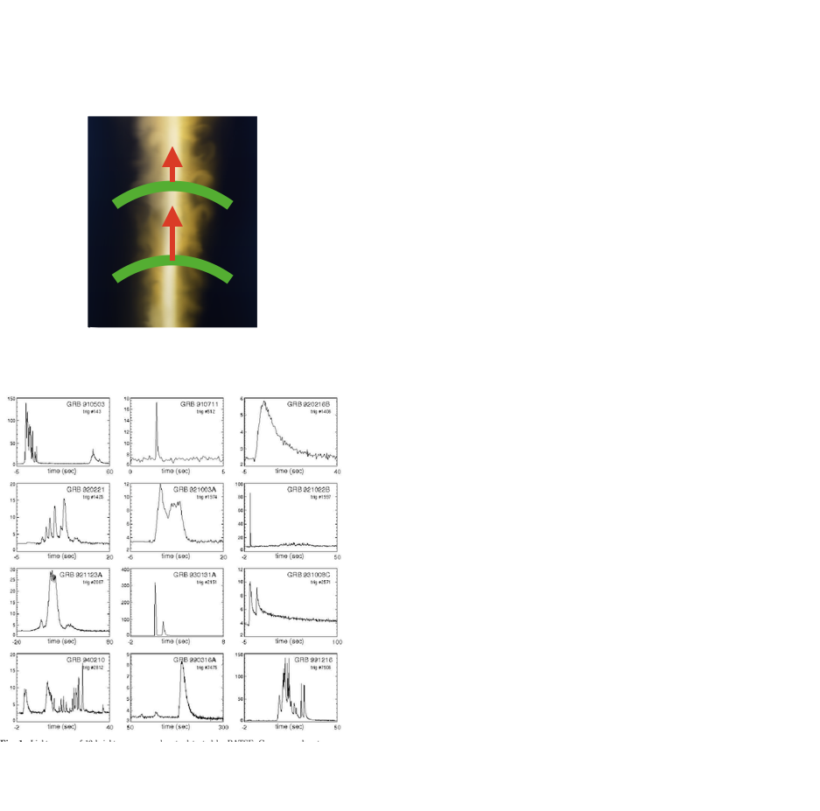
Short Gamma Ray Burst
Credit: Ronchini
Afterglow emission
Optical, X-ray, radio
hours, days, months
Prompt emission
ϒ-ray within seconds

Slide 13
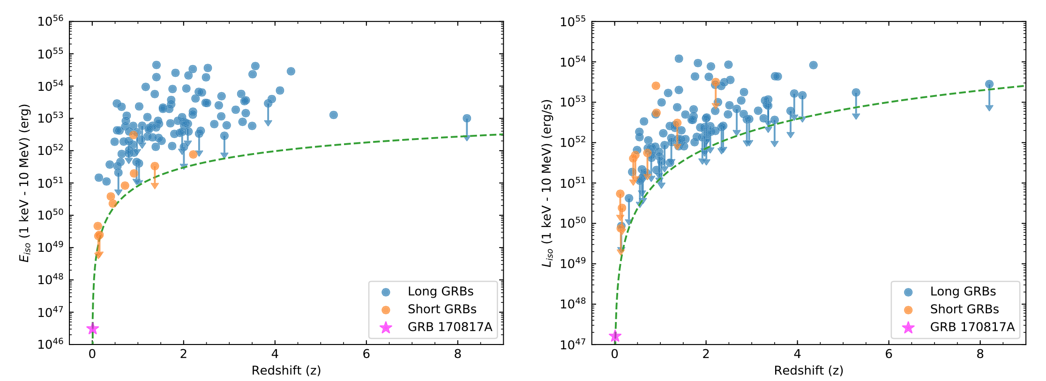
GRB 170817A
100 times closer than typical GRBs observed by Fermi-GBM
it is also "subluminous" compared to the population of long/short GRBs
10² – 10⁶ less energetic than other short GRBs
Abbott et al. 2017, APJL, 848, L13
Intrinsically sub-luminous event
or a classical short GRB viewed off-axis?

Slide 14
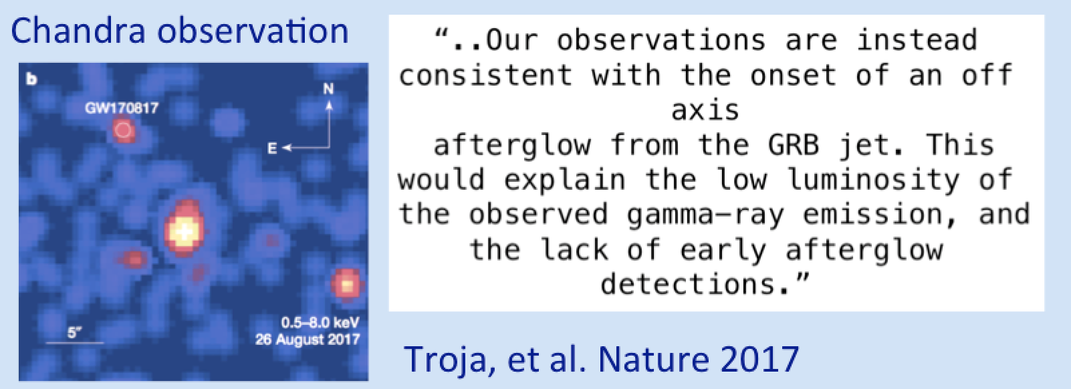
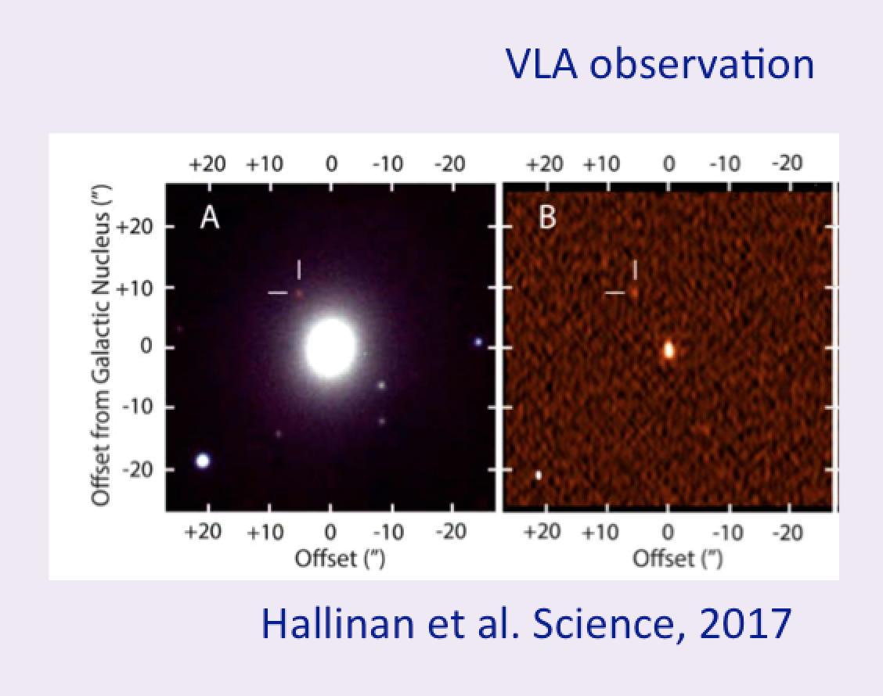
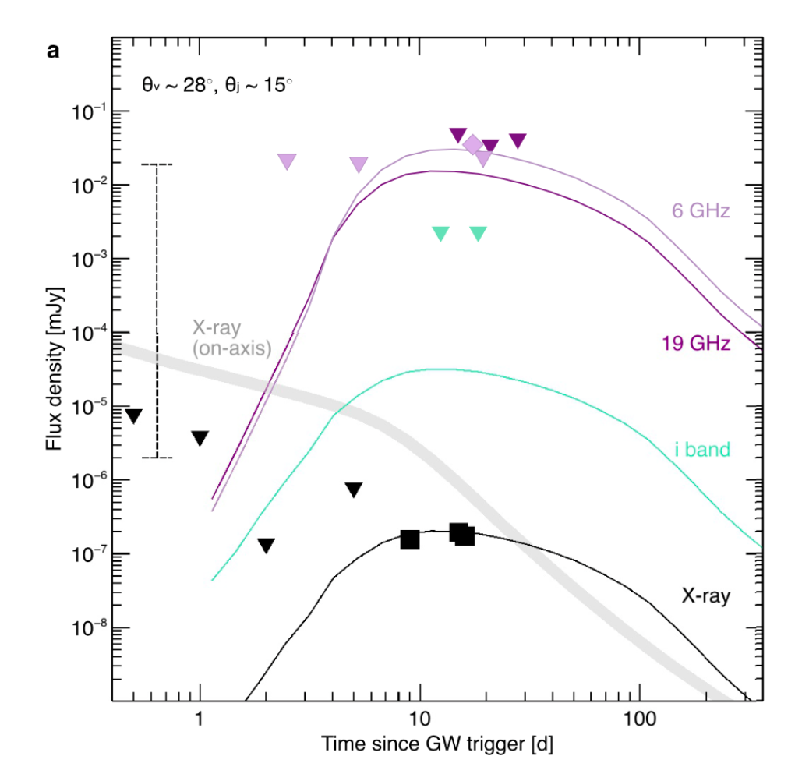
X-ray and radio emissions 9 and 16 days after the merger
unknown
First GRB observed off-axis?
Hallinan et al. Science, 2017

Slide 15
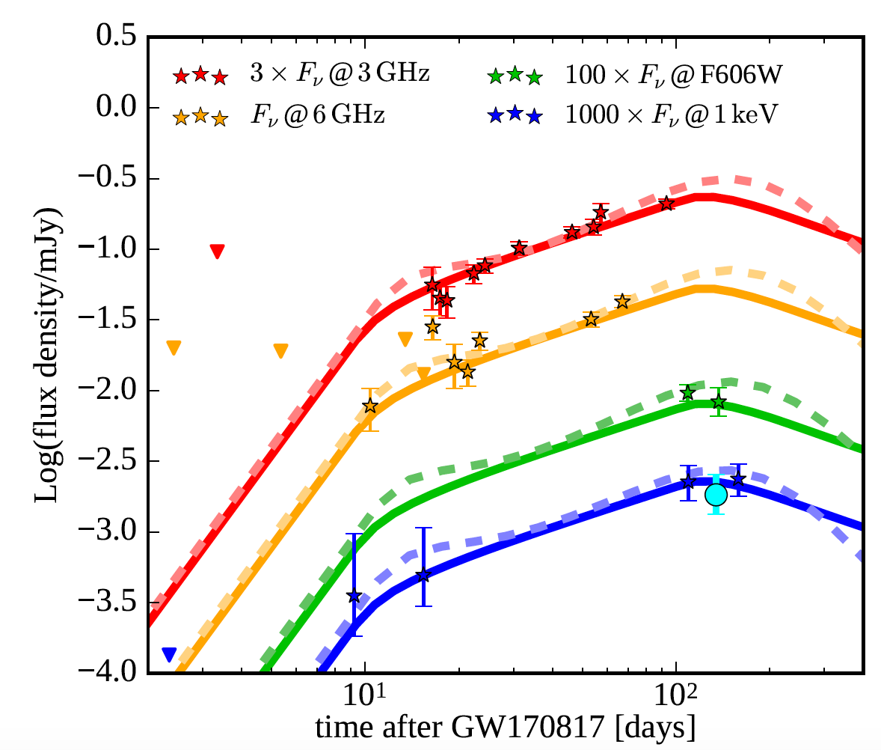
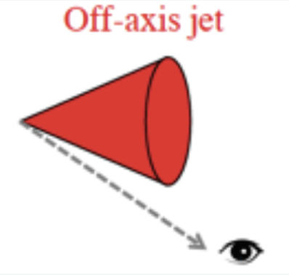
After 150 days from the BNS merger…
..unexpected slow achromatic flux–rise until ∼ 150 days!
F(t) ∝ t^{0.7−0.8}
D’Avanzo et al. 2017, A&A

Slide 16
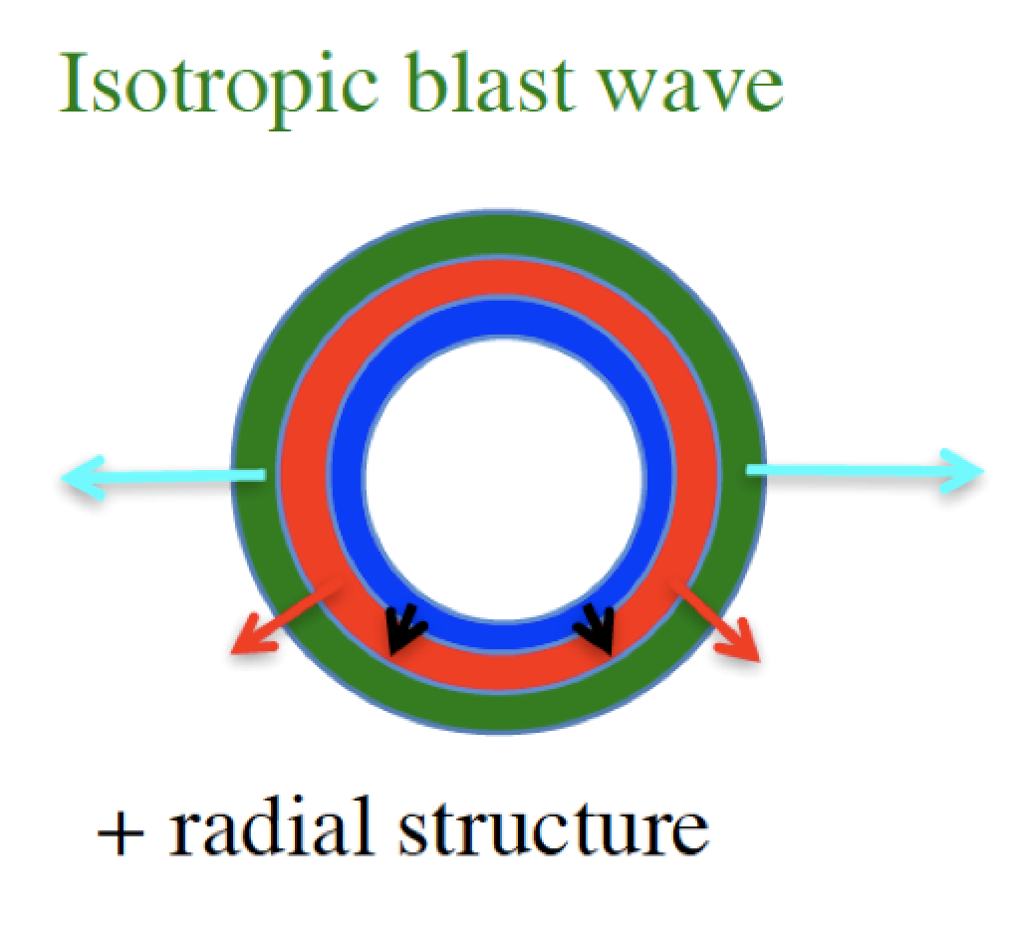
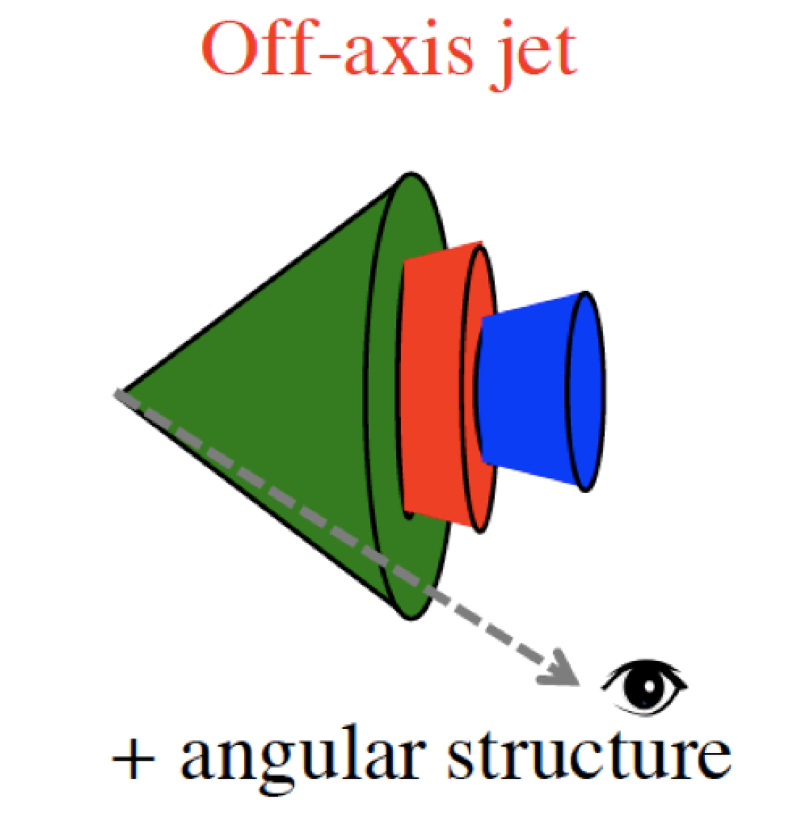
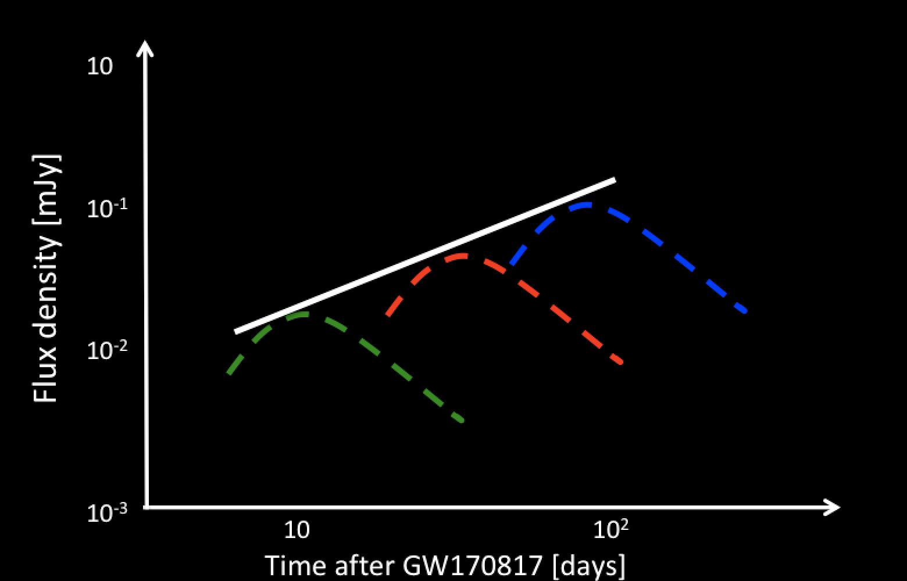
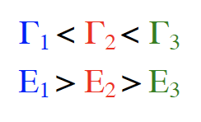
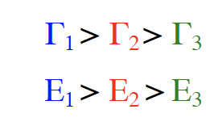
RADIAL or ANGULAR STRUCTURE?
Mildly relativistic isotropic outflow (choked jet)
Structured Jet (successful)
off-axis jet
Rise t^{-0.8}
[see e.g. Rossi et al. 2002, Zhang et al. 2002, Ramirez-Ruiz et al. 2002, Nakar & Piran 2018, Lazzati et al. 2018, Gottlieb et al. 2018, Kasliwal 2017, Mooley et al. 2017, Salafia et al. 2017, Ghirlanda et al. 2019]
Notes:
Account for the low lum and shallow rise

Slide 17
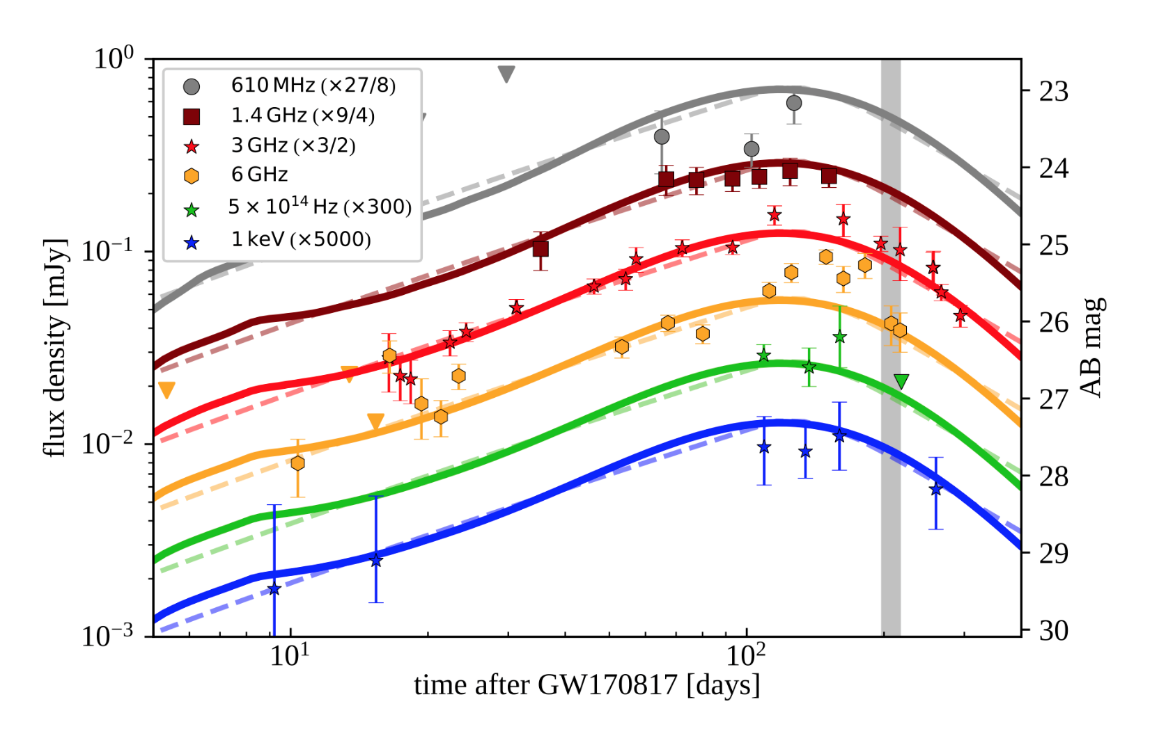
After 150 days from the BNS merger…decaying phase!
Ghirlanda et al. 2018
MULTI-WAVELENGTH LIGHT CURVES CANNOT DISENTANGLE THE TWO SCENARIOS!
Dashed lines
Solid lines
[Margutti, et al. 2018, Troja, et al. 2018, D’Avanzo et al. 2018, Dobie et al. 2018, Alexander et al. 2018, Mooley et al. 2018, Ghirlanda et al. 2019]
Notes:
[Margutti, et al. 2018, Troja, et al. 2018, D’Avanzo et al. 2018, Dobie et al. 2018, Alexander et al. 2018, Mooley et al. 2018, Ghirlanda et al. 2018]

Slide 18
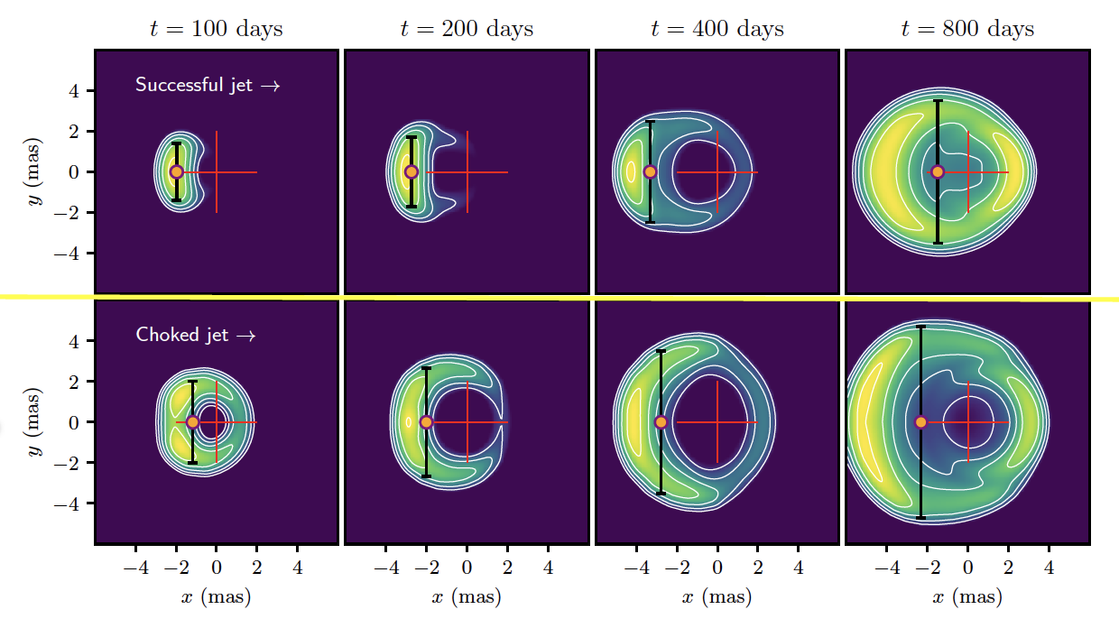
RADIO HIGH RESOLUTION IMAGING
At the same epoch: structured jet has LARGER DISPLACEMENT and SMALLER SIZE than isotropic midly relativistic outflow!

Slide 19
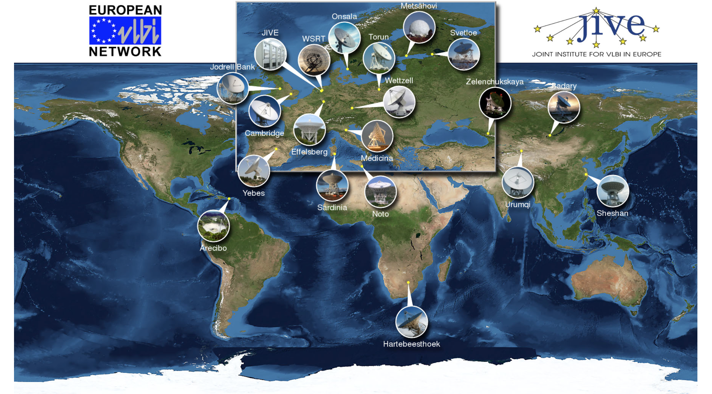
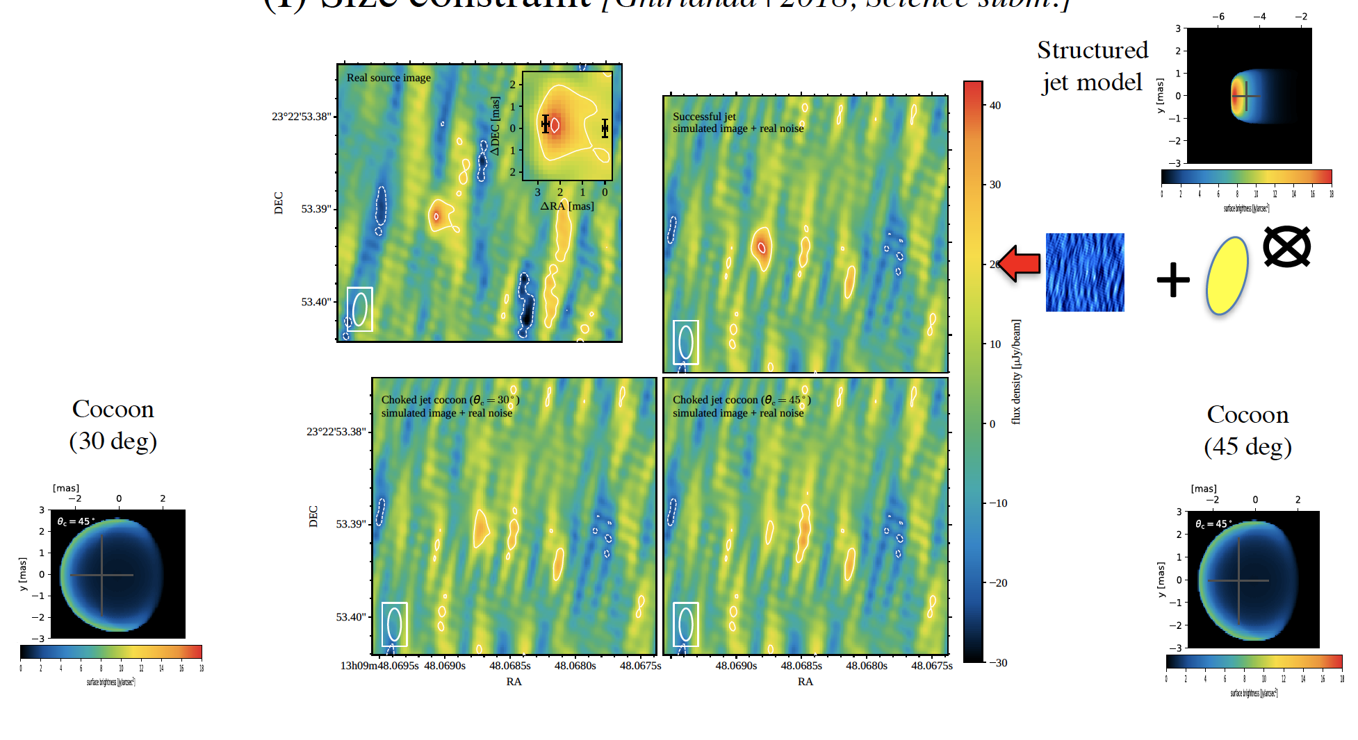
SIZE CONSTRAINTS
Observations 207.4 days after BNS merger by
global VLBI network of 33 radio telescopes over five continents constrain SOURCE SIZE < 2 mas
Ghirlanda et al. 2019, Science
See also Mooley, Deller, Gottlieb et al. 2018

Slide 20
SIZE CONSTRAINTS
Ghirlanda et al. 2019, Science
Ghirlanda et al. 2018, arXiv:1808.00469
Ruled out nearly isotropic, mildly relativistic outflow ,
which predicts proper motion close to zero and
size > 3 mas after 6 months of expansion

Slide 21
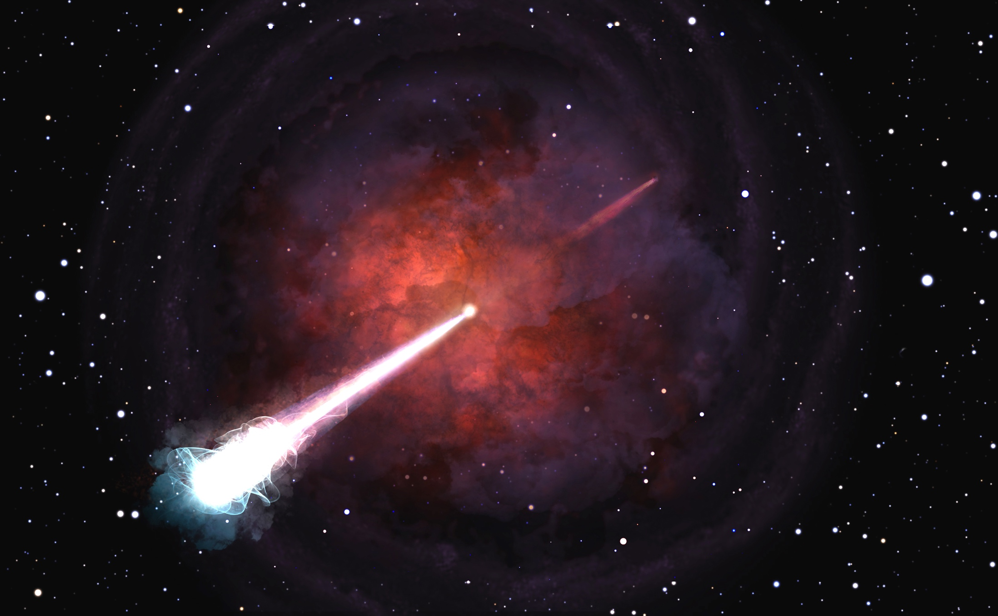
Ghirlanda et al. 2019, Science
A relativistic energetic and narrowly-collimated jet successfully emerged from neutron star merger GW170817!

Slide 22
Thermal-emission

Slide 23
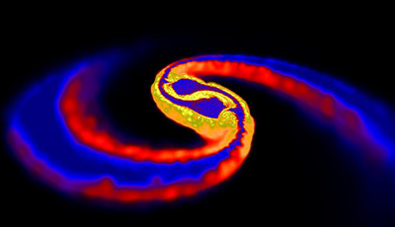
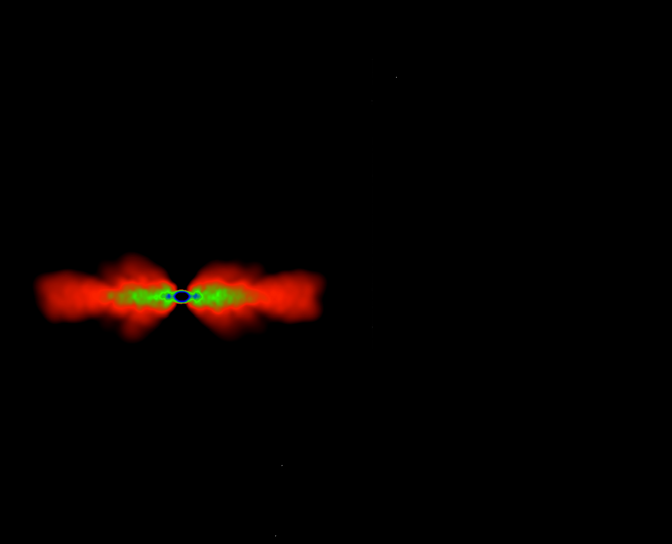
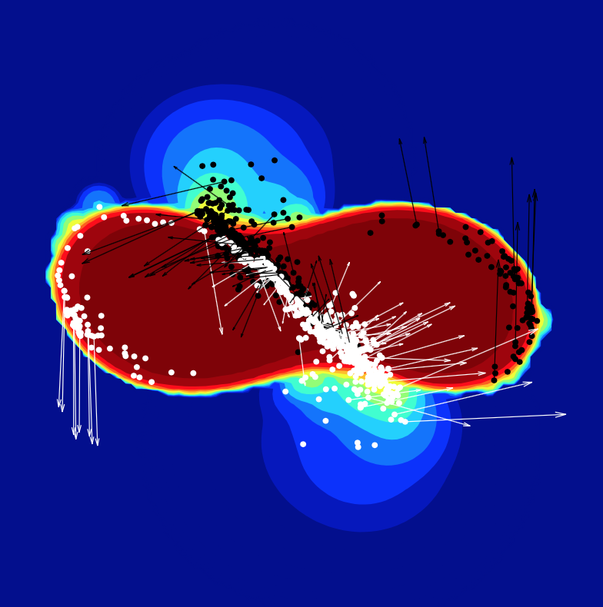

Kilonova
Relativistic Jet
Tidal-tail ejecta → r-process
Neutron capture rate much faster than decay, special conditions: T > 10⁹ K, high neutron density 10²² cm⁻³
Dynamical
outflow
nucleosynthesis of heavy nuclei
radioactive decay of heavy elements
Power short lived RED-IR signal (days)
Rosswog et al. 2013
Li & Paczynski 1998; Kulkarni 2005 Metzger et al. 2010; Tanaka et al. 2014; Barnes & Kasen 2013
Shock-heated ejecta, accretion disc wind outflow, secular ejecta
Weak interactions: neutrino absorption, electron/positron capture
Higher electron fraction, no nucleosynthesis of heavier element
Lower opacity
brief (∼ 2 day) blue optical transient
Kasen et al. 2015, Perego et al. 2014, Wanajo et al. 2010
Notes:
viscous processes
Timesacle ms, 10-100 ms, 1 s
winds” unbind a fraction of the disk
ejecta from the shocked interface at the point of NS collision
neutrino-driven (ejecta (mainly) driven by neutrino-heating, magnetically launched winds or accretion disk matter that becomes unbound by viscous and nuclear heating (electron/positron captures
Neutrino irradiation and captures
Shocked-heated → alta T → electron-positron

Slide 24

Observables: expectations
Kasen et al. 2017
Light curve shape (duration and peak luminosity) and spectarl shape are dramatically affected by lanthanides

Slide 25

UV/Optical/NIR Light Curves
(Villar+ 2017 and refs therein)
Extremely well characterized photometry of a Kilonova:
thermal emission by radiocative decay of heavy elements synthesized in multicomponent (2-3) ejecta!
Notes:
Fast decay in the UV and possible peak/plateau at ~1 day in the blue optical bands
Peak/plateau ~1-2 day in the red optical bands and peak at ~3-6 days in the infrared bands

Slide 26

ESO-VLT/X-Shooter
First spectral identification of the kilonova emission
the data revealed signatures
of the radioactive decay of
r-process nucleosynthesis
(Pian et al. 2017, Smartt et al. 2017)
BNS merger site for heavy element production in the Universe!
(Cote et al. 2018, Rosswog et al. 2017)
Credit: ESO/E. Pian et al./S. Smartt & ePESSTO/L. Calçada

Slide 27

Nucleosynthesis
Smartt et al. 2017
Spectral analysis hampered because of:
heavy elements have forest of lines hence strong blending
relativistic velocity makes for extremely broad lines (multi-components and different velocities)
atomic data are incomplete and uncertain
Attempt to identify elements

Slide 28


A recent work…
Watson, D. et al. accepted in Nature
identification of the
neutron-capture element strontium
See also Perego et al. 2020
Notes:
abundances in stars in dwarf galaxies suggest that large amounts of Sr are produced together with Ba (Z=56) in infrequent events
Sr strong absorption feature inthe regionof kilonova

Slide 29


Multi-component kilonova emission (Pian et al. 2017, Nature,551, 57)
0.05c wind lanthanide-free
0.05c wind lanthanide-mixed
0.2c ejecta lanthanide-rich
Best fit requires three
components
ejected mass ∼ 0.03 – 0.05 M⊙
At present models are not able to reproduce consistently all the observed spectral features

Slide 30
Multi-messenger studies

Slide 31





GRB/GW FUNDAMENTAL PHYSICS/COSMOLOGY
GRB/GW delay
and 40 Mpc distance
difference speed of gravity
and speed of light between
GWs propagate at the speed of light
to within 1:10¹⁵!
130.000.000 ly
LVC 2017, APJL, 848, L13
Consequences of multi-messenger detection of GW170817 for cosmology →
Constraint on the speed of GWs ruled out many classes of modified gravity models (quartic/quintic Galileons, TeVeS, MOND-like theories, see, e.g., Baker et al. ’17, Creminelli & Vernizzi ’17)

Slide 32




GRAVITATIONAL-WAVE COSMOLOGY
CMB
By Plank
Cepheids and
type Ia SN
Recession velocity /redshift
GW distance
GW data
Combining the distance
measured from GWs
and NGC4993 recession velocity
→ H0 = 70 kms-1 Mpc-1
Abbott et al. 2017, Nature, 551, 85A
Notes:
SBF distance → recession velocity

Slide 33


MULTIMESSENGER CONSTRAINTS ON NUCLEAR EOS
Simulations in NR
EM observations → Mej,tot > 0.05Mo
suggests a lower limit Λ > 400
EM observations exclude
very soft EOS!
Radice, Perego, Zappa, Bernuzzi 2017
Notes:
simulation using realistic mycrophsyics with approximate gravity Full-GR models and approximate description of matter

Slide 34

EM constraints on the TYPE OF REMNANT and multi-messenger constraints on RADII and maximum MASS of (TOV) NSs
GWs tidal deformability (LVC 18)
Notes:
No platau, kilonova Ekin 10^51 erg, off-axis jet < 10^50 erg + no extended emission
Aggiorna con Duncun results, rezzolla
Compact NS
→ closer binary, higher orbital velocity at merger
stronger shock

Slide 35
EM constraints on the TYPE OF REMNANT and multi-messenger constraints on RADII and maximum MASS of (TOV) NSs
Margalit & Metzger +17
Rezzolla+18
No energy injection from long-lived NS remnant
SMNS
Bauswein+17
No prompt collapse to BH
Blue KN ejecta
Nicholl+ 17
GWs tidal deformability (LVC 18)
Mass priors from radio Galactic double NS, single pulsars
Soumi+ 18
Notes:
No platau, kilonova Ekin 10^51 erg, off-axis jet < 10^50 erg + no extended emission
Aggiorna con Duncun results, rezzolla
Compact NS
→ closer binary, higher orbital velocity at merger
stronger shock
radio observations of double neutron star binaries, and the third is informed by the masses of isolated pulsars

Slide 36
Radioactively powered transients
Relativistic astrophysics
Nucleosynthesis and
enrichment of the Universe
GW170817
Compact object
formation and evolution
Nuclear matter physics
Cosmology

Slide 37
First run O1, second run O2,
and half of third run O3a

Slide 38


O3a Event Rate
39 candidate GW events in ~26 weeks of O3a (FAR 2 per year → contamination fraction of less than 10%)
26 candidate events low-latecy reported
in GCN alerts
+
13 candidate events offline analysis
Credits:LVC
LVC Catalog paper, arXiv: 2010.14527
O1, O2, O3 → 50 candidate GW events
Notes:
3 noise

Slide 39


TOTAL MASS vs MASS RATIO
LVC Catalog paper, arXiv: 2010.14527

Slide 40

Notable candidate events
GW190425:
m1 and m2 < 3 Mo
Consistent with BNS
GW190814: m2 < 3Mo
NSBH or BBH?
GW190521:
most massive component BHs
→ intermediate massive BH
LVC Catalog paper, arXiv: 2010.14527

Slide 41



GW190425: another BNS detection!
☹
NO firm EM counterpart!
Sky localization of 8284 deg²
Abbott et al. 2020, ApJL, 892

Slide 42

GW190814: FIRST NS-BH or low-mass BBH?
23 Mo
2.6 Mo
Notes:
Some EOS support such a large mass for NS but not consistent with small tidal deformability of GW170817
extreme natal NS spin angular momentum → can support this mass but unlikely merger before dissipating it
boson star or gravastar
- Electromagnetic observations of Galactic NSs and stellar-mass BHs suggest a dearth of compact objects in the∼2.5M⊙to5M⊙range
- The tendency to disfavor mergers with highly asymmetric masses in isolated binaries may be the consequence of mass transfer (e.g., Postnov & Yungelson 2014)
and common envelope episodes (e.g., Ivanova et al. 2013) that cause systems with initially asymmetric masses to evolve towards more symmetric configurations.
Dynamical origin yes this mass ratio but no in GC where BHs dy-namically dominate the cores over the complete lifetime of the clusters, preventing the interactions between BHs and NSs
We conclude that the combination of masses, mass ratio and inferred rate of GW190814 is challenging to explain
Young star clusters and active galactic nucleus disks seem to be more promising hosts for GW190814-like mergers, since both these environments may enhance the formation of either progenitors of or directly merg- ing compact-ob ject binaries with more asymmetric masses to relevant rates.
Spin of BH tightly constrained to ≤ 0.07 precession little to no spin precession → tight constrain because it is nor face-on no face-off

Slide 43


GW190814
2.6 Mo
Abbott et al. 2020, ApJL, 896
23 Mo
NO evidence of measurable tidal effects in the GW signal
NO EM counterpart
Consistent with both BBH and NSBH scenarios
In the NSBH, observation
results can be explained by
the large mass ratio
Sky localization of 18.5 deg²
Notes:
no evidence of measurable tidal effects in the signal

Slide 44

GW190521
The birth of a intermediate massive black-hole!
Credit: Mark Myers, ARC Centre of Excellence for Gravitational Wave Discovery (OzGrav)

Slide 45

credit: LIGO/Caltech/MIT/R. Hurt (IPAC)
Abbott et al 2020, PRL, 125
Abbott et al 2020, APJ, 900

Slide 46


BBH in the accretion disk of a
supermassive black hole?
Caltech/R. Hurt (IPAC)
ZTF detected a candidate counterpart(!?)
EM flare close to AGN
∼ 34 days after the GW event
consistent with expectations for a kicked BBH merger in the accretion disk AGN
765 deg² localization area
ZTF observed 48% of the 765 deg² (90% c.r.)
Graham et al 2020, PRL 124

Slide 47
Next observating runs

Slide 48


A new window into the Universe
KAGRA
KAGRA, Japan
Credit: LIGO–Virgo
Virgo, Cascina, Italy
LIGO, Livingston, LA
LIGO, Hanford, WA

Slide 49

Strain sensitivities as a function of frequency
Abbott et al. 2020, LRR

Slide 50
Observing run timeline and BNS sensitivity evolution
Starting of 04 not before June 2022

Slide 51


LOCALIZATION: sky-area and volume
Abbott et al. 2020, LRR
BNS
NS-BH
BBH
Detection: SNR > 4 in at least two detectors and network SNR > 12
EXPECTED NUMBER OF DETECTIONS FOR O3 and O4
detection counts per one-calendar-year observing run
Detection: SNR > 4 in at least two detectors and network SNR > 12
About FAR < 1/100 yr
Notes:
A percentage of 38 - 44 %
( 11 - 15 %) of the events are expected to have a 90% credible region smaller than
20 deg2 (5 deg2).
A percentage of 10 􀀀 14 %
( 2 - 4 %) of the events are expected to have a 90% credible region smaller than
20 deg2 (5 deg2).

Slide 52
3G detector

Slide 53


The European 3G idea
In Europe we developed the idea of a 3G GW observatory
  Factor 10 better (x1000 Volume) than Advanced (2G) detectors
  Wide frequency, with special attention to low frequency (few HZ)
  Capable to work alone (but aiming to be in a 3G network)
  50-years lifetime of the infrastructure
ESFRI proposal submitted in September
Notes:
European Strategy Forum on Research Infrastructures

Slide 54

3G effort worldwide
NSF funded in 2018 the Conceptual Design Study of a 3G facility: Cosmic Explorer: 40km – L shaped detector

Slide 55

Einstein Telescope

Slide 56
What ET and future EM observatories can do?

Slide 57


Binary systems of Compact Objects
Kilonova/GW - EOS constrains
Kilonova/GW - Nucleosysthesis
GRBs – BNS/NSBH merger up to high z
Relativistic jet properties
Jet-less/jet GRBs
GRB/stable NS remnant
Link to Star Formation History
Emission mechanism
Cosmology
Study BNS/NSBH/BBH along the cosmic history
Large increase of detatction rate
Better parameter estimation
10⁶ BBH detections per year
10⁵ BNS detections per year

Slide 58


Credit: Ghirlanda

Slide 59

Kilonovae detectable by the Vera Rubin Observatory survey up to 1 Gpc
In this volume
ET about 100 event per year have sky loc < 10 sq. degrees
For ET+LVKI 10³ per year have sky loc < 10 sq. degrees
A few tens of joint detections!

Slide 60

High-energy Kev-MeV
GRB
In this volume
ET poor sky localization
For ET+CE order of 10³ events per year with sky loc < 10 sq. degrees
Mission concept THESEUS (wide FoV) → Tens of joint detections!

Slide 61
























Next decades multi-messenger observatories
Euclid
ELT
Cosmic Explorer
Advanced GW detectors+

Slide 62

ET DETECTION EFFICIENCY for BNS

Slide 63
EINSTEIN TELESCOPE DETECTION/SKY LOCALIZATION
up to z=0.26
ET
ET+LIGO/Virgo/KAGRA/LIGOindia
ET SNR>12
ET SNR>12 and LKVI included when SNR > 4
1 year of observations
Up to z=0.26
Among ~4000 mergers per year detected 3210 per year
For Et about 100 per year have sky loc < 10 sq. degrees
For ET+LVKI 10³ per year have sky loc < 10 sq. degrees
Prelimiary results by Stefan Grimm, GSSI
Notes:
Check Yann file

Slide 64
EINSTEIN TELESCOPEDETECTION/SKY LOCALIZATION
up to z=1.8
ET
ET+CE
ET SNR>12
ET SNR>12 and CE included when SNR > 4
1 week of observations
Among ~10⁴ mergers per week up to z=1.8 detected 1492
For ET+ CE 128 per week have sky loc < 10 sq. degrees
Prelimiary results by Stefan Grimm, GSSI

Slide 65
THERMAL EMISSION - KILONOVAE

Slide 66

OPTICAL BAND
Adapted from Chornock+ 2019
105 Mpc
460 Mpc
Vera Rubin
1 Gpc
☹
Too faint counterpart
Large sky-localization/many contaminants
Joint detections for ET limited by optical instruments capabilities!!
Notes:
Mej,red = 0.001 − 0.05 M⊙ and vej,red = 0.1 c
Solid total component bblu + red per M=0.01
Dashed red component per M=0.01

Slide 67

The Vera C. Rubin Observatory survey able to detect kilonova emission up to 800 Mpc
BNS mergers detectable in this volume are of order 10³ per year
A few hundred kilonova are expected to be in the Rubin Observatory surveyed field
→ For the majority of these sources, the GW localization by ET will make it difficult to identify the optical counterpart among many contaminants
→ Joint GW/kilonova detections (of order of several tens) becomes possible considering ET+2G with 2G detectors
The 39-m E-ELT able to observe the kilonova up to z ∼ 0.5 photometrically, and up to z ∼ 0.3 spectroscopically

Slide 68
WHY HIGH-ENERGY?

Slide 69
Credit: Ronchini
GRB detectable up to high z
Small number of contaminants
Promising wide FoV hard-soft Xray instruments
Good sky localization to drive a prompt EM follow-up

Slide 70



















May 2018: THESEUS selected within ESA Cosmic Vision science programme as midium class mission concept for study with SPICA and EnVision Venus
Final decision 2021
IF SELECTED LAUNCH 2032!
Notes:
Space Infrared Telescope for Cosmology and Astrophysics
mission to Venus

Slide 71

THESEUS MISSION CONCEPT →a unique combination of instruments:
Soft X-ray Imagers (SXI)
  4 Lobster-eye telescopes
  0.3-5 keV
  FoV ~ 0.5 sr
  Location accuracy ~ 0.5’-1’
X-Gamma-ray Imager Spectrometer (XGIS)
  3 Coded mask telescopes + X(Si) – Gamma(CsI) ray cameras
  2 keV – 10 MeV
  FoV ~ 2 for 2-150 keV band and > 4 sr for > 150 keV band
  sr (overlapping SXI)
  Location accuracy ~ 5’
InfraRed Telescope (IRT)
  0.7mt class telescope
  0.7-1.8 mm (IZYJH)
  FoV: 15’x15’
  Imaging (H=20.8;150 s) and high resolution spectroscopy (H=17.5;1800s) capabilities (→ redshift)
Amati et al. 2018
  BROAD FIELD OF VIEW (more than 1sr) with ACCURATE LOCALIZATION (down to 0.5’-1’ in the X-rays)
  LARGE SPECTRAL COVERAGE from 0.3 keV up to several MeV
  an on-board prompt (few minutes) follow-up with a 0.7 m CLASS IR TELESCOPE with both imaging and spectroscopic capabilities

Slide 72

THESEUS in Multi-Messeger context
On-axis short GRB detection rate of THESEUS di 12/yr within 1’ – 5’
about 25% is expected to be detected also with IRT with arcsec loc
Maximum THESEUS/XGIS detectable distance
versus viewing angle.
At the typical ET range for BNS
(330 Mpc)
THESEUS can detect a GRB up to a viewing angle of ~20-40°, potentially increasing the event rate by a
factor of >20-100 the on-axis
rate
short GRB like 170817
core jet < 4°
Credit: O. Salafia

Slide 73


THESEUS in Multi-Messeger context
Credit THESEUS Yellow Book

Slide 74

THESEUS in Multi-Messeger context
Credit THESEUS Yellow Book

Slide 75




OTHER PROMISING HIGH-ENERGY COUNTERPARTS
for SXI (0.5- 5 KeV sky loc < 1-2’
High latitude emission
from structured jet?
Magnetar?
or

Slide 76

What happen off-axis?
Ascenzi et al. 2020 A&A
Promising X-ray couterparts!

