Slide 1
"Experimental searches of neutrino anomalies.
Feb. 18th, 14:40 - 15:10
(Venice NeuTel 2021)

Slide 2
Neutrino related anomalies ?
Several anomalies have been collected for two decades in the neutrino sector suggesting the existence of some additional new related states beyond an ordinary 3-flavour mixing picture
anti−νe appearance in the accelerator LSND experiment; Reaction is anti ν-e to e++n with n captured by a p; n + p into d + γ.
    νe disappearance: SAGE, GALLEX experiments with Mega-Curie sources and observed/predicted rate R = 0.84±0.05;
    anti-νe disappearance of near-by nuclear Reactor experiments and rate R = 0.934±0.024
    recent observation of sterile neutrino oscillations by the NEUTRINO-4 experiment..

Slide 3

The NEUTRINO-4 experiment
The experiment has studied the possible observation of neutrino produced oscillations by an additional sterile neutrino as a function of L/E, with L the distance travelled (m) and E energy (MeV) by an incoming anti ν-e on a proton.
At 8 m from the 90 MW Reactor core of 35 x 42 x 42 cm³ , one can record about 300 anti ν-e events/day with 1 m³ of liquid scintillator. At a typical 9 meter distance, the neutrino energy is 9 MeV for L/E = 1 and 3.6 MeV for L/E = 2.5.
The reaction is fitted according to the following form
where E_{ν} is anti-neutrino energy in MeV, L the distance in meters, ∆m₁₄² is difference in eV² between square masses of electron and sterile neutrinos, θ₁₄ is mixing angle between electron and sterile neutrinos.

Slide 4
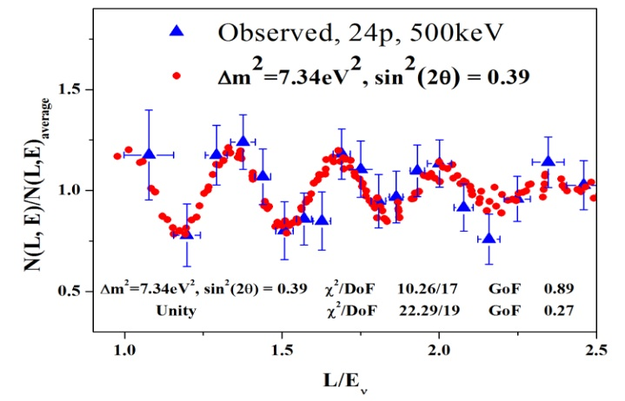
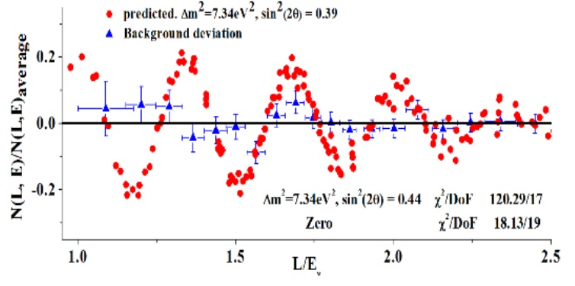
NEUTRINO-4 reactor signal
Reactor ON
Reactor OFF
Data has been collected for 3 years until June 2019, followed by background measurements until January 2020: 720 days reactor “on” and 417 days reactor “off”, with 87 reactor cycles.
The difference ON-OFF is 223 events per day in the range from 6.5 to 9 meters. The signal/background ratio is 0.54.
The obtained value of the difference between the masses of the electron and sterile neutrinos is Δm14² = 7.26 ± 0.13 stat ± 1.08 syst => 7.25 ± 1.09 eV² and the angle θ14 parameter sin²(2θ14) = 0.26 ± 0.08 stat ± 0.05 syst => 0.26 ± 0.09. Lower probability satellite peaks are also observed at other masses.

Slide 5
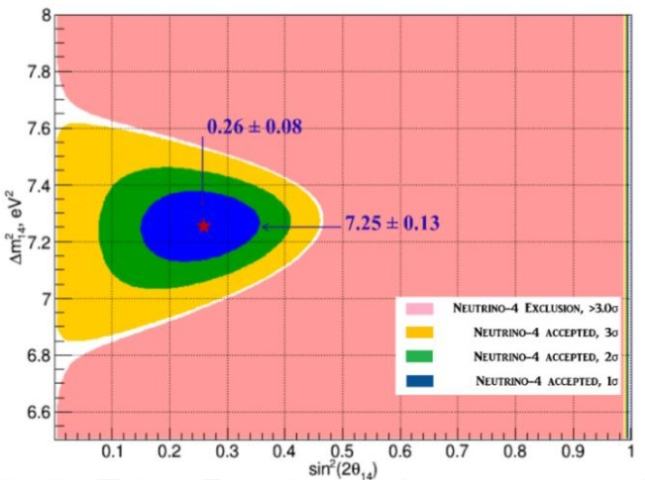
Main result
The result on an expanded scale in terms of SD (σ)
The energy intervals of 500 keV corresponding to the energy resolution of the detector give χ²/DOF = 17.1/17, compared with χ²/DOF = 30/19 for the version without oscillations.
3 σ
1 σ

Slide 6
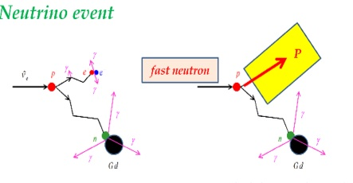
Main background
The electron anti-neutrino signal is anti ν-e + p -> e⁺ +n followed by second delayed step with n captured by gadolinium
Fast neutrons emitted outside the detector in interactions of high energy cosmic ray muons with matter around the detector become the main source of the background.
The fast neutron background is n + p -> p + n with neutron also captured by gadolinium
Background event

Slide 7
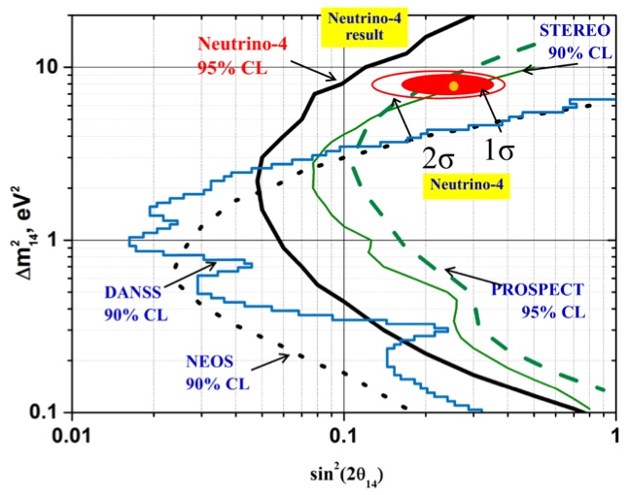
Summary
Comparison of results of the NEUTRINO-4 and experiments STEREO and PROSPECT

Slide 8


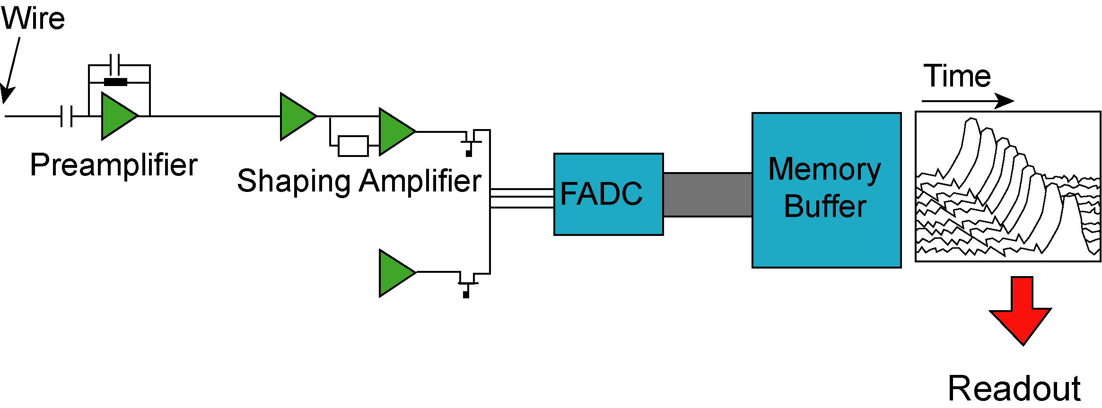
A new, powerful detection technique initiated at CNGS
Time
m.i.p. ionization
~ 6000 e-/mm
Scintillation light yield 5000 e/mm @ 128 nm
E-drift direction
Edrift ~ 500 V/cm
    Drifting electrons are moving to transparent wire arrays oriented in different directions, where signals are recorded.
High density
Non-destructive readout
Continuously sensitive
Self-triggering
Very good scintillator: T0
Low noise Q-amplifier
Continuous waveform recording
Slide# : 8

Slide 9
Non destructive, multiple charge readout
Induced current Collected charge
T=0
Edrift
u-t
u-t view
v-t
E1
w-t
v-t view
Drift time Drift time
E2
w-t view
Edrift = 500 V/cm
p = 3 mm
d = 3 mm
r = 0.1mm
For the ICARUS
T600
At FNAL’s shallow depth, the T600 will require two additions:
  3 m concrete overburden to mitigate the c. rays background,
  Particles entering the detector must be removed with a Cosmic Rays Tagging (CRT) around the full LAr volume

Slide 10
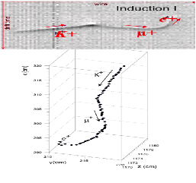
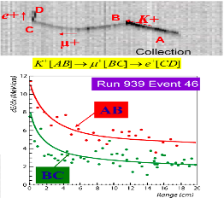
3 D particle Identification (k⁺ → µ⁺ → e⁺) at CNGS
ICARUS EVENT
Efficient, low mis-identification, due to precise 3D reconstruction, dE/dx, range measurement
stopping power
recognition of secondary particle production after decay interaction
K⁺
μ⁺
Slide: 10

Slide 11
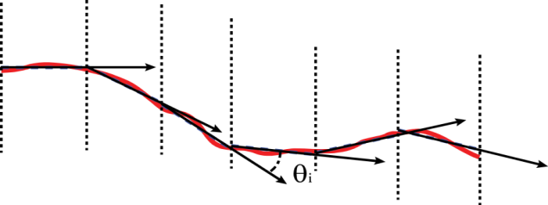
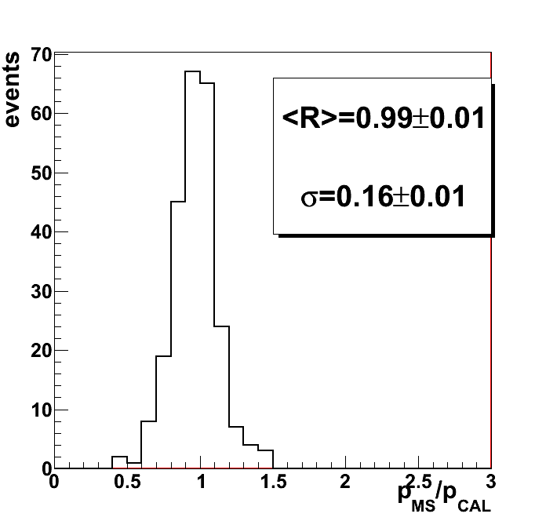
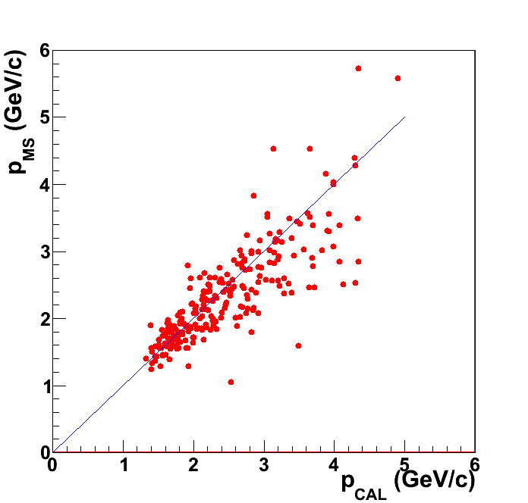
Measurement of muon momentum via multiple scattering
In absence of a magnetic field, the initial m momentum may be determined through the reconstruction of multiple Coulomb Scattering (MS) in LAr
RMS of θ deflection of μ depends on p, spatial resolution σ and track segmentation
Method tested on ~103 stopping μ’s from CNGS ν interactions in upstream rock, comparing PMS measured by MS with the corresponding calorimetric PCAL
Ratio MS/
calorimetry
4 m
Initial p from MS ->
μ track length: > 5m Used length: 4m
Initial p from calorimetry ->
~16% resolution has been obtained in the 0.4-4 GeV /c momentum range of interest for the future short/long base-line experiments

Slide 12
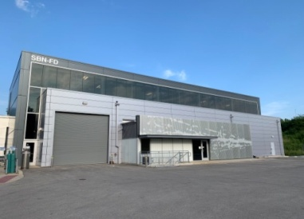
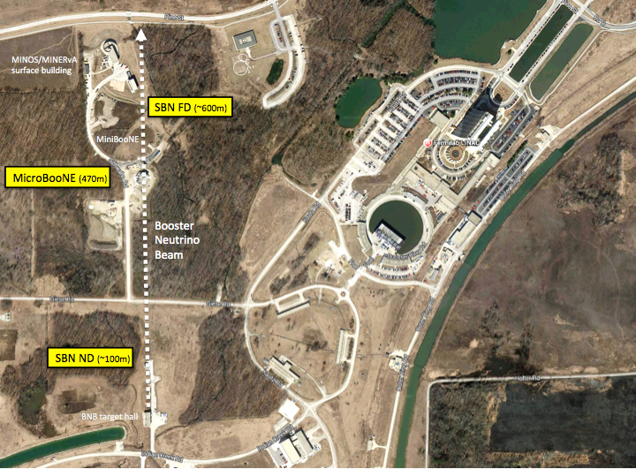
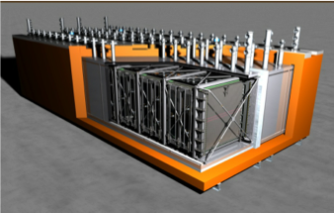
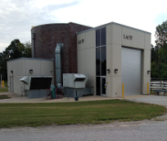
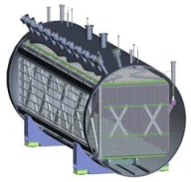
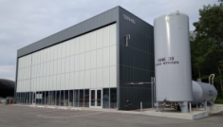

Neutrino layouts at Fermilab
ICARUS T600
476 t active mass
MicroBooNE
89 t active mass
NuMi
Line
SBND
82 t active mass
2020 data summary
Slide# : 12
12
    ICARUS T600 will collect also ~3 GeV νe NuMI Off-Axis:)

Slide 13
Similarities between NEUTRINO-4 and ICARUS
ICARUS at the Booster (1) and at the NUMI (2) have remarkable similarities to NEUTRINO-4. We should be able to settle the NEUTRINO-4 prediction both in the ν−μ with the Booster and ν-e with NUMI.
The Booster at about 600 m from the target can be directly compared to NEUTRINO-4 with a target of 42 cm followed by the detector between 6 and 12 m. with the ν−μ collected with ~ 100 times the energy. The number of Booster events with 1.6 µs spill, 5 10¹² pot/spill, 5 Hz repetition rate are 12’800 ev/day of which ~7’800 ev/day are due to cosmic rays.
The NUMI off-axis proton beam is located at ~ 700 m of distance from ICARUS and at an off-axis angle of 6 degrees. For 1 year with 0.75 Hz NUMI repetition rate and spills of 6 × 10¹³ ppp we expect for positive (negative) focussing 4.64 x 10⁵ CC events/y (3.78 x 10⁵ CC events/y).
.

Slide 14
The analysis procedure for the early ICARUS data
The proposed early search will be limited to the observation of the CC quasi elastic processes ν−μ + neutron -> muon + proton for Booster and ν−e + neutron -> electron + proton for NUMI.
Only events with only one and well separated sizeable PMT’s fast signal during the duration of the t = 0 burst will be retained.
Initial, automatic event selection is based on:
  (1) a sum of signals from the PMT ‘s above a threshold and
  (2) the absence of signals from the CRT over its 4π surface, occurring a few ns after or before the earliest of the PMT signals within the event.
Events missed by the CRT detection inefficiency are also kept.
This simple fast signal selection will reduce of about one order of magnitude the events initially in excess of 10:000/day.
Next the 3-D 1 ms long image will be displayed only for these resulting triggers.

Slide 15
3-D 1 ms long image
All connected vertices of two joining tracks will be searched inside the whole 1 ms image — one for a high dE/dx stopping proton and the other either for a stopping muon (for Booster) or a single electron showering (for NUMI).
All other kinds of tracks visible in the the 3-D 1 ms long image and escaping events will not be considered.
The position of the pattern in the visual 1 ms display will coincide with the one from the PMT’s only for t = 0 patterns. This is why the search for patterns in the visual image should cover the full visible area.
The kinematics of the finally recorded vertices will be compared with the predictions of the NEUTRINO-4 experiment, confirming the absence of these events for a test sample of out of beam-time recorded events.

Slide 16
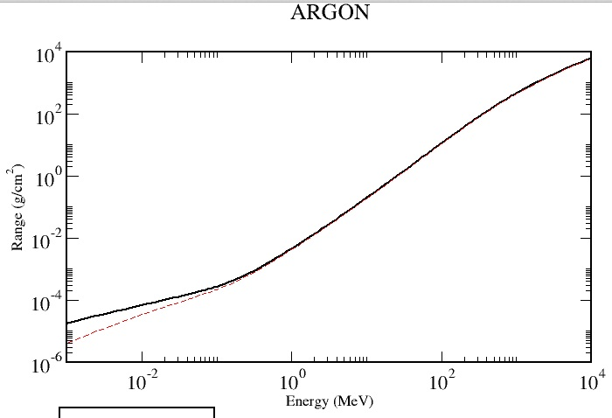
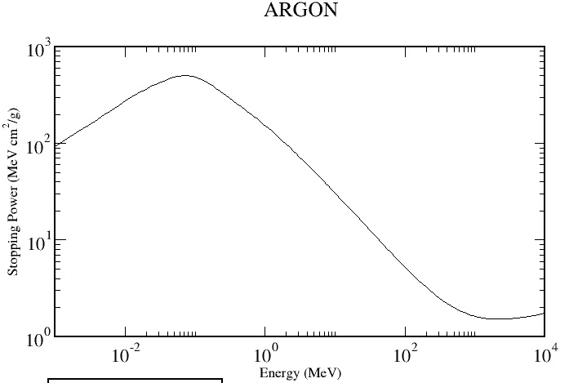
Automatic detection of a proton stopping end track
Stopping power from
end point vs p. energy
10 gr/cm²
100 MeV
30 MeV cm²/g
1.8 MeV cm²/g
10 MeV
Range from end point
vs.proton energy
Min. Ioniz.
The search for 1 ms displays will be started by the instrumental detection of end point proton 3D tracks with its above features.
At an observed proton track, one must require an “attached” minimum ionizing track, either a muon for Booster or an electron for NUMI. No distinction is made between on-time and off-time
Validity of the automatic process will be verified by comparing it with some events scanned visually.

Slide 17
General expectations for the future SBN data taking
The data taking is based on a future and definitive demonstration of the 2.8σ L/E decay pattern observed by the NEUTRINO-4 experiment.
The experiment will be primarily dedicated to the following four main observations:
  1.- Detection of the ν-mu disappearance in the Booster beam with the ICARUS detector
  2.- Similar detection of the ν-e disappearance in the NUMI off-axis k beam
  3.- Comparison between the ICARUS at 590 m and SBND at 110 m from the target in the Booster beam to test validity of the 3-1 model and appearance of the ν-e signal.
  4.- Confirmation of a sterile mass for the effective masses of the light active neutrino. The m_{ve}^{eff} ~ sqrt[m₄²|U_{e4}|²)] and m_{vμ}^{eff} and m_{vτ}^{eff} may be compared with future direct experiments, f.i. with next KATRIN.

Slide 18
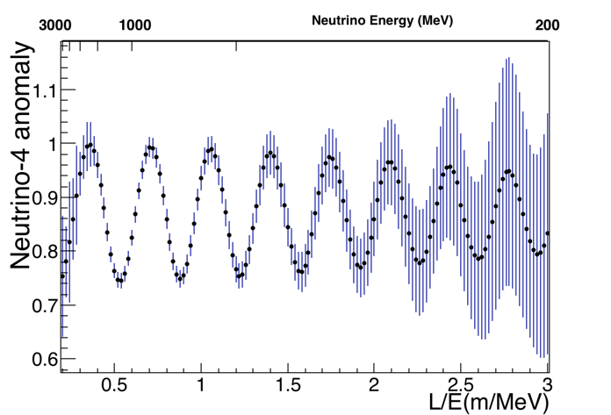
1.- Booster beam
The figure represents the survival oscillation probability in the presence of the Neutrino-4 anomaly.
The calculation has been performed considering a 3 years long run (~117k νμCC QE contained events) for steps of delta(L/E) = 0.02 and considering the best fit of NEUTRINO-4 parameters Δm²_{N4}=7.25 eV² and sin² 2θ_{N4}=0.26 (only statistical errors are reported)

Slide 19
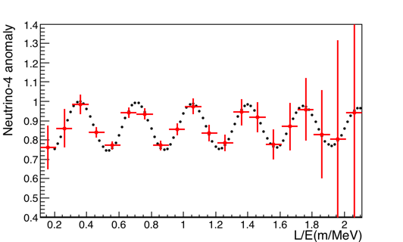
Results already after 3 month, with Lμ > 50 cm
^{L/E steps of 0.02 (black)}
L/E steps of 0.1 and statistical errors corresponding to 3 months and the described selection (red)
The additional request on the muon length Lμ > 50 cm for a better μ identification has been also included (~8600 events expected in 3 months)
It removes all the neutrino events with Eν<300 MeV and reduces the statistics at low ν energy, increasing the statistical errors at high L/E

Slide 20
2.- NUMI results
The NUMI off-axis proton beam is generated at ~800 m of distance from ICARUS and at an off-axis angle of 6 degrees)
Kaons are primarily in the off-axis NUMI, leading to a much larger participation of the v-e signal, with a neutrino energy distribution similar to the Booster beam case.
One year at 0.53 Hz rate and 4 x 10¹³ ppp and an exposure to 6 x 10²⁰ pot corresponds to 1 CC event every 32 spills for positive and to 1 event for 40 spills for negative focussing .
The ratio v-e CC/v-μ CC = 17.2 k/388 k = 4.4 % for positive focussing and about 50% are quasi-elastic.
Reasonable fiducial cuts event brings the number of ν-e events to about 7300/year for positive focussing , sufficient to verify conclusively the NEUTRINO-4 observation as well with ν-e events already after few months of data taking.

Slide 21
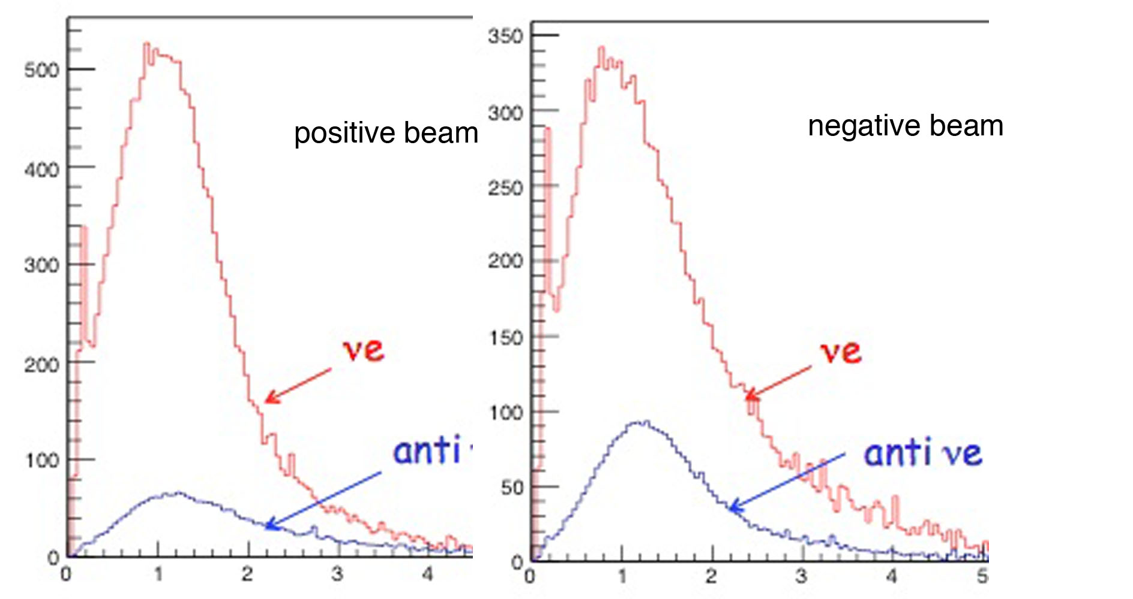
2,- NUMI results – cont.
CC rates of the off-axis NUMI beam to ICARUS for M = 430 ton and 6 x 10²⁰ pot (one year @ 0.53 Hz repetition rate and 4.10¹³ proton per pulse). Data on the left refer to CC Spectra for ν-e anti ν-e positive focusing; data on the right are for negative focusing.

Slide 22
Summary of the procedure for the early ICARUS analysis
The main purpose is the confirmation of the NEUTRINO-4 experiment with ICARUS in the ν−μ and ν-e channels.
Analysis is initiated by the presence within the 1 ms visual signal of all higher ionization stopping tracks confirmed to be due to a proton. The line trajectory is reconstructed backwards from its highest ionization point.
The other end of the “proton” must be attached either to a “muon“ or of a singly ionizing electron departing at an angle.
The activations of the CRT trigger and of the 3 m concrete shielding presumed at a later time do not modify the analysis procedure but only reduce the number of events to be studied.
The V is reconstructed in 3D views and for contained events.
The distribution following NEUTRINO-4 of t L/E is plotted with E = the total energy of the V and L= the distance to the neutrino beam, searching for sterile neutrino oscillations.

Slide 23
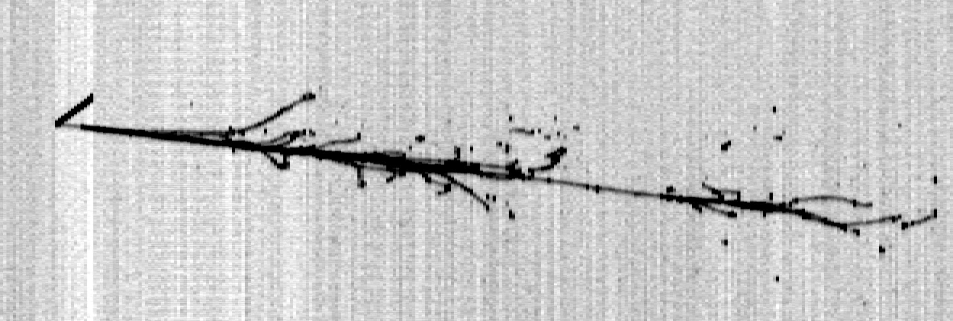
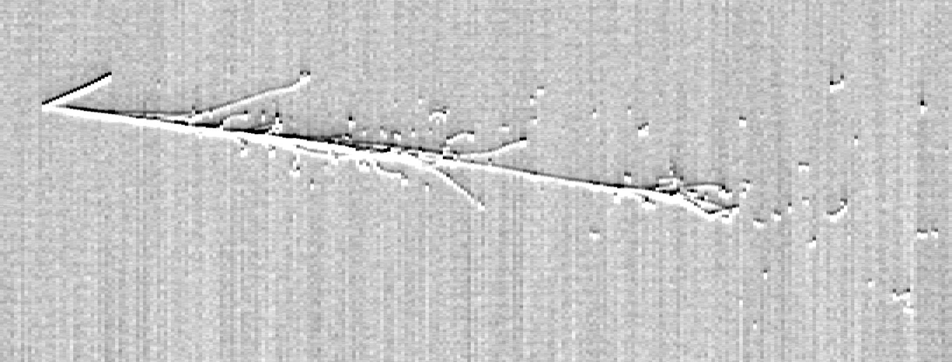
MC event Run 5 SubRun 44 Event 64
A clear q.e. νe event: p + e.
Eν = 1.34 GeV Edep = 1.29 GeV
Collection view
44 cm
Incoming neutrino
90 cm
Ee = 1.21GeV
Tp = 93 MeV
Rp = 7cm
Tp/Rp = 13.2 MeV/cm
44 cm
Induction2 view
78 cm

Slide 24
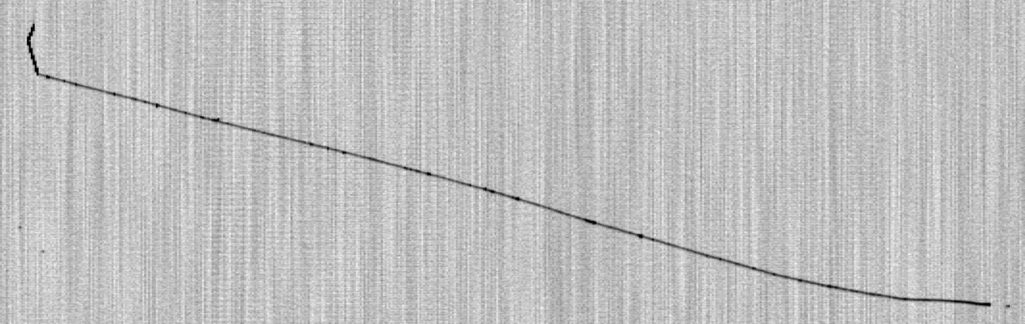
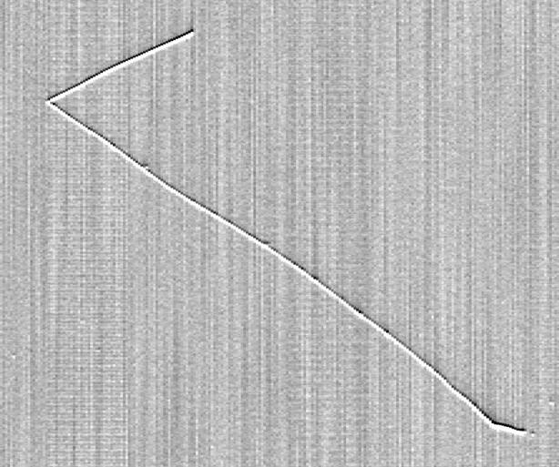
MC event Event 14
A low energy q.e. νμCC event p + μ.
Collection view
95 cm
Incoming neutrino
160 cm
Eν = 0.74 GeV Edep = 0.61 GeV
Tμ = 0.4 GeV
Rμ = 166 cm
Tp = 0.2 GeV
Rp = 25 cm
Tp/Rp =8 MeV/cm
Tμ/Rμ = 2.4 MeV/cm
95 cm
To obtain the total neutrino energy we should include to the Edep the mass of the muon
Induction2 view
66 cm

Slide 25
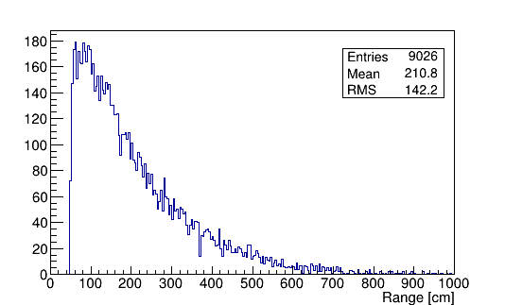
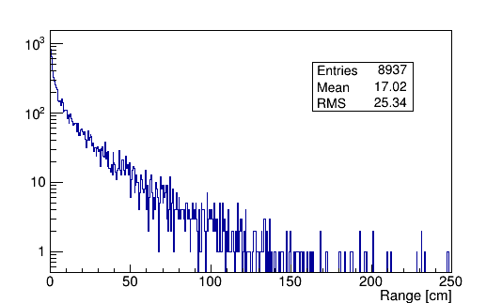
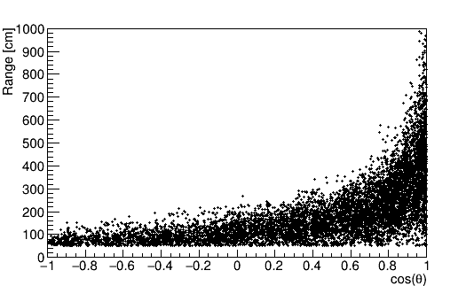
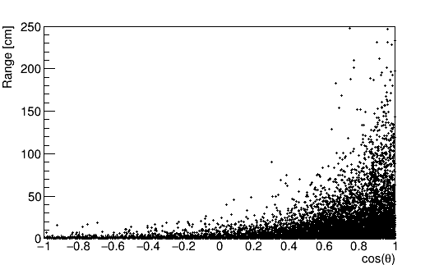
The νμ CC QE contained events with a muon track > 50 cm
Muon range (cm)
Proton range (cm) : log scale
Muon range (cm) vs. Muon angle
P range (cm) vs.P angle
In ~1% of the events have no proton produced
In ~8% of the events, the proton range is below 0.5 cm

Slide 26
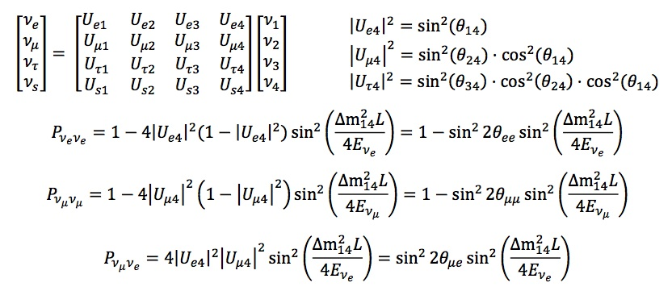
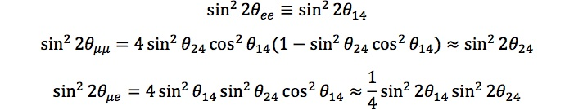
3.- Combined ICARUS and SBND appearance of ν- signal
The structure of 3 + 1 neutrino model and representation of probabilities of various oscillations
1.->
2.->
3.->
predict ? ->

Slide 27
3.-confirming the 3 +1 model jointly by ICARUS and SBNB
Cancellations may occur between disappearance and appearance. There is an important difference between the original LSND and the future FermiLab programs.
This is due to the fact that νe events are now produced both from a R_{νμ}(E) generated LSND νμ-> νe effect and from a R_{νe}(E) “intrinsic” νe source with about 0.5% of the muon rate.
Attenuation, in analogy with the case of nuclear reactors, must occur also for the “intrinsic” beam produced ve source
Therefore cancellation between this and LSND generated νμ -> νe conversion are expected in the detected νe signal S_{νe}:
S_{νe} = [R_{νμ}(E)sin²(2θ_{eμ}) - R_{νe}(E) sin²(2θ_{ee})] sin²(1.27 Δm₄₁² L/E)
where Δm₄₁² ,the squared mass difference with respect to the fourth heavier neutrino is a common factor as a function of mass difference and L/E.

Slide 28
Examples of electron neutrino spectra
Giunti Laveder best fit:
Δm² ~ 1.5 eV² ;
sin²(2θμμ) = 0.05 ;
sin²(2θee) = 0.1 ;
sin²(2θμe) = 1.25 x 10⁻³
Extreme case of full cancellation
Δm² ~ 1.5 eV² ;
sin²(2θμμ) = 0.016 ;
sin²(2θee) = 0.1 ;
sin²(2θμe) = 0.4 x 10⁻³

Slide 29
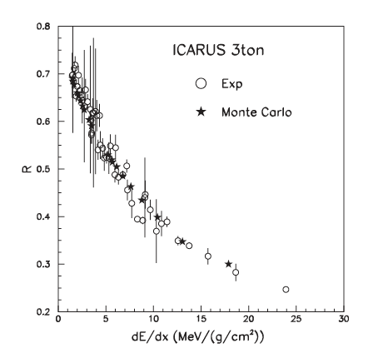
Electron recombination effects
None of the electron recombination theories developed so far is fully successful in describing all the experimental data in liquid argon. Nevertheless, they provide the basis for its understanding and for all phenomenological approaches.
The recombination effect has been already carefully studied by us and it is a very important process which needs to be further studied.
R = signal fraction recovered
There are several minor additives to the LAr which may modify this effect, transforming some of the produced light into additional ionization which could be useful also for the future FNAL programs.
The introduction of a dopant will be highly valuable for protons.

Slide 30
Doping with tetra-methyl-germanium (TMG)
The nonlinear detector response may degrade the particle identification capability of the LAr-TPC.
A possible solution to improve the linearity of the detector response is to introduce photo-sensitive dopants able to convert part of the scintillation light into additional free electron-ion pairs, thus enhancing the linearity as a function of the deposited energy density and electric field.
We have chosen TMG as photo-sensitive dopant since:
  TMG is not absorbed in the recirculation system
  TMG can be easily purified (electron lifetime better than 10 µs in pure TMG)
  TMG has a large photo-absorption cross section of 62 Mbarn and has an acceptable quantum efficiency
The performance of the detector is greatly improved and is remarkably stable in time
TMG growth of +25% to +220% found from 1.6 to 32 MeV/cm.

Slide 31
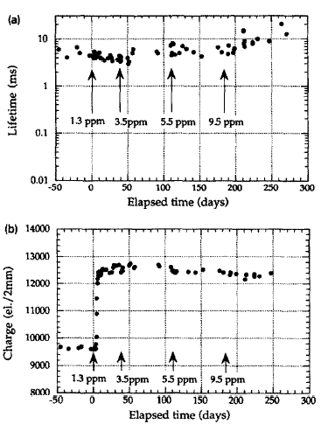
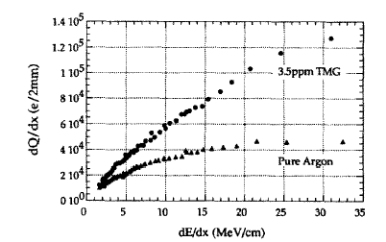
Doping with tetra-methyl-germanium (TMG)
Collected charge and deposited energy at an electric field of 200 V/cm and TMG concentration of 3.5 ppm for stopping muon and proton events.
Time evolution at 300 V/cm during the LAr doping with TMG.
10 ms lifetime
3 ton LArTPC
2 mm p events at 8, 12, 13.2, 25 and 32 MeV/cm
Periodic additions of TMG

Slide 32
Effects due to positive ions in Argon
At shallow depths one has to contend with the presence of intense backgrounds due to cosmic ray muons which have to be separated out from the neutrino signals.
This background also generates Ar positive ions which flow very slowly toward the cathode with a mobility , μ_{i} ~ 1.6 10⁻³ cm²s⁻¹V⁻¹
With μi as here expressed in( cm/sec) /(Volt/cm) — the experimental drift velocity for trapped electrons in pure liquid Argon and for a electric field of 500 Volt/cm is 0.8 cm/s , corresponding to 190 sec LAr drift path for travel of 1.5 m.
The very long time may produce space charge effects
TDEYt and T. J. LEWIS, “Ion mobility and liquid motion in liquefied argon “BRIT. J. APPL. PHYS. (J. PHYS. D), 1968, SER. 2,VOL. 1. PRINTED IN GREAT BRITAIN

Slide 33
Effect of the slow LAr ions (tentative)
Non-negligible distortions of the drift field may arise because of the space charge which must be stabilized with wire grids for larger drift distances
No additional LAr multiplication at the wire planes is assumed

Slide 34
4.- Search of effective ν−e, ν−μ masses with sterile neutrino
Cosmology and three neutrinos give a very small value for the sum of neutrino masses. Quite independently from the outcome of the NEUTRINO-4 experiment, there is a very solid information about the possible existence of one sterile neutrino m₄, that ICARUS may be able to observe with L/E over a wide mass range, provided m₁², m₂² , m₃²≪ m₄². |U_{e4}| = ¼ sin²(2𝜃₁₄)
Both 𝑚_{νμ}^{eff}, and 𝑚_{νe}^{eff} masses may be estimated: 𝑚_{νe}^{eff} ≈ sqrt (m₄²|U_{e4}|² ) ≈ ½ sqrt (m₄² sin²(2𝜃₁₄) and 𝑚_{νμ}^{eff} ≈ sqrt (m₄²|U_{m4}|².
This is simply due to the fact that a fraction of the effective sterile mass m_{s} is mixed to the effective masses of the light neutrinos ν−e and ν−μ.
A value m_{νe}^{eff} = (0.58 ± 0.09) eV has been derived from the m₄² prediction of NEUTRINO-4 and it does not contradict the upper direct limit of neutrino mass m_{νe}^{eff} ≤ 1.1 eV (CL 90%) of KATRIN.

Slide 35
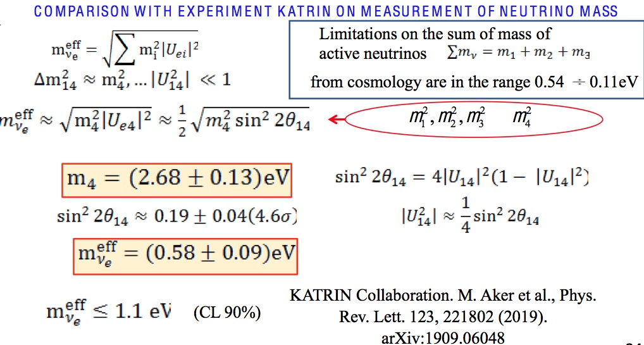
Predicting the ν−e effective mass for NEUTRINO-4
NEUTRINO -4 RESULTS

Slide 36
Conclusions
The problem of neutrino anomalies has been with us for about ¼ of the century.
The recent NEUTRINO-4 experiment is a major step forward, however still statistically weak, representing only a 2.8 σ signal. Further analysis is needed.
The re-activation of the Fermilab Booster and NUMI beams is expected by the end of 2020, followed by the initial operation of ICARUS in both locations. Definitive and eventually confirming evidences 1.- and 2 with ν-mu and ν-e are foreseen after a few months.
After approximately the first year of operation, the SBND L-Ar TPC detector will be added at a shorter distance of the Booster beam to perform a definitive 5 σ analysis of sterile neutrinos in evidence 3.
Values of effective light neutrino masses will be calculated as evidence 4.

Slide 37
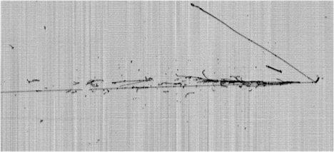
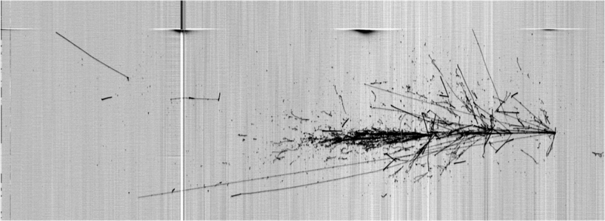
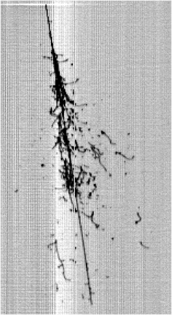
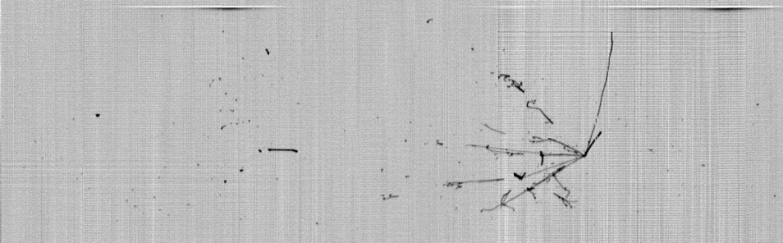
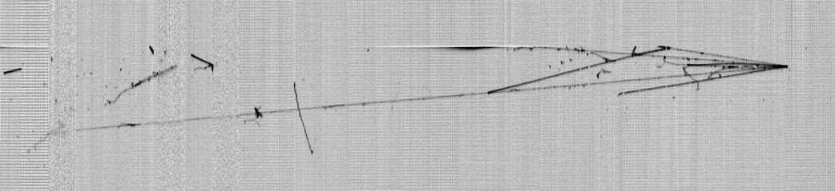
Thank you !
LNGS_May2011
Slide 37

