Slide 1


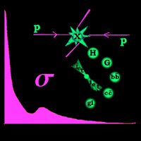

π p and π π scattering: towards the first LHC results
IHEP Diffractive group
V.Petrov, R.Ryutin, A.Godizov, A.Sobol, V.Samoilenko
R.Ryutin, IHEP
DIFFRACTION 2010, Otranto, Italy Forward Physics R.Ryutin
Notes:
1) Historical review (HERA, ISR, PHENIX, ...)
2) Model
3) Requirements for the extraction of the cross-sections, errors, extraction from the PHENIX and ISR data.
4) Experimental situation (in CMS, ATLAS, ALICE, ...), upgrades, ...
5) 900 GeV data and total pi-p and pi-pi cross-sections (MC, real data(?))
6) Future prospects: elastic cross-sections (detector modifications), di-jet cross-sections (LHC, JLAB, ...)

Slide 2
Plan
Historical outlook and motivations
Model for charge exchange processes
Extraction of the cross-sections from data. Theoretical errors.
Experimental situation.
Total π p and π π cross-sections. Monte-Carlo and real data at 900 GeV and 7 TeV.
Future prospects: elastic and inclusive di-jet cross-sections
DIFFRACTION 2010, Otranto, Italy Forward Physics R.Ryutin

Slide 3
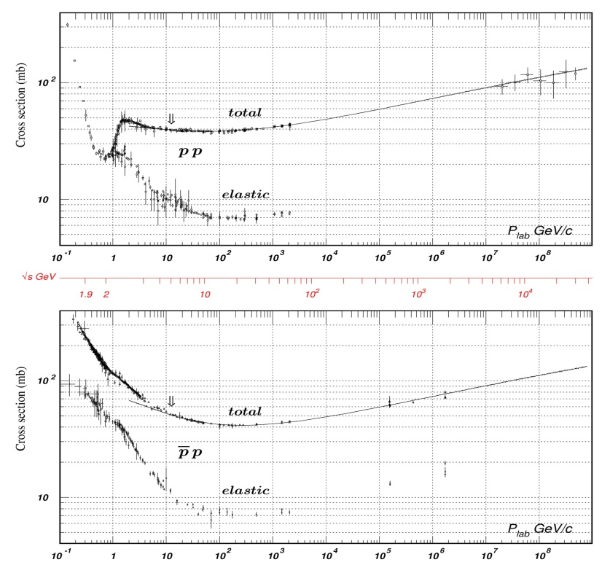
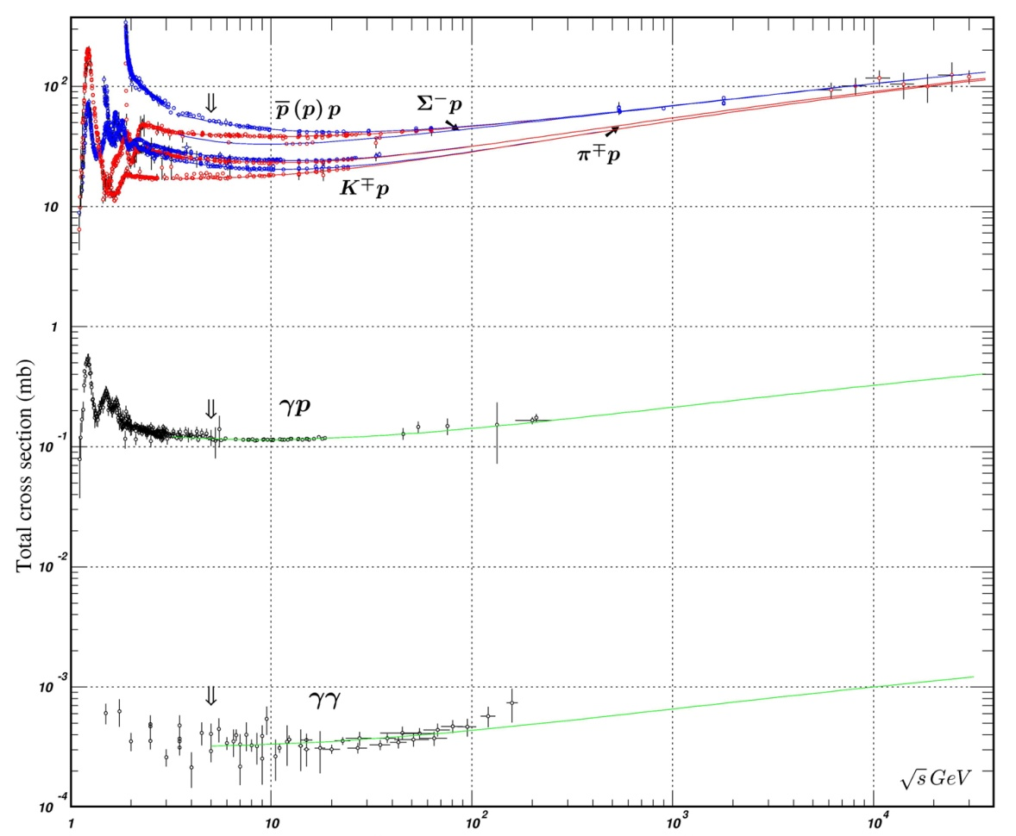
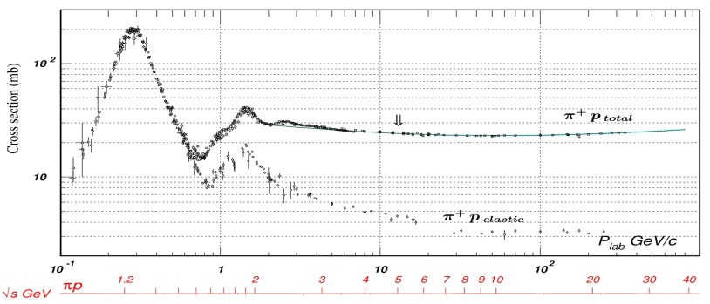
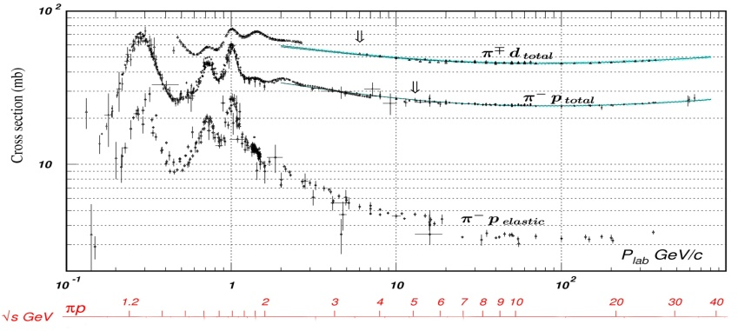
Historical outlook and motivations
_
pp (pp): √s ~10 TeV
Universality of strong interactions at super-high energies
max
http://pdg.lbl.gov/
π p: √s ~30-40 GeV !
max
DIFFRACTION 2010, Otranto, Italy Forward Physics R.Ryutin
Notes:
Why to measure pp, pbar p, pi-p, pi-pi, … cs
Data on pi-p and pi-pi
Idea of extraction

Slide 4
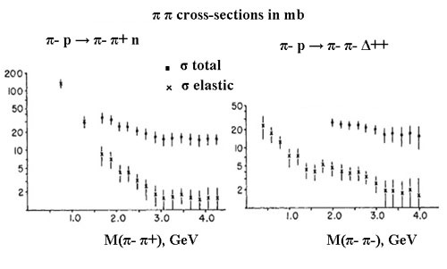
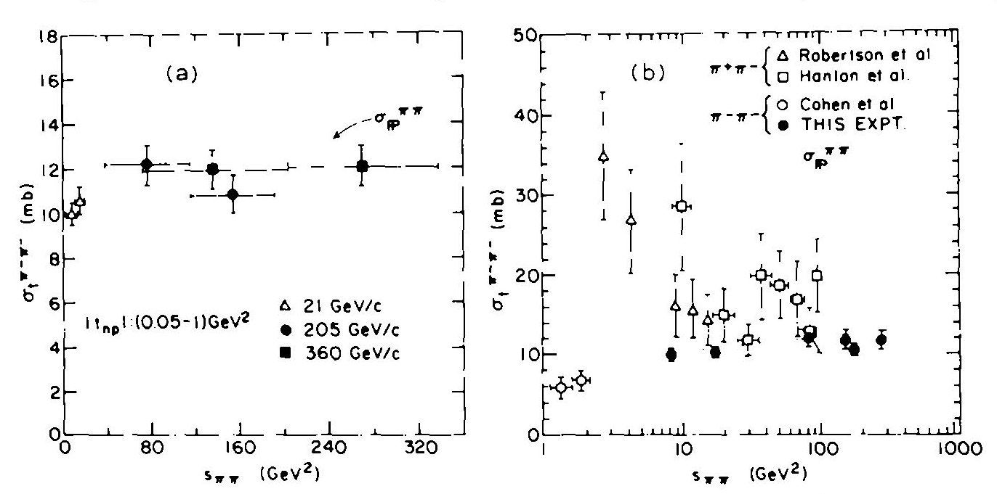
Historical outlook and motivations
Extraction of π p and π π cross-sections
[ W.J. Robertson, W.D. Walker, J.L. Davis,
Phys. Rev. D7 (1973) 2554 ]
Basic idea of the extrapolation to t → m²:
π
[ G.F. Chew, F.E. Low,
Phys. Rev. 113 (1959) 1640 ]
[ C. Goebel, Phys. Rev. Lett. 1 (1958) 337 ]
from γ* p → π+ π- p
[ H. Abramowicz et al., Nucl. Phys. B166 (1980) 62 ]
σtot (πp)=31±3.6 mb
at
√s=50 GeV
[ M.G. Ryskin, Y.M. Shabelski, Yad. Fiz. 61(1998) 89]
[ J.Breitweg (ZEUS Collab.), Eur. Phys. J. C2 (1998) 247 ]
from π- n → p X
√s<18.4 GeV
DIFFRACTION 2010, Otranto, Italy Forward Physics R.Ryutin

Slide 5
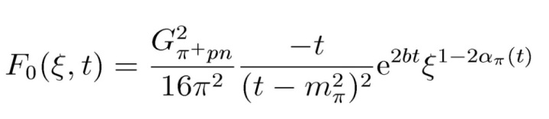


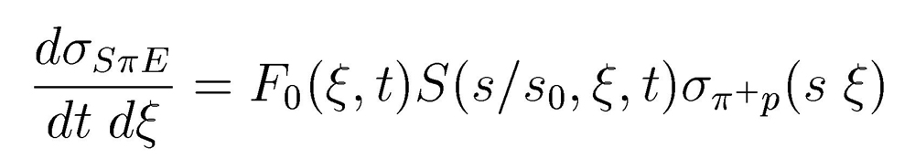
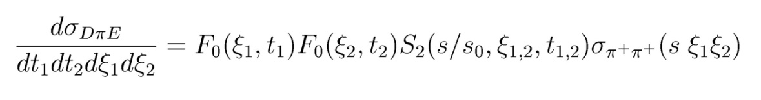
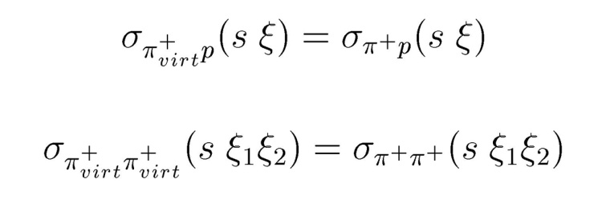
Model for Charge Exchange processes
SπE
t
200→550 GeV at 0.9 TeV
1.5→4 TeV at 7 TeV
p
Fπ
n
π
+
s
Ŝ
virt
M²≈s ξ
p
DπE
t
1
50→350 GeV at 0.9 TeV
0.35→2.8 TeV at 7 TeV
p
F π
n
π
+
virt
Ŝ2
M²≈s ξ ξ
1 2
p
π
+
F π
virt
n
Main contribution
for |t|<0.3 GeV²
virtual → real pion
t
2
DIFFRACTION 2010, Otranto, Italy Forward Physics R.Ryutin
Notes:
CE and DCE diagrams
Kinematics and formulaes for cross-sections

Slide 6
Model for Charge Exchange processes
SπE Born term
Leading contributions (eikonalization)
p
n
π
Σ =
P
σ
p
...
...
...
πp
absorbtion
A
[ V.A. Petrov, A.V. Prokudin,
Eur. Phys. J. C23 (2002) 135 ]
It is possible to keep
interpretation of πp scattering
B
“enhanced” diagrams
with 3IP vertexes
C
[ A.B. Kaidalov, V.A. Khoze, A.D. Martin and M.G. Ryskin, Eur. Phys. J. C47 (2006) 385 ]
DIFFRACTION 2010, Otranto, Italy Forward Physics R.Ryutin
Notes:
Absorptive effects (initial state, 1-reggeon ex.=>1-reggeon ex.+multipomerons -> low corrections)

Slide 7
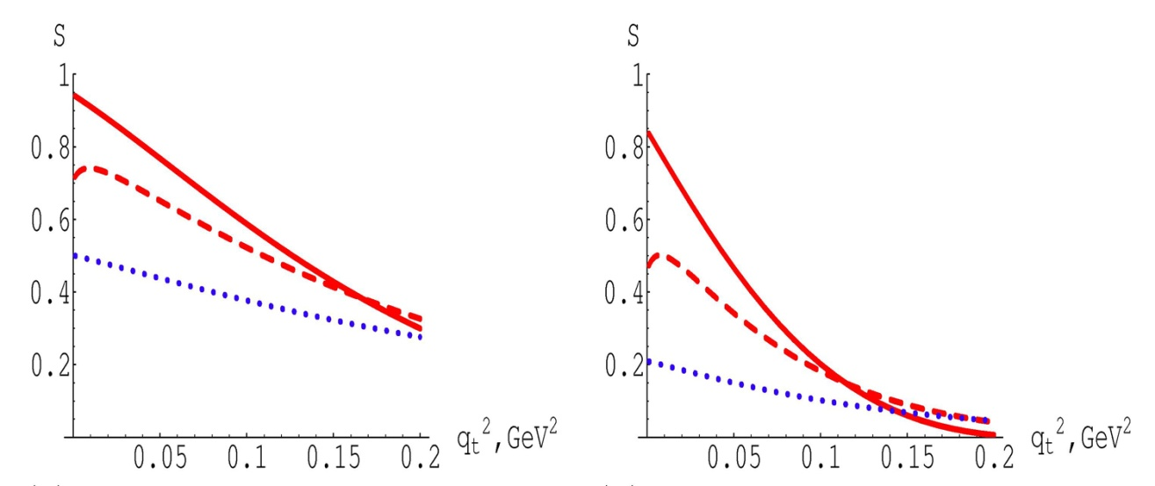
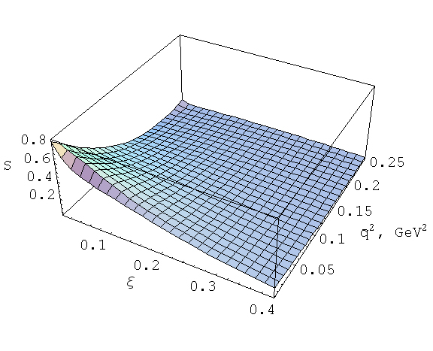
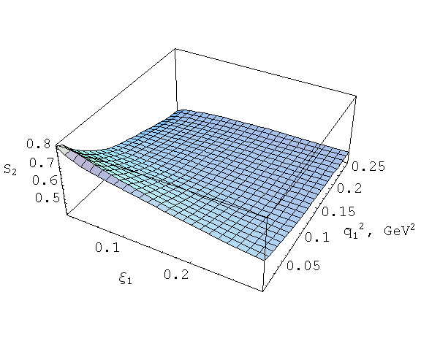
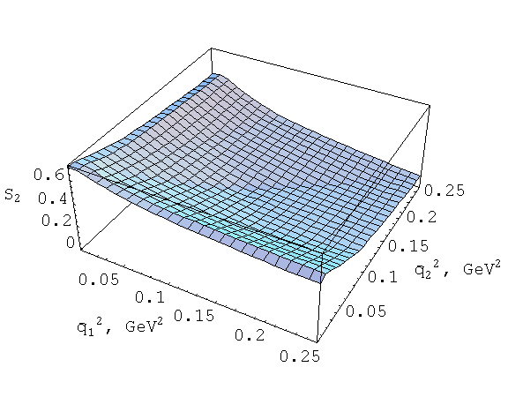
Model for Charge Exchange processes
√s=62.7 GeV (ISR) √s=10 TeV (LHC)
M, GeV ξ M, TeV
0.627 0.0001 0.1
19.8 0.1 3.16
34.3 0.3 5.48
Absorbtion at √s=10 TeV
_
_
_
_
_
S(ξ,q²)
S(ξ ,q²,ξ =0.1,q²~0)
S (ξ =0.1,q²,q²)
2 1 1 2 2
2 1,2 1 2
DIFFRACTION 2010, Otranto, Italy Forward Physics R.Ryutin
Notes:
Pictures for absorbtion, S (62 GeV, 10 TeV), S2(qt1,qt2,xi1 xi2=fixed=0.1^2, y=0 and y=1)

Slide 8
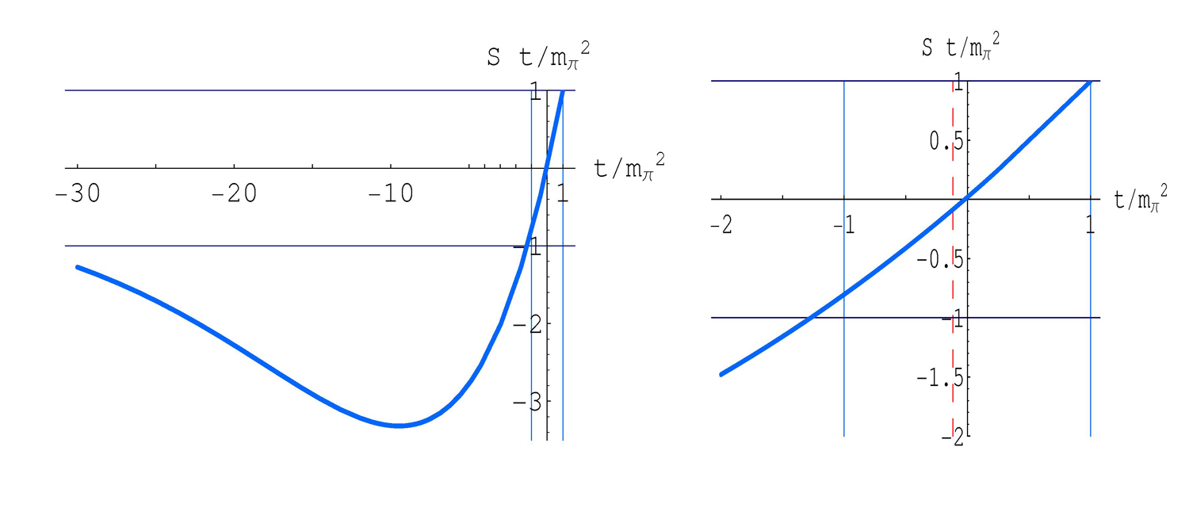
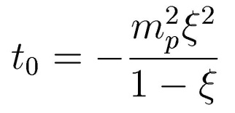
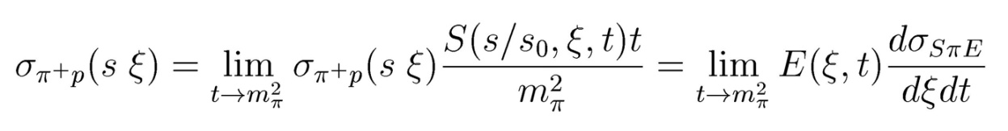
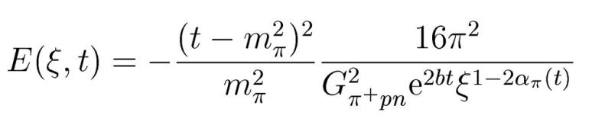
Extraction of π p and π π cross-sections
Function S*t/m² for ξ=0.05
π
The boundary
of phys.reg.:
Exact extrapolation procedure (“model independent”)
DIFFRACTION 2010, Otranto, Italy Forward Physics R.Ryutin
Notes:
Chew-Low method formulaes, pictures S t/mpi^2, what do we need from an experiment?

Slide 9
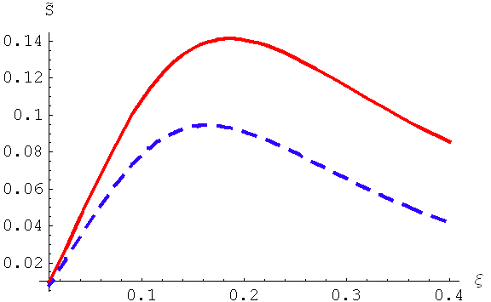
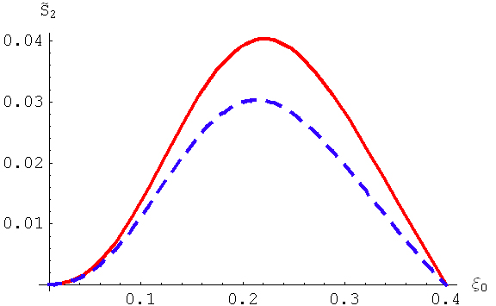
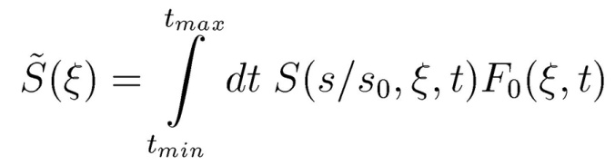
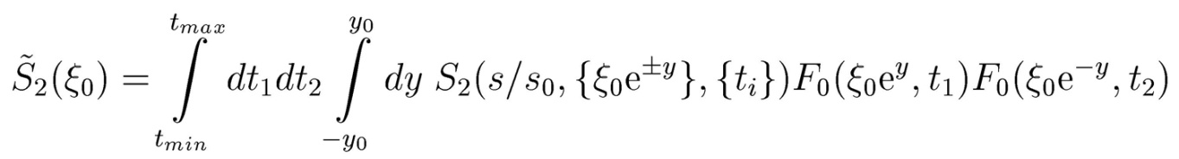
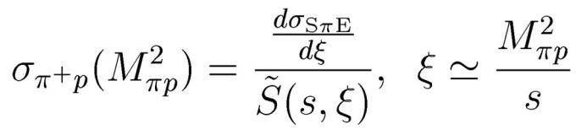
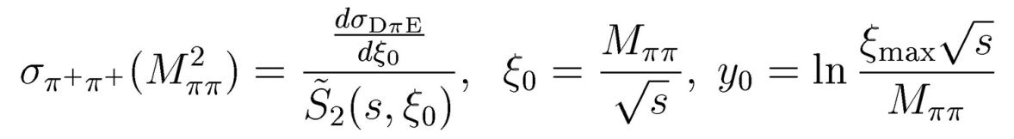
Extraction of π p and π π cross-sections
Integral extraction procedure
(depends on the model for absorbtion,
but can be normalized to pp cross-sections!)
Without LHC measurements (TOTEM, …) at 10 TeV theoretical error from most popular models is about 10%, at 0.9 TeV errors are low, since we have
the data at 1.9 TeV.
√s=0.9 TeV
√s=7 TeV
DIFFRACTION 2010, Otranto, Italy Forward Physics R.Ryutin
Notes:
Integral method fromulaes, Stilda, S2tilda pictures, errors from models (10%), what do we have in reality?

Slide 10
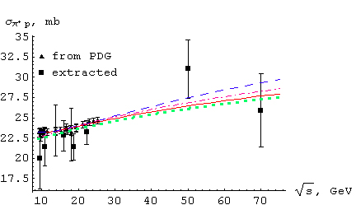
Extraction of π p cross-sections from data
ISR
NA49
HERA
PHENIX
√s | 9.4 | 10.8 | 15.9 | 18.7 | 22.2 | 50 | 70
σ(ext.) | 20±3.8 | 21.4±2.3 | 22.8±1.9 | 21.4±1.6 | 23.2±1.5 | 31±3.6 | 25.9±4.5
σ(PDG) | 23.2 | 23.19 | 23.55 | 23.85 | 24.27 | 27.43 | 29.3
COMPETE
[ B. Nicolescu et al. (COMPETE Coll.),
ArXiv: hep-ph/0110170]
DL
[ A. Donnachie, P.V. Lanshoff,
Phys. Lett. B296 (1992) 227]
GP
[ A.A. Godizov, V.A. Petrov, JHEP 0707 (2007) 083]
BSW
[ C. Bourrely, J. Soffer, T. T. Wu,
Eur. Phys. J. C28(2003)97]
DIFFRACTION 2010, Otranto, Italy Forward Physics R.Ryutin
Notes:
Extraction from ISR,HERA, PHENIX,NA49 (table and picture with 4 models)

Slide 11
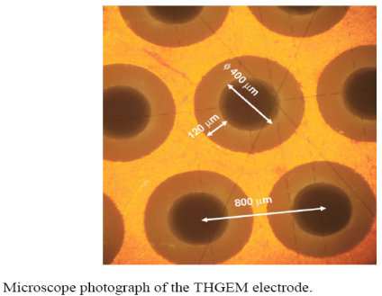
Experimental tools
At 140 m for 5 TeV neutron t ~ 0.128 R^2: t < 0.3 =>R<1.5 cm
ATLAS ZDC
Central cell (2x10 cm) of EM ZDC: t<1.2 GeV-2
CMS ZDC
We suggest to change fiber layers by THGEM plates
1. A Concise review on THGEM detectors.
Nucl.Instrum.Meth.A598:107-111,2009.
e-Print: arXiv:0807.2026 [physics.ins-det]
2. Development of detector active element based on thgem.
e-Print: arXiv:0906.4441 [physics.ins-det]
cheap
fast
high rad. resistance
coordinate and energy measurement
upgrade HE CMS
DIFFRACTION 2010, Otranto, Italy Forward Physics R.Ryutin
Notes:
ZDCs, construction, sizes, efficiency, …
Possible upgrades

Slide 12
Signal and backgrounds
[R.Ryutin ,V.Petrov, A.Sobol, in preparation ]
[ V.Petrov, R.Ryutin, A.Sobol, EPJC 65 (2010) 237 ]
[ A.Sobol, R.Ryutin, V.Petrov and M.Murray, Arxiv:1005.2984 ]
p
n
π
ρ,a
2
p
n
n
T
T
P,R
P,R
π
π
π
p
SπE
SRE
n
Double Dissociation
Single
Dissociation
p
n
π
ρ,a
n
n
n
2
T
T
P,R
π
P,R
π
MB
π
π
(ρ,a )
2
π
π
p
n
P,R
π
n
n
n
DπE
DRE
Central Diffraction
DIFFRACTION 2010, Otranto, Italy Forward Physics R.Ryutin
Notes:
backgrounds

Slide 13
Signal and backgrounds distributions
We propose to perform measurements of CE and DCE processes at LHC.
For the leading neutron detection Zero Degree Calorimeter could be used.
SD:
pp → p X
pp → X p
SπE:
pp → n X
σ ~ 1.5 mb
(ξ<0.4)
σ ~ 14 mb
MC Generator
MonChER1.0:
(Monte-Carlo for
Charge Exchange
Reactions)
ZDCB
ZDCF
DD:
pp → XY
σ ~ 9.7 mb
ZDCB
ZDCF
DπE:
pp → n X n
σ ~ 0.2 mb (ξ<0.4)
MB:
pp → X
σ ~ 50 mb
η
All processes have leading neutrons at |η|>8.5. So
SD, DD and MB can imitate SπE and DπE;
SπE can imitate DπE
η
DIFFRACTION 2010, Otranto, Italy Forward Physics R.Ryutin
Notes:
Pseudorapidity distributions of signals and BGs, Generato MonChER1.0 (Monte-Carlo for Charge Exchenge Reactions)

Slide 14
Monte-Carlo for CE (methods)
ξ=∆p/p
M=√S*√ξ
CE
MB
BG /S ~ 0
SD
DD
ξ
M
t
We selected events with 1 neutron detected in ZDCForward and look on Calo in forward and backward region
N forward hits N backward hits E forward E backward
Nhits(HF) >7
diffraction ~ 0,
but MB ~ CE
ZDC
CASTOR
HF
ENDCAP
BARREL
DIFFRACTION 2010, Otranto, Italy Forward Physics R.Ryutin
Notes:
Eta and M distributions for 900 GeV and 7 TeV for signal and BGs
Selections => result

Slide 15
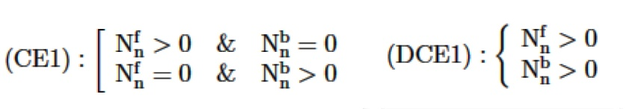
Total π p &π π cross-sections from CE&DCE (MC)
CE & DCE at 10 TeV
Additional selections
No selection
S/B
CE 1/28
DCE 1/380
CE
MB
SD
DD
M, GeV
M, GeV
CE: Nhits(HF)>7
S/B ~ 1/0.56
CE: |t|<0.2 GeV²
S/B ~ 1/0.08
Simple selection:
S/B
{ξ<0.4 & CE1} (CE) 1/2.7
{ξ<0.4 & DCE1} (DCE) 1/1.6
DCE
CE
MB
SD
DD
M, GeV
M, GeV
DCE: Nhits(HF)>7
S/B ~ 1/0.7
DCE: |t|<0.3 GeV²
S/B ~ 1/0.07
DIFFRACTION 2010, Otranto, Italy Forward Physics R.Ryutin
Notes:
Eta and M distributions for 900 GeV and 7 TeV for signal and BGs
Selections => result

Slide 16
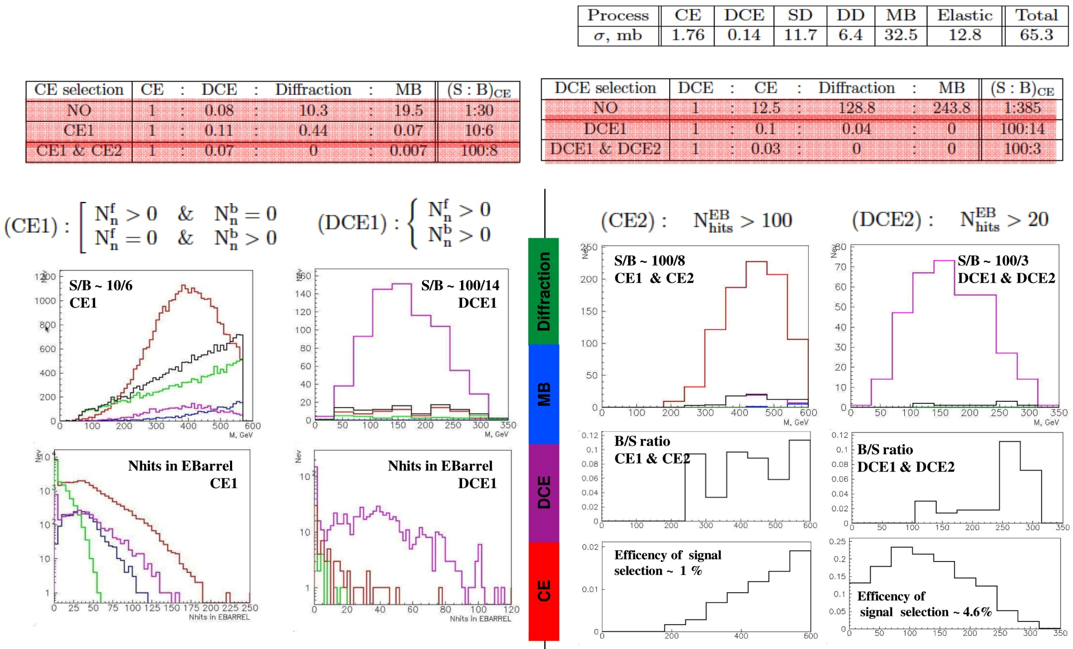
Total π p &π π cross-sections from CE&DCE (MC)
CE & DCE at 900 GeV
At 900 GeV we have good chances to get
10^7 CE and 10^6 DCE events at 1 pb^-1,
using ZDC+CMS Calorimeters only!
Model dependent extraction of π p & π π
total cross-sections at 200-600 & 50-350 GeV
DIFFRACTION 2010, Otranto, Italy Forward Physics R.Ryutin
Notes:
Eta and M distributions for 900 GeV and 7 TeV for signal and BGs
Selections => result

Slide 17


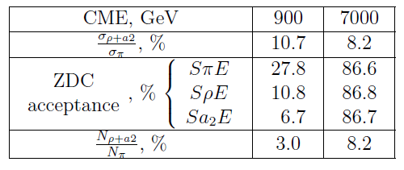

Total {π,ρ,a2}p cross-sections from CE (MC)
SπE
N
N
900 GeV
η of neutron
900 GeV
SρE
Sa2E
M, GeV
ZDC acceptance
SρE+Sa2E
η
M, GeV
N
7000 GeV
M, GeV
At 900 GeV ρ and a2 exchanges are suppressed up to 3%
just by ZDC acceptance due to different neutron
kinematics.
At 7000 GeV there is no such difference and ρ+a2 exchange
remains at level ~8%.
M, GeV
DIFFRACTION 2010, Otranto, Italy Forward Physics R.Ryutin
Notes:
Rho and a2!
Eta and M distributions for 900 GeV and 7 TeV for signal and BGs
Selections => result

Slide 18


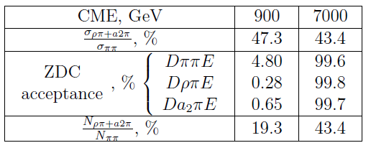

Total {π,ρ,a2}π cross-sections from DCE (MC)
DππE
η of forward neutron if η backward <-8.5
N
N
900 GeV
900 GeV
DρπE
Da2πE
ZDC acceptance
M, GeV
DρπE+Da2πE
η
M, GeV
N
7000 GeV
M, GeV
At 900 GeV ρπ and a2π exchanges are suppressed from
47% to 19 % by ZDC acceptance.
At 7000 GeV ρπ+a2π exchanges remain at level ~43%.
M, GeV
DIFFRACTION 2010, Otranto, Italy Forward Physics R.Ryutin
Notes:
Rho and a2 mesons!
Eta and M distributions for 900 GeV and 7 TeV for signal and BGs
Selections => result

Slide 19
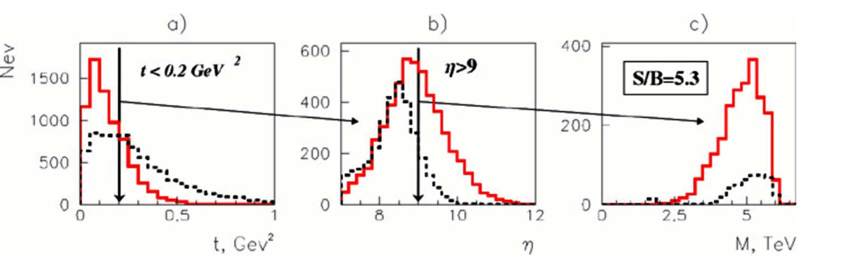
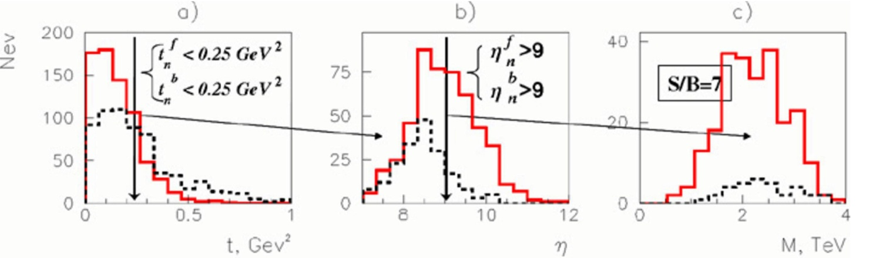
Elastic πp & ππ cross-sections from CE&DCE (MC)
Elastic CE & DCE at 10 TeV
No selection
S/B
CE 0.004
DCE 0.0025
Simple selection: S/B
{ξ<0.4 & CE1} (CE) 0.05
{ξ<0.4 & DCE1} (DCE) 0.04
Nhits(Barrel,Endcap,
HF,CASTOR,EZDC)=0
CE S/B ~ 0.9
DCE S/B ~ 1.1
S/B ~ 0.9 1.7 5.3
n
π
+
P,R
p
S/B ~ 1.1 2.1 7
n
n
π
π
+
π
+
+
P,R
π
π
+
+
n
n
DIFFRACTION 2010, Otranto, Italy Forward Physics R.Ryutin
Notes:
From itep report

Slide 20
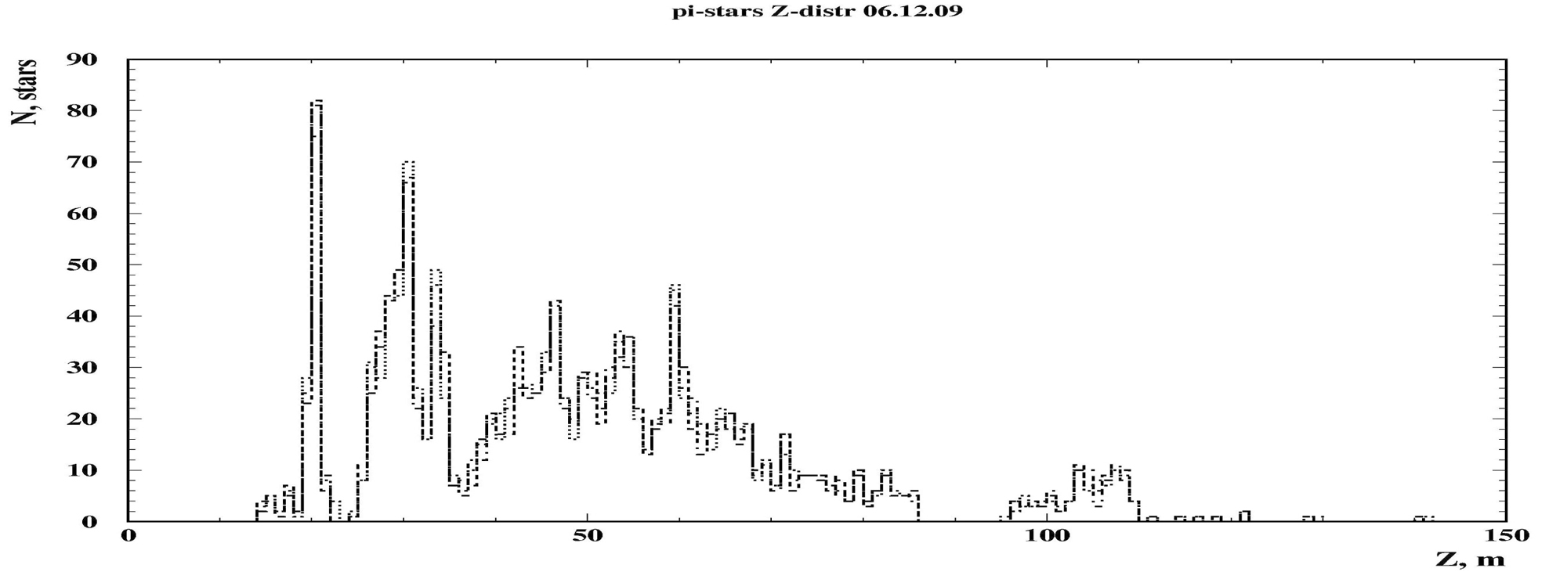
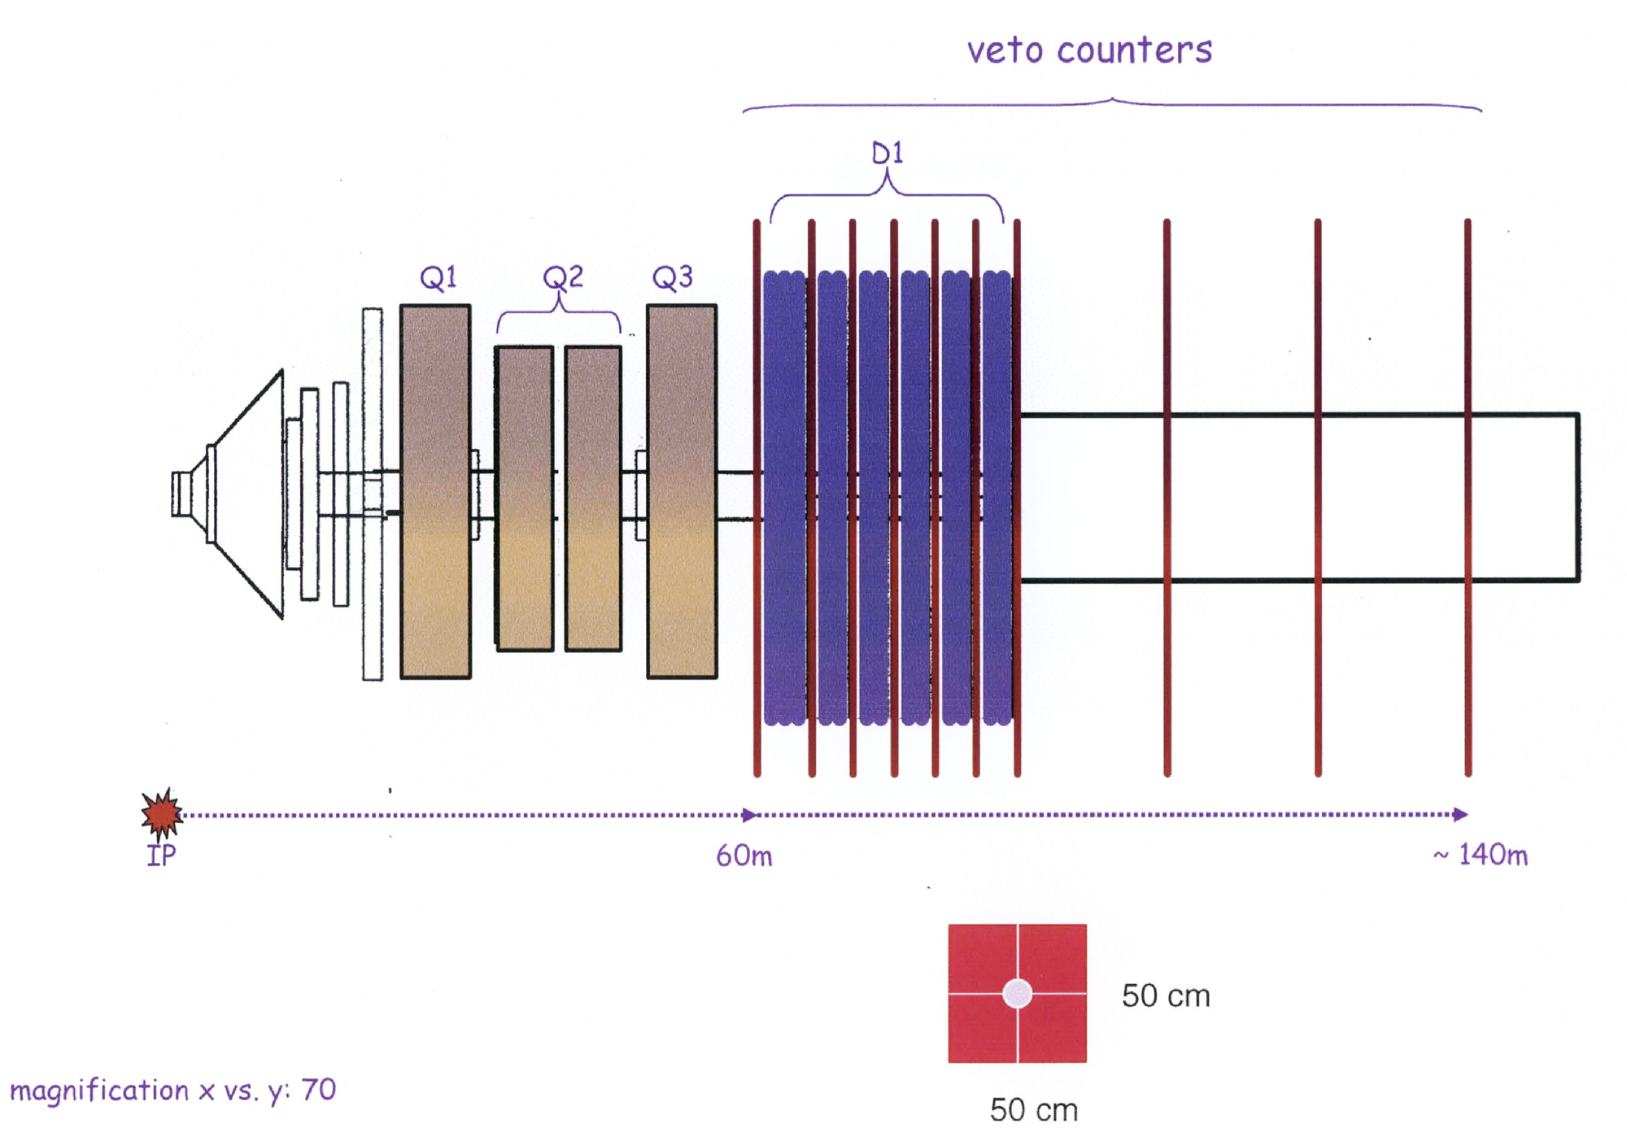
Elastic πp cross-sections from CE
Elastic CE at 10 TeV: pion detection
[ M. Albrow et al., JINST 4, (2009) P10001 ]
Forward Shower Counters (FSC): 8<η<11
DIFFRACTION 2010, Otranto, Italy Forward Physics R.Ryutin
Notes:
Mark ZDC, Albrow reference, FSC detectors.

Slide 21
Future prospects: pion structure functions
Parton distributions in a pion in a still unexplored
domain of Q² and x
LHC
σ ~ 20 nb ← pt(jet)>40 GeV →
ξ<0.2
σ ~ 0.5 nb
n
n
π
π
+
+
jet
jet
jet
jet
p
π
+
n
HERA, JLAB
p
n
π
+
jet
jet
e
γ*
e
DIFFRACTION 2010, Otranto, Italy Forward Physics R.Ryutin
Notes:
HERA (Show domain x, Q^2)
LHC (show domain of x, Q^2)
JLAB (show domain x,Q^2)
Simple formulaes

Slide 22
Summary
CE (pp→nX) and DCE (pp→nXn) processes measured at LHC could provide us
with unique information on π+p and π+π+ cross sections at very high c.m. energy (up to several TeV): total, elastic, inclusive jet cross-sections, … => universal behaviour, value of absorbtion, diffractive patterns, parton distributions in a pion, …
Cross-sections for CE & DCE processes are estimated to be 1.5 mb & 0.2 mb at 10 TeV (very large number of events, even with low efficiency of registration)
Model for charge exchange processes (with π, ρ and a2 reggeons) in the range 0<qt<0.5 GeV, 0.0001<ξ<0.4, 0.9 TeV<√s<14 TeV was developed and applied to MC (generator MonChER1.0: 4 models for pion-proton scattering, 3IP model for absorbtion)
Model-independent extraction of π+ p and π+ π+ cross-sections is possible for LHC if we can measure t-distributions. It is not possible for the present design of ZDC (or at 900 GeV with some restrictions) => At this moment only model-dependent extraction is possible with uncertainties in absorbtion (can be normalized to pp, at present we have 10% model error from most popular models)
Backgrounds: SD,DD,CD,MB are suppressed at |t|<0.25 GeV² (S/B~10). But even for the whole ZDC acceptance we can reach also S/B~10 with efficiency 1-3% for SπE and 5-10% for DπE without t-cuts, using the information from CMS detectors. Reggeon backgrounds can reach 3% (8%) at 0.9 (7) TeV for CE and 19% (43%) for DCE. Pile-up is supposed to be low at first runs.
Total and inclusive dijet cross-sections π p and π π cross-sections could be extracted from the real data at 0.9!!! and 7 TeV in a model-dependent way.
For elastic cross-sections and t-measurements we need modifications of detectors (FSC, ZDC, THGEM).
DIFFRACTION 2010, Otranto, Italy Forward Physics R.Ryutin
Notes:
Motivations->possibilities->real results->future

Slide 23
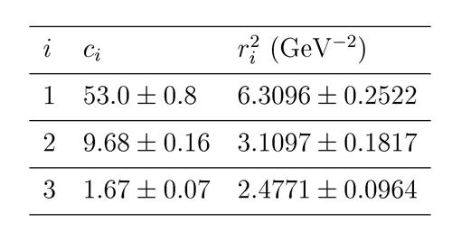
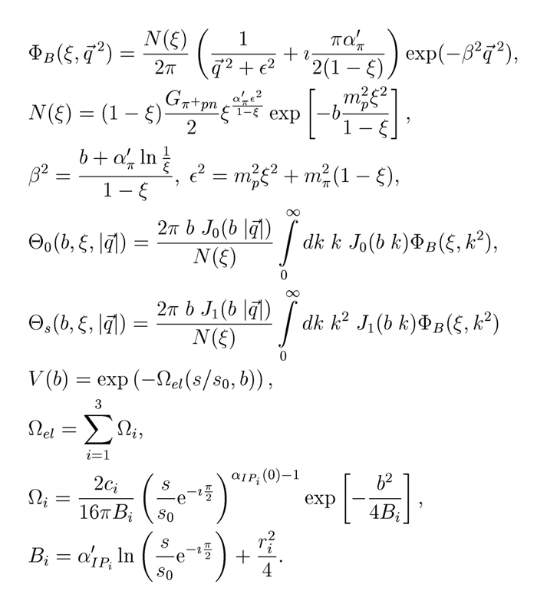
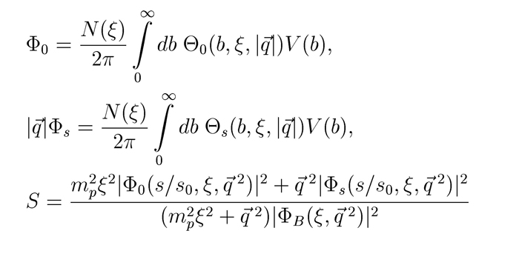
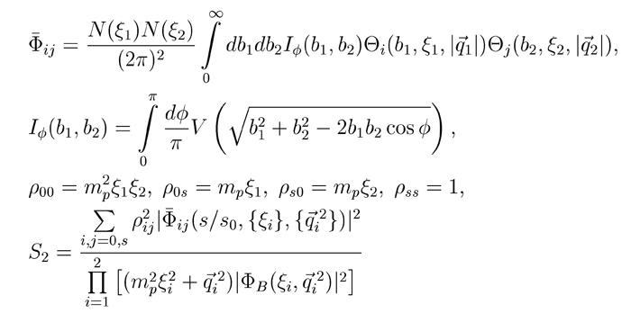
Backup slides (absorbtion formulaes)
DIFFRACTION 2010, Otranto, Italy Forward Physics R.Ryutin
Notes:
3 IP parameters, spin amplitude, Bessel Integrals, …

Slide 24
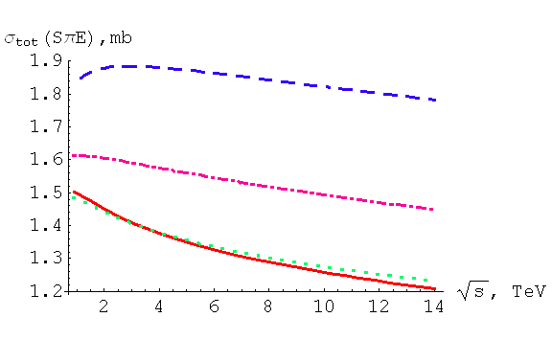
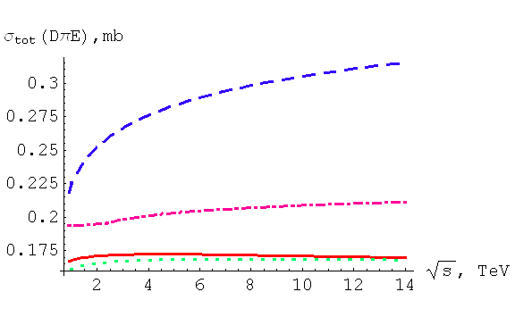
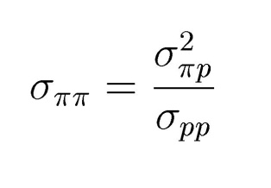
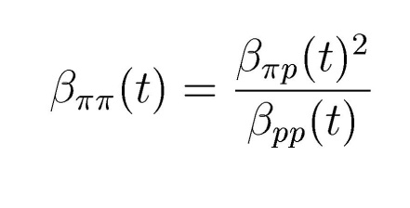
Backup slides (total SπE and DπE cross-sections)
Total CE and DCE cross-sections in the region
Ω={0<qt<0.5 GeV, 0.0025<ξ<0.4}
COMPETE
DL
GP
BSW
parametrizations for σ
πp
Since there are no real data for ππ cross-sections,
we can use factorization assumptions:
GP
β(t) are residues of reggeon
poles in eikonals
COMPETE
BSW
DL
DIFFRACTION 2010, Otranto, Italy Forward Physics R.Ryutin
Notes:
Pictures (tables) for CE and DCE cs (partially integrated with total pi-p or pi-pi). Formulaes for sigpipi: DL, COMPETE sigpipi=sigpip^2/sigpp, BSW,GP eikonals ratios.
Theoretical errors

Slide 25
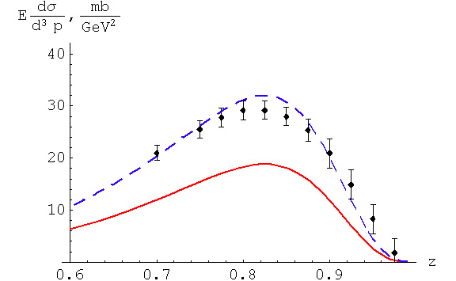
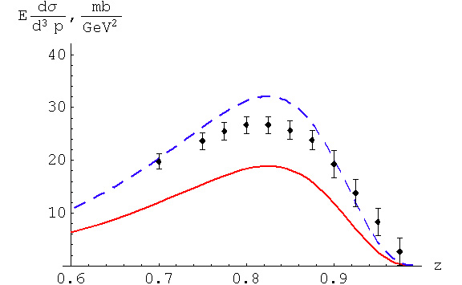
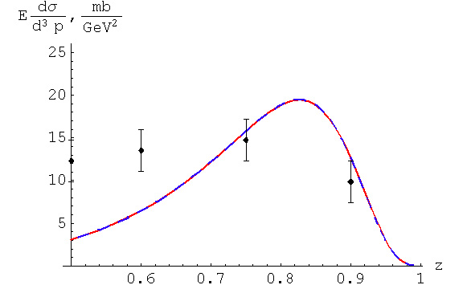
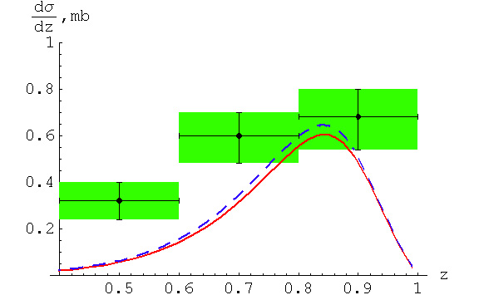
Backup slides (π p cross-sections from data)
ISR, √s =44.9 GeV
ISR, √s =52.8 GeV
1.7·Theor.
Theor.
NA49, √s =17.2 GeV
PHENIX, √s =200 GeV
Theor.
DIFFRACTION 2010, Otranto, Italy Forward Physics R.Ryutin
Notes:
ISR,NA49,PHENIX data with curves

Slide 26
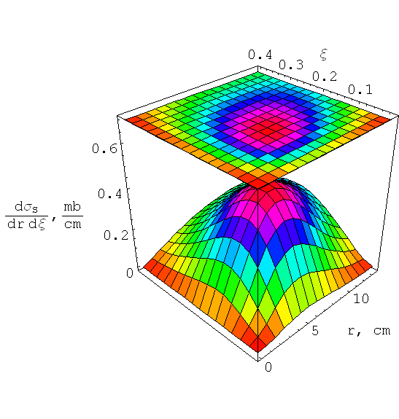
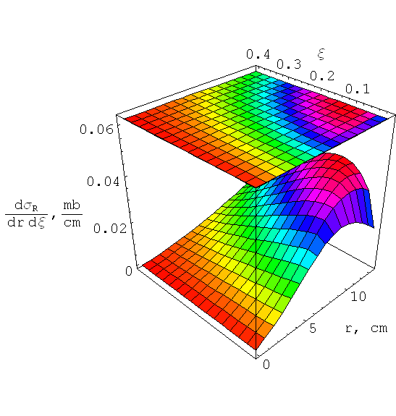
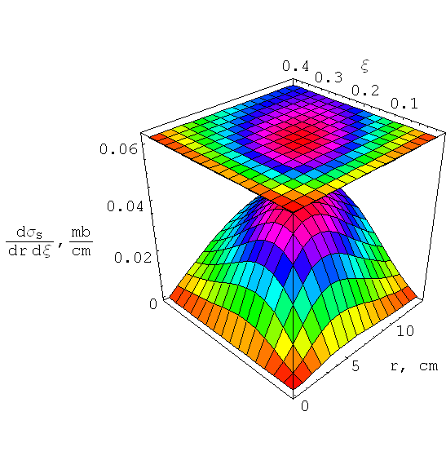

Backup slides (cross-sections at 900 GeV)
dσ/drdξ (mb/cm)
SπE
SρE+Sa2E
DρπE+Da2πE
DπE
r is the transverse distance from the center of ZDC
DIFFRACTION 2010, Otranto, Italy Forward Physics R.Ryutin
Notes:
xi-r plots for pi,rho,a2

Slide 27




Backup slides (cross-sections at 7 TeV)
dσ/drdξ (mb/cm)
SπE
SρE+Sa2E
DρπE+Da2πE
DπE
r is the transverse distance from the center of ZDC
DIFFRACTION 2010, Otranto, Italy Forward Physics R.Ryutin
Notes:
xi-r plots for pi,rho,a2

