Slide 1
Progress on the FTM prototype

Slide 2
Measurements - Setup
Main goal to measure the effective gain
Estimation of the ionization current
Setup
CAEN 1471H
has 50pA current
Resolution
Able to scan low
amplification fields
Prototype
Gas Inlet
Amptek Ag X-ray gun
2 GΩ
Connector to drift foil
CAEN 1471H
Gas Outlet
Connector to FTM foil
Connector to Anode foil
2 GΩ
1 GΩ

Slide 3
Ongoing Tests
From the previous meetings
Agreed to perform effective gain measurements also with different gas mixtures
Ar/CO₂ 70/30
Ar/CO₂ 93/7
Ar/CO₂/CF4 45/15/40
We faced proble with the gas mixing system capable to mix 3 gas components
Issue was resolved in August
Performed Effective Gain measurement tests → Only conductive foil (the resistive is defective)
Outstanding issues have risen

Slide 4
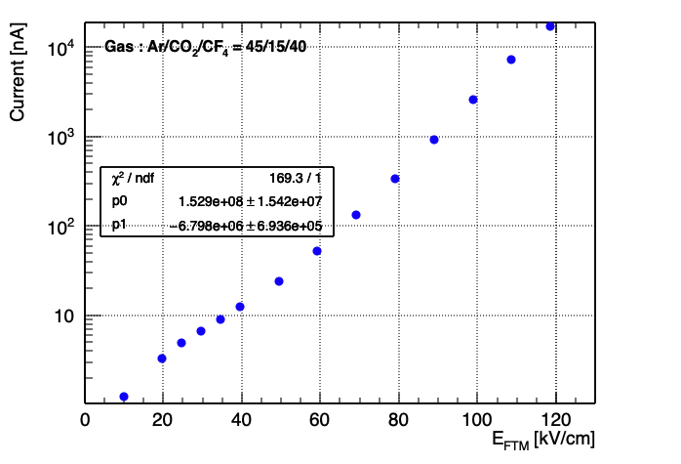
Eff. Gain tests
After fixing the gas mixing system
Performed test with Ar/CO₂/CF4 45/15/40
First test performed using only the CAEN 1471H power supply
i.e. Monitoring the current from all the three layers
The behavious is differet from the
”flat” region that we were expecting

Slide 5
Eff. Gain tests
Comparing the two gases (and the two mixing systems) shows this strange behaviour

Slide 6
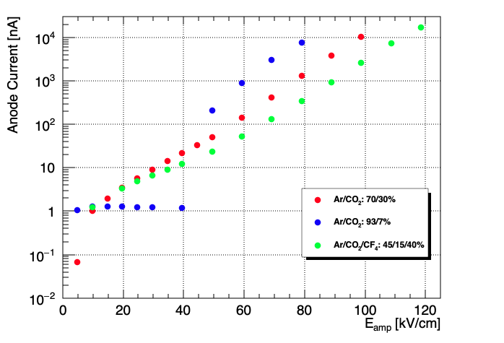
Eff. Gain tests
Ar/CO₂ 70/30 performed with the same mixing system as in the Ar/CO₂/CF₄
Performed Ar/CO₂ 93/7 with the standard gas mixer (the one used for the GE1/1 project)
The results were interesting
The plot depicts only the Anode current in absolute value (normally the values are negative)

Slide 7
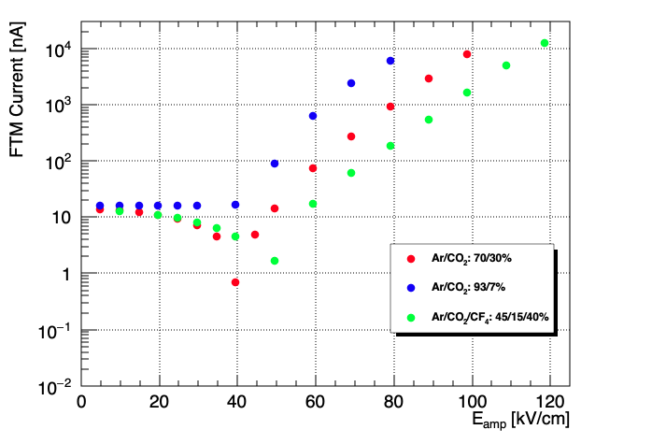
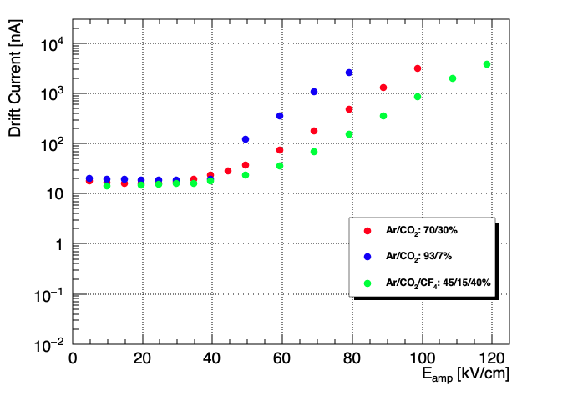
Eff. Gain tests
For completeness, I plotted also the FTM and the Drift currents in the standard values

Slide 8
Eff. Gain tests
During a discussion with Marcello we have observed what the plots show
i.e. maybe this methode
It is observed that the collected current in the drift is constant while due to low collection efficiency the anode current is only a fraction is collected → reformulate?

Slide 9
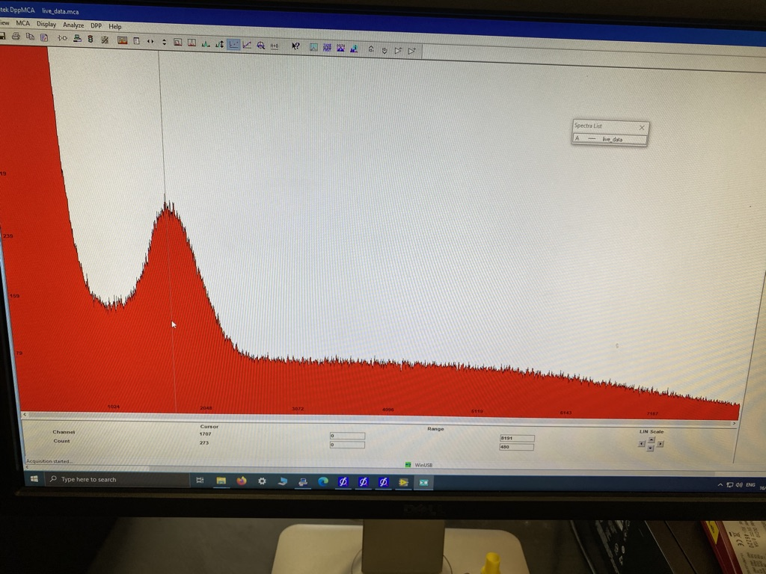
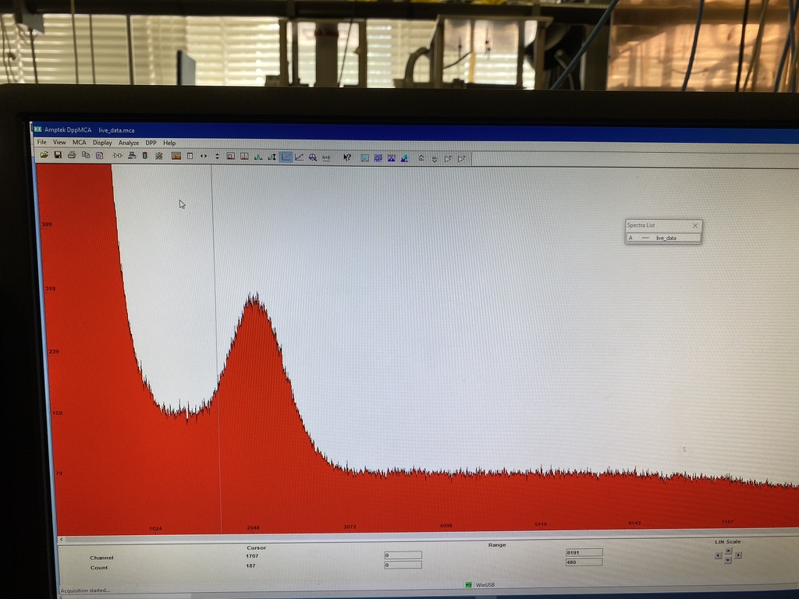
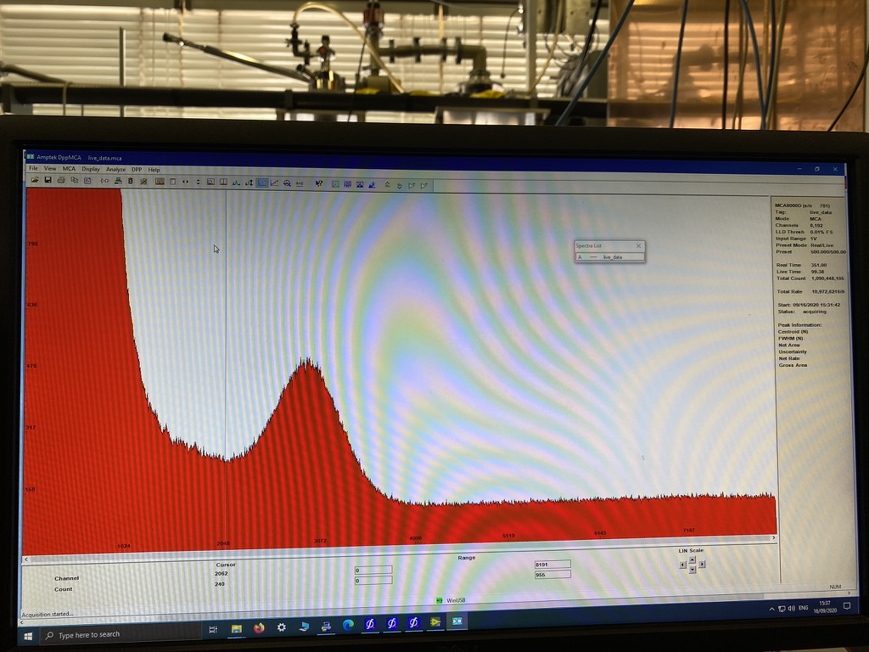
Eff. Gain tests
Since signal is observed → shifted the eff. Gain to a QC5 like test (assuming a # of primaries 346 – just like in the GE1/1)
The photopeak was visible for quite high voltages > 140 kV/cm
Gas Ar/CO₂/CF4 45/15/40
X-rays: 40kV/5μA

Slide 10
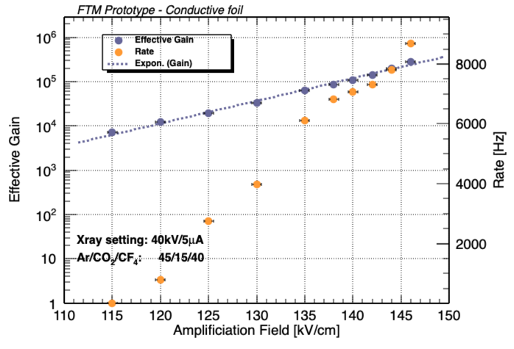
Eff. Gain tests
In the plot there is a small plateau region
Similar is the case for the Ar/CO₂ 70/30 situation

Slide 11
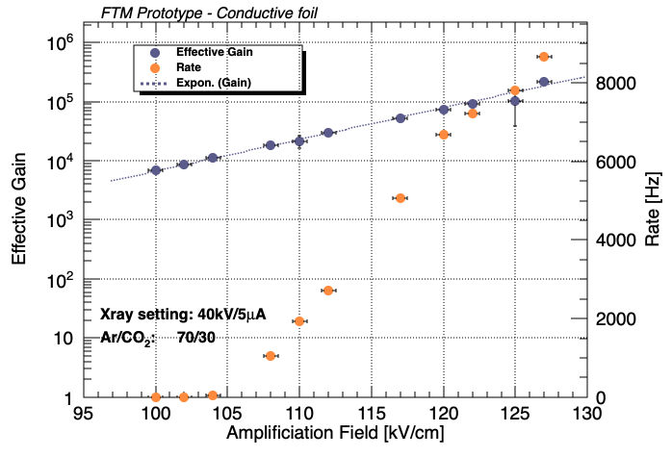
Eff. Gain tests

