Slide 1
Muon Collider
D. Schulte

Slide 2
Context
Muon collider has in the past been studied in the US (MAP)
effort largely ceased after last P5 process
some effort mainly in the UK on MICE
some, mainly in Italy, on LEMMA on alternative muon source
For the European Strategy the Laboratory Directors Group (LDG) established a muon collider working group to provide input on the muon collider
LDG represents: CERN, DESY, INFN, STFC, IRFU (CEA), CIEMAT, NIKHEF, LNGS, IJCLab (CNRS), PSI
Working group has been chaired by N. Pastrone
Proposed to the European Strategy Process to form an international collaboration to study the muon collider
The European Strategy Update proposed to include the muon collider in the accelerator R&D roadmap
To start implementing this the Laboratory Directors Group has established an international muon collider collaboration on July 2nd 2020

Slide 3
Objective and Scope
Objective:
In time for the next European Strategy for Particle Physics Update, the study aims to establish whether the investment into a full CDR and a demonstrator is scientifically justified.
It will provide a baseline concept, well-supported performance expectations and assess the associated key risks as well as cost and power consumption drivers. It will also identify an R&D path to demonstrate the feasibility of the collider.
Deliverable:
Report assessing muon collider potential and describing R&D path to CDR
Scope:
Focus on two energy ranges:
  3 TeV, if possible with technology ready for construction in 10-20 years
  10+ TeV, with more advanced technology
Explore synergy with other options (neutrino/higgs factory)
Define R&D path

Slide 4
A Potential Way Forward
Exploratory
phase
Definition
phase
Technically limited
1
2
3
4
5
6
7
8
9
10
11
12
13
14
15
16
17
18
Collider Design
Baseline design
Design optimisation
Project preparation
Approve
Test Facility
Design
Construct
Exploit
Technologies
Design / models
Prototypes / t. f. comp.
Prototypes / pre-series
Ready to decide on test facility
Cost scale known
Ready to commit Cost know
Ready to construct

Slide 5
Tentative Roadmap
Exploratory Phase
Definition Phase
4
1
2
3
4
1
2
3
4
1
2
3
4
1
2
3
4
1
2
3
4
Explore design
Identify critical issues
Explore and prioritise issues
Make design choices
Define realistic goals
Define design
Address feasibility issues
Develop design, refine choices
Develop R&D programme to demonstrate performances
Go through full collider to complete and update tentative list
Tentative list
Work
Study the most critical issues from initial list to find solutions, further refine understanding, iterate
Initial list ready
Work
Prioritised list ready

Slide 6
Proton-driven Muon Collider Concept
MAP collaboration
Acceleration to collision energy
Collision
Short, intense proton bunches to produce hadronic showers
Pions decay into muons that can be captured
Muon are captured, bunched and then cooled by
ionisation cooling in matter
No CDR exists, no coherent baseline of machine
No cost estimate
Need to extend to higher energies (10+ TeV)
But did not find something that does not work

Slide 7
Tentative Target Parameters
Parameter | Unit | 3 TeV | 10 TeV | 14 TeV
L | 10³⁴ cm⁻²s⁻¹ | 1.8 | 20 | 40
N | 10¹² | 2 | 2 | 2
f_{r} | Hz | 6 | 4 | 4
P_{beam} | MW | 5.8 | 12.8 | 17.9
C | km | 4.5 | 10 | 14
<B> | T | 7 | 10.5 | 10.5
ε_{L} | MeV m | 7.5 | 7.5 | 7.5
σ_{E} / E | % | 0.1 | 0.1 | 0.1
σ_{z} | mm | 5 | 1.5 | 1.07
β | mm | 5 | 1.5 | 1.07
ε | μm | 25 | 25 | 25
σ_{x,y} | μm | 3.0 | 0.9 | 0.63
Scaled from MAP parameters
Emittance is constant
Collider ring acceptance is constant
Bunch length decreases
Betafunction decreases

Slide 8
Proton Complex
Muon production proportional to total energy in proton beam
Expect to need 80 GeV proton energy per muon
Assume that only 10% of the muons survive the cooling
Hence need 1.6 x 10¹⁵ GeV to produce one bunch
e.g. 2.5 x 10¹⁴ protons per pulse at 6.25 GeV
Need proton complex design
Review and optimisation of the MAP design
Develop and incorporate new ideas
Identification of existing infrastructure in particular in view of the test facility
Need effort also for test facility

Slide 9
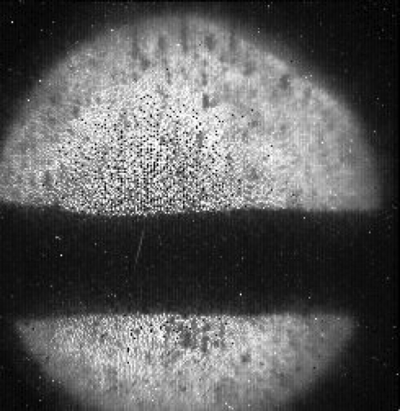
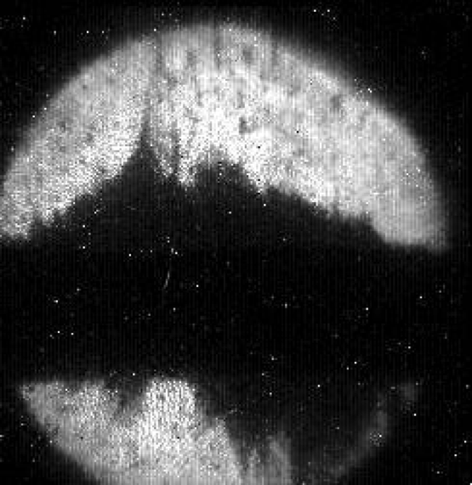
Front-end
MAP design
Target has to withstand strong shock
liquid mercury target successfully tested at CERN (MERIT)
but solid target better for safety
or beads
or …
Ambitious high-field solenoid system
Need to capture muon efficiently (optics, RF design)
Important power of proton driver (at least O(1.3 MW)) leads to losses downstream (optics, protection of RF)
Need effort also for test facility

Slide 10
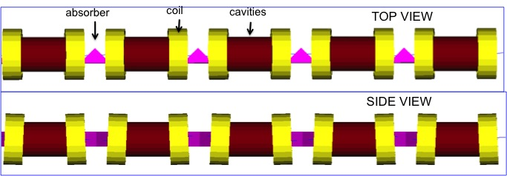
Cooling Concept
Superconducting solenoids
High-gradient normal-conducting RF in strong magnetic field
Liquid hydrogen targets
Compact integrated design
Beam dynamics (optics, collective effects)
MAP collaboration

Slide 11
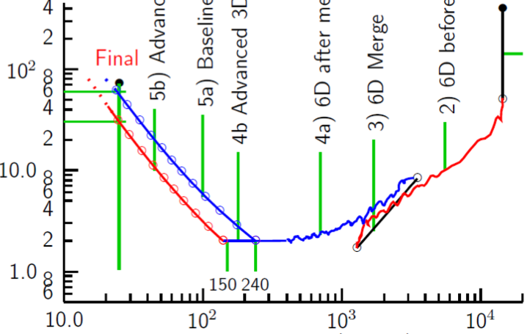
Cooling: The Emittance Path
Target
Y
Specification
•
•
•
For acceleration to
multi-TeV collider
Front End
For acceleration to NuMAX (325MHz injector acceptance 3mm,24mm)
Phase
Rotator
Exit Front End
(15mm,45mm)
Initial Cooling
Longitudinal Emittance (mm)
Final
Cooling
post-merge 6D Cooling
pre-merge
6D Cooling (original design)
For acceleration
to Higgs Factory
Bunch
Merge
Transverse Emittance (microns)
MAP collaboration

Slide 12
Cooling: The Emittance Path
Target
Y
Specification
Achieved (simulations)
•
•
•
For acceleration to
multi-TeV collider
Front End
For acceleration to NuMAX (325MHz injector acceptance 3mm,24mm)
Phase
Rotator
Final
Exit Front End
(15mm,45mm)
Initial Cooling
Longitudinal Emittance (mm)
Initial
(X)
Initial
(Y)
Final
Cooling
post-merge 6D Cooling
pre-merge
6D Cooling (original design)
For acceleration
to Higgs Factory
HCC
VCC &
Hybrid
Bunch
Merge
Transverse Emittance (microns)
MAP collaboration

Slide 13
Cooling: The Emittance Path
Target
Y
Specification
Achieved (simulations)
•
•
•
For acceleration to
multi-TeV collider
Front End
For acceleration to NuMAX (325MHz injector acceptance 3mm,24mm)
Several ideas to improve final cooling
Need to work out the solution
Highest field HTS helps (50 T, if we can do it)
Phase space manipulations of beam
Phase
Rotator
Final
Exit Front End
(15mm,45mm)
Initial Cooling
Longitudinal Emittance (mm)
Initial
(X)
Initial
(Y)
Final
Cooling
post-merge 6D Cooling
pre-merge
6D Cooling (original design)
For acceleration
to Higgs Factory
HCC
VCC &
Hybrid
Bunch
Merge
Maybe can improve this
Transverse Emittance (microns)
MAP collaboration

Slide 14
High-energy Acceleration
Rapid cycling synchrotron (RCS)
Inject beam at low energy and ramp magnets to follow beam energy
Could use combination of static fast-ramping and static superconducting magnets
Fast-pulsing magnets (O(ms) ramps))
Field defines size of accelerator ring
normal-conducting
HTS is interesting
Important energy in fast pulsing magnets
O(200 MJ) @ 14 TeV
need very efficient energy recovery
FFAG
Challenging lattice design for large bandwidth and limited cost
High field magnets
RF challenge:
High efficiency for power consumption
High-charge, single-bunch beam (10 x HL-LHC)
Maintain small longitudinal emittance

Slide 15
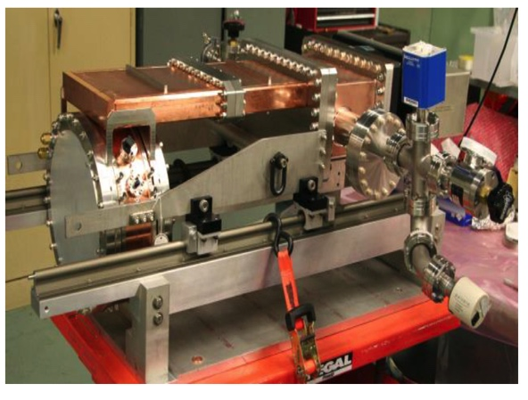
RF Challenge
Acceleration and collider ring RF
High bunch charge of 2x10¹² muons, mostly like single bunch
Start with long bunch that is subsequently compressed
14 TeV: 1 mm long bunch with 0.1 % energy spread in collider ring
Almost same longitudinal emittance (7.5 MeVm) as after muon cooling
Need to work out scheme for this
Muon cooling RF
High-field (50 MV/m) in strong field (> 4 T)
Proof of principle in US (gas-filled copper cavities and Be cavities in vacuum)
But need to get in our hands
MuCool: >50 MV/m in 5 T field
Other RF
e.g. front-end and proton complex RF

Slide 16
Collider Rings
Need minimum field-free distance between magnets and combined function magnets to minimise neutrino radiation by minimising the path with no bending
High field dipoles to minimise collider ring size and maximise luminosity
Protect from O(400 W/m) beam loss
1/3 of beam energy
large aperture and shielding
  150 mm in MAP at 3 TeV, 30-50 mm shielding
insolation and cooling of shielding
  7 MW at 14 TeV
open mid-plane magnets considered (but still some power lost in magnets)
efficient cooling of magnets (HTS)
consider collimators to localise losses
  but with no gaps in magnets
Combined function magnet design
V.V. Kashikhin et al.

Slide 17
Final Focus
Need smaller betafunctions at higher energy
Or smaller longitudinal emittance / larger energy acceptance
And focusing of higher energy beam is more difficult
FCC-hh example (R. Martin)
R. Tomas
First look from Rogelio Tomas on final triplet at 14 TeV (L* = 6 m):
Challenging system
Need to add shielding
0.7 m for 10 σ
0.3 m for 6 σ

Slide 18
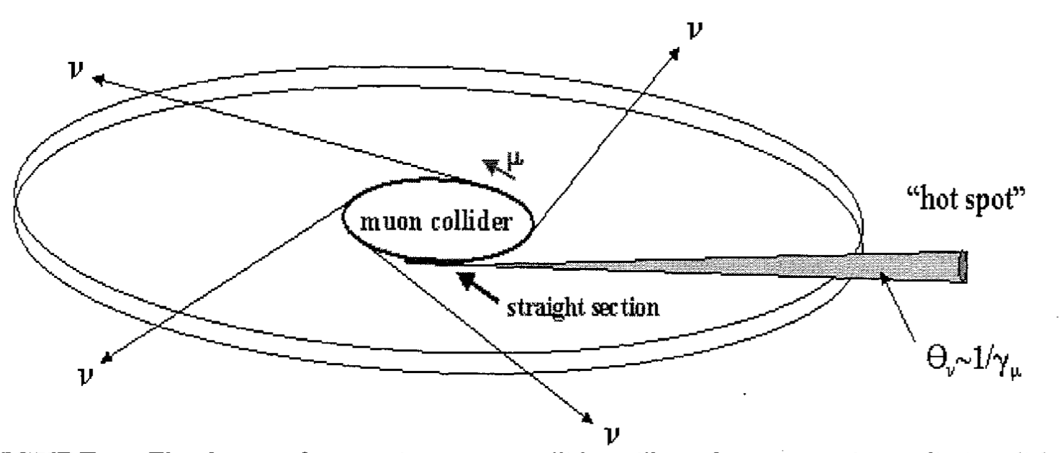
Neutrino Radiation Considerations
Neutrinos from decaying muons can produce showers just when they exit the earth
Particularly bad in direction of straights
Mitigated by owning the land at exit
But also an issue in the arcs
Becomes more important at higher energies (scaling E³)
US study concluded that 6 TeV parameters are OK
Reasonable goal maybe 0.1 mSv/ year, but has to be verified
For 1.5 + 1.5 TeV arcs require depth of 40 m
LHC effective depth is 23 m in worst direction
1.5 TeV accelerator in LHC: tunnel OK for arcs, have to work on straights
For 7 + 7 TeV 500 m depth requires factor 8 improvement

Slide 19
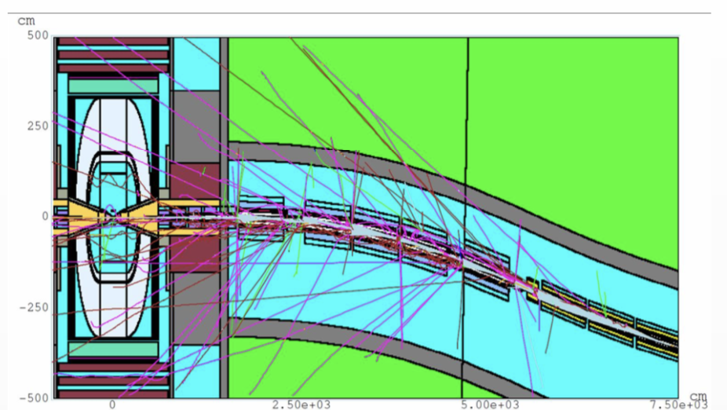
Physics and Detector
Physics at 10+ TeV is in uncharted territory
need important effort, theorists are motivated
Explore what can be done to develop physics case, also in comparison to other options
Need to include realistic assumptions about the detector performance
largely use technology similar to what is developed for other detectors
Main detector challenge in machine detector interface (MDI)
At 14 TeV: 40,000 muons decay per m and bunch crossing
At 3 TeV: 200,000 muons per m and bunch crossing
D. Lucchesi et al.
Detector must be designed for robustness
effective masking
high granularity
fast timing
clever algorithms
Detailed design of machine is required for this

Slide 20
Collective Effects
Phase space density is critical
Systematically identify limits of charge and emittance
Need to mitigate beam-beam effects if we push beyond current goal (0.1)
Space charge
Impedances in collider ring (short, high-charge bunch)
Beamloading
transverse wakefields
Interaction of beam with matter (wakefields?), loading of gas-filled structures, …
Systematic survey of all collective effects is required

Slide 21
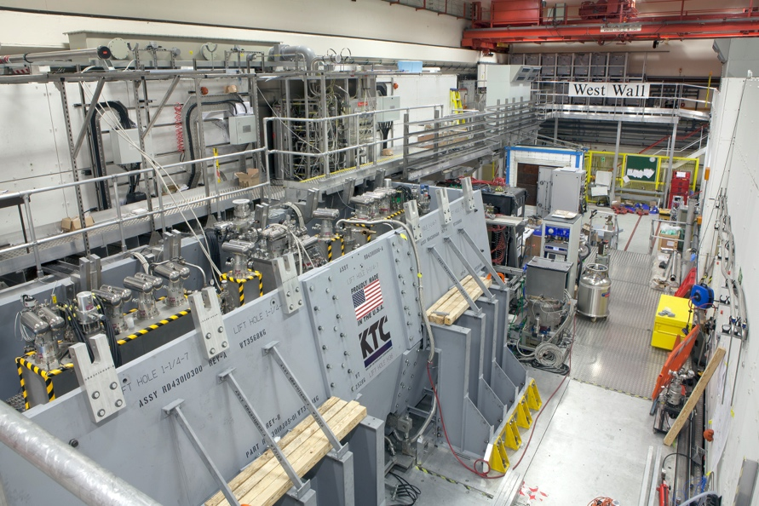
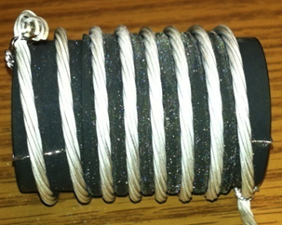
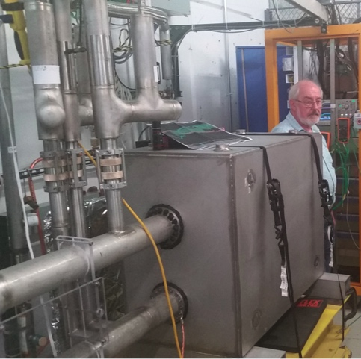
Design Status
Key systems designed for 3 TeV in US
A number of key components has been developed
Cooling test performed according to theory
But no CDR, no integrated design, no 10+ TeV, no cost estimate
More work to be done, e.g. substantial, 6D cooling
MICE
(UK)
MuCool: >50 MV/m in 5 T field
FNAL
Breakthrough in HTS cables
NHFML
32 T solenoid with low-temperature HTS
FNAL
12 T/s HTS
0.6 T max
Mark Palmer

Slide 22
Alternative: The LEMMA Scheme
45 GeV positrons to produce muon pairs
Accumulate muons from several passages
Low-emittance muon beam can reduce radiation
Less mature than proton-driven scheme
Large positron current required
Target is challenging
Large positron production rate [O(10¹⁷/s)]
Currently do not reach luminosity goal

Slide 23
LEMMA Issues
Highest priority is to develop concept with sufficient luminosity
Key issue is production of dense muon beam
Concept for production of very high bunch charge positron beam
Concept for target that can sustain positron beam
LEMMA uses different combination schemes (in the target and outside)
Making the assumption that these systems work (will have to prove later)
Additional challenges (if above looks OK)
Muon acceleration (e.g. in plasma)
collider ring with very small betafunctions

Slide 24
Demonstrator
Demonstrator facility to produce useful muon beam
Demonstrator needs
to be based on muon collider source concept
a more detailed design than the collider source
to be based on technologies available in 5 years
to be affordable (0.5 GCHF?)
Hence we need to
Need to confirm choice of muon source concept
Have to have concept of full muon source
Identify use exiting infrastructure (e.g. proton beams)
Scale design to funding and available technology
Explore if it serve some physics
Develop source concept over the first two years
Then design demonstrator, preferably the same people

Slide 25
Ideas for Subjects for INFN
MDI
Fast-ramping magnets
Other magnets to be defined
High-energy superconducting cavities
Muon cooling RF (normal-conducting)
Dark current etc. in cooling RF
Targets (protons and positrons)
Proton complex accelerator design / beam dynamics
Front-end accelerator design / beam dynamics
Other accelerator design
Beam dynamics / collective effects
Fundamental LEMMA parameter set that motivates and directs research
What else is interesting?
Iteration with all partners required
some subjects fully uncovered for now some have interests

Slide 26
Reserve

Slide 27
Critical Issues Include:
Advanced detector concepts and technologies, requiring excellent timing, granularity and resolution, able to reject the background induced by the muon beams.
Advanced accelerator design and beam dynamics for high luminosity and power efficiency.
Robust targets and shielding for muon production and cooling as well as collider and detector component shielding and possibly beam collimation.
High field, robust and cost-effective superconducting magnets for the muon production, cooling, acceleration and collision. High-temperature super-conductors would be an ideal option.
High-gradient and robust normal-conducting RF to minimise muon losses during cooling.
High rate positron production source and high current positron ring (LEMMA).
Fast ramping normal-conducting, superferric or superconducting magnets that can be used in a rapid cycling synchrotron to accelerate the muons and efficient power converters.
Efficient, high-gradient superconducting RF to minimise power consumption and muon losses during acceleration.
Efficient cryogenics systems to minimise the power consumption of the superconducting components and minimise the impact of beam losses.
Other accelerator technologies including high-performance, compact vacuum systems to minimise magnet aperture and cost as well as fast, robust, high-resolution instrumentation.

Slide 28
Tentative R&D list: Magnets
Final cooling solenoid (O(50 T))
  ultimate field, luminosity proportional to field and need only few small solenoids
  maybe need other superconductor (Bi-2212 ?), hardware tests (cable tests to start)
Fast-ramping magnets in accelerator ring
  normal or superferric
  site size, cost and power consumption driver, (test of superconducting cables)
  power converters with energy recovery
Collider ring arc magnets
  high-field, cost-effective, dealing with beam loss
  integrated study with loss team (shielding, optics, cooling)
Final quadrupoles
  high-field, large aperture, they limit luminosity
Proton target solenoid
  large aperture, high-field, high radiation area, machine protection
6D cooling solenoids
  high-field, robust, cost-effective, integration in cooling cell
FFA magnets
  special design for FFA
Test facility magnets (need to adjust technology to what is available soon enough)
Other magnets

Slide 29
Tentative R&D List: RF
Superconducting high-energy accelerating cavities
  Maintain beam quality for short high-charge bunch
    longitudinal and transverse stability and emittance
  High efficiency for low current but high-charge, short bunch
Normal-conducting 6D cooling RF
  Gas-filled, high-gradient cavities
  High charge bunch, important losses
Front-end and proton complex RF
  To capture and accelerate protons and capture muons
Other RF

Slide 30
Tentative R&D List: Targets and Losses
High-power production target (1.3 - 4 MW)
Beam dumping and losses downstream of target
Muon cooling absorbers
Shielding of collider ring mangets
Shielding of detector
Losses in the machine

Slide 31
Tentative List: Start-to-end Accelerator Design
Too early to know work distribution
Everyone has to ask for resources
Contributions to all system useful
Open areas
Proton driver
Front end
Key systems to define luminosity performance
Together with cooling is part of the demonstrator
Needs more detailed work

Slide 32
Some LEMMA Considerations
Assume production target of 3 mm Be
Positron probability to loose 10% of energy is 0.01 per passage
Muon pair production probability is 10⁻⁷ per positron and passage
loose 10⁵ positrons per muon pair
total energy to produce one muon pair is 0.72 mJ
Assume limit of 100 MW of positron loss
produce 1.4 x 10¹¹ muon pairs per second
70 times less muon current than in proton collider (10¹³ / s)
assume to use factor 5 smaller betafunctions than proton collider
total of factor 14 denser muon beam required:
N/ε_{T} = 14 x 2 x 10¹² / 25 μm = 1.12 x 10¹² / μm

Slide 33
Some LEMMA Considerations
First model: assume infinite muon lifetime and do many turns
Optimum betafunction in target centre is 0.866 mm (3 mm/(2 sqrt(3)))
Emittance from production is O(100 nm) depending on positron beam energy, neglect this and assume many turns
Emittance growth per muon beam passage is 0.6 nm
Accumulating beam of n passages yields N = n x N₀ and ε_{T} = ε₀ + n/2 Δε (ignoring muon decay)
To achieve beam density of 1.12 x 10¹² / μm
need to produce 0.3 x 10⁻³ x 1.12 x 10¹² = 3.4 x 10⁻⁸ muons per passage
need 10⁷ positrons per muon
this requires 3.4 x 10¹⁵ positrons per passage

Slide 34
Some LEMMA Considerations
Second model: assume we can collect all muons over one second (1.4 x 10¹¹)
obviously worse than first model
Required emittance to achieve beam density of 1.12 x 10¹² / μm is 125 nm
Production emittance is 40 to 160 nm
Can combine about 0-300 turns
Assuming 300 turns requires 4 x 10¹⁵ positrons per bunch

Slide 35
Some LEMMA Considerations
Third model: assume we can collect all muons over 200 s (2.8 x 10¹³)
First collect n bunches N₁ = n x N₀ and ε₁ = ε₀ + n/2 Δε
Then combine m² of them side by side N = m² x N₀ and ε_{T} = m x ε₁
Emittance to achieve beam density of 1.12 x 10¹² / μm is 25 μm
  this has been the reason to define 200 s
  beam has a much higher charge than in proton case
  aperture in final triplet needs to be much larger
  but gives the most optimistic goal for emittances at production
Assume production emittance of 40 nm and accumulate 133 turns
  optimum density (no proof here, but easy to do)
Leads to 80 nm emittance
Need to produce 2 x 10⁶ muons per passage
Need 2 x 10¹³ positrons
Pretty unrealistic assumptions and still need very high bunch charge

Slide 36
Note: Stacking
Can increase relevant beam density by stacking n bunches
Could combine m x m bunches in transverse phase space
Charge also scales optimistically with number of bunches
in each plane emittance scales optimistically with m and total as
Hence
Particularly interesting for LEMMA
But difficult to do…
x’
New injected bunch
x
Shift common orbit for next turn

Slide 37
Some LEMMA Considerations
Third model: assume we can collect all muons over 200 s (2.8 x 10¹³)
First collect n bunches N₁ = n x N₀ and ε₁ = ε₀ + n/2 Δε
Then combine m² of them side by side N = m² x N₀ and ε_{T} = m x ε₁
Emittance to achieve beam density of 1.12 x 10¹² / μm is 25 μm
  this has been the reason to define 200 s
  beam has a much higher charge than in proton case
  aperture in final triplet needs to be much larger
  but gives the most optimistic goal for emittances at production
Assume production emittance of 40 nm and accumulate 133 turns
  optimum density (no proof here, but easy to do)
Leads to 80 nm emittance
Need to produce 2 x 10⁶ muons per passage
Need 2 x 10¹³ positrons
Pretty optimistic assumptions and still need very high bunch charge

Slide 38
Optics and RF Challenge
Longitudinal motion in collider ring
average lifetime is O(3000) turns
want short bunches O(1mm) @ 14 TeV
significant energy spread O(10⁻³)
large ring (14 km @ 14 TeV)
Need very small momentum compaction
Almost completely suppress motion for
i.e. 2.5 x 10⁻⁸ @ 14 TeV
5 x 10⁻⁶ @ 3 TeV
Or need enough RF voltage
e.g. 10 GV @ 14 TeV, α = 10⁻⁶, f_{RF} = 0.4 GHz
e.g. 200 MV @ 3 TeV, α = 10⁻⁵, f_{RF} = 0.4 GHz
Need to minimise momentum compaction and higher order effects

Slide 39
Target Parameter Examples
From the MAP collaboration: Proton source
Even at 6 TeV above target luminosity with reasonable power consumption
But have to confirm power consumption estimates

Slide 40
Comparison MAP vs. CLIC
In linear collider, the luminosity per beam power is about constant
In muon collider, luminosity can increase linearly with energy
A linear collider is single-pass so need full voltage in main linac
Muon collider is multi-pass so have lower voltage
But have to carefully verify this
Overall muon colliders have the potential for high energies
May overcome the energy limitations of linear colliders
The working group concluded that an International collaboration should be formed to study the muon collider

Slide 41
Muon Collider Luminosity Scaling
Fundamental limitation
Requires emittance preservation and advanced lattice design
Applies to MAP scheme
Large energy acceptance
High beam power
High energy
Dense beam
High field in collider ring
Luminosity per power increases with energy
Provided all technical limits can be solved
Constant current for required luminosity
Better scaling than linear colliders

Slide 42
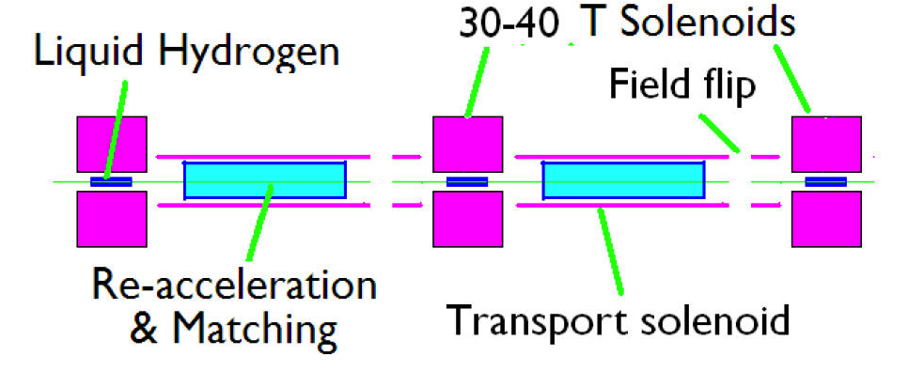
Transverse Cooling Concept
Strong solenoids to minimise betafunction
Example: final cooling solenoids >30 T aperture 25 mm
Higher field means better emittance and more luminosity

