Slide 1

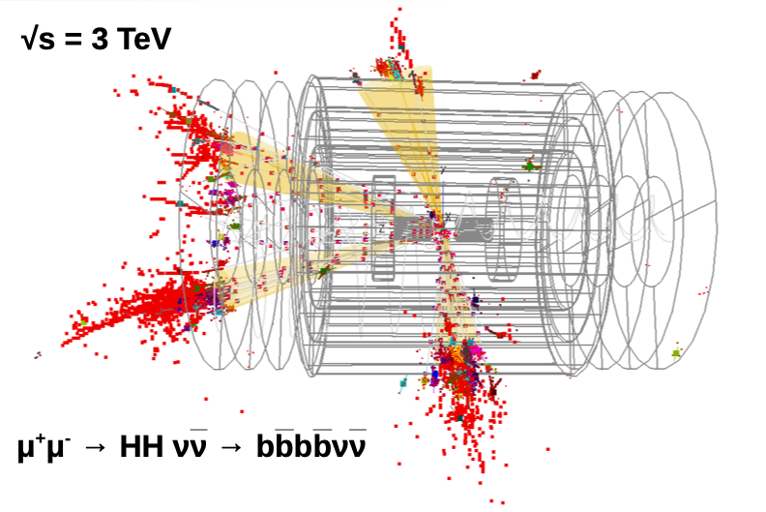
Work done in Italy towards the international collaboration and further steps
International Collaboration
to develop an integrated muon collider design concept
that encompasses the physics, the detectors, and the accelerator
Mainly @ CSN1 since 2021 RD_MUCOL: 17.3 FTE / 90 phys/eng 13 sections
2016-2020 RD_FA (WP8) and CSN5-grant 2019-2020
Nadia Pastrone
https://indico.cern.ch/event/930508
Meeting with INFN-Accelerators October 12th, 2020

Slide 2
Ongoing activities not discussed today
Physics Potential 10+ TeV is a completely new regime to explore!
Direct/indirect discovery reach – VBF and VBS – precise Higgs measurements
Benchmarks at different energies steer machine parameters and experiment design
Experiment and Physics Validation
Flexible framework - background simulation, detector simulation and event reconstruction in use to study detector requirements/performances at different center of mass energies experiment design and performances constrained by beam induced background
➔ Machine Detector Interface
Experiment Design and Detector R&D
Flexible framework to study detector requirements/performances at physics benchmarks
R&D to exploit state of the art “5D” detectors and beyond are mandatory ➔ synergies
INFN experts and infrastructures cover many crucial area of interest to be explored
Strong synergy within the new submitted EU project AIDAinnova

Slide 3
LEMMA Source Activities
Positron-based Muon Source – LEMMA
Positron production and acceleration, muon targets, muon accumulation
M.Antonelli, M.E.Biagini, M.Boscolo, S.Guiducci, P.Raimondi, A.Variola et al. arXiv:1905.05747v2 [physics.acc-ph] ➔ paper in preparation
  Positron source studies – collaboration with IJCL + A.Bacci, I.Drebot et al.
  also on crystal applications: L.Bandiera, A.Mazzolari et al.
  Material simulations and studies for positron and muon production targets
  M.Antonelli, R.Li Voti, G.M. Cesarini et al. LNF, RM1 + RM3 + LNL + MIB + PoliTO
  measurements and R&D planned using beam at LNF and CERN
  Muon accumulator optics and multi-target new layout + O.Blanco, A. Ciarma:
  FFAG – with UK multibend-achromat – with ESRF Phys. Rev. Accel. Beams 23, 051001
  CERN test beam to evaluate targets and emittance J. Inst. 15 P01036, 20
  ➔ new proposal to run at CERN in 2022 with improved set-up
  + N.Amapane, F. Anulli, A.Bertolin, M.Zanetti et al.
  Resource plan towards a pre-CDR submitted by Alessandro Variola (10/19)
need consolidation to prove feasibility
to overcome technical limitations and reach higher muon intensities

Slide 4
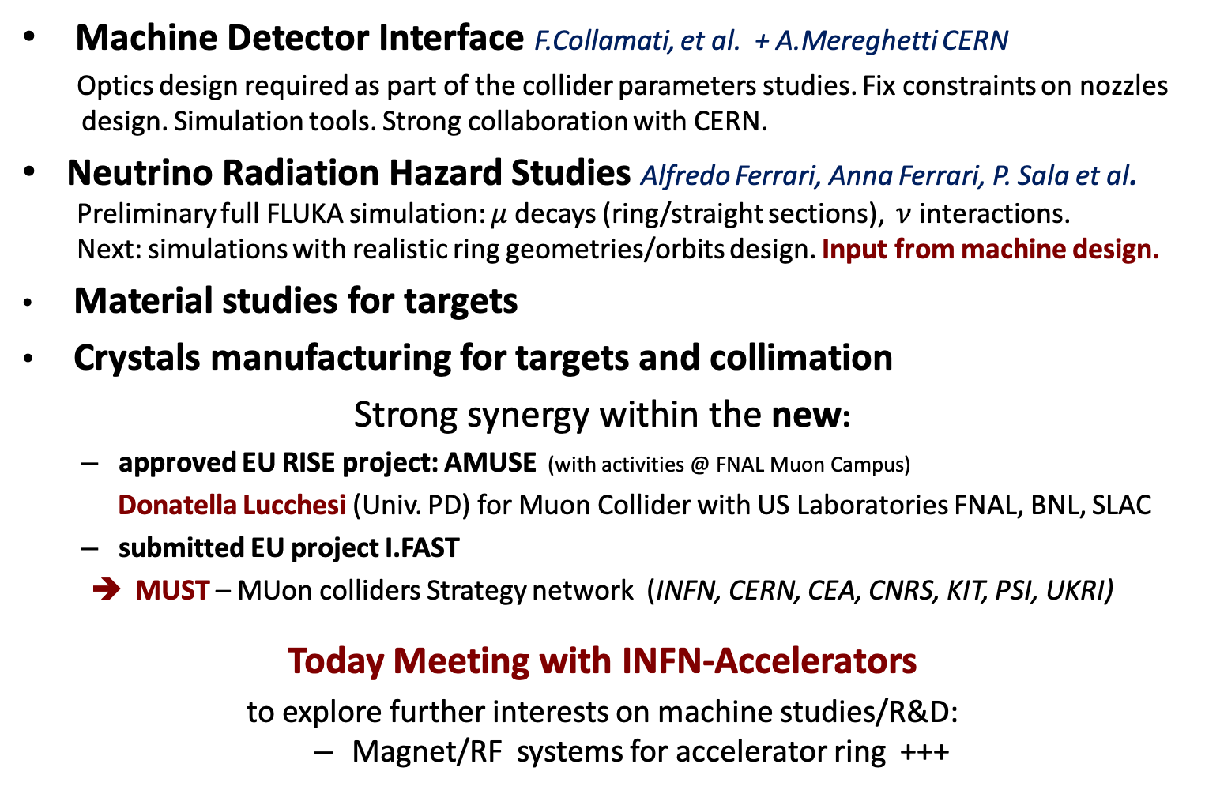
Ongoing activities and interests @ INFN
Machine Detector Interface F.Collamati, et al. + A.Mereghetti CERN
Optics design required as part of the collider parameters studies. Fix constraints on nozzles design. Simulation tools. Strong collaboration with CERN.
  Neutrino Radiation Hazard Studies Alfredo Ferrari, Anna Ferrari, P. Sala et al.
Preliminary full FLUKA simulation: $μ$decays (ring/straight sections), $ν$ interactions.
Next: simulations with realistic ring geometries/orbits design. Input from machine design.
Material studies for targets
Crystals manufacturing for targets and collimation
Strong synergy within the new:
  approved EU RISE project: AMUSE (with activities @ FNAL Muon Campus)
  Donatella Lucchesi (Univ. PD) for Muon Collider with US Laboratories FNAL, BNL, SLAC
  submitted EU project I.FAST
MUST – MUon colliders Strategy network (INFN, CERN, CEA, CNRS, KIT, PSI, UKRI)
Today Meeting with INFN-Accelerators
to explore further interests on machine studies/R&D:
  Magnet/RF systems for accelerator ring +++

Slide 5
LEMMA: a positron driven muon source for a Muon Collider
M. Antonelli, M.E. Biagini, O. Blanco-Garcia, M. Boscolo, A. Ciarma, A. Giribono, S. Guiducci, C. Vaccarezza
(INFN, Frascati National Laboratories, Italy)
F. Anulli, M. Bauce, G. Cesarini, F. Collamati, R. Li Voti, A. Variola
(Roma La Sapienza University, Italy)
I. Chaikovska, R. Chehab (IJCLab, Orsay, France)
A. Bacci, I. Drebot (INFN, Milan, Italy)
S. Liuzzo, P. Raimondi (ESRF, Grenoble, France)

Slide 6
LEMMA in a nutshell
The Low EMittance Muon Accelerator (LEMMA) source is a new concept aiming at producing muon pairs from a 45 GeV positron beam annihilating with the electrons of a target, close to threshold for pair creation, thus generating muon beams with low transverse emittance for a high energy muon collider
The first idea developed at the INFN Frascati Laboratories [1,2] had the muon production target installed in a positron ring, in order to allow for multiple interactions of the e⁺ with the e⁻ at rest in the target. However, this layout has encountered several limiting difficulties
An alternative design [3] is presently under study to identify the challenges within reach of the existing technology, and those requiring further innovation
[1] M. Antonelli, P. Raimondi, “Snowmass Report: Ideas for muon production from positron beam interaction on a plasma target”, INFN-13-22/LNF (2013)
[2] M. Antonelli, M. Boscolo, R. Di Nardo, P. Raimondi,
“Novel proposal for a low emittance muon beam using positron beam on target”,
Nucl. Instrum. Meth. A807 101-107 (2016)
[3] arXiv:1905.05747v2 [physics.acc-ph]

Slide 7
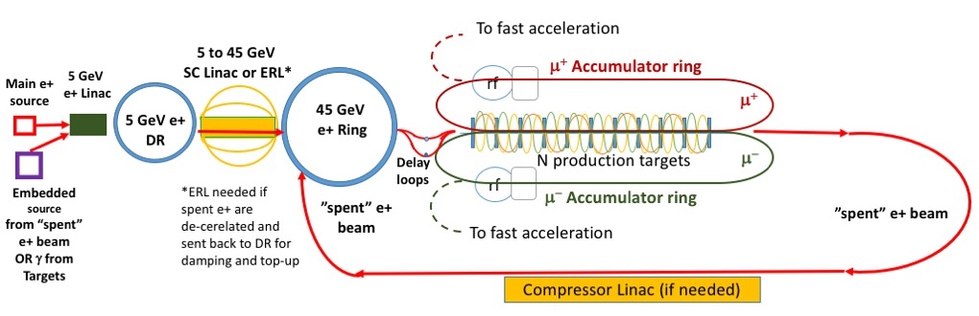
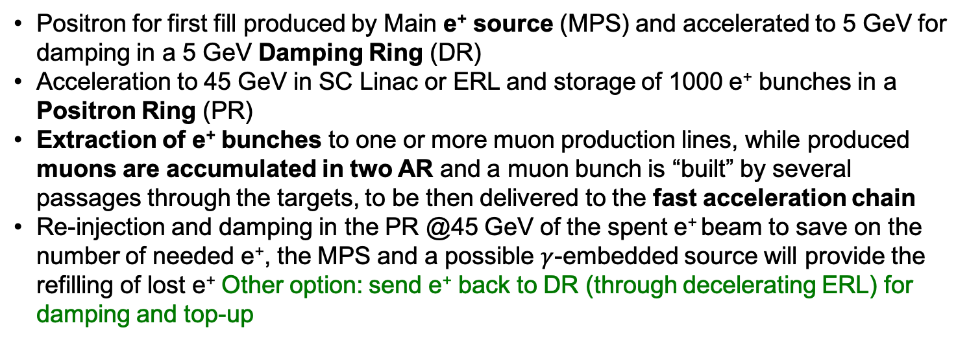
LEMMA muon source, 2019 scheme, A. Variola et al.
arXiv:1905.05747v2 [physics.acc-ph]
Positron for first fill produced by Main e⁺ source (MPS) and accelerated to 5 GeV for damping in a 5 GeV Damping Ring (DR)
Acceleration to 45 GeV in SC Linac or ERL and storage of 1000 e⁺ bunches in a Positron Ring (PR)
Extraction of e⁺ bunches to one or more muon production lines, while produced muons are accumulated in two AR and a muon bunch is “built” by several passages through the targets, to be then delivered to the fast acceleration chain
Re-injection and damping in the PR @45 GeV of the spent e⁺ beam to save on the number of needed e⁺, the MPS and a possible $γ$-embedded source will provide the refilling of lost e⁺ Other option: send e⁺ back to DR (through decelerating ERL) for damping and top-up

Slide 8
Accelerator studies during 2020
Design for the Damping Ring, 45 GeV e+ ring, and compressor Linac were studied last year
This year the work has been focused on:
  Positron source and embedded sources
  (I. Chaikovska et al., IJCLab, A. Bacci Milano, LNF, Roma I)
  Injection of spent beam
  (M. Biagini et al., LNF, I. Debrot Milano, Roma I)
  Accumulator design and targets line (M. Boscolo et al., LNF)
  Target studies (R. Li Voti et al., Roma I )

Slide 9
I. Chaikovska, IJCLab

Slide 10
I. Chaikovska, IJCLab

Slide 11
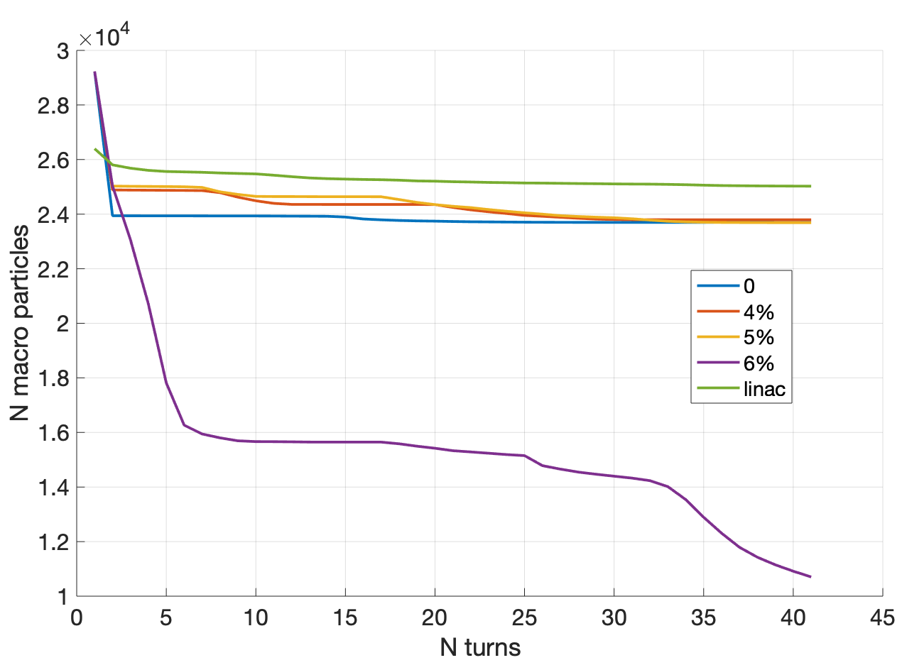
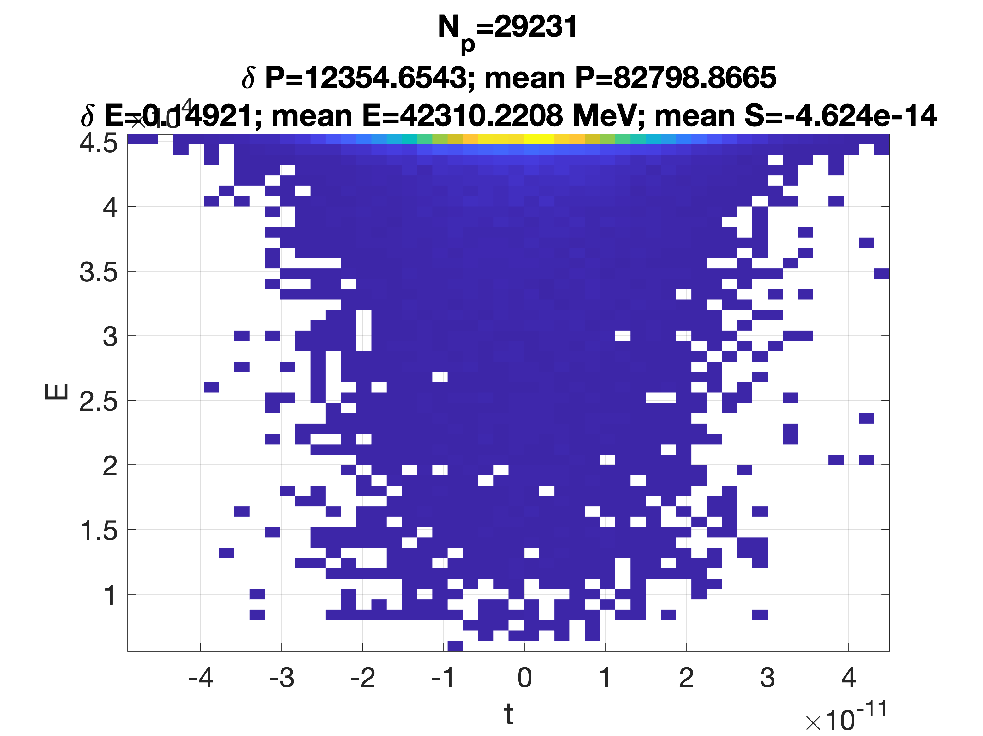
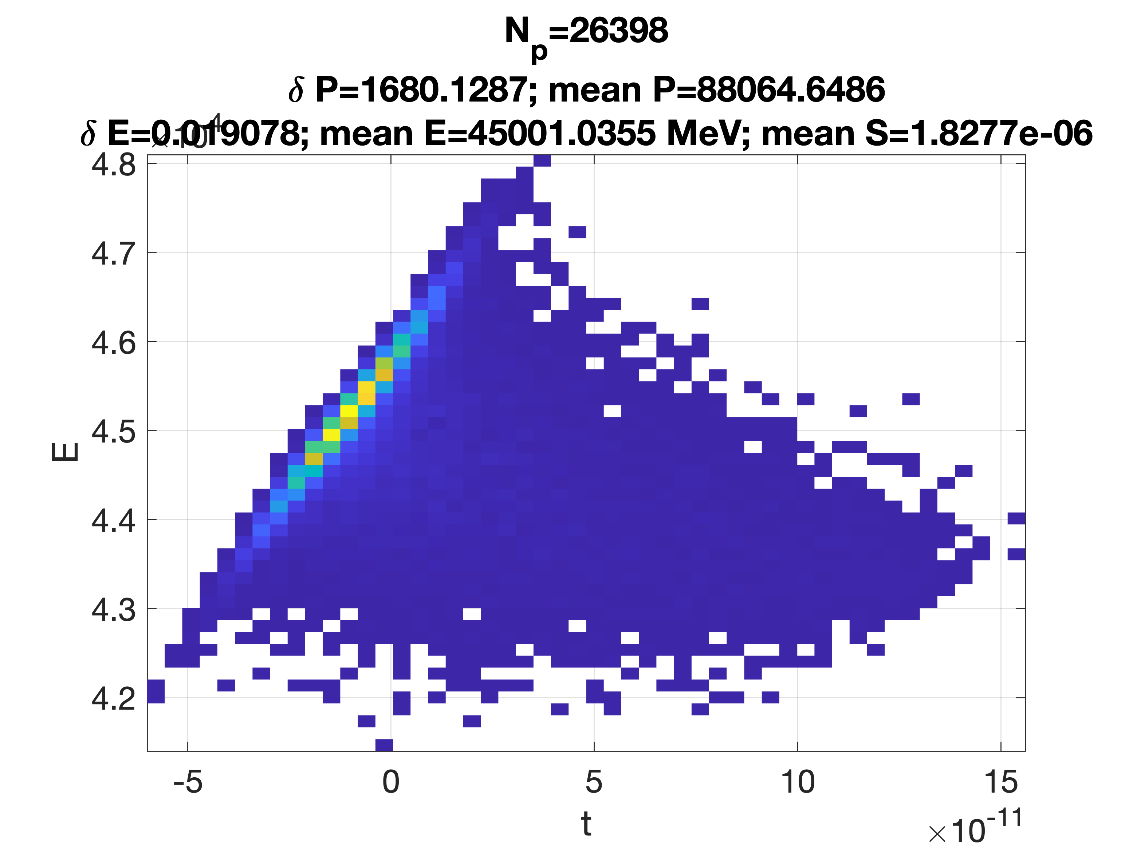
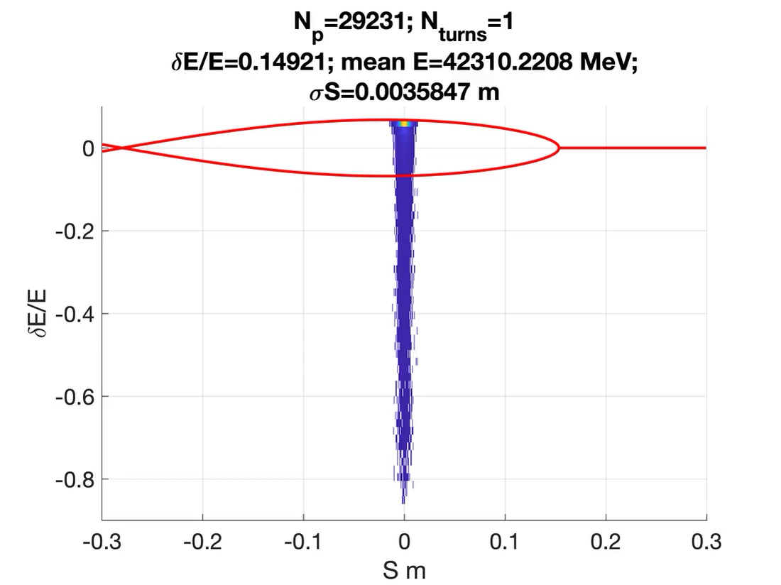
Study of injection of spent positrons in 45 GeV ring: 2 beam options
e+ beam after target
(O. Blanco)
2) e+ beam after linac compression
(C. Vaccarezza)
~80% survival rate
Number of survived e⁺
energy offset 0%
Trying to increase the number of survived e⁺ by playing with different parameters at injection, like energy offset
Still to do: benchmarking Elegant with AT codes
With a 80-90% efficiency we can refill the 45 GeV beam in the 50 msec available, and release stress on main PS
Illya Drebot, INFN MI

Slide 12
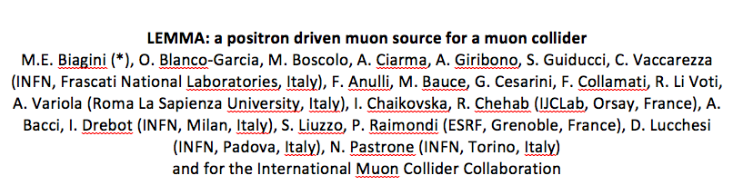
Snowmass Letter of Interest
3 LoI LEMMA related were presented:
  General layout and possible R&D topics
  Studies on target materials and layout
  Physics and technologic challenges of generating high intensity e⁺ beams

Slide 13
LEMMA R&D - LoI - AF4 Multi-TeV colliders
  TARGETS → common to e⁺ and μ± source. Material studies and experimental tests done and several options to be explored for the μ source. Prototype of rotational target (single thick target or ensemble of close thin targets) with an amorphous and a granular amorphous material. Hydrogen target (pellet) studies. Crystal targets studies for muons recombination and post-production cooling. Synergy with AF7, separate LoI presented by R. Li Voti
  VERY HIGH PRODUCTION RATE e⁺ SOURCE → synergy with AF7, separate LoI presented by I. Chaikovska
  BEAM PHYSICS → design e⁺ and μ± rings with very high energy acceptance, design of Interaction Region and Separation Region for 3 beams (e⁺, μ⁺, μ⁻). Synergy with AF1
  HIGH FIELD MAGNETS → need to focus 45 GeV e⁺ and 22.5 GeV μ± together in a short low β-function IR → high gradient, large aperture and compact quadrupoles. Design of the multi-targets μ± production line requires efficient 3-beams separation design, aiming at minimising particle losses, with high field, large aperture dipoles. Synergy with AF1, AF7
  RF CAVITIES → high gradient SCRF cavities able to cope with a high average train current (order of 100 mA). Synergy with AF7
  MUON COOLING → longer μ± lifetime at production allows for introducing moderate cooling mechanism to further reduce production emittance. Different evaluations were done in the past for the cooling efficiency given by stochastic cooling, optical stochastic cooling, crystal cooling. A full revaluation of these mechanisms associated to high energy, low emittance and bunch current needs to be done. Synergy with AF1, AF7
  MUON RECOMBINATION → testing muon bunches recombination techniques, that can increase the number of particle per bunch without been drastically affected by the consequent emittance increase. New hypothesis: possible recombination of different muon bunches by injection in a curved crystal. Combining the channeling angle with the volume reflection it should be possible to merge two different bunches with a relative emittance increase, mainly in the distribution tail. The efficiency of this process should be optimized. Synergy with AF1, AF7
IDEAS

Slide 14
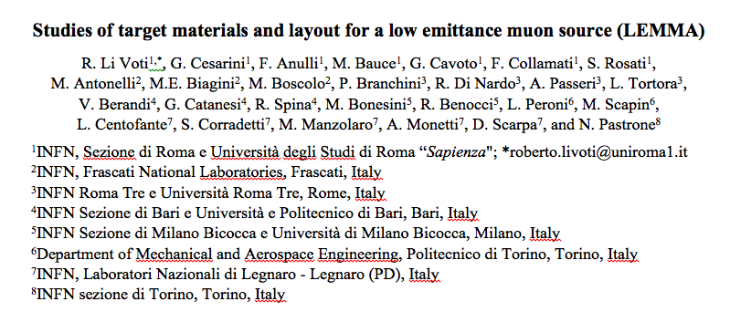
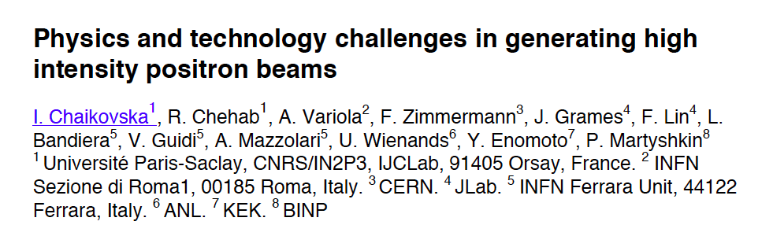

Slide 15
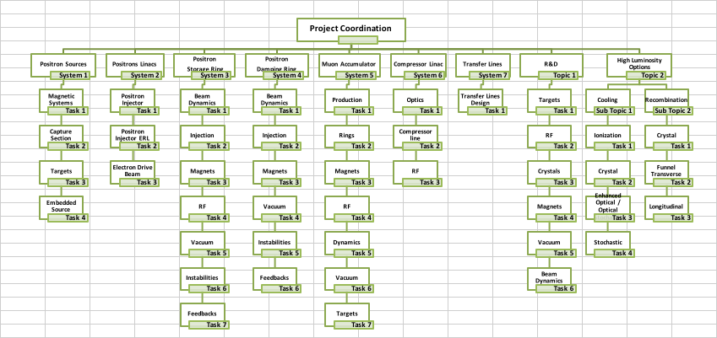
LEMMA CDR preparation Tasks
A. Variola, Roma I

Slide 16
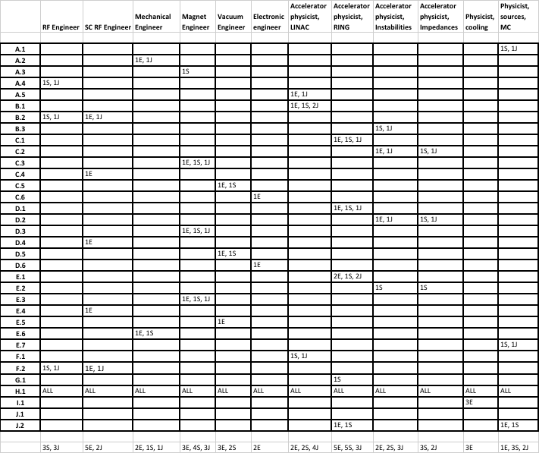
Resources needed by Task
E = Expert, highly experienced physicist/engineer capable to coordinate the task activity AND propose and evaluate innovative solutions taking into account the global constraints of the design
S = Senior, well experienced physicist or engineer providing all the skills to realize simulations, analysis and test necessary to finalize the tasks, while coordinating the work of less experienced staff
J = Junior, PhD student or post-doc physicist or engineer, with the capability to perform the activities required in the framework of the task
Total: 31 E, 22 S, 23 J
Note: E and S figures can overlap more than 1 task!

Slide 17
Positron Source Tasks - HIGH
Montecarlo simulations of the positron production in the target with three different type of drive beams, electrons (classical source), positrons and photons (embedded sources). Definition of the produced positrons 6D phase space. Generation of the particle showers in the target and evaluation of the deposited energy. Optimization of the target thickness and material (even hybrid configuration) vs the energy of the drive beams. Input for task A.5.
Evaluation of the thermo-mechanical efforts on the targets for both classical and embedded sources. Determination of the damage and fusion thresholds. Evaluation of technical designs for heating evacuation and PEDD remedies.
Design of the possible configuration for the magnetic capture line, AMD or QWT for both classical and embedded sources. Input for task A.5.
Design of the capture section accelerating structures, optimization for L Band or S band with large iris for both classical and embedded sources. Input for task A.5.
Simulation of the capture line and optimization of the magnetic and RF parameters, evaluation of the captured beam emittance and global capture efficiency for both classical and embedded sources. Input for task B.1.
Task | A.1 | A.2 | A.3 | A.4 | A.5
Resource | 1S, 1J | 1E, 1J | 1S | 1S, 1J | 1E, 1J

Slide 18
Muon Accumulator and Muon Production
Design of the lattice for muon accumulator and production lines for both single and multi-interaction point, with single and multitarget systems. Evaluation of the dynamic aperture and of non linearities. Simulation of the beam stacking and of the parasitic beam generation, with their dynamics. Input for task E.2.
Impedances budget evaluation, also for the electron cloud remedies. Single bunch instabilities thresholds determination and analysis of the eventual electron cloud effect.
Definition of the parameters for the ring magnets, preliminary design for special systems. Design of high energy acceptance kickers and injection Septum. Input for task E.1
Preliminary evaluation of a high accelerating voltage SC RF system. Input for task E.1
Preliminary design of the vacuum chamber and evaluation of ring vacuum pressure in static and dynamic configuration taking into account the generation line integration. Target integration in vacuum in the case of liquid or gaseous targets.
Analysis of the baseline and alternative targets system. Average power, melting or evaporation characteristics, temperature profile, PEDD and remedies. Configuration engineering for single or multitarget, rotation velocity evaluation and eventual cooling systems.
Muon production in single and multitarget system. Secondary beam production and propagation.
Task | E.1 | E.2 | E.3 | E.4 | E.5 | E.6 | E7
Resource | 2E, 1S, 2J | 2S | 1E, 1S, 1J | 1E | 1E | 1E, 1S | 1S,1J

Slide 19
Strong interest on Muon Collider!
RD_MUCOL (CSN1) at present a group of about 90 physicists/engineers
Ongoing activities:
Physics and detector simulations ➔ not discussed today
Detector R&Ds ➔ not discussed today
LEMMA studies and other machine technologies to be further discussed and agreed ➔ discussing at this meeting
Targets simulations and R&Ds and crystals for targets and beam manipulation ➔ discussing at this meeting
MDI studies ➔ discussing at this meeting
Neutrino hazard studies ➔ discussing at this meeting
New interests: Magnets, RF, beam dynamics, collective effects
➔ to be further discussed beyond this meeting
AOB

Slide 20
extras

Slide 21
A long story… up to now and here!
The muon collider idea was first introduced in early 1980’s [A. N. Skrinsky, D. Neuffer et al., ]
Idea further developed by a series of world-wide collaborations
US Muon Accelerator Program – MAP, created in 2011, was terminated in 2014
MAP developed a proton driver scheme and addressed the feasibility of novel technologies required
for Muon Colliders and Neutrino Factories "Muon Accelerator for Particle Physics," JINST,
https://iopscience.iop.org/journal/1748-0221/page/extraproc46
LEMMA (Low EMittance Muon Accelerator) proposed in 2013 [M. Antonelli e P. Raimondi]
a new end-to-end design of a positron driven scheme presently under study by INFN-LNF et al.
to overcome technical issues of initial concept ➔ arXiv:1905.05747
CSN1 – RD_FA new activity on Future Colliders ➔ 2015-2020
CERN-WG on Muon Colliders since September 2017
MAC discussion ➔ report
Padova Aries2 Workshop on Muon Colliders – July 2018
Input document submitted to ESPPU: “Muon Colliders” arXiv:1901.06150 December 2018 (*)
LEMMA project presented to INFN Management by A. Variola in October 2019
Various workshop/meeting to prepare for Granada (2019) and during ESPPU
    FINDINGS and RECCOMENDATIONS (*):
    Set-up an international collaboration to promote muon colliders
    And organize the effort on the development of both accelerators and detectors and to define the road-map towards a CDR by the next Strategy update….
    Carry out the R&D program toward the muon collider

Slide 22

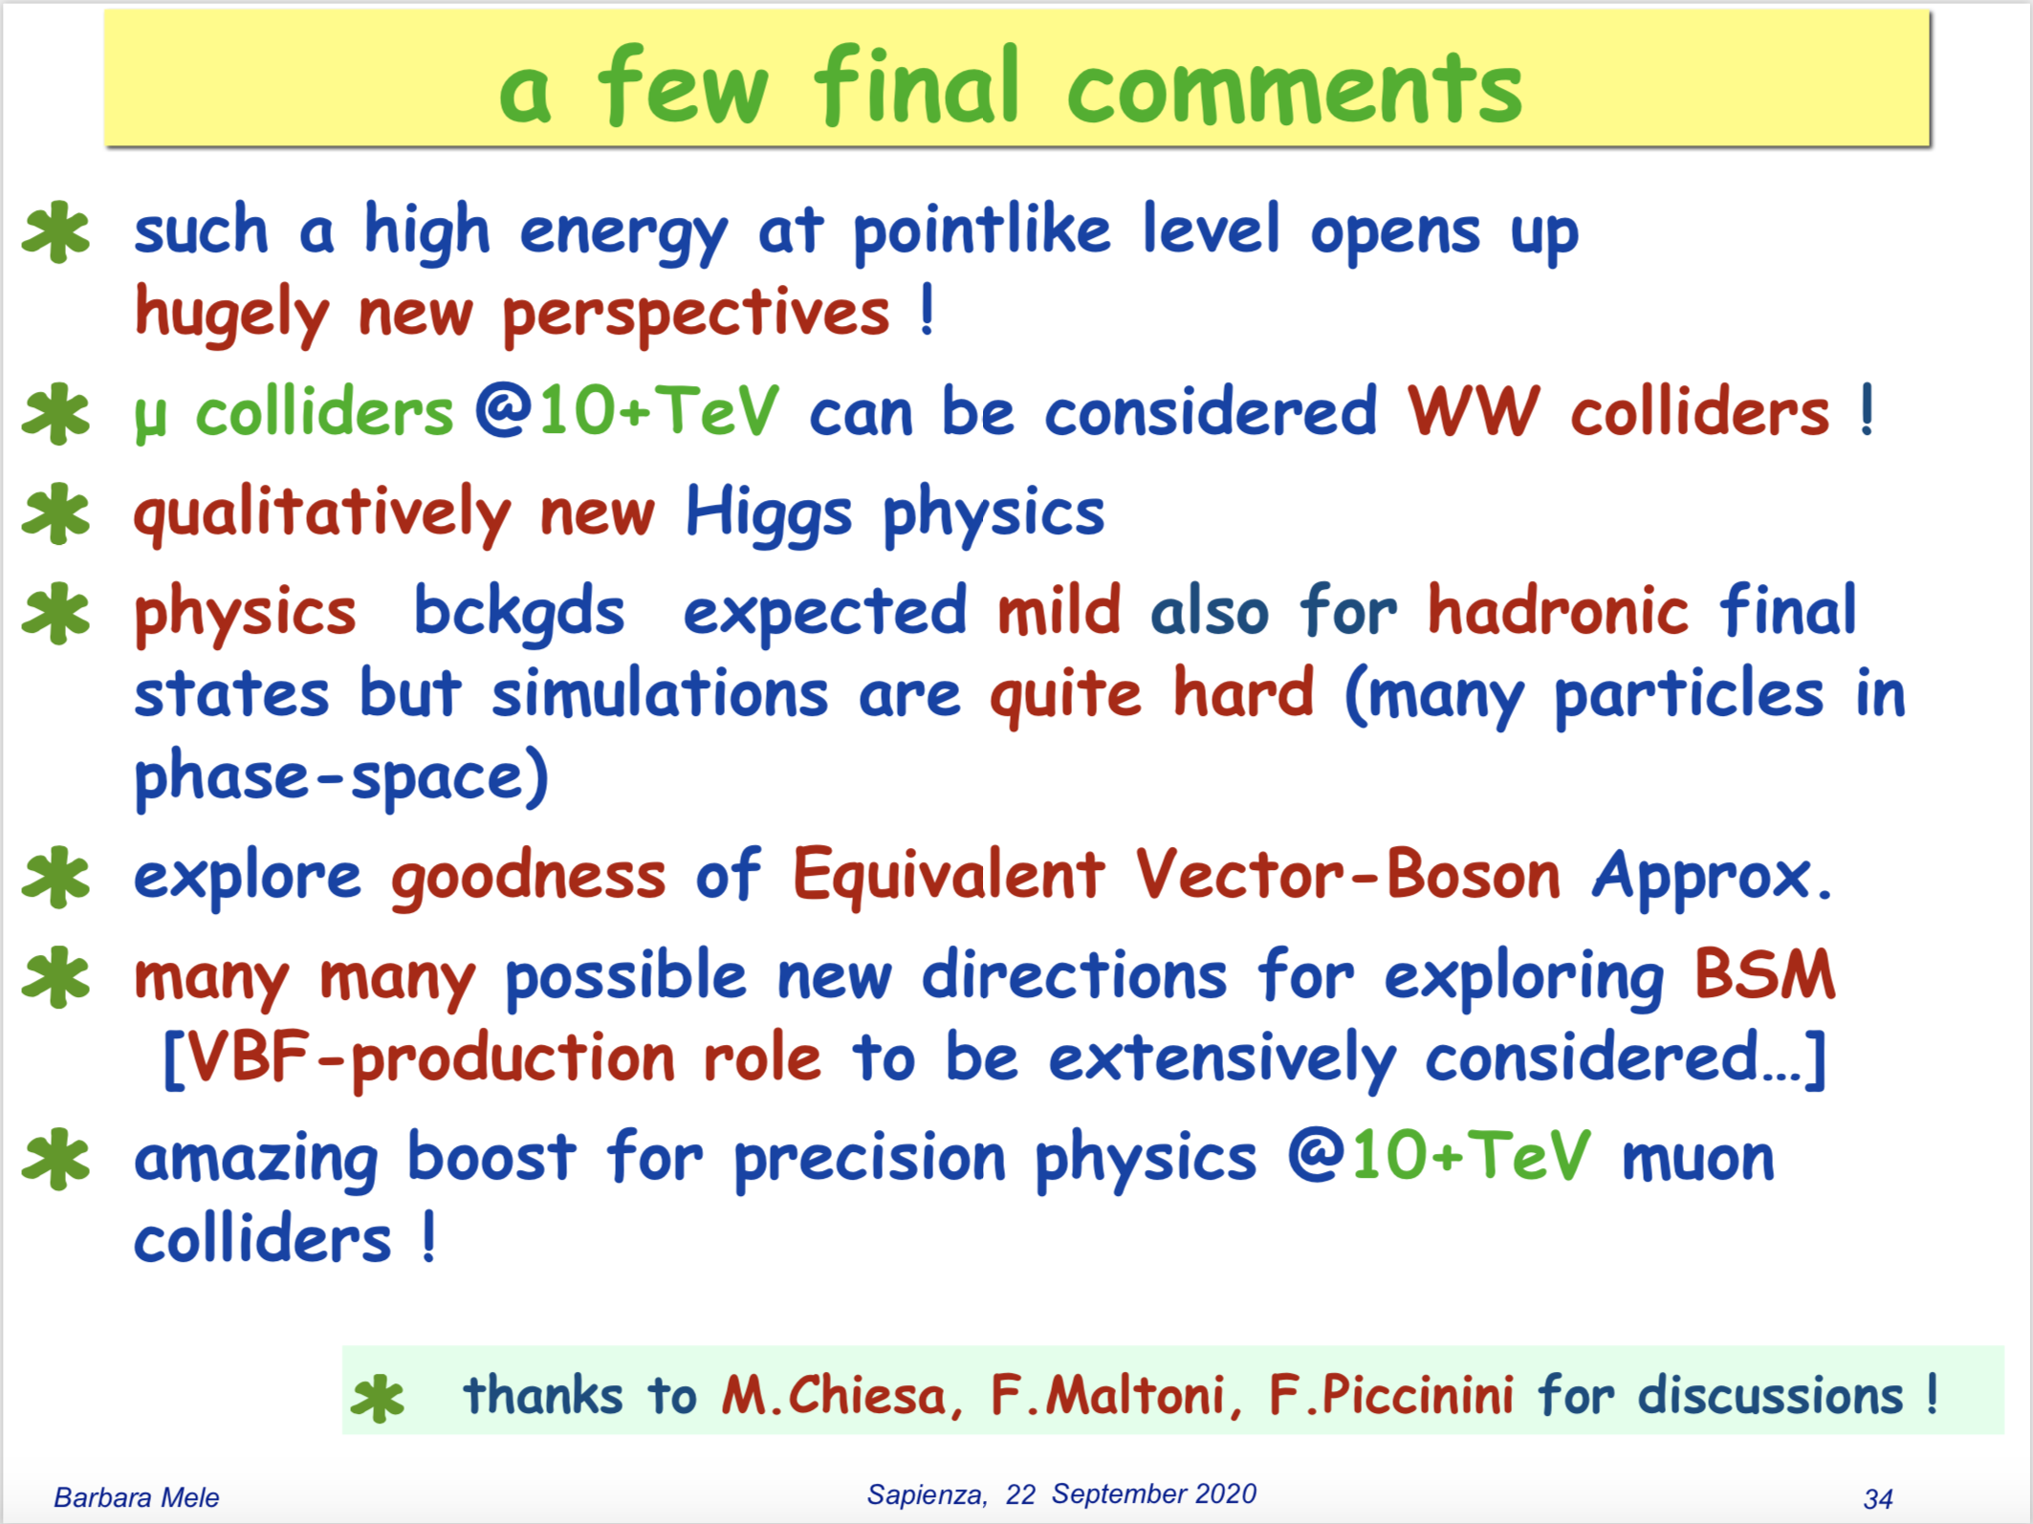
Physics potential
Quartic Higgs self-coupling: arXiv:2003.13628 [hep-ph]
Vector Boson Fusion: arXiv:2005.10289 [hep-ph]
https://agenda.infn.it/event/23693/

Slide 23
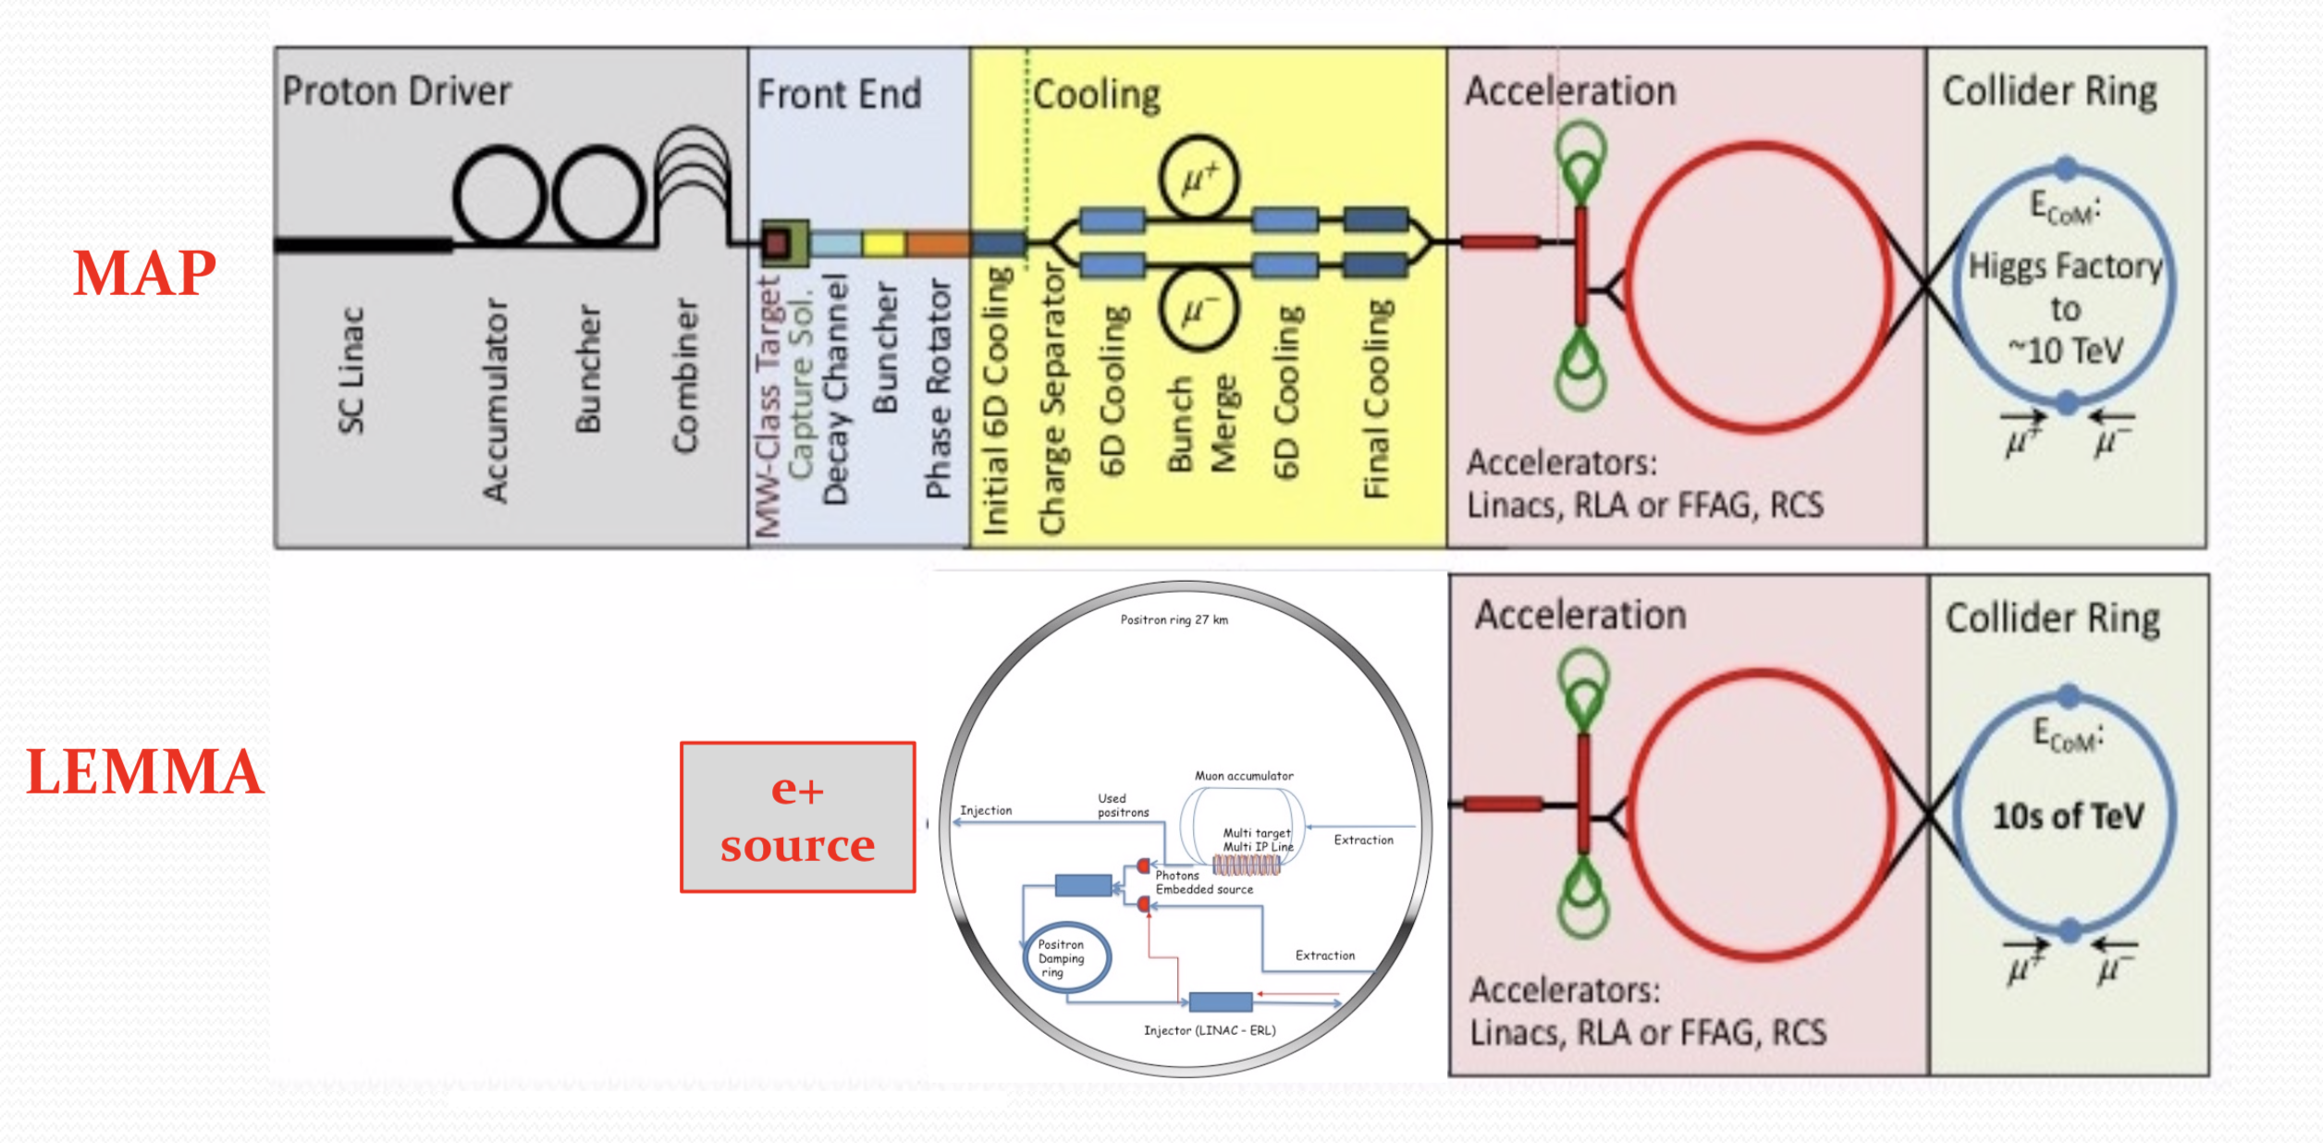


proton (MAP) vs positron (LEMMA) driven muon source
${10}^{13}$-${10}^{14}μ/sec$
MUON JINST, shorturl.at/kxKU7
arXiv:1905.05747v2 [physics.acc-ph]
➔ need consolidation to overcome technical limitations to reach higher muon intensities

Slide 24
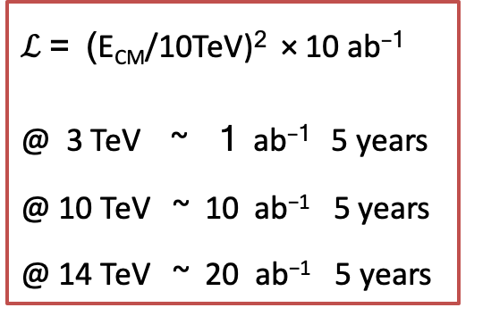
Tentative Target Parameters
Based on extrapolation of MAP parameters
Parameter | Unit | 3 TeV | 10 TeV | 14 TeV
L | 10³⁴ cm⁻²s⁻¹ | 1.8 | 20 | 40
N | 10¹² | 2.2 | 1.8 | 1.8
f_{r} | Hz | 5 | 5 | 5
P_{beam} | MW | 5.3 | 14.4 | 20
C | km | 4.5 | 10 | 14
<B> | T | 7 | 10.5 | 10.5
ε_{L} | MeV m | 7.5 | 7.5 | 7.5
σ_{E} / E | % | 0.1 | 0.1 | 0.1
σ_{z} | mm | 5 | 1.5 | 1.07
β | mm | 5 | 1.5 | 1.07
ε | μm | 25 | 25 | 25
σ_{x,y} | μm | 3.0 | 0.9 | 0.63
Note:
The study should verify that these parameters can be met
$ℒ$ = (E_{CM}/10TeV)² × 10 ab⁻¹
@ 3 TeV ~ 1 ab⁻¹ 5 years
@ 10 TeV ~ 10 ab⁻¹ 5 years
@ 14 TeV ~ 20 ab⁻¹ 5 years

Slide 25
Critical Issues to be studied
Advanced detector concepts and technologies, requiring excellent timing, granularity and resolution, able to reject the background induced by the muon beams.
Advanced accelerator design and beam dynamics for high luminosity and power efficiency.
Robust targets and shielding for muon production and cooling as well as collider and detector component shielding and possibly beam collimation.
High field, robust and cost-effective superconducting magnets for the muon production, cooling, acceleration and collision. High-temperature super-conductors would be an ideal option.
High-gradient and robust normal-conducting RF to minimise muon losses during cooling.
High rate positron production source and high current positron ring (LEMMA).
Fast ramping normal-conducting, superferric or superconducting magnets that can be used in a rapid cycling synchrotron to accelerate the muons and efficient power converters.
Efficient, high-gradient superconducting RF to minimise power consumption and muon losses during acceleration.
Efficient cryogenics systems to minimise the power consumption of the superconducting components and minimise the impact of beam losses.
Other accelerator technologies including high-performance, compact vacuum systems to minimise magnet aperture and cost as well as fast, robust, high-resolution instrumentation.

Slide 26
Accelerator Themes/Working Groups
MDI
High-energy complex
Muon cooling
Target area
Proton complex
LEMMA specific activities
  generally integrate with other working groups (e.g. targets)
  LEMMA is an alterative
Magnets (and power converters)
RF (normal and superconducting)
Targets, shielding, collimation, vacuum, cooling, …
Technologies: Exploratory technology review: Instrumentation, beam transfer, …
Beamdynamics, simulation codes, …
Layout, environment, infrastructure

Slide 27
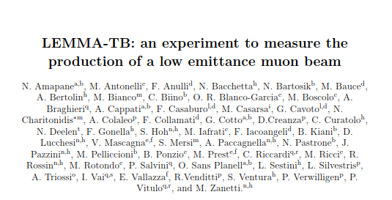
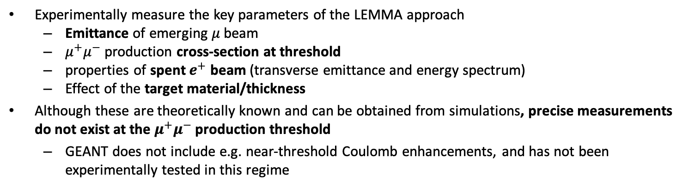
Test Beam @ CERN
Experimentally measure the key parameters of the LEMMA approach
  Emittance of emerging $μ$ beam
  $μ^{+}μ^{−}$ production cross-section at threshold
  properties of spent $e^{+}$ beam (transverse emittance and energy spectrum)
  Effect of the target material/thickness
Although these are theoretically known and can be obtained from simulations, precise measurements do not exist at the $μ^{+}μ^{−}$ production threshold
  GEANT does not include e.g. near-threshold Coulomb enhancements, and has not been experimentally tested in this regime
Pixels
GEMs
 | CERN-SPSC-2020-004
Request for 3-weeks beam time in H4 submitted to SPSC http://cds.cern.ch/record/2712394

Slide 28
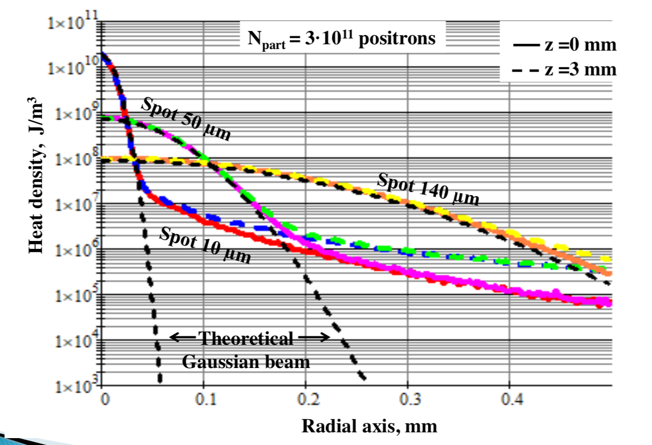
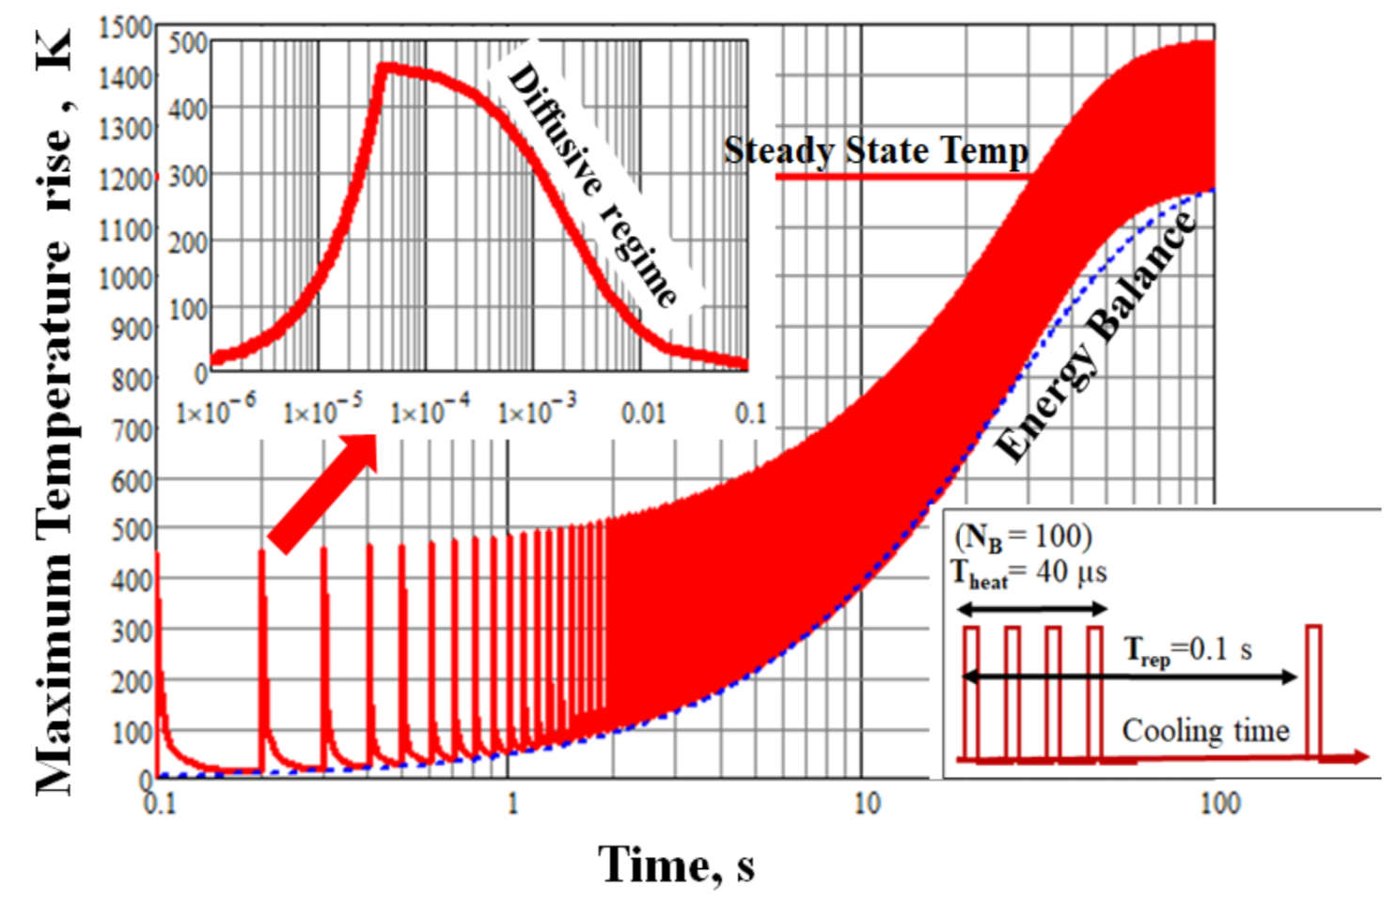
Targets and material studies - simulation

Slide 29
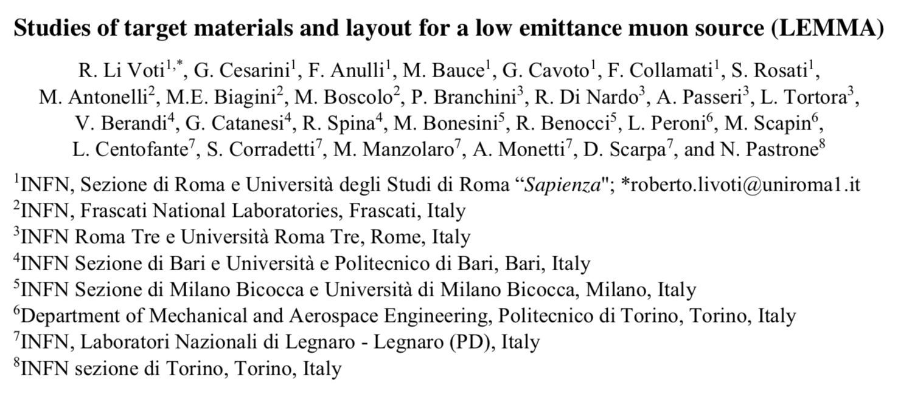
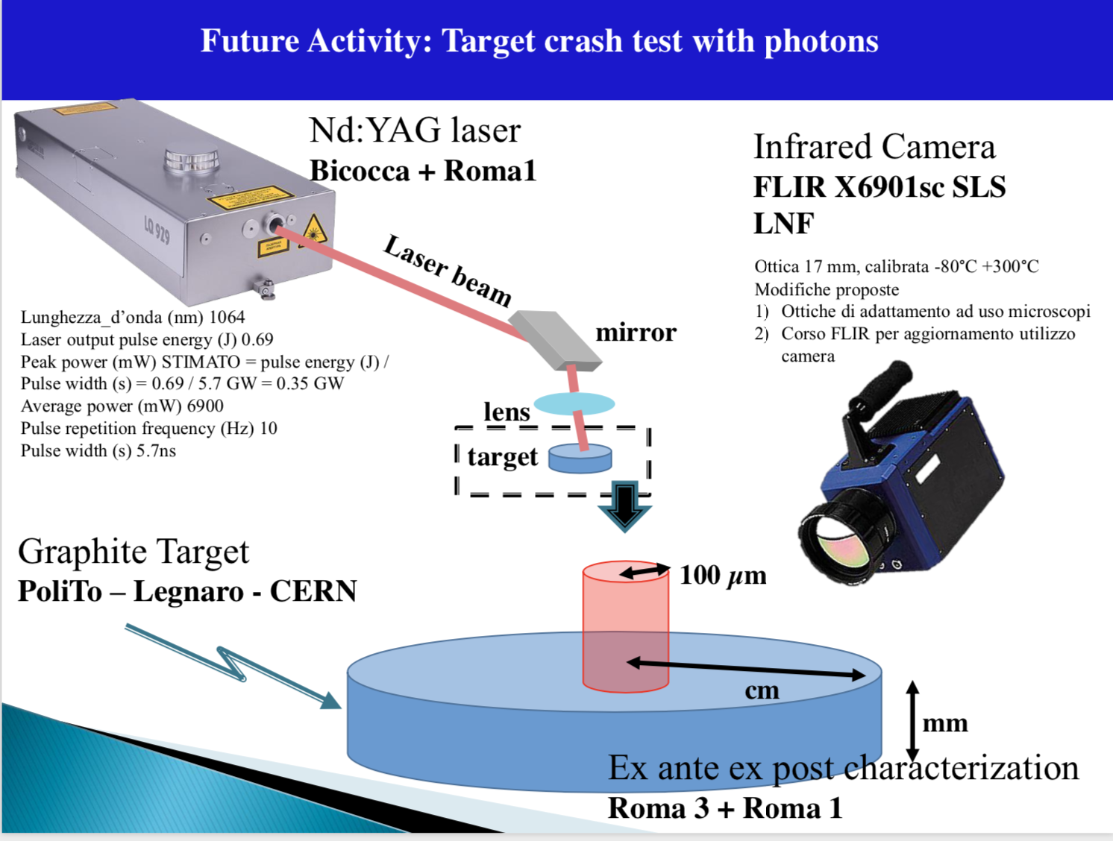
Targets and material studies - plans

Slide 30
Crystals manifacturing and studies
Positron source using a crystal
I.Chaikovska and R.Chehab, responsible for FCC-ee positron source are already involved in the Muon Collider group and recently iniziated a formal collaboration with the our team (Coord. L. Bandiera) in Monte Carlo simulation and crystal tests on beam.
Idea of R. Chehab, V. Strakhovenko and A. Variola
Possible usage of bent crystal collimators in the muon collider facility
First attempt to start an investigation in collaboration with the CERN Muon Collider group

Slide 31
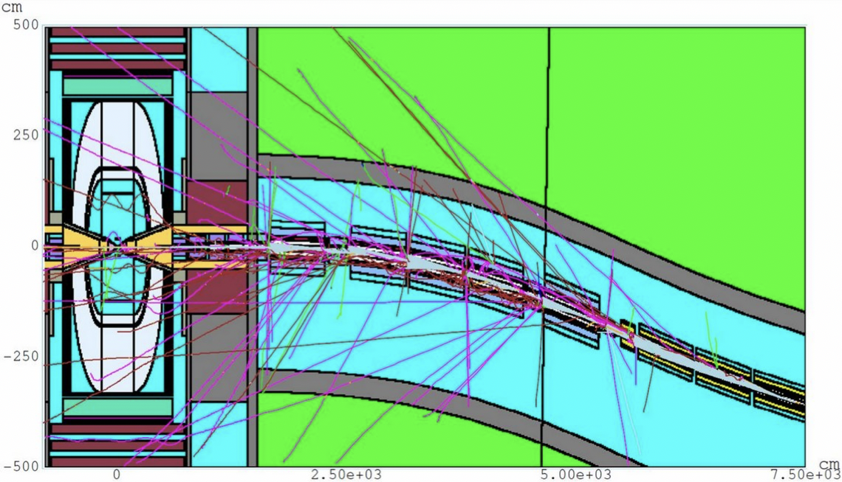
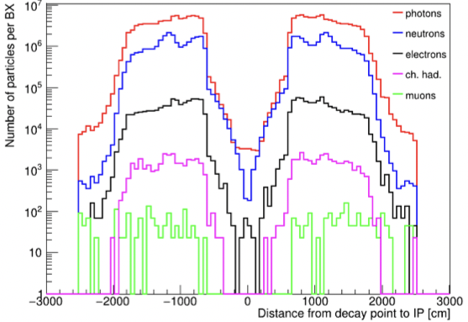
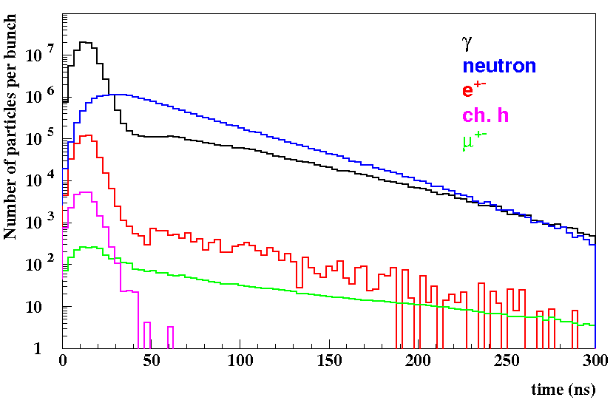
Beam Induced background @ 1.5 TeV
Nikolai Mokhov et al. - MARS15
JINST 15 (2020) 05, P05001
JINST 13, P09004 (2018)
Beam muons decay products interact with machine elements and cause a continuous flux of secondary and tertiary particles (mainly γ, n, e±, h±) that eventually reach the detector
The amount and characteristics of the beam-induced background (BIB) depend on the collider energy and the machine optics and lattice elements
muon beams of 0.75 TeV with 2⨉10¹²muons/bunch
➔ 4⨉10⁵ muon decays/m in single bunch crossing
Secondary and tertiary particles have low momentum and different arrival time in the Interaction Point

Slide 32
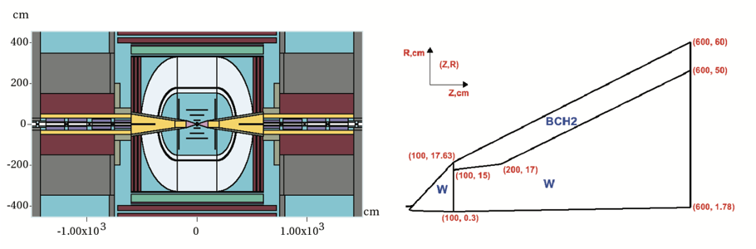
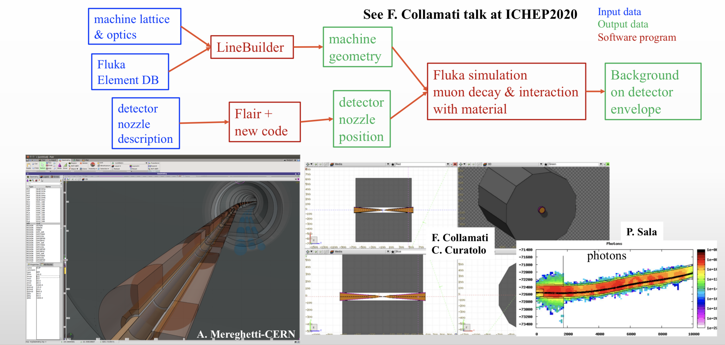
Machine Detector Interface
Need for a flexible tool from machine optics to simulation

Slide 33
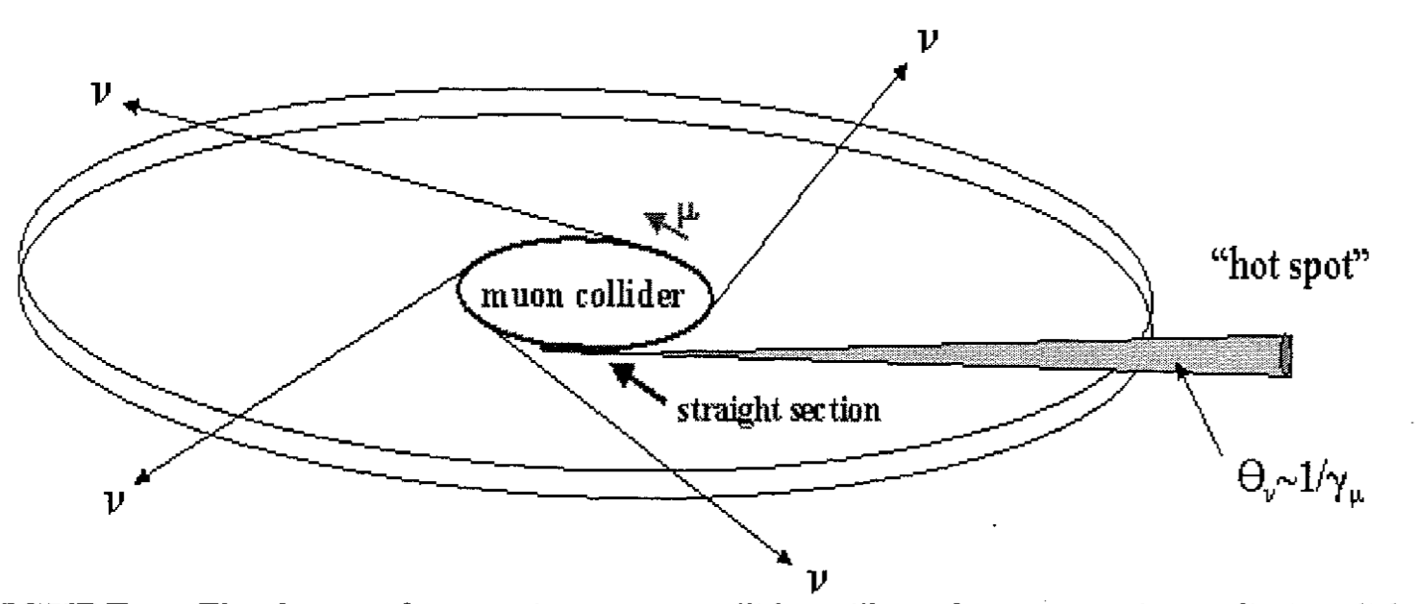
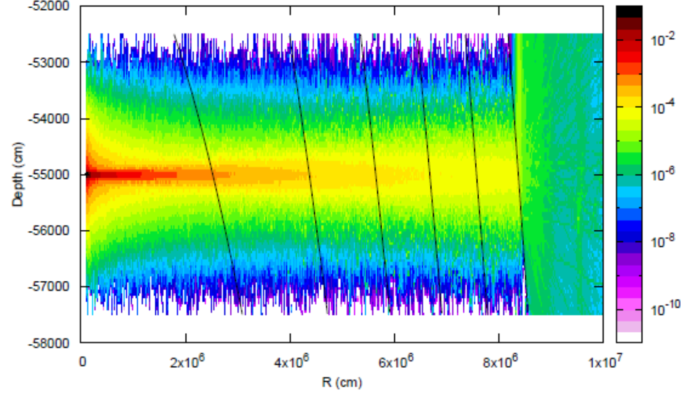
Challenge: Neutrino Radiation Hazard
Neutrinos from decaying muons can produce showers just when they exit the earth
Particularly bad in direction of straights
But also an issue in the arcs
Potential mitigation by
Site choice
Owning the land in direction of experimental insertion
Having a dynamic beam orbit so it points in different directions at each turn in the arcs
  Or at least paint the beam in the the straights to dilute radiation
Dose from 1 TeV μ± vs distance from ring, pSv/10¹⁰ decays
More important at higher energies (scaling E³)
US study concluded: 6 TeV parameters are OK
Reasonable goal 0.1 mSv/ year, to be verified
40 m
On-going simulations and studies
for mitigation with existing/future tunnels
80 km
33

