Slide 1
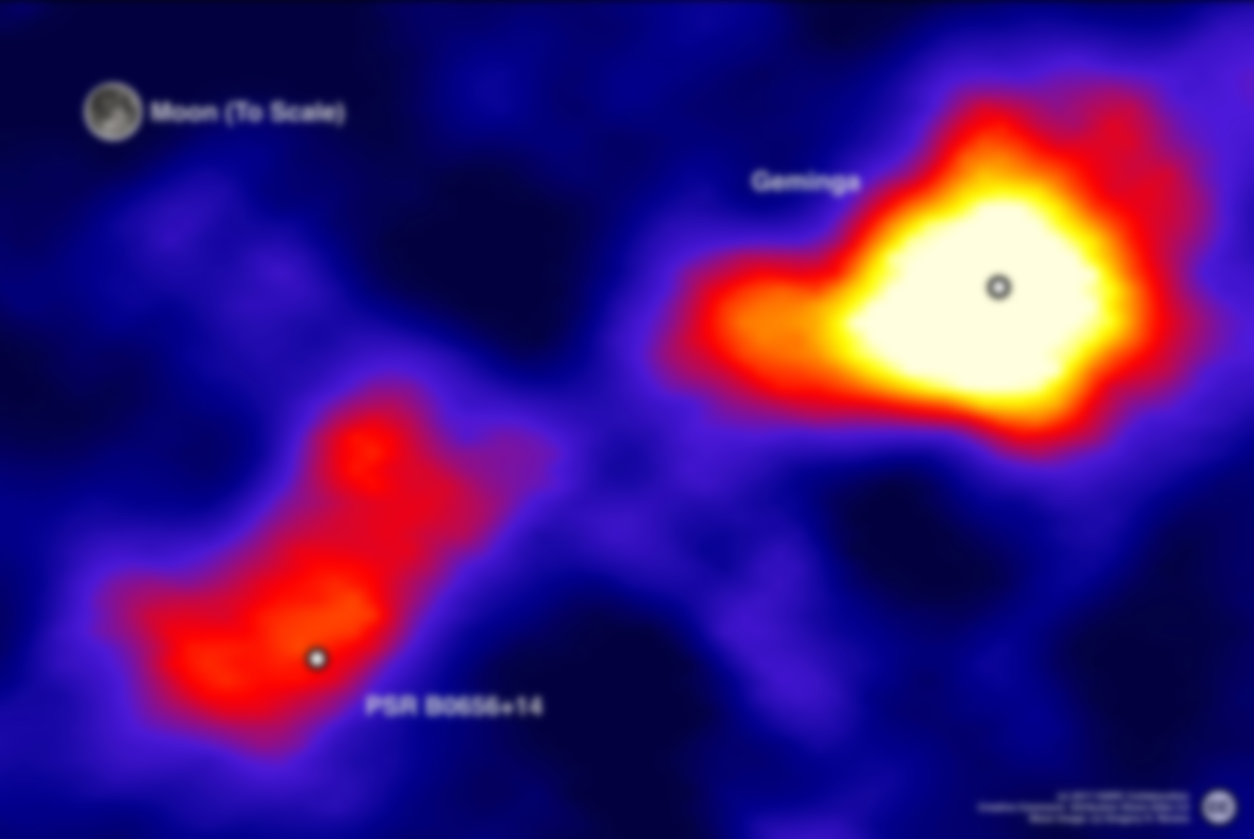

Extended Inverse Compton gamma-ray emission beyond PWNe:
the Morphology
Ruoyu Liu (柳若愚)
Nanjing University
2 Dec 2020, 1st Workshop on Gamma-ray Halos around Pulsars, Online

Slide 2
Outline
Pulsar, pulsar wind nebula (PWN) and pulsar halo
Particle transport and radiation
Expected γ-ray morphology of pulsar halo
Summary

Slide 3

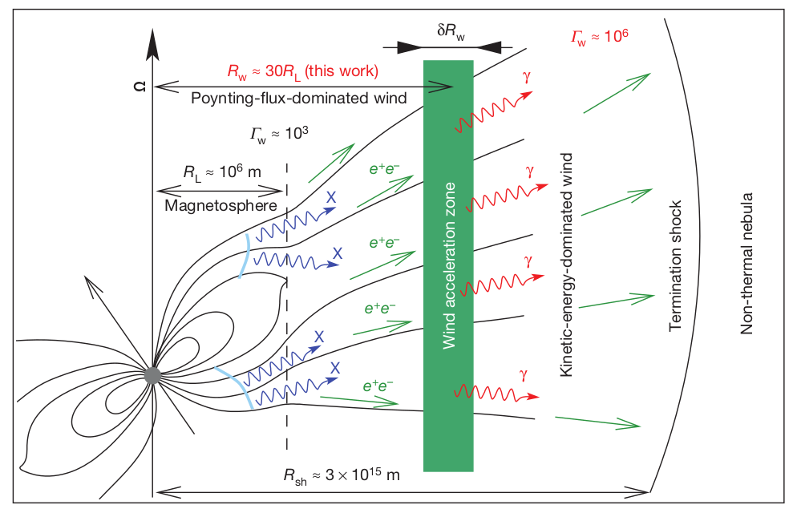

Pulsar: highly magnetized, fast-rotating neutron star
Rotational energy → electromagnetic energy
n: braking index (1<=n<=3)
τ₀: initial spin-down timescale
L_{s,0}: initial spin-down luminosity
Aharonian et al. 2012
Notes:
3

Slide 4
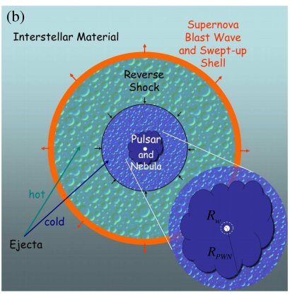
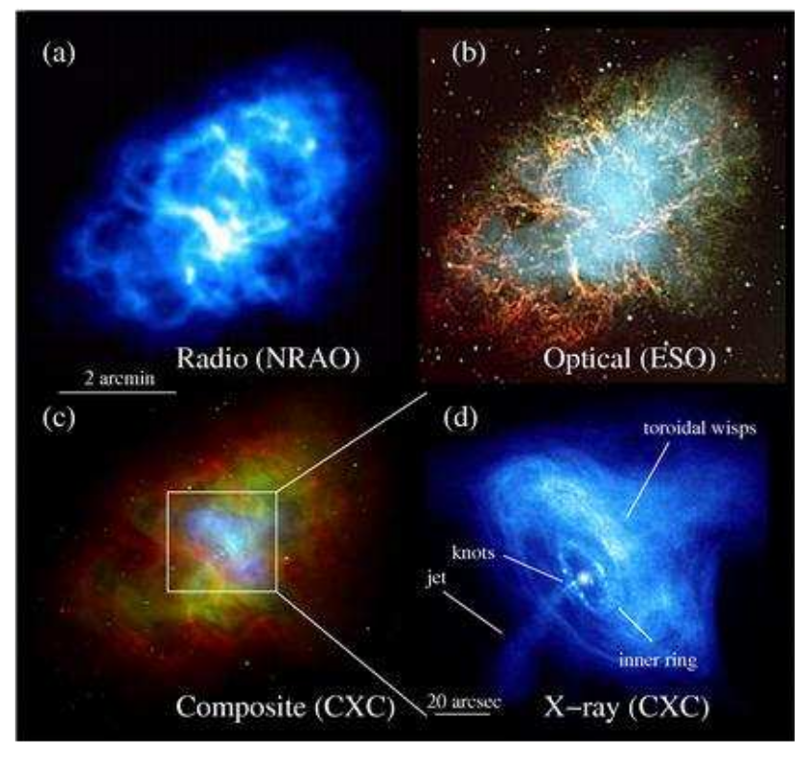
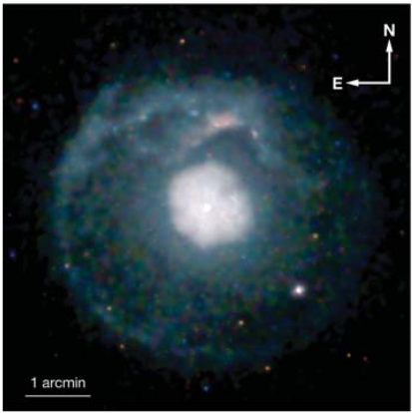
Pulsar Wind Nebula: shocked pulsar wind
A guaranteed high-energy leptons reservoir
SNR G21.5-0.9
PSR J1833-1034
Gaensler & Slane 2006

Slide 5
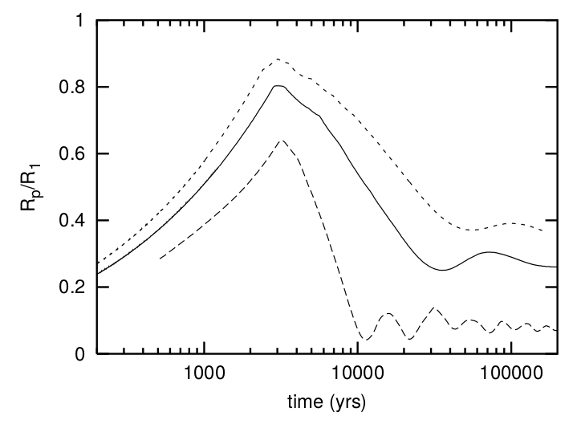
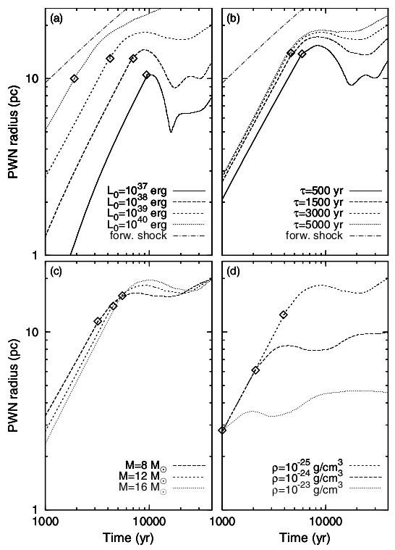
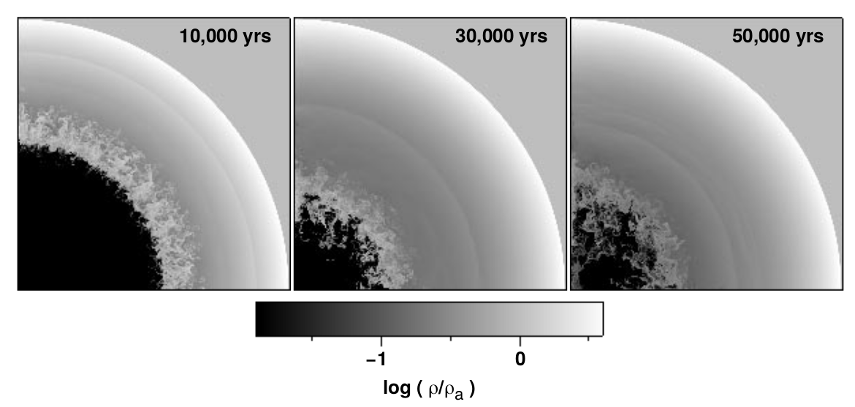
What’s going to happen next?
Vorster et al. 2013
Blondin et al. 2001

Slide 6
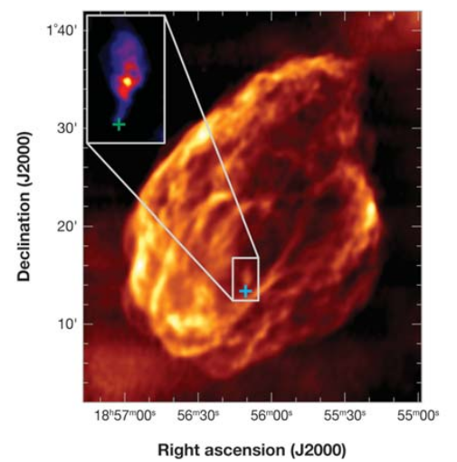

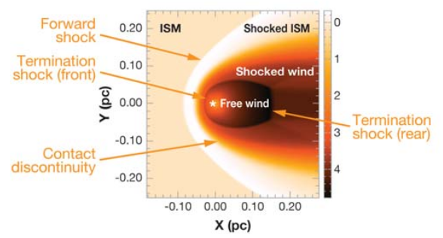
Pulsar will eventually leave the related SNR
W44
Natal kick velocity: 400-500 km/s
Gaensler et al. 2004
Giacani et al. 1997
Frail et al. 1996
Notes:
Giacani et al., 1997
6

Slide 7
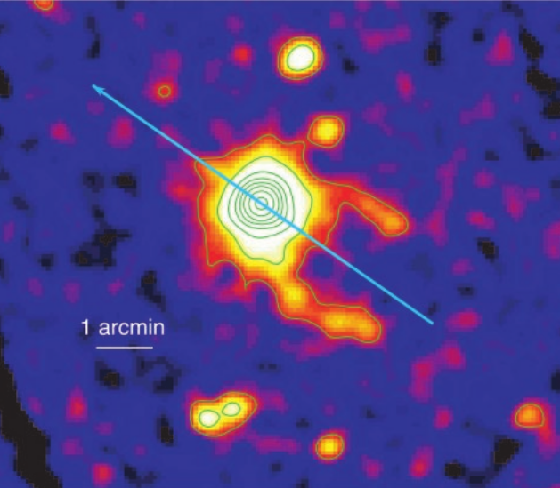
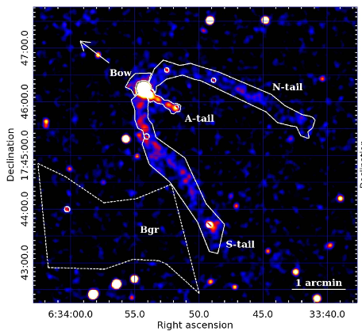
Geminga:
One of the closest pulsar (d=250pc)
One of the brightest persistent GeV point source (F_{>0.1GeV}~10⁻¹⁰ergcm⁻²s⁻¹)
High proper motion velocity: 200km/s (for d=250pc)
Middle age: 340 kyr
Geminga’s PWN:
two lateral tails :0.2pc; axial tail: 0.05pc
Termination shock: unresolved
Cavareo et al. 2003
Possvelt et al. 2017

Slide 8
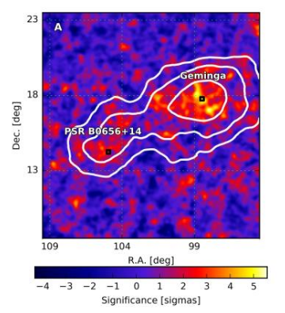
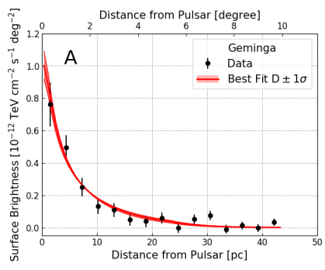

HAWC’s observation on Geminga and Monogem
Inverse-Compton Scattering of 100TeV electron/positron off CMB
HAWC Collaboration 2017, Science, 2017, 358, 911
Two orders of magnitude smaller than the typical ISM diffusion coefficient!

Slide 9
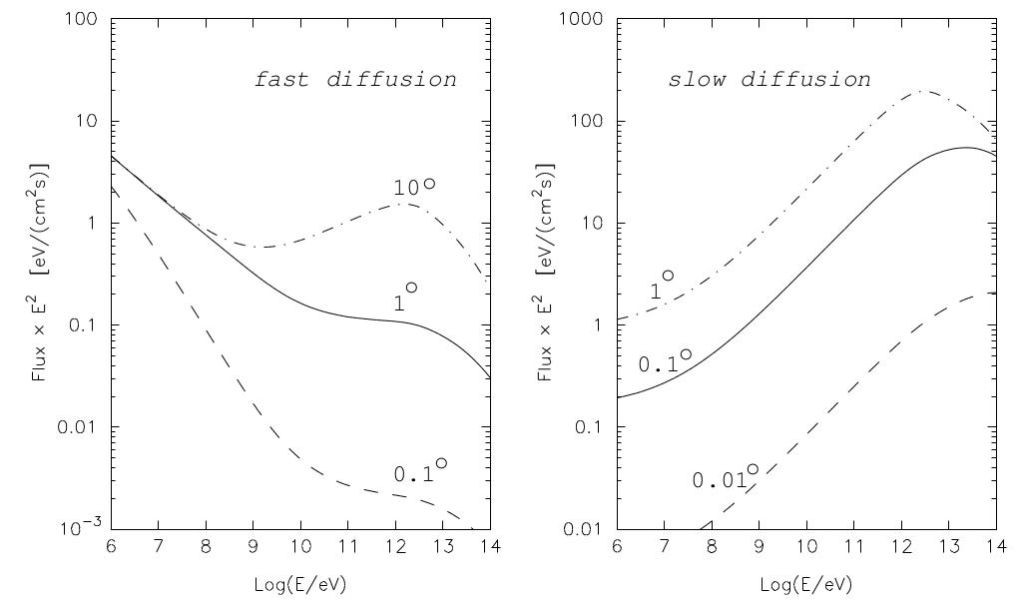
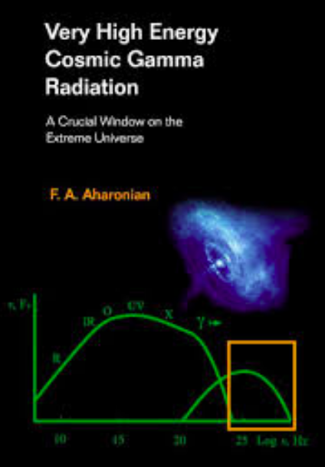
Prediction of halo around CR sources
Prediction of relativistic electron clouds expanding in the ISM around CRe sources
Inverse Compton of electrons on IR/CMB → gamma ray
Aharonian 2004

Slide 10
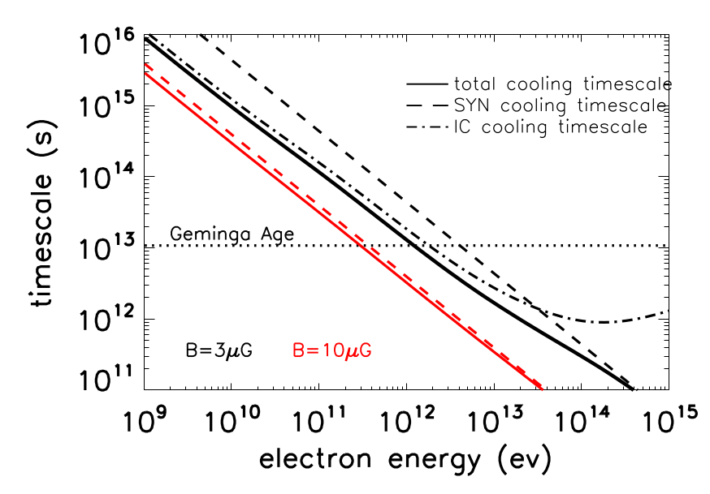
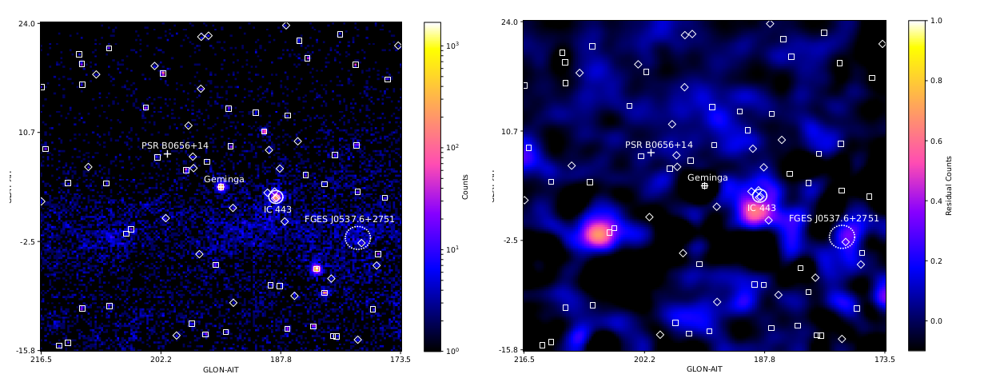
Fermi-LAT observation on the TeV halo
D(100GeV)~2x10²⁶cm²/s, 2(Dt_{gem})^{1/2}~60pc ~ 14°
40°x40° ROI, 10-500GeV
Count map
Residual map

Slide 11
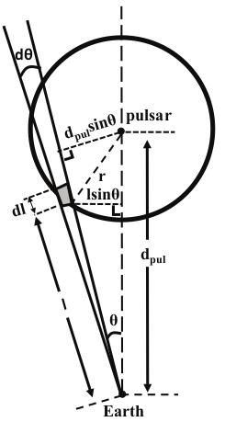

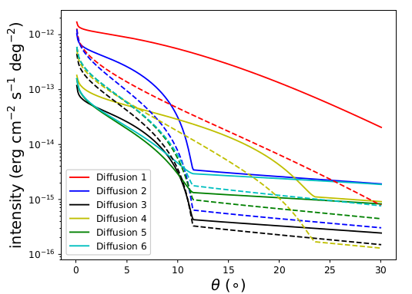
Produce spatial templates (on the premise of fitting HAWC’s observation
Line of sight integration
Soild:10GeV
Dashed: 500GeV

Slide 12
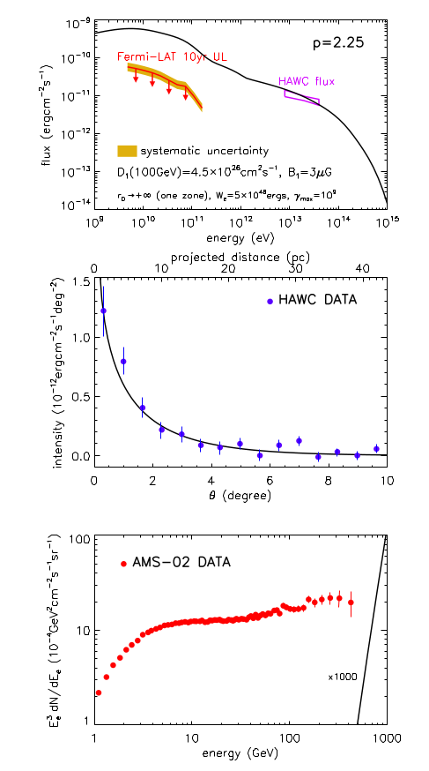
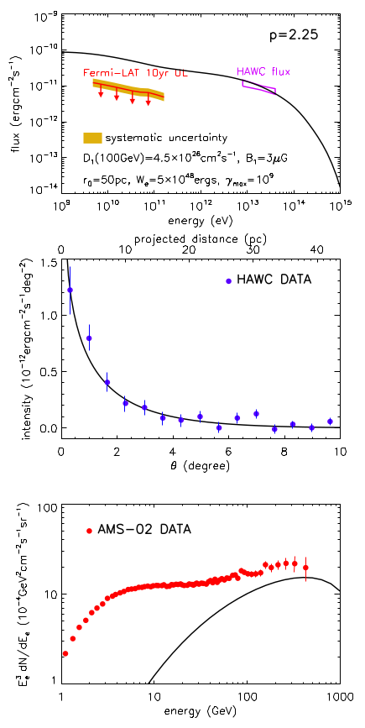
HAWC’s best-fit parameters
Two diffusion zone

Slide 13
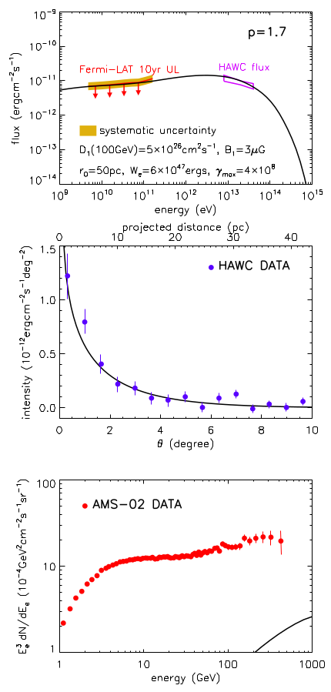
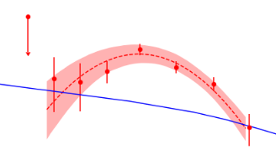
A harder injection spectrum
p<1.7
Xi, RYL et al. 2019
c.f. Di Mauro et al. 2019

Slide 14
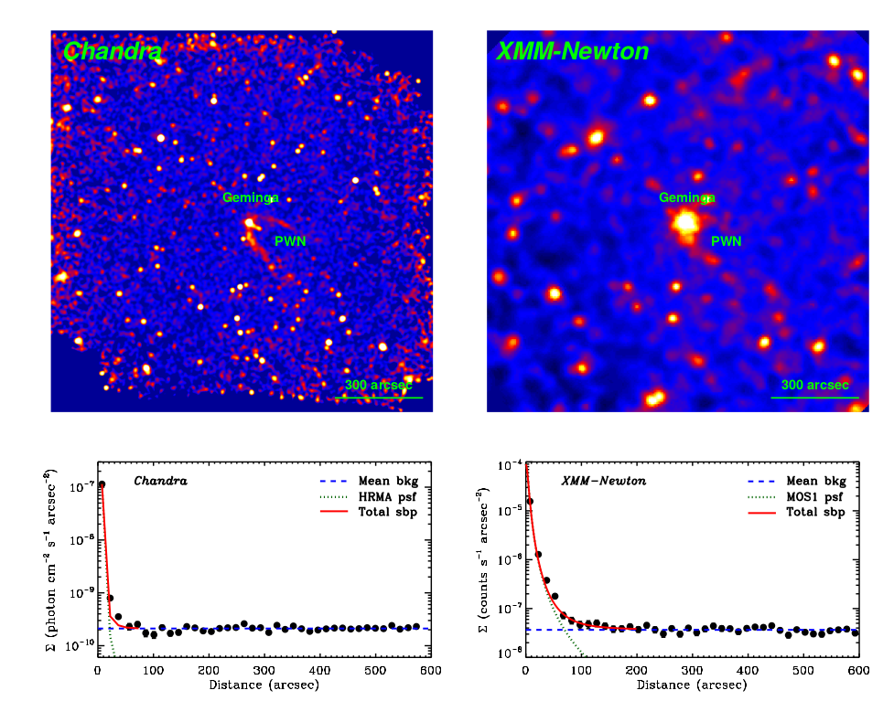
X-ray observation on the central 10 arcmin
f_{0.7−2.0 keV} =
6.1 × 10⁻¹⁵ erg cm⁻²s⁻¹
f_{xmm,0.7−1.3 keV} =
5.0 × 10⁻¹⁵ erg cm ⁻²s⁻¹
RYL et al. 2019a

Slide 15
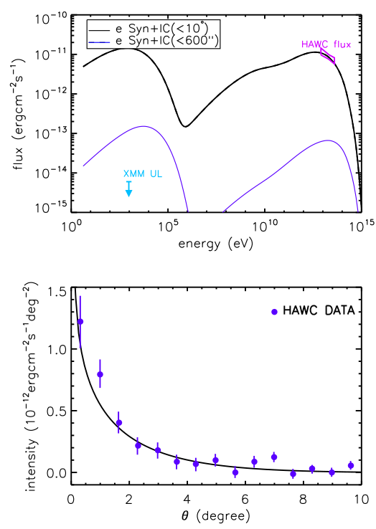
B=3μG
Line of sight integration
pulsar
HAWC
XMM
observer
B=3μG → 0.8μG
TeV Observation
→ small diffusion coefficient → ‘’strong’’ & chaotic B field
X-ray Observation
→ weak B field

Slide 16
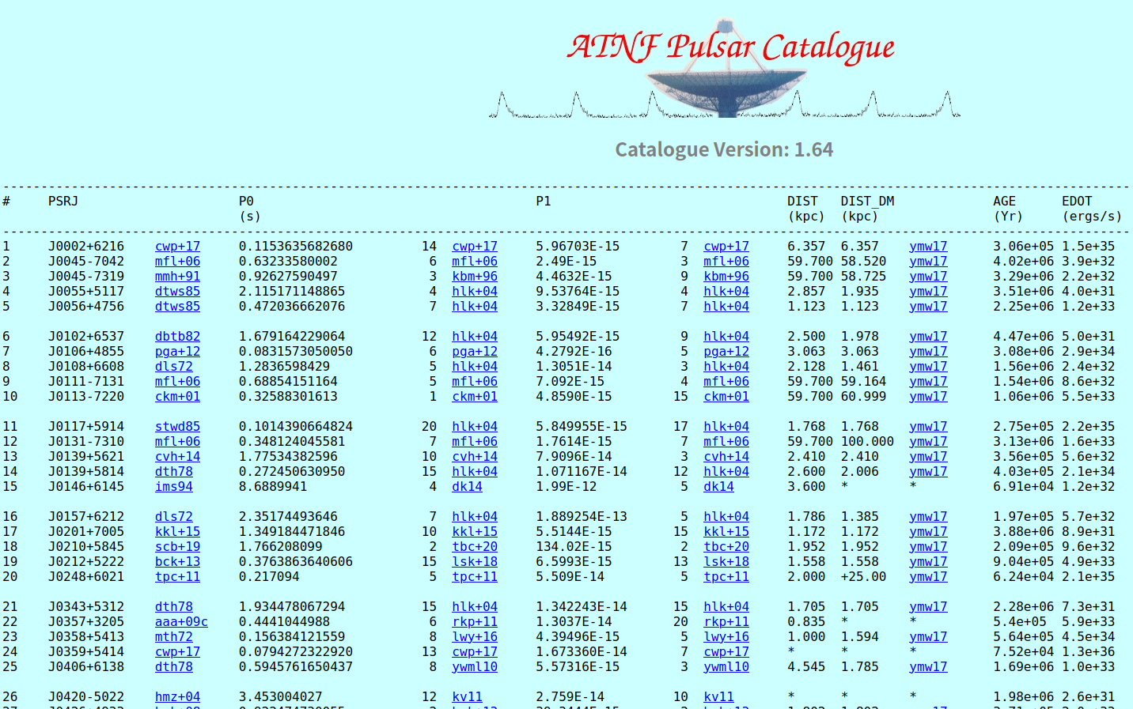
There are many more Geminga-like pulsars
More than 900 pulsars with age between 50kyr and 10Myr

Slide 17
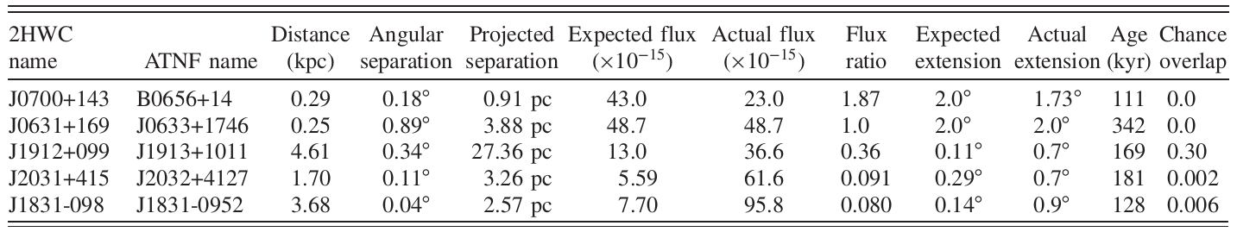
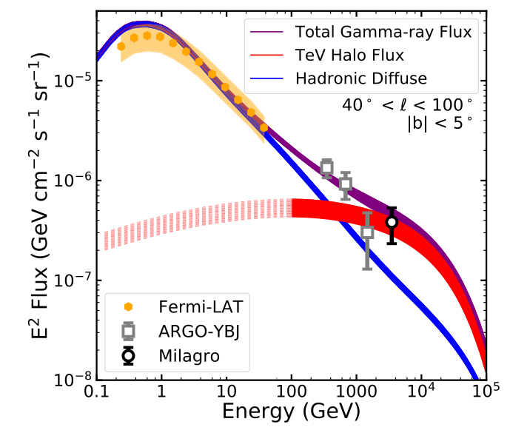
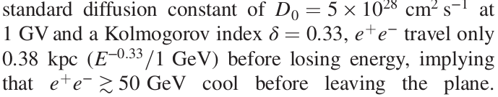
Linden et al. 2017
integrated Milky Way SN(=pulsar birth) rate of ∼0.015 yr⁻¹
10% of the spin-down power e pairs above 1 GeV
Injection: PL+exp.cutoff
p=1.7, E_{c}=100TeV
Linden & Buckman 2018

Slide 18
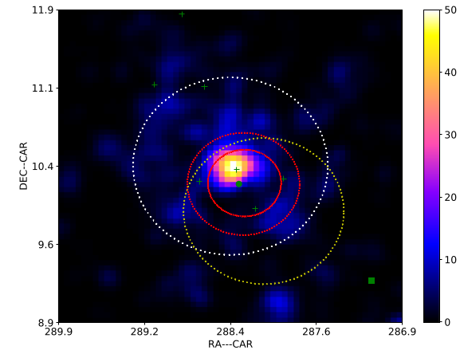
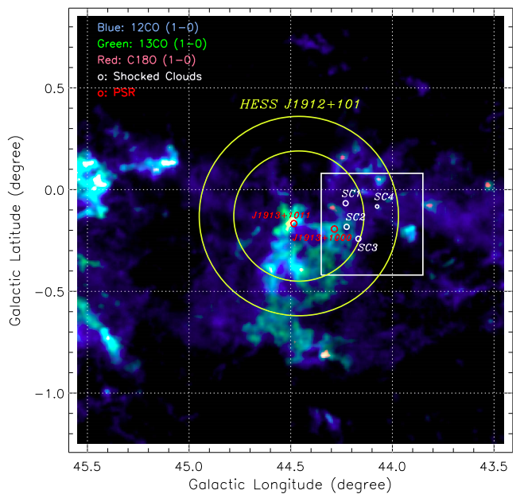
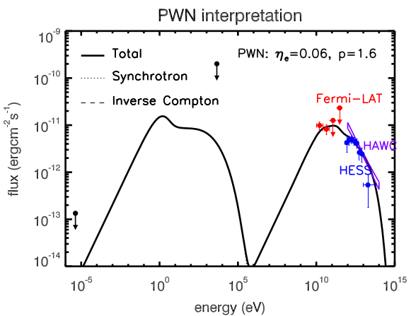
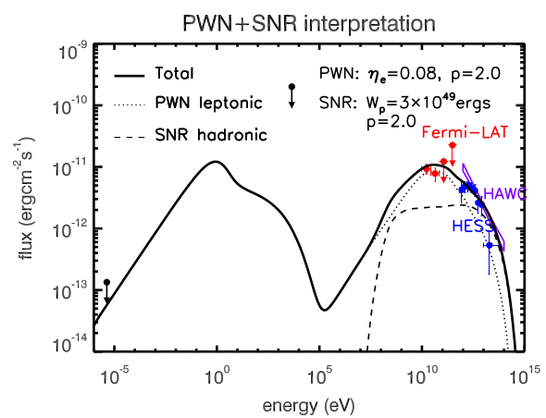
HESS J1912+101 (2HWC J1912+099) :
Red: HESS
Yellow: HAWC
White: LAT
LAT TS map
Related pulsar: PSR J1913+1011
τ_{c}=170kyr, L=2.9e36 erg/s
HESS observation presents shell-like structure, but no obvious radio or X-ray counterpart
GeV: 0.8 degree
HAWC: 0.7 degree
HESS: 0.3/0.5 degree
H Zhang, Xi, RYL et al. 2020
Halo/Plerion? SNR? YMC?
CO intensity map
Su et al.2017
Notes:
18

Slide 19
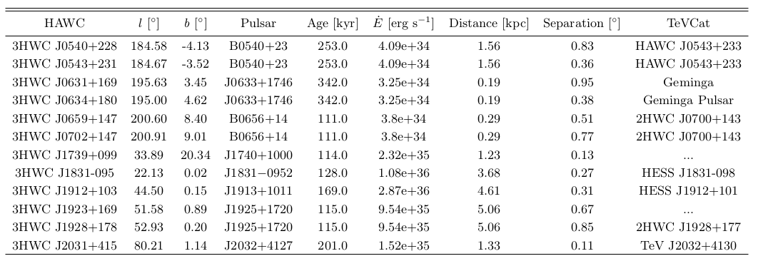
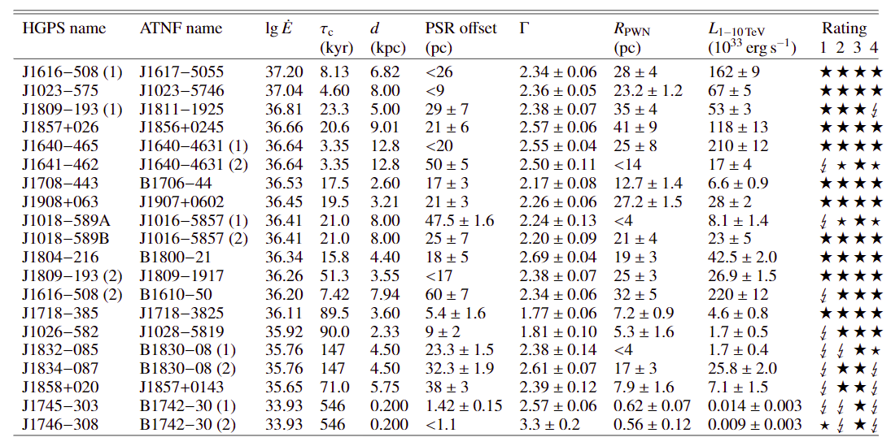
Offset between pulsar and halo (candidate) is common
Pulsar halo candidate listed in 3HWC
HAWC Collaboration 2020
PWN candidate listed in HGPS catalogue
HESS Collaboration 2018

Slide 20
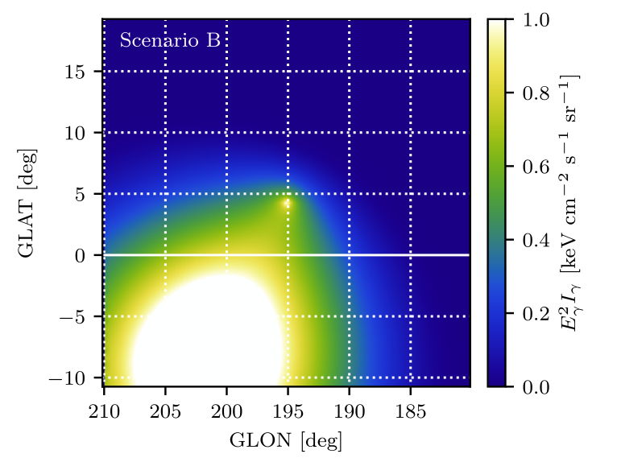
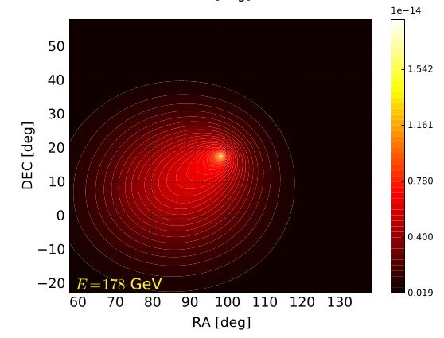
Proper motion of pulsar?
10GeV
Jóhannesson et al. 2019
Di Mauro et al. 2019
Dependence on energy, proper velocity, diffusion coefficient, injection history...

Slide 21
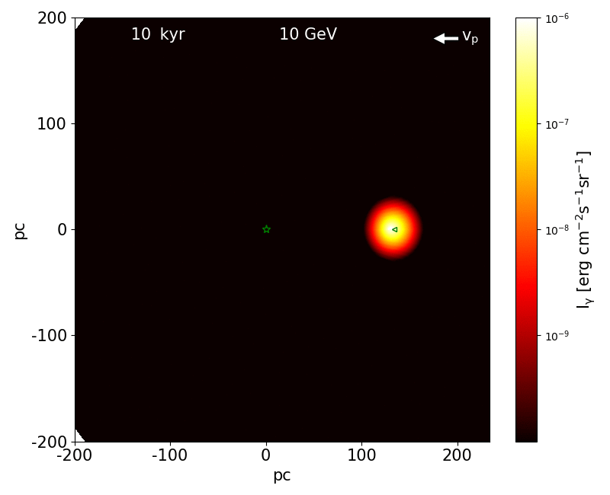
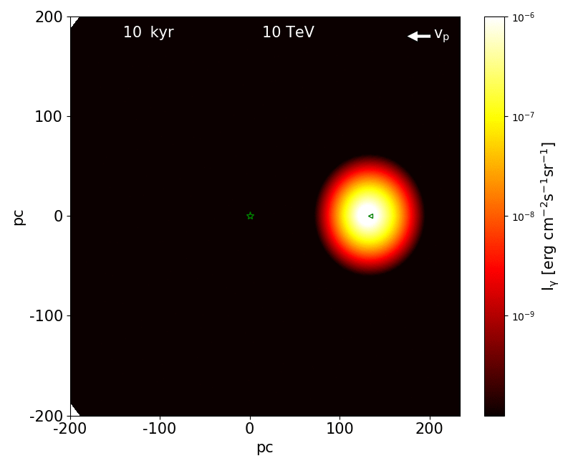
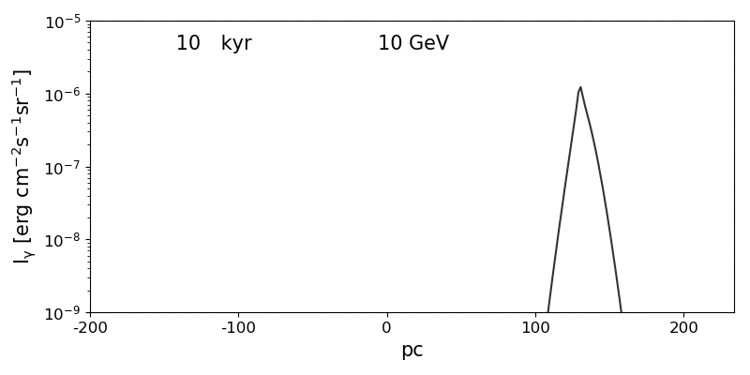
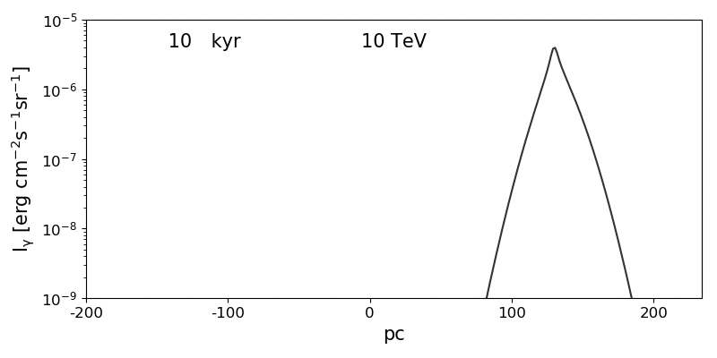
Morphology: Offset and surface brightness profile

Slide 22
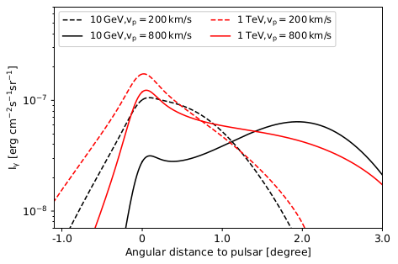



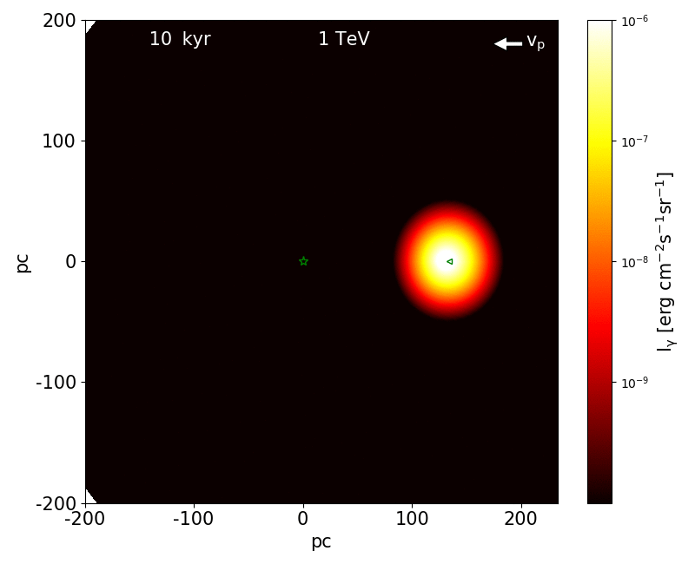


Three Evolutionary Phases of Pulsar Halos
Diffusion distance = proper motion displacement
Cooling time of E_{max} to E_{e}
a few times larger than
Single peak (probably broad)
Double peaks or single peak+long tail
Single peak (narrow， symmetric)

Slide 23
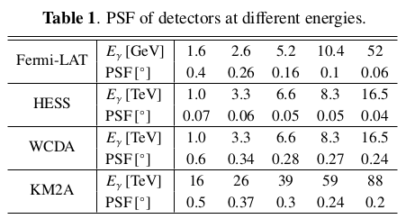

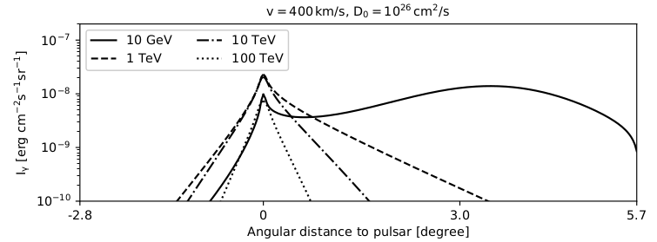
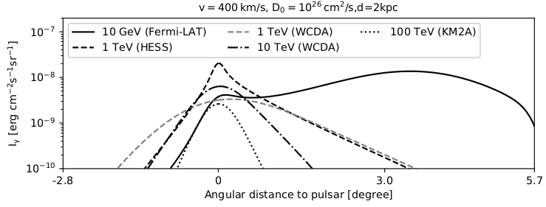
Convolution of PSF
Intrinsic profile
convolved profile
Y Zhang, RYL et al. 2020

Slide 24
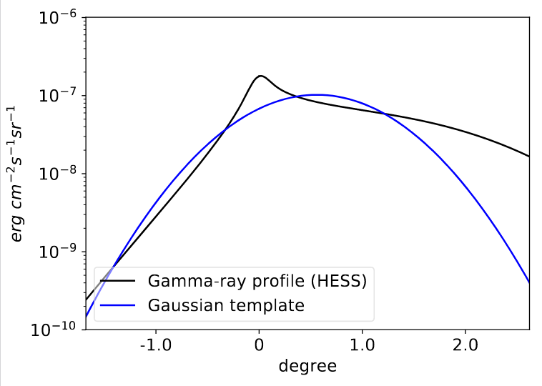
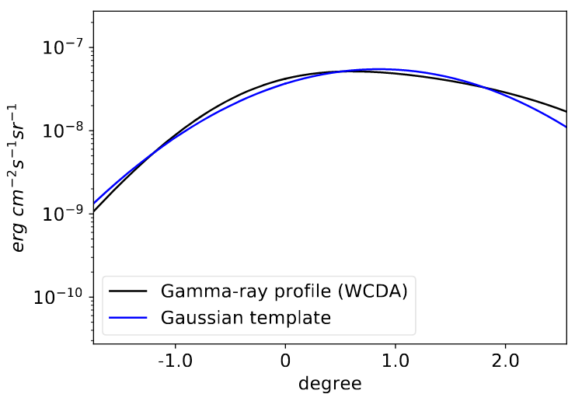
Offset between the halo and the pulsar
Separation angle between the centroid of the source and the pulsar:
Separation angle between the intensity peak (brightest point) and the pulsar

Slide 25
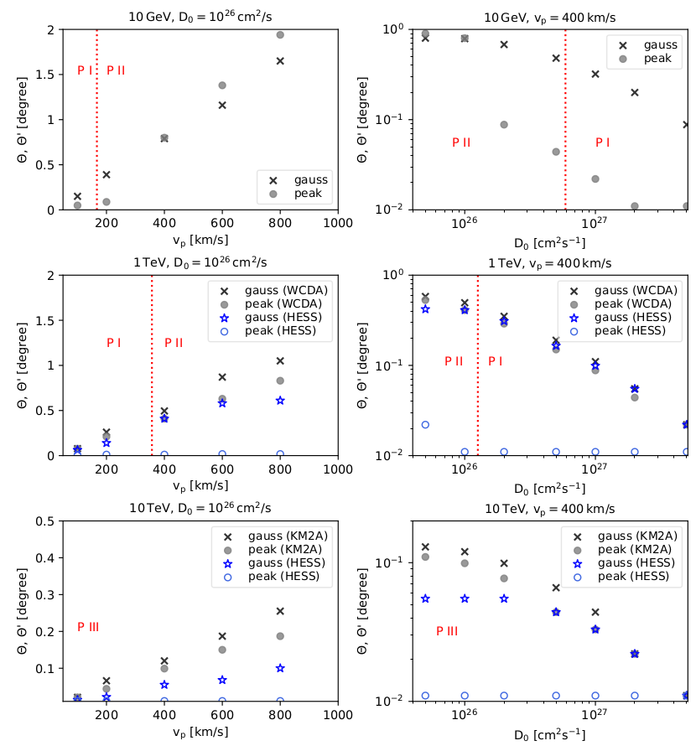

Continuous injection reduce the offset
v_{p}t_{c}/d
v_{p}t_{c}/d

Slide 26


The maximum expected separation
Stop the injection at t_{age}-t_{c}

Slide 27



Alternative explanation
anisotropic diffusion
sub-Alfvenic (M_{A}~ΔB_{inj}/B₀<1) turbulence, anisotropic
follow the field line
Low D just reflects D_{perp}
RYL, Yan, Zhang 2019
(See also e.g. Giacinti et al. 2012 PRL)
HESS Collaboration 2006, 2019
PWN in nature, crushing by reverse shock (characteristic age may deviate from the true age)
HESS J1825-137
(perhaps a hybrid of PWN+halo, RYL & Yan 2020)
Notes:
27

Slide 28
Summary
In the candidates of pulsar halos, offset between the source and the associated pulsar is common – challenge to connect the pulsar and the source
Below 1TeV, the halo could appear highly asymmetric, the offset between the centroid of the halo and the pulsar could be observable. Beyond 10TeV, the halo is largely isotropic and the offset is not expected unless the source is very close-by or the proper velocity is very large.
Offset between the brightest point of the source and the pulsar is not expected to be seen by instrument of good angular resolution (should be cautious to use this criteria without high statistics)
Thanks for your attention!

Slide 29
Back up Slides

Slide 30

More realistically
ISM turbulence: coherent length 50-100pc, mean B field 3-6μG
sub-Alfvenic (M_{A}~ΔB/B<1) turbulence, anisotropic
Diffusion coefficient -> Diffusion coefficient tensor

Slide 31




Synchrotron radiation also becomes anisotrpic
X-ray emission can be reduced significantly if the mean B field is roughly aligned with our line of sight
Rybicki & Lightman 1979

Slide 32

Horizontal: different viewing angle
Vertical: different Alfvenic Mach Number
D//=4x10²⁸ (E/1GeV)^{1/3}cm²/s
M_{A}=0.1, φ=0, too concentrated
M_{A}=0.1, φ>0, anisotropic morphology
M_{A}=0.3 insufficient gradient

Slide 33

M_{A}~0.2, φ<5°
Mean B field well aligned with LOS
Mean B field in other TeV halos cannot be always aligned with LOS

Slide 34





Slide 35



HESS J1825-137 ：an extremely extended PWN
HESS Collaboration 2019
Khangulyan+2018
PSR J1826-1334
τ_{c}=21kyr
100pc
1ms period at birth, braking index<2, R_{pwn} ~ 60pc
Energy-dependent extension can be well reproduced in a pulsar halo scenario
Voisin+2016
Hybrid system:
plerion+halo
Liu & Yan 2020
c.f. Principe+2020

