Slide 1
FCC-ee: Machine Detector Interface
Conveners: Manuela Boscolo, Nicola Bacchetta

Slide 2
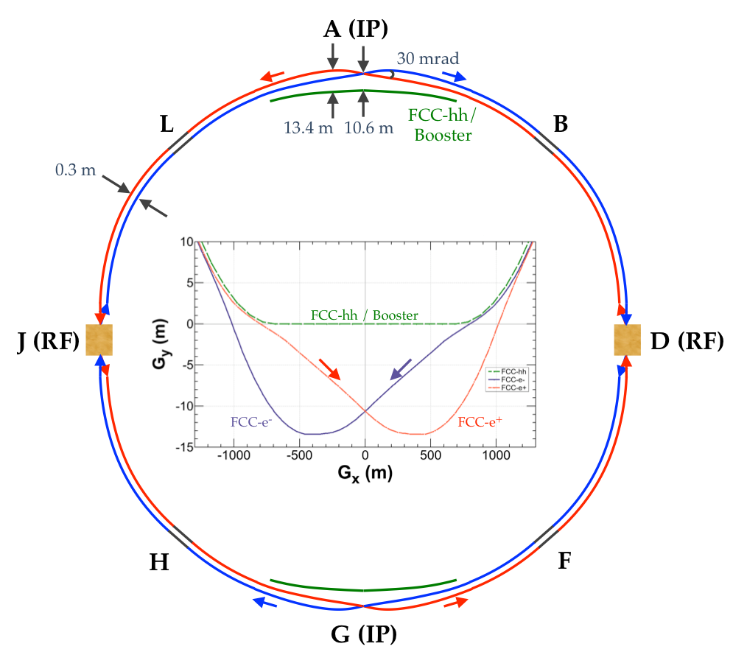
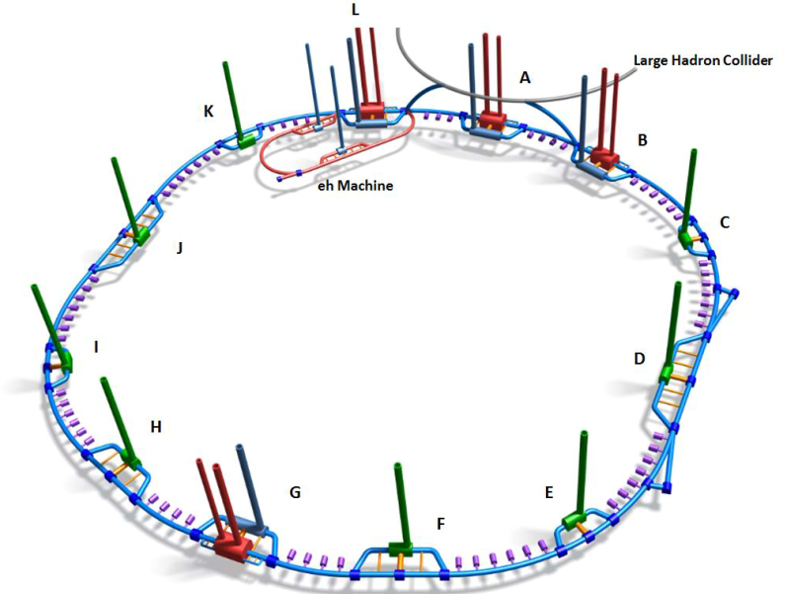
FCC-ee: Machine Detector Interface (M.Boscolo, N.Bacchetta)
Key Parameters:
Double ring e+/e- collider ~100km
Crab-waist scheme implies large crossing angle (30 mrad)
Baseline design follows the footprint of the FCC-hh except around the IPs.
Baseline with 2 IP (alternative 4 IPs under study)
Flexible optics design allows for a common lattice at all energies (except for RF re-arrangement at top energy)
Asymmetric IR layout & optics to limit SR at the IPs.
SR Ecrit. < 100 KeV at IP
SR power 50MW/beam for all energies.
SR Ecrit. < 100 KeV at IP and (possibly) < 1MeV throughout the ring
Top-up injection requires booster synchrotron in collider tunnel

Slide 3
FCC-ee: Machine Detector Interface
parameter | Z | WW | H (ZH) | ttbar
beam energy [GeV] | 45 | 80 | 120 | 182.5
beam current [mA] | 1390 | 147 | 29 | 5.4
no. bunches/beam | 16640 | 2000 | 393 | 48
bunch intensity [10¹¹] | 1.7 | 1.5 | 1.5 | 2.3
SR energy loss / turn [GeV] | 0.036 | 0.34 | 1.72 | 9.21
total RF voltage [GV] | 0.1 | 0.44 | 2.0 | 10.9
long. damping time [turns] | 1281 | 235 | 70 | 20
horizontal beta* [m] | 0.15 | 0.2 | 0.3 | 1
vertical beta* [mm] | 0.8 | 1 | 1 | 1.6
horiz. geometric emittance [nm] | 0.27 | 0.28 | 0.63 | 1.46
vert. geom. emittance [pm] | 1.0 | 1.7 | 1.3 | 2.9
bunch length with SR / BS [mm] | 3.5 / 12.1 | 3.0 / 6.0 | 3.3 / 5.3 | 2.0 / 2.5
luminosity per IP [10³⁴ cm⁻²s⁻¹] | 230 | 28 | 8.5 | 1.55
beam lifetime rad Bhabha / BS [min] | 68 / >200 | 49 / >1000 | 38 / 18 | 40 / 18

Slide 4
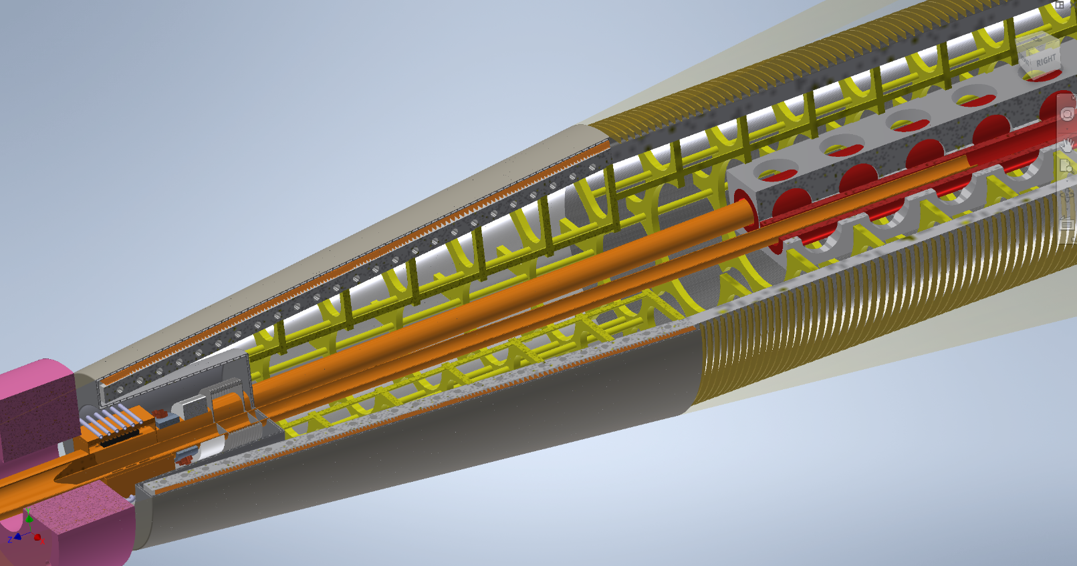
FCC-ee: Machine Detector Interface
Concentrate our efforts on 4 main areas:
Beam physics (optics, beam dynamics, collective effects)
Experimental environment, beam induced backgrounds & luminosity measurement
Software for simulation tools
Engineering (mechanical, magnets, diagnostics, vacuum, cooling, ...)
Our goal is to have a feasible and well engineered design of the Interaction Region that meets optics, beam dynamics and high current requirements, foresees tolerable radiation and achieves as well the mechanical requirements in terms of integration, stability and assembly.
Compensating
Solenoid
QC1
LumiCal
Winding
Flange
Beam Pipe
HOM absorber
3D modeling effort: compensating solenoid, cryostat, beampipe
Sketch of the FCC-ee Interaction Region

Slide 5
FCC-ee: Machine Detector Interface
Next steps (towards the TDR) will cover the following macro-areas:
  Beam physics (optics, beam dynamics, collective effects)
  Experimental environment & Luminosity measurement
  Simulation software
  Engineering (mechanical, magnets, diagnostics, vacuum, cooling, ...)
Consolidate baseline of the MDI design for FCC-ee including now more mechanical details:
  try to converge on a design of the IR with enough details to constitute a real engineering baseline
  understand installation procedures, mechanical detector interfaces, detector and machine elements accessibility for maintenance/upgrades
  mechanical stability and position precisions of some detector elements (i.e. Lumical) is a relevant element to consider in the design
  define better the general strategy for services in and out of the detector
Much work continues in order to complete a full simulation tool (MDIsim/GEANT) that allow us to have detailed background studies (Synch. Radiation)

Slide 6
FCC-ee: Machine Detector Interface
A thorough overview of the MDI status here: https://indico.cern.ch/event/838435/contributions/3635847/attachments/1967957/3272813/MDI_mboscolo_FCCworkshopJan20.pdf
Richieste finanziarie per il 2021:
  Nessuna richiesta particolare (solo metabolismo + responsabilita’)
  N. Bacchetta (PD)
  M. Boscolo (LNF)
  L. Pellegrino (LNF)
  A. Ciarma (LNF)
  M. Zobov (LNF)

Slide 7
Extra Slides

Slide 8
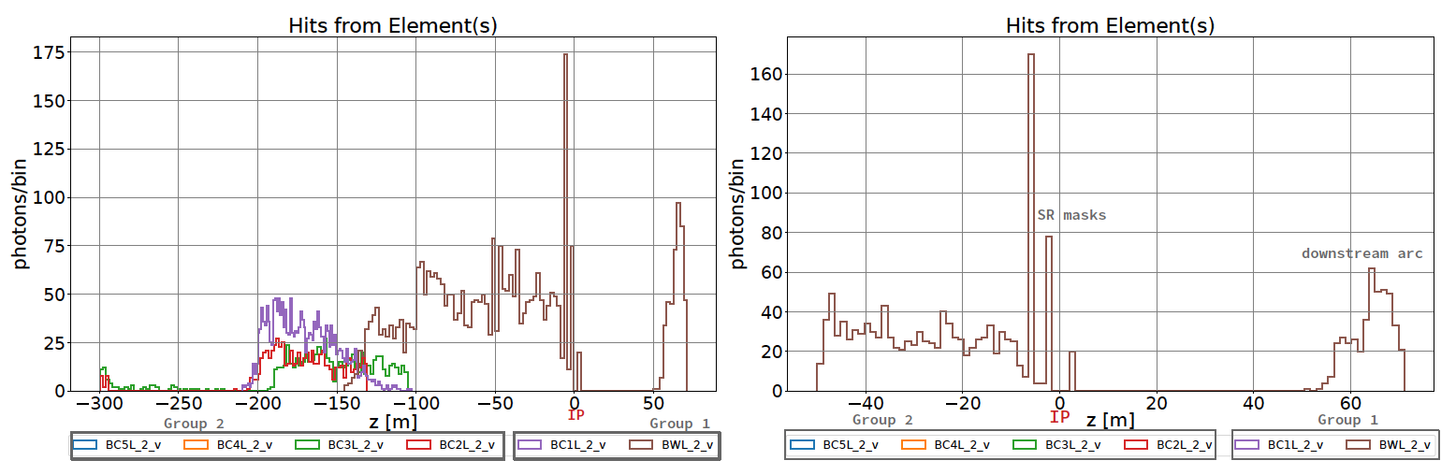
FCC-ee: Machine Detector Interface
Example of Synchrotron Radiation studies (MDI-Sim, M.Luckhof):
synchrotron radiation fans (dipoles)
100
_{B1.}B₁1₂.₅B1₄12._{B}515_{L}2₄5.6₂
Negligible effects on IP
100
15
synchrotron radiation fan BWL.2
15
BBLL32.2.2
75
B1S.1152
Group 3 B1S.1151
B1L.492
BL1.2
75
50
B1L.491
BC5L.2
BC4L.2
50
10
10
X [m]
25
B1.1253
BC3L.2
BC2L.2
BC1L2
25
aperture [m]
5
5
aperture [m]
0
B1S.1150
Group 2
BWL2
IP
0
BWL.2
B1S.1149
Group 1
0
IP 0
25
B1.1252
25
50
B1.1251
50
5
Collimators position
5
75
B1L.490
75
100
100
10
-200
-150
10
1200
1000
800
Z [m]
600
400
200
0
400
-350
-300
-250
100
50
0
Last bent @ 200m from IP
Z [m]

