Slide 1
Study on the particle identification efficiency of the TOP detector at Belle2
Matteo Feltre

Slide 2
DECAY CHANNEL
The physical process considered in the following study is:
$D^{∗}→$ $D^{0}$+ $π→$ $π^{±}+K^{∓}+π$
Therefore, the stage is focused on the identification efficiency of :
K meson;
$π$ from $D^{∗}$ and $D^{0}$ decay. I will refer to them as pi and D0_pi
Pi is also called “pi soft” due to its lower momentum respect to D0_pi
A comparison between data and Monte Carlo simulations will be performed

Slide 3
PHYSICAL CONSTRAINTS
In order to distinguish signals and other processes, kinematical considerations are taken into account:
0.1434 $\frac{GeV}{c^{2}}$<$M_{D∗}$- $M_{D0}$<0.1474 $\frac{GeV}{c^{2}}$
$p_{pi}$< $p_{D0_pi}$
gACC>0.9 for every particle (geometric acceptance)
${40}^{°}<θ<$ ${110}^{°}$ for every particle;
Impact position parameters $\left|d_{0}\right|<2$ cm and $\left|z_{0}\right|<4$ cm
Monte Carlo simulation contains also the variable “isSignal” which is set > 0.9.

Slide 4
“PAIR” CONFIGURATION
The particle identification is made with the hypothesis of only two possible different particles: $π$ and K
Only particles that passed the previous selections are considered;
The efficiency is defined as:
$$\frac{\# of particles with \text{Pair}>0.9}{\# of total particles}$$
The process is repeated for all the three kind of particles.

Slide 5
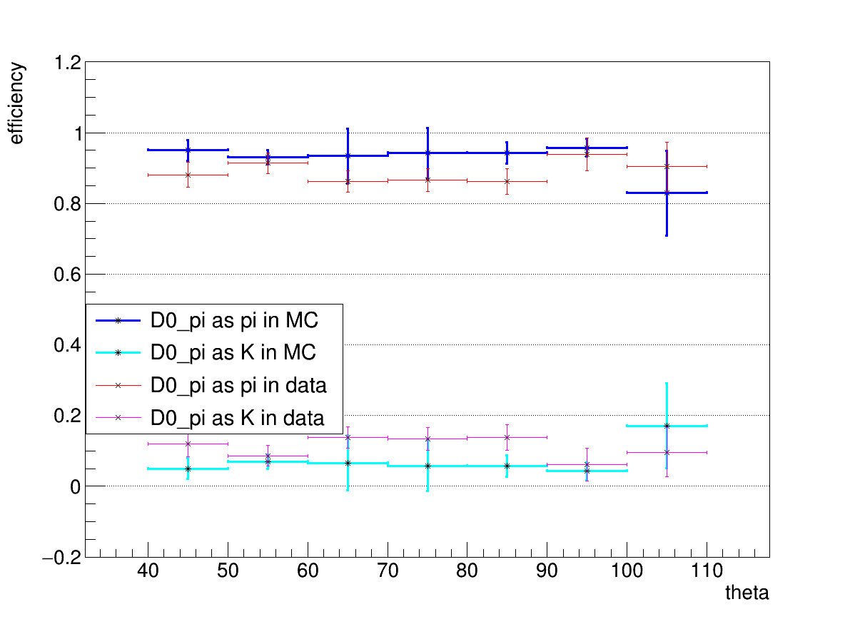
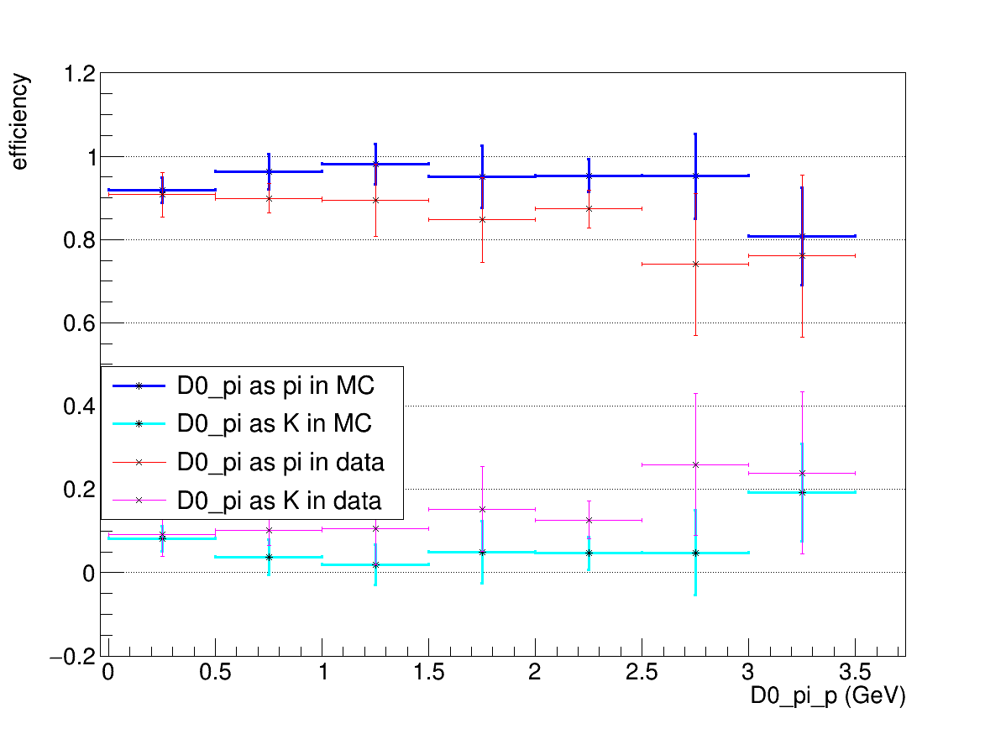
“PAIR”- D0-pi
Theta classification:
Efficiency near 0.9;
MC presents generally a better efficiency;
The trends in data and MC are similar
Error bars between 100° and 110° are larger due to lower statistics.
Momentum classification
Very high efficiency until 3.5 GeV
Good comparison between data and MC

Slide 6
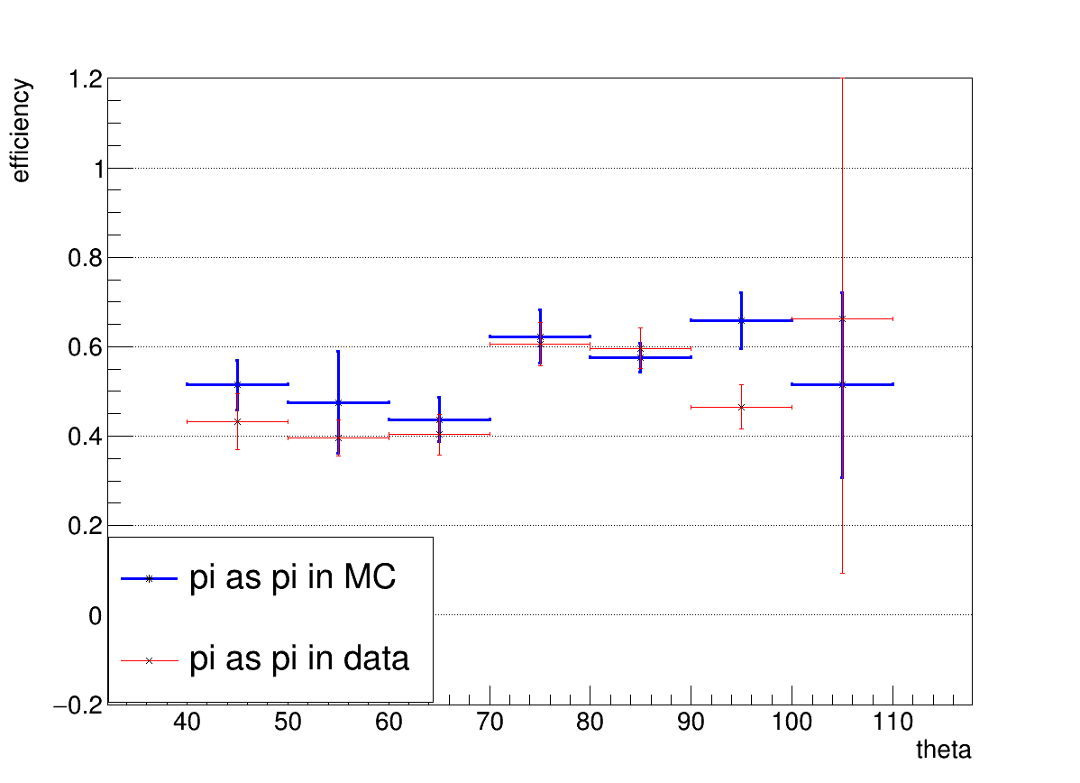
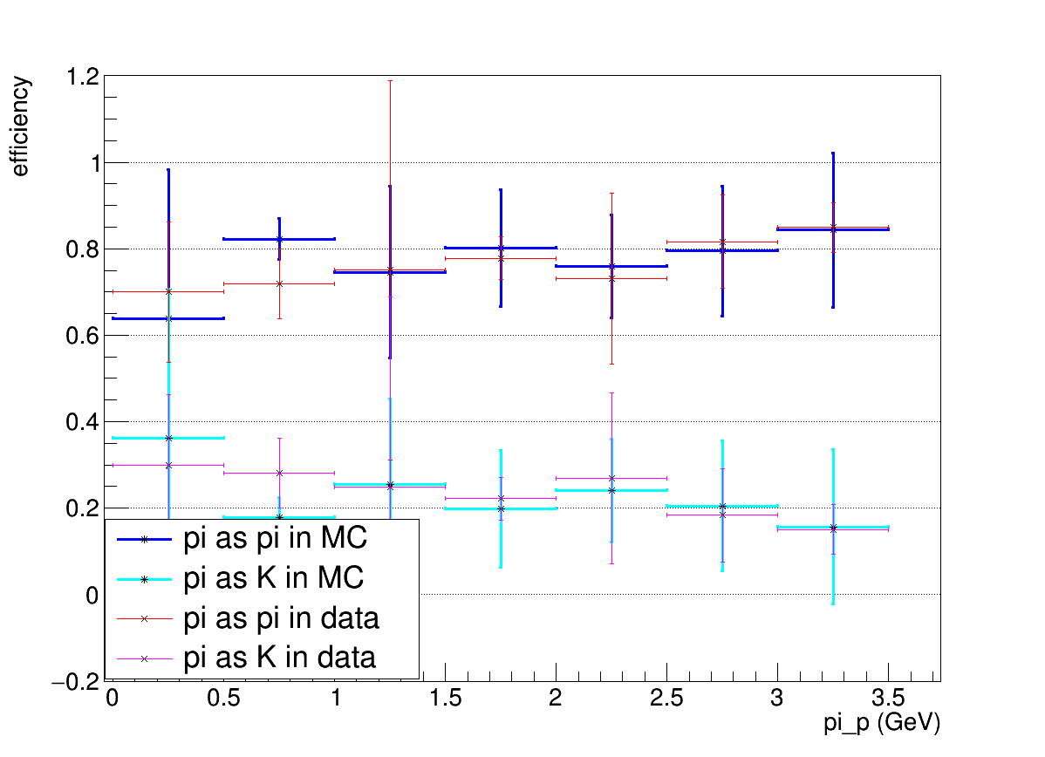
“PAIR”-pi
Theta classification:
Efficiency variates locally;
Lower than D0_pi, probably for its lower momentum;
Difference between MC and data noticeable only between 90° and 100°.
Momentum classification
Very low statistics for high momenta;
For p<0.5 GeV the uncertainties are high due to TOP configurarion;
Data and MC are in agreement;

Slide 7
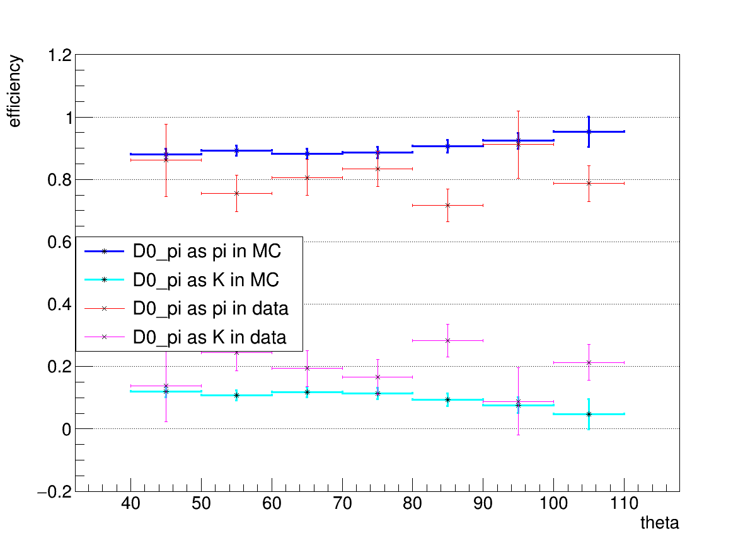
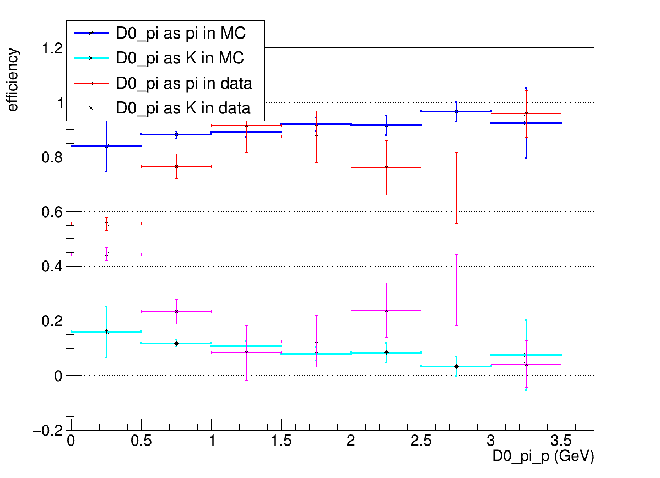
“PAIR”-D0-K
Theta classificarion:
In MC efficiency slightly increases with angles;
In data local fluctuations are present;
The data underline an underestimation of the efficiency for angles until 70°
Momentum classification
Data trend is very unstable;
Clear underestimation of MC values.
MC behaviour slightly increases with momentum.

Slide 8
“PIDE” CONFIGURATION
The particle can now be detected as:
$π$,$μ$,K,p,e,d;
A particle is recognized as one of the previous six if:
PIDE of that particle is the maximum
Pion and Muon are often misidentified, so for Pion there is a Second Method:
$Particle=π→PIDE_{pi}=\max{ ∨}$ $(PIDE_{mu}=\max{ ∧PIDE_{pi}>0.3)}$
In this way we can consider also uncertain events that are very likely a pion not correctly identified

Slide 9
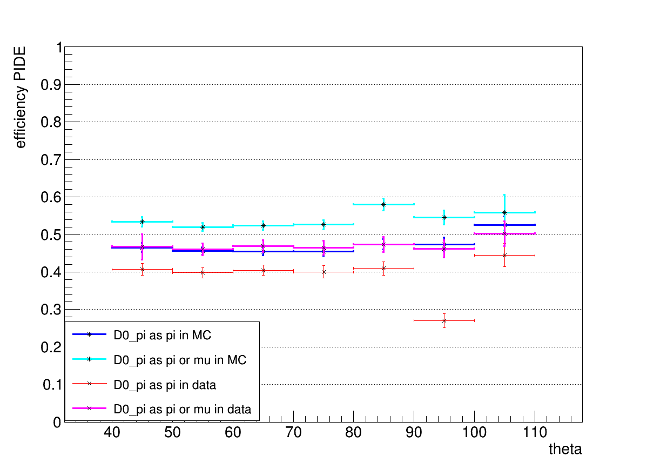
“PIDE”-D0-pi
Theta classification:
PIDE efficiency is smaller than Pair
MC is constantly ~5% higher than data
Both methods show same consistency between data and MC behaviour
Exception between 90° and 100°

Slide 10
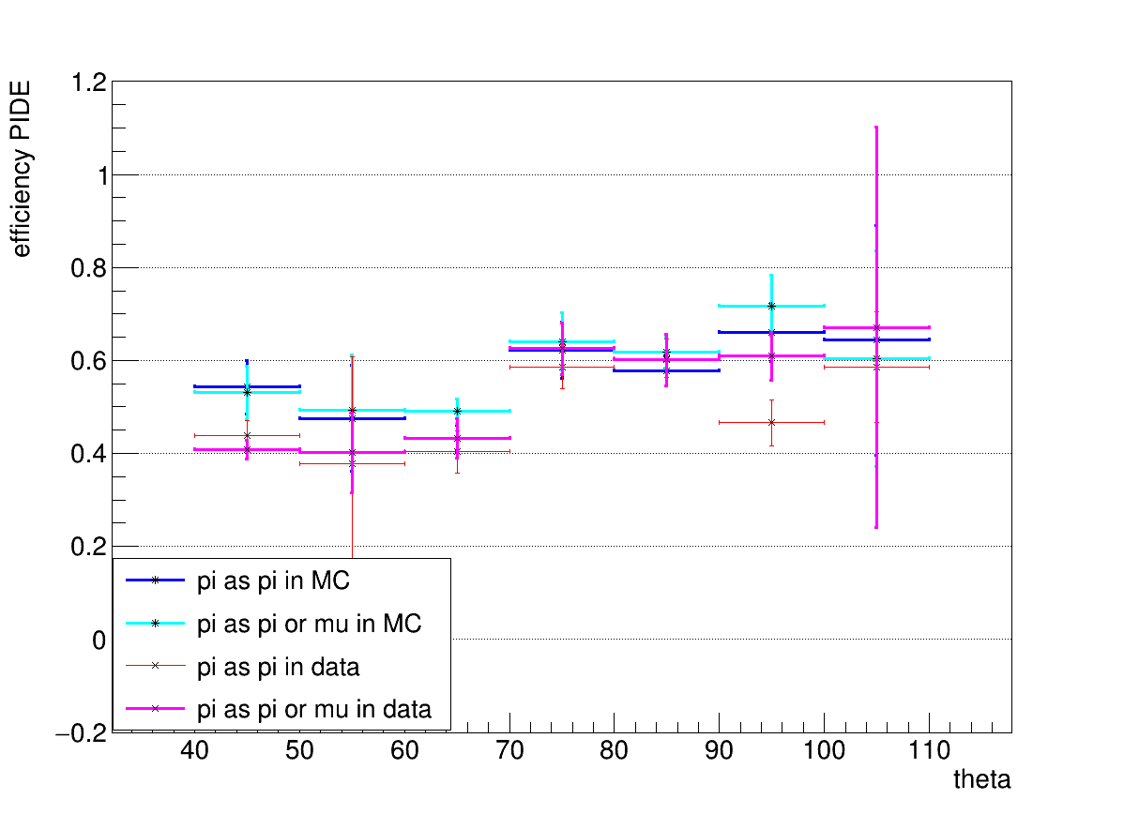
“PIDE”-pi
Theta classification:
The trend is variable
PIDE efficiency is higher than D0-pi. This could mean that a low momentum pi is more recognizable
Data and MC are very close

Slide 11
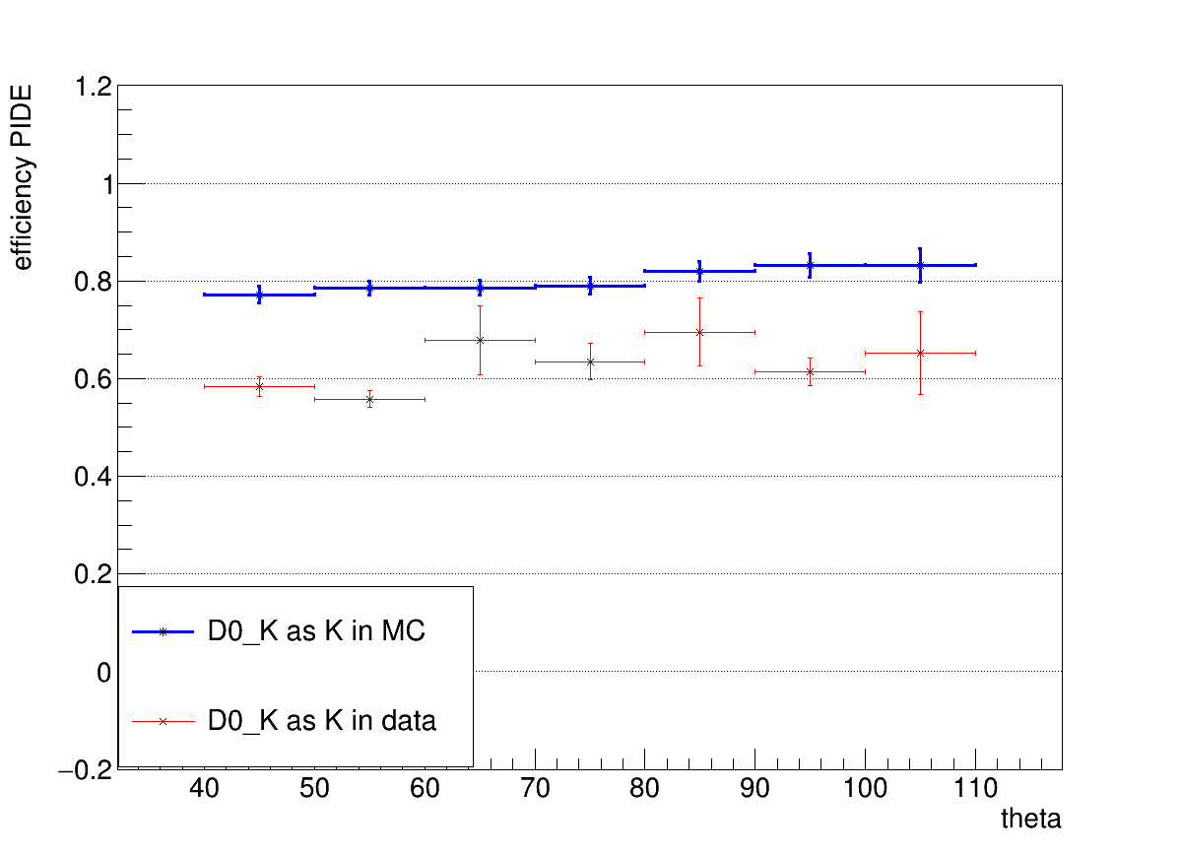
“PIDE”-D0-K
Theta classification:
The MC shows a clear trend;
Data efficiencies are lower and more variable than MC.
Data fluctuations are in agreement with Pair behaviour
PIDE efficiency is higher than pions because K is more distinguishable

Slide 12
“PIDE”-Misidentification
In this bar plots are reported:
Percentage of identification of the 6 kind of particles;
The second highest when the “correct” PIDE is the maximum;

Slide 13
“PIDE”-Misidentification
In this bar plots are reported:
Percentage of identification of the 6 kind of particles; (upper)
The second highest when the “correct” PIDE is the maximum;
D0-pi:
After the constraints pi, mu percentage increase sensibly;
Also electron percentage increases;
Pi is mainly mistaken for a muon

Slide 14
“PIDE”-Misidentification
In this bar plots are reported:
Percentage of identification of the 6 kind of particles; (upper)
The second highest when the “correct” PIDE is the maximum;
pi:
The behaviour is similar to D0-pi;
After the “cut”, K percentage is more relevant than D0-pi

Slide 15
“PIDE”-Misidentification
In this bar plots are reported:
Percentage of identification of the 6 kind of particles; (upper)
The second highest when the “correct” PIDE is the maximum;
D0-K:
The K after the selection has a very high percentage of right reconstruction;
Data K reconstruction percentage is lower than MC in agreement with previous graphs;

Slide 16
Alternative ways? (D0-pi example)
Using a neural network could be a possibility:
Train the net on MC to recognize D0-pi events;
Apply the net to data;
Check the percentage of event marked as signal by the net which is really a D0-pi.
Indeed, the net will confuse events with similar kinematics properties that are reconstructed as D0-pi or others by the TOP detector.
Problems:
Network intrinsic efficiency $→$ on a subset of only signal the 70% is recognized as signal by the net
The intrinsic efficiency confuses with the TOP efficiency

Slide 17
Alternative ways? (D0-pi example)
Results:
In both cases a lot of events are discarded;
Kinematic constraints make the peak narrower;
In both cases the efficiency is quite similar:
Net efficiency reconstruction~0.46

