Slide 1
LEMMA-TB: an experiment in the CERN NA for the positron-induced muon collider

Slide 2
LEMMA
Low Emittance Muons Accelerator (LEMMA) is an alternative scheme has been proposed to the traditional “protons-on-target” scheme for the production of muon beams for the muon collider
  Positrons on target, aiming at e+e- → mu+ mu-
  Process at threshold: e+ at 45 GeV, e- at rest → high boost (~200) of the CoM system → muons preserve original e+ beam emittance
  No cooling needed!

Slide 3
Why an experiment?
Production process is a simple QED one, but no experimental data available at threshold
Tiny muon beam emittance, but how much exactly? How much does it depend on the properties of the e+ beam, kinematics, target features? (and so on)
Spent e+ beam needs to be recuperated and re-utilized for additional muon production: what are its properties? Can it be reused indeed?
This will set the basis for future tests of the LEMMA production scheme if the proper infrastructure will be realized. The path to a future demonstrator at CERN?

Slide 4
Past experiences
We had two beam tests in the CERN NA in the past (2017 and 2018)
  both done with essentially ~0 budget, reusing equipment from other experiments
  One week only at the time
Despite the tiny investment, we managed to extract some physics results out of those data takings
Most importantly, we gather experience on what are the critical issues and how to tackle them

Slide 5
The challenge (I)
The issue with the emittance:
  Intrinsic emittance due to muon kinematics and interaction with the target is tiny
  Emittance of e+ beam in the NA is very large (several order of magnitudes larger than intrinsic muon beam)
Need to correct event-by-event for the incoming e+ kinematics:
Requires extremely good tracking resolution before and after the target

Slide 6
The challenge (II)
Each muon track –and corresponding e+ track- needs to be tracked individually ➔ need to resolve in time the structure of the NA spill
  5 second long, ~5e6 particles per spill
➔ Fast and dead-time-less trigger and DAQ systems
Cross section measurement requires full control on trigger efficiency and detector acceptance
  Luminosity normalization shall require reference to other physics process, e.g. γγ production ➔ dedicated calorimeter

Slide 7
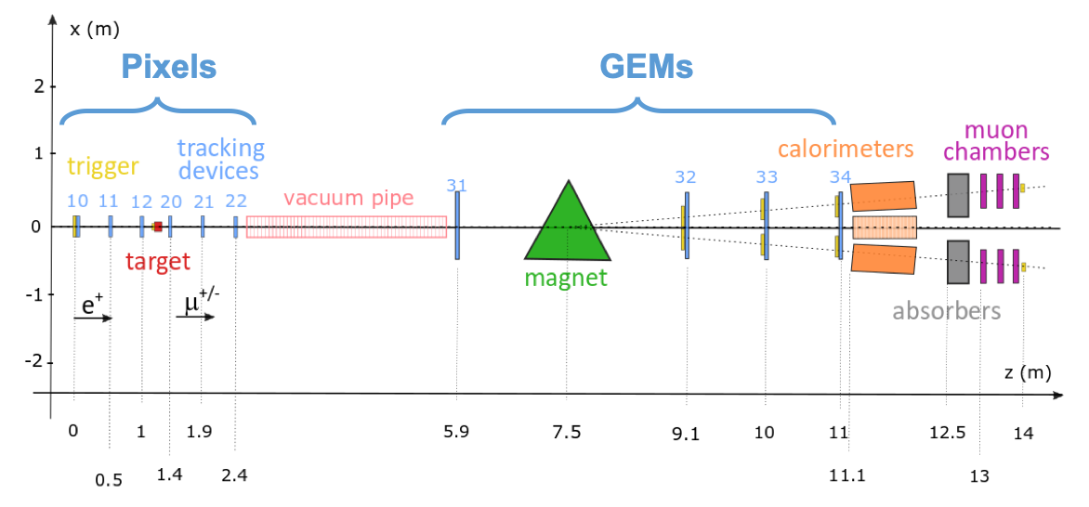
Experiment in 2021 (->2022)
Fast and high-resolution pixel-based telescopes (CMS modules) in the target region
Fast GEM detectors from CMS beyond the magnet
Combination of several Calorimeters
4+2 Muon chambers (triggerless readout)
Improved (integrated, low dead time) DAQ system
Improved trigger system

Slide 8
Pixels
12 new modules produced by PSI:
  20kE from 2020 budget
mechanical supports to be designed and realized at PD workshop
Expertise and technical support from the CHROMIE community
  Need to go to CERN for that..
  We’ll borrow all read-out and powering/control electronics
Need to develop an appropriate trigger system (TTC based)
N. Deelen, N. Bacchetta

Slide 9
GEM
2 Dedicated hi-res 10x10 triple-GEM
  X-Y, 260 um pitch (75 um resolution)
Standard CMS GE2/1 M1 and Me2 modules in muon arms
  Trapezoidal, 360-600 um resolution
All read-out by a DAQ “CMS-style”

Slide 10
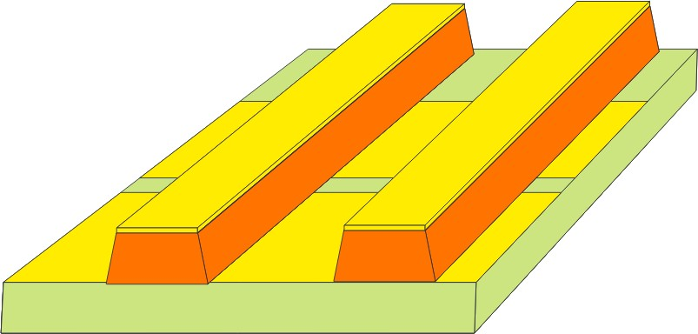
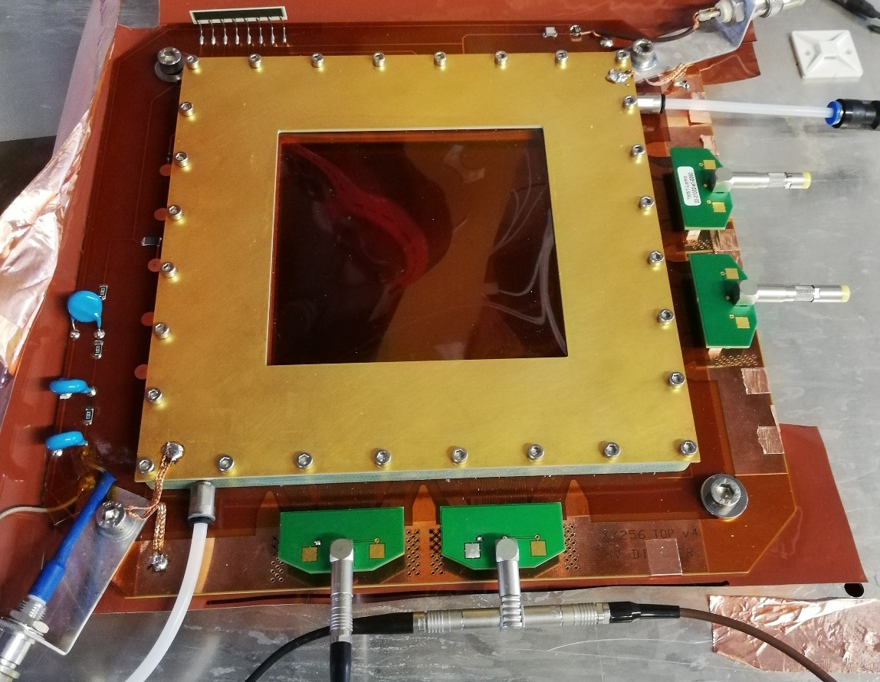
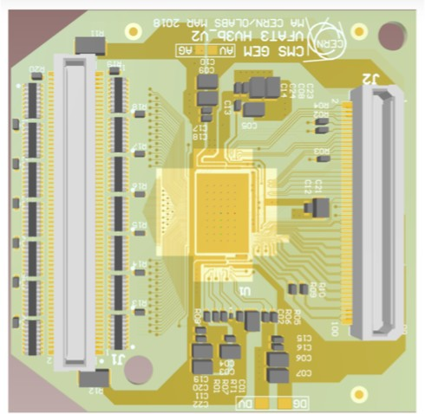
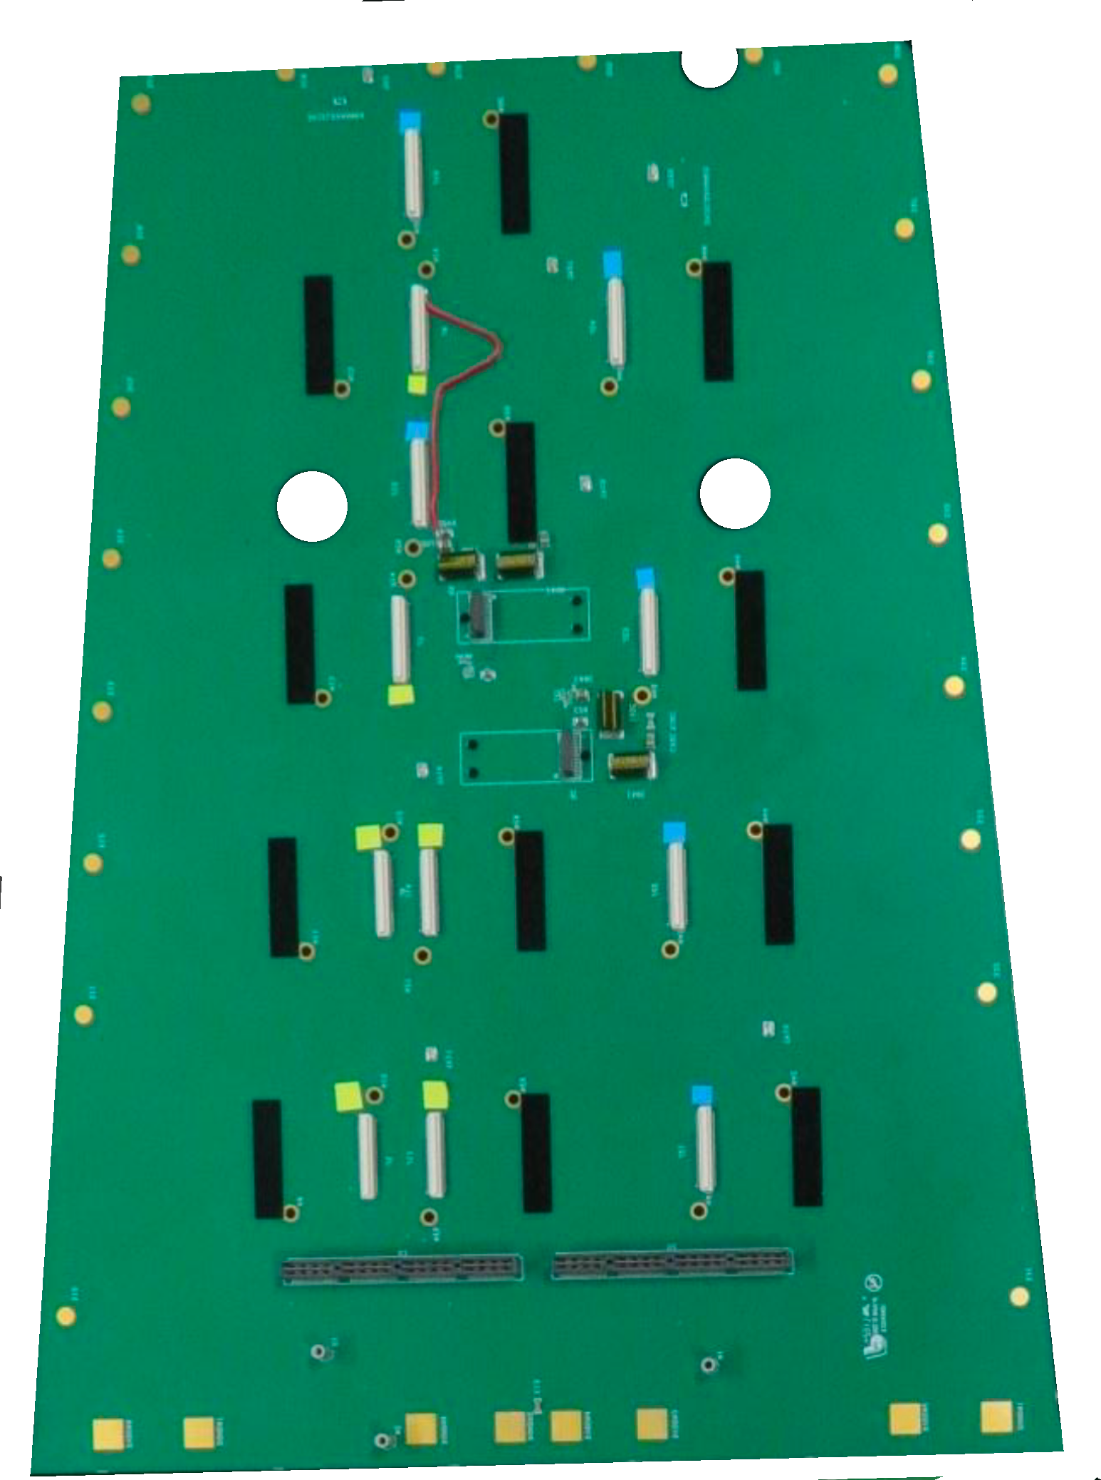
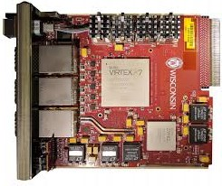
GEM readout (CMS DAQ)
Provide TRACKER before & after the magnet: 10 x 10 cm²
Offered pitch: 260um = resolution 75um
New readout board for standard 10x10 with 366 strips for each coordinate
Digital readout with VFAT3: 260um/ 12 = 75um
1: 10x10 Triple GEM with modified readout board:
3*122 = 366 strips in X,Y (260um pitch)
2: VFAT3b hybrid boards
3: SAMTEC cables (new) for high speed ( ~82EUR/piece) with connectors
4: CMS GEM GE1/1 GEB
2
1
2
2
3
2 2 2
4
GE1/1 GEB
6 cables x 3 chambers = 18 high speead cables
Panasonic 130
Panasonic 100
GE1/1 GEB + Opto-Hybrid (not shown)
Triple-GEM (1)
VFAT3 HV3b_V2 (2)
CPT7 Board in uTCA crate
5

Slide 11
Activities ahead (2021)
Detectors (GEM, pixels) completion
  Construction, mechanics
Trigger
  Detectors (scintillators and/or lyso), strategy, timing distribution, etc.
Detectors integration
  All to be put together and integrated in NA (beside GIF++)
  Possibly aim at a continuous readout (a.k.a. “triggerless”), based on lpGBT links
Further studies on simulation
  Optimization of experiment configuration
  Reconstruction code
  Monitoring for calibration and alignment

Slide 12
Richieste
Padova:
  Consumo: “Sistema avanzato DAQ a 40 MHz con link GBT” ➔ 20 kE
    3 FPGA XiliX (Ultrascale+), 1 adattatore, 2 schede di memoria Optane
  Missioni: “Integrazione al CERN” ➔ 3kE
Bari:
  Consumo:
    “3 rivelatori GEM 10x10 cm2 ad alta risoluzione spaziale. Costo rivelatore singolo 3.5 kEuro (CERN)” ➔ 10.5kE
    “18 Cavi Samtec (totale 1.4 kEuro)+ 36 connettori (totale 0.216 kE) per integrazione rivelatori 10x10cm2 a readout CMS-Phase2 GEM” ➔ 1.50
    “Meccanica per supporto rivelatori (3 rivelatori 10x10 cm2 + 4 moduli CMS-GE2/1)” ➔ 1.5 kE
  Missioni: “Caratterizzazione GEM e Integrazione al CERN” ➔ 8kE
Torino:
  Consumo: “Sistema di trigger (rivelatori e meccanica) per test beam e altri consumi per laboratorio bersagli” ➔ 5kE
  Missioni: “Integrazione al CERN” ➔ 3kE

Slide 13
Dettagli (DAQ)
Memoria Persistente
DIMM Optane 256GB # SKU835807-B21 2267 € + IVA
https://buy.hpe.com/it/it/options/enterprise-memory/persistent-memory/persistent-memory/intel-optane-persistent-memory-for-hpe/p/1011306266
Network Adapter
NVIDIA Mellanox MCX516A-CCAT ConnectX-5 955 $ + IVA
https://store.mellanox.com/products/nvidia-mellanox-mcx516a-ccat-connectx-5-en-network-interface-card-100gbe-dual-port-qsfp28-pcie3-0-x16-tall-bracket-rohs-r6.html
FPGA board
Xilinx Kintex UltraScale+ FPGA KCU116 EK-U1-KCU116-G 2995 $ + IVA
https://www.xilinx.com/products/boards-and-kits/ek-u1-kcu116-g.html
Il setup completo ammonta a:
3 FPGA + 2 Mellanox Adapter → 12k + IVA
2 DIMMS Optane -> 512GB → 5k + IVA

Slide 14
Dettagli (GEM)

Slide 15
Dettagli (Trigger)
Realizzazione degli scintillatori a monte e a valle della targhetta, necessari per definirne in modo accurato l'accettanza.
3 scintillatori plastici circolari, con fibra WLS in groove nella superficie circolare letta da SiPM ai due estremi
  Acquisto tile+WLS assemblato (o materiali da lavorare e assemblare in casa)
  SiPM
  Elettronica di lettura e generazione trigger: si sta valutando l’utilizzo di una scheda DT5550W in prestito
  Cavi, connessioni etc.
  Supporto meccanico (da progettare integrandolo con il support della targhetta)
Il sistema è ancora in fase di definizione anche sulla base del sistema finale di DAQ (richiesta di PD), ma comunque da realizzare nel 2021.
Si propone la richiesta SJ alla presentazione del progetto definitivo

Slide 16
BACKUP

Slide 17
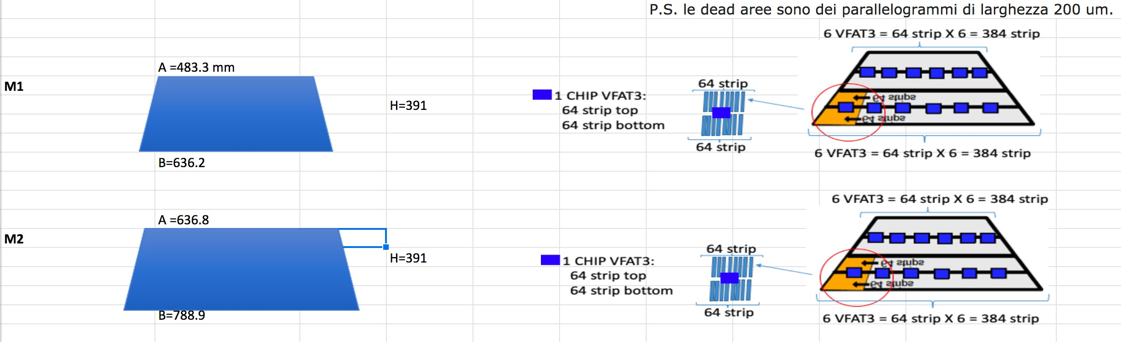
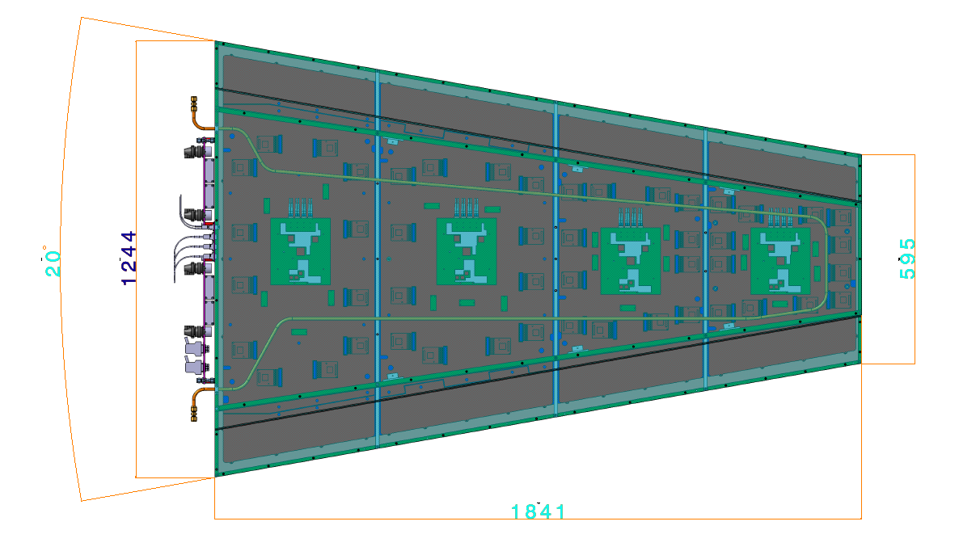
Details of GEM M1 and M2
Standard CMS GE2/1 M1 and M2 modules (trapeziodal shape) with strip pointing to the beam (they are inclined trapezoids).
M1
M1
M2
M2
M3
M4
4

Slide 18
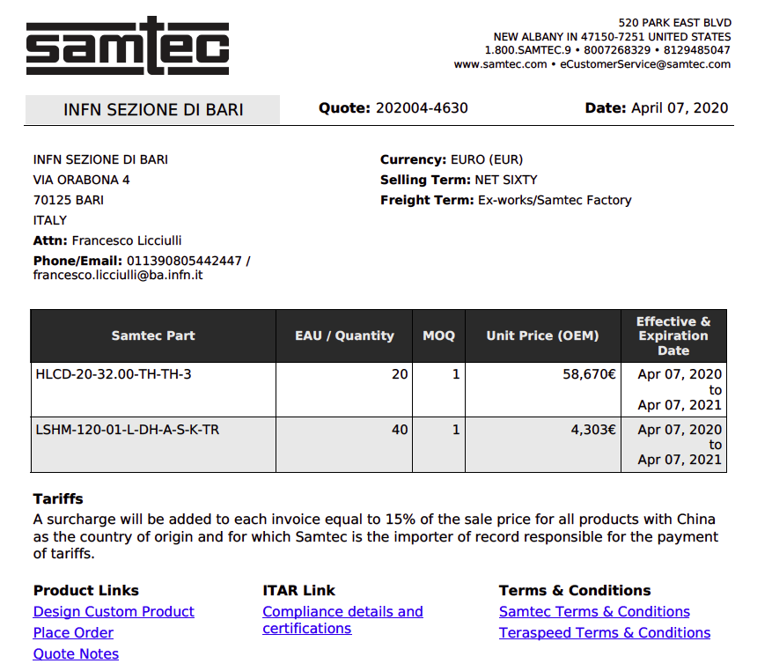
Costo dei cavi non include IVA: costo cavo 82 Euro, costo connettore= 6 euro

Slide 19
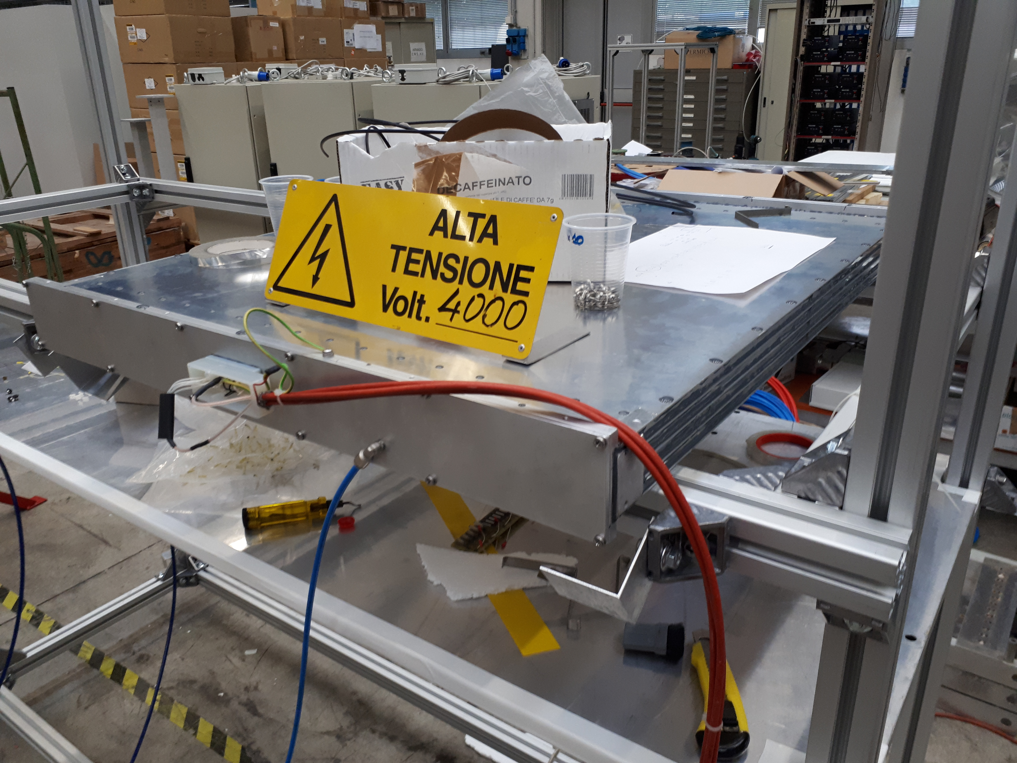
Dedicated Muon Chambers
For the beam test we designed and realized in LNL dedicated muon chambers:
  A rescaled, optimized in design and grounding version of the CMS Drift Tubes chambers
4 chambers have been constructed in 2018, other 2 in 2019 (for INFN TO), and other 2 in 2020 (for INFN BO)
Synergetic with CMS electronics and hardware developments

Slide 20
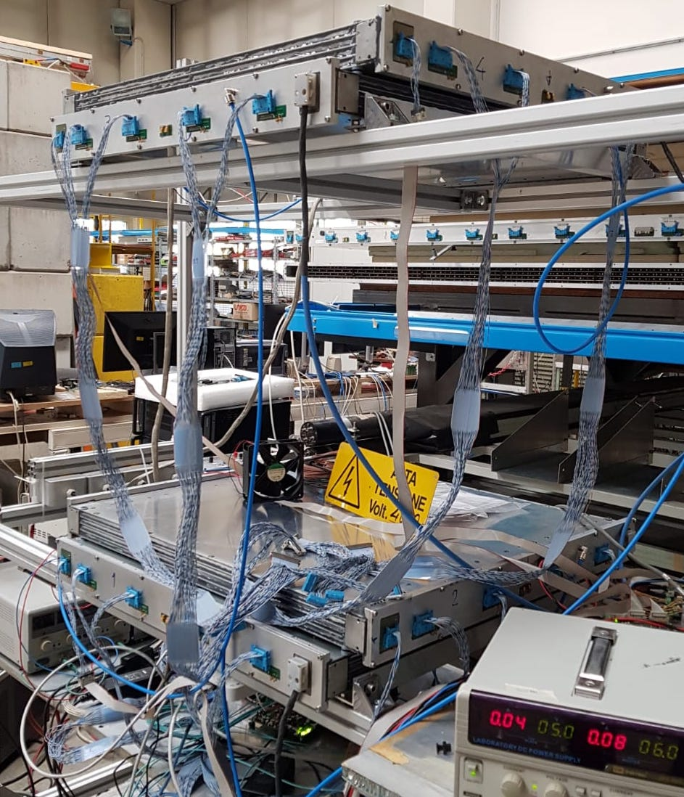
Trigger-less readout
Chambers operated regularly at LNL, used for testing CMS electronics for HL-LHC
  “New minicrates” a.k.a OBDT
Operate with cosmics (O(100) Hz) or test pulses
  Possibly firing all channels at 40 MHz
Some firmware developed for the local trigger of HL-LHC also deployed in a dedicated PCIe-board
The overall setup allows for 40 MHz (e.g. trigger-less) readout
  Combined effort to develop a data processing pipe-line that can cope with that

