Slide 1
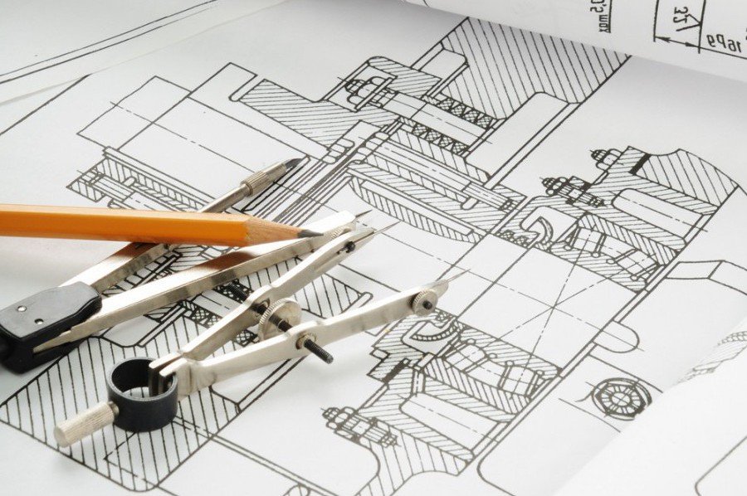
Electromagnetic Calorimeter - IFB flanges (cables and fibers) –
Alessandro Saputi – Ivano Sarra docDB xxxx

Slide 2
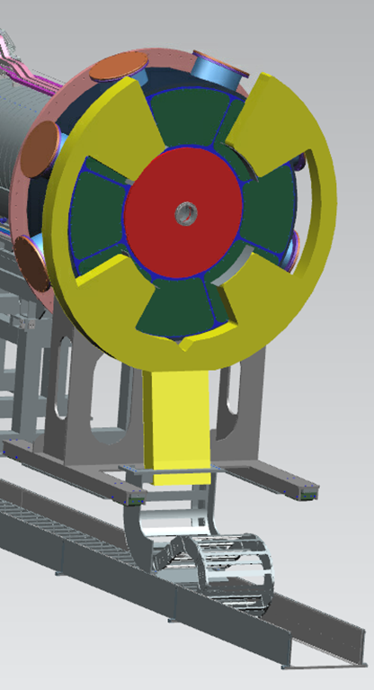
IFB envelope for EMC cables and fibers
Rmax
Rmin
nil volentibus arduum
Assigned envelope
DZmax = 175 mm
Rmax = 1320 mm
Rmin = 1050 mm
Z

Slide 3
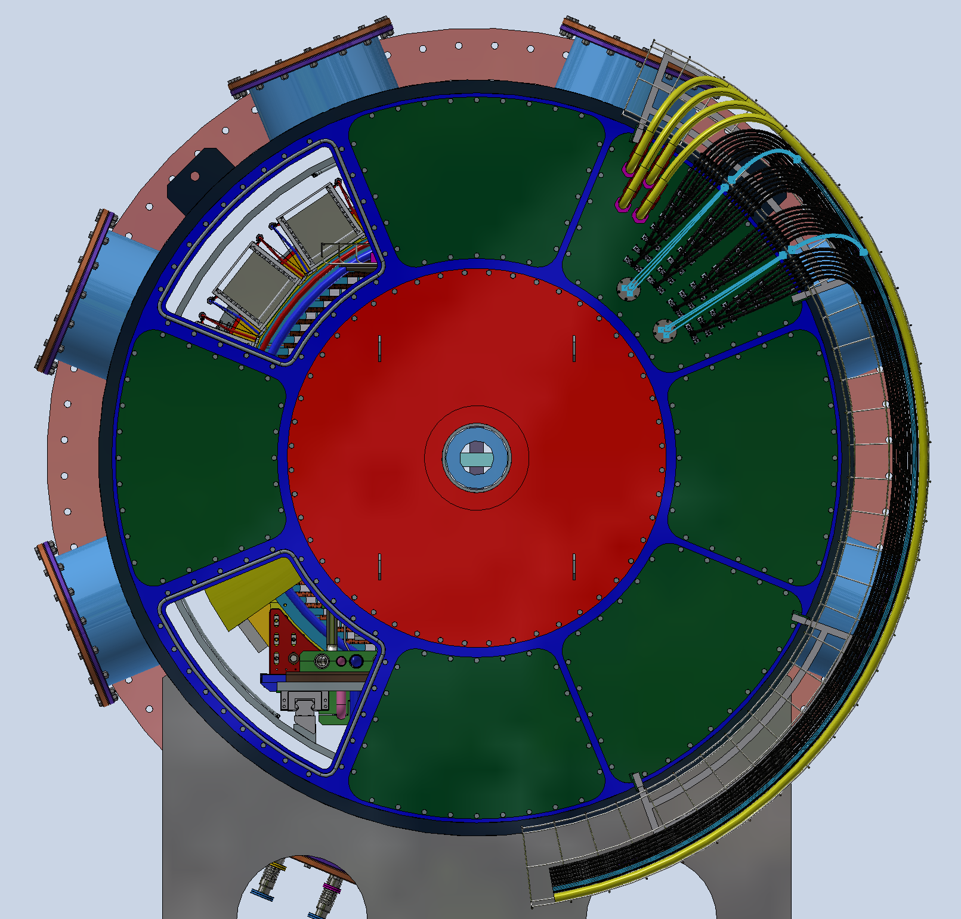
IFB flanges reserved for EMC
Our design uses 2 sectors of the IFB for the optical fibers and cables
10 o’clock
2 o’clock
nil volentibus arduum

Slide 4
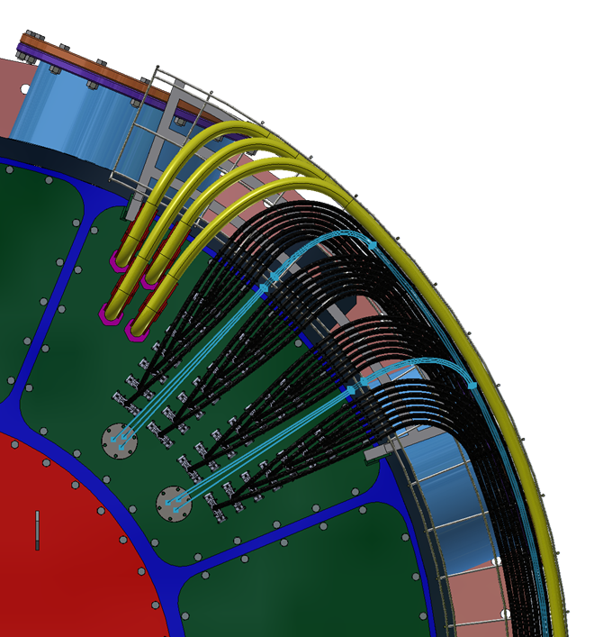
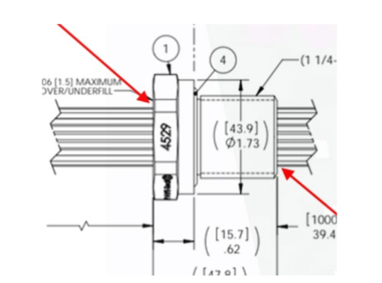
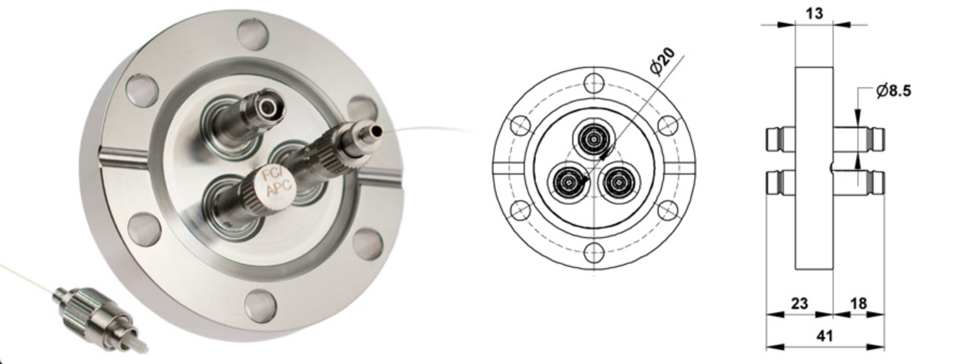
IFB cables&fibers layout
TDAQ: 48 fibers per connector
→ 4 connector per flange
nil volentibus arduum
HV/LV: 28 connectors
Laser: 3 fibers per connector
→ 2 connector per flange

Slide 5
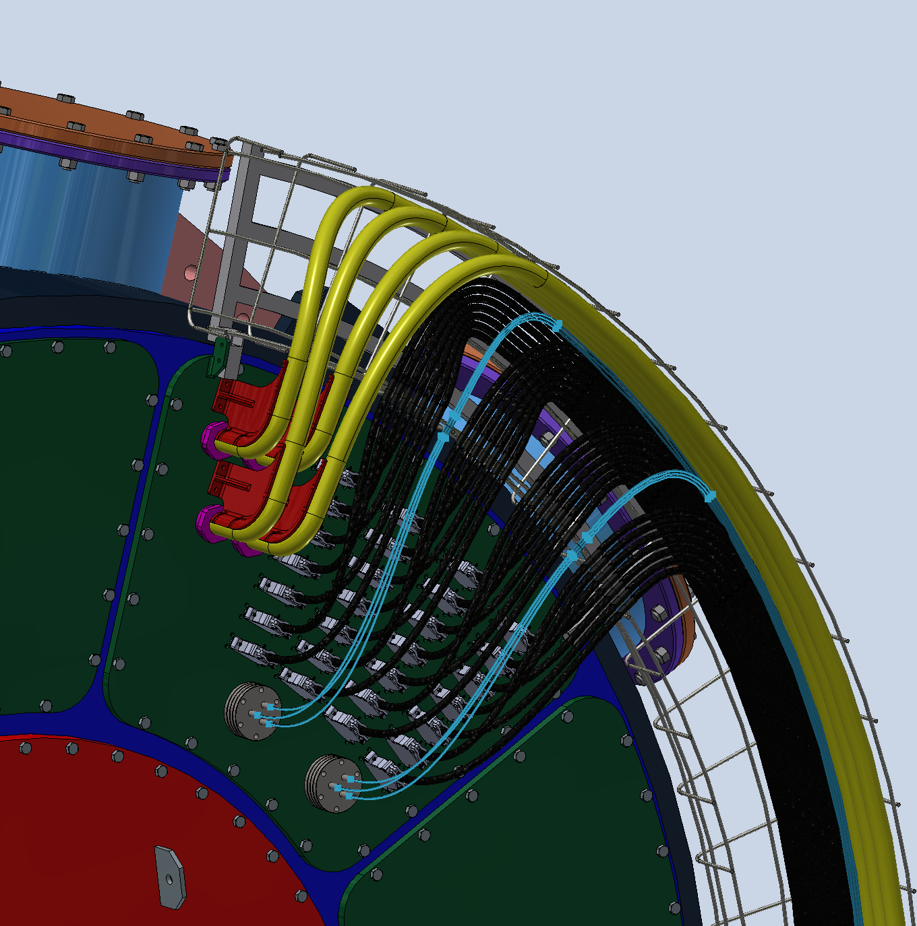
IFB cables&fibers layout
Cable tray & support
TDAQ fibers
nil volentibus arduum
HV/LV cables
Laser fibers

Slide 6
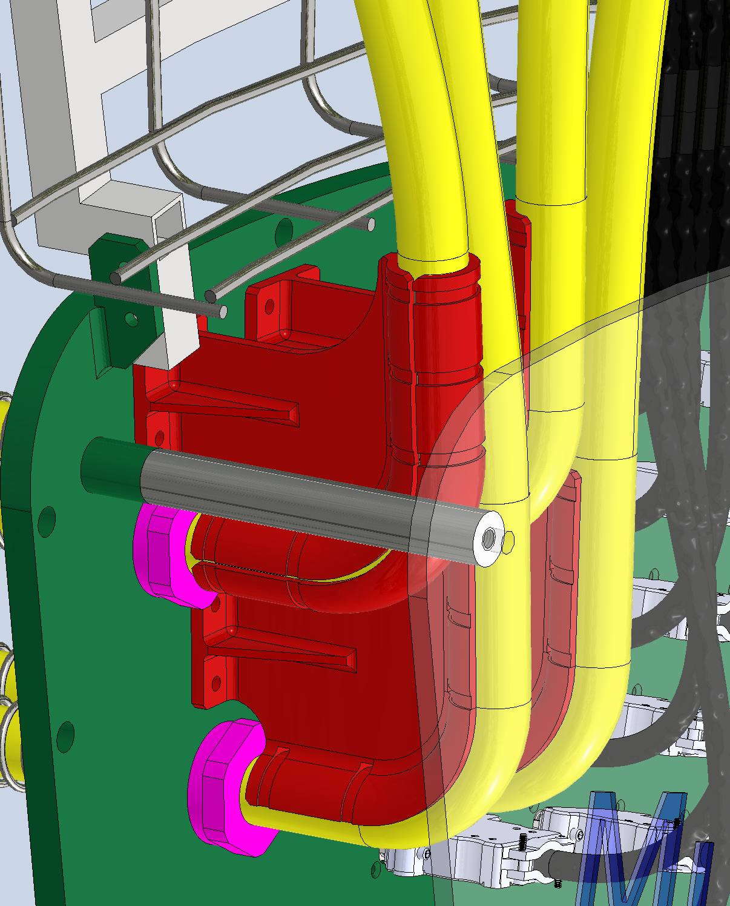
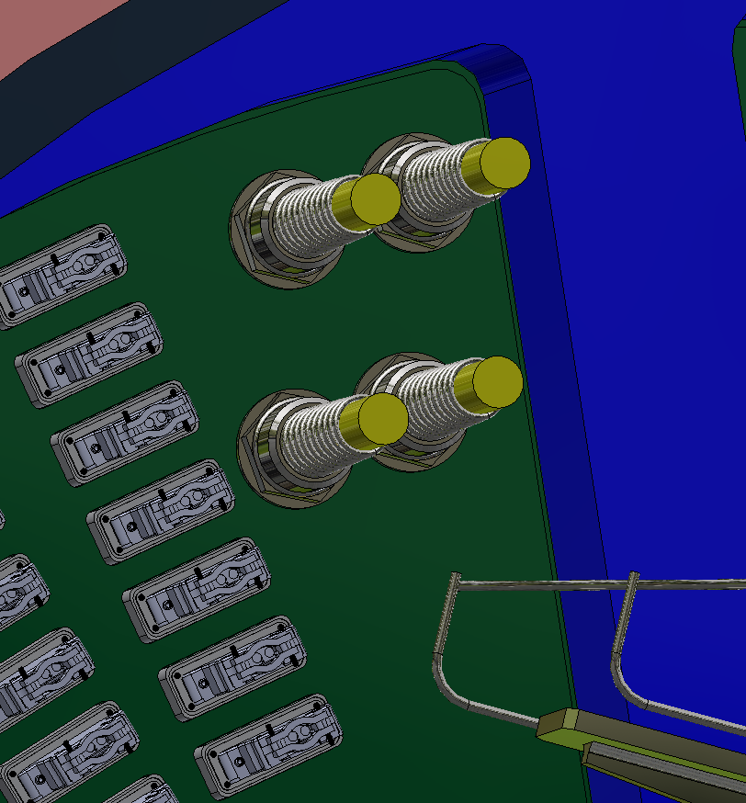
TDAQ fibers layout
nil volentibus arduum
Bending cable gland (back side)
TDAQ fiber supports (front side)
Bending radius = 50 mm

Slide 7
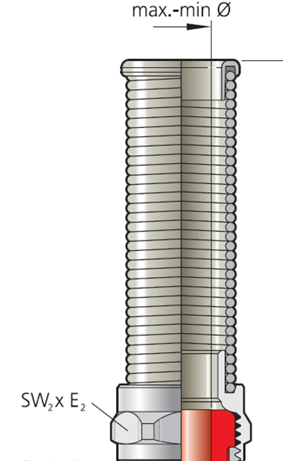
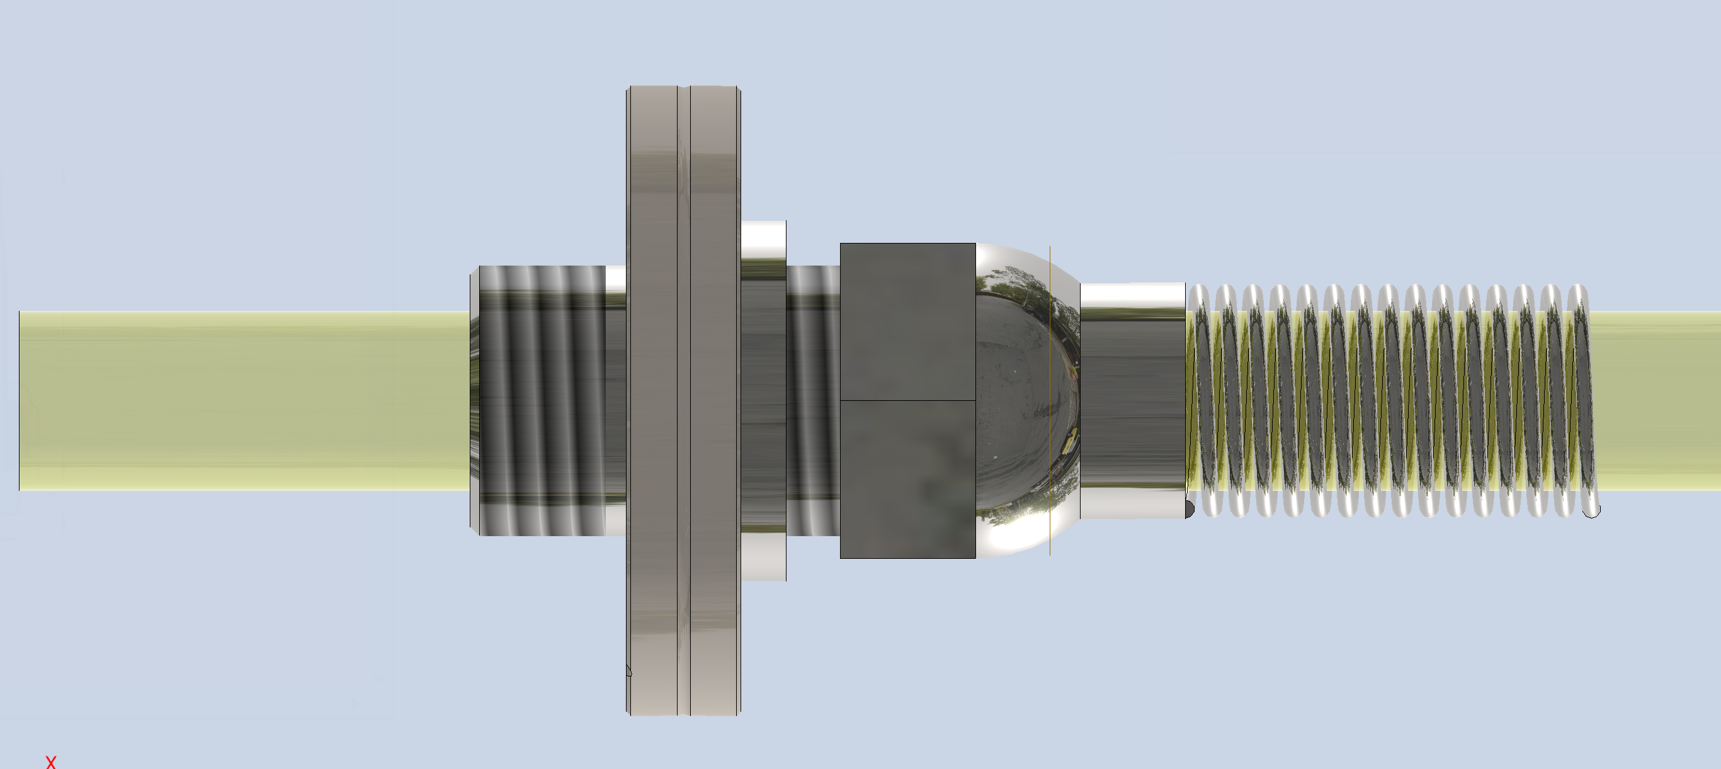
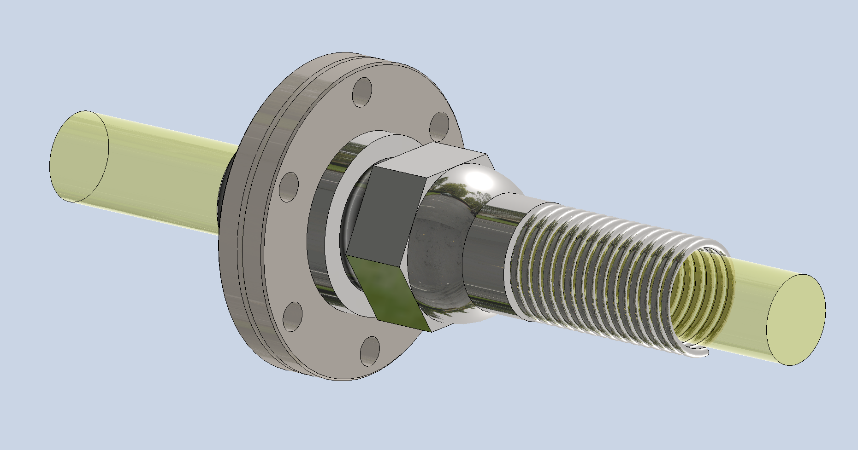
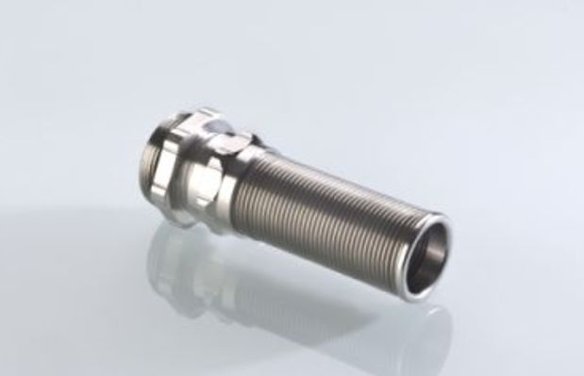
Bending Cable Gland
Bending cable gland
nil volentibus arduum
Bending cable gland

Slide 8
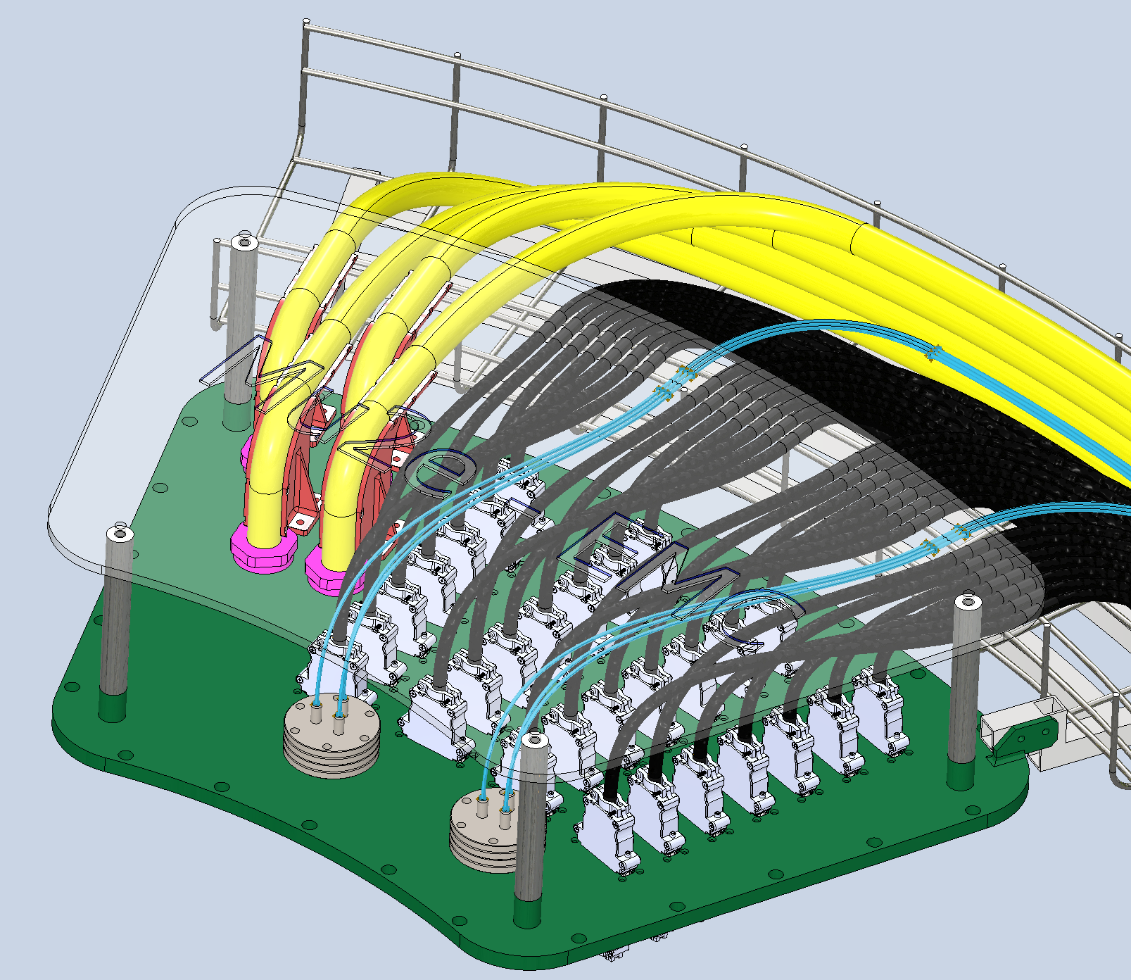
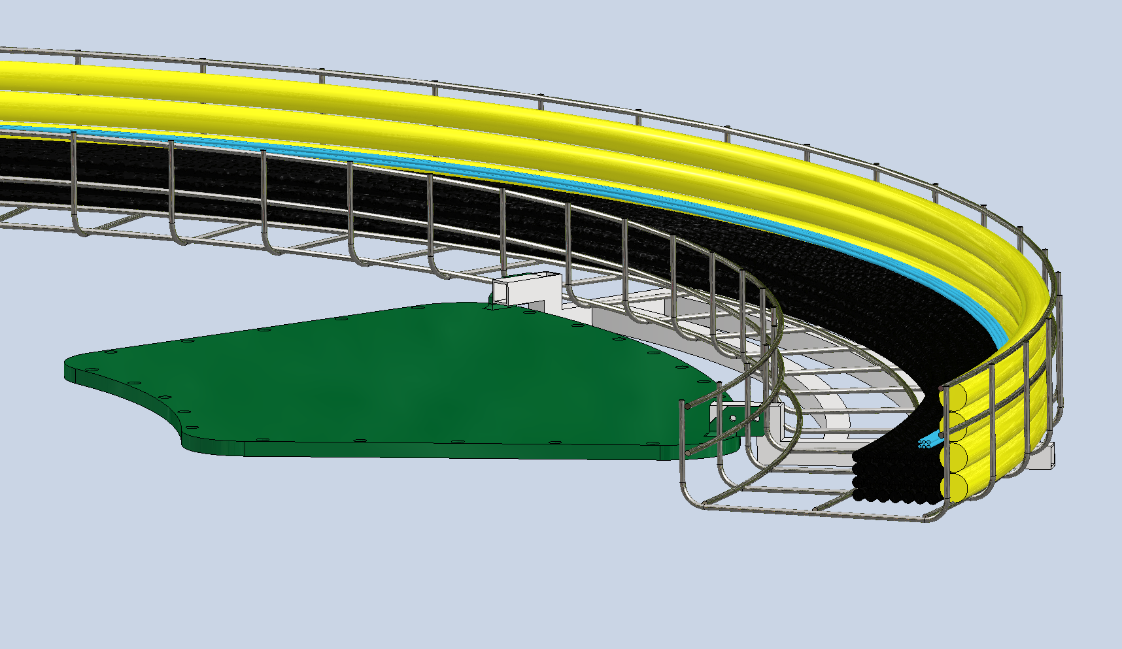
IFB layout
nil volentibus arduum
IFB Tracker Flange
Protection Panel
Cable Tray
IFB EMC Flange

Slide 9
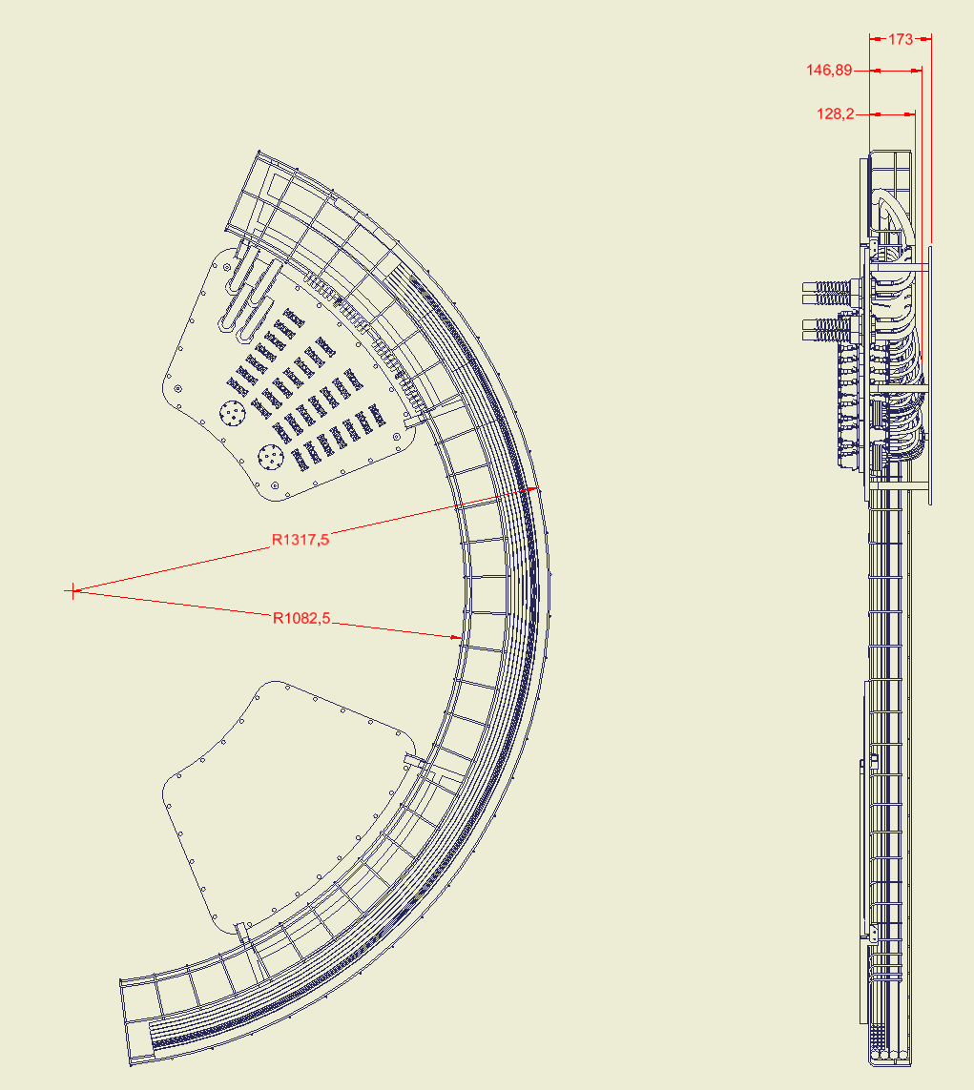
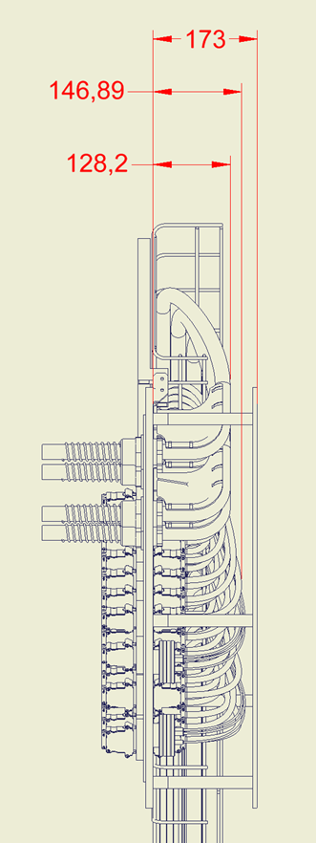
IFB cables & fibers max sizes
nil volentibus arduum

Slide 10
Things to do
nil volentibus arduum

Slide 11
nil volentibus arduum

Slide 12
nil volentibus arduum
BACKUP

Slide 13
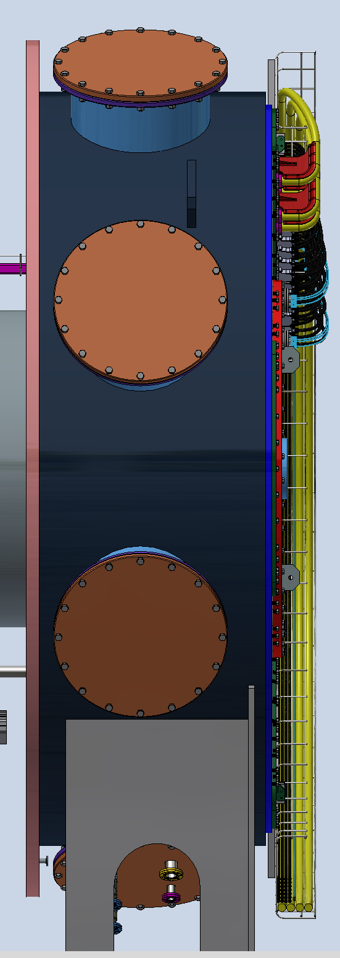
IFB layout
nil volentibus arduum

