Slide 1
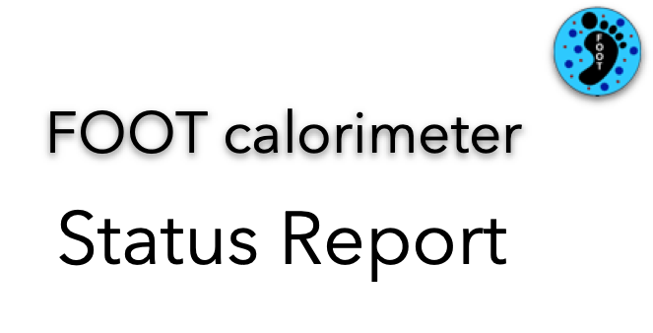
2020
Crystals: ready, fully characterised
SiPM:
problem with run @ FBK. Substrate selected, but quenching resistance 2 order of magnitude higher than it should be
new production starting, tiles ready by March 2021. Hopefully, no need for second run.
Gluing & Wrapping with Tyvek: @ CERN as soon as tiles ready. Cost: 18 kE, already allocated
Front-end board: ready to place order. Cost: ~ 15 kE, already allocated
Readout: WaveDream (40 kE) or CAEN digitisers (70 kE): test @ CNAO, August 30th
Cables: quotation to be requested
Power supply: CAEN SY5527, 3 HV boards, 3 LV boards: Cost: ~ 37 kE, already allocated
Distribution boards (48 HV and 24 LV out to 320 tiles): to be designed
Cables: quotation to be requested
All these orders can be placed by the end of 2020. Total: 110 (140) kE + cables
Availability: 1kE + 142.5 kE (sj)

Slide 2
2021
Cables: see above
Temperature readout: under study (slow control, serial readout, 320 channels)
Crate
DAQ: request could be avoided if test with WaveDream boards (CNAO, August 30th) will be successful
Mechanics:
design nearly finished
module holder validated, could be 3D printed @ LNF
general structure to be finalised
no need for cooling, just air flushing
holder for crystal gluing designed: to be 3D printed
holder for calibrations (9 crystals in line) to be designed & 3D printed
holder for module assembly to be designed & 3D printed

Slide 3
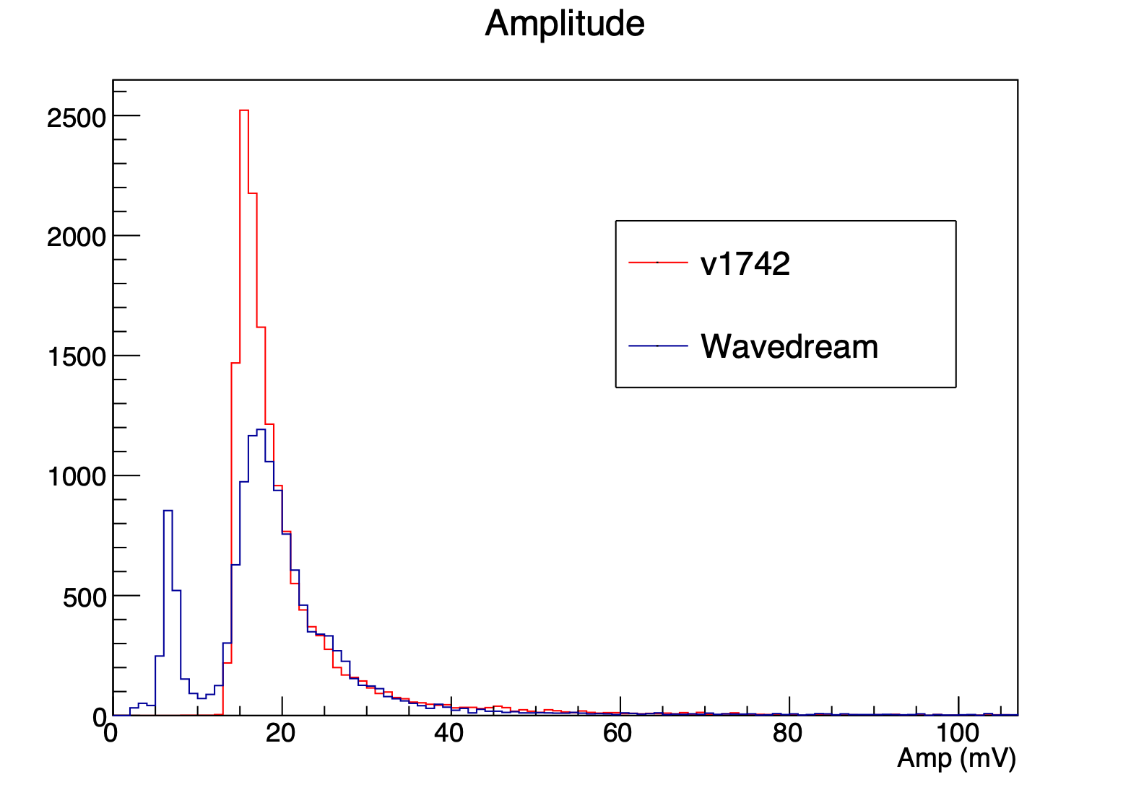
Wavedreams?
2020-08-25/26 Cosmic rays Data
Wavedreams
CAEN V1742
Crystal1
Crystal1
Crystal2
Crystal2
Crystal3
Crystal3
Trigger: 1&3
Trigger: 2
2020-08-28 Test @ CNAO

Slide 4
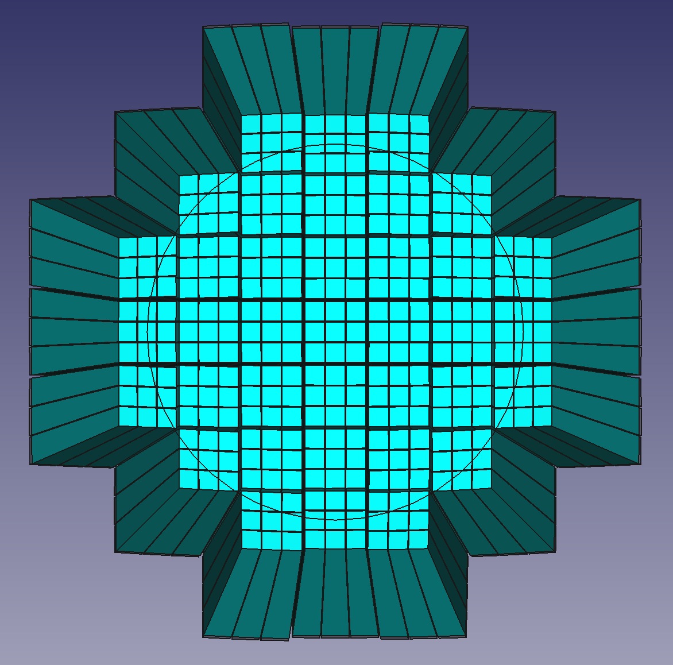
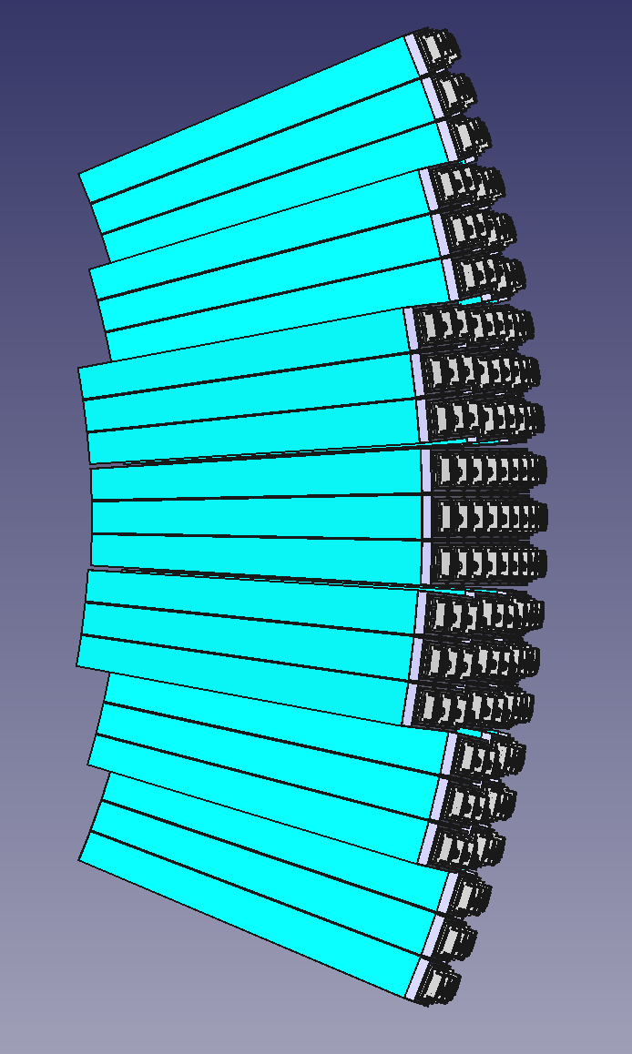
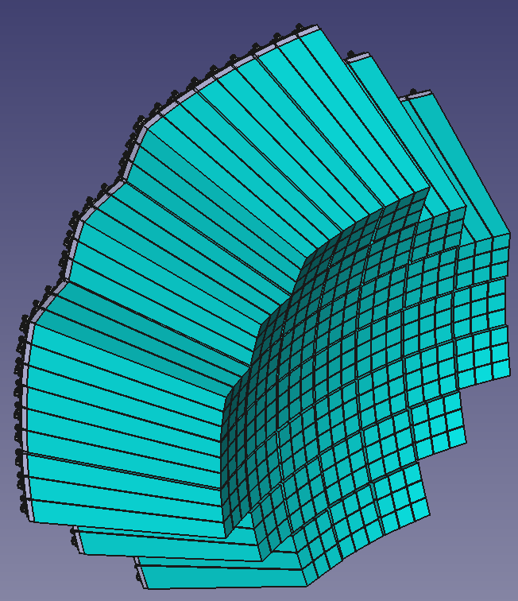
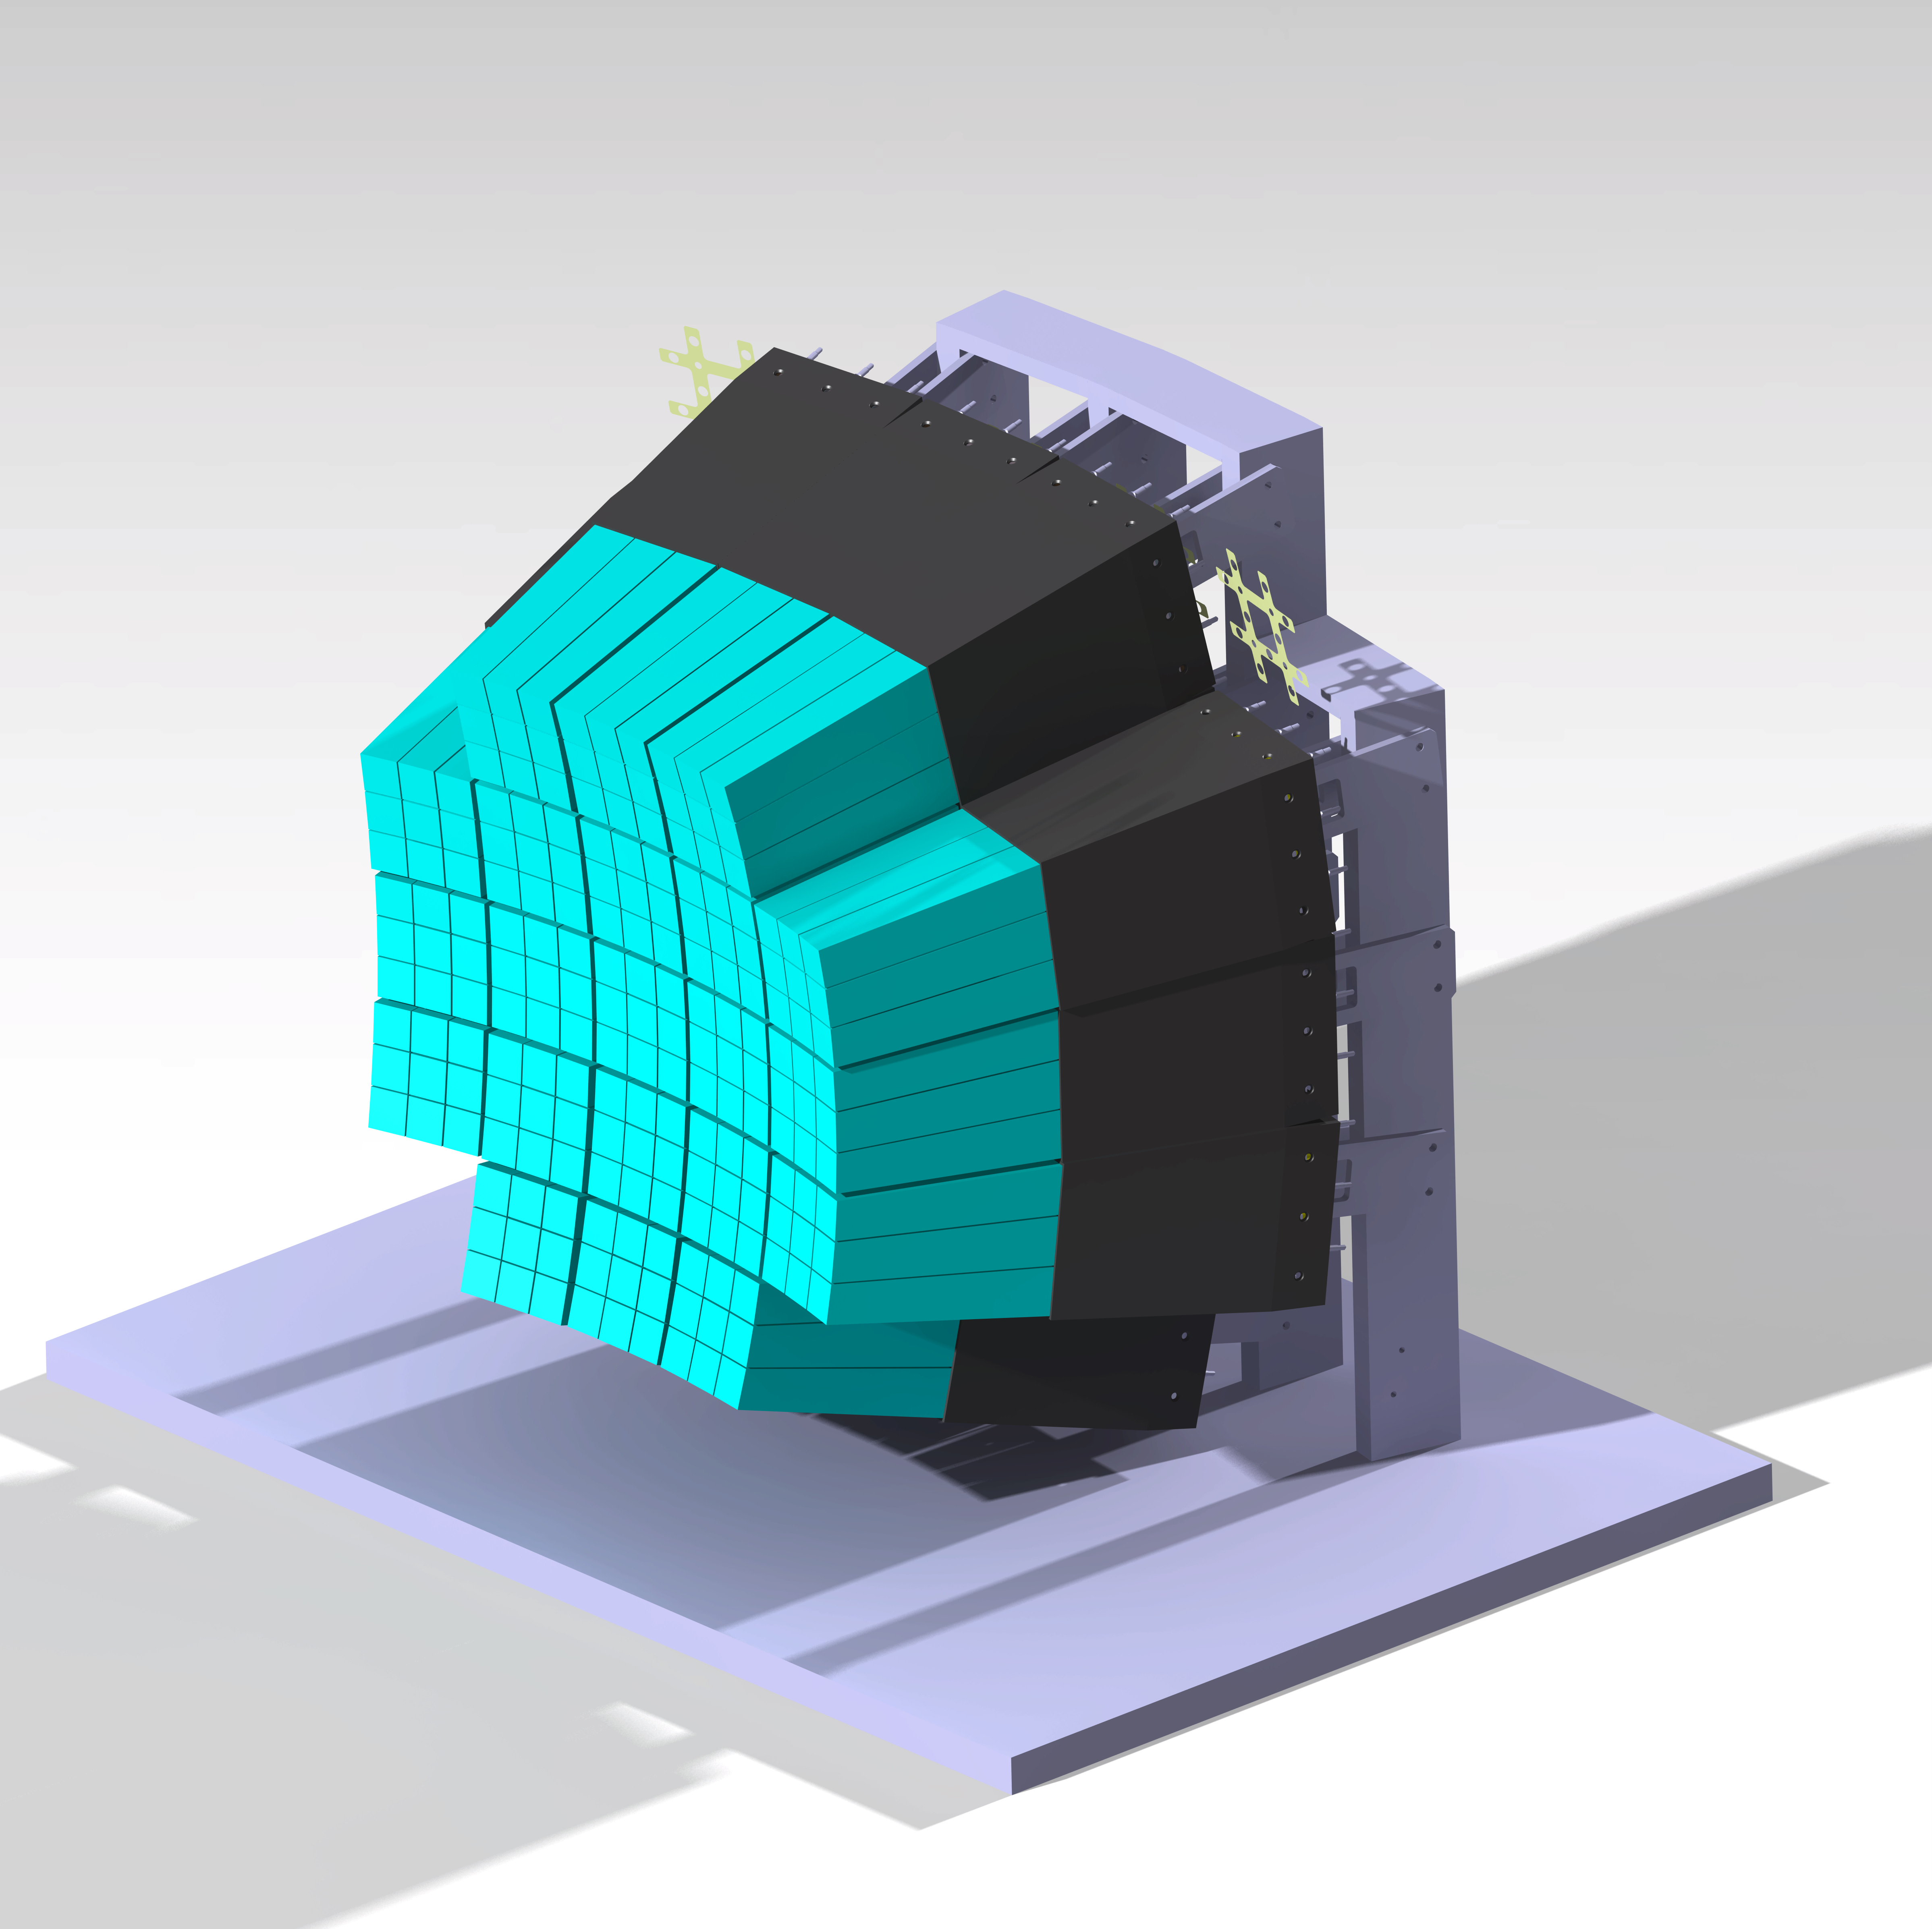
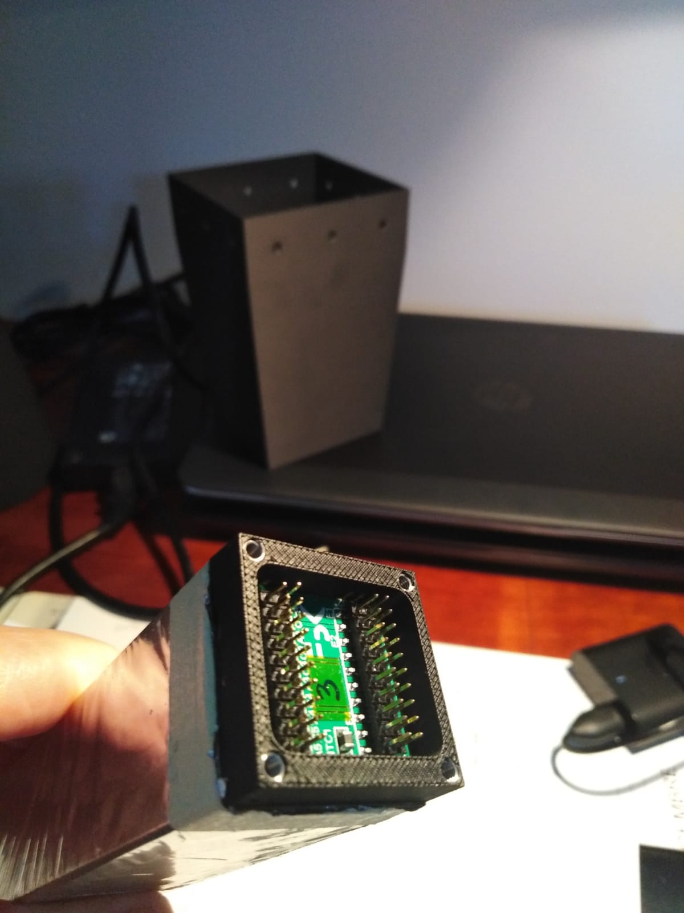
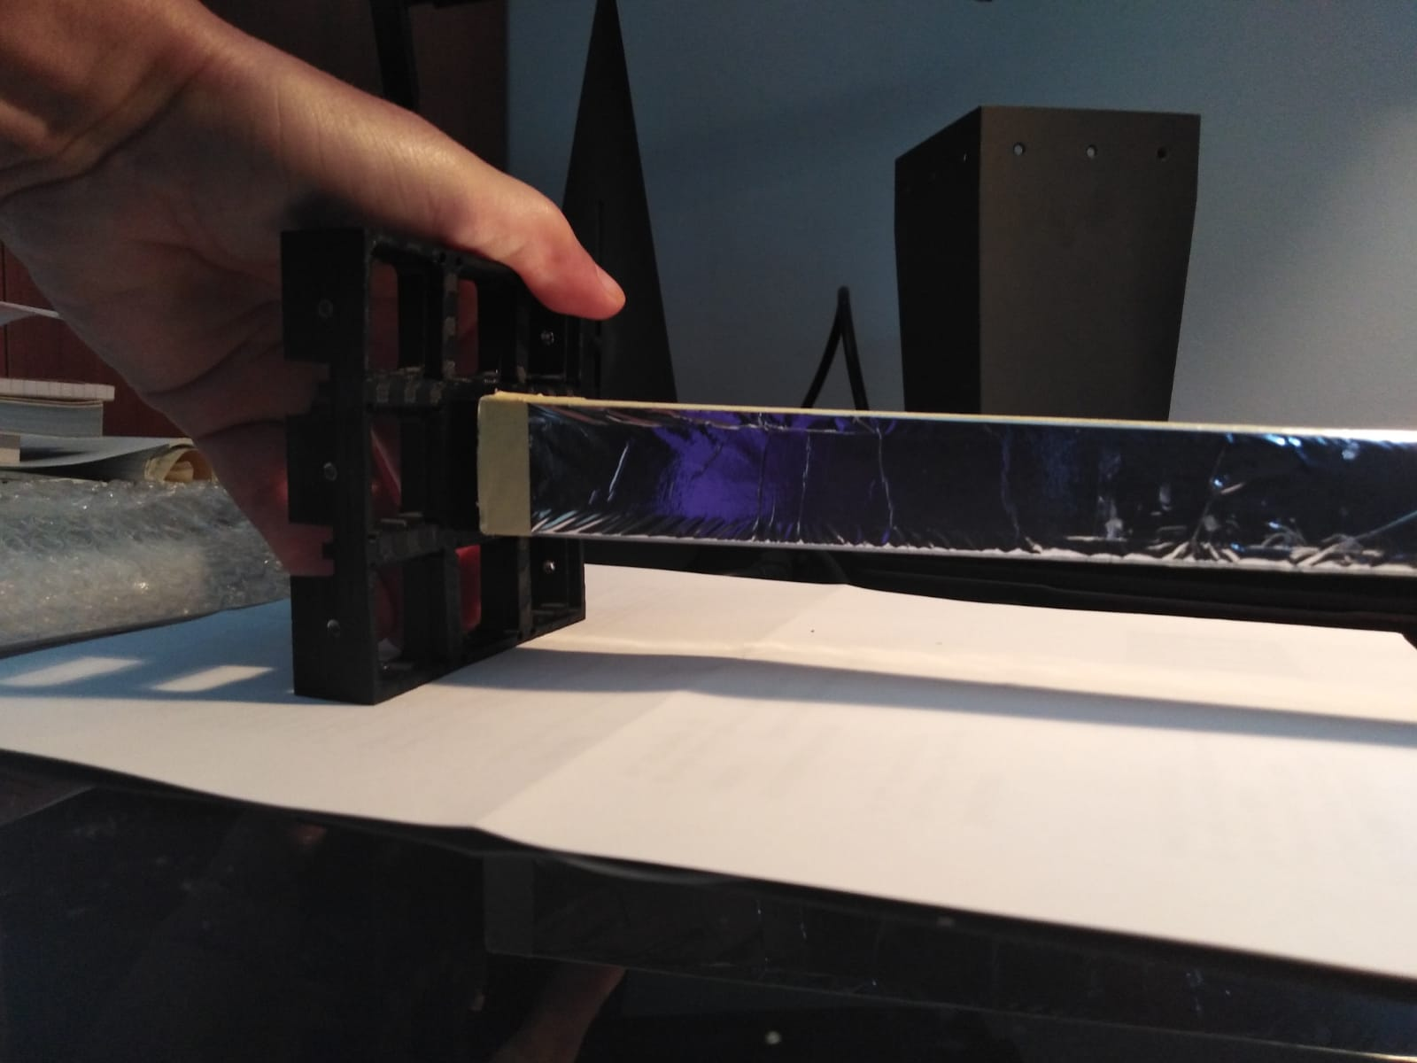
Mechanics

Slide 5
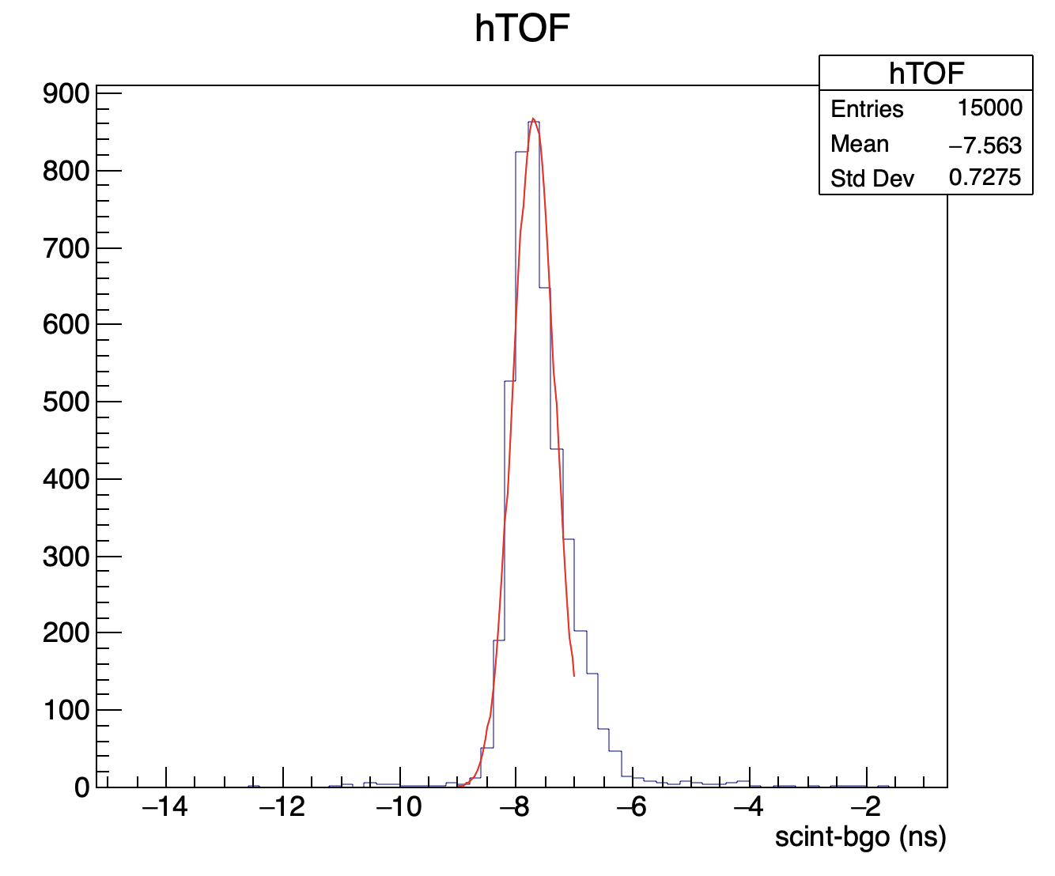
Neutrons?
Sci
Crystal
Beam

Slide 6
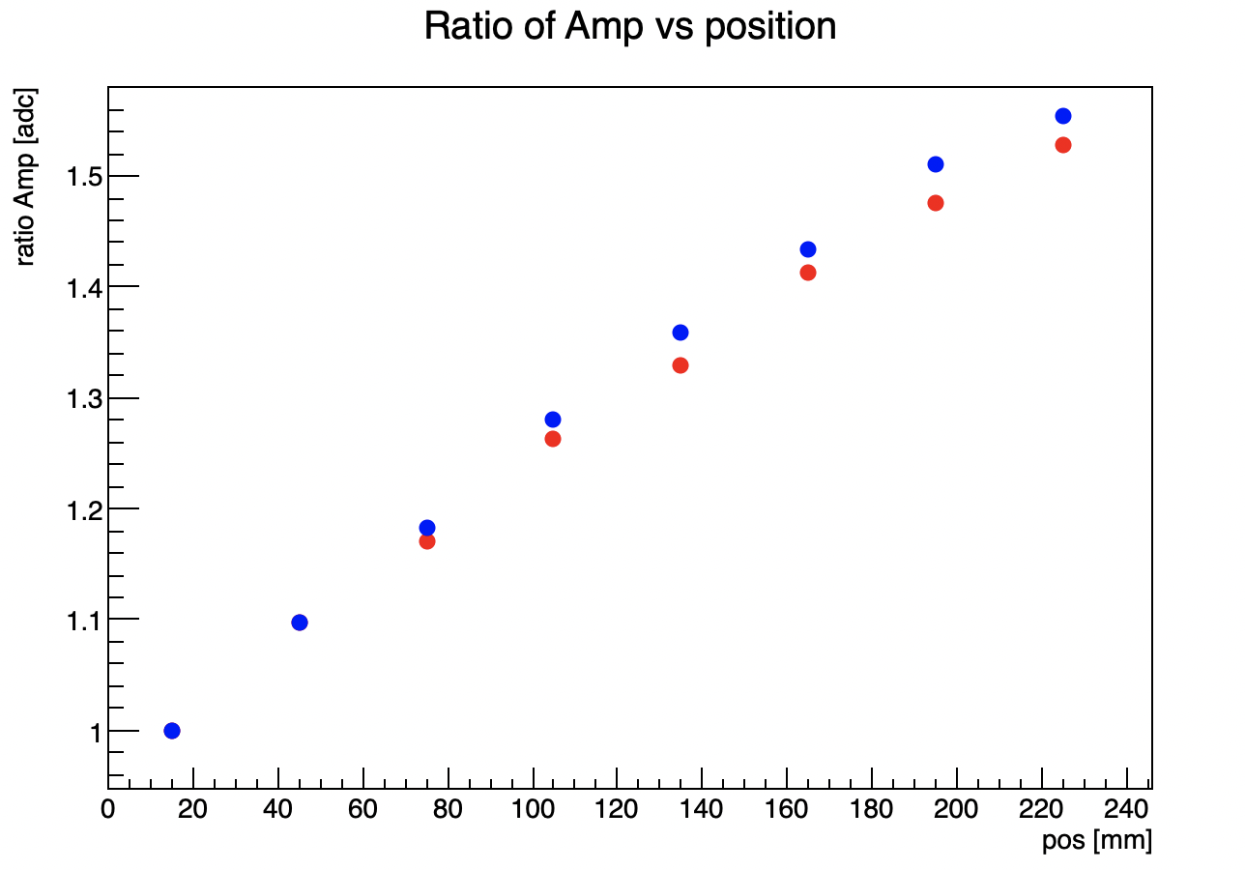
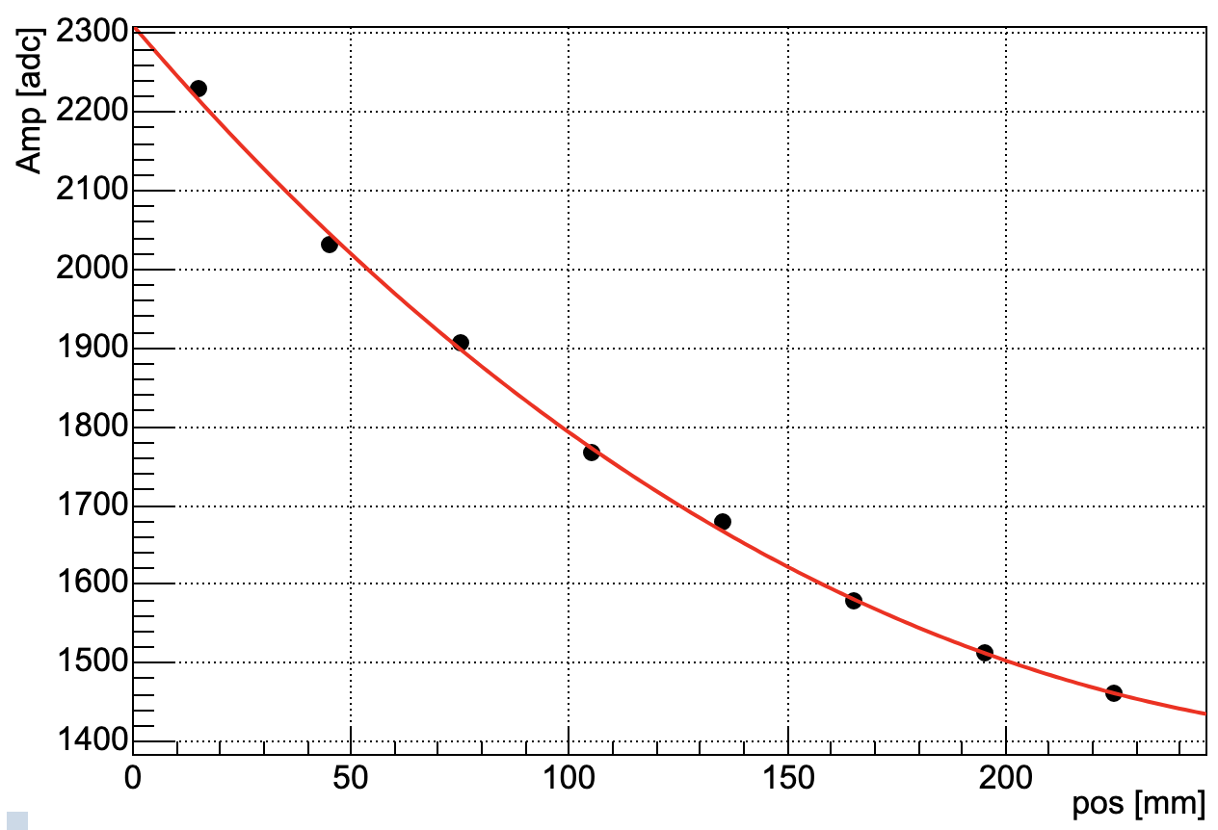
Range correction?
12C, 115 MeV/A
12C
115 MeV/A
260 MeV/A
Crystal1
Crystal2
Beam

