Slide 1
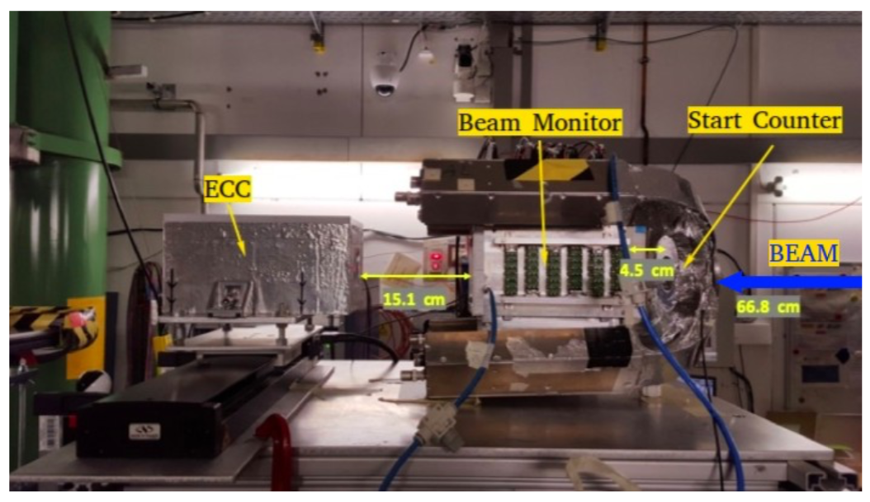
FOOT@TIFPA
Current activities:
Beam Monitor operation (emulsion and electronic setup)
GSI Run Coordination
Support for test beam @Trento
General Data Analysis
Best determination of A through standard χ² fit
12.14 ± 0.53
11.97 ± 0.45
12.4 ± 1.2

Slide 2
FOOT@TIFPA: anagrafica & servizi 2021
 | FTE (%)
F. Tommasino (RL) | 50
C. La Tessa | 30
B. Di Ruzza | 60
S. Colombi | 50
E. Verroi | 40
E. Bellinzona | 20
P. Spinnato | 20
E. Scifoni | 30
Contributi TIFPA:
Beam Monitor operation (TIFPA+Mi)
Run Coordination @GSI
Data Taking @CNAO
Supporto per test beam @Trento
Contributo Simulazioni/Analisi
Tot. 3 FTE
Richieste finanziarie 2019:
Consumo (gas e piccolo metabolismo): 1 kEuro
Traporti per GSI/CNAO 1 kEuro
Missioni (prese dati, meetings): 15 kEuro
Totale: 17 kEuro

