Slide 1
brief summary of 2020 analysis
2020 analysis summary
  Performance
    All subdetectors have been improved
    SC + Tof Wall (data CNAO+GSI)
  Physics measurements
    CNAO: XSection of 12C fragmentation
    GSI Data: Emulsion chamber
    GSI + CNAO Data:
  Neutron analysis
    evaluate FOOT capability to reconstruct n
Each subdetector is preparing a paper
Paper circulates in collaboration
Paper published (IEEE Transaction on Radiation and Plasma Medical Science)
Paper circulates in collaboration
Xsection analysis ongoing

Slide 2
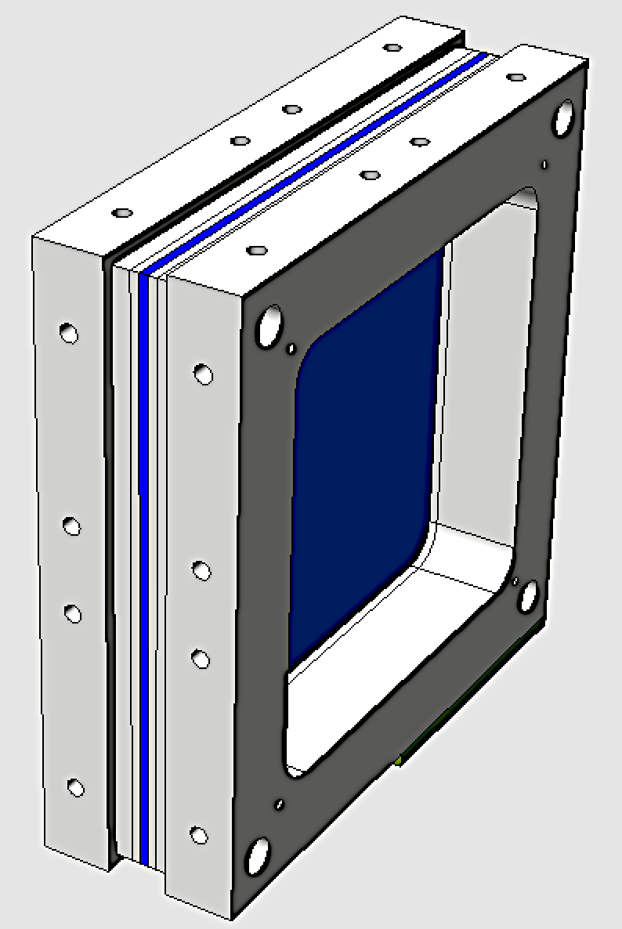

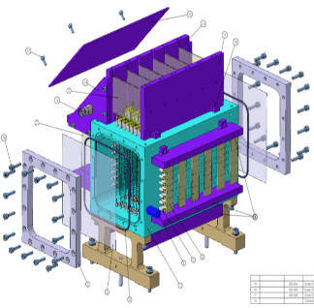
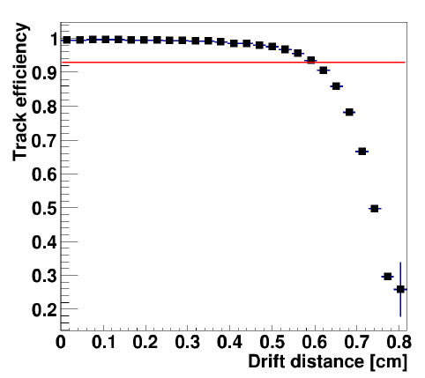
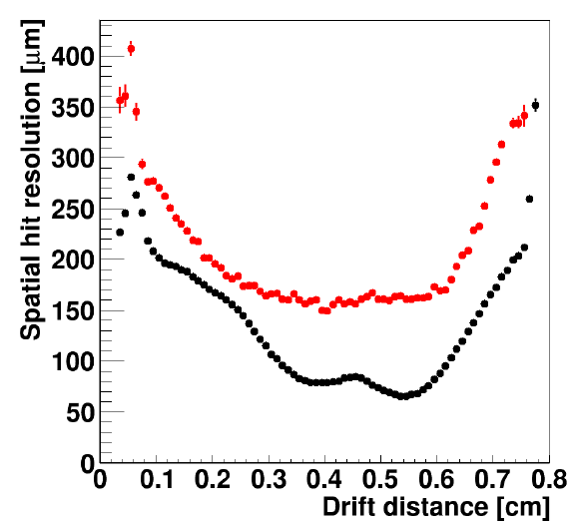
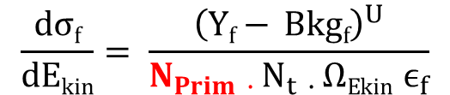
Beam definition: SC + BM
SC
BM
FOOT
. . .
. .
.......
….
. .
….
. .
$$\frac{dσf}{dEkin}= \frac{{\left(Yf− Bkgf\right)}^{U}}{N_{Prim ∙ }{N_{t ∙ }ΩEkin ϵ}_{f}}$$
. . .
. .
Count n° of particles
Initial Trigger
Time start
Discard SC fragmentation
Extrapolate vertex direction
Evaluate beam direction
Intrinsic spatial resol
60 - 100 μm
hit efficiency ~ 0.93
NEW: 53 ps!!
Beam monitor
(BM)
GSI-2020
Angular resolution:
  1.6 mrad p@228 MeV/u
  2.1 mrad p @ 80 MeV/u
Spatial resolution:
  150 ± 10 μm p@228 MeV/u
  300 ± 10 μm p@ 80 MeV/u

Slide 3
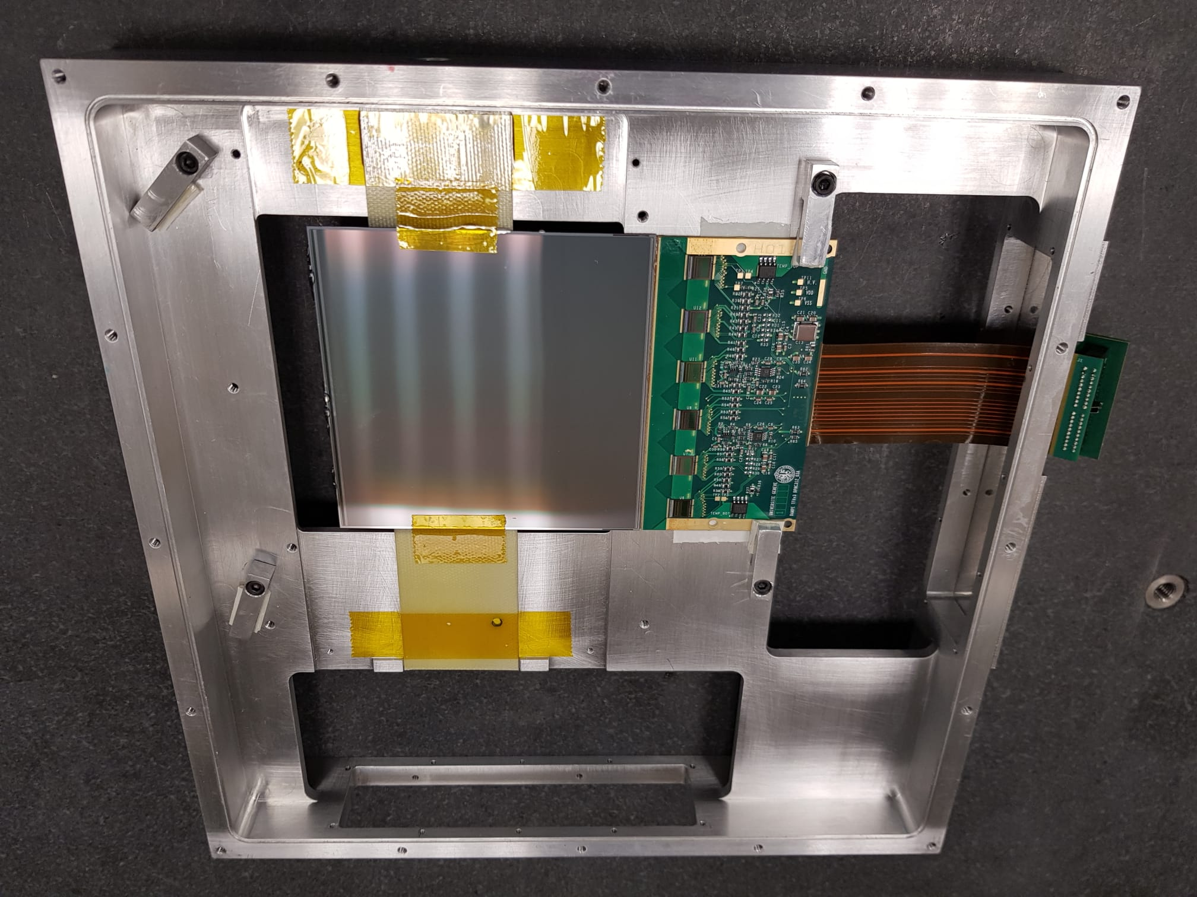
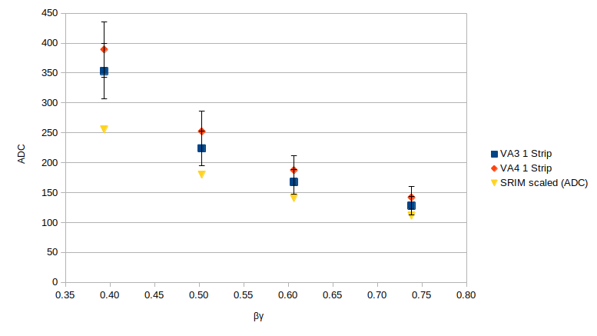
Tracking system: VTX – ITR - MSD
MSD
Trento 12/2019
  p energy: 10, 112, 159, 228 MeV
  Comparison OLD/NEW chips
VTX
GSI (2019) data taking:
  Track efficiency ~25%
BTF (july 2019)
  Firmware → eff.~ 100%
ITR
new
Beam ꓕ MSD
Saturation when beam at 5° wrt MSD

Slide 4
Tof Wall
CNAO + GSI
Tof
Detector is complete
Data taking at CNAO-GSI (march-april 2019) and CNAO (dec 2019)
Energy
Z resolution 2.5-6%
¹⁶O @ 400 MeV/u on C
Resolution:
  Energy: 4-6 %
  Time SCN: 40-50 ps for ¹²C and 150-190 ps for p
  Tof (SC+TofW): 50-75 ps for ¹²C – ¹⁶O
  250 ps for p
  Position: 7 mm for 12C and 15 mm for p
Paper circulates inside collaboration

Slide 5
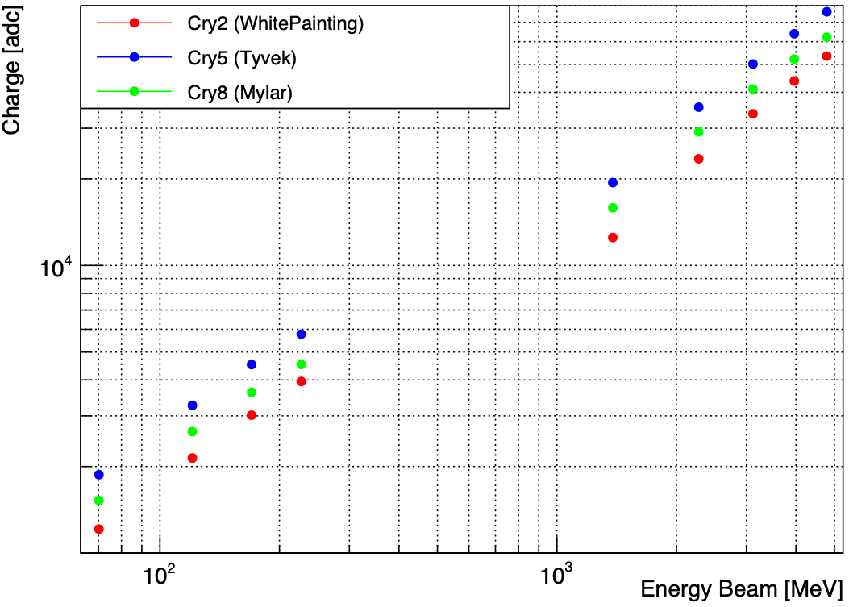
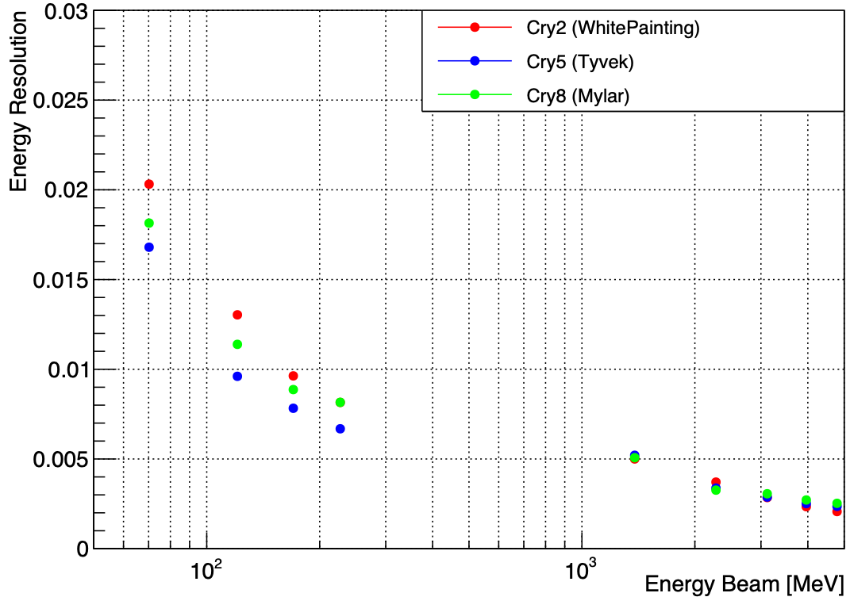
Calorimeter, 1
White Paint
1
2
3
Test beam overview:
9 crystals
15 µm SiPM arrays
3 reflective wrappings: White Painting, Mylar and Tyvek
Proton Energy: 70, 120, 170, 227 MeV
Carbon Energy: 115, 190, 260, 330, 399 MeV/A
Temperature part:
  For each energy 4 different temperature
Tyvek
Tyvek
Tyvek
4
5
6
7
8
9
Mylar
Tyvek reflects more light
Better Energy Resolution

Slide 6
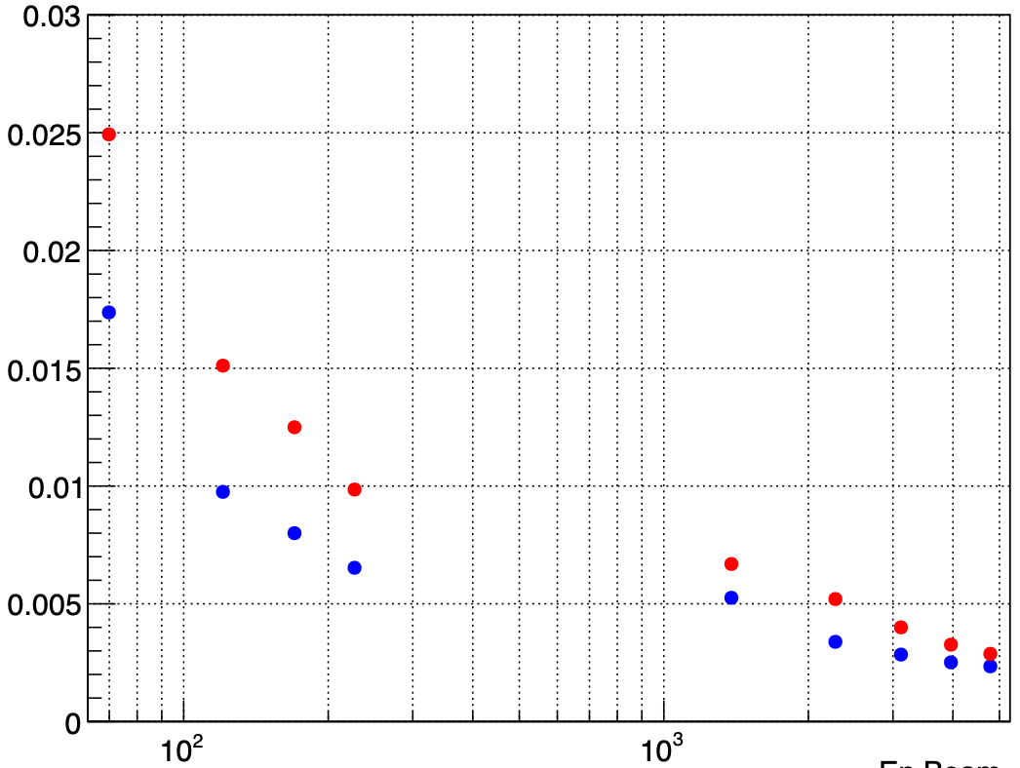
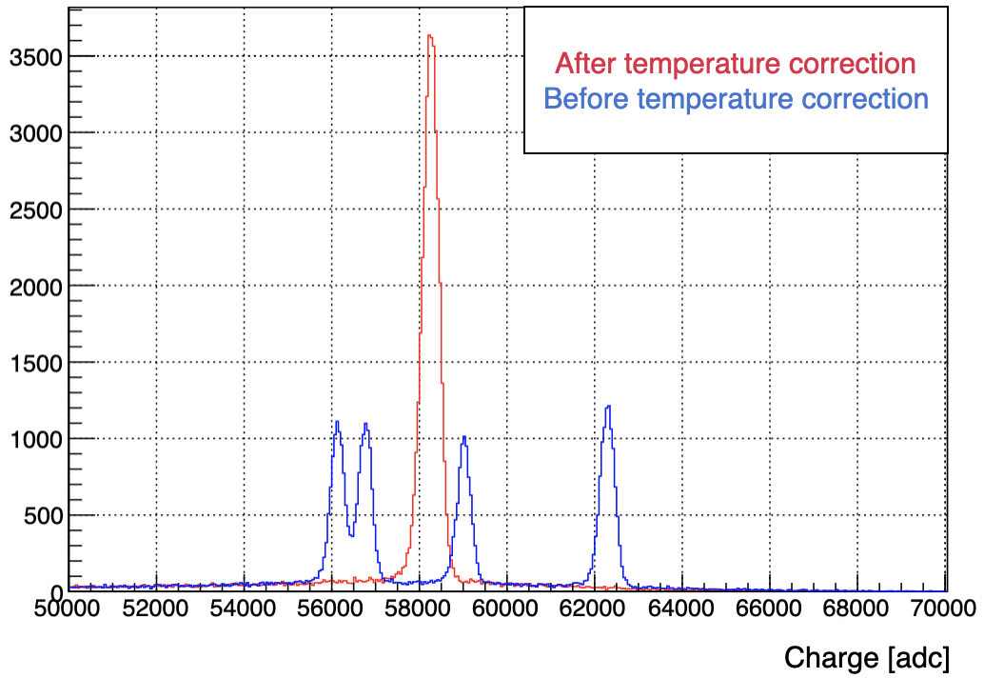
White Paint
Calorimeter, 2
Sum of 4 histograms after T correction
1
2
3
Tyvek
Tyvek
Tyvek
goal
4
5
6
7
8
9
Mylar
Signal depends on temperature (max fluctuation ~ 10%)
temperature sensor?
Ebeam [MeV]
Slightly worsening resolution, but better than 2% after T correction
Peaks at ≠ T
¹²C @ 330 MeV/A
Crystals: all set
Mechanics: full design
SiPMs: in production
DAQ: integration to global to be started

Slide 7
Physics measurements 2020
Data taking @CNAO
First Cross Section measurement published by FOOT
Emulsion setup:
  April 2019
  February 2020
Data taking @GSI (2019-20)
Paper circulates in collaboration
Analysis ongoing
Data taking @CNAO & GSI (2019)
Experimental Setup (partial)
Xsect: analysis ongoing

Slide 8
Differential Cross Section measurements
p on C, O, H
Detector: scintillators + crystal
p production
d on C, O, H
Published:
  60° and 90°
Ongoing
  32° and 50°
T on C, O, H

Slide 9
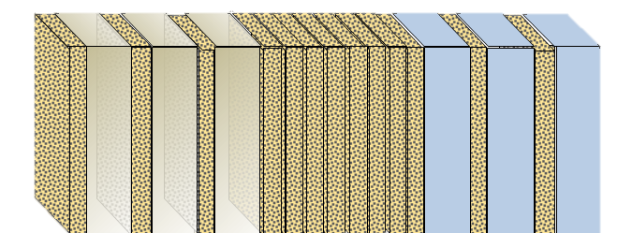
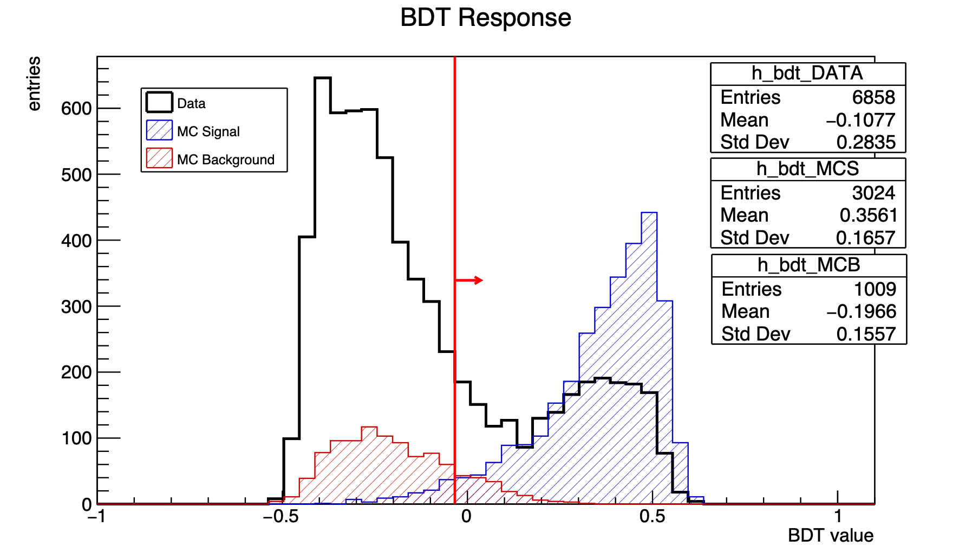
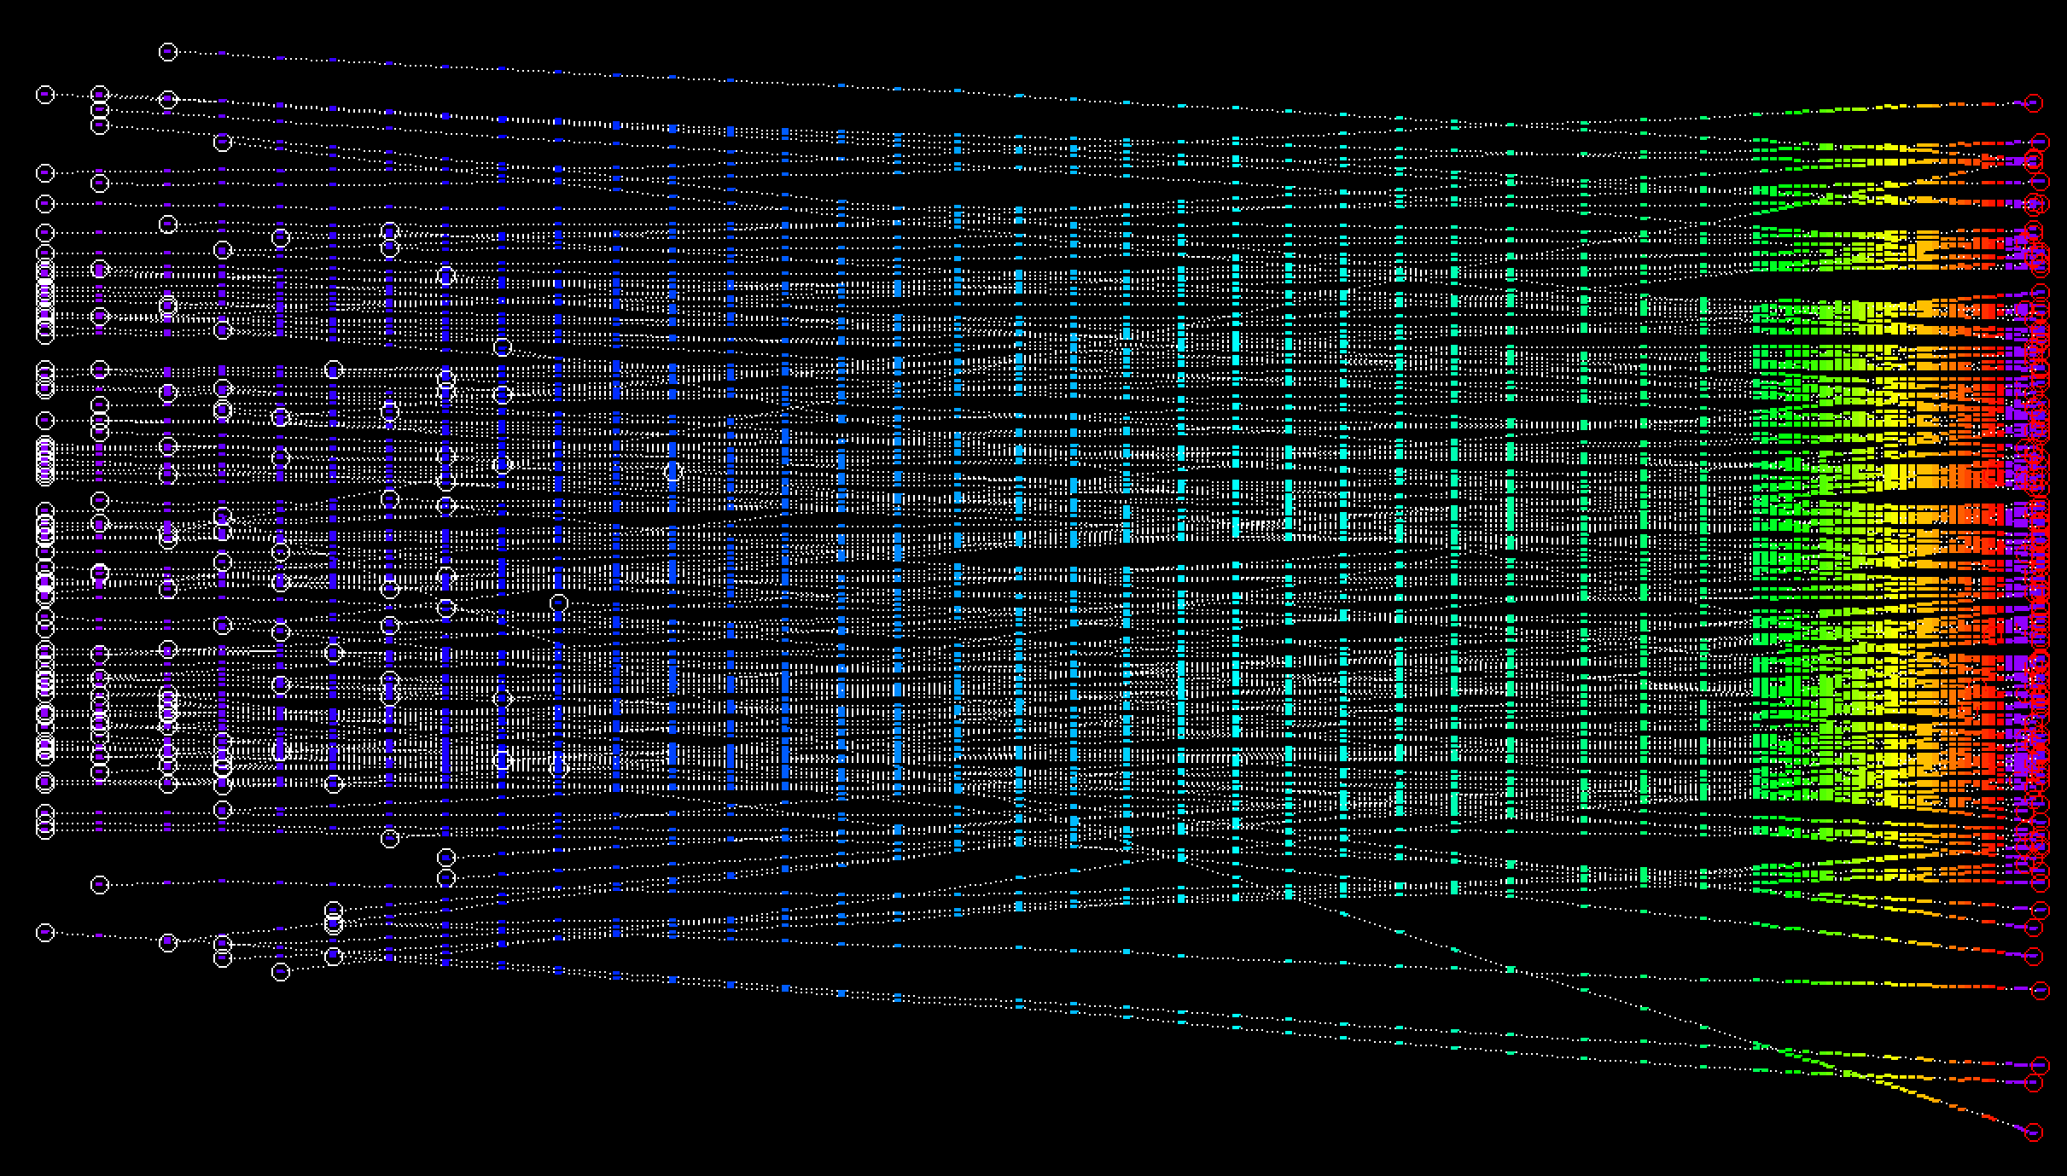
10 cm
Emulsion setup: Tracks and vertices
Section 1
vertexing
Section 2
Charge Id
Section 3
momentum
Paper circulates inside collaboration
Track reconstruction done separately for each section
Merge tracks in two sections: 13026 tracks crossing > 30 layers
BDT multivariate analysis to select good vertexing out of bkg
  MC: 72% of true vertices selected
  DATA: ~ 40% of expected vertices reconstructed
Vertex search to be improved
300 μm
1 mm
Emulsion layer
1 mm
Emulsion layer
C or C₂H₄
Pb layer
GSI 2019
MC signal
DATA
MC bkg
S1
S2

Slide 10
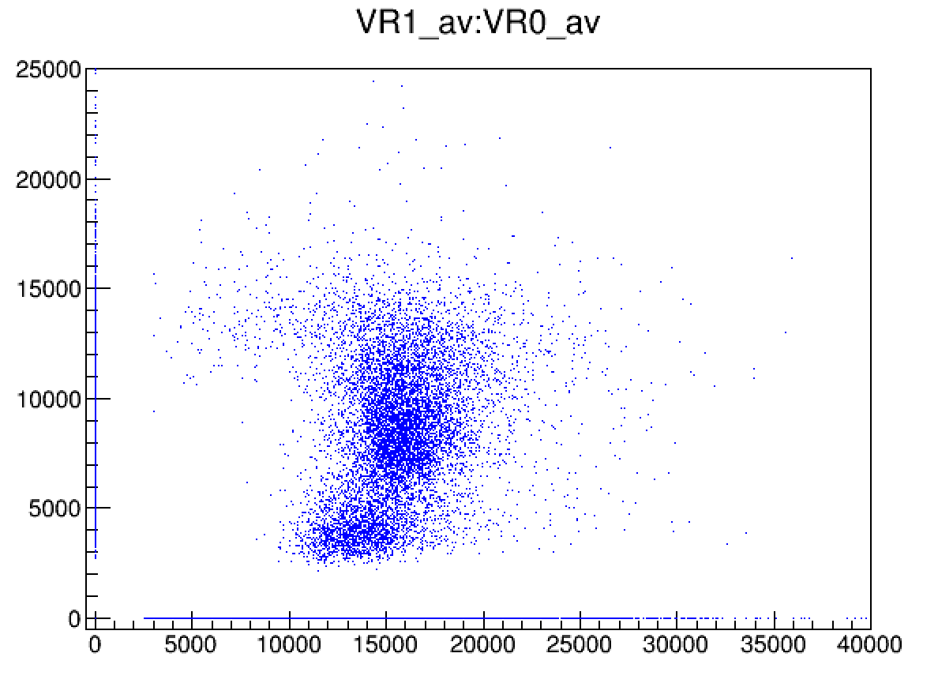
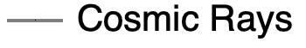
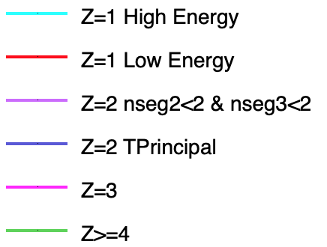
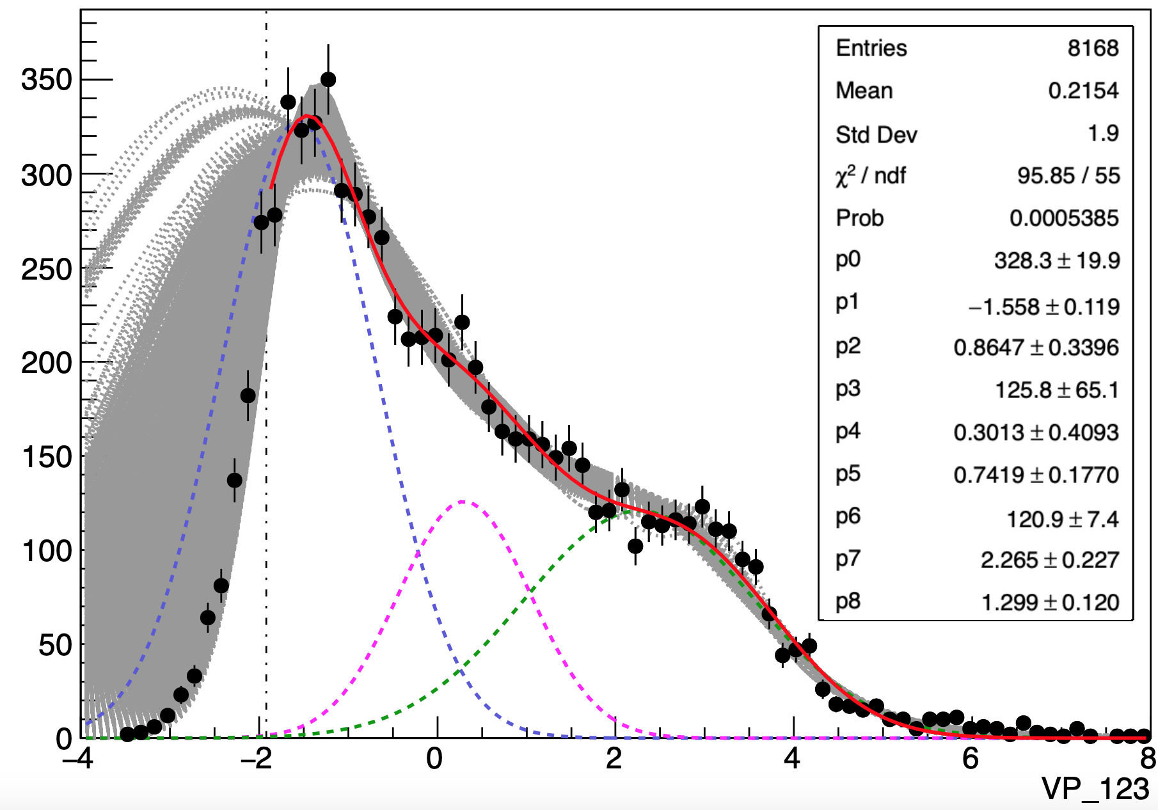
Emulsion setup: charge measurement
VR1
Charge assigned to 99.4% of reconstructed tracks
Sharp cuts
Principal Components Analysis
Charge assigned to 91.4% of tracks attached to a vertex
VR0
Z | % on total charged reconstructed tracks
 | Result | Systematic err | Gauss Par err | Statistic err
1 | 67.9% | 5.3% | / | 0.5%
2 | 19.8% | 1.2% | 0.02% | 0.4%
3 | 7.0% | 0.6% | 0.03% | 0.2%
≥4 | 5.3% | 0.3% | 0.01% | 0.2%

Slide 11
Cross section with CNAO-GSI data (2019): electronic setup
MC
Z_MC
MC: ¹⁶O – 200 MeV/u
Z_rec
DATA
DATA
Fragments Z identification in SHOE available
Good ZID performances (wrong Z charge assigment < 4.8%)

Slide 12
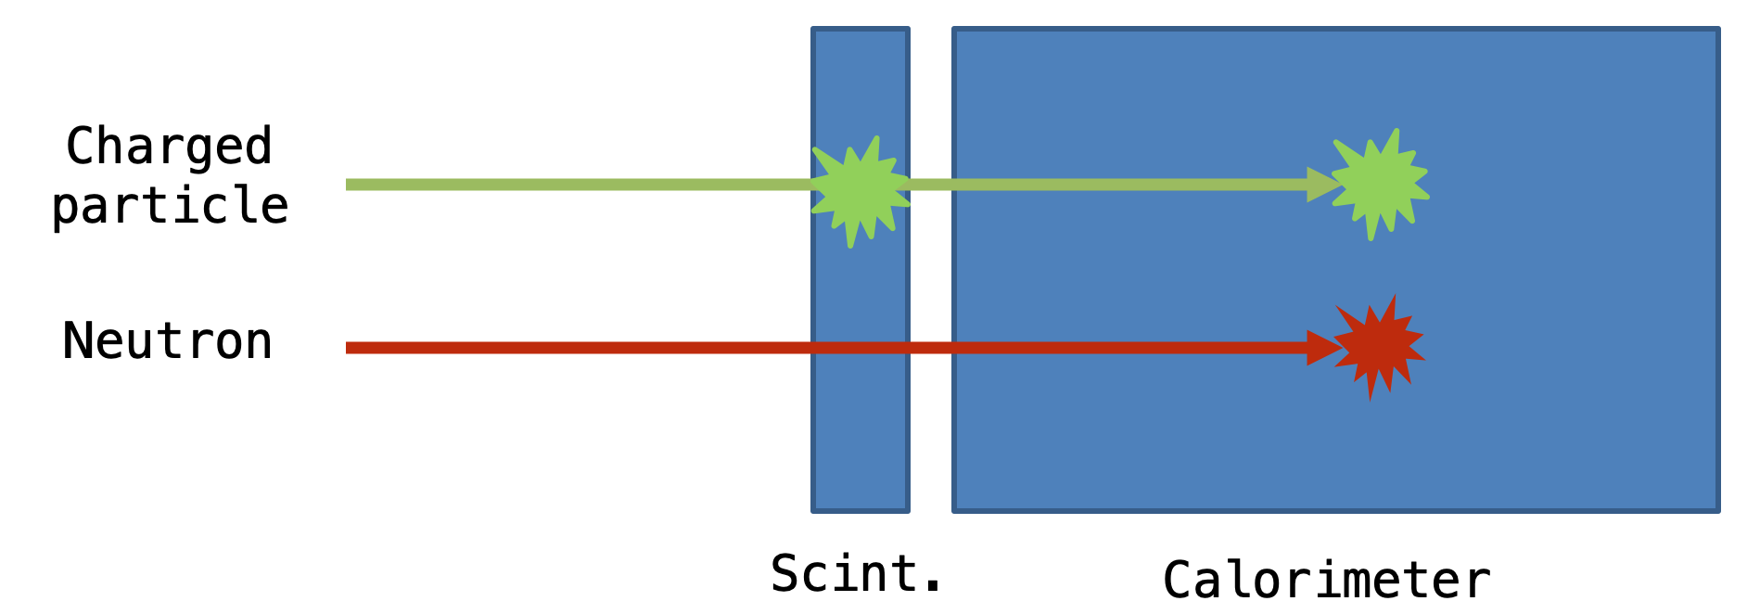
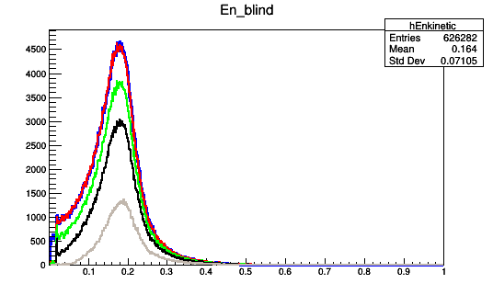
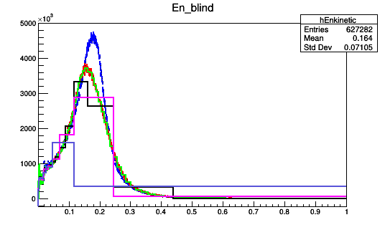
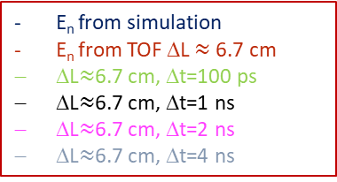
Neutron @ FOOT
Preliminary studies on ¹⁶O+C₂H₄ @200 MeV/u (MC data)
Investigate the possibility to use SCN & CALO to detect neutrons
Neutron detection and energy measurement with TOF method
E_{n} from simulation
No threshold
Th. 5 MeV
Th. 10 MeV
Th. 50 MeV
E_{n} from simulation
E_{n} from TOF ΔL $≈$ 6.7 cm
ΔL$≈$6.7 cm, Δt=100 ps
ΔL$≈$6.7 cm, Δt=1 ns
ΔL$≈$6.7 cm, Δt=2 ns
ΔL$≈$6.7 cm, Δt=4 ns
Kinetic Energy, GeV
Reliable Calorimeter Threshold ~ 20 MeV
ε ~ 25% accettable
γ Bkg contribution negligible
Kinetic Energy, GeV
Calorimeter Time resolution better 1 ns

Slide 13
Backup slides

Slide 14
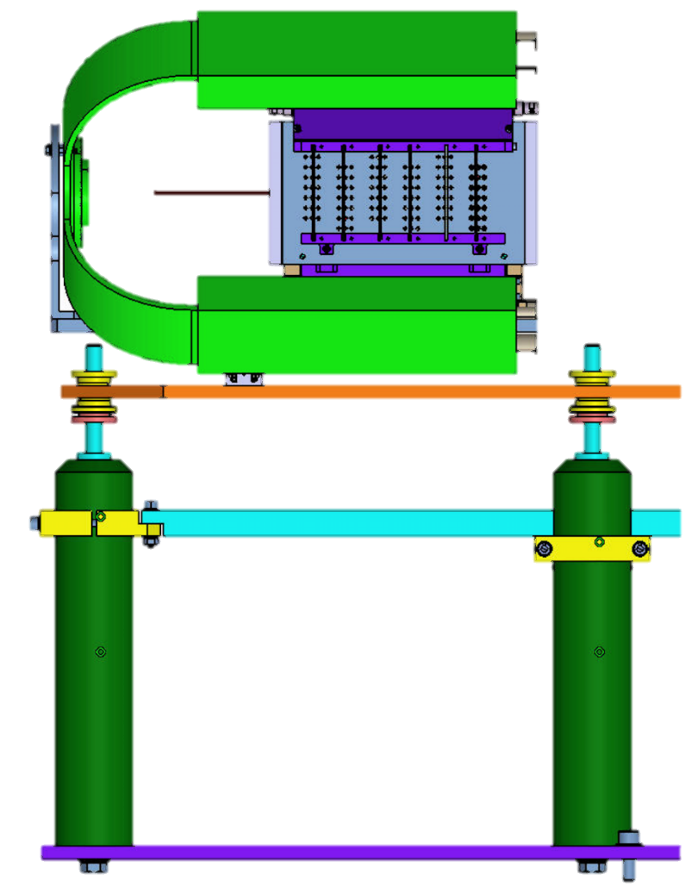
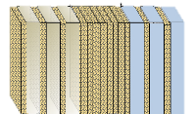
FOOT
. .
. .
. . .
Detector performance requests
.......
….
….
. .
. . .
. .
Beam Energy: 200 MeV/u
Beam monitor
Start counter
Emulsion Chamber
We have to remember:
  tof: 70 ps or better
  p: 4% or better
  E_{kin}: 1.5% or better
  ΔE: 4% or better
Beam
Reconstruction of:
  vertex
  p with range
  p with multiple scattering
  Z id: (thermal treatment)
  E_{kin}: range measurement
Beam Energy: 700 MeV/u
Analysis without calorimeter:
  Tof, p, ΔE: more precise

