Slide 1
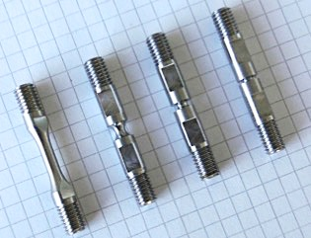

Materials testing in extreme loading conditions
The Laboratory

Slide 2
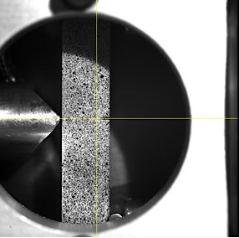
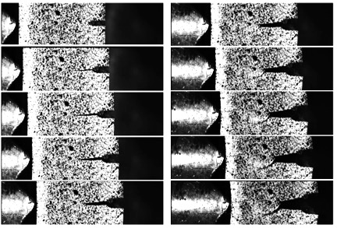
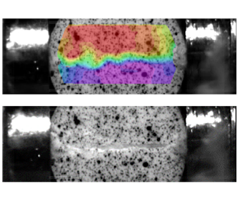
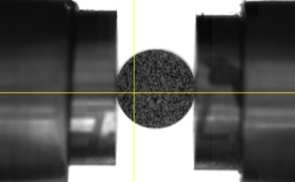
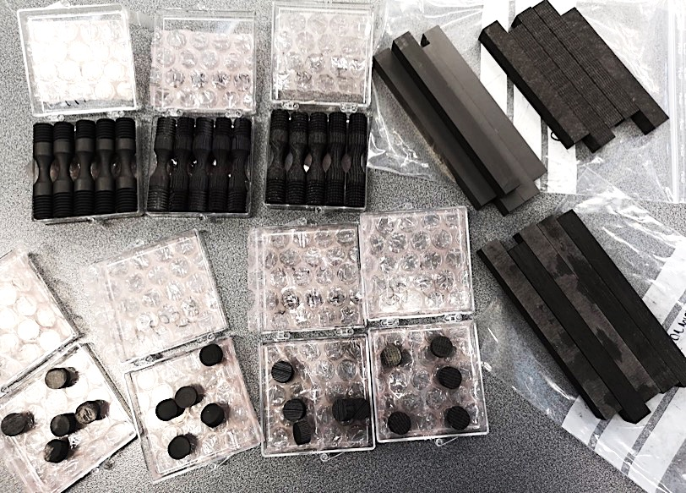
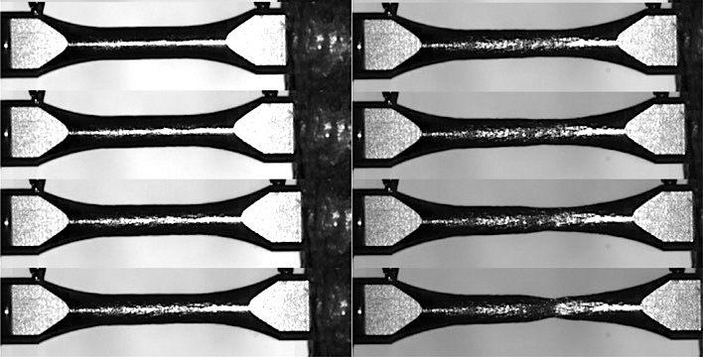
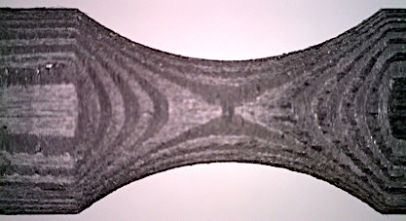
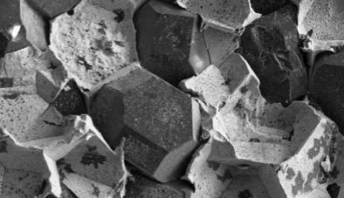
_{Steel}
Dynamic Fracture Mechanics
Dynamic testing of brittle material
Mechanical testing of carbon based composites material at high temperature
Al₂O₃
GR
2DCC
3DCC
Dynamic high temperature tensile tests
HRC 70
HRC 40
3DCC
Metal-Diamond
Iridium @1250°C
Extreme loading conditions lab tests

Slide 3
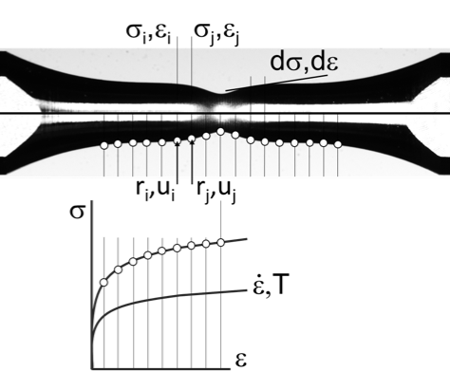
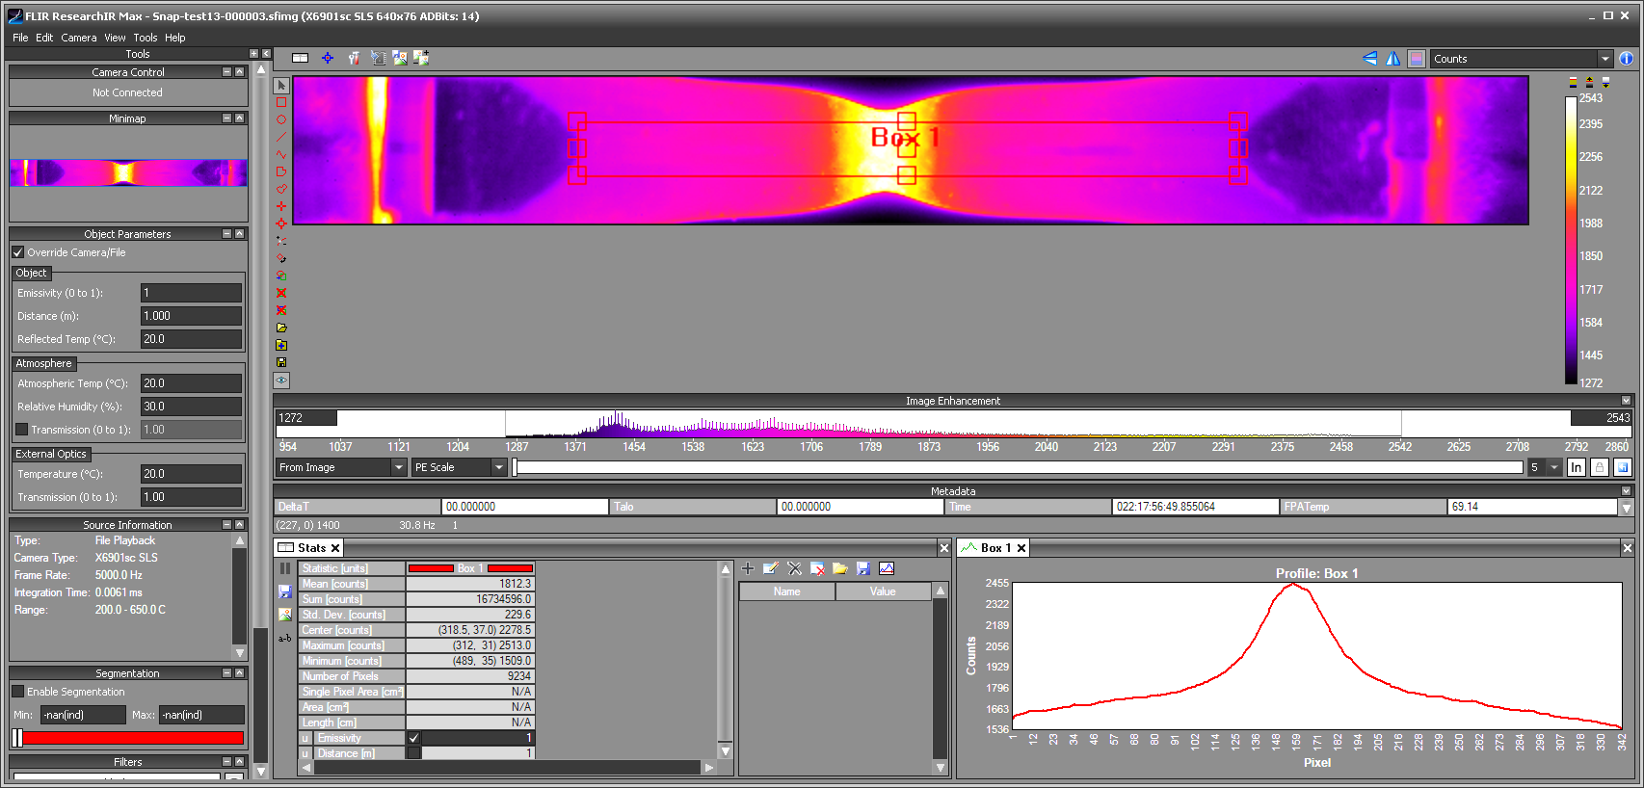
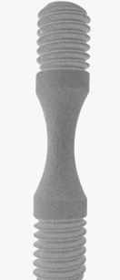
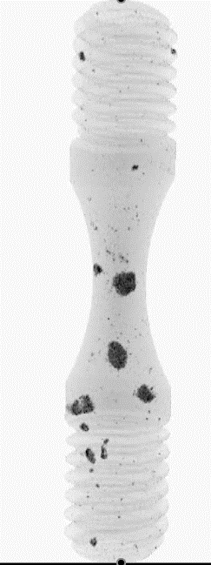
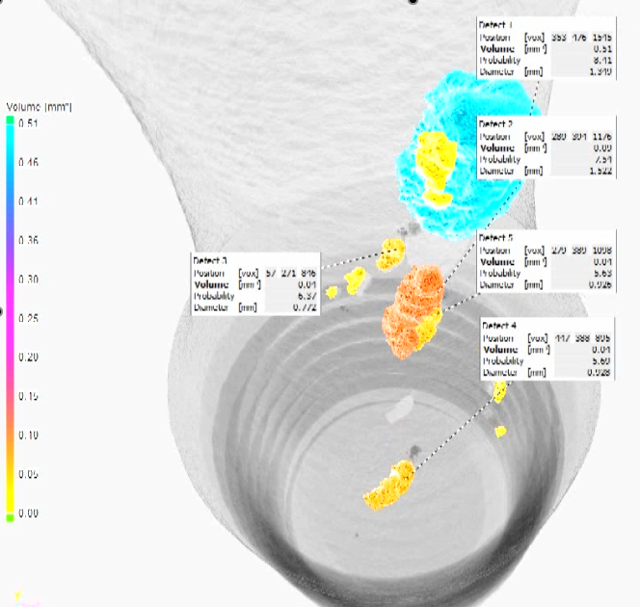
Material model calibration
Non conventional methods for material characterization based on digital image analysis
Direct Temperature evaluation in dynamic tests
CT scan
High speed infrared camera
Structure & defects effects on materials behaviour
Material characterization and analysis

