Slide 1
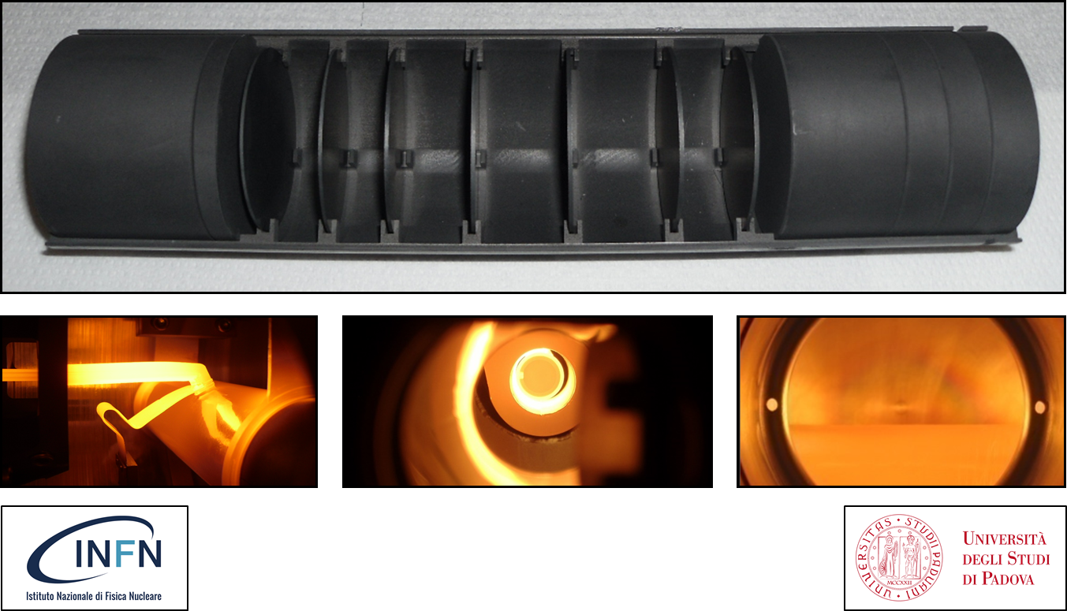
Design of High Temperature ISOL Targets
Mainly taken from M. Manzolaro’s
presentation at the HPTW 2018
S. Corradetti, M. Manzolaro, D. Scarpa, A. Monetti, L. Centofante

Slide 2
Introduction: the ISOL (Isotope Separation On Line) technique
primary beam driver
production target
high temperature
diffusion
effusion
P
transfer line
high temperature
radiative heat transfer
ion source
+
+
+
+
+
charge breeder (1+ → n+)
& post accelerator
mass separator

Slide 3
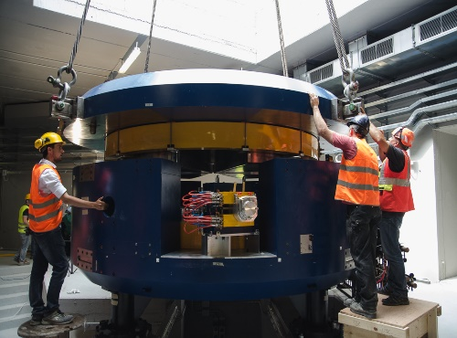
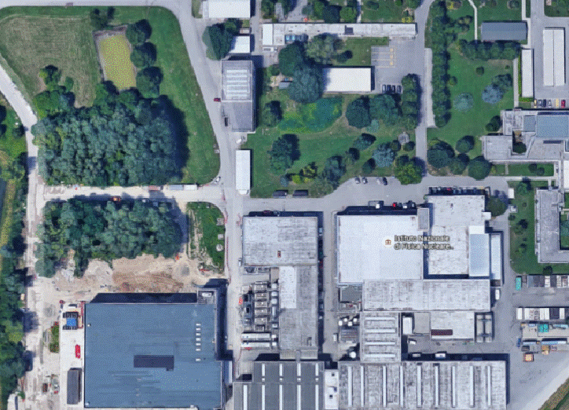
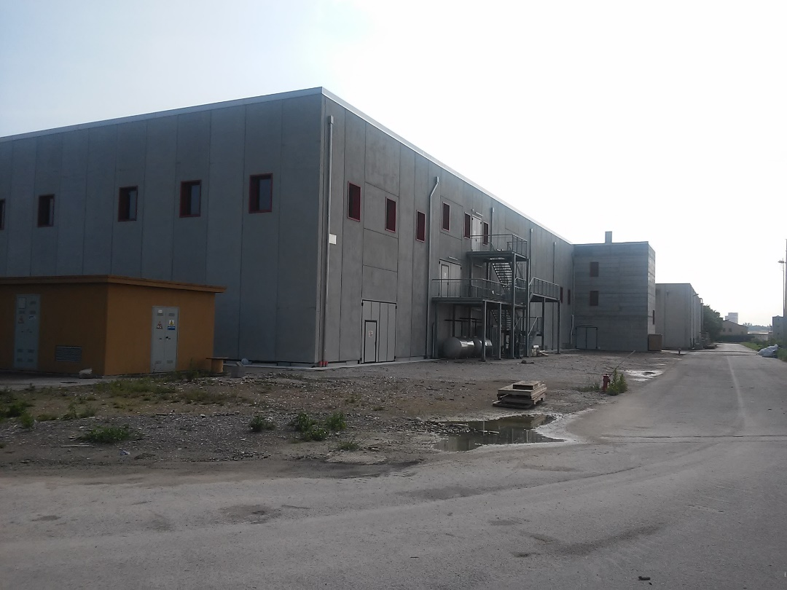
Introduction: the SPES facility @ LNL
SPES is: 1) A second generation ISOL RIB Facility (for neutron-rich radioactive ion beams)
2) An interdisciplinary Application Facility (for p,n applications)
New infrastructure for:
Cyclotron
ISOL RIB Facility
Application Facility

Slide 4
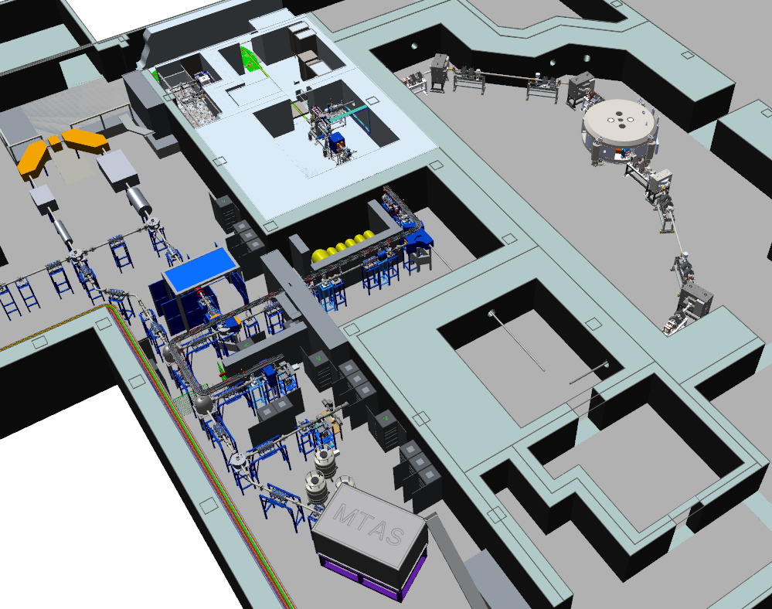
Introduction: the ISOL RIB (Radioactive Ion Beam) facility
ISOL hall
40 MeV 200 µA primary proton beam
1⁺ RIB @ LE
to MRMS/HRMS
and n⁺ RIB @ HE

Slide 5
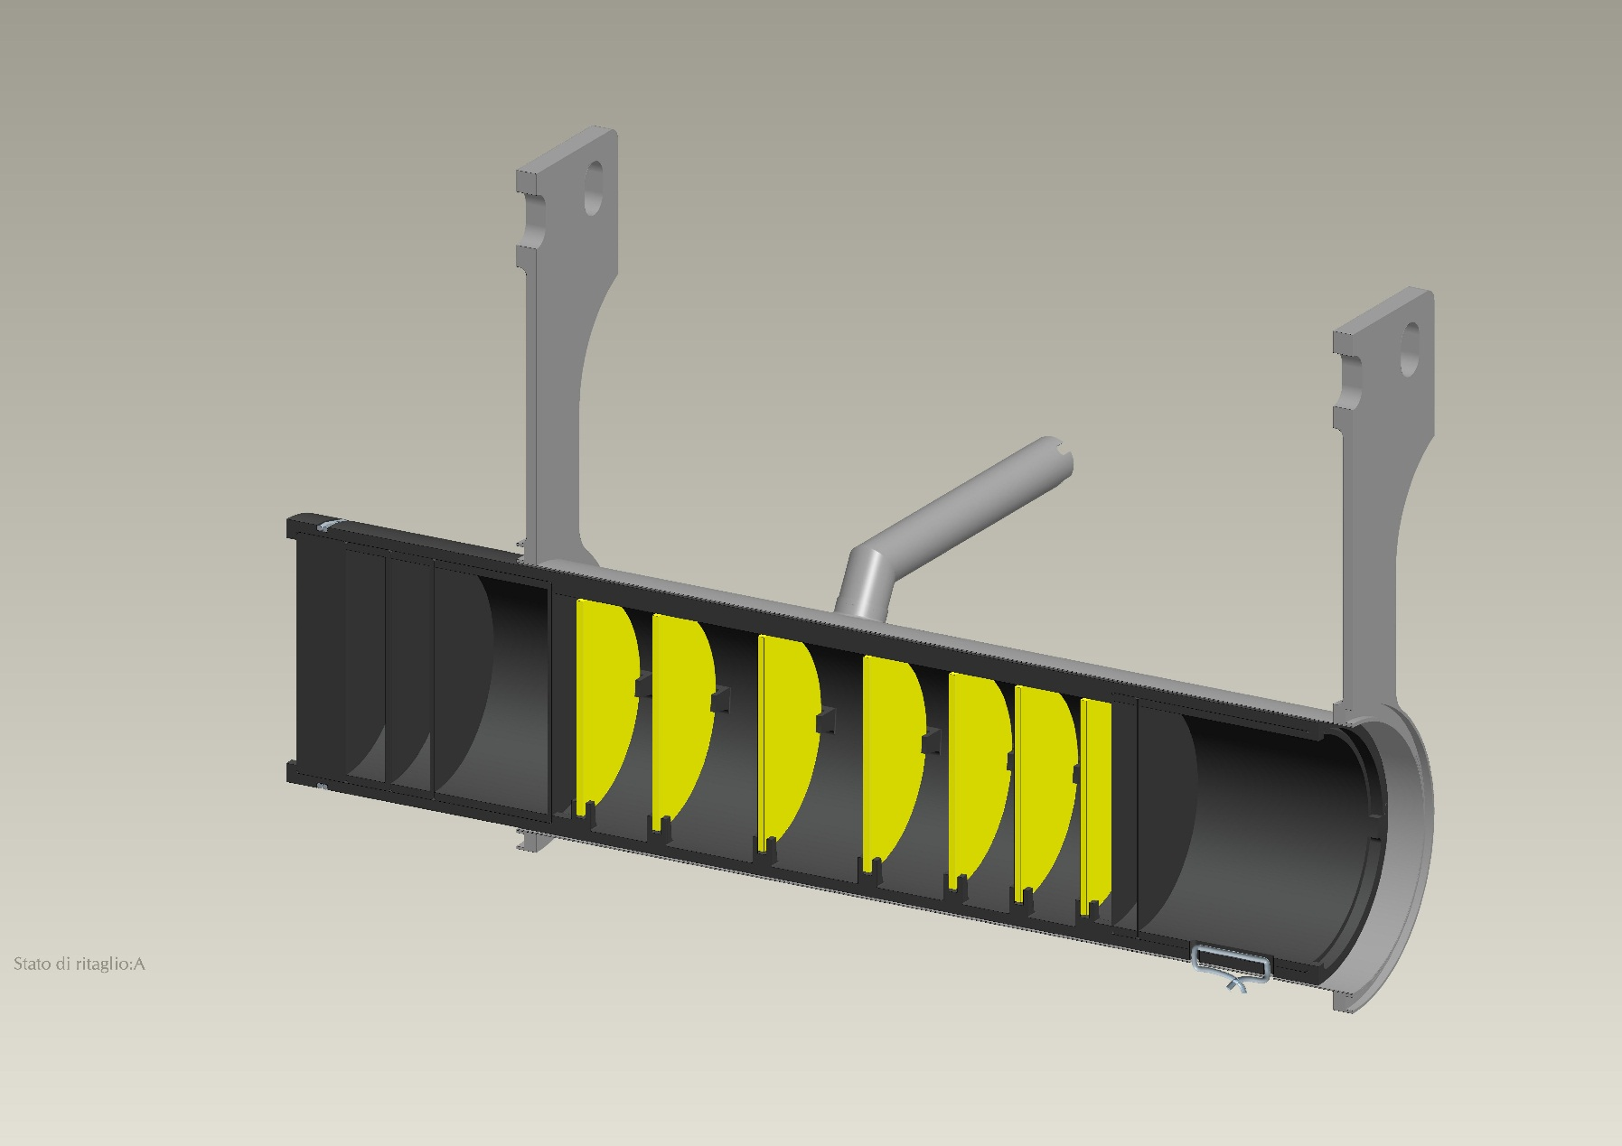
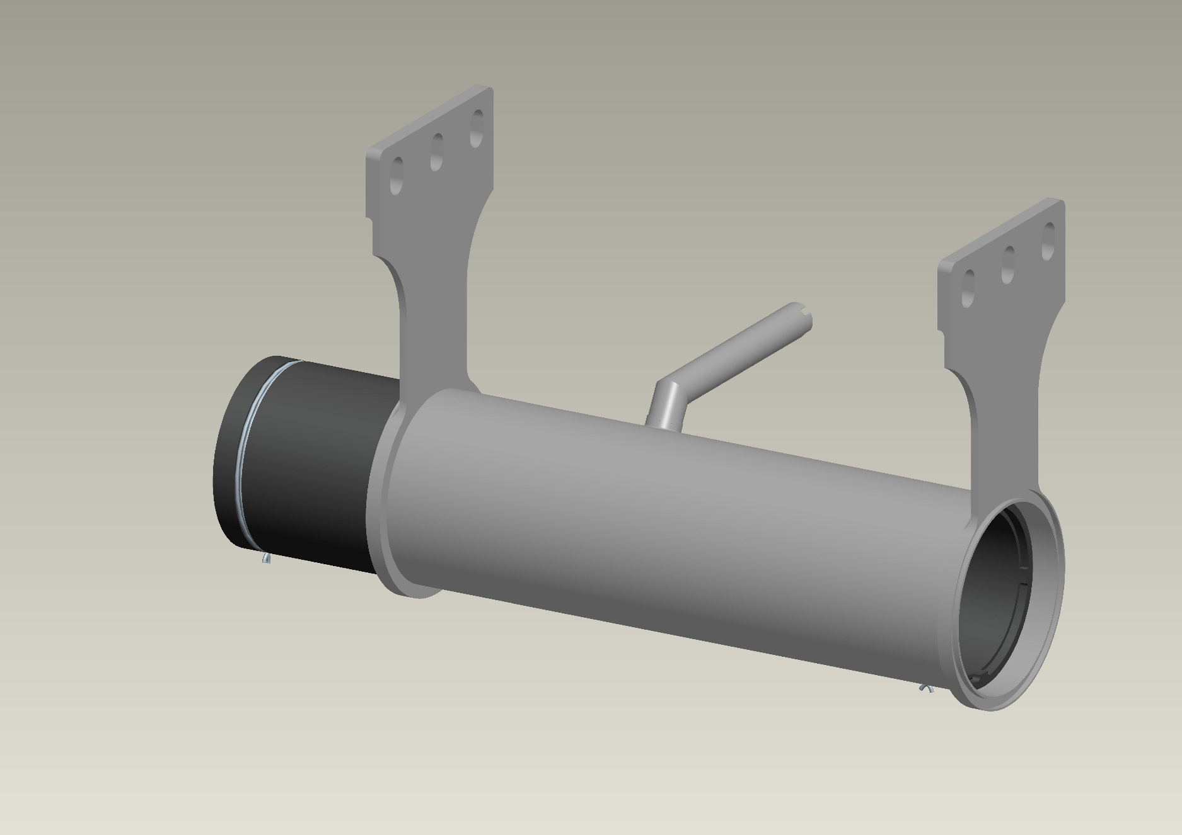
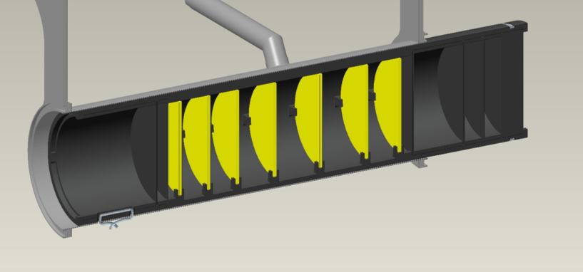
The SPES target: general architecture and main characteristics
the whole target system must be operated at extremely high temperature (2000°C and more)
p energy: 40 MeV
p intensity: 200 µA
40 MeV, 200 µA
proton beam
box (C)
heater (Ta)
window (C)
disc (UCx)
dumper (C)

Slide 6
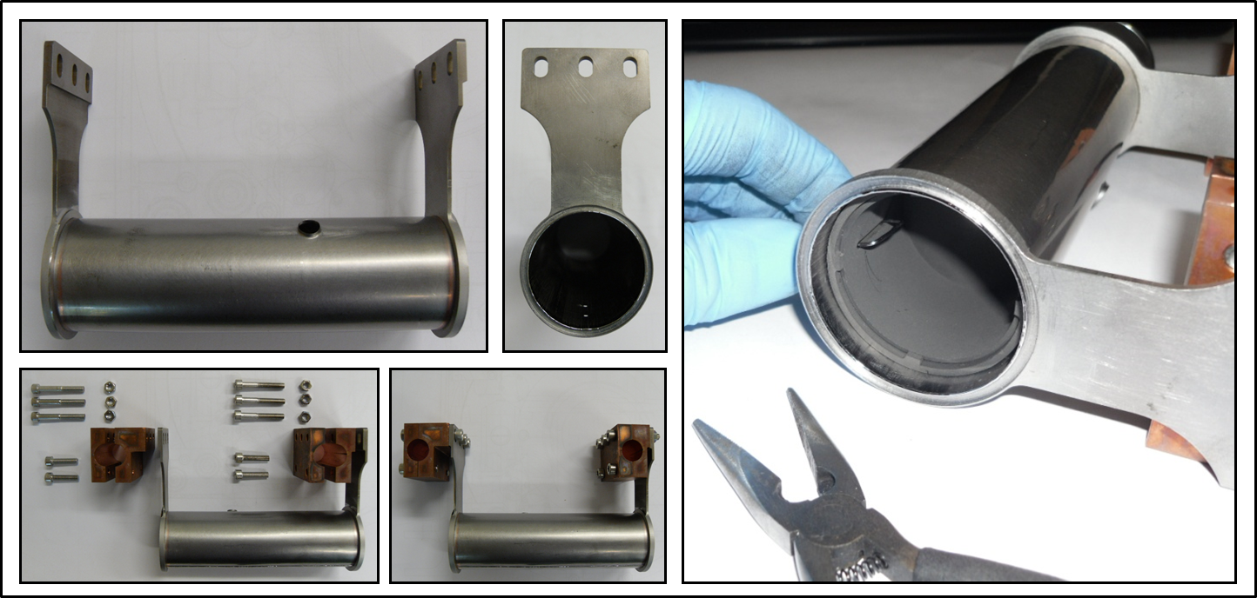
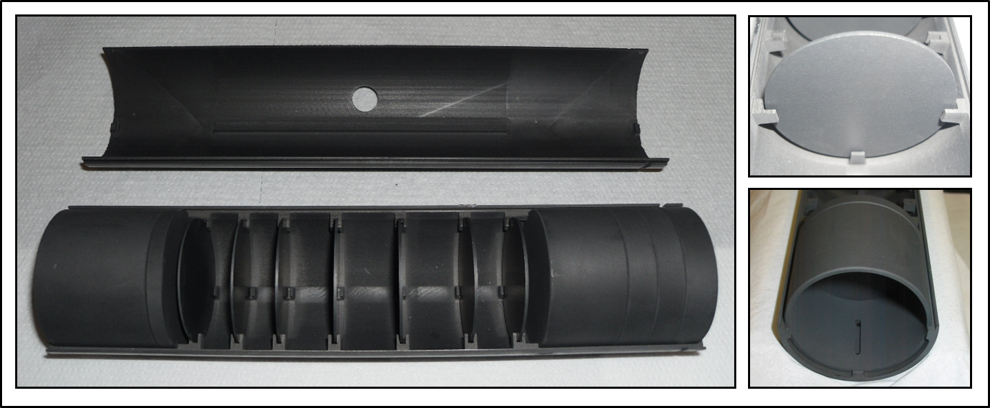
The SPES target: general architecture and main characteristics

Slide 7
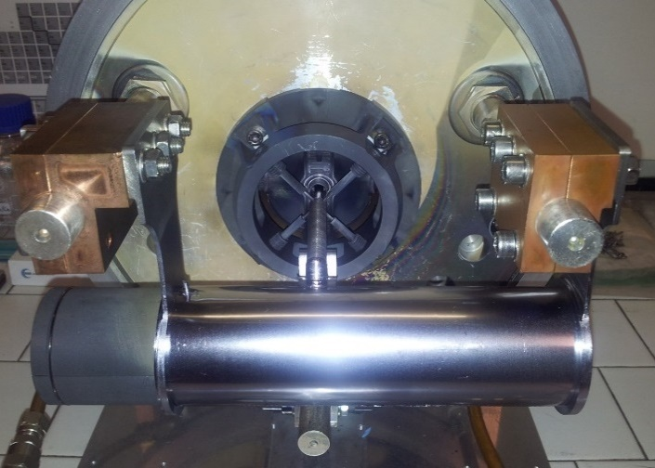
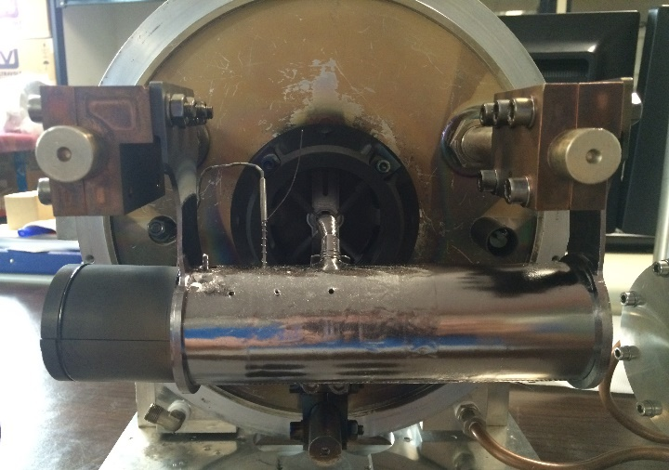

The SPES target: general architecture and main characteristics
Endurance tests at high temperature with Joule heating thermal load → 10 kW
(primary proton beam thermal load → 8 kW)
before testing
after testing
400 testing hours at ≈ 2000 °C → 200 hours at maximum power (10 kW)
80 heating-cooling cycles → 10 with current ramps of 1 s from 0 A to 1300 A (!)
TIS UNIT STILL OPERATIVE !
Mattia Manzolaro

Slide 8
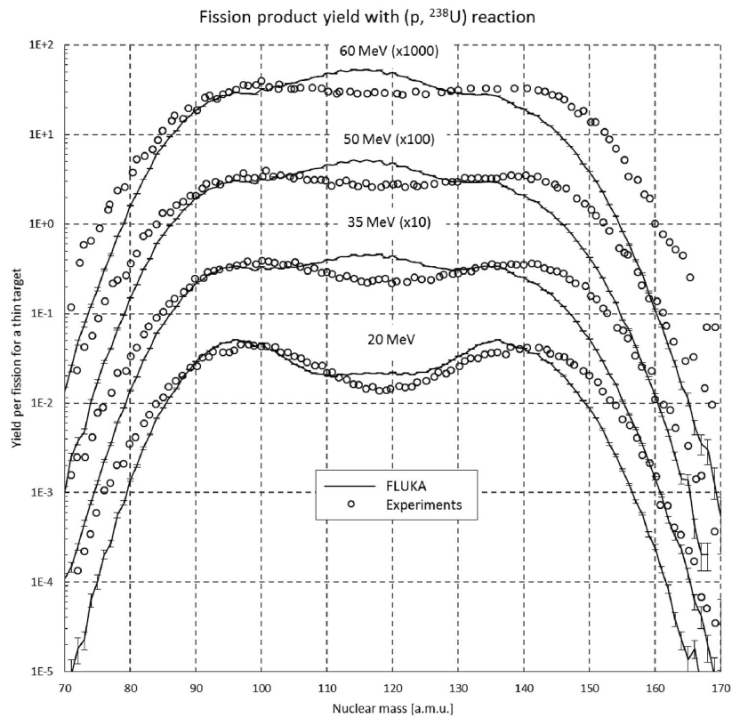
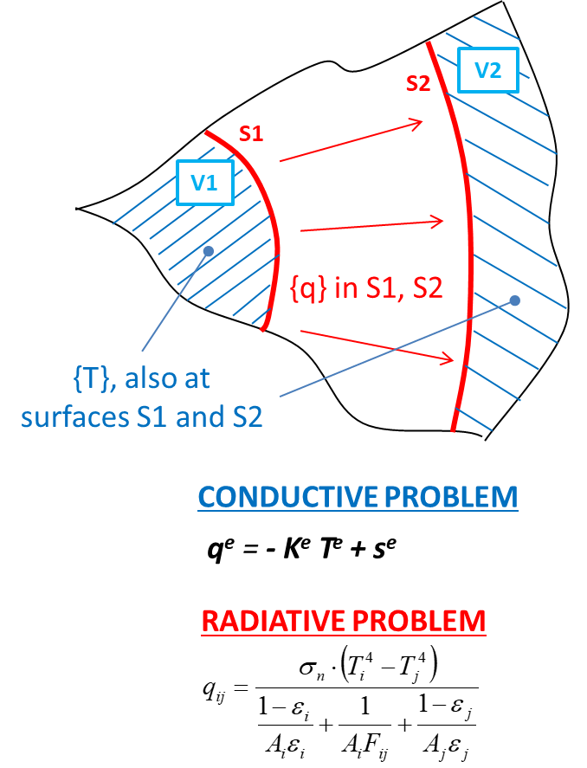
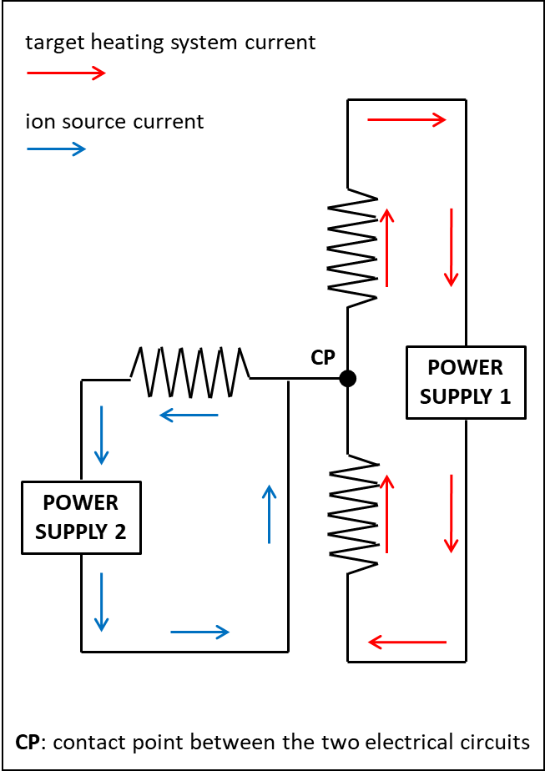
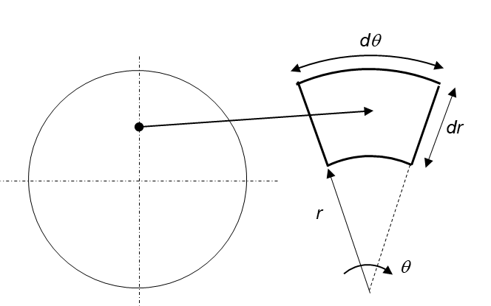
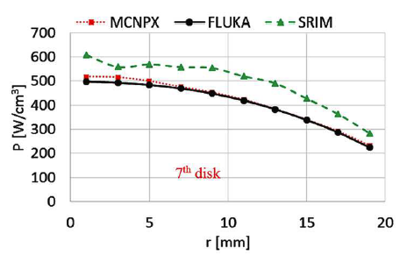
Numerical models: a multiphysics approach
electrical-thermal Finite Element model
thermal analysis
- thermal conduction
- thermal radiation
particle-matter interaction
electrical conduction
structural analysis
TWO-WAY coupling
Joule heating (x,y,z) – ρ (T)
temperature distribution (x,y,z)
ONE-WAY coupling
ONE-WAY coupling
power density (x,y,z)
temperature distribution (x,y,z)

Slide 9
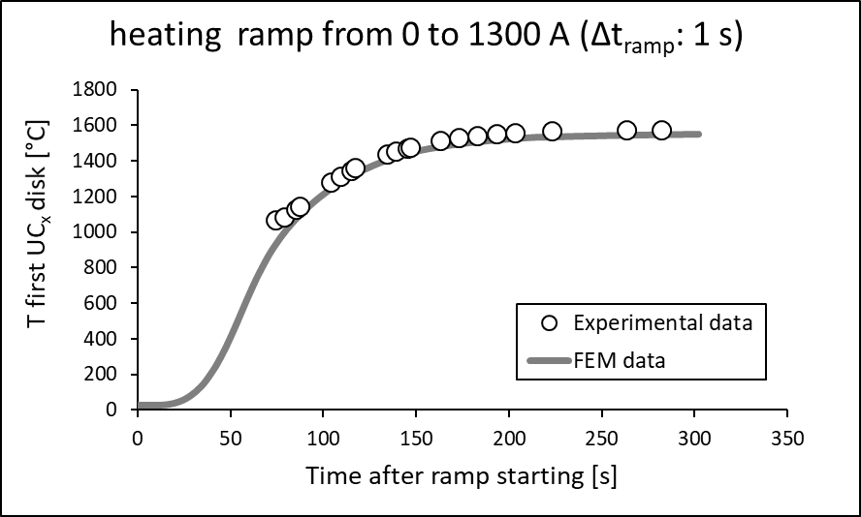
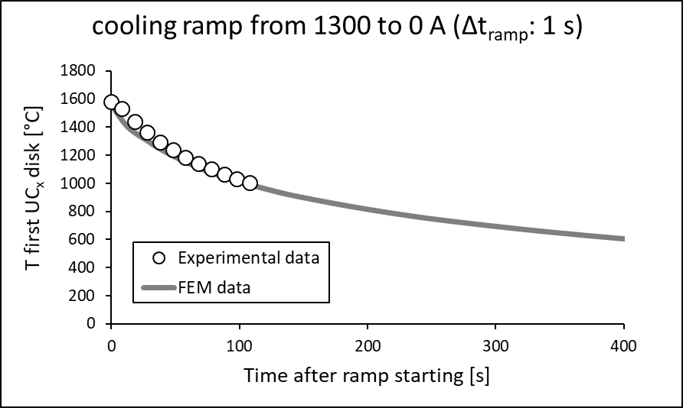
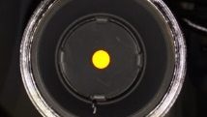
Numerical models: the electrical-thermal Finite Element model
Joule heating thermal load (1300 A) to heat the target during the conditioning phase
Reference: M. Ballan et al., Nucl. Instrum. Methods Phys. Res., Sect. B 376, 28-32 (2016)

Slide 10
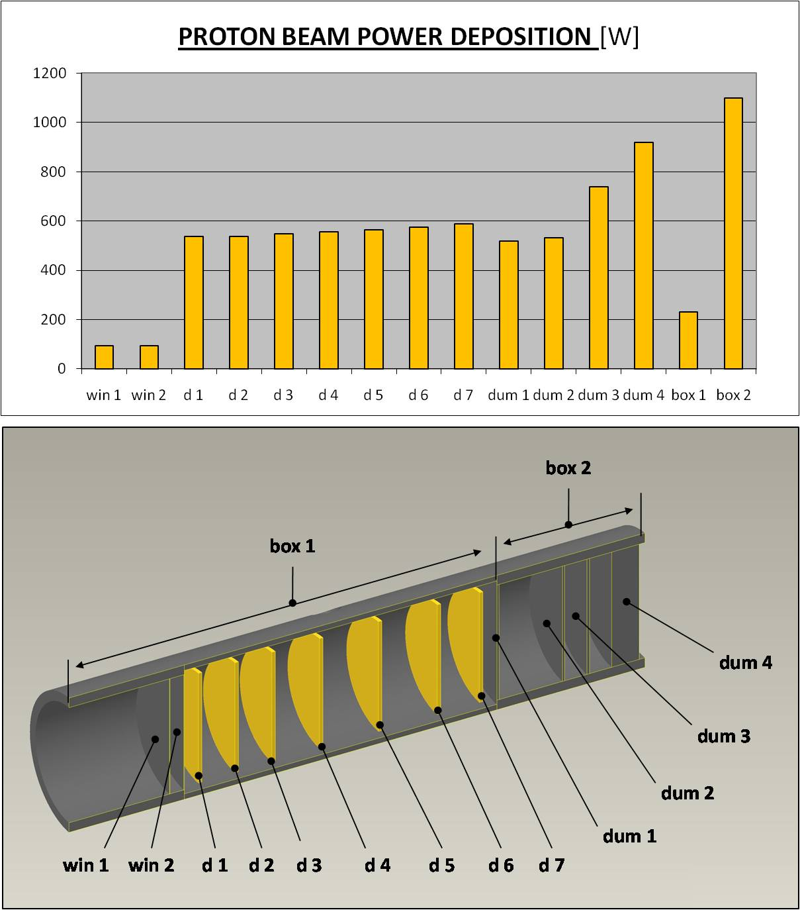
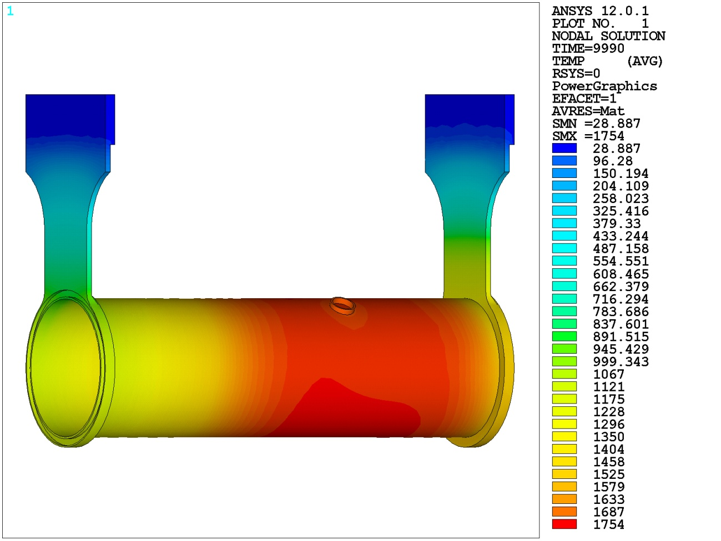
Numerical models: the electrical-thermal Finite Element model
Proton beam thermal load: 40 MeV, 0.2 mA (≈ 8 kW) (power density input for the Finite Element model calculated by means of particle physics MonteCarlo codes)
TEMPERATURE DISTRIBUTION [°C]

Slide 11
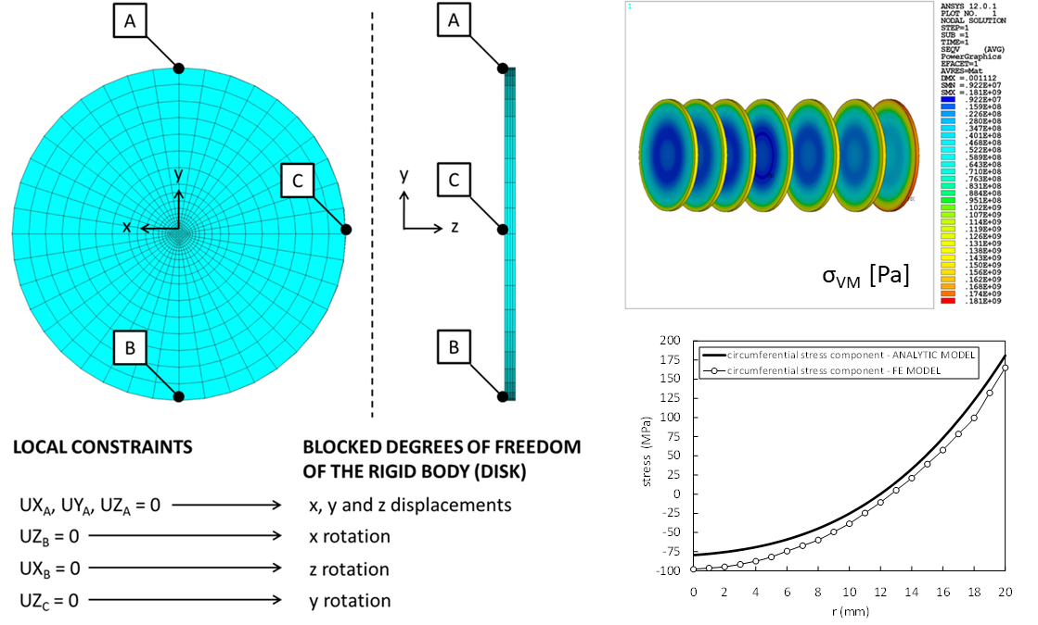
Numerical models: the electrical-thermal Finite Element model
Proton beam thermal load: 40 MeV, 0.2 mA (≈ 8 kW) (power density input for the Finite Element model calculated by means of particle physics MonteCarlo codes)
THERMAL STRESS STATE [Pa]
(induced by temperature gradients)

Slide 12
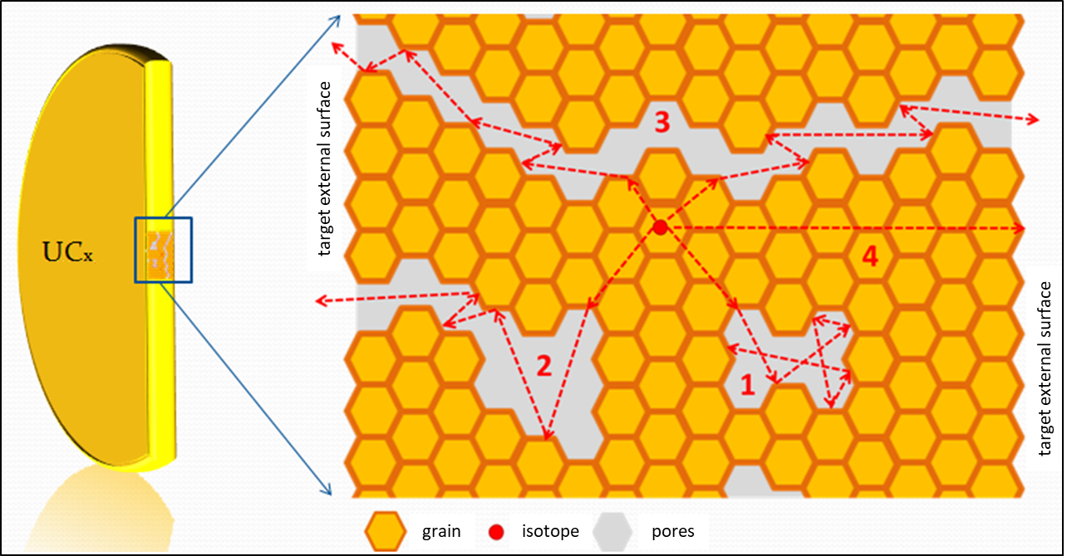
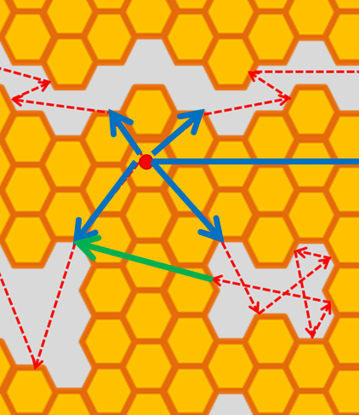
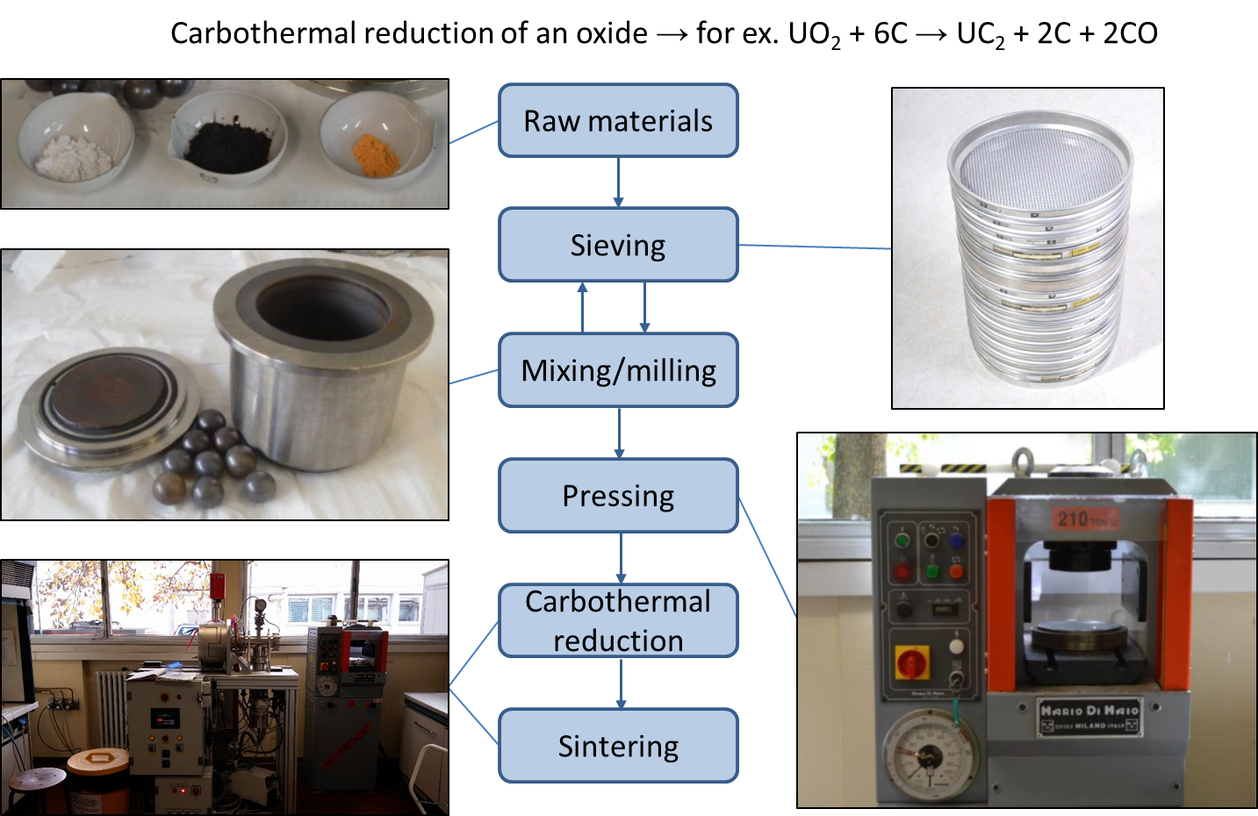
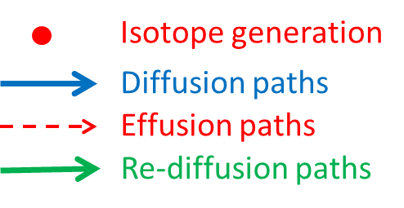
Target material characterization @ HT
homemade materials for the target disks (strong R&D activity required)
main requirements for ISOL target materials @ high temperatures
- open porosity and reduced grain size (diffusion & effusion)
- low vapor pressure (low gas load in the ion source and long term stability at high temperature)
- high emissivity
- high thermal conductivity
- good mechanical properties
total isotope yield deeply affected by open porosity (diffusion/effusion processes)
Courtesy of Stefano Corradetti

Slide 13
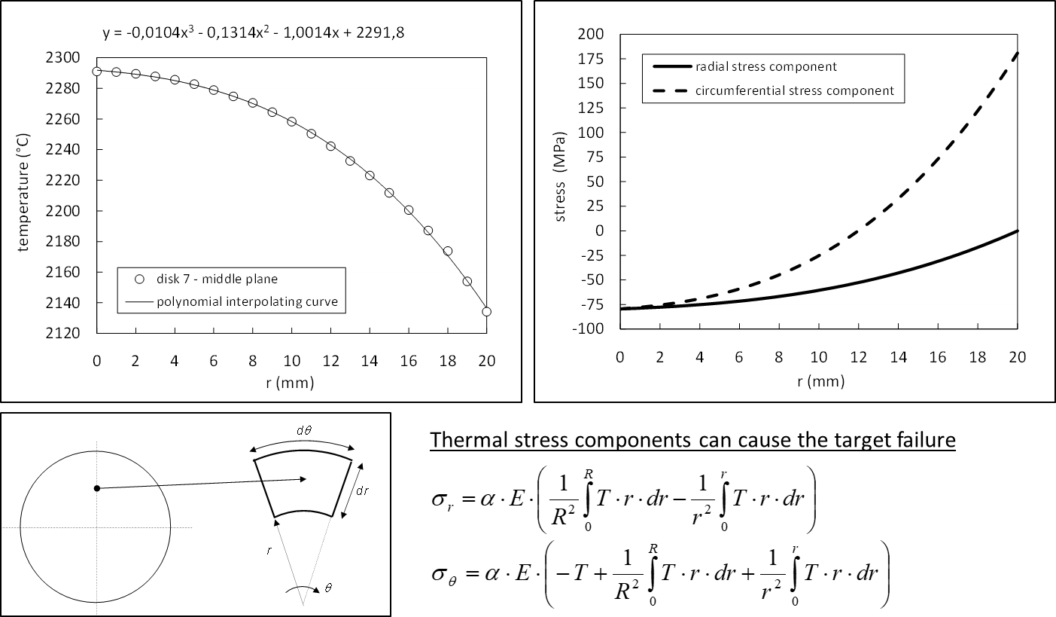
Target material characterization @ HT
Emissivity ε (th. radiation) and thermal conductivity λ (th. conduction) control the target temperature field
Temperature gradients generate stress states and a good tensile/compressive strength σ_{TS} is required

Slide 14
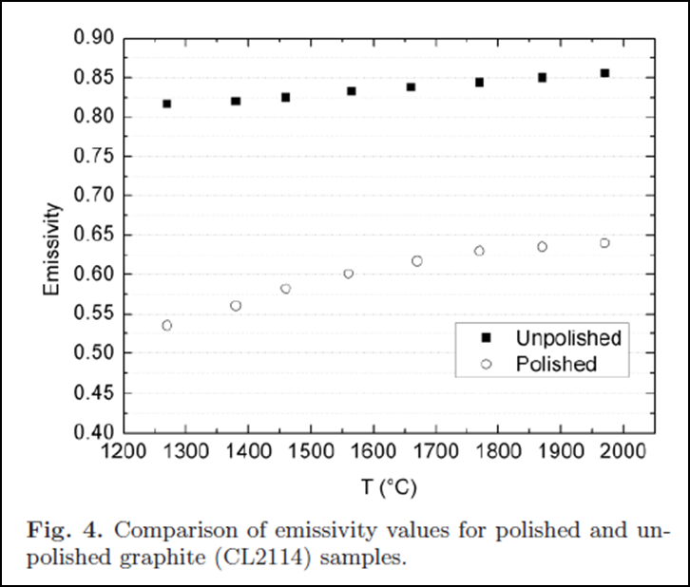
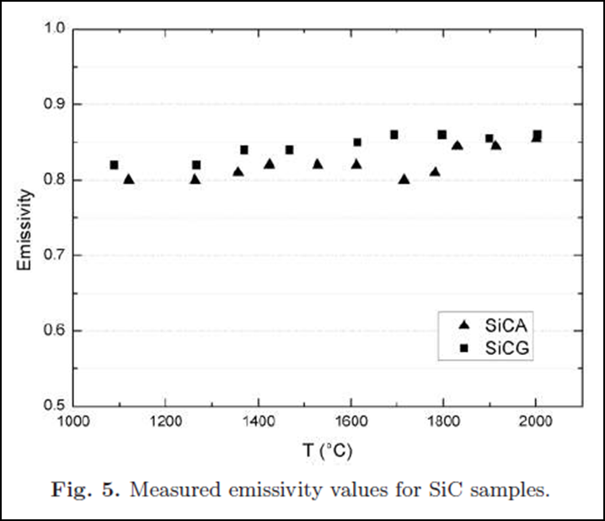
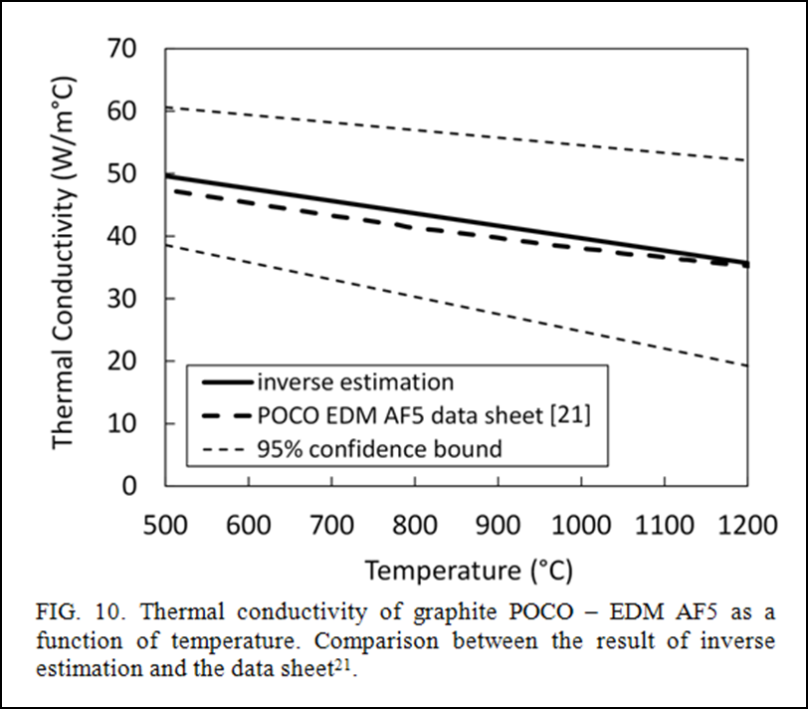
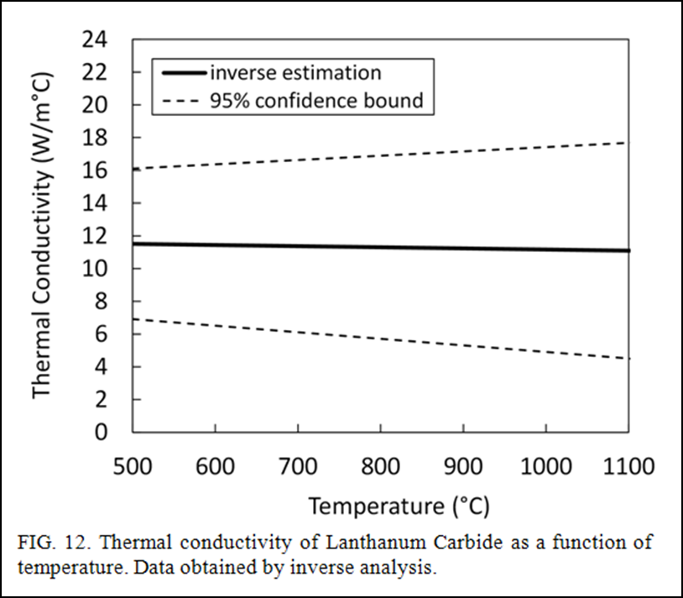
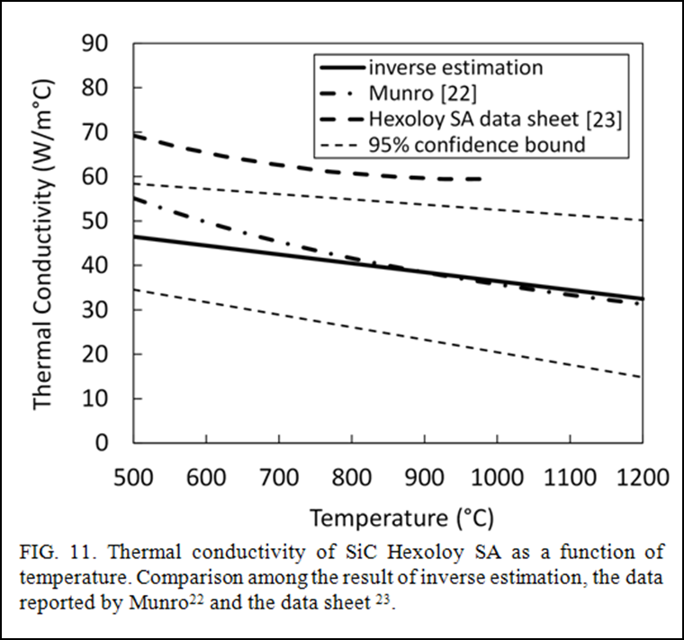
Target material characterization @ HT
Emissivity ε meas. method
L. Biasetto, M. Manzolaro, A. Andrighetto, Eur. Phys. J. A 38 (2008) 167-171
Thermal conductivity λ meas. method
M. Manzolaro, S. Corradetti, A. Andrighetto, L. Ferrari, Rev. Sci. Instrum. 84, (2013) 054902

Slide 15
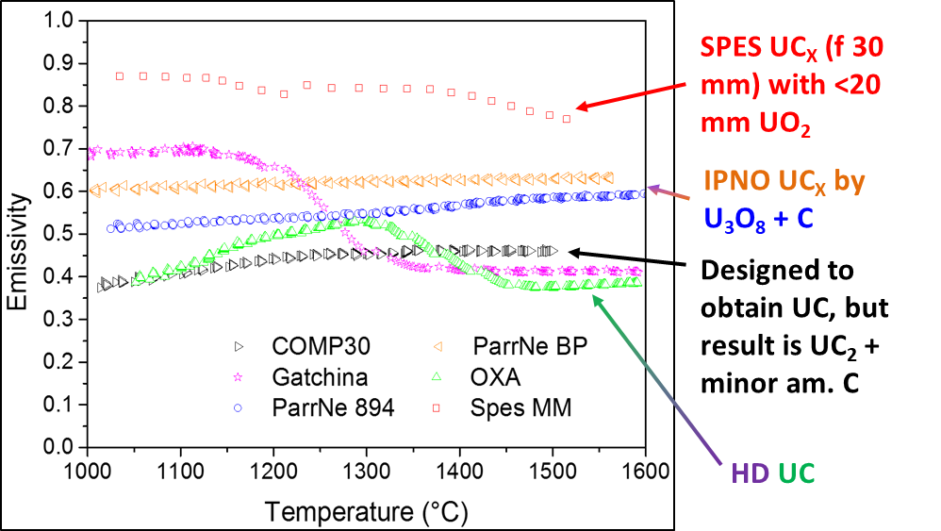
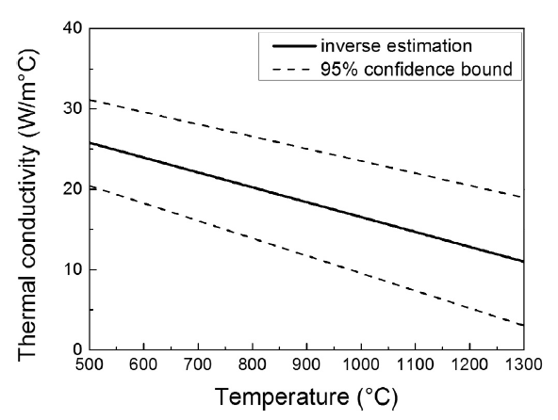
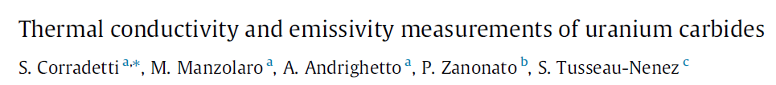
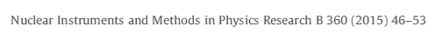
Target material characterization @ HT
Emissivity measurements for different Uranium Carbides
- Direct emissivity measurements on heated UC_{x} discs using a dual frequency pyrometer
- UC_{x} samples of different composition and synthesis routes produced in different laboratories participating to ActiLab
Thermal Conductivity estimations for the SPES Uranium Carbide
- Creation of thermal gradients on UC_{x} disks → thermal conductivity obtained by inverse analysis using Ansys®
- Activity performed in the context of ActiLab Work
Package in ENSAR (7th Framework Program)

Slide 16
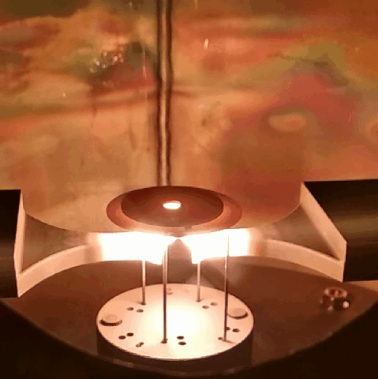
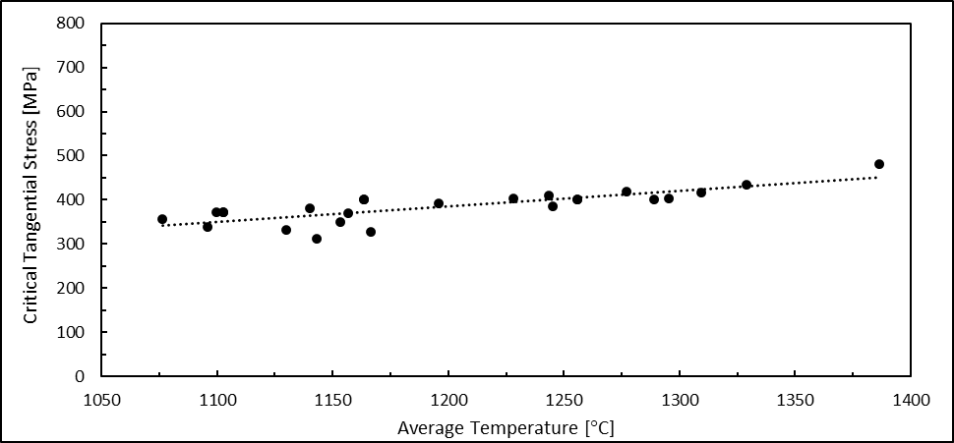
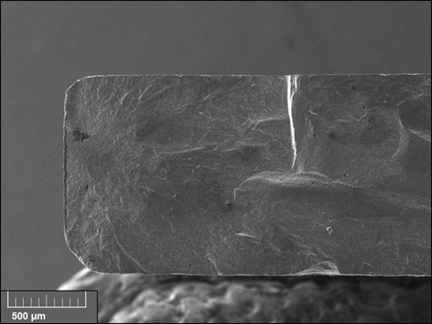
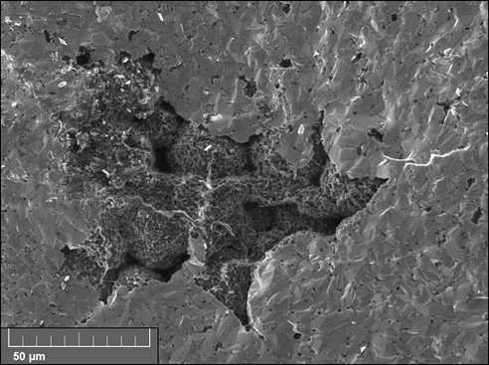
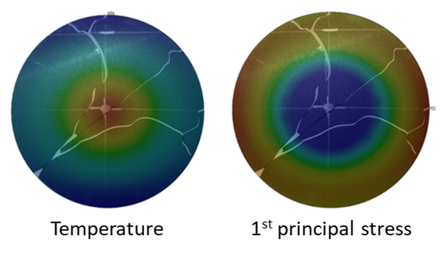
Target material characterization @ HT
A new method to estimate the Tensile Strength @ HT (Silicon Carbide)
SiC disk (Hexoloy SA) – Matteo Sturaro master’s thesis, University of Padova
Supervisors: G. Meneghetti, A. Andrighetto, M. Manzolaro, M. Ballan
average stress level during operation with primary beam

Slide 17
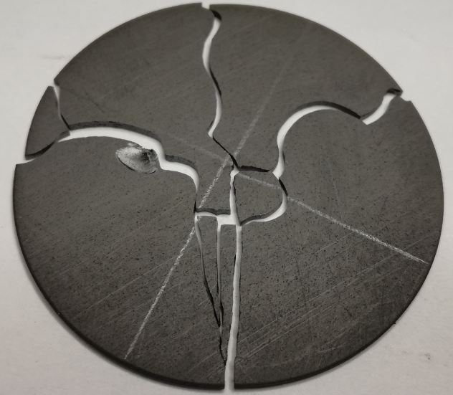
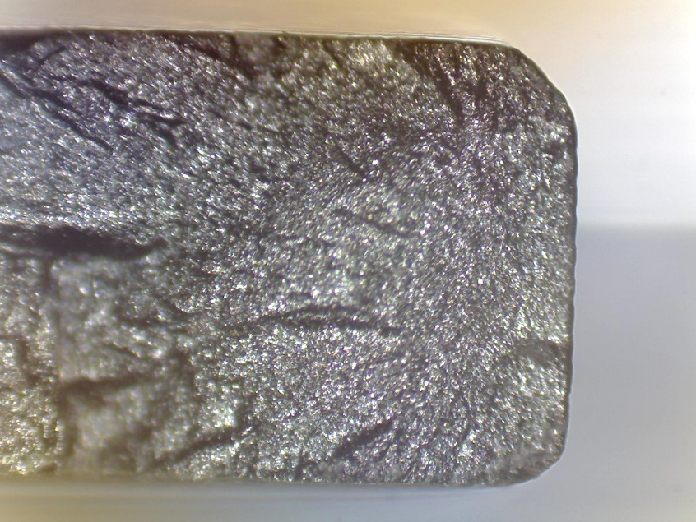
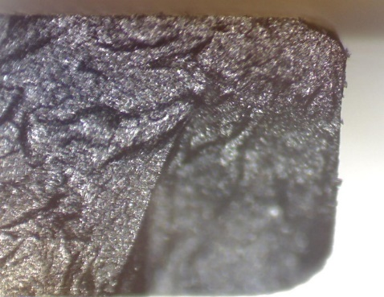
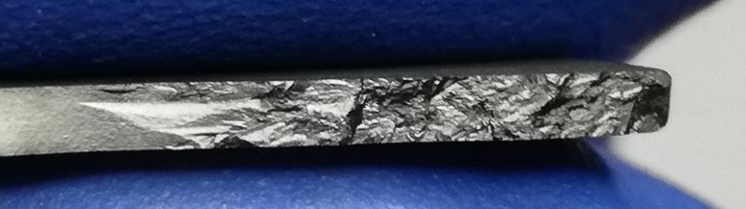
Target material characterization @ HT
Peculiar fracture shape
Fracture surface morphology
SiC SP
Hackle Lines
G.D. Quinn, Fractography of Ceramics and Glasses, NIST Recommended Practice Guide, 2016
dpc
Mirror
V_{pc}=1500 m/s
Initial propagation direction
90°
Defect
σ_{1max}
SiC SA
V_{pc}=0 m/s
50X
Defect
Silicon Carbide Hexoloy SA
Mirror
50X
200X
Hackle Lines

Slide 18
Target material characterization @ HT
 | Weibull Modulus m | σ₀ [MPa]
SiC SA | 9,13 | 413,54
SiC SP | 7,58 | 239,09
SiC Hexoloy® SP
 | σ_{lim} strength at Ps 99,9% (survival %) [MPa]
SiC SA | 194,07
SiC SP | 96,12
200X

Slide 19
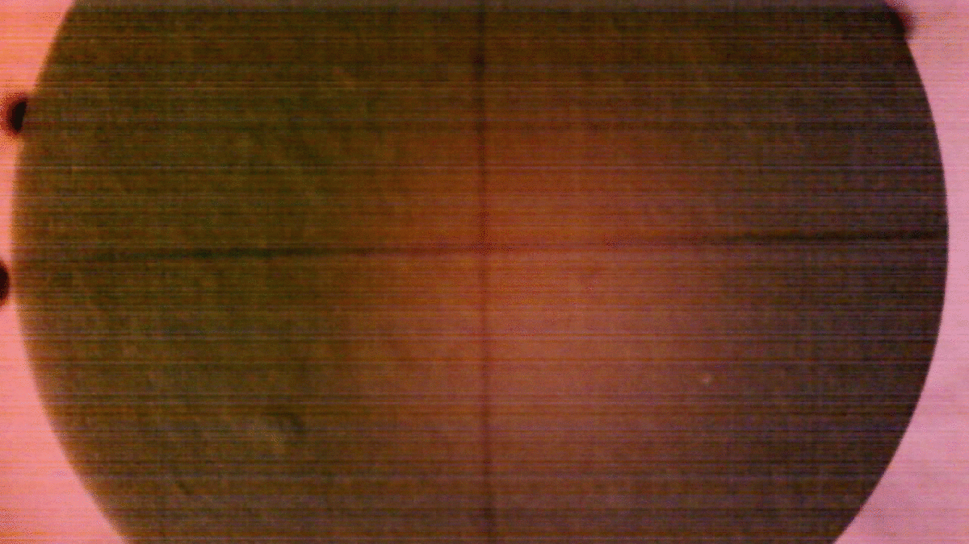
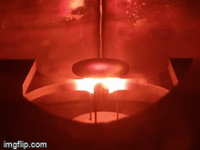
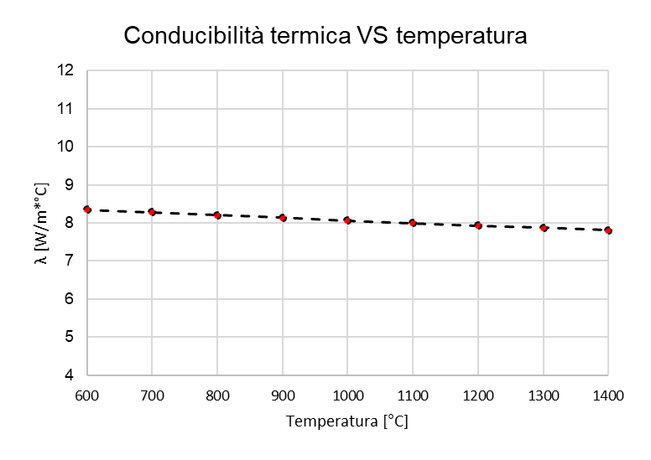
Target material characterization @ HT
TiC thermal conductivity
Type of fracture in TiC
Slow propagation
Fast fracture
 | σ_{lim} strength at Ps 99,9% [MPa] | σ₀ strength at Ps 37% [MPa] | m
TiC | 0,6 | 1,922 | 5,946

Slide 20
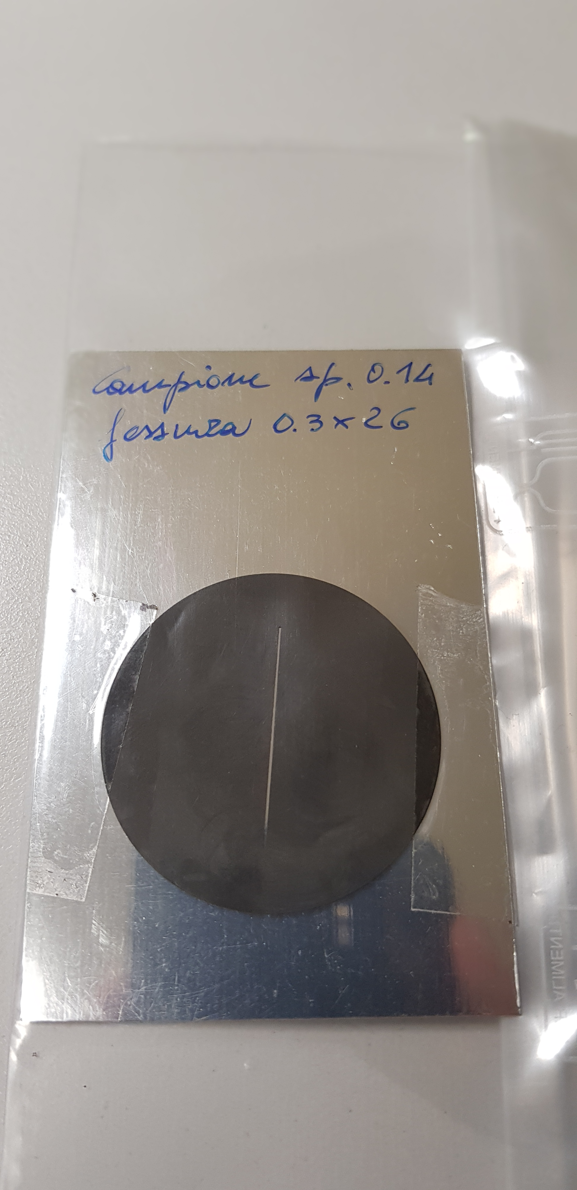
Target material characterization @ HT

Slide 21

Target material characterization @ HT

Slide 22
Target material characterization @ HT

