Slide 1

R&D on Magnets for FCC-hh (and variants)
Lucio Rossi – CERN A&TS
Former LHC Magnet Group Leader – Former HL-LHC Project Leader
(On leave form Univ. of Milano- Physics Dept.)
Giornata sulla European Strategy for Particle Physics @ INFN-Roma1 – 21 Sept.2020

Slide 2
LHC full energy exploitation
LHC was operated in Run2 at 2x6.5 TeV, i.e. dipoles at 7.7 tesla – For 2x7 TeV → 8.33 tesla, 86% of the max Ic
14 T=2x7 TeV operation (8.3 T dipole field)
  Tests before YETS 2016/2017 revealed problem with diode box that prevented termination of the proposed tests ➔ LS2 consolidation of diode boxes.
  The test in sector 1-2 for validating magnet performance at 7TeV prior to LS2 showed that we may need 1 quench/magnet: ≥ 1000 quenches, 2-3 months of intense quench campaign.
15 TeV=2x7.5 TeV (ultimate energy, dipoles at 9 T - 93% of intrinsic limit):
  Not impossible but very challenging due to large overhead and possible reduced availability in operation. Some magnets were never trained to ultimate and some may need replacement. Will be a trade off with lumi loss: 20% lost seems the maximum acceptable, difficult to assess today if we are below that level.
Beyond ultimate energy by replacing 1 LHC dipole out of 3 with an 11 T HiLumi dipole:
  15.5 TeV= 2x7.75 TeV at nominal current (2x 8.33 T + one 11.1 T)
  16.6TeV= 2x8.3 TeV at ultimate current (2x9 T + 12 T, since are powered in series)
  Very unlikely: big change, big overheads of de and re-installation (2-3 y?) and very difficult operation. The cost is in the 2-3 BCHF range. Luminosity will be reduced by less avialbility.
  The HiLumi 11 T dipole is not optimized for cost since must be in series with LHC dipoles: big constraints.

Slide 3
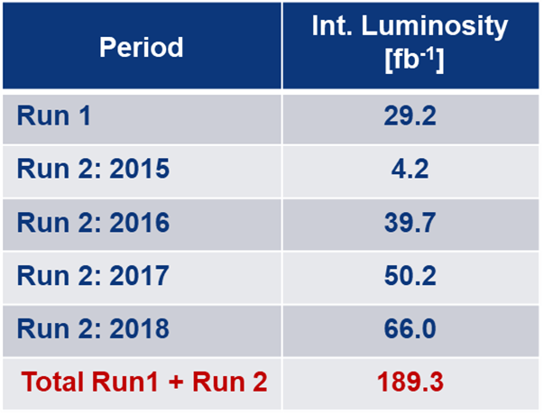
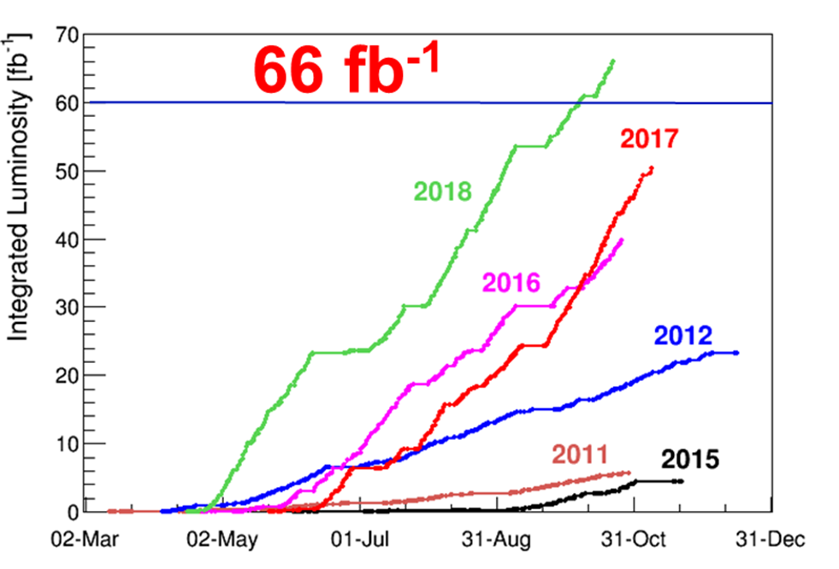
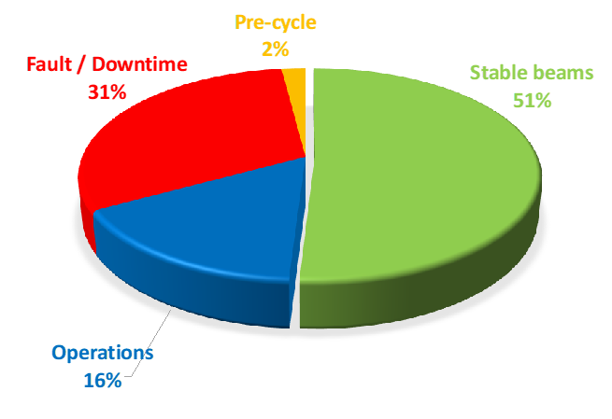
Performance: Integrated Luminosity
F. Bordry, CERN Director for A&T
Cryo availbility: 97-99 % !
Goal of Run1+Run2 was 150 fb⁻¹!

Slide 4
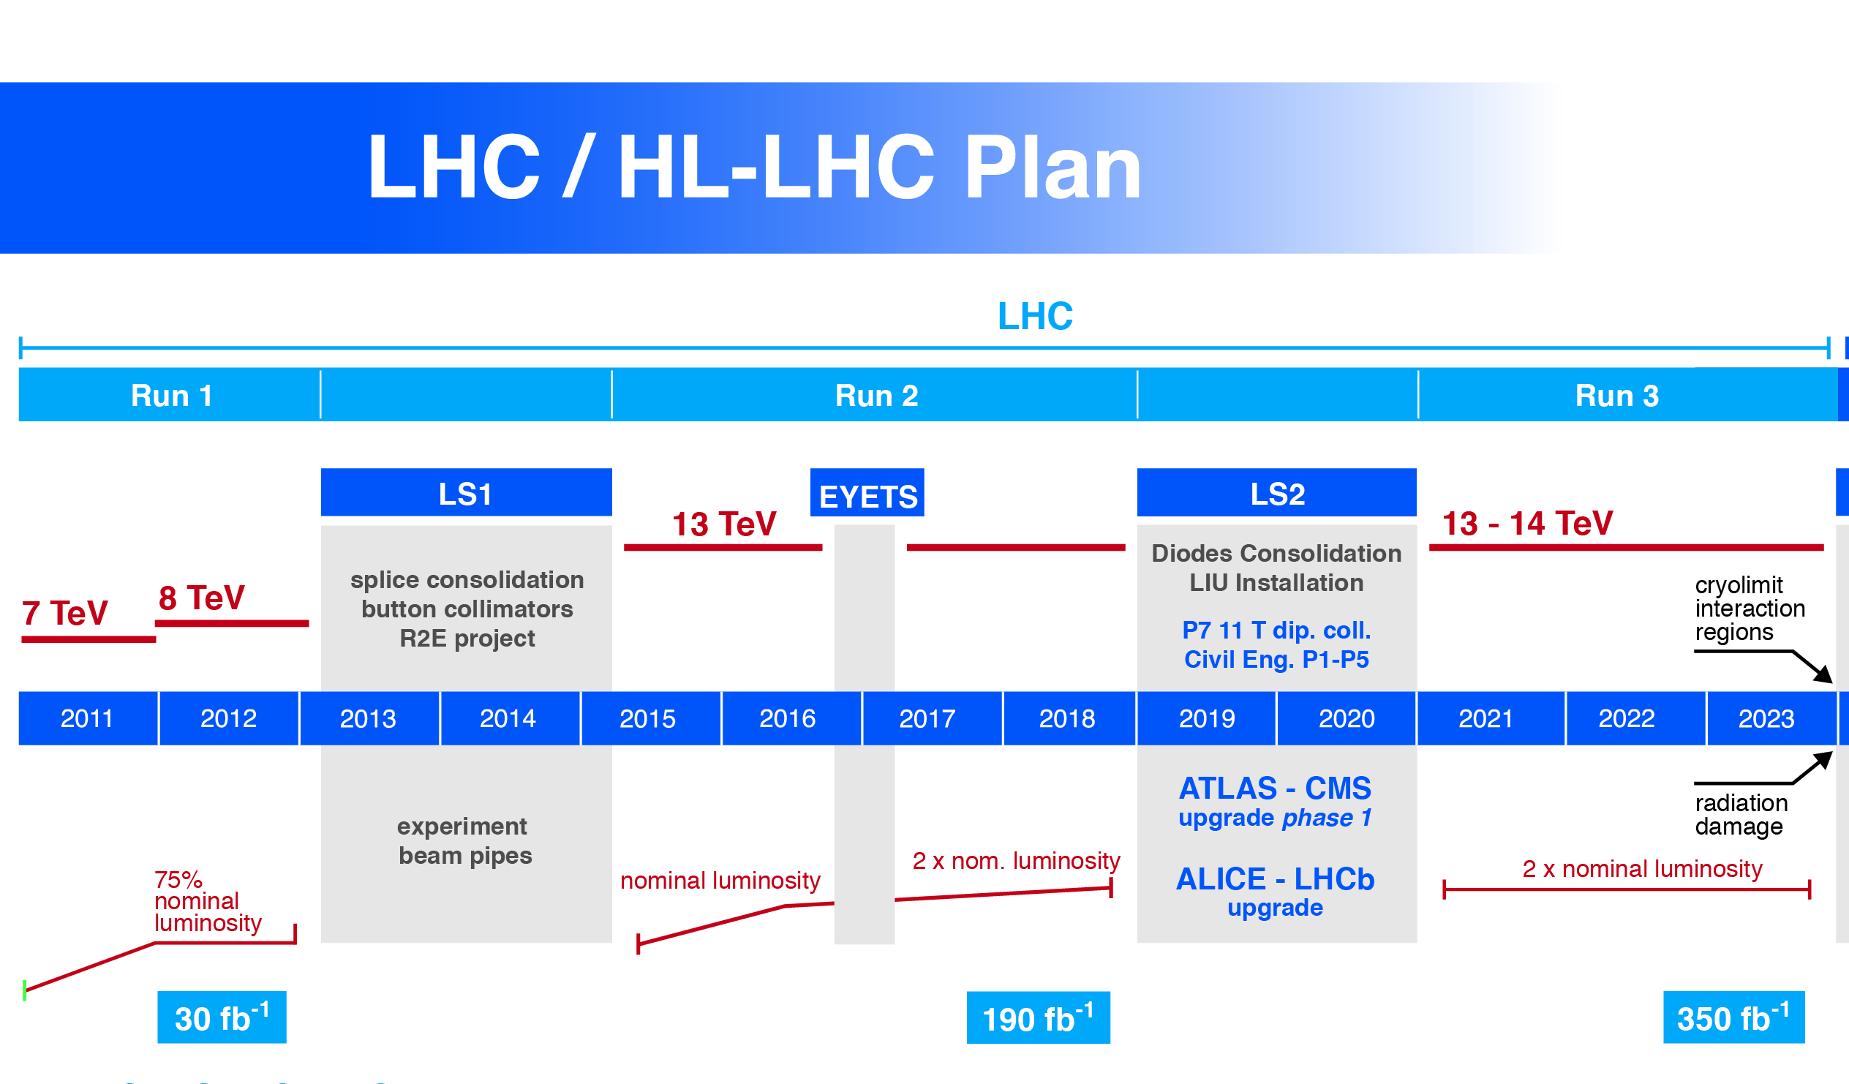
Technical limitation on the istantaneous lumi:
1. Collider (cryolimit in the triplet region) at 2×10³⁴ cm⁻²s⁻¹ twice the nominal design luminosity)
2. Experiments (pile up in the detectors). Designed for PU 40 they are actually dealing with 60!
Technical limitation on integrated lumi:
1. Collider (radiation damage to the IT magnets – correctors and quadrupoles)
2. Experiments (radiation damage in the Inner Tracker)
0.75 10³⁴ cm⁻²s⁻¹
50 ns bunch
high pile up ∼40
1.4 10³⁴ cm⁻²s⁻¹
25 ns bunch
pile up ∼40
2 10³⁴ cm⁻²s⁻¹
25 ns bunch
pile up ∼60
2 10³⁴ cm⁻²s⁻¹
with levelling, 25 ns b.
pile up ∼60 continuous
Notes:
Radiation damage and halveningtime

Slide 5

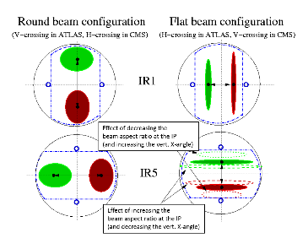
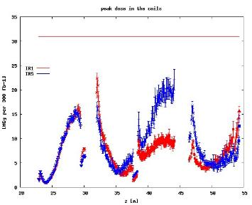
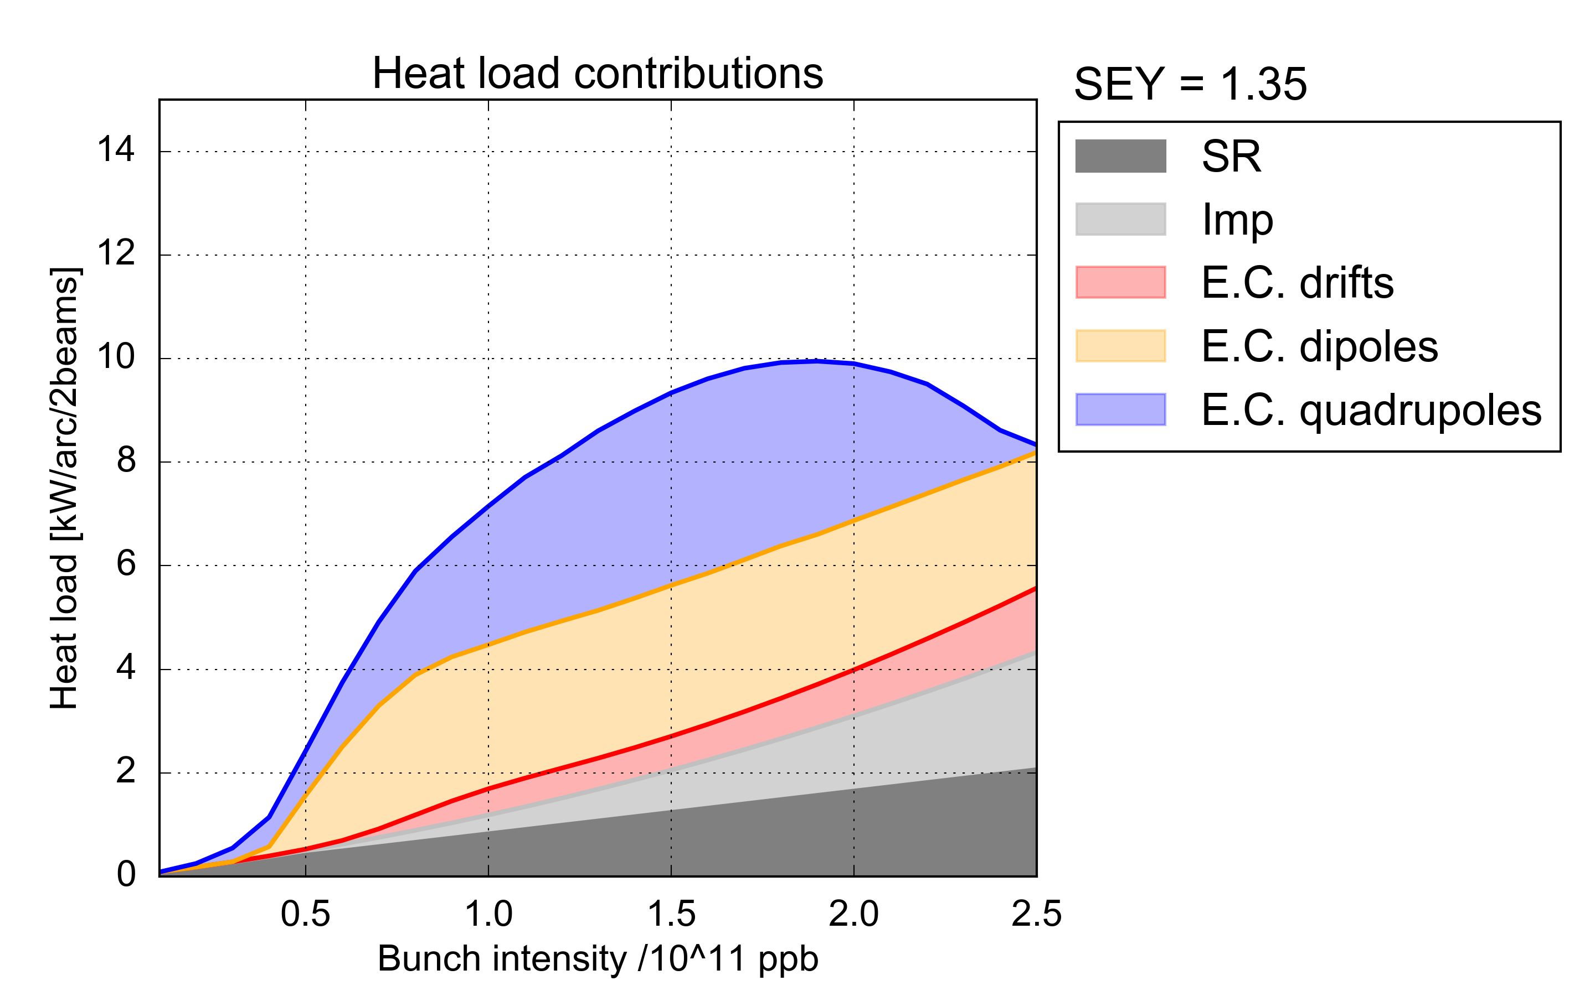
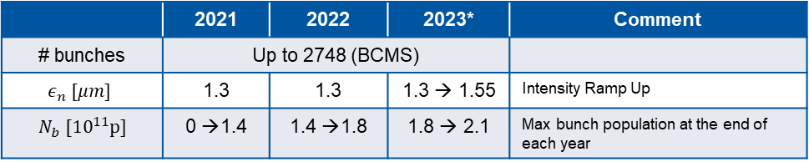
Outlook to LHC Run 3 (2021-2023)
Run3 WG ,
S. Fartoukh, chair
N. Karastathis
LIU forecast for beam intensity ramp up for HL: can be used in LHC Run3 ?
 | 2021 | 2022 | 2023* | Comment
# bunches | Up to 2748 (BCMS)
$$ε_{n} [μm]$$ | 1.3 | 1.3 | 1.3 → 1.55 | Intensity Ramp Up
$N_{b} [{10}^{11}p]$ | 0 →1.4 | 1.4 →1.8 | 1.8 → 2.1 | Max bunch population at the end of each year
Pushing present LHC at the limits (using HL-LHC studies and early installation of HiLumi equipment in LS2…: Levelling, collimator low-Z and DS, TDIS…
Approaching cryogenic limitations different heat load emerged in Run2 is to be understood
Swapping the vertical crossing polarity
Pure BCMS
9.7 kW/arc (195 W/hc)
L_{int} 160 fb⁻¹ at reach in Run3 with margins
> 350 fb⁻¹ we enter in unknown territory for radiation damage
➔
40% increase in integrated luminosity
r=30% decrease

Slide 6
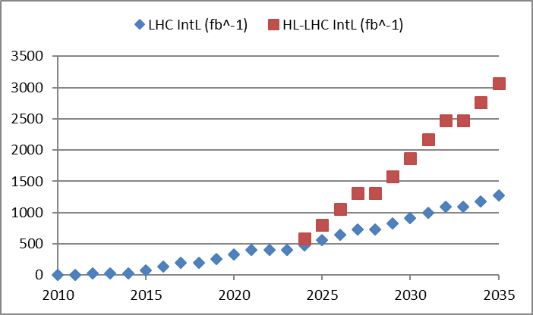
Why not just keep going with cons?
Now performace pushed up to 4000 fb⁻¹ as ultimate value
Upgrade!
Performance improving consolidation

Slide 7
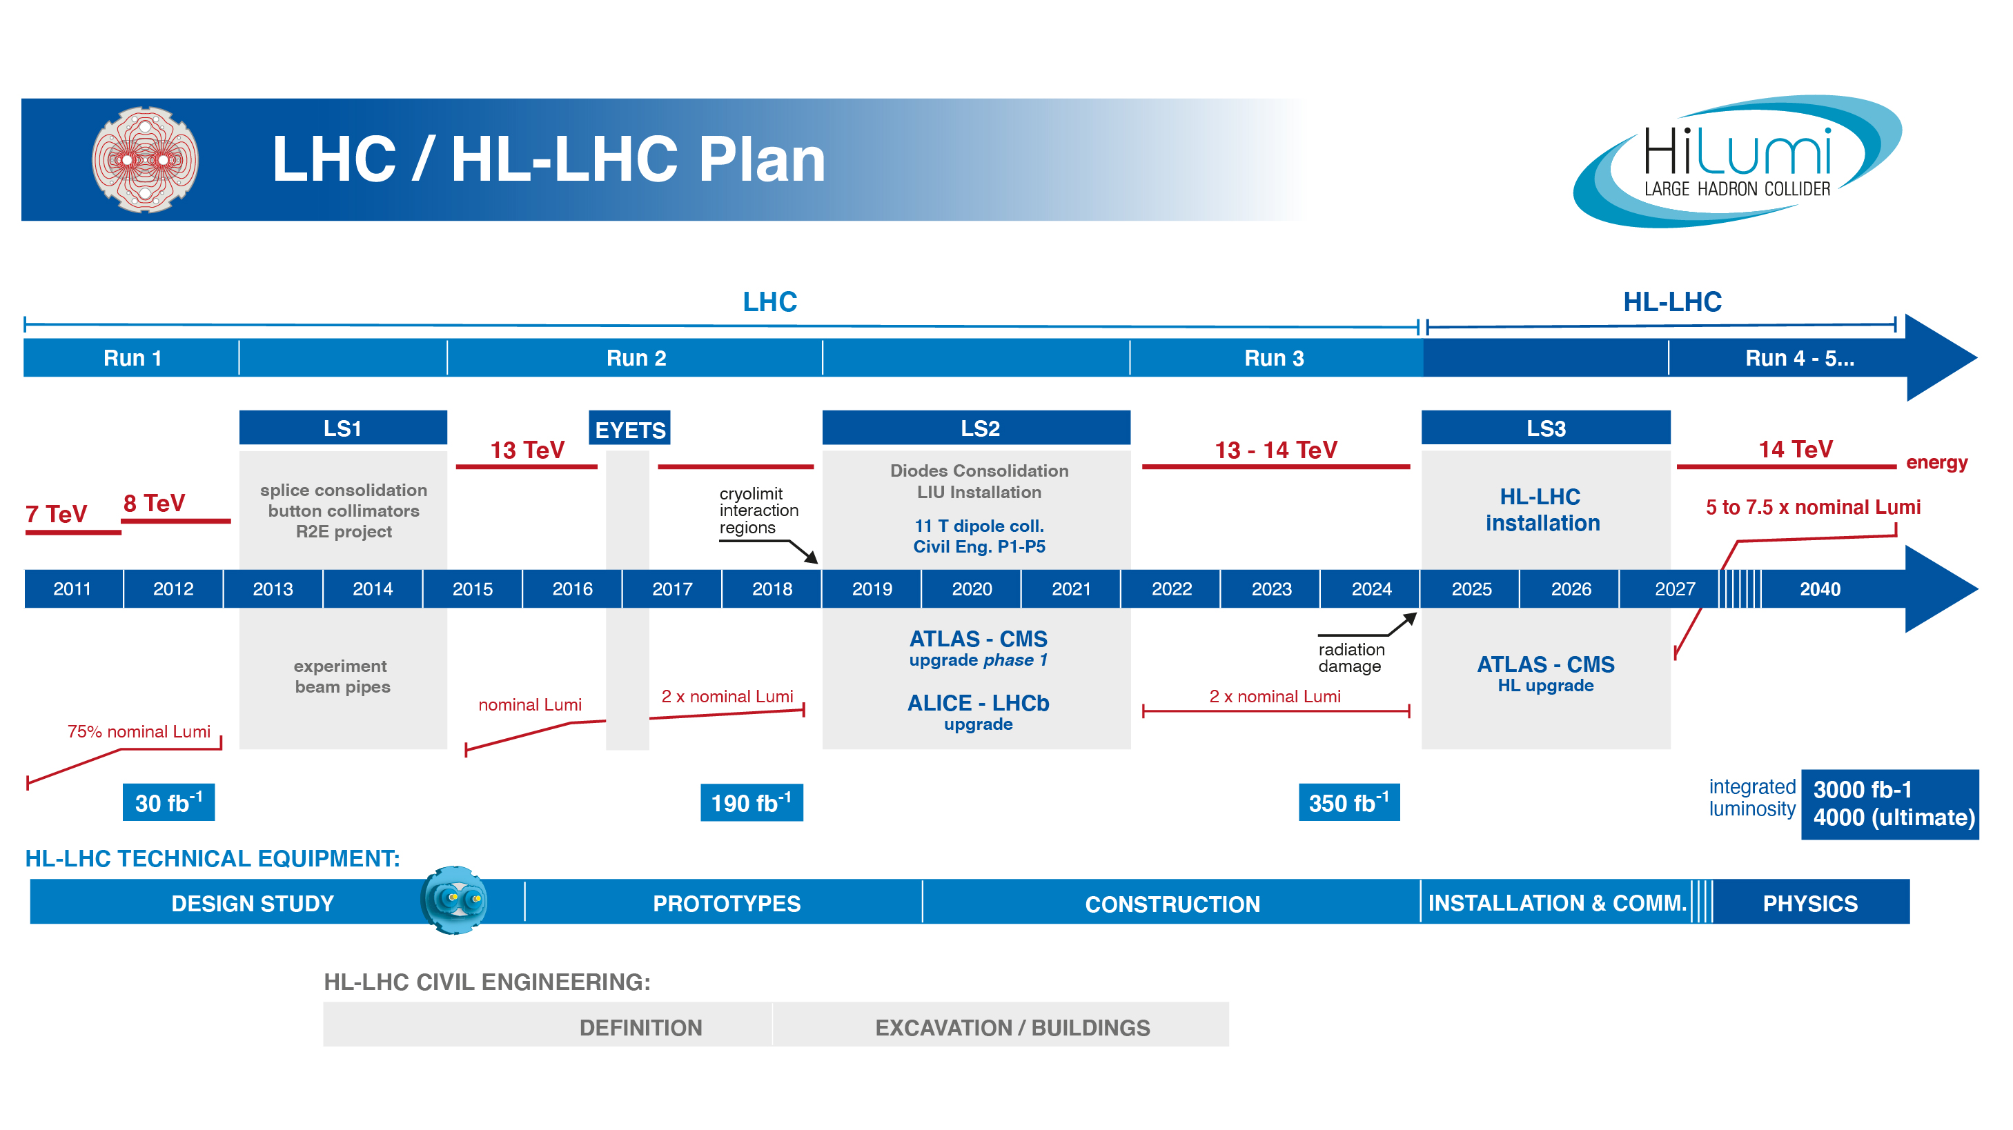
> Half way

Slide 8
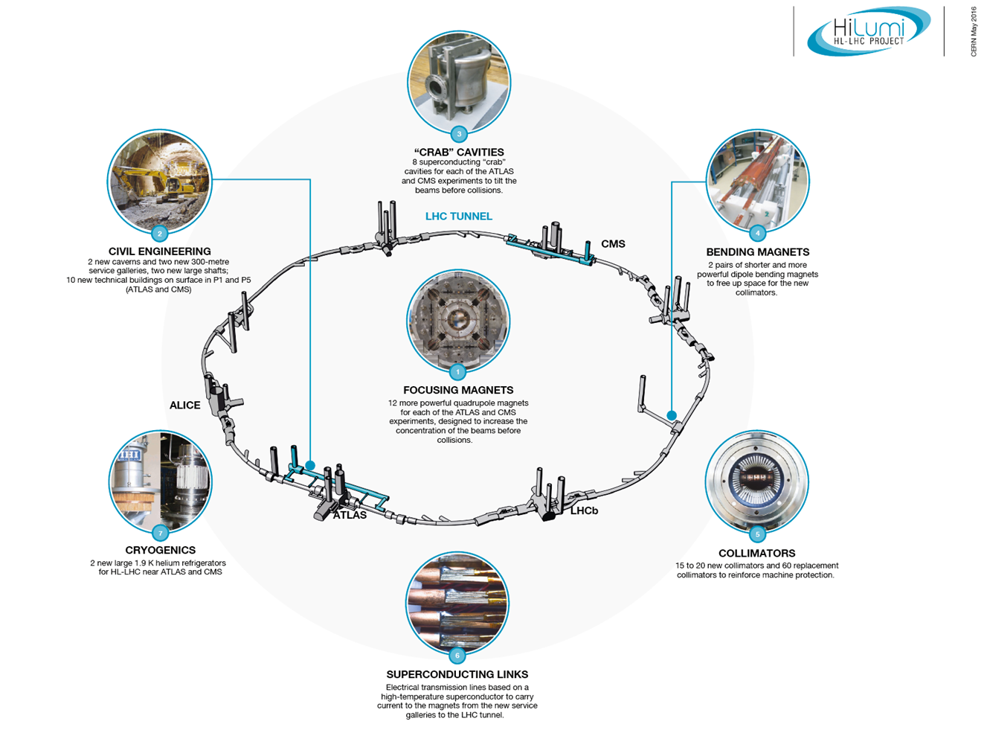
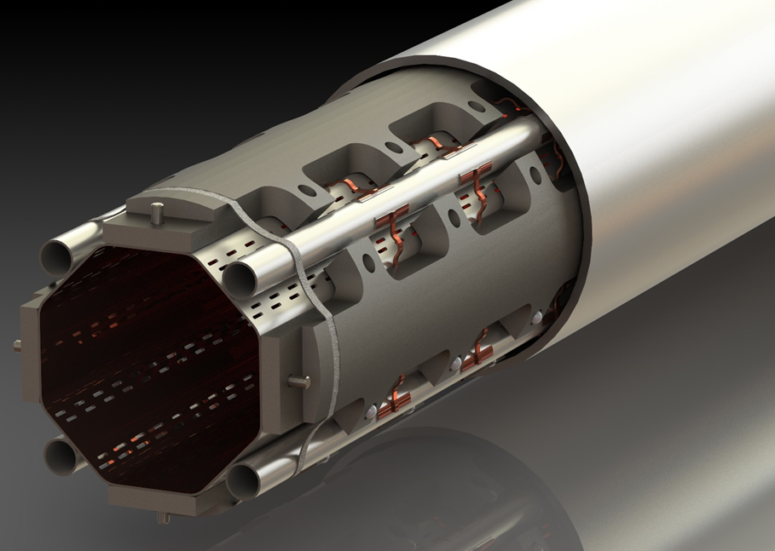
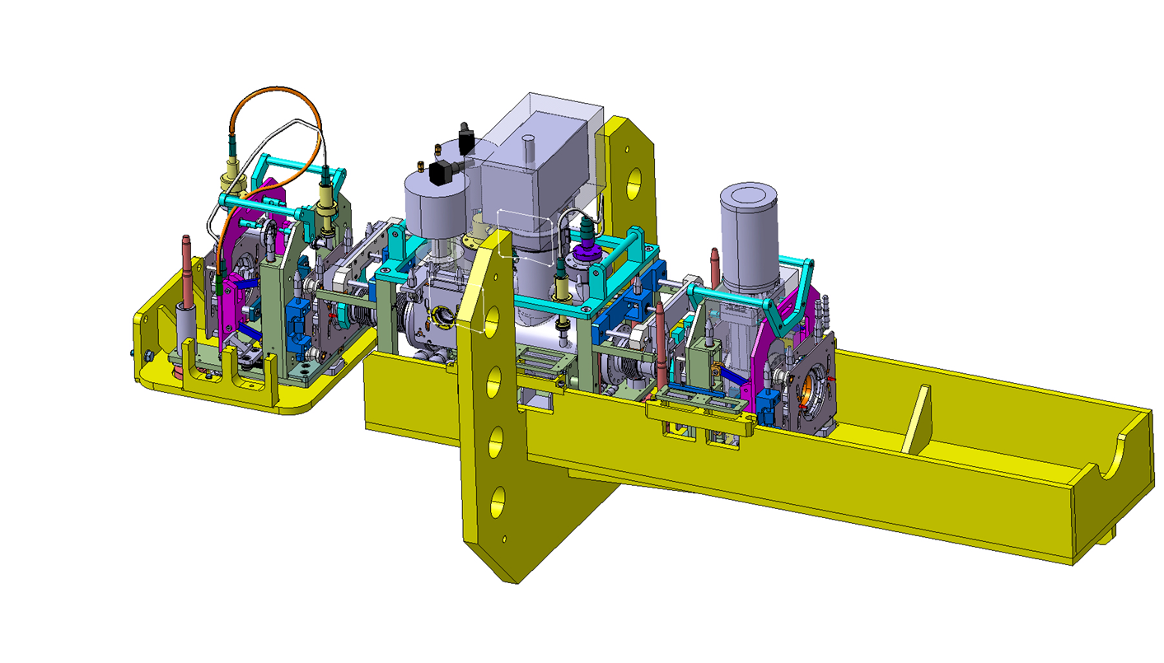
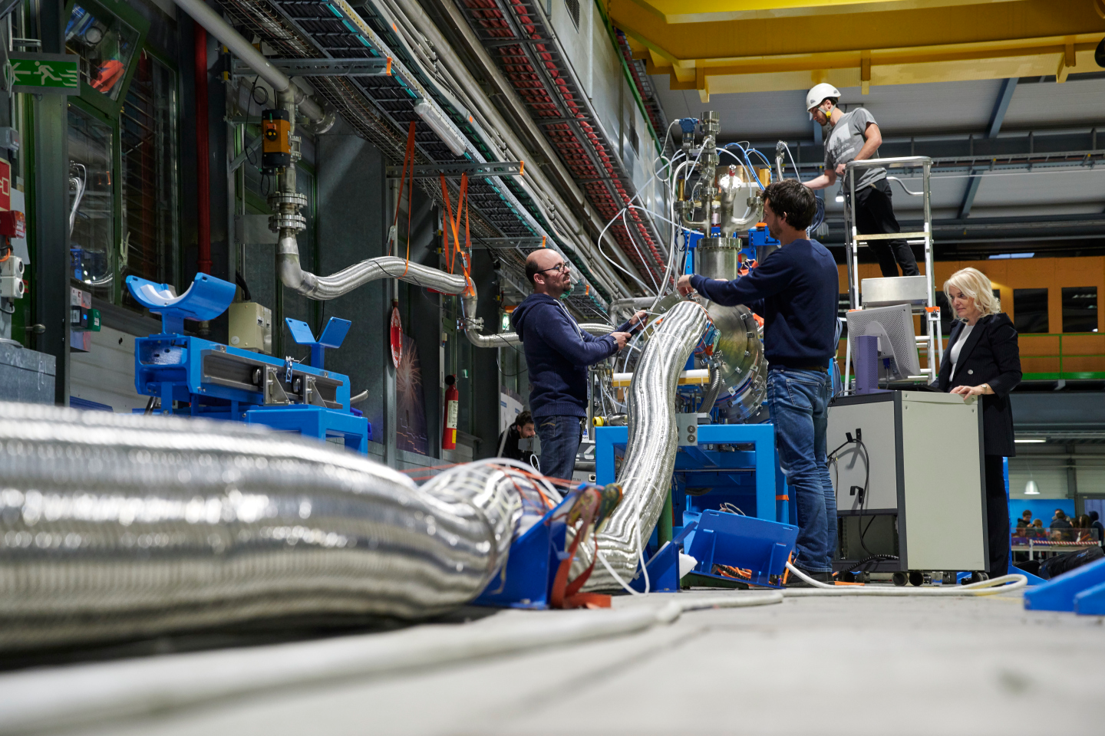
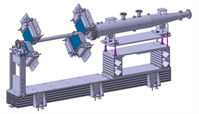
Technology landmarks

Slide 9
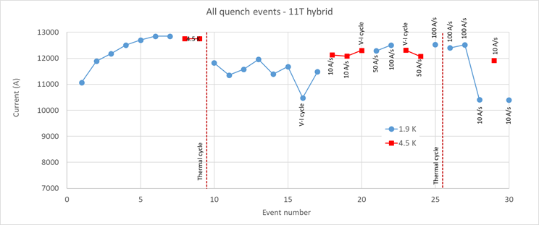
LBH_A (11T)
By-pass cryostat with collimator
LBH_B (11T)
Complete 11.2 T cryo-assembly replacing a 15 m long 8.3 LHC dipole
Operation 7 TeV
7 TeV
L. Bottura & A. Devred
HiLumi WP11- F. Savary et al.
Hybrid (long proto): Excellent at first ! But strong permanent degradation after thermal cycle. Absence of thermal gradient control in the procedure.

Slide 10
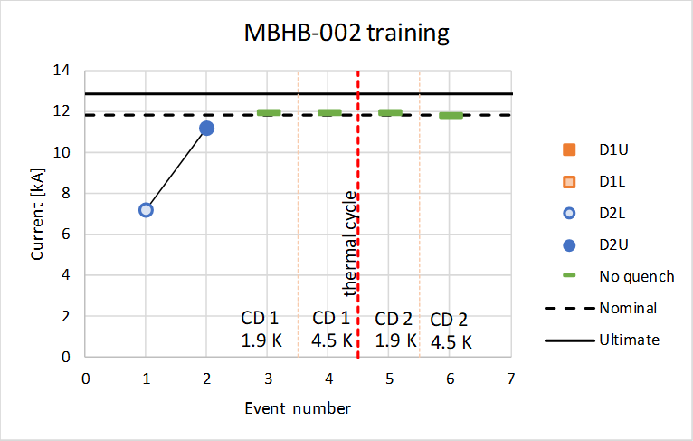
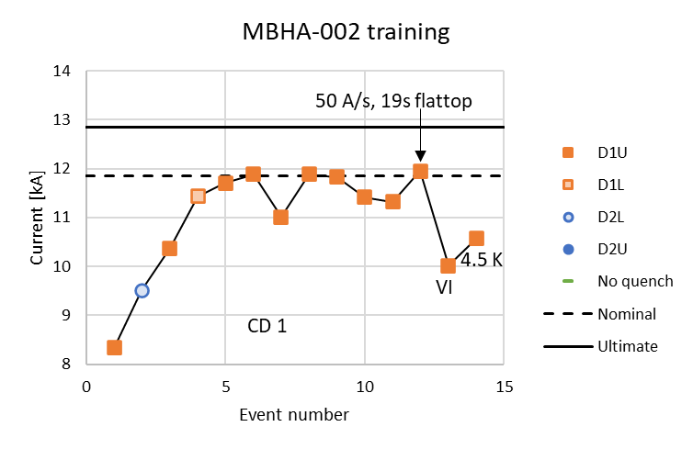
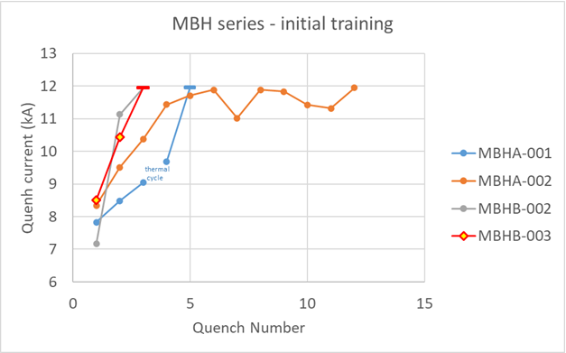
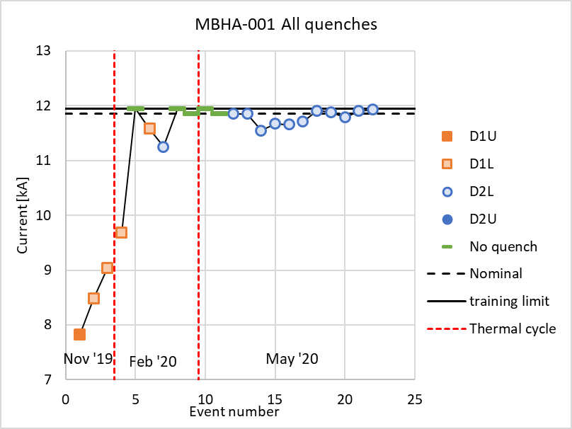
6 11 T to build: 2 pairs to test + 1 pair spare
Each pair is 1 MBHA with 1 MBHB
Terzo di serie, tipo A: 1 QH rotto e una bobina degradata
In riparazione
Primo dii serie, tipo B: OK!!!
Quarto di series,
MBHB-003: OK al primo col down
Ma occorre fare il ciclo termico e nuovo powering e verificare che vada bene!
Secondo di serie, tipo A e ideale da accoppiare con il primo tipo B.
Terzo in test per problemi elettrici: ottimo come quench ma diversi strani segnali elettrici hani richesto tanti test e poi si è degradato

Slide 11
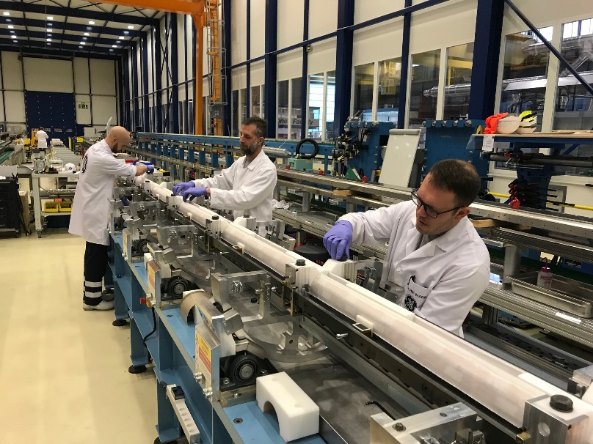
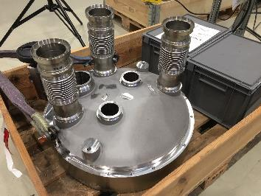
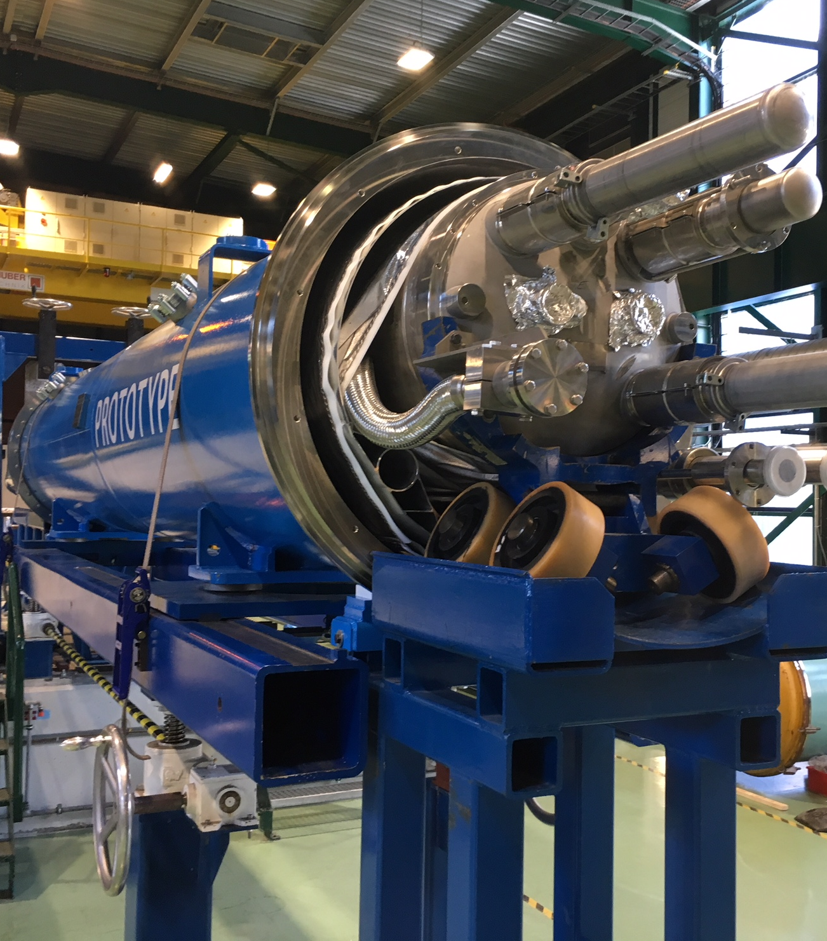
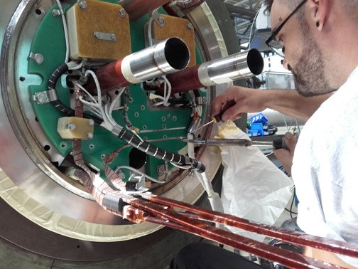
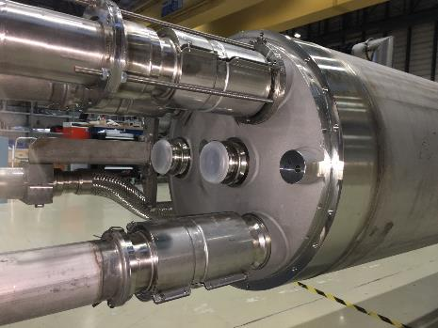
11 T in full swing production: trying to get at least one pair installed during LS2 in 2021!

Slide 12
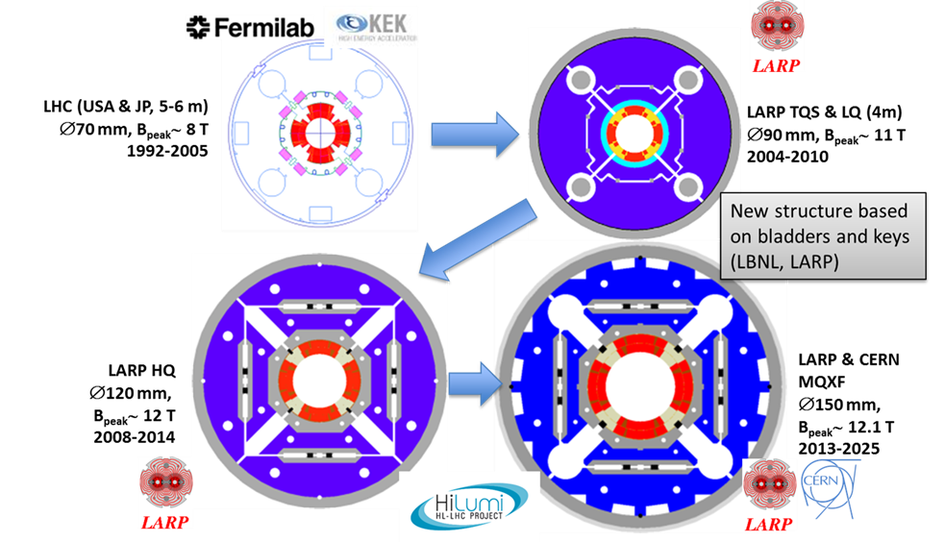

IT quadrupole. Increase in field but also in size wrt LHC. Very relevant also for FCC magnets

Slide 13
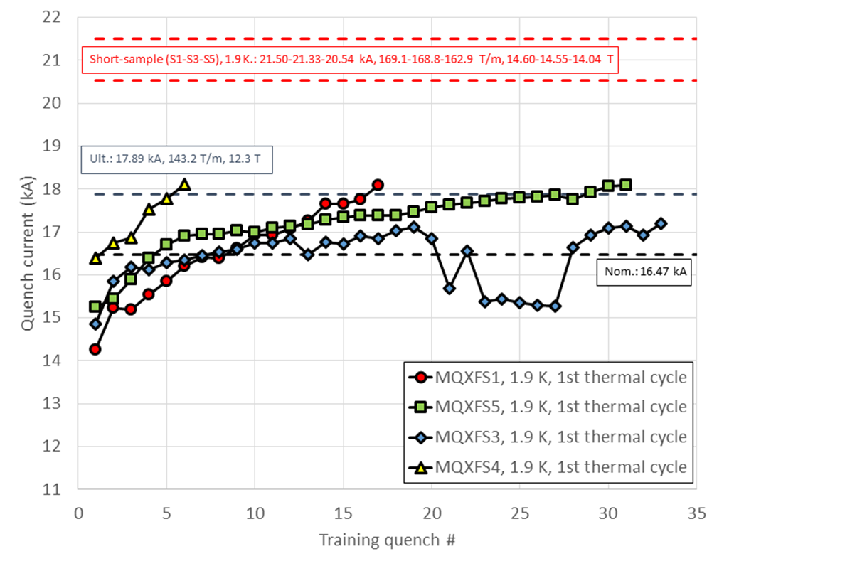
Excelent results IT quadrupoles short models
(thanks also to US-LARP)
All magnets have exceptional memory (no low current quench after thermal cycle)
Best HF magnet ever tested in terms of behaviour (not max field)
Final conductor, final prestress procedure
This magnet had a too high prestress The last higher quench have fast ramp rate
HiLumi WP3:
E. Todesco et al.
However we found recently electrical and structural problems on the first two long prototypes (partly seen also on 11 T).
Structural problems on IT Quads understood and being solved: traced to too small margin (in shells).
Electrical problem (QH insulation): 2 solutions identified.
Industrialization of long magnets is being more difficult than anticipated! Difference from LHC NbTi.

Slide 14
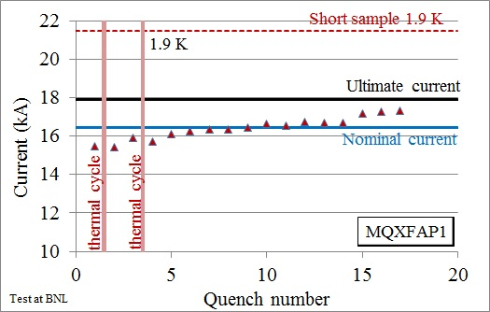
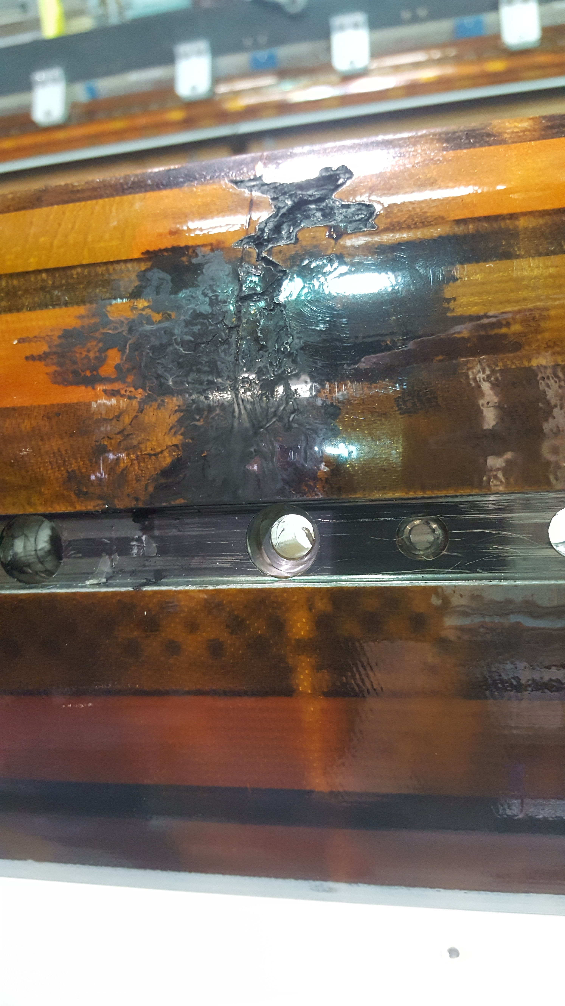
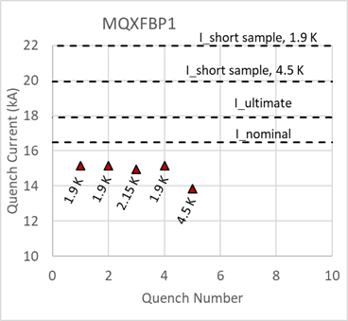
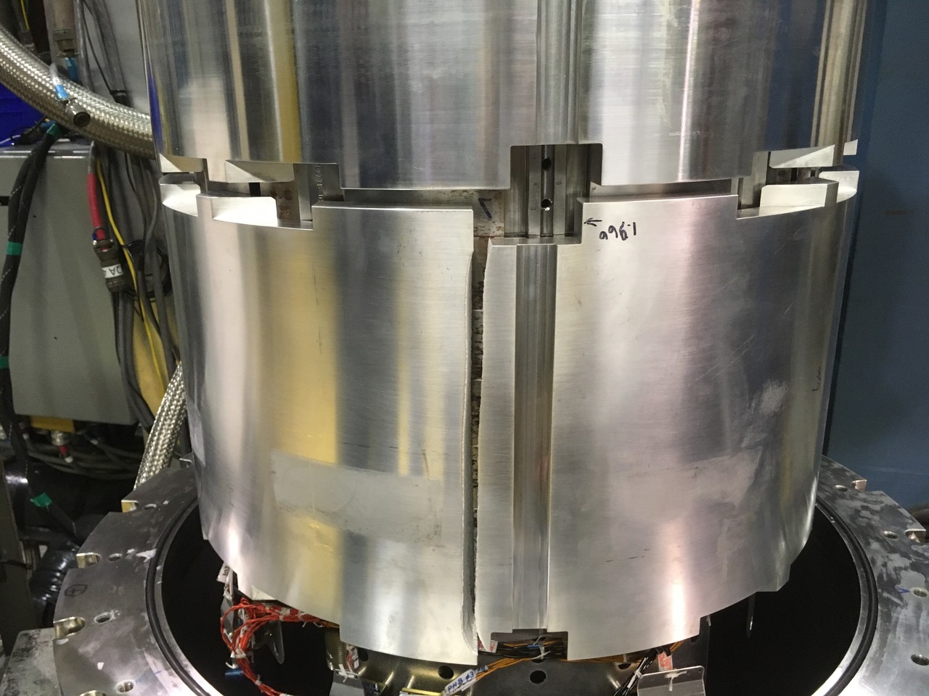
First two US long (4.2 m) IT quads:
Succesful Proto P1 but then voltage breakdown trigged by test at too high Voltage. Repair not successful.
US proto n.2: very bad. Structural failure on a component that was already modified. Howeve triggered a rview and a decise increase of the structural margin.
Primo prototipo lungo CERN (7.2m): degradazione di una bobina: da riparare

Slide 15
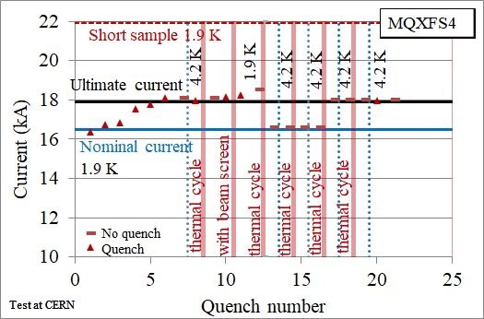
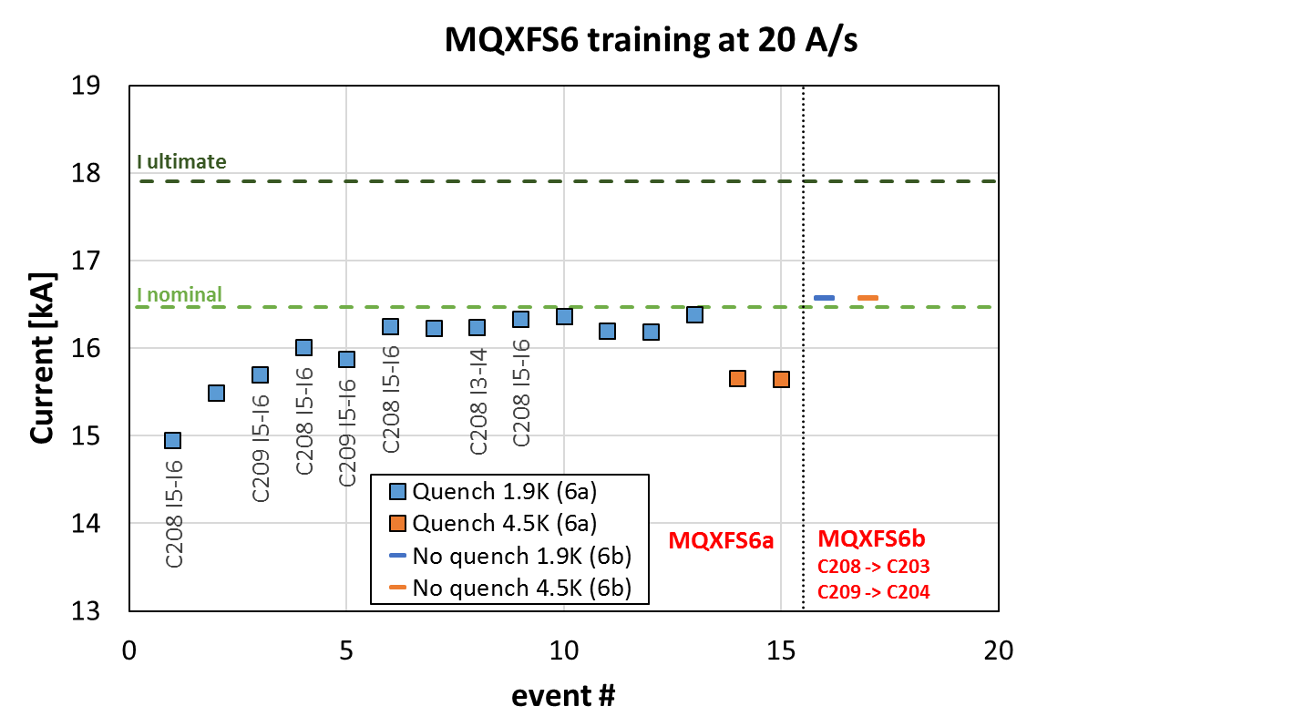
Endurance test on a short IT quad and coil replacement test at CERN
Short models allowed to explore long term behaviour
  MQXFS1 had 8 thermal cycles and 150 quenches, always reched nominal after thermal cycle without quench
  No performance degradation, alwqays reached ultimate after training
Second long term test on MQXFS4
  Special VI measurements - no degradation
  7 thermal cycles done
  Ultimate reached at 1.9 and 4.2 K
A weak short model (with cable not conform, was repaired successfully with old coils
Courtesy of E. Todesco
Leader of the HiLumi Magnets for the insertion regions

Slide 16
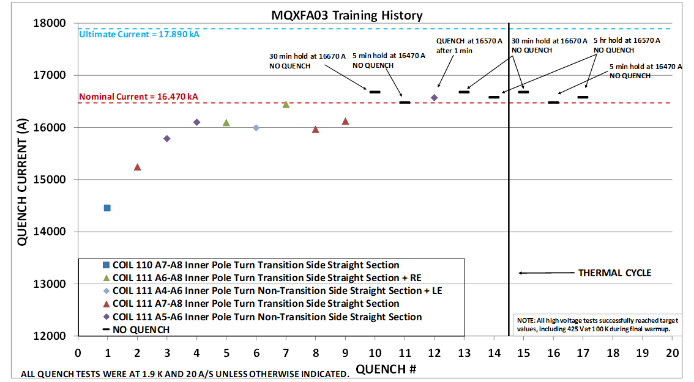
Dec 2019: first US series test: it worked!

Slide 17
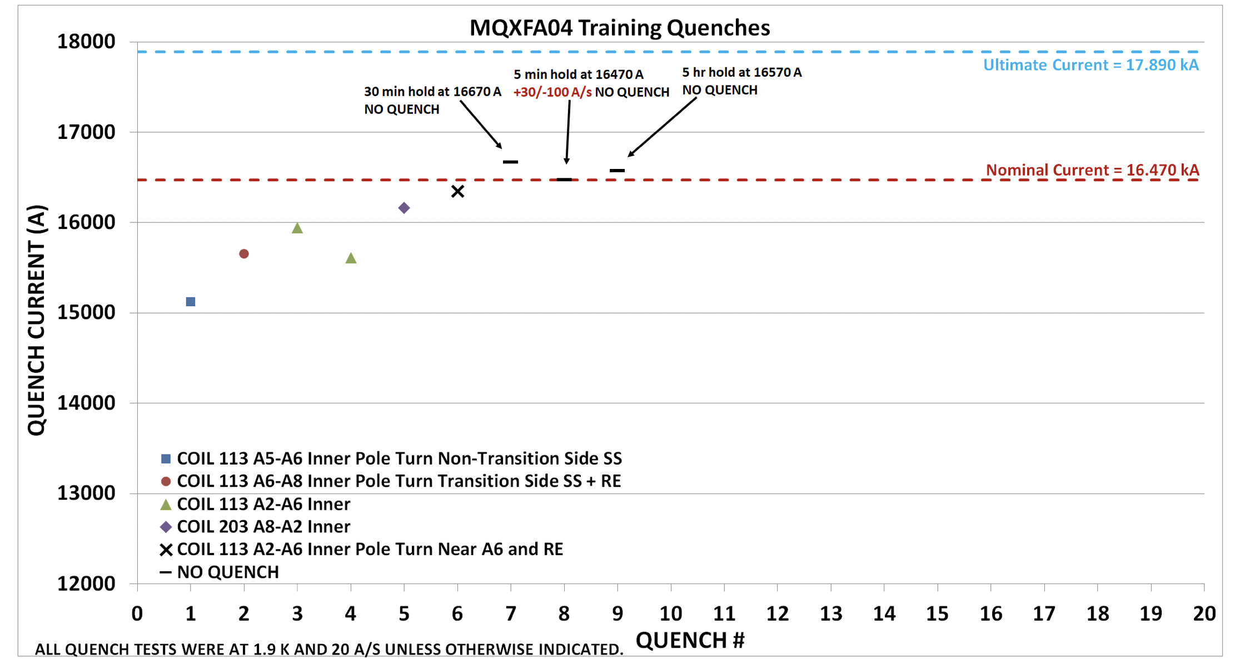
2st series US quad: 2 weeks ago! Success!

Slide 18
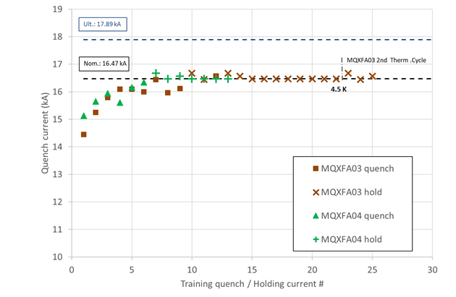
The US magnets must be paired to have a complete quadrupole set (4.2m+4.2m)
So now they can couple the two magnets, put them into the cryostat and deliver the first IT Quad for the IT string

Slide 19
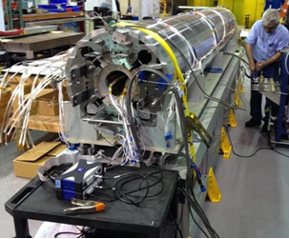
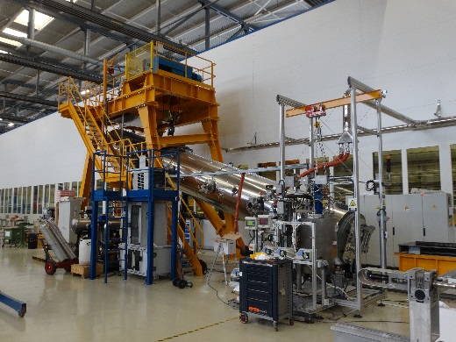
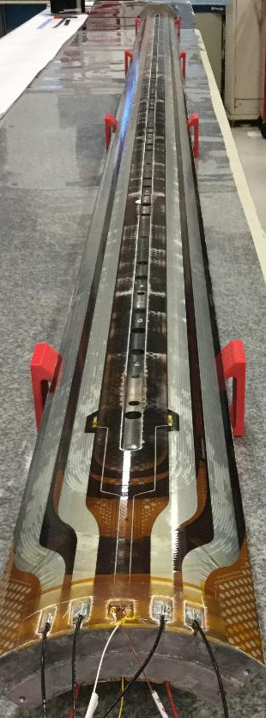
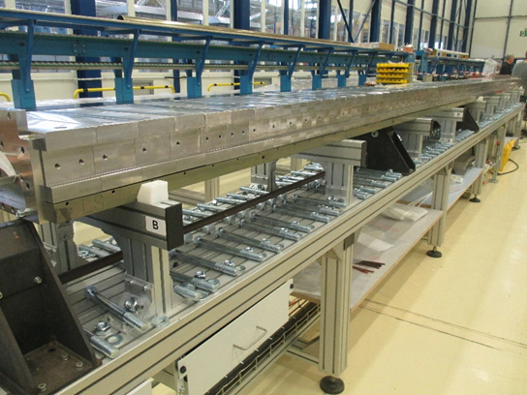
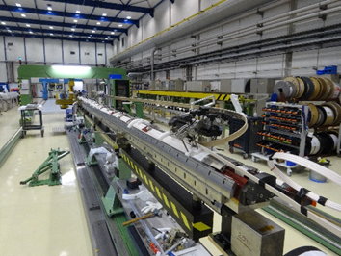
P2 IT Quad in CERN; in USA P5/P6
Making long magnets in Nb₃Sn is challenging – especially in view of for mass production. We are confident for HiLumi: the project is big but not enormous (about 30 magnets of 4.2, 5.5 and 7.2 m length) by 2024 (2025?). Consider that basic R&D started in 2005 and specific R&D in 2010

Slide 20
The LHC after HiLumi
LHC as FCC-hh (expensive) injector
  Foreseen to work at low maintenance 3 TeV beam
  Can provide also beam for fixed target at 1..3 TeV
High(er) Energy LHC (for HEP community to assess if interesting or not)
  33 TeV c.o.m. : 20 T magnets (2010 Malta Workshop)
  27 TeV c.o.m. : 16 T magnets (FCC baseline magnet)
  21 TeV c.o.m. : LHC1.5, based on 12 T magnets
LHeC compatible with
  Present LHC (with important modifications)
  New HE-LHC, whatever configuration (a bit easier than present LHC)

Slide 21
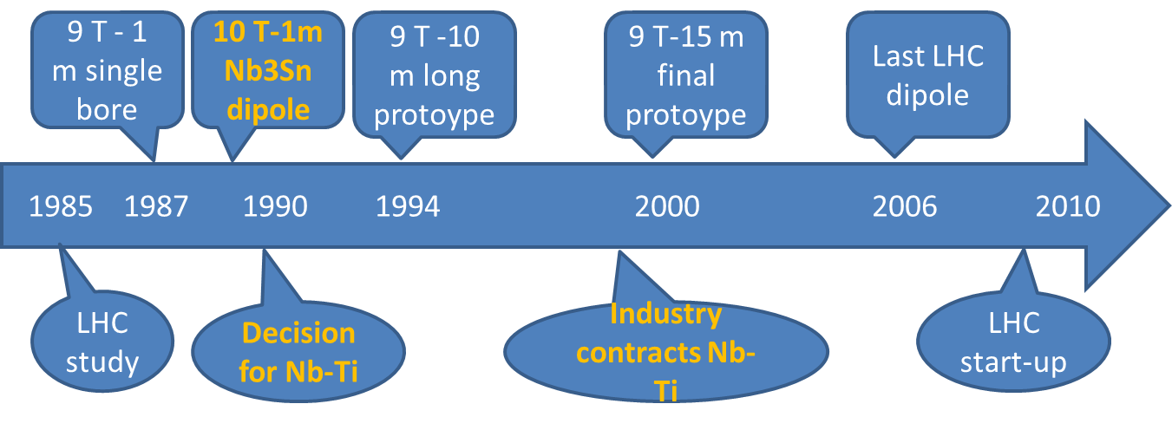
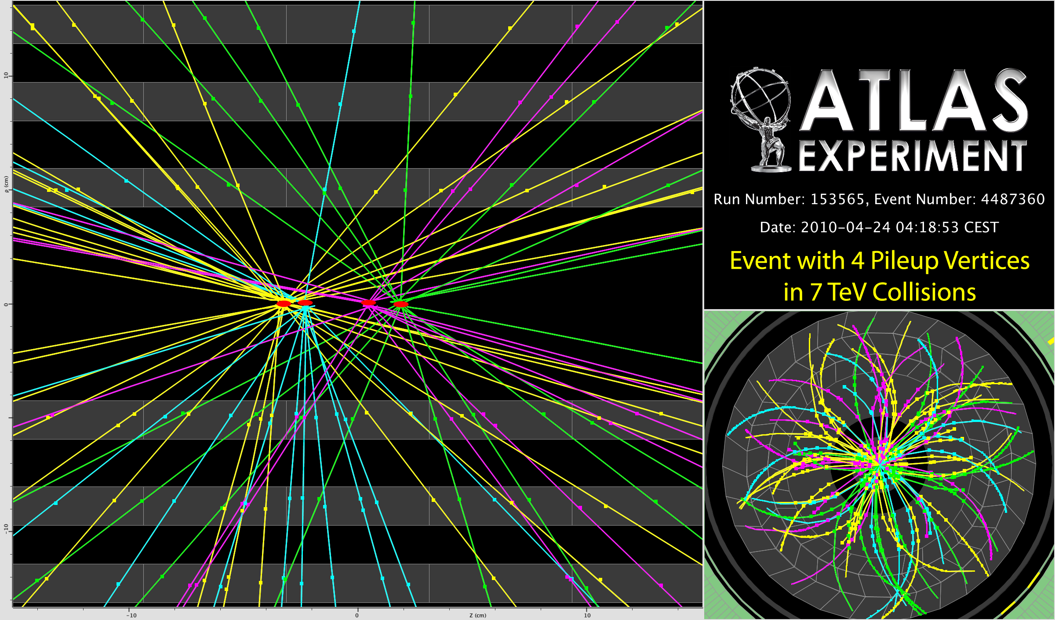
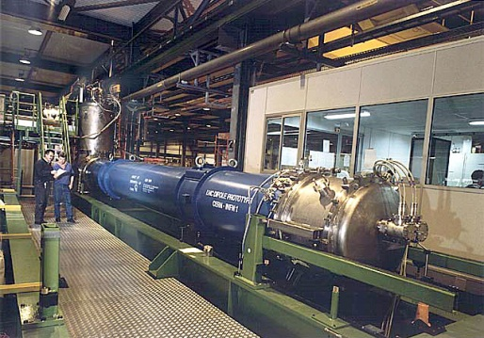
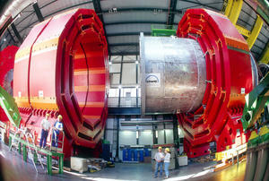
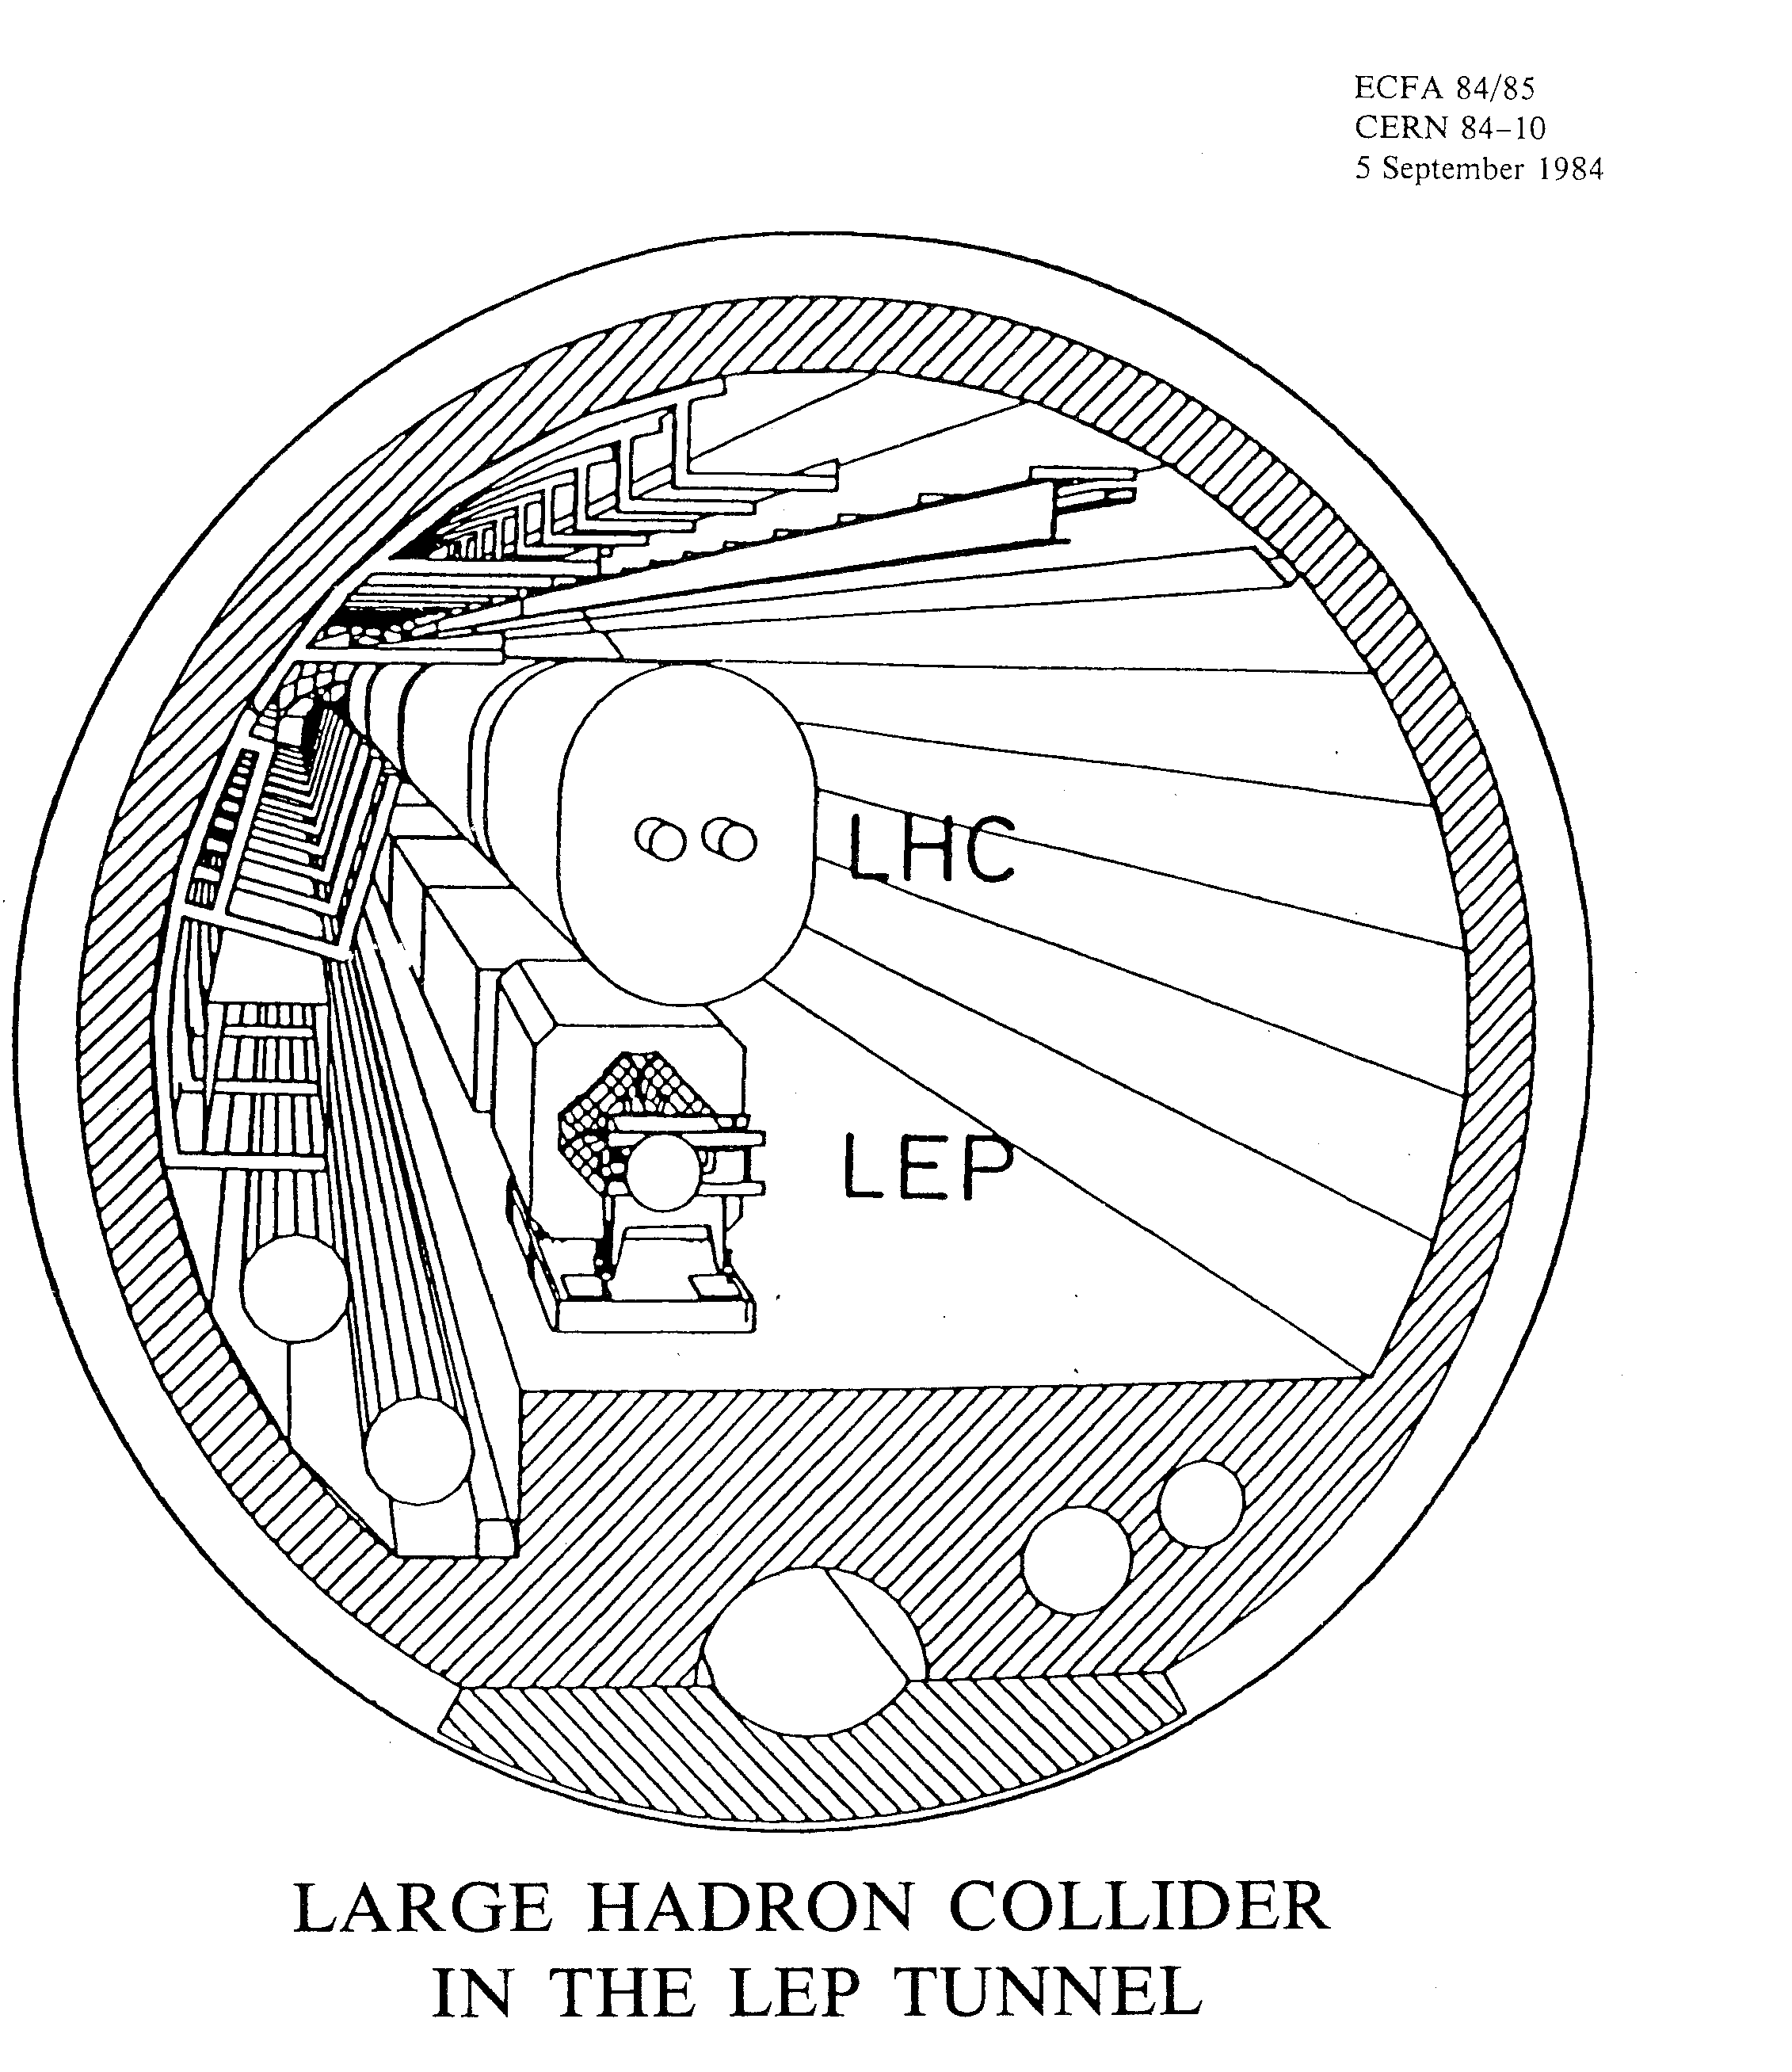
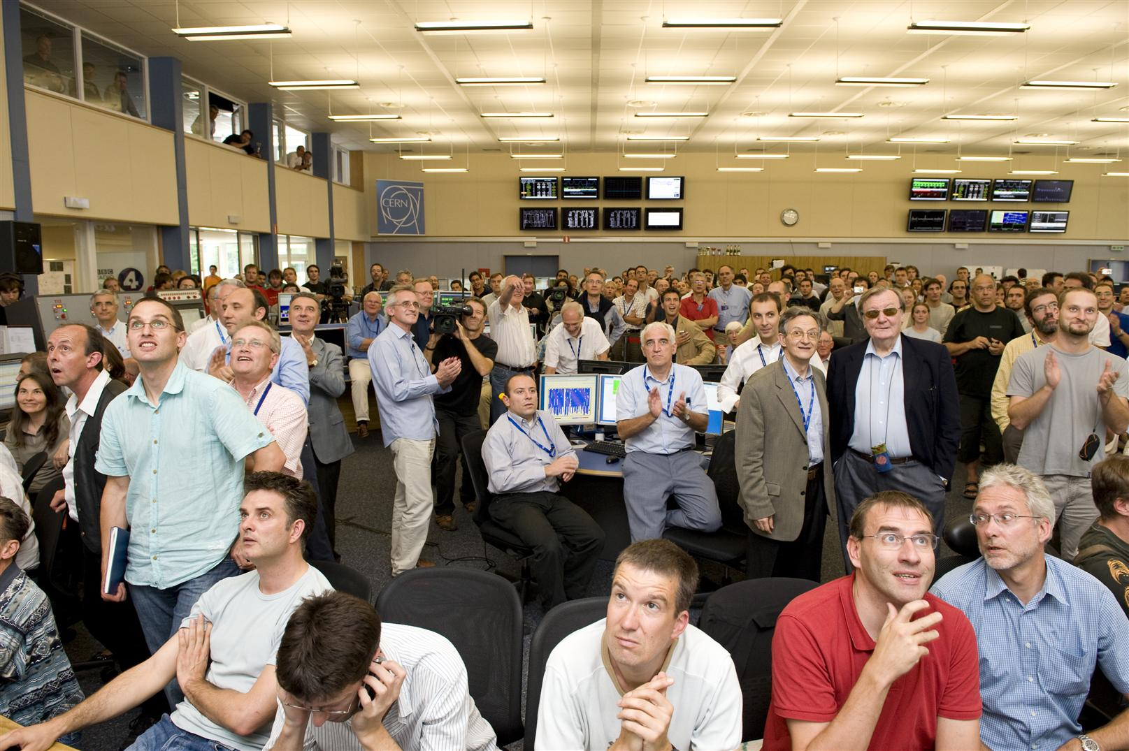
The 25 y LHC construction time line possible only because SSC developed the superconductor…
Only 2 y to make a short magnet «near to final». Conductor available(SSC)
7 years from start R&D to 1st Industry proto
12 y from first working prototype to last magnet

Slide 22
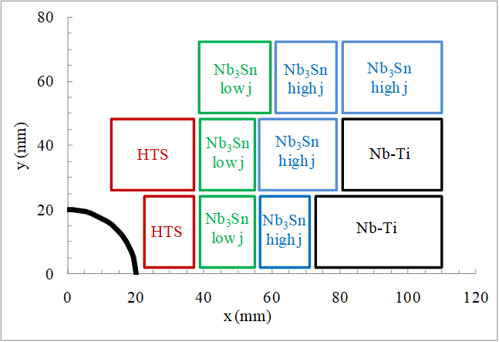
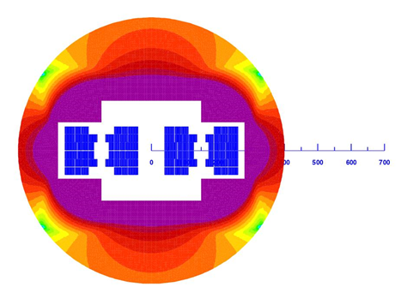
HE-LHC Malta FP7-Eucard workshop (2010)
Dipole at 20 T
Energy 33 TeV (c.om.)
Where are we?
Little work in that direction.
Magnet technology Hilumi (11-12 T) is taking longer than anticipated
Minimal resources for HTS
It took > 10 years to develop the SC for HiLiumi (2003-2015)
SC for B>12-14 T is not yet there. Effort for a more realistic HE-LHC done in the frame of FCC-hh (since 2013)
L. Rossi & E. Todesco, CERN

Slide 23
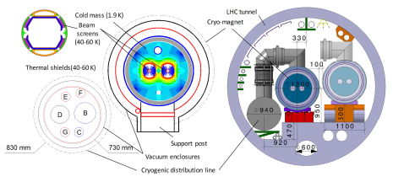
HE-LHC as designed inside FCC-hh project
Dipole Field 16 T → 27 TeV c.o.m.
M. Benedikt, F. Zimmermann et al.

Slide 24


Circular hadron colliders: FCC-hh and SppC
circumference $\sim$100 km, two high-luminosity experiments up to 3 (1) x 10³⁵ cm⁻²s⁻¹, two additional experiments possibly combined with injection section, collimation insertions (betatron and momentum cleaning), extraction/dump insertion, RF insertion,
values in brackets refer to CEPC
FCC-hh
SppC
based on existing CERN injector chain,
Luminosity goal ~20 ab-1 per main IP within 25 years
new injector chain,
simultaneous operation with e+e- collider
M.Benedikt @ Granada

Slide 25
p-p machine CERN
parameter | FCC-hh |  |  | HE-LHC | HL-LHC | LHC
collision energy cms [TeV] | 100 |  |  | 27 | 14 | 14
dipole field [T] | 16 |  |  | 16 | 8.33 | 8.33
circumference [km] | 97.75 |  |  | 26.7 | 26.7 | 26.7
beam current [A] | 0.5 |  |  | 1.1 | 1.1 | 0.58
bunch intensity [10¹¹] | 1 |  | 1 | 2.2 | 2.2 | 1.15
bunch spacing [ns] | 25 |  | 25 | 25 | 25 | 25
synchr. rad. power / ring [kW] | 2400 |  |  | 101 | 7.3 | 3.6
SR power / length [W/m/ap.] | 28.4 |  |  | 4.6 | 0.33 | 0.17
long. emit. damping time [h] | 0.54 |  |  | 1.8 | 12.9 | 12.9
beta* [m] | 1.1 | 0.3 |  | 0.25 | 0.15 (min.) | 0.55
normalized emittance [μm] | 2.2 |  |  | 2.5 | 2.5 | 3.75
peak luminosity [10³⁴ cm⁻²s⁻¹] | 5 |  | 30 | 28 | 5 (lev.) | 1
events/bunch crossing | 170 |  | 1000 | 800 | 132 | 27
stored energy/beam [GJ] | 8.4 |  |  | 1.4 | 0.7 | 0.36

Slide 26

The timeline of a FCC-hh is determined by magnet technology wich depends on SC development16 T
Main development goal is wire performance increase:
J_{c} (16T, 4.2K) > 1500 A/mm² →50% increase wrt HL-LHC wire
Reduction of coil & magnet cross-section
This is difficult
Present FCC targets
A. Ballarino & L. Bottura, CERN

Slide 27













Conductor R&D
Specification: 1500 A/mm² @ 16T, 4.2K
2850 A/mm² @ 12T, 4.2K
≈ 1250 A/mm² @ 16T, 4.2K
1750 A/mm² @ 15T, 4.2K
≈ 1400 A/mm² @ 16T, 4.2K
≈ 950 A/mm² @ 16T, 4.2K
1274 A/mm² @ 15T, 4.2K
≈ 1000 A/mm² @ 16T, 4.2K
Results expected later this year

Slide 28







FCC Magnet 3 Designs
T_{op} ≈ 1.9 K
I_{op}/I_{C}(loadline) ≈ 86 %
V_{dump} < 2.5 kV
σ_{max} < 200 MPa
T_{hot} < 350 K
D_{out} ≈ 600 mm
Falcon-D
HE-LHC !
 |  | blocks |  | cos(θ) |  | common coil
Current | (A) | 11230 |  | 10000 |  | 16100
Inductance | (mH/m) | 40 |  | 50 |  | 19.2
Stored energy | (kJ/m) | 2520 |  | 2500 |  | 2490
Coil mass | (tons) | 7400 |  | 7400 |  | 9200
From 2013 this the only results!!
(of course nto true: Sc development + small racetracks +… Hilumi
+ launching costruction of 1 m short models
Very efficient use of superconductor
Simplified mechanics and manufacturing ?

Slide 29




Highest “dipole” fields
LBNL HD1
Magnets with “bore”
CERN RMC
Field records
CERN/CEA FRESCA2
From Luca.Bottura-CERN
Record fields for SC magnets in “dipole” configuration

Slide 30

Recent very successful > 14 T magnet reached by US MDP cosϑ dipole at FNAL
But the route is long… a 16 T 100 km accelerator is not yet at hand and a long R&D is necessary.
In May 2020 in Budapest gthe new ESPP will be approved…

Slide 31



high-field magnet R&D for SppC
10.2 T @ 4.2 K dipole field
in two apertures
(Performance limited by NbTi coils)
Notes:
New slide from Davide.
Showing that conductor development is launched at international level, Russia, Japan, (Korea and Europe in preparation)
Underline importance of that development as main cost driver for the hadron collider machine.

Slide 32



High Temperature Superconductors – HTS: next technology step
Plot courtesy of
C. Senatore, UNIGE
Opening a new page?

Slide 33



High Temperature Superconductors – HTS
The dream of 20-25 tesla! (2 x HilumiLHC!)
A 5 T, 40 mm bore HTS based dipole demonstrator

Slide 34



Trying the magnets of the future… 20 tesla or more...

Slide 35







European Strategy for Particle Physics 2018-2020
European Strategy for Particle Physics 2025-2027
WP2/WP3: Nb₃Sn Magnets
2020
2021
2022
2023
2024
2025
2026
2027
Falcon
R2D2-FD
F2D2
RMC-CC
HF Models
CCT
CCT?
DEMO
SMC, (e)RMC, RMM
Goal: Evaluate options for ultimate Nb₃Sn performance (16 T)
VE Models
VE Prototypes
Goal: Demonstrate technology for large scale Nb₃Sn accelerator magnets (12 T)
HF: High Field (16 T target operating field)
VE: Value Engineered (operating field in the 12 T range)

Slide 36





European Strategy for Particle Physics 2018-2020
European Strategy for Particle Physics 2025-2027
WP5: HTS Magnets
2020
2021
2022
2023
2024
2025
2026
2027
EuCARD2 F2
EuCARD2
HTS Inserts demonstrators
EuCARD2 cosθ
UHF models
HTS Standalone demonstrators (“cloverleaf”)
Small Coil Technology
Goal: Select options for HTS accelerator magnet design (20 T)
Fresca2 at 163
New HF test station
Goal: Assess and quantify potential of HTS for accelerator magnets applications
SCT for Superbend
ASI demonstrator
Undulator demonstrator
Self-funded applications
GaToroid demonstrator
UHF: Ultra High Field (in excess of 20 T target operating field) GaToroid: funded by KT-MA
SCT: Small Coil Technology Superbend: Part of SLS upgrade at PSI
ASI: Agenzia Spaziale Italiana

Slide 37
PERSONAL considerations -1
(Not checked by CERN or INFN management)
The New ESUPP has clarified that the community support the R&D for a new pp collider
EU (and US) has a big advantage in magnet technology: if we want to have the collider better to keep it.
The period 2013-2020 has been useful but now is needed much more focussed R&D
Clearly is different if to work for having an acclerator working at 16 T or 12 T field. The 16 T si compatible only with a start afterr 2050 in my opinion.
But for >2050 a HTS si possible, too (probably) making 20 T and reaching 125 TeV in pp 100 km tunnel
  On a short (2040) time scale only HE-LHC at 20-22 TeV or a FCC-hh with simple NbTi (40 TeV) is possible I believe.
  On a long time scale (>2050) I think a 120-150 TeV shodul be puirsuied ad the highest energy frontier.
  Tthe interemdiate hypothesis a FCC-hh working at 12 T field, i.e. 75 TeV, si possible for somehow 2040-2050…

Slide 38

PERSONAL considerations -2
Four possibilties for a p-p collider
HTS
12 T Nb₃Sn dipoles HiLumi technology in LHC: 21 TeV c.o.m.
LHC1.5
Energy tripler 100km
7 T Nb-Ti dipole (low cost LHC, 4.2 K):
44 TeV c.o.m. (100 km)
2040

Slide 39

Thanks you

Slide 40


Pile up
400
events
5 events
Pushing at the maximum the parameters of HL-LHC we would start the fill at L = 15x10³⁴ with 400 events/crossing.
Notes:
Ask Rogelio how degrade sensitivity wit pile up and ple up density.

Slide 41


Long term development of SC is critical for HEP Hadron Collider: Open SC Lab Proposal
L. Bottura and F. Bordry
Phase I - Construction and commissioning (3 years)
• Equipment and labour: 10 MCHF
• Surface: 2000 m2
• Personnel: 10 FTEy (1 project engineer + 2 techn.)
Phase II - Facility ramp-up and initial operation (7 years, processed R&D material of the order of 25 kg/week, operation 40 weeks/year)
• Total cost: 20-30 MCHF

Slide 42

Great performance of 30 km 1.9 K cryo-system
D. Delikaris
S. Claudet, CERN

Slide 43

(Peak) Luminosity evolution and limitation
2018
F. Bordry, CERN Director for A&T
Notes:
Ask picture of heat exchanger in triplet

Slide 44




Asymmetric IR Design: example LHeC
O. Bruning
and M. Klein
Beam pipe: in CDR 6m, Be, ANSYS calculations
Composite material R+D, prototype, support..
→ Essential for tracking, acceptance and Higgs
Have optics compatible with HL-LHC ATS optics and β*=0.1m
Head-on collisions mandatory →
High synchrotron radiation load, dipole in detector
Optimize LHeC to LHC ATS optics
Specification of Q1 – NbTi prototype
Revisit SR (direct and backscattered),
Masks+collimators
Beam-beam dynamics and 3 beam operation studies
S. Russenschuck
44

Slide 45


HE-LHC time line and cost
2020?
2040?
2900 Magnets; 260 for LHC disposal
1 TeV beam from SPS

Slide 46
Consideration on HE-LHC
Assume we want to have for installing in 2035-2040, right after HiLumi
We need to have the magnet proof tomorrow (2023-25)
But for tomorrow we will have «only» the HiLumi Magnets: 30 magnets, 4- to 7.5 m long, B= 11.2-11.5 T operative, B=12.3 T ultimate. I do not think that 16 T dipole industrial construction for HE-LHC can be launched by 2030 (only way to have it by beginning of 2040).
For 16 T dipole project we need a «buy-time project» like LHeC , see later. Or…
With a moderate effort a 12 T operative dipoles can be engineerized with HiLumi SC wire shortly after HiLumi.
  Still SC needs to cost less and needs a small, key, improvements: D_{eff} is ∼ 45 µm for HiLumi; we need 20 µm. But we have plenty of I_{c}…
  Still the magnet technology at 11-12 T level is not yet fully gained, especialy in view of a mass production. We need to understand and improve long term degradation, stress control (mechanical & thermal) and electrical insulation robustness

Slide 47
Timeline and cost (very rough, no study)
Cost scaled from 2019 HE-LHC study. If it is of real interest the study could be done
Domain | Cost MCHF | Comments | Wrt HE-LHC
Collider | 4500 | 2400 for Magnets | -500
Injectors | 500 ÷ 1100 | New optimization TBD | 0 ÷ -600
Tech Infr.+C.E. | 900 ÷ 1100 | Probably is less (< P_{syn}) | ? (-200?)
TOT | 6100 ÷ 6700 | (LHC2008 was 3400) | Cost should be optimized as upgrade

Slide 48


Can LHC system & T.I. be re-used, lasting 15 years more?
YES if proper maintenance and consolidation is done. Already now Consolidation and serious maintenance are keys for the LHC availbilty and success.
Consolidation cost: 15-20 MCHF (10-15 MCHF for LHC and 5-8 for Injectors).
For system the maintenance (under Operation) is critical for duration: cryogenics
CONS Budget by system
40% Tech. Infrastr. & Transp.
33% Magn. & Powering
Courtesy M. Lamont, CERN

Slide 49
LHeC and LHC1.5
In case of HE type LHC1.5 (realisitic for 2040)
  The option Ring-Ring should be again considered
  It consists of an electron ring in the LHC tunnel on the top of the HE new magnets.
  Certainly possible: was so at the design of LHC (LEP inside). Abandoned in 2001 to make simpler a few points.
  In a new ring design it should be accommodate
  The lepton magnets can be used alosd as LER (Low Energy Ring) for proton injector to avoid upgrade of SPS for post LHC1.5 use: LHC3 with HTS, if anything else is done). We have a (narrow!) tunnel and infrastructure to exploit at the maximum.

Slide 50

LHeC: RL with ERL Operation as Baseline
O. Bruning
and M. Klein
Super Conducting Recirculating Linac with Energy Recovery
Choose ⅓ of LHC circumference ➔
Two 1 km long, 10 GeV
SC LINACs with
3 accelerating and
3 decelerating passes in CW operation
SRF sees 6*current
at the IP (≈ 4ns spacing)
➔ Q₀ = 10¹⁰ requires
cryogenic system
comparable to LHC
system! Q₀ > 10¹⁰
10³³ cm⁻² s⁻¹ Luminosity reach | PROTONS | ELECTRONS
Beam Energy [GeV] | 7000 | 60
Luminosity [10³³cm⁻²s⁻¹] | 1 | 1
Normalized emittance γε_{x,y} [μm] | 3.75 | 50
Beta Funtion β∗_{x,y} [m] | 0.1 | 0.12
rms Beam size σ∗_{x,y} [μm] | 7 | 7
rms Beam divergence σ’∗_{x,y} [μrad] | 70 | 58
Beam Current @ IP [mA] | 430 (860) | 6.6
Bunch Spacing [ns] | 25 (50) | 25 (50)
Bunch Population | 1.7*10¹¹ | (1*10⁹) 2*10⁹
Bunch charge [nC] | 27 | (0.16) 0.32
10³⁴ cm⁻² s⁻¹ Luminosity reach | PROTONS | ELECTRONS
Beam Energy [GeV] | 7000 | 60
Luminosity [10³³cm⁻²s⁻¹] | 16 | 16
Normalized emittance γε_{x,y} [μm] | 2.5 | 20
Beta Funtion β∗_{x,y} [m] | 0.05 | 0.10
rms Beam size σ∗_{x,y} [μm] | 4 | 4
rms Beam divergence σ’∗_{x,y} [μrad] | 80 | 40
Beam Current @ IP[mA] | 1112 | 25
Bunch Spacing [ns] | 25 | 25
Bunch Population | 2.2*10¹¹ | 4*10⁹
Bunch charge [nC] | 35 | 0.64
Over 600MW Beam power in electron Beam!!!
Thanks to energy recovery the bill is only 100 MW!
ERL is a must for efficient operation!!!
ERL is new technology for energy efficiency and must be pursued: LHeC is the ideal first HE demonstrator
Cost: 1000-1500 MCHF (30÷60 GeV e⁻ beam)
944 cavities; 59 cryo modules per linac
ca. 9 km underground tunnel installation
more than 4500 magnets (same magnet design as for RR option)
50

Slide 51

O. Bruning
and M. Klein
S. Russenschuck
The insertion region in LHC must be studied in detail to asses properly the feasibility

