Slide 1
The VIP-2 Experiment
-Looking for the violation of the Pauli exclusion principle
LuCA DE PAOLIS
for the VIP2 Collaboration, LNF-INFN
106° Congress of Italian Society of Physics, 14-18/09/2020

Slide 2
How it is possible to investigate the PEP with VIP-2
In Quantum Mechanics the Pauli Exclusion Principle (PEP) can be formalized starting from two fundamental principles:
1) All states, including those related to identical particles, are described in terms of wave functions
2) Bosonic and fermionic states have a different behavior in relation to the application of the exchange transformation (permutation) of identical particles: the former are symmetrical and the latter are anti-symmetrical
This superselection rule "does not appear as a necessary feature of the quantum-mechanical description of nature".
Messiah A.M.L. and Greenberg O.W.; Physics Review 1964, 136, B248.
States of mixed symmetry could, therefore, in principle, exist
Possible existence of particle states that follow a different statistic than the fermionic or bosonic one.

Slide 3
How it is possible to investigate the PEP with VIP-2
The experimental method of VIP-2 is based on the introduction of "new" electrons in a copper bar by applying an electric current.
A small violation of PEP can be described in Quantum Mechanics as proposed by Greenberg in
O.W. Greenberg, Nucl. Phys. B (Proc. Suppl.)6, 83–89(1989):
Whenever an electron is captured by an atom, a new state is formed that can have a certain probability of being a mixed symmetry state. This state is highly excited and from its decay one could observe a possible transition prohibited by the PEP.
Experimental goal: Search for X-rays from PEP violating transitions
Energy transition Kα allowed:
8.05 keV in Cu
PEP forbidden Kα energy transition:
C. Curceanu, L. De Paolis et al., “Evaluation of the X-ray transition energy for the Pauli-principle-violating atomic transitions in several elements by using Dirac-Fock method”, 2013, INFN-13-21/LNF.
~ 7.74 keV in Cu
An e- in any level n>2 make a transition to level 2P.
The non-Paulian transition to level 1S produces the emission of a PEP violating X-ray.

Slide 4
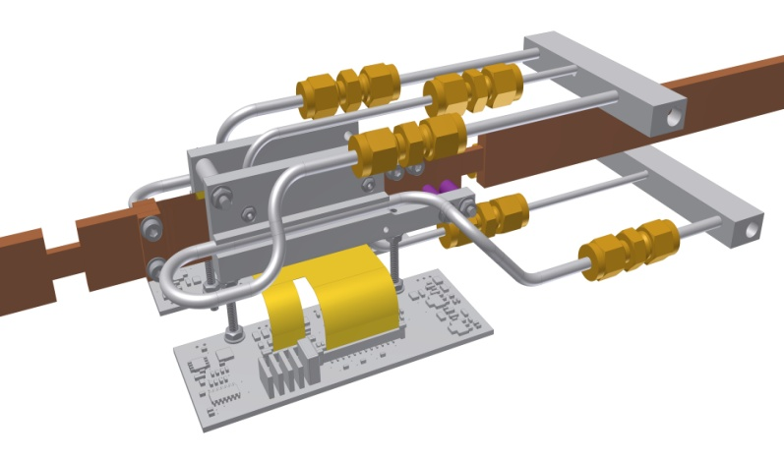
The VIP2 experiment: purpose and apparatus.
Schematization of the VIP2 chamber
Target of VIP2
Characteristics of the target: the 2 strips (10 cm x 1 cm x 50 µm) are connected to an external generator by 2 thin copper bars. Due to the Joule effect, the current(100 A) heats the target to 20 ° C.
A water circuit cools the 2 copper strips so that the temperature of the SDDs does not increase by more than 2K.

Slide 5
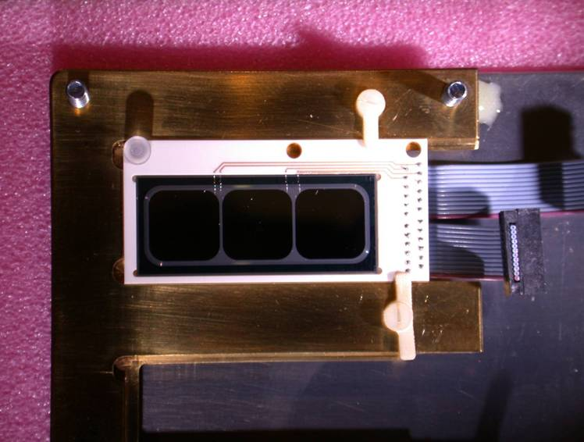
The VIP2 experiment: Silicon Drift Detectors (SDDs)
In the apparatus the SDDs are organized in 2 chips containing 3 cells with 100 mm2 of active area each. Those chips surround the target to optimize the coverage on a solid angle and are cooled to T≈ 100 K by liquid Argon to get a better performance in terms of energy resolution.
The energy resolution was tested with a Fe-55 source through a 25 μm thick Ti-plate. The lines of the K series of Mn and Ti are used to calibrate the spectrum and measure the energy resolution at 6 keV (rate of about 2 Hz). This test resulted in a resolution of about 150 eV at 6 KeV.
SDDs provide information on radiation energy and timing -> measurement performed with respect to the scintillator trigger: 400 ns (FWHM).
SUFFICIENT TEMPORAL RESOLUTION TO DISCRIMINATE THE BACKGROUND EVENTS

Slide 6
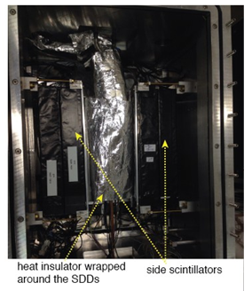
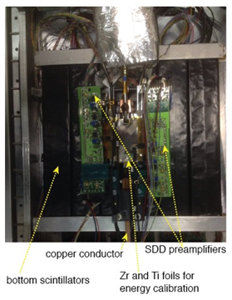
2. The VIP2 experiment: VETO system and location
Used to select incident events with high energy RC unshielded from rock and environmental background.
Composed of 32 plastic scintillators measuring 45 cm x 3 cm x 3 cm and covering a solid angle > 90% compared to the target.
They are read by pairs of SiPM (with 3x3 cm2 of active surface each) located at both ends.
THE ACTIVE SHIELD ALLOWS TO REDUCE THE BACKGROUND IN THE RANGE OF INTEREST FOR A VIOLATION X-RAY OF ABOUT 1 ORDER OF GRANDNESS
The experiment is taking place at National Laboratories of Gran Sasso (LNGS), an extremely low background environment inside the Gran Sasso mountain.

Slide 7
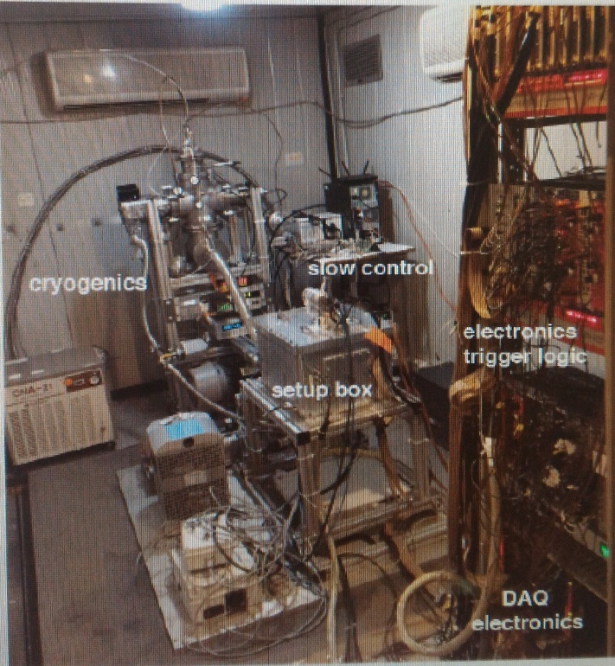
2. The VIP-2 experiment: Improvements and goal
Previous upper limit on the probability of violation of PEP for electrons in copper set by VIP:
$4.7×{10}^{−29}$ [Curceanu C. et al.: J. Phys. 306, 012036 (2011)]
Improvements made compared to VIP:
More compact system → improves acceptance
New target → 2 strip 10 cm x 1 cm x 50 µm
Different cooling system for target (water)
Current flowing into the target > 100 A
Nitrogen flushing to reduce radon in barrack
New detectors SDD with better resolution, cooled with liquid Argon (100 K).
Veto system with plastic scintillators read by SiPM (Silicon Photomultiplier)
FUTURE GOAL:

Slide 8
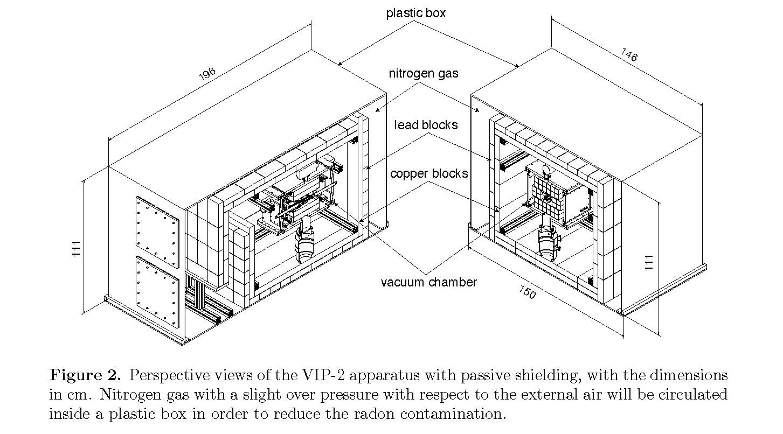
New significant improvements of the VIP-2 apparatus performed
during 2018
A further upgrade of the VIP-2 setup was performed in April 2018:
the SDDs arrays were replaced with two arrays $2×8$ for a total of 32 SDDs
$${Eff}_{geom}:1,82\% →4\%$$
new thinner ($25 μm$) copper targets were realized, in order to reduce the X-rays absorption inside the target.
In November 2018 the final configuration of the VIP-2 experimental apparatus was completed with the passive shielding, made of two layers of lead and copper blocks.
The passive shield will kill most of the background due to environmental gamma radiation.
FIGURE: Perspective views of the VIP-2 apparatus with passive shielding, with the dimensions in cm. Nitrogen gas with a slight over pressure with respect to the external air will be circulated inside a plastic box in order to reduce the radon contamination.

Slide 9
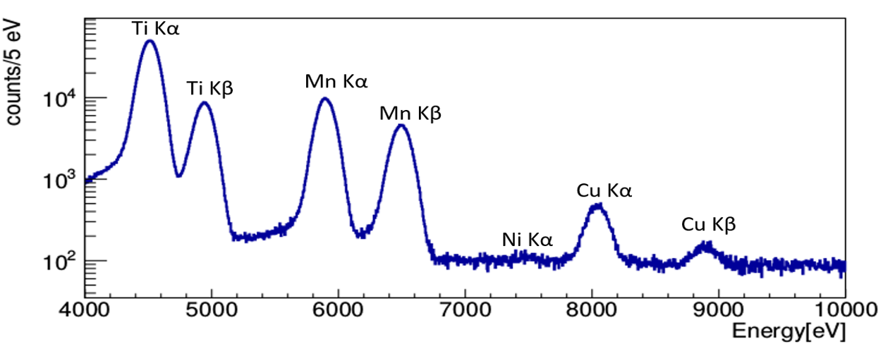
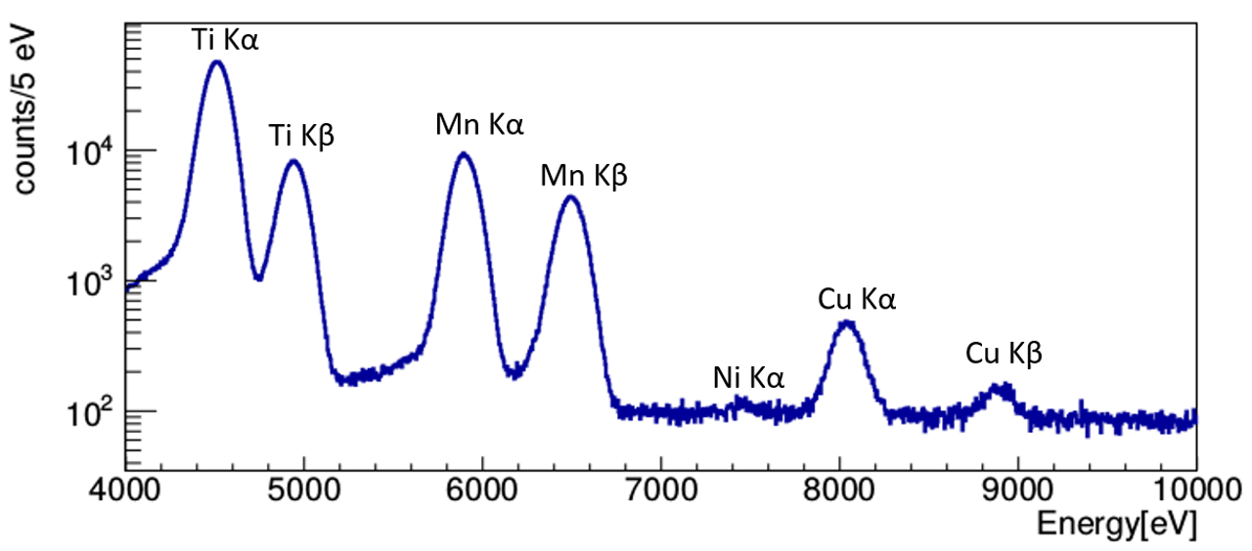
A NEW preliminary upper LIMIT for the PEP violation probability of electrons in copper calculated in the new present configuration of the apparatus
A preliminary result has been calculated using 39 days of data acquired during 2018 in the new present configuration of the apparatus.
Energy calibrated spectrum with current circulating on target (100 A)
Confidence Level: 99.73%
We note how with VIP2 we have managed, in the space of about 39 days of data collection, to determine a value of the upper limit of the PEP violation slightly better than that obtained by VIP in about three years of measurement.
Energy background calibrated spectrum with current off normalized to 39 days

Slide 10
A particular recognition goes to ....
The support from the Foundational Question Institute (FQXi) in the framework of the project:
"Events' as we see them: experimental test of the collapse models as a solution of the measurement-problem." (FQXi Grant number: FQXi-RFP-1505)
The support from the John Templeton Foundation in the framework of the project:
58158: Hunt for the “impossible atoms”: the quest for a tiny violation of the Pauli Exclusion Principle, Implications for physics, cosmology and philosophy.
THANK YOU ALL FOR YOUR ATTENTION
!!!

