Slide 1
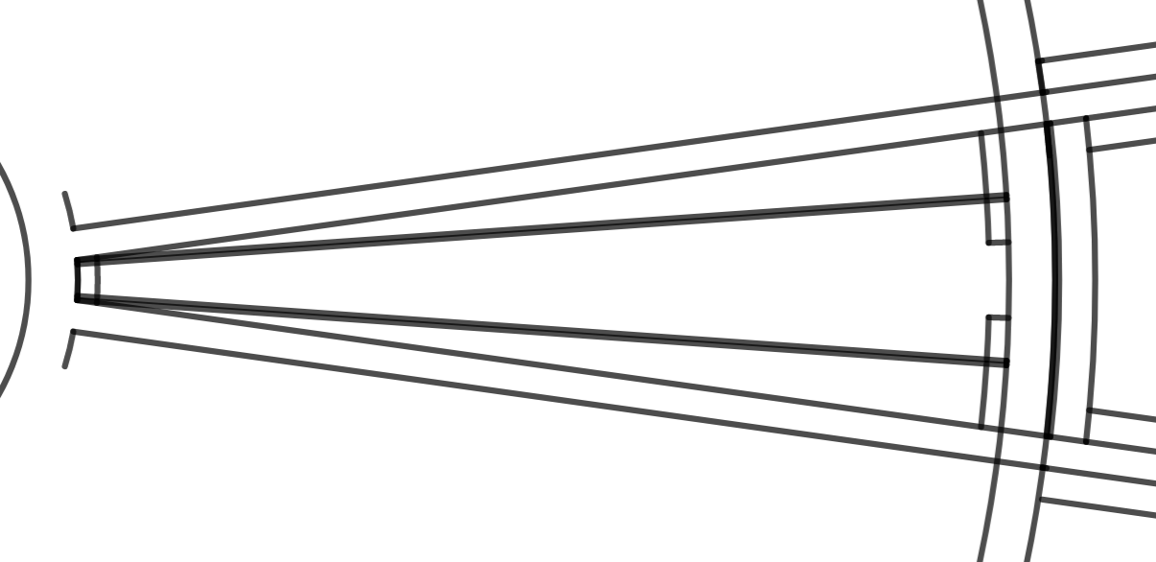
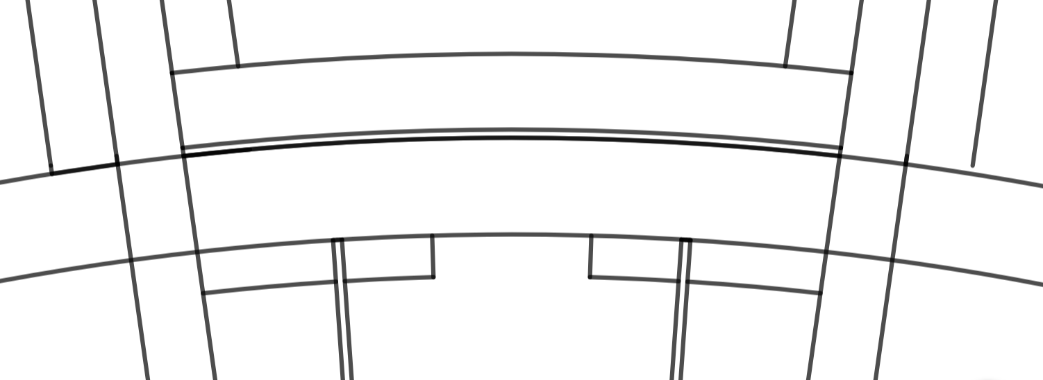
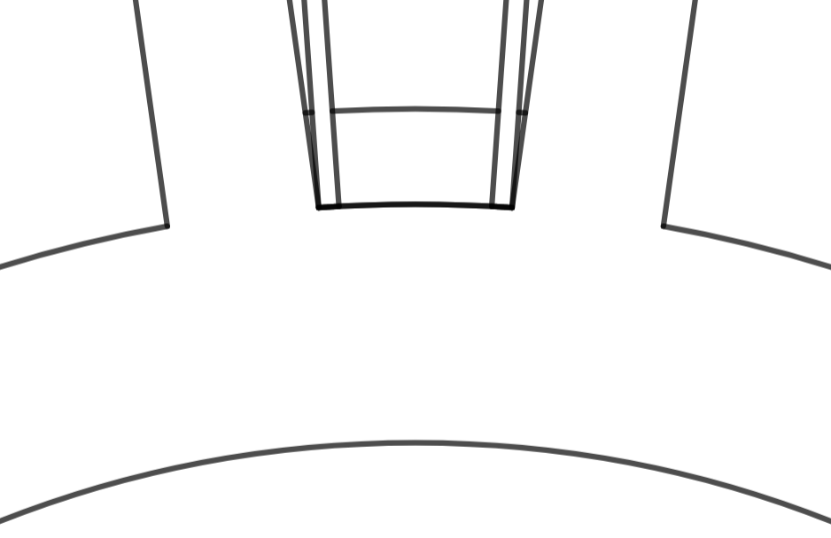
inner region A

Slide 2
inner region A details

Slide 3
inner region A details
spacer
first guard wire
wire PCB
intermediate ring
"cross" spoke
wire PCB
flat spoke
outer PCB
retaining plates
inner PCB
locking plate
inner ring

Slide 4
inner region A details
r=128.68mm
r=125.07mm
spacer
first guard layer
wire PCB
r=124.65mm
intermediate ring
"cross" spoke
r=120mm
7mm
r=118mm
wire PCB
flat spoke
outer PCB
retaining plates
1.5mm
r=28mm
r=26mm
inner PCB
locking plate
inner ring
r=21mm

Slide 5
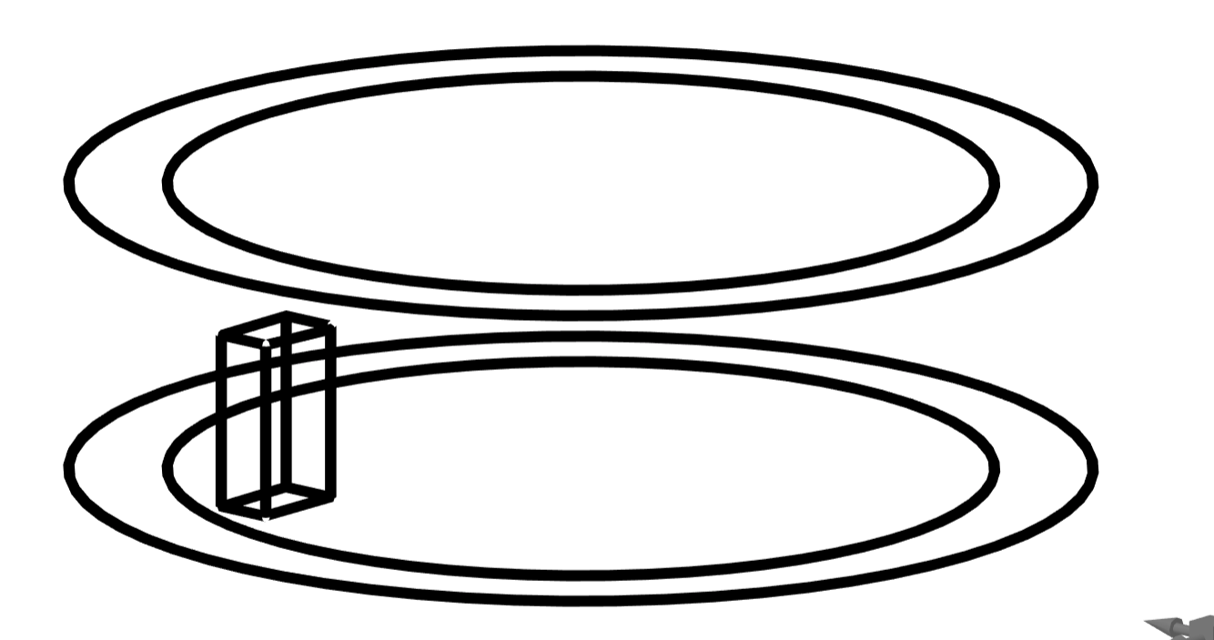
inner ring
r=26mm
r=21mm
1.2mm
9mm
15mm
5mm
3mm

Slide 6
spoke
1.2mm
3mm
6mm
3mm
103.65mm
9mm
15mm
3mm
3mm
5mm
r=124.65mm
r=21mm
r=26mm

Slide 7
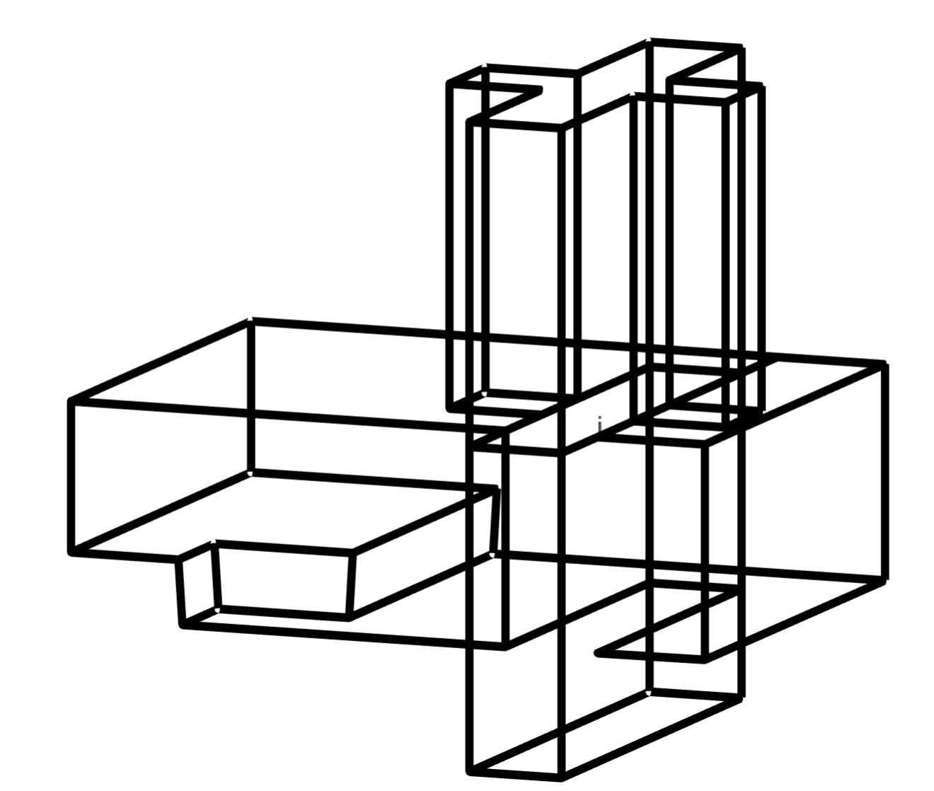

Slide 13
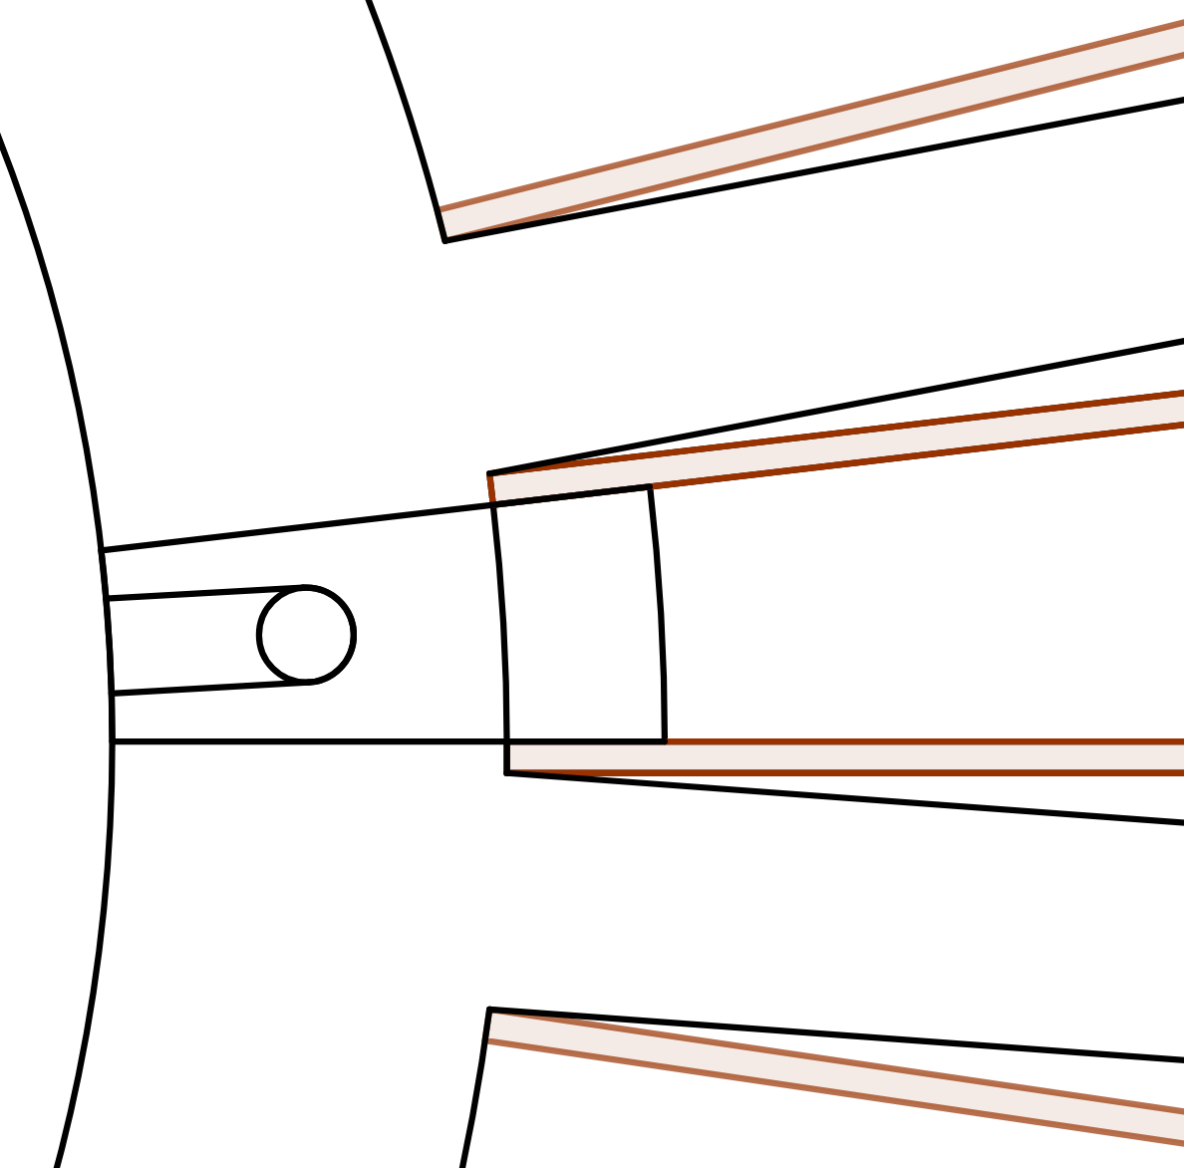
inner locking wedge
(outside view)
0.4mm PCB
spoke
3mm
field
sense
first
guard layer
4mm
r=28mm
2mm
r=26mm
3.8mm
threaded
dowel pin
1.2mm
1.5mm
r=21mm

Slide 14
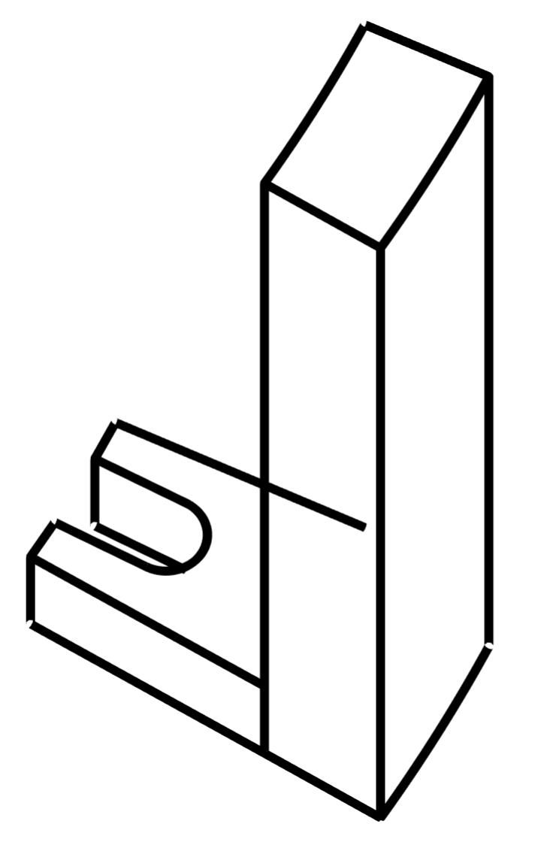
inner locking wedge
(minimal dimensions)
2mm
17mm
3.8mm
opening angle 15°/2 − 0.4/26×180°/π
=6.62°
r=0.6mm
2.5mm
r=26mm
1.5mm
r=28mm
r=28mm
2mm

Slide 15
inner locking plate
(inside view)
first
guard layer
2mm

Slide 16
inner locking plate
(minimal dimensions)
2.0mm
r=28mm
2.5mm
5mm
r=0.6mm
2.5mm
r=21mm
opening angle =13.4°

