Slide 1
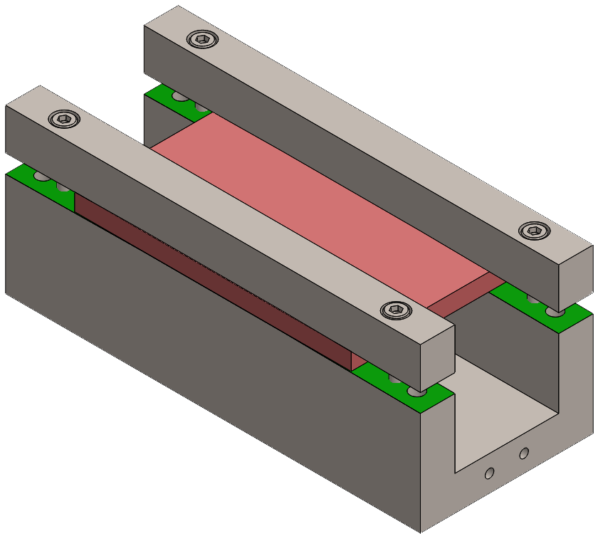
ERC-SELDOM
Crystal for extraction of the LHC beam halo
The crystal is clamped between properly shaped surafaces of a «holder».
Extremely challening mechanical accuracy
Already manufactured prototypes of silicon crystals
Futher developments in 2020 and 2021
Crystal for spin precession
The extracted beam is direct to a target, where short-living particles are generaged. Such particles are captured by a second crystal, where spin precession occurs.
Crystal is clamped between properly shaped surafaces of a «holder».
Bending uniformity driven by surfaces’s imperfections.
Already manufactured silicon crystals
Germanium crystals under manufacturing
Futher developments in 2020 and 2021

