Slide 1

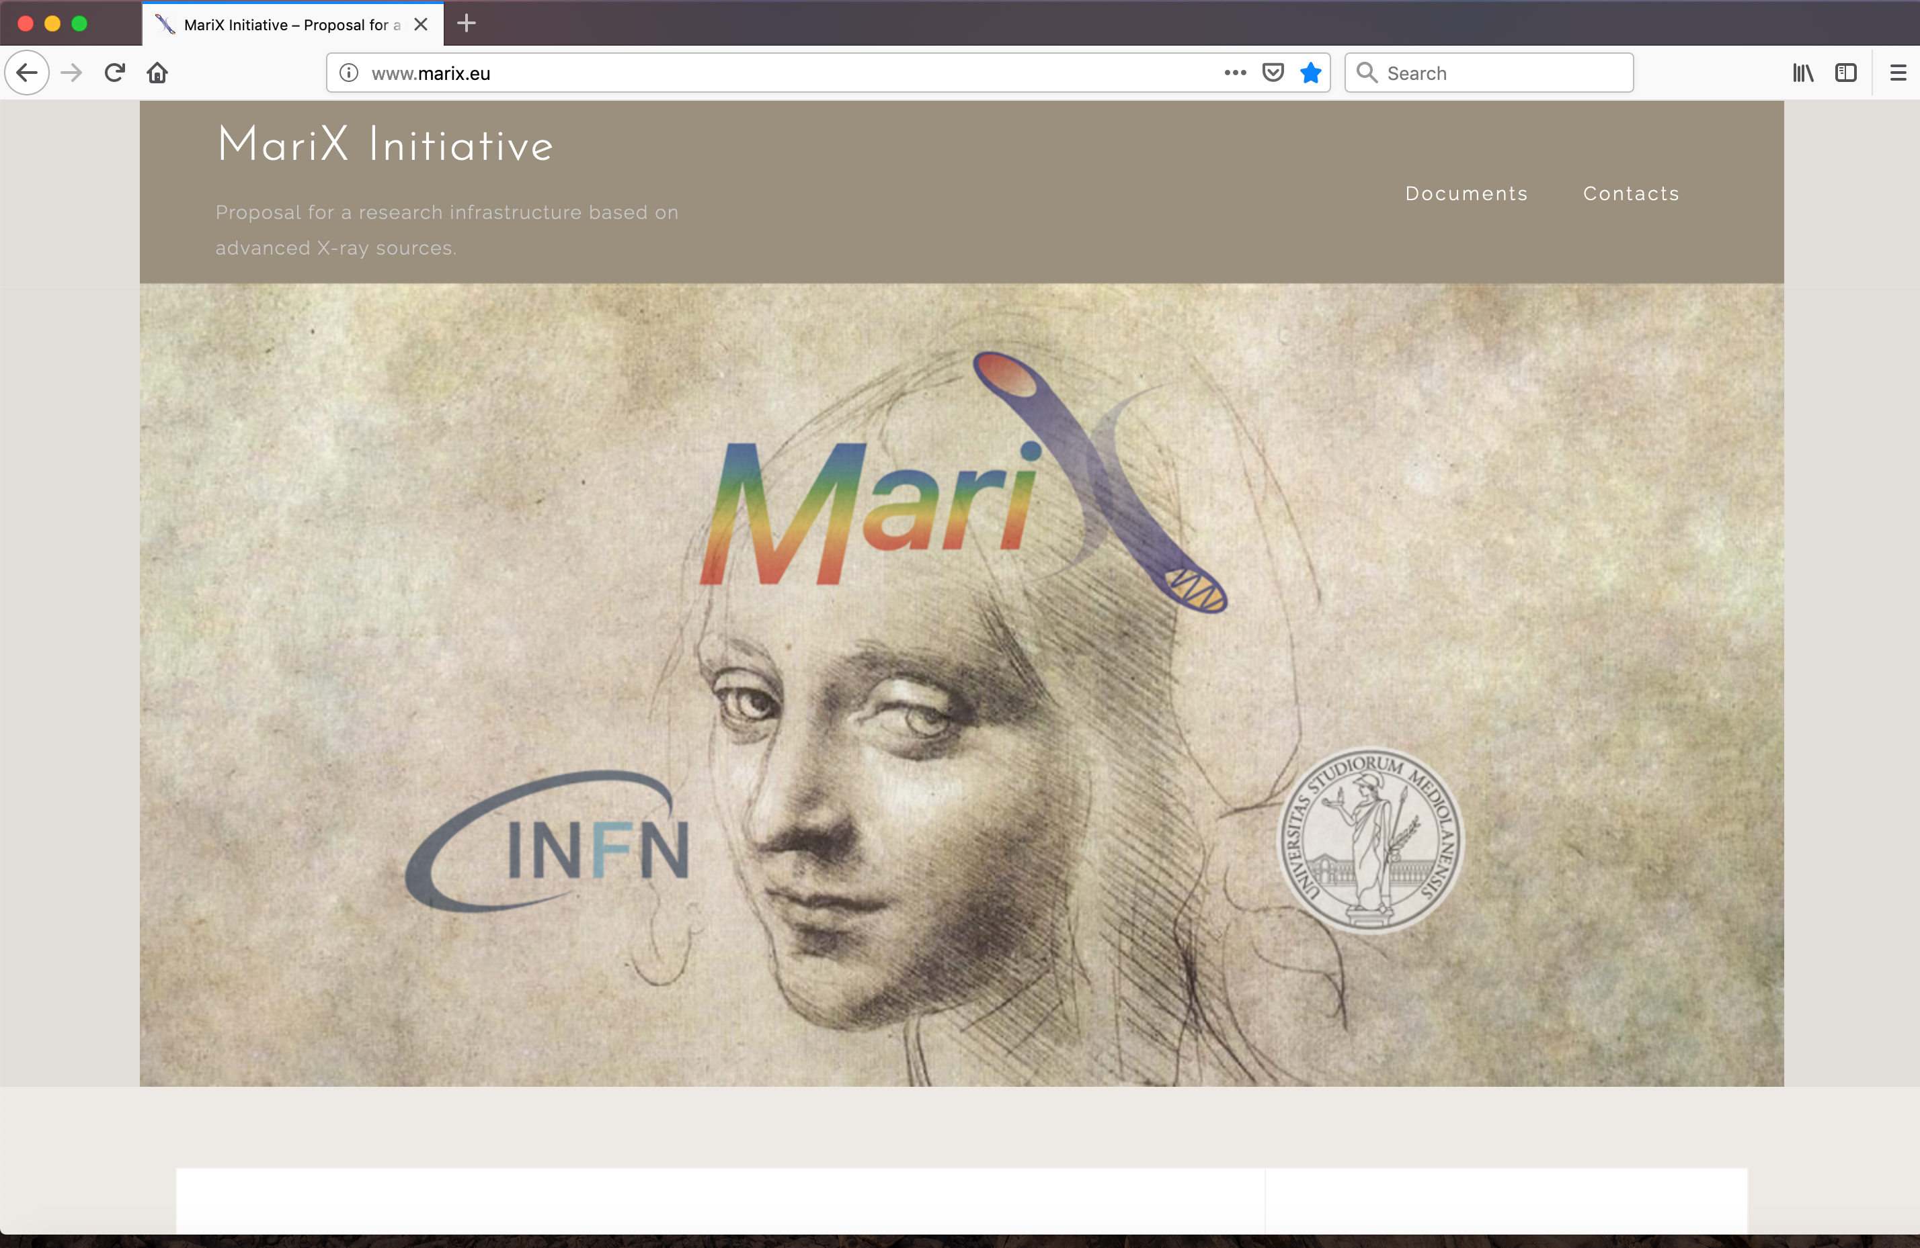
MariX: dal C.D.R. al Dimostratore (BriXSino)
MariX Conceptual Design Report consegnato agli Stake-holders (INFN, UniMi) a Maggio 2019 (site independent)
In attesa di una executive decision sul T.D.R. (site dependent!) il team progettista ha proposto all’INFN di costruire un Dimostratore al LASA (BriXSino, O(5M€))
BriXSino finanziato dalla Giunta (220 keuro + ass. ric.) per la preparazione di un T.D.R. al LASA e l’attività di R&D collegata
Generazione, accelerazione, distribuzione all’utenza e recupero efficiente di energia, di fasci di elettroni ad alta corrente e potenza media (10 mA, 40 MeV, 400 kW). Accelerazione a doppio senso di circolazione di fasci di elettroni ad altissima brillanza FEL-graded
CdS- Milano - July 3rd, 2020

Slide 2
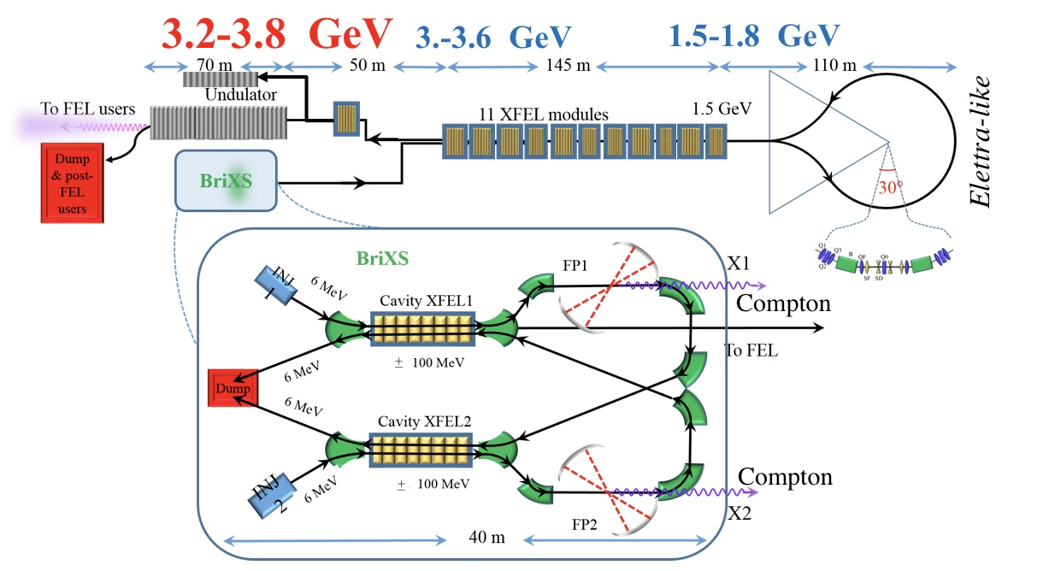
MariX: a Multi-disciplinary Advanced Research Infrastructure
for the generation and application of X-rays
Luca Serafini – INFN-Milan and University of Milan –
on behalf of MariX-C.D.R. Collaboration
The Challenge:
sustainable CW (50 W) coherent X-ray FEL & (W-class) ICS
inside and compatible with a University Campus
multi MW electron beams with
recovery/recirculation to keep
power consumption / radio-protection
below 100 kW
MariX Seminar – ALBA/CELLS - Barcelona - Jan. 13th, 2020

Slide 3

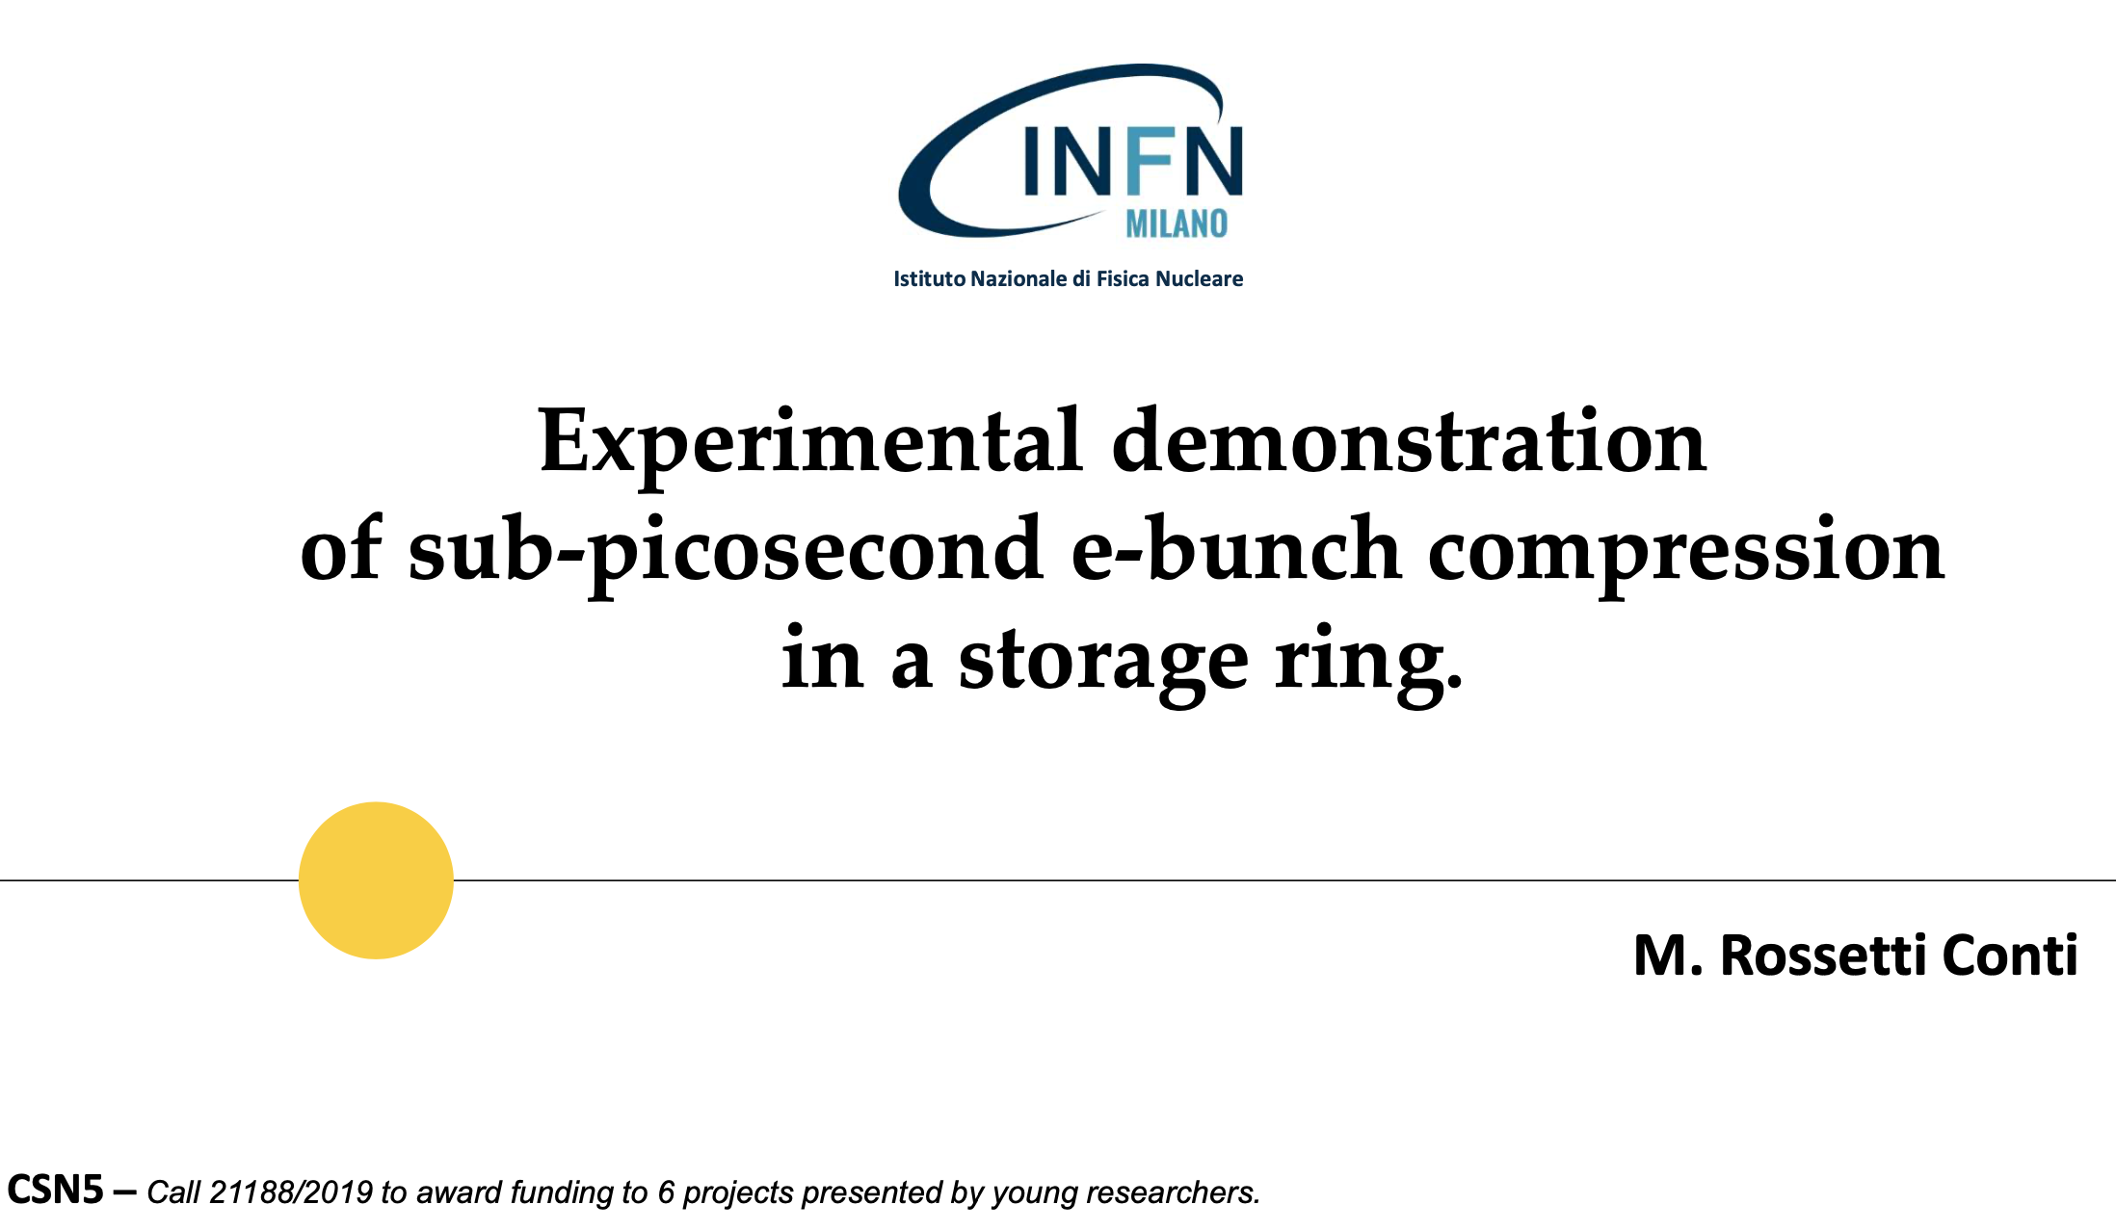
Arc Compressor Test In a Synchrotron
CdS- Milano - July 3rd, 2020

Slide 4
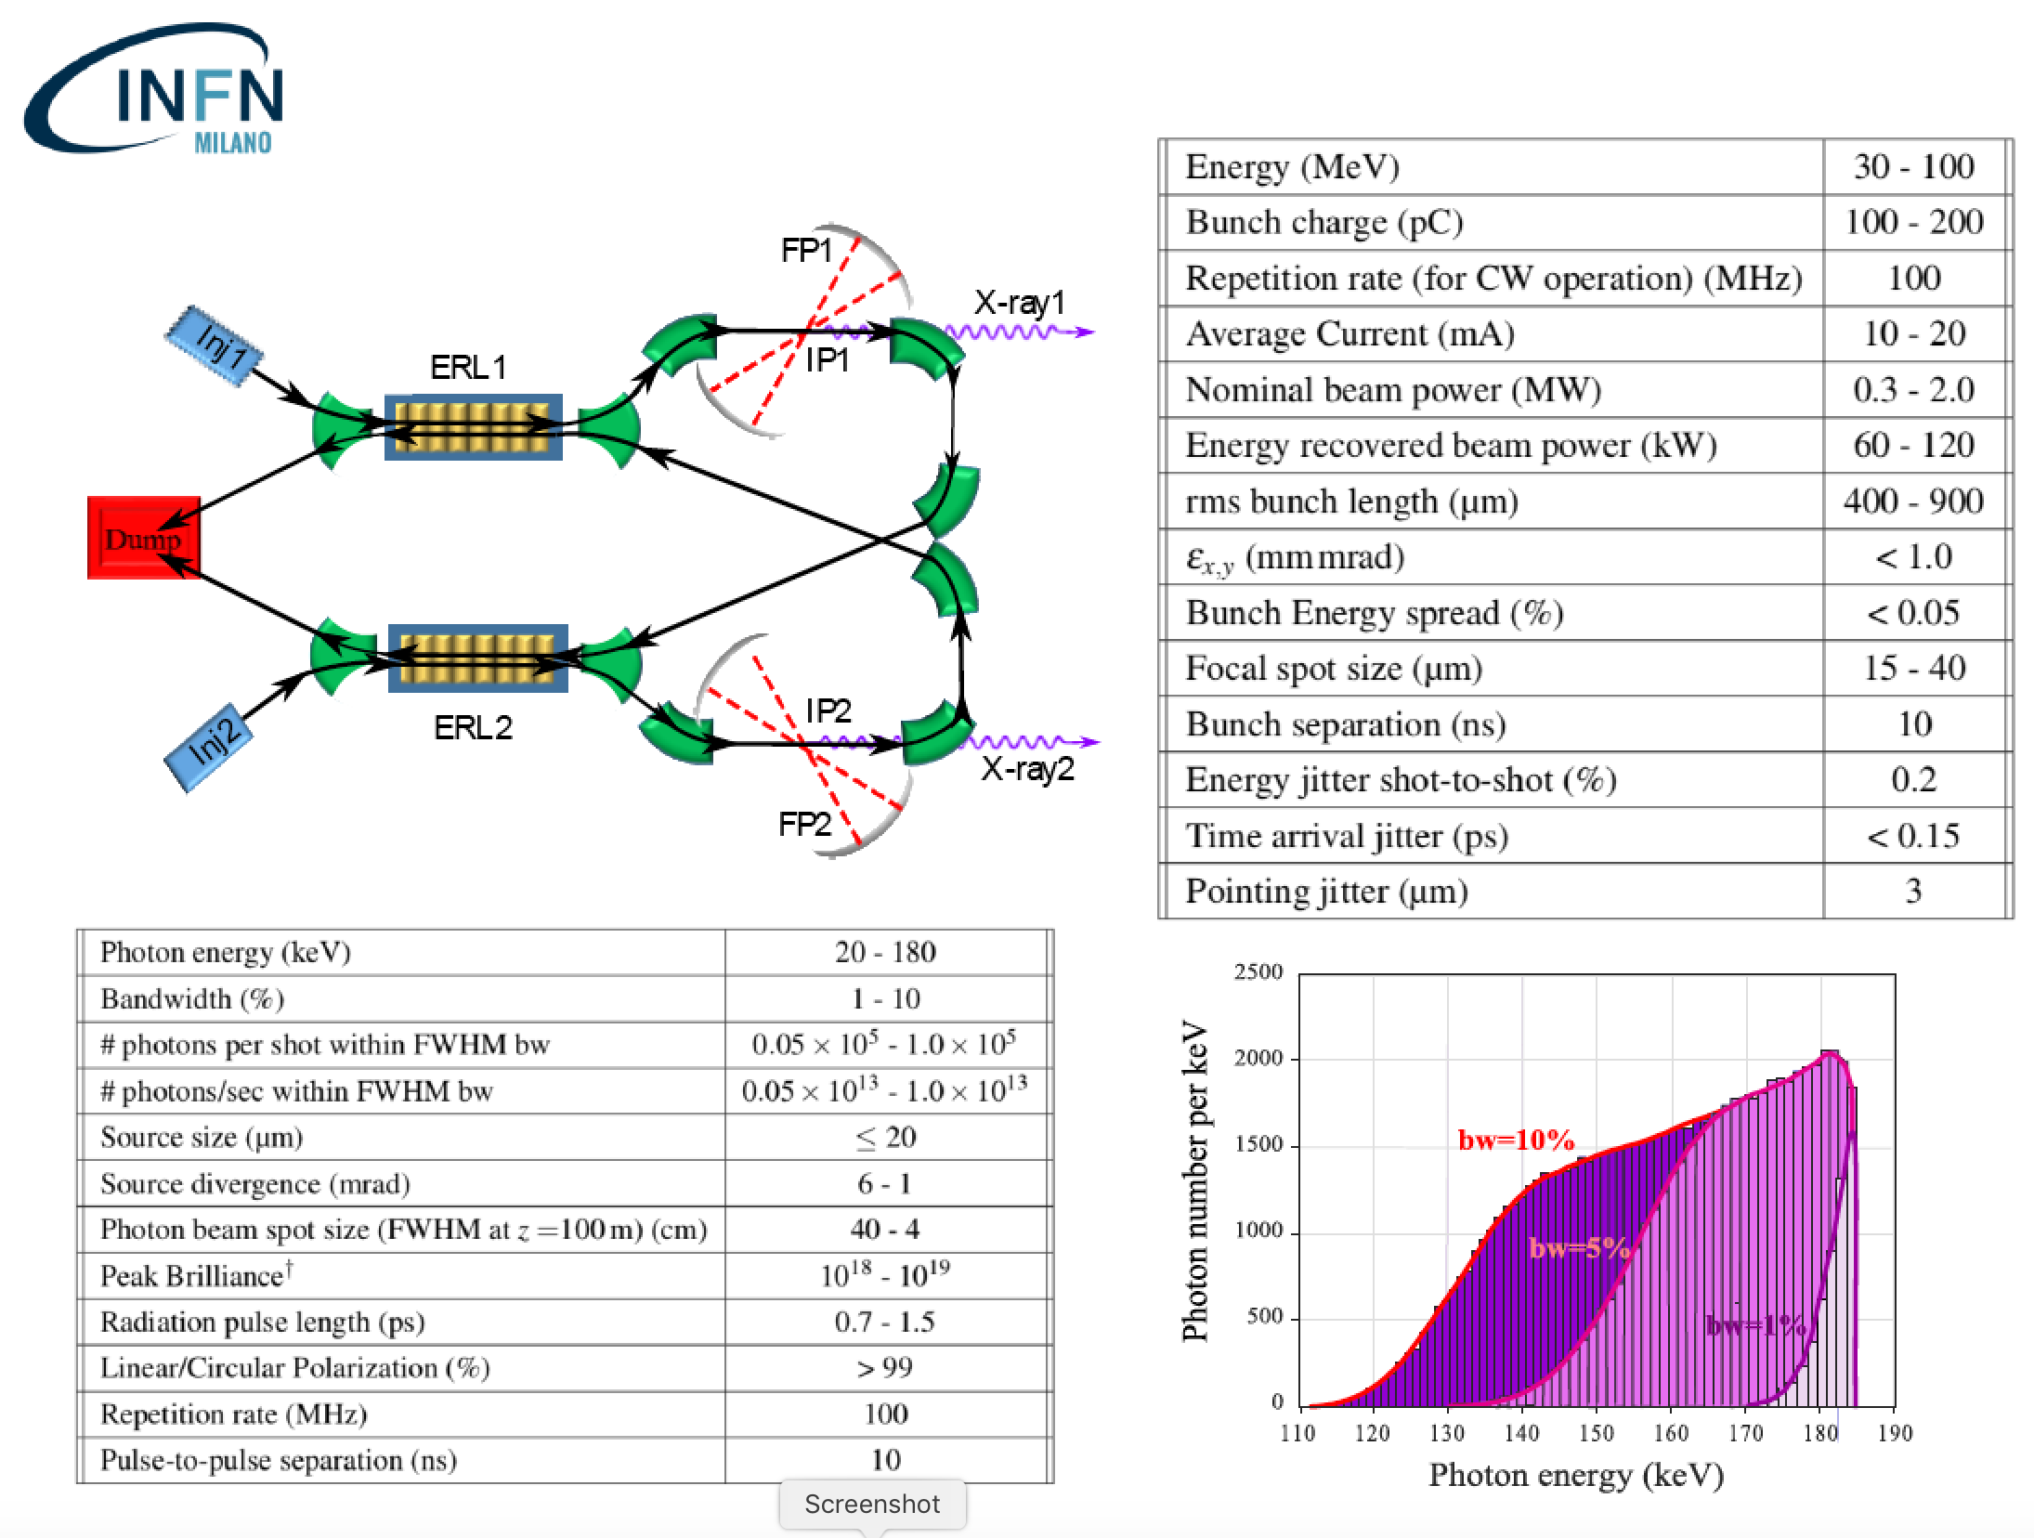
BriXS: an example of high sustainability. High power 2 MW beam delivered to user with only 200 kW power consumption/dissipation with outstanding beam quality (larger than storage rings, same current)
CdS- Milano - July 3rd, 2020

Slide 5
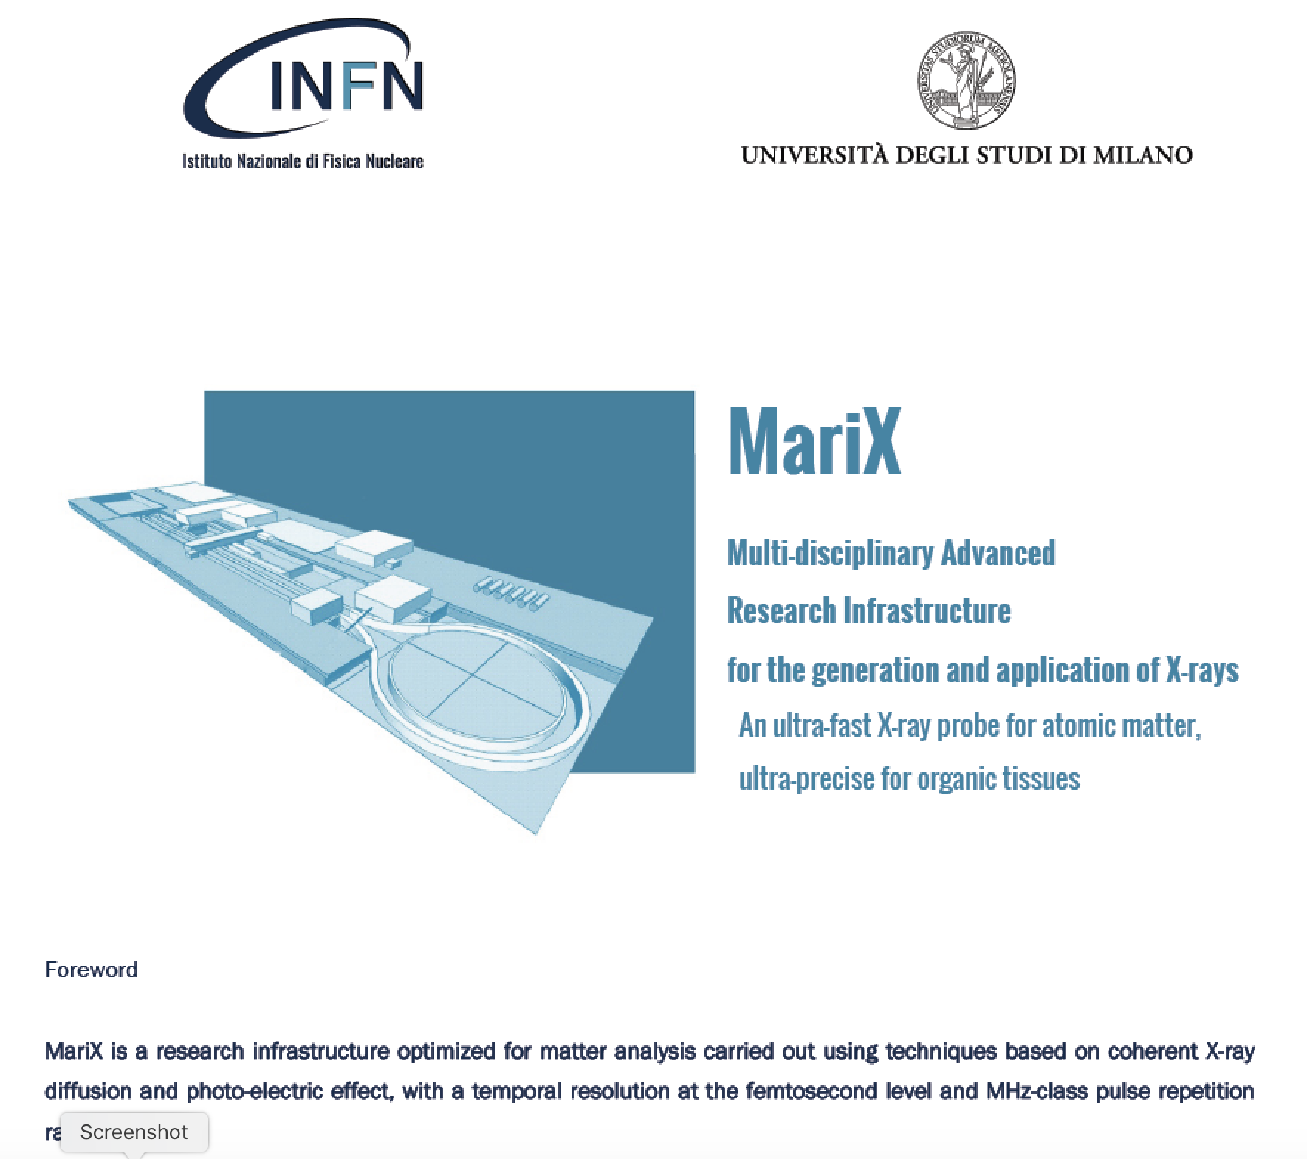
CdS- Milano - July 3rd, 2020

Slide 6
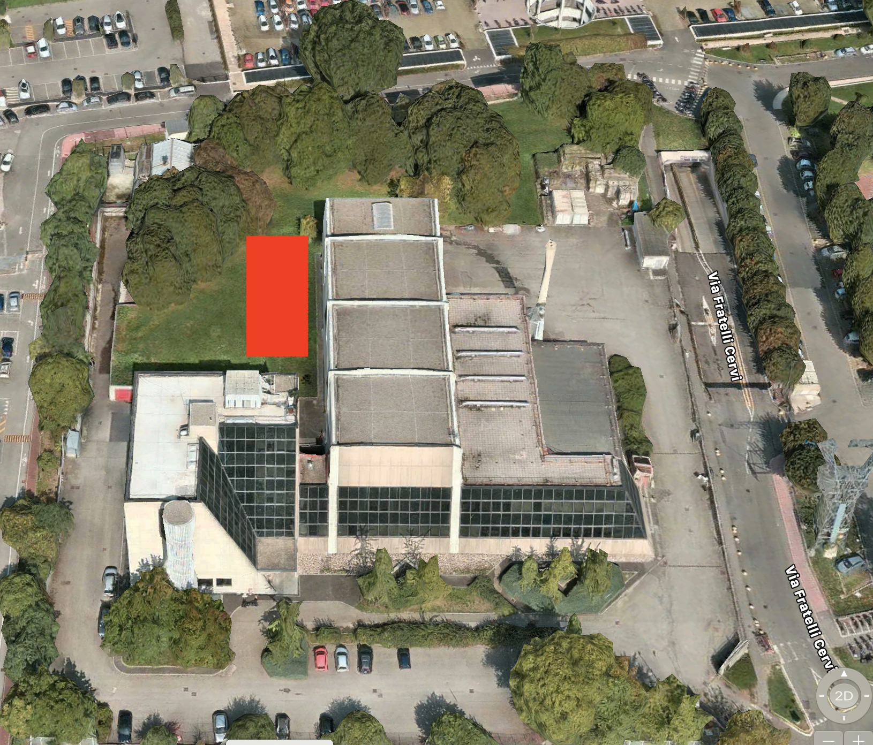
Un prato per BriXSino
36 m
12 m
CdS- Milano - July 3rd, 2020

Slide 7
X
I.C.S.
undulator
THz
THz FEL
CdS- Milano - July 3rd, 2020

Slide 8
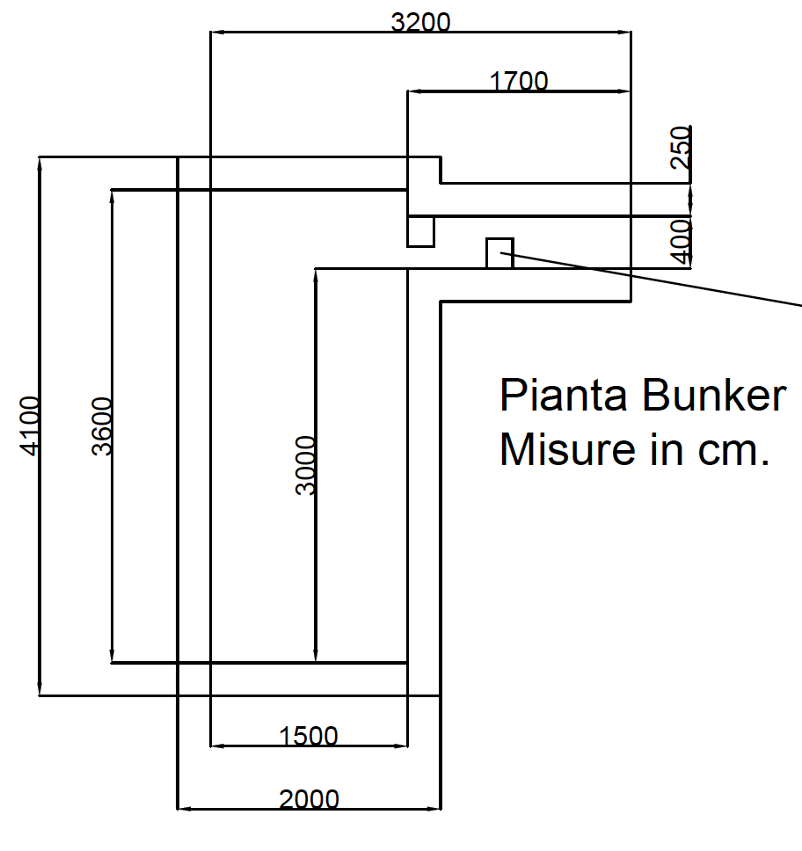
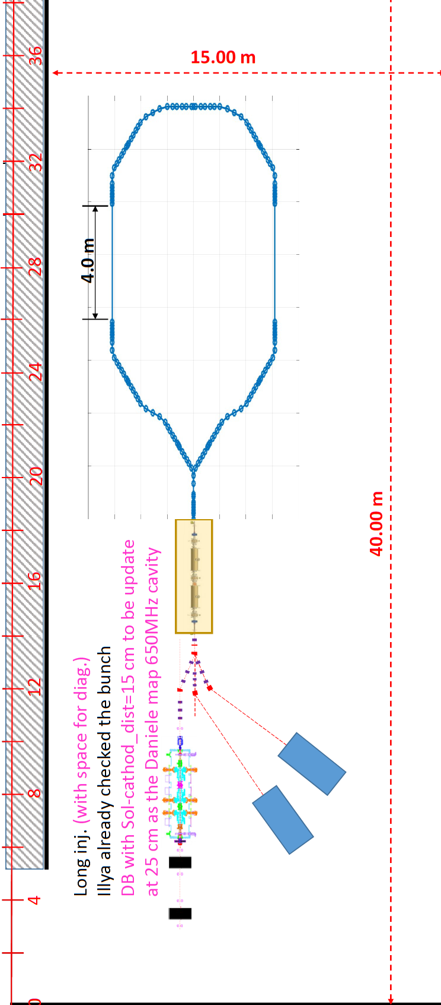
CdS- Milano - July 3rd, 2020

Slide 9
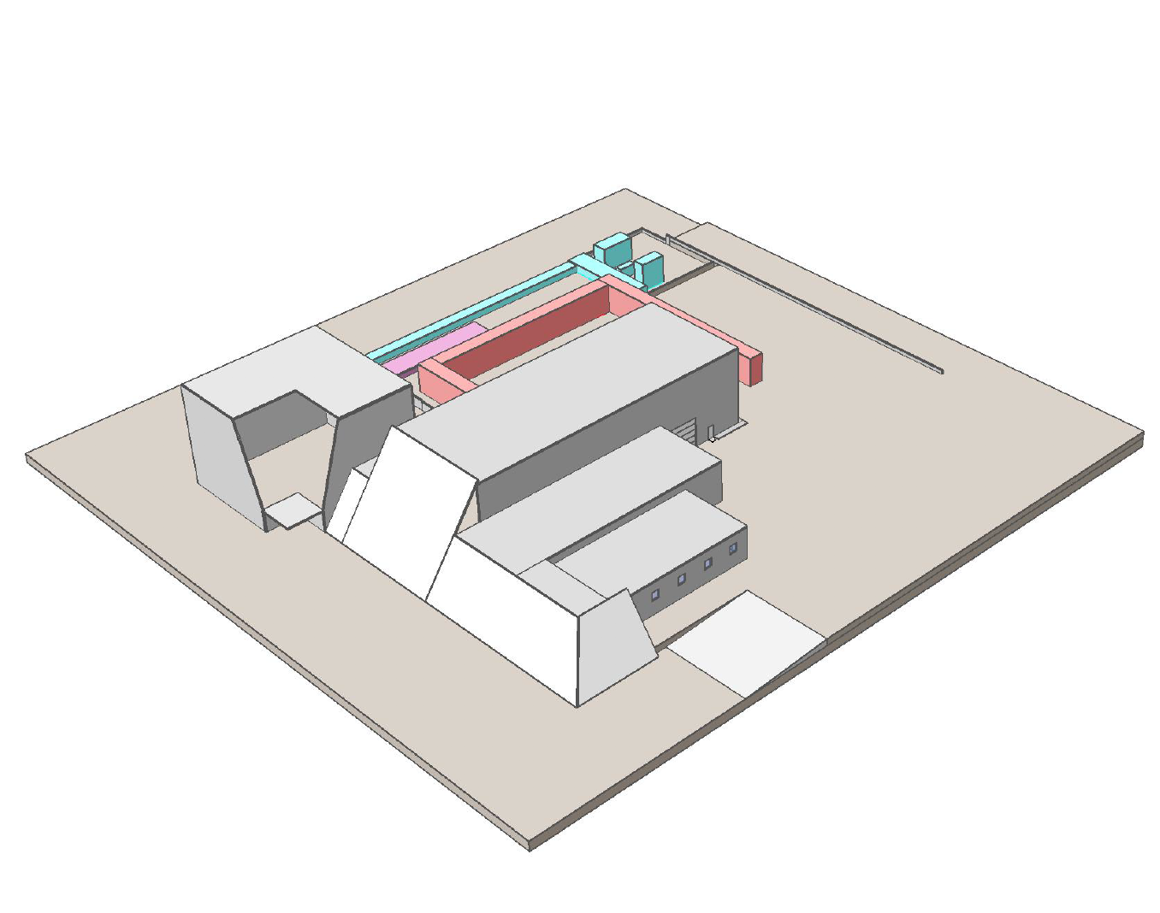
CdS- Milano - July 3rd, 2020

Slide 10
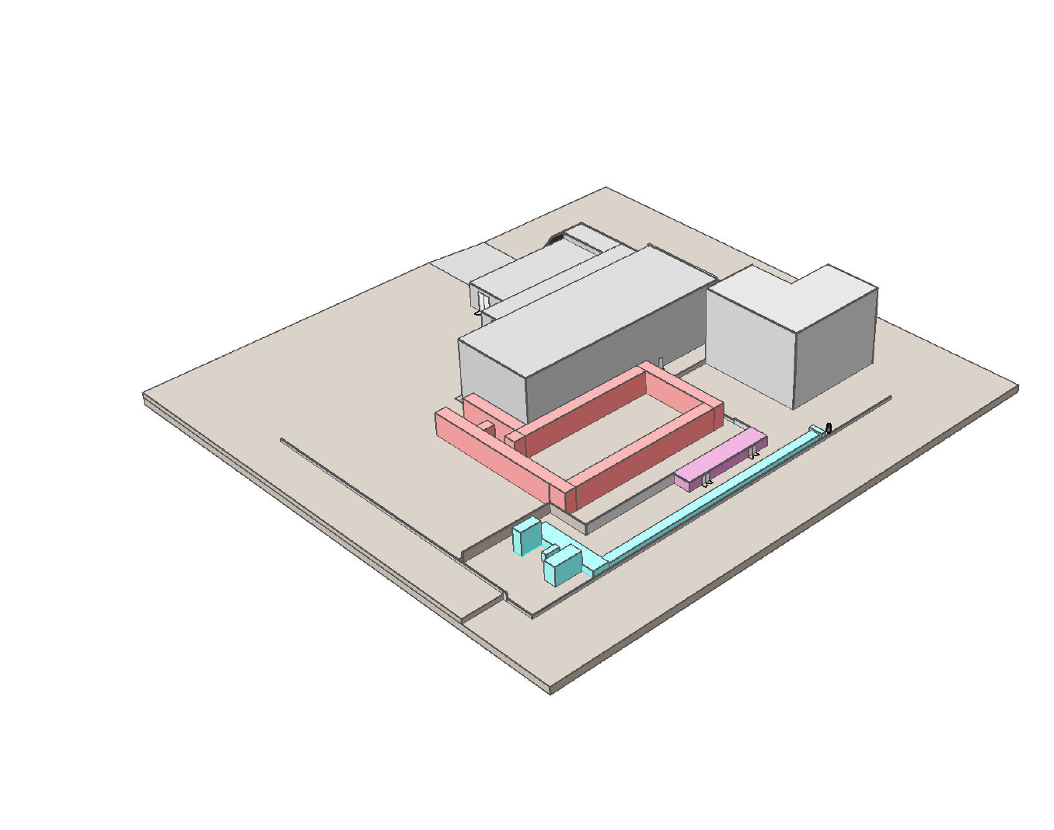
CdS- Milano - July 3rd, 2020

Slide 11
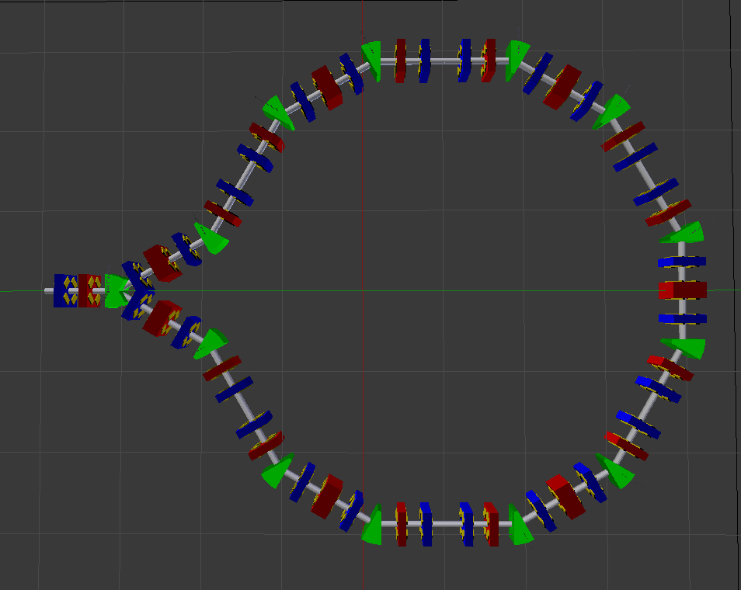
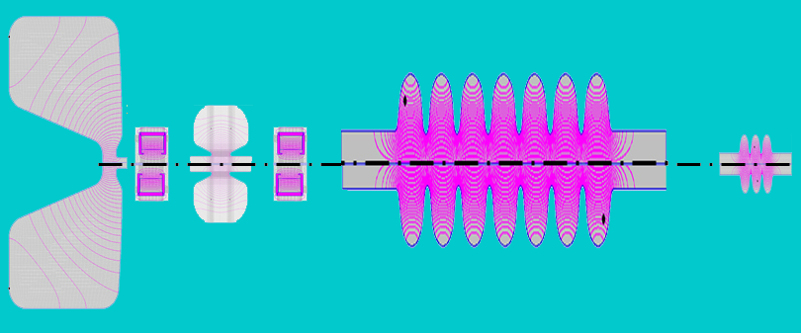
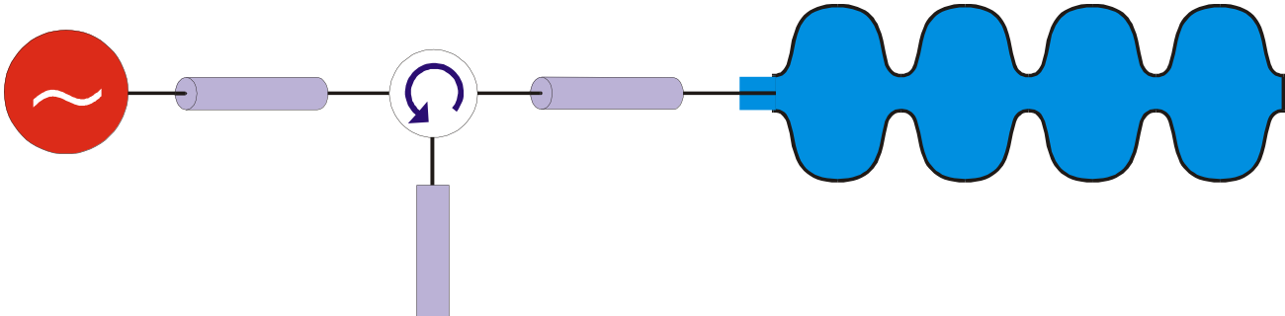
BriXSinO
3 MeV
Dump
80 MeV
3 MeV
+ 40 MeV
Dump
Advantage of ARC in possibility be spitted and upgraded into two beam line scheme.
In place of splitting dispersion is close.
3 MeV
Dump
80 MeV
3 MeV
+ 40 MeV
Dump
CdS- Milano - July 3rd, 2020

Slide 12
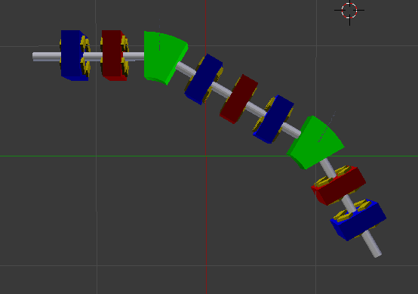
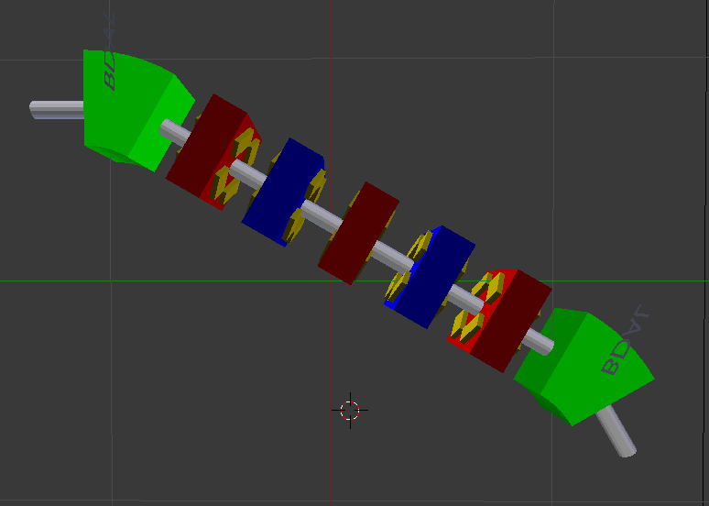
BriXsinO new arc design
Old
New
The idea was to hide all quads between bendings.
Like this we will have more space for matching elements in the arc.
Second but not last this design work much better with a new beam
CdS- Milano - July 3rd, 2020

Slide 13
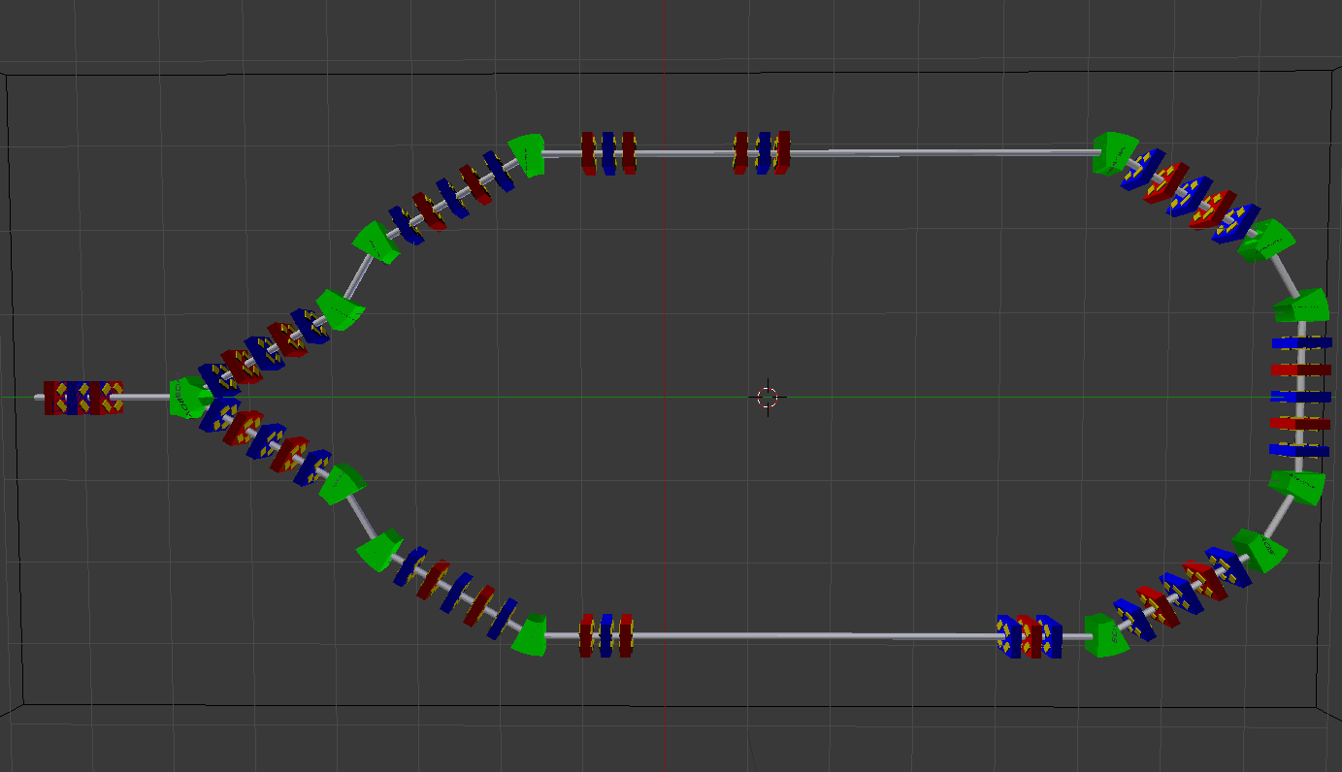
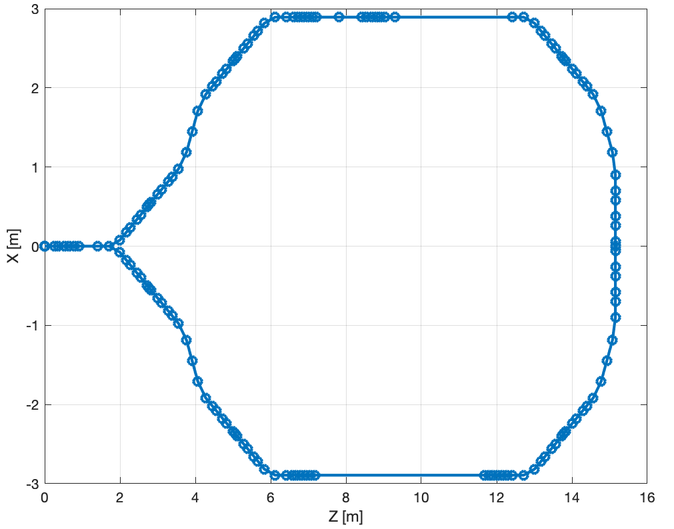
BriXSinO
Arc footprint. 6x16 m
Compton
IP
X
Space for undulator 4.5 m
CdS- Milano - July 3rd, 2020

Slide 14
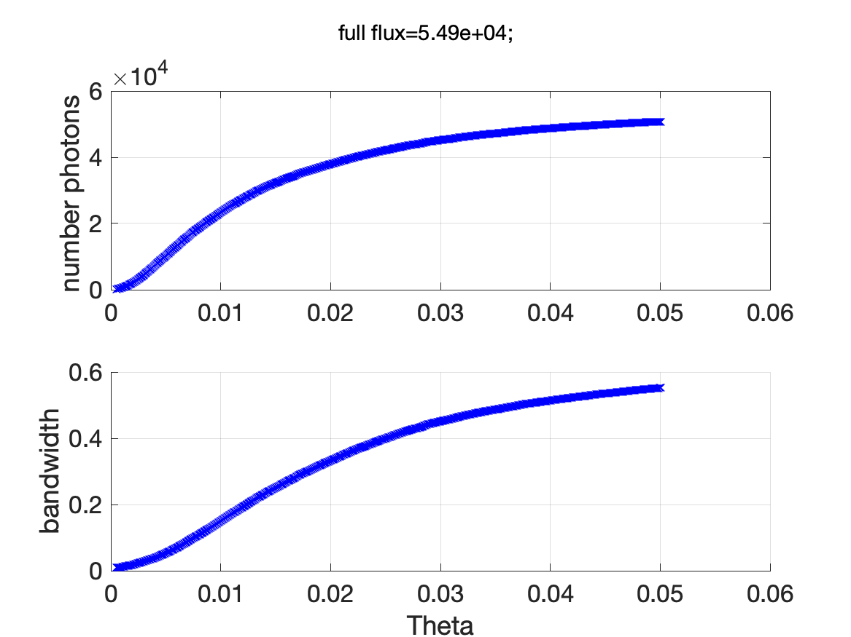
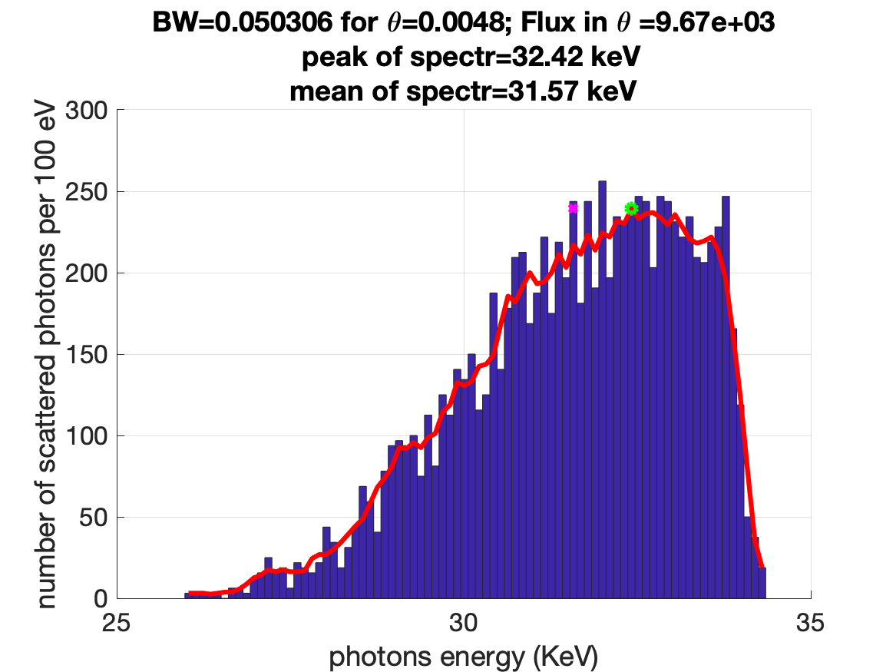
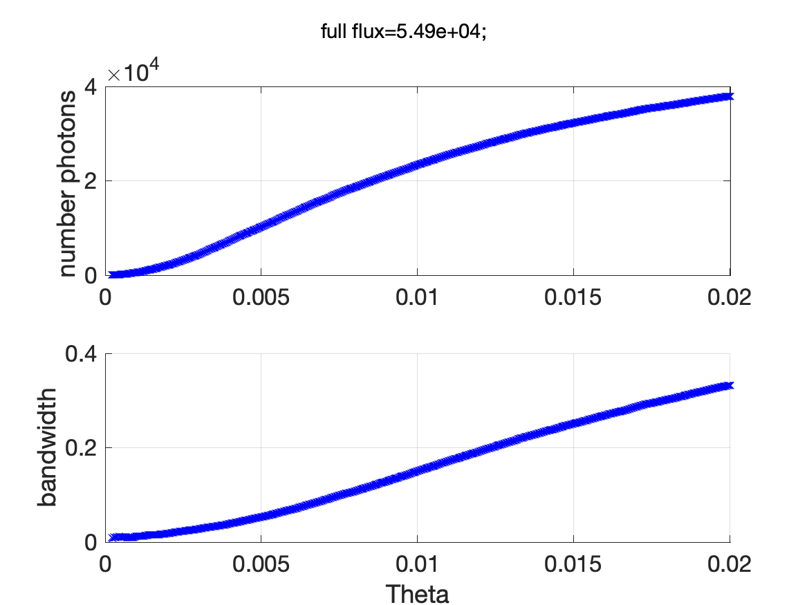
Compton experimental line first evaluation
*100 MHz~10^12
CdS- Milano - July 3rd, 2020

Slide 15
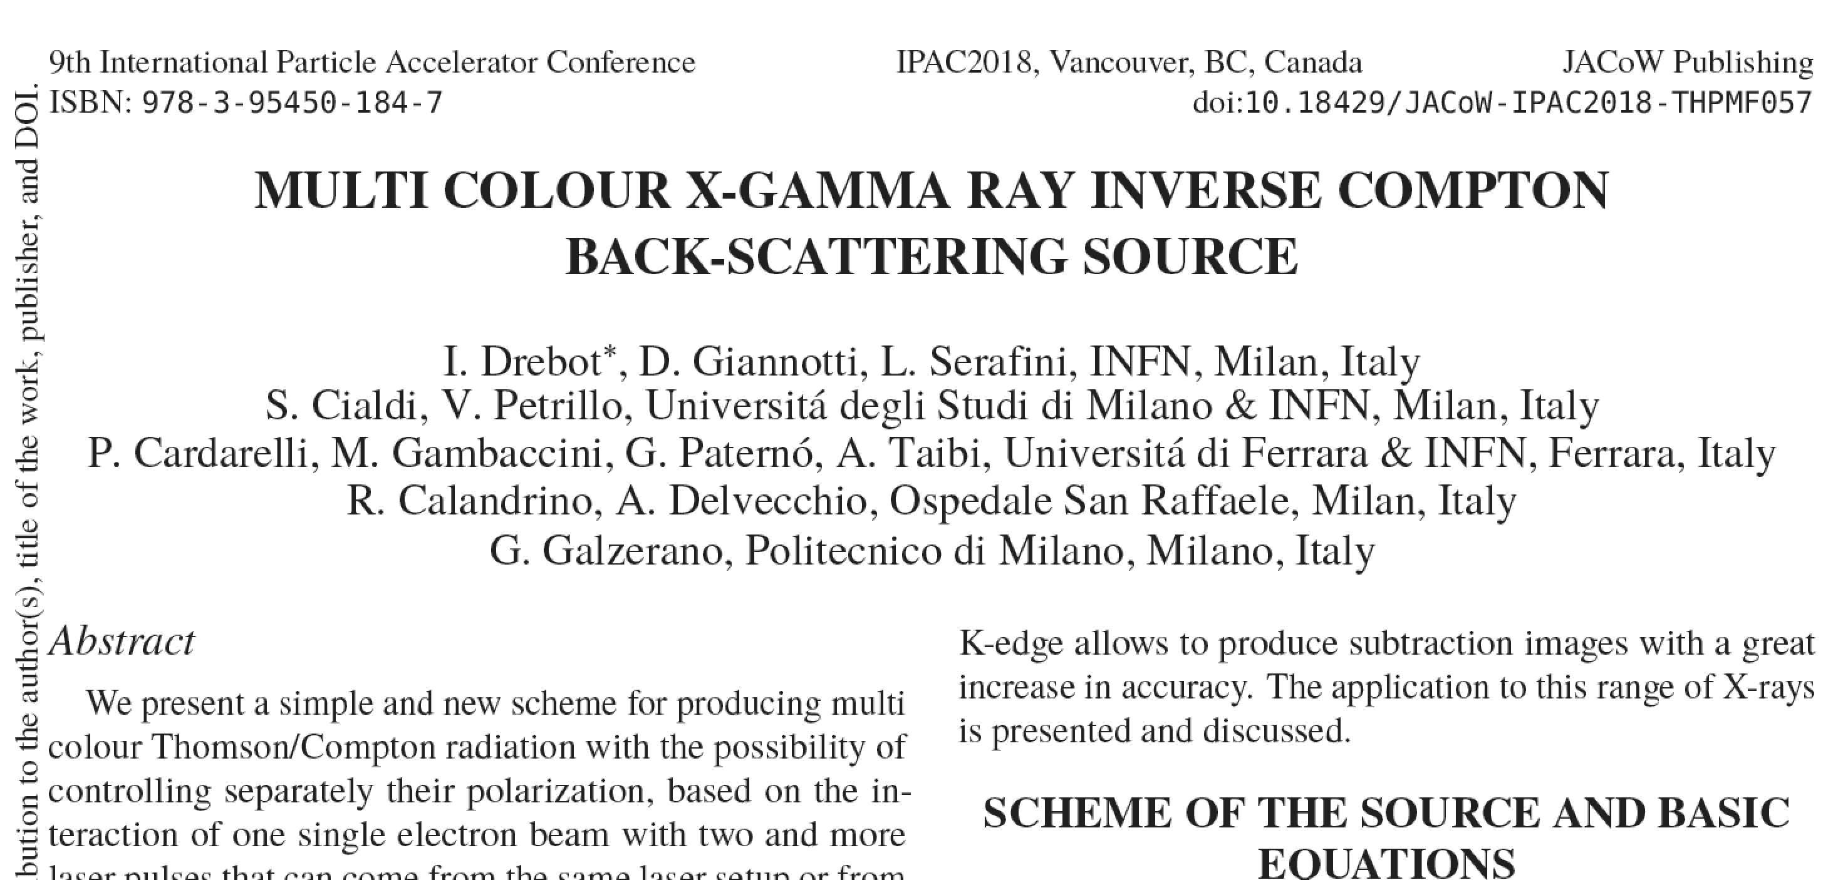
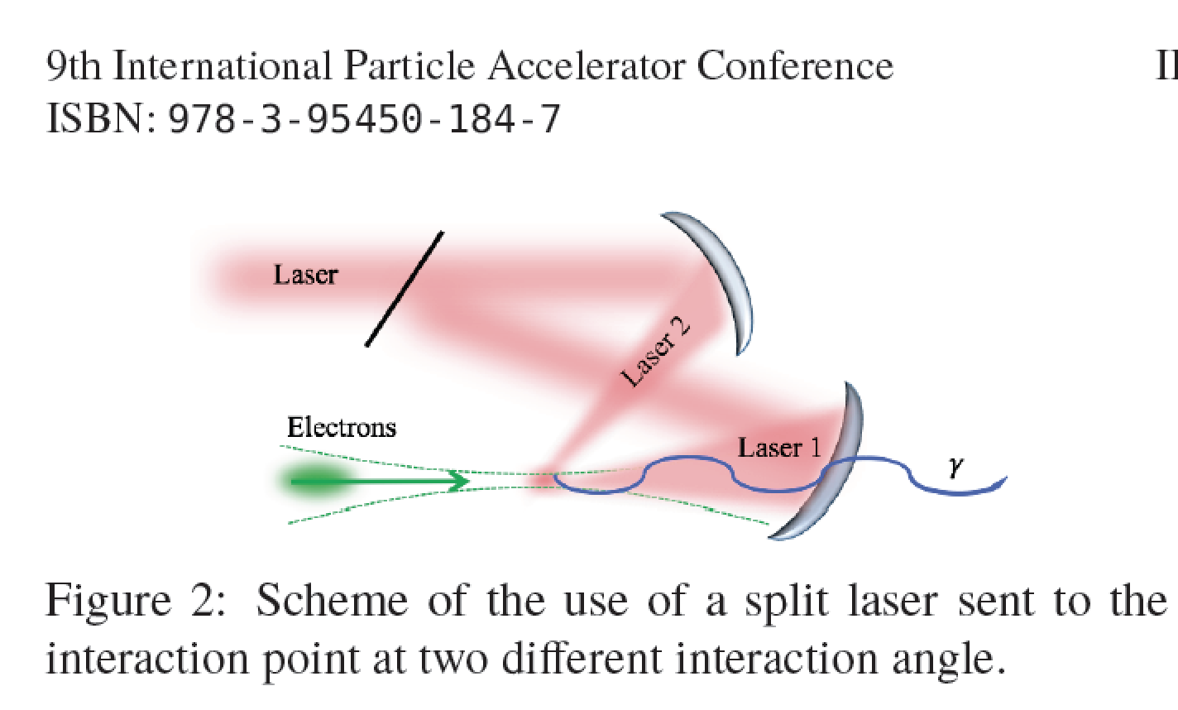
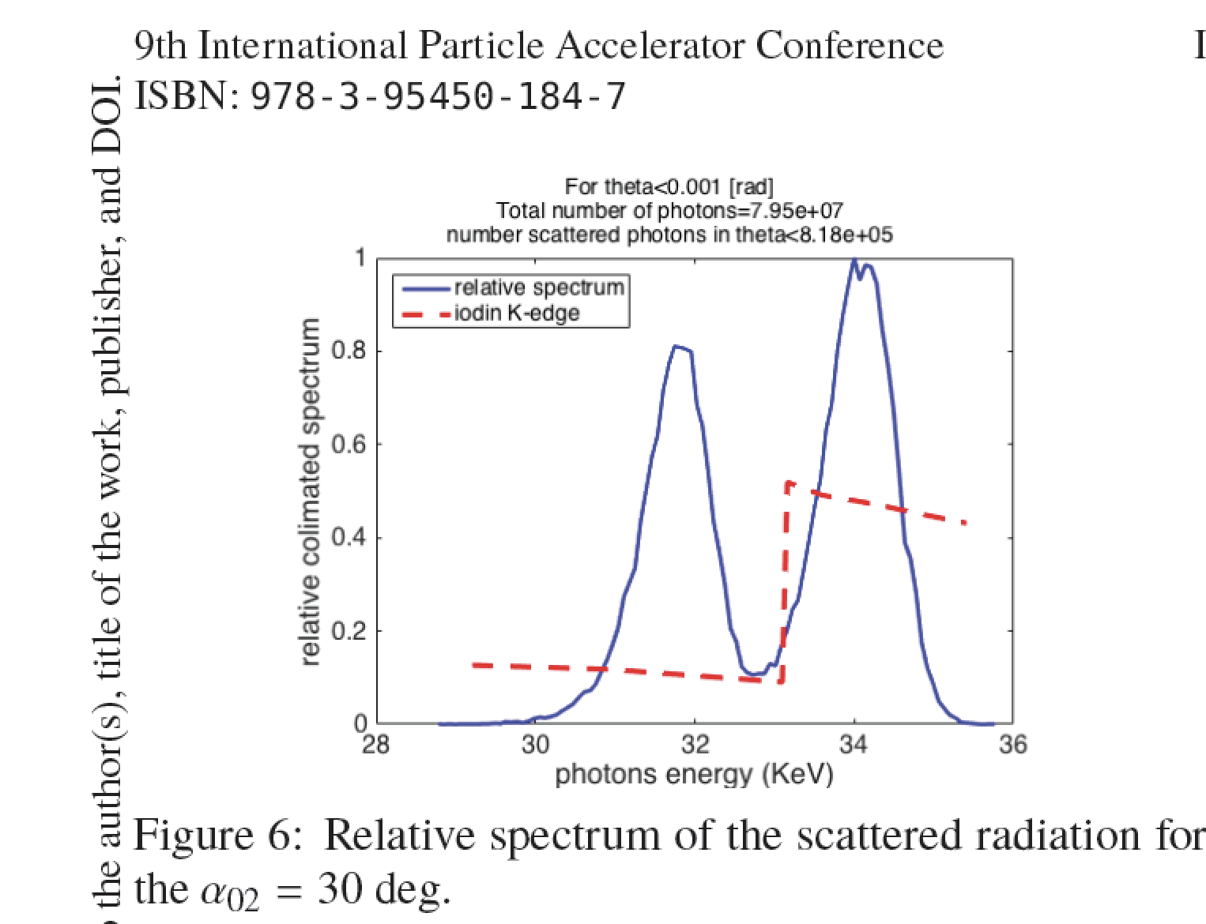

Slide 16
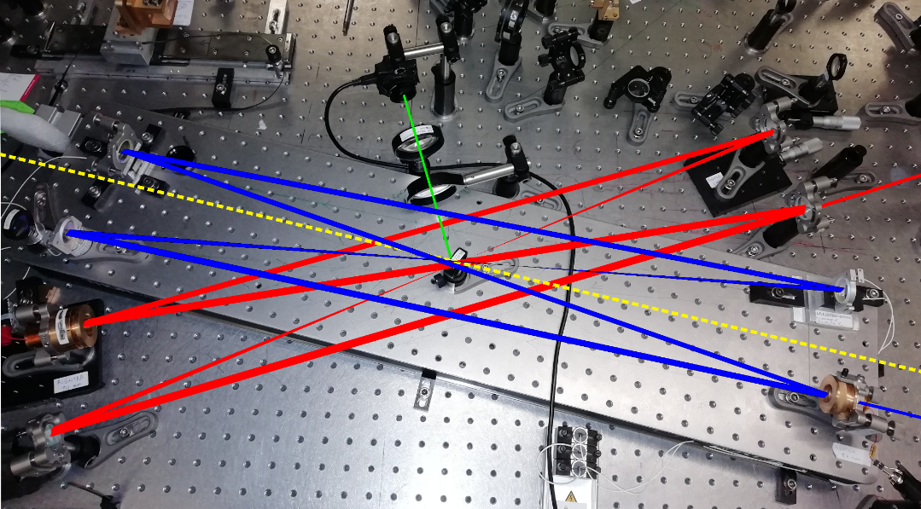
Twin swappable Fabry-Perot Cavity
S. Cialdi, Laboratorio Ottica
CdS- Milano - July 3rd, 2020

Slide 17
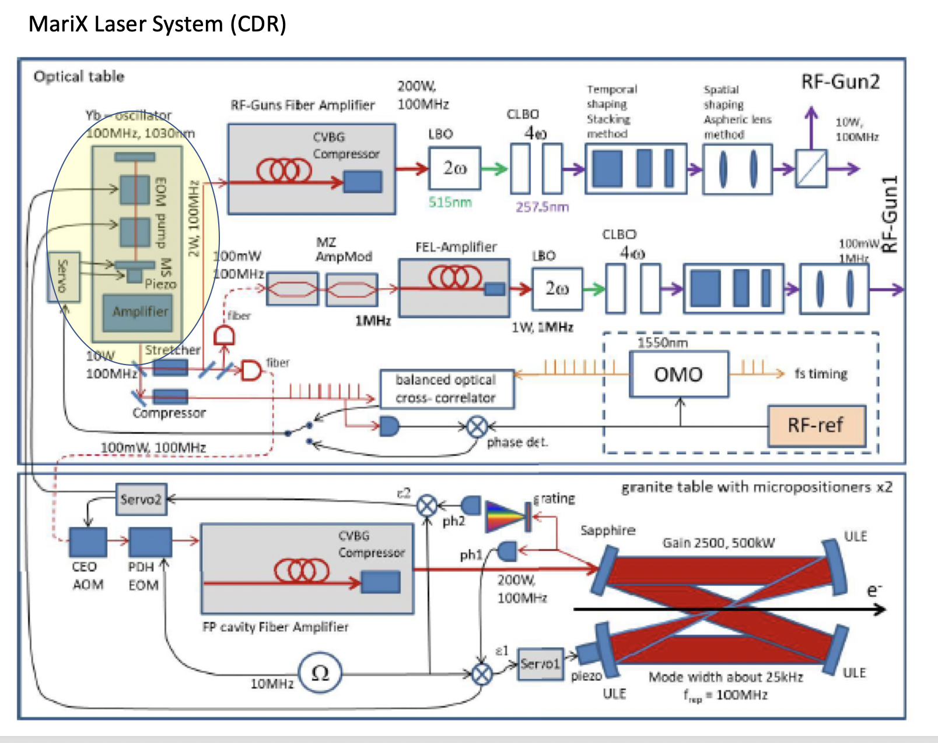
In fase di installazione al LASA in Laboratorio dedicato – Ottica/Fotocatodi
CdS- Milano - July 3rd, 2020

Slide 18
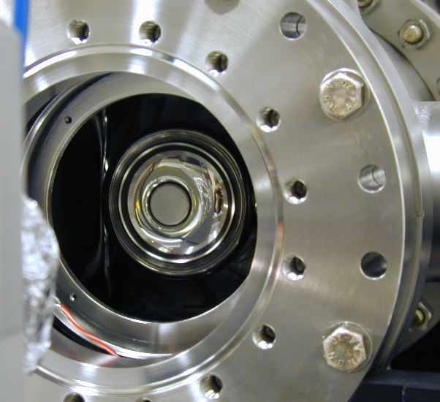
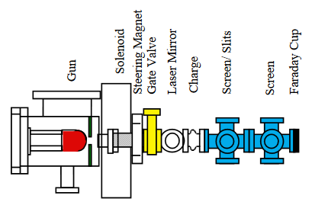
Photocathode Stress test for CW operation (BriXSinO)
The operation of photocathodes at 1 MHz as SHINE, LCLS II, MariX, and even more at the 100 MHz repetition rate foreseen for BriXs is a challenge for the present photocathodes and lasers.
INFN supported a photocathode stress test, funding the buying of a first part of the 100 MHz BriXSinO laser system.
We plan a stress test for Cs₂Te photocathodes at LASA in our DC gun with a dedicated laser (tender in progress)
  Laser: 10 W in IR and 0.5 W in UV @ 100 MHz
  DC Gun: 100 kV (max), 8 mm gap
  Photocathode extractable charge
  (QE=5 % @ 254 nm): 50 pC
CdS- Milano - July 3rd, 2020

Slide 19
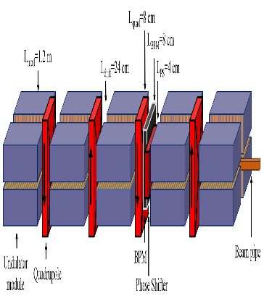
THz Free Electron Laser: Oscillator option (no SASE)
100 MHz
3 metri
6 metri, 9 metri, 12 metri, ecc)
3 metri
3 metri
Specchio
Specchio
semiriflettente
3 metri
3 metri
CdS- Milano - July 3rd, 2020

Slide 20
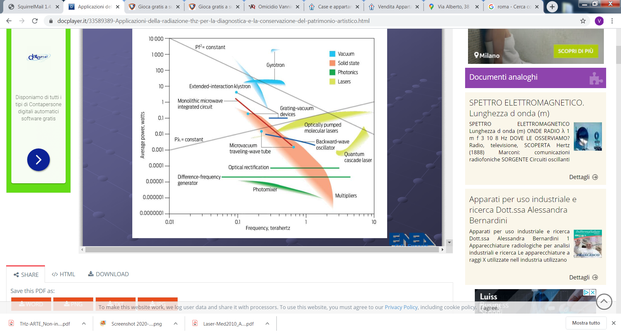
BriXino
10 100
CdS- Milano - July 3rd, 2020

Slide 21
BriXSino Meeting – 2 Luglio 2020 ore 14:00/17:30 – LASA AGENDA
L. Serafini: comunicazioni (10’)
Bacci: Iniettore-Linac-ERL-2way (20’)
I. Drebot: Recirculation Arc & I.C.S. (20’)
V. Petrillo: THz FEL (15’)
V. Torri: Bunker & CAD (15’)
S. Cialdi: Laboratorio Ottica e R&D (15’)
D. Giove / D. Sertore: Stress Test Fotocatodi (15’)
Round the Table on X-rays and THz applications, brainstorming (20’)
Calandrino, Cardarelli, DelVecchio, Galzerano, Gambaccini,
Lenardi, Mettivier, Paroli, Puppin, Russo, Taibi
CdS- Milano - July 3rd, 2020

Slide 22
CdS- Milano - July 3rd, 2020

Slide 23
CdS- Milano - July 3rd, 2020

Slide 24
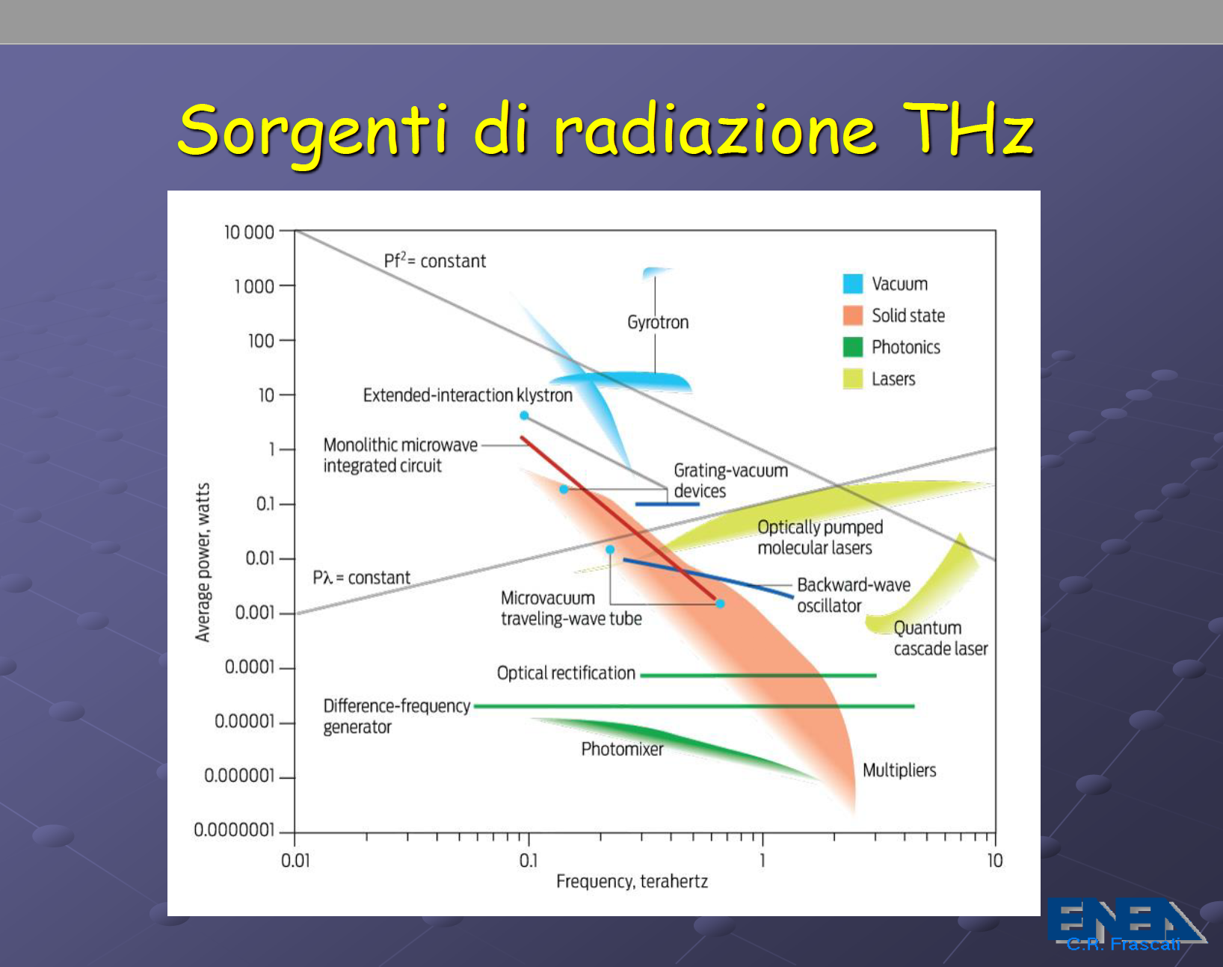

Slide 25

MAC Meeting - LASA - June 20, 2019

Slide 26

After 1 year of hard work...
CDR has been published and
available for download at
www.marix.eu
CdS- Milano - July 3rd, 2020

Slide 27
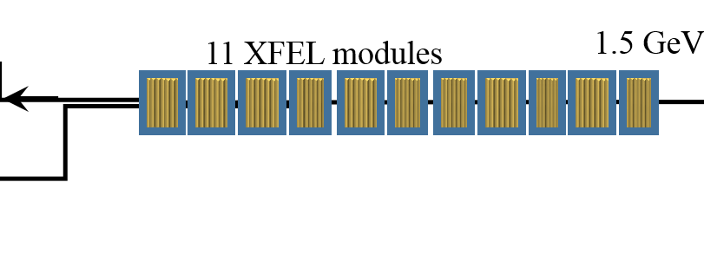

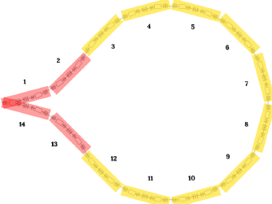
We had to conceive a new kind of machine: the Two-Way Linac (TWL)
All Accelerators are one way – the beam propagates in one direction (ERL too)
MariX uses the CW Linac twice – forward and backward
Superconductiong Linac: 13 XFEL crio-modules Compr Undulator
Traditional
FEL layout
Injector
dV/dz=17 MV/m
100 MeV 1.6-1.8 GeV
λ=7 Ang
0
100m
200m
300m
400m
500m
Linac2
Linac1: 11 XFEL crio-modules
Arc
compr
MariX
layout
λ=1.5 Ang
Injector
3.4-3.8 GeV 2.8-3.2 GeV 1.4- 1.6 GeV
Only Standing Wave RF Cavities can accelerate particles in both directions!
CdS- Milano - July 2nd, 2019

Slide 28
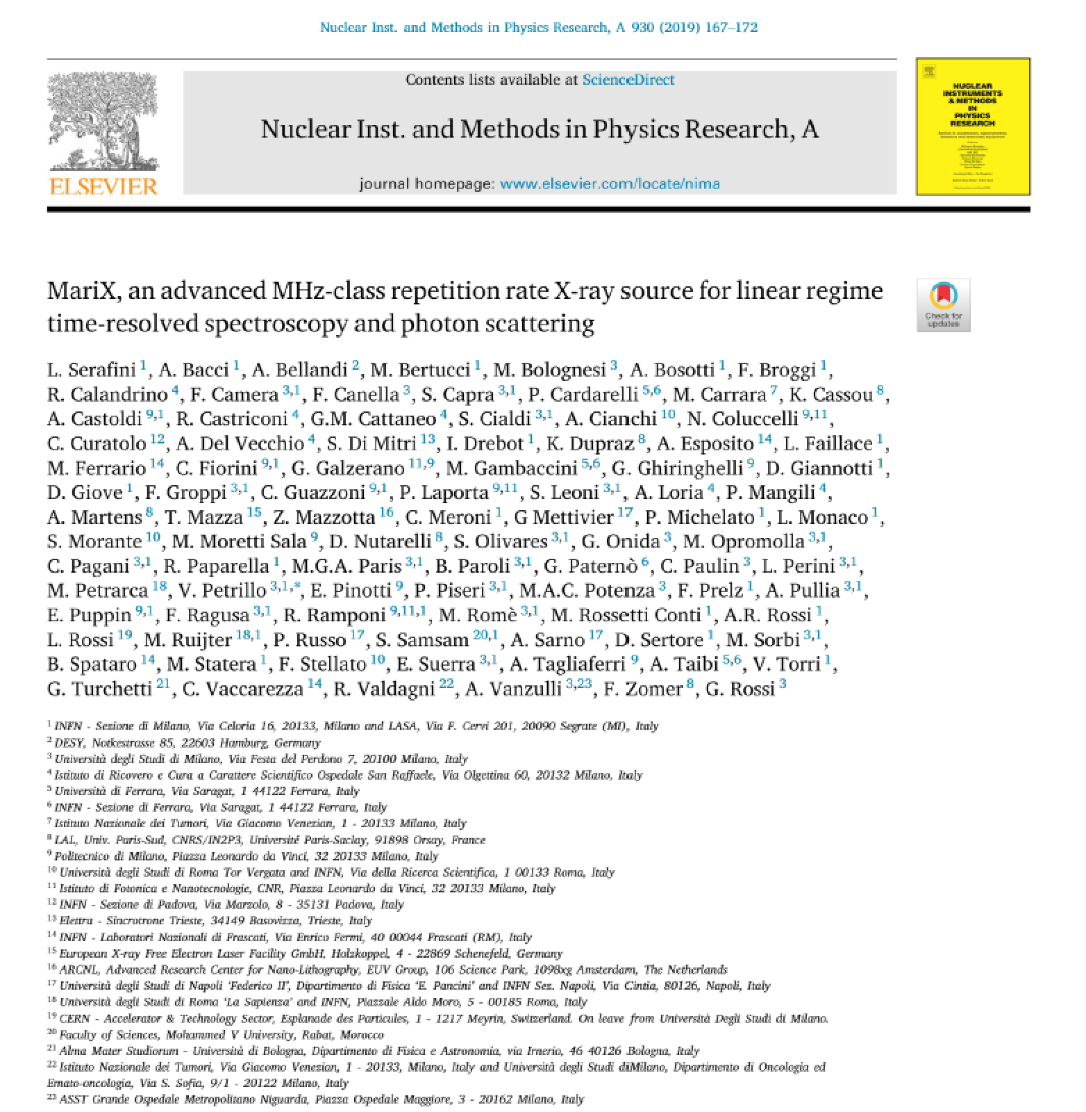
Executive Summary
published on NIM-A

Slide 29
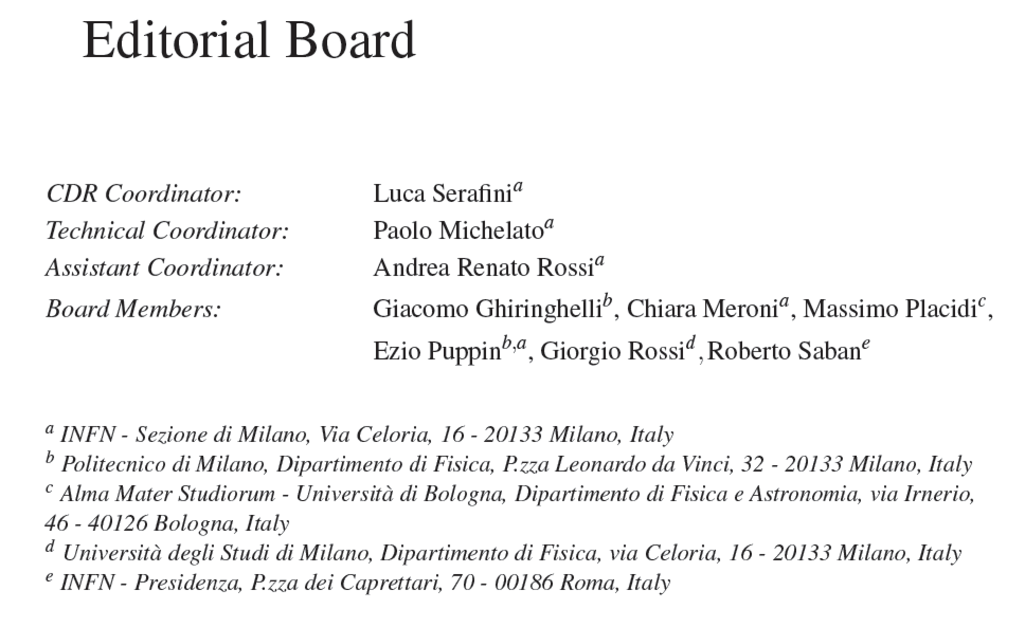
Machine Team: A. Bacci, A. Bosotti, F. Broggi, S. Cialdi, I. Drebot, A. Esposito (LNF), D. Giove,
G. Galzerano (PoliMi/CNR), P. Michelato, L. Monaco, R. Paparella, V. Petrillo, F. Prelz,
E. Pinotti (PoliMi), M. Placidi (Univ. BO), E. Puppin (PoliMi), A.R. Rossi, D. Sertore, V. Torri
Assegnisti: D. Giannotti^{INFN}, L. Faillace^{INFN}, M. Rossetti Conti^{INFN}, S. Capra^{UniMi}
PhD/Master Students: F. Canella, M. Opromolla, C. Paulin, M. Ruijter^{INFN},
S. Samsam^{ICTP}, E. Suerra
CdS- Milano - July 2nd, 2019

Slide 30
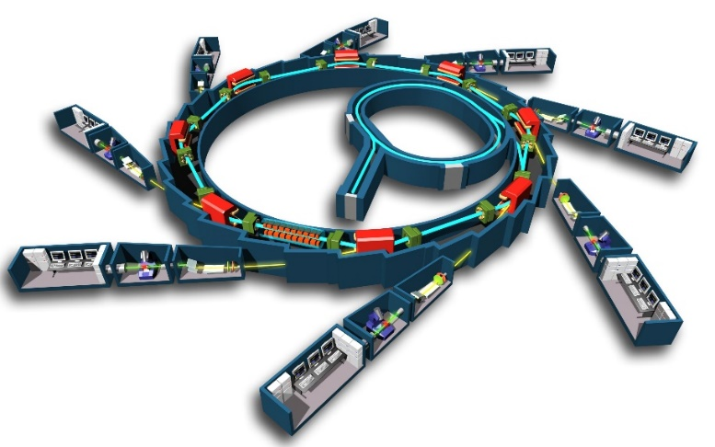
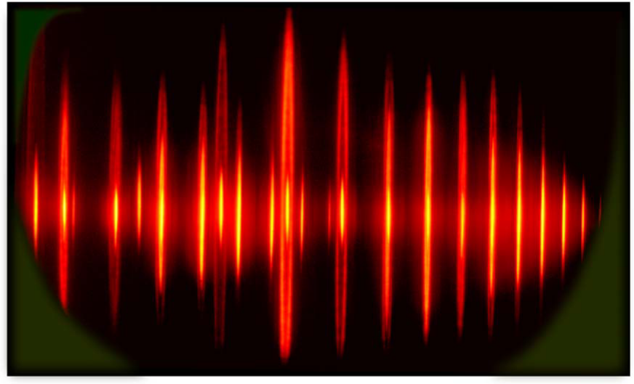
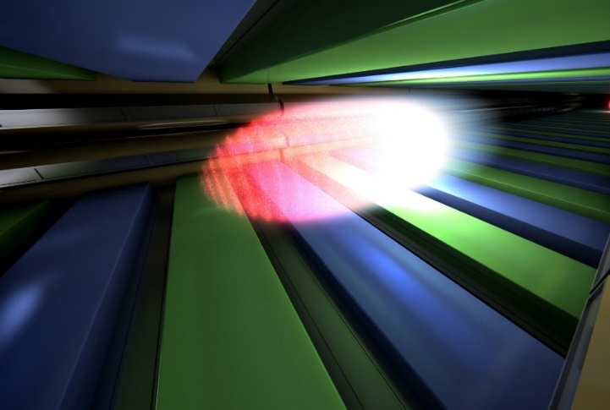

Laser-HHG UV-Soft X
Synchrotron Radiation sources
Free Electron Laser sources
500 MHz repetition
nJ pulse energy; ≈50ps
10⁵⁻⁶ photons x (5)x10⁸pulses
^{Linear response} ^{regime:}
^{Imaging} and spectroscopy (perturbation theory)
10Hz-27kHz repetition
mJ pulse energy; ≈50fs
10¹²⁻¹³ photons x
10¹⁻³⁻⁽⁶⁾pulses
Ultrafast Non-linear response regime
Imaging, flash+destroy
MARIX+FEL (10 keV)
1 MHz repetition
100nJ pulse energy; ≈50fs
10⁹⁻¹² photons x 10⁶pulses
Ultrafast Linear response
Courtesy Giorgio Rossi – Chair ESFRI
CdS- Milano - July 2nd, 2019

Slide 31
Scientific/Clinical Case: 2 Research Fields
enabled by MariX originality (Compton+FEL in CW)
High resolution low dose Radio-logical Imaging (<100 μm) with mono-chromatic X-rays up to 150 keV: mammography, 2 color angiography, radio-therapy with auger electrons on cis-platine, CAT 3D imaging of Cult.Herit./Archeological/Paleontological samples
Time resolved spectroscopy with fs coherent X-rays up to 8 keV @ 1 MHz rep rate: catalisys and chemistry in solvents, structure of nano-objects from coherent diffraction, bio-chemistry @ atomic and fs scale, pump&probe spectroscopy of strongly correlated materials, magnetism, superconductivity, topological materials, materials under strong spin-orbit interaction. Protein Crystallography with single-shot imaging (flash-and-destroy)

Slide 32
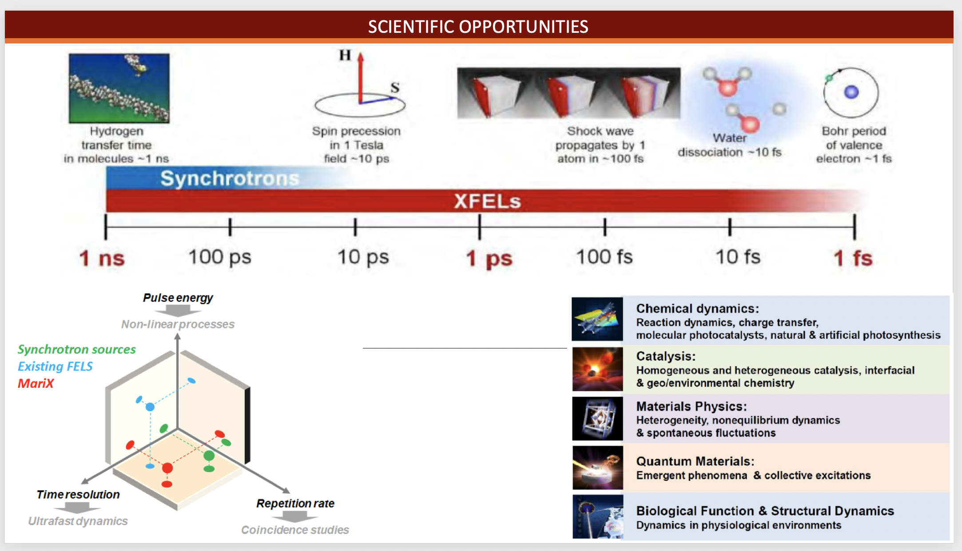
CdS- Milano - July 2nd, 2019

Slide 33
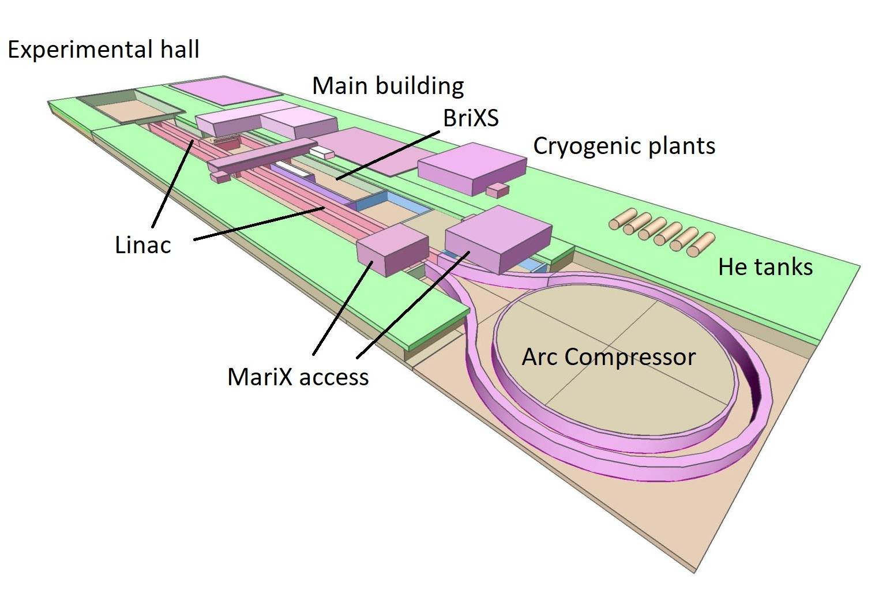
CdS- Milano - July 2nd, 2019

Slide 34
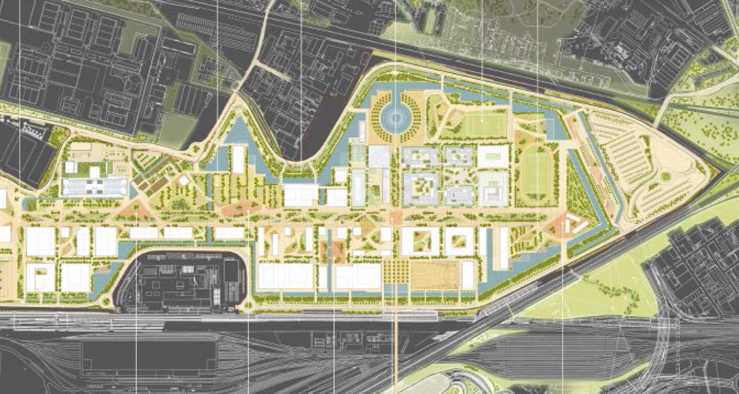
500 m
Next generation CW FELs like LCLS-II are km-long: not enough space in new UniMi Campus
CdS- Milano - July 2nd, 2019

Slide 35
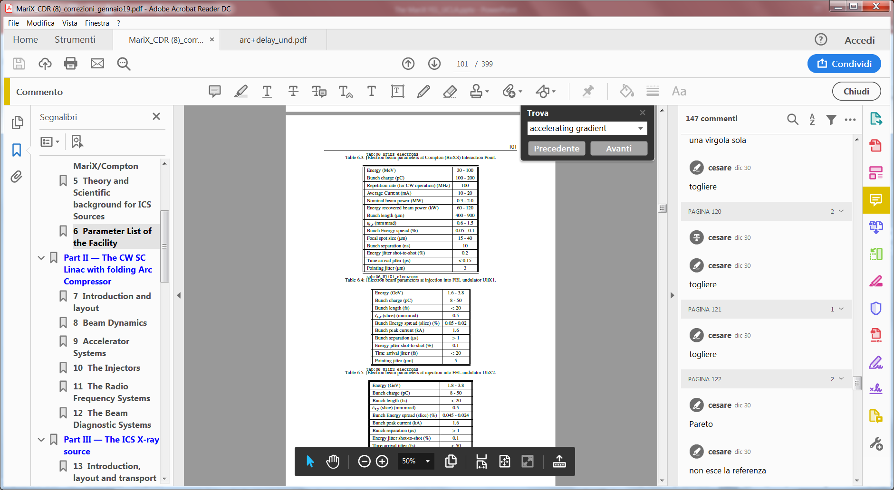
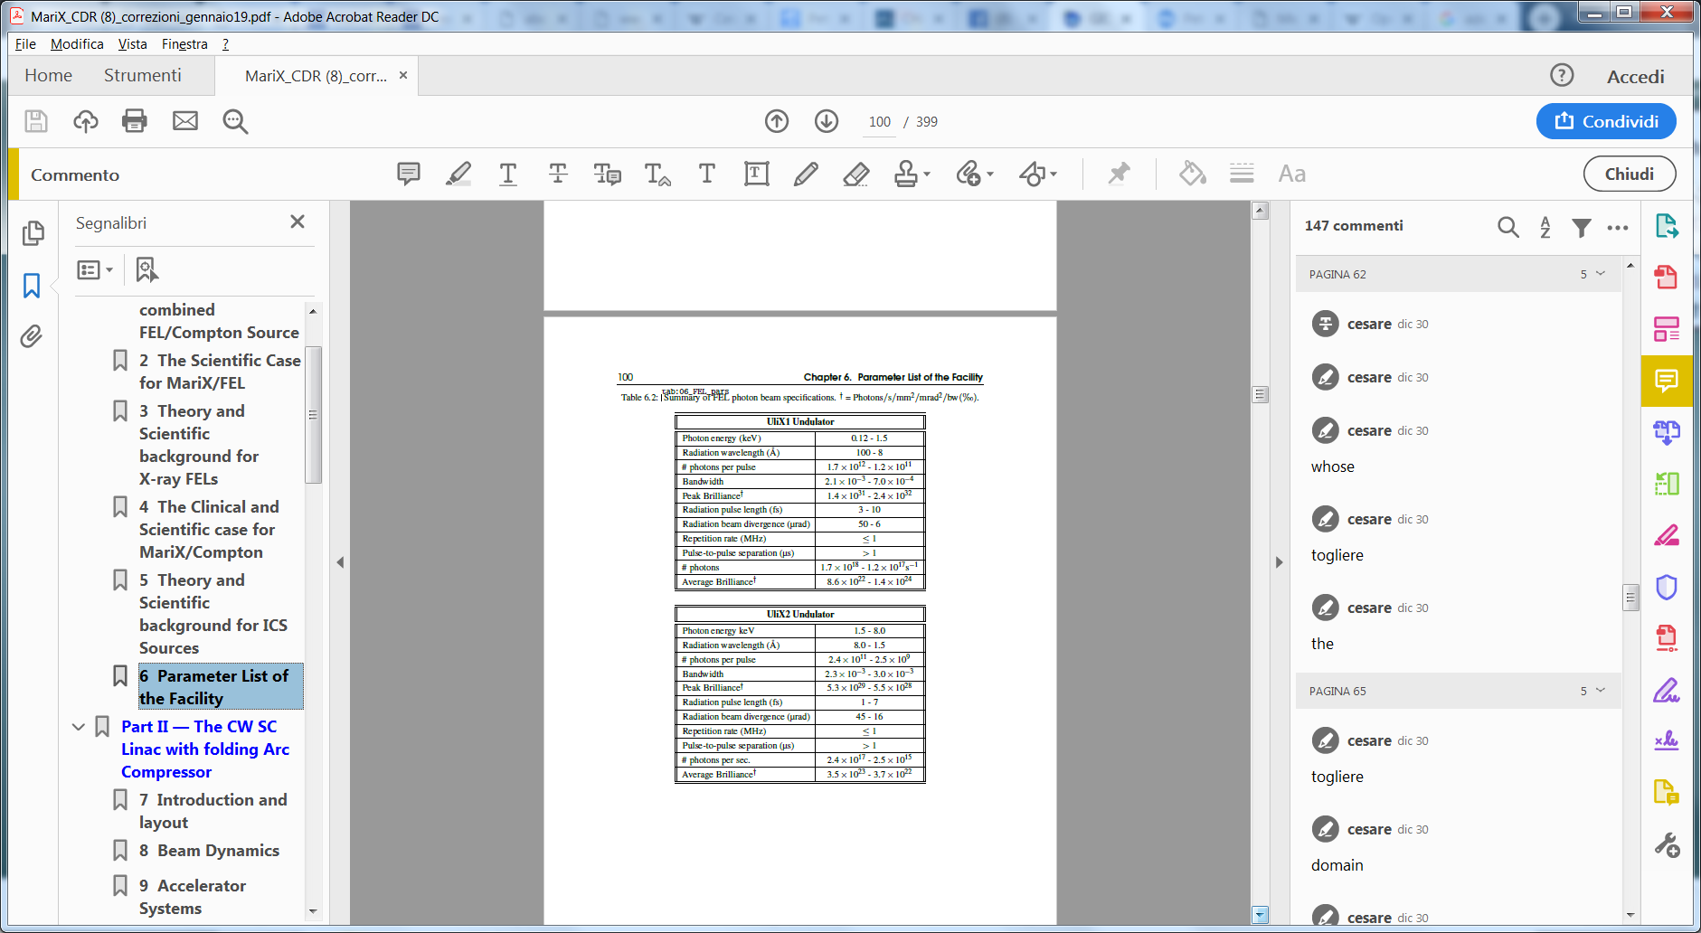
FEL simulations
With ELEGANT simulations we obtained
an electron beam with parameters very
similar to the nominal ones
0.5-0.35
Sirius-like
CdS- Milano - July 2nd, 2019

Slide 36
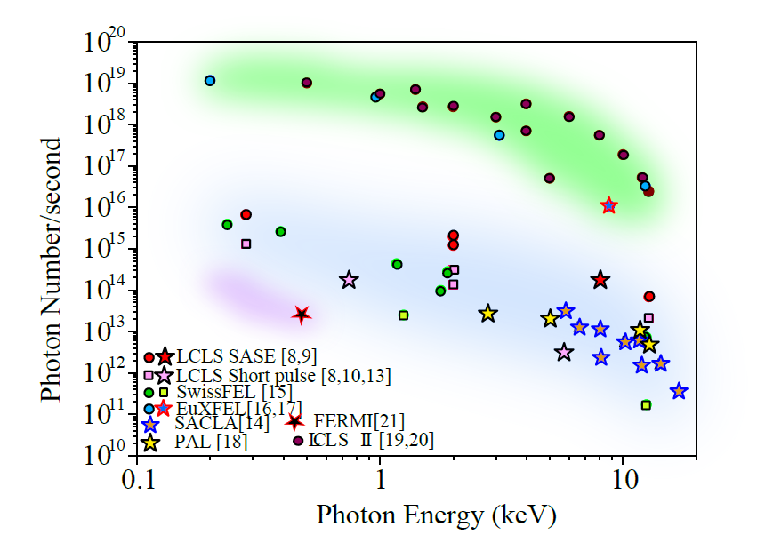
Comparison between X FELs, photons per second
FEL | Pulse per second
LCLS | 120 Hz
SACLA | 30-60 Hz
FERMI | 10-50 Hz
PAL | 30-60 Hz
PSI | 100 Hz
EuXFEL | 27 kHz
LCLS II | 1 MHz
MariX | 1MHz
Super conducting
Normal conducting
CdS- Milano - July 2nd, 2019

Slide 37
Comparison between X FELs, photons per second
FEL | Pulse per second
LCLS | 120 Hz
SACLA | 30-60 Hz
FERMI | 10-50 Hz
PAL | 30-60 Hz
PSI | 100 Hz
EuXFEL | 27 kHz
LCLS II | 1 MHz
MariX | 1MHz
CdS- Milano - July 2nd, 2019

Slide 38
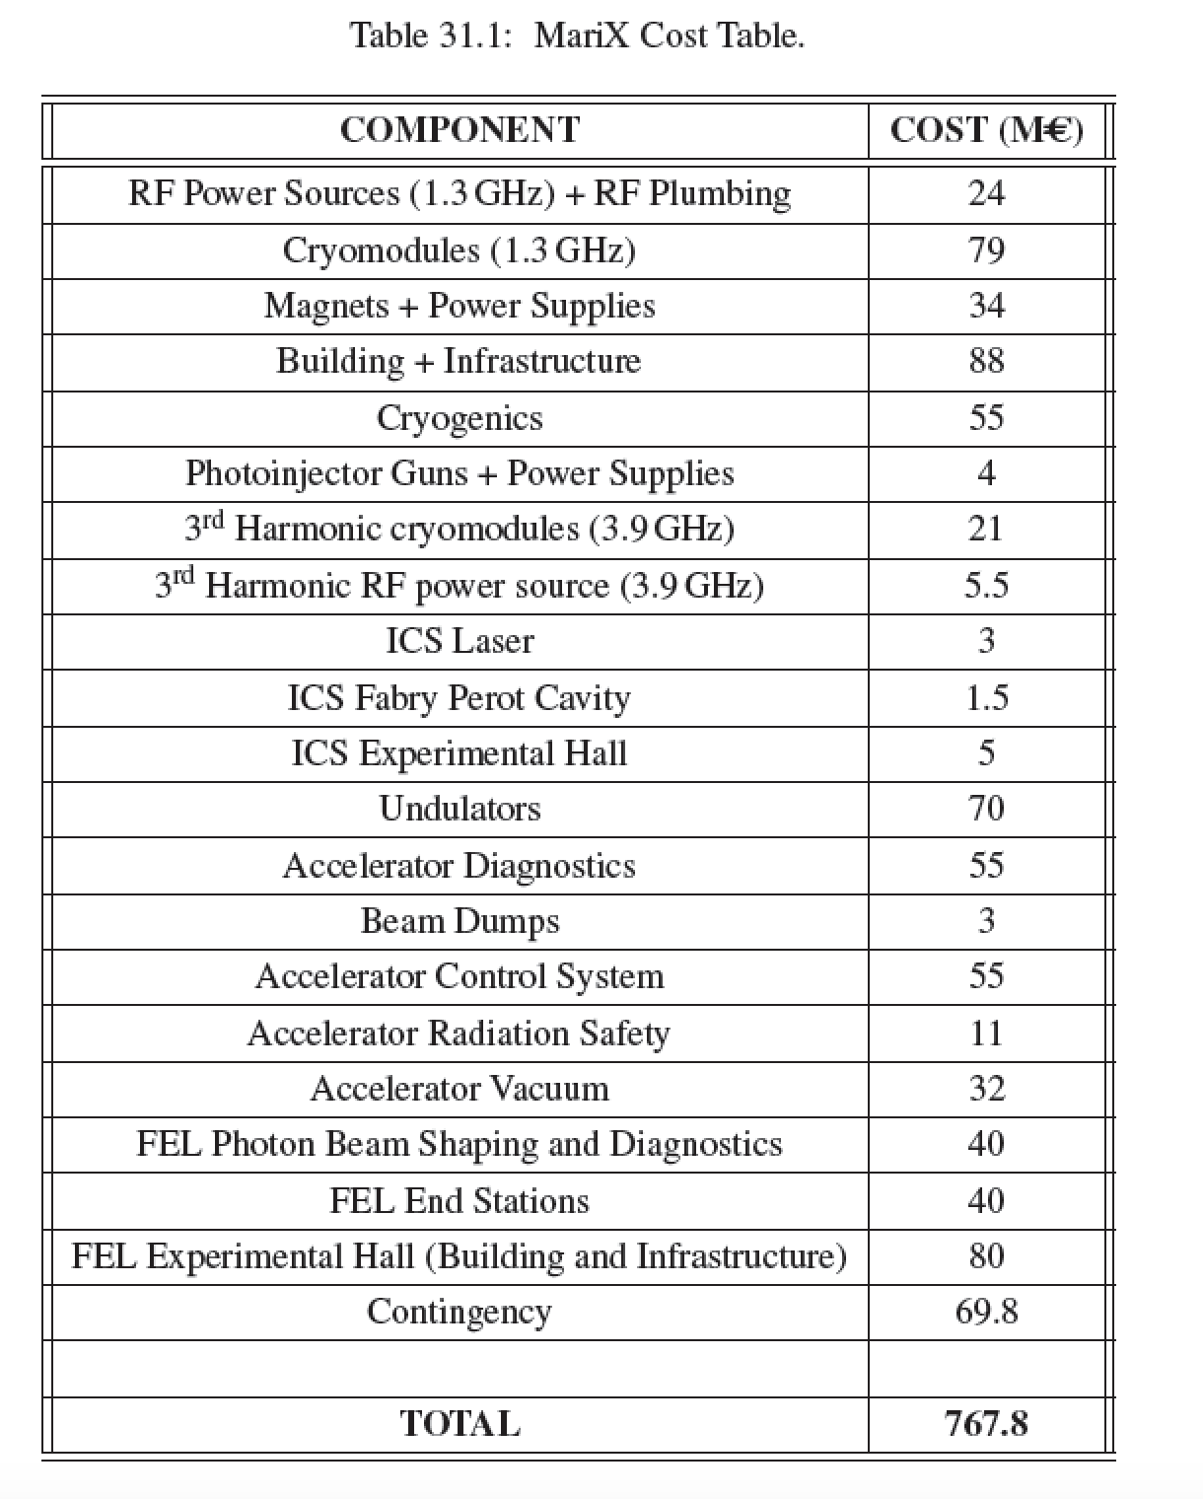
MariX 2-Phases (M€)
BriXS 82.5
MariX-FEL 685.3
cmp. LCLS-II > 1 G€
XFEL > 1 G€
Centro Brasileiro de Pesquisas Fisicas, Rio de Janeiro, May 2nd, 2019

Slide 39
Operational Costs (M€/year) Footprint (m²) (€/kwh)
MariX 45.5 (18 A/C) 35.000 0.234
LCLS 110
XFEL 120
SIRIUS 35 68.000 0.11
Centro Brasileiro de Pesquisas Fisicas, Rio de Janeiro, May 2nd, 2019

Slide 40
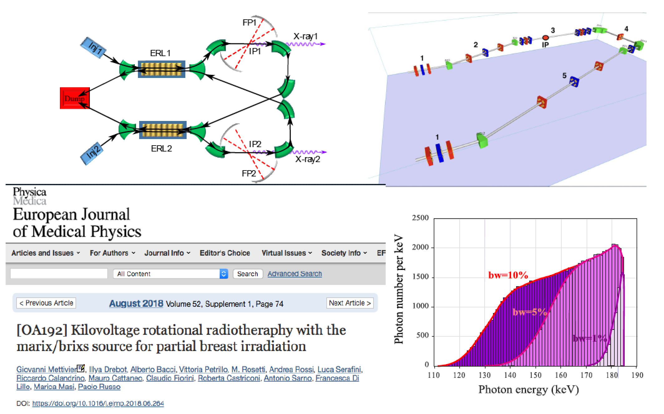
CdS- Milano - July 2nd, 2019

Slide 41
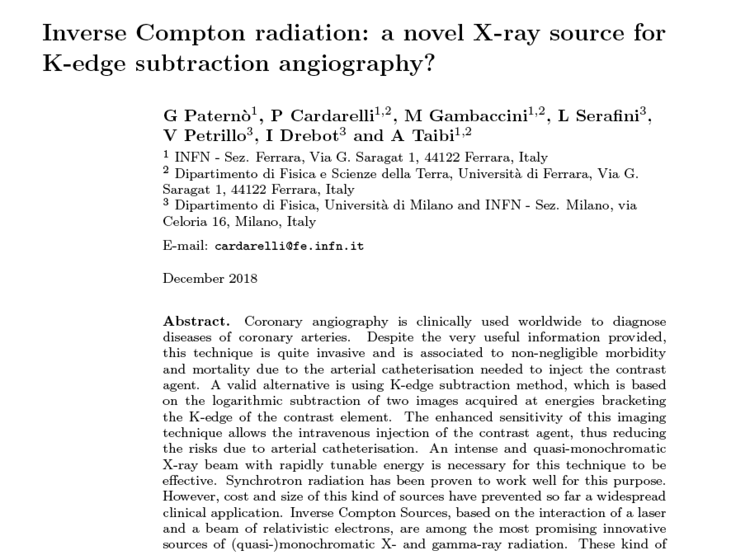
MariX-RAD CSN5-INFN
Resp. Naz. Paolo Cardarelli
Univ. di Ferrara
accepted for publication on Physics in Medicine and Biology
CdS- Milano - July 2nd, 2019

Slide 42
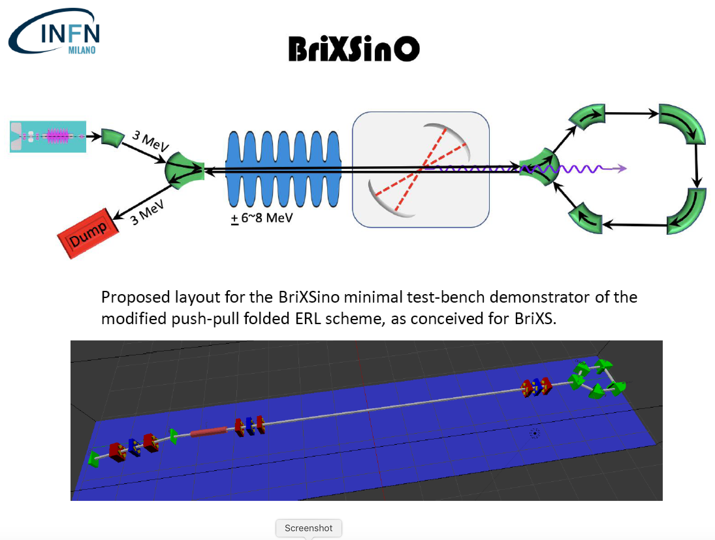
20 mA, 100 MHz, 10 MeV
> 60% energy recovery
6 M€, TDR within 2019
CdS- Milano - July 2nd, 2019

Slide 43
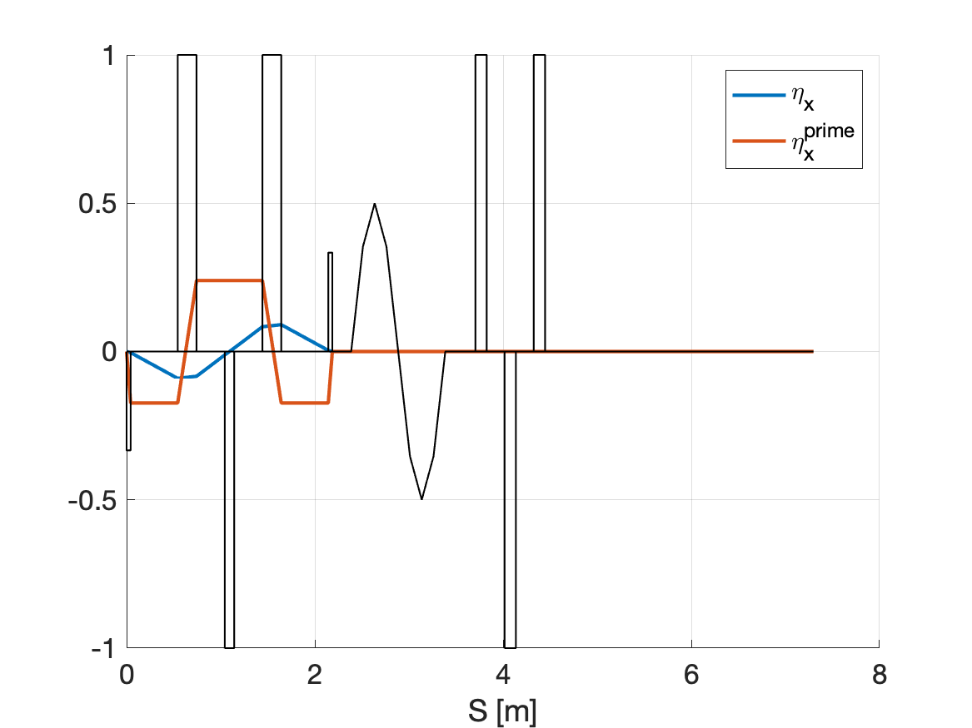
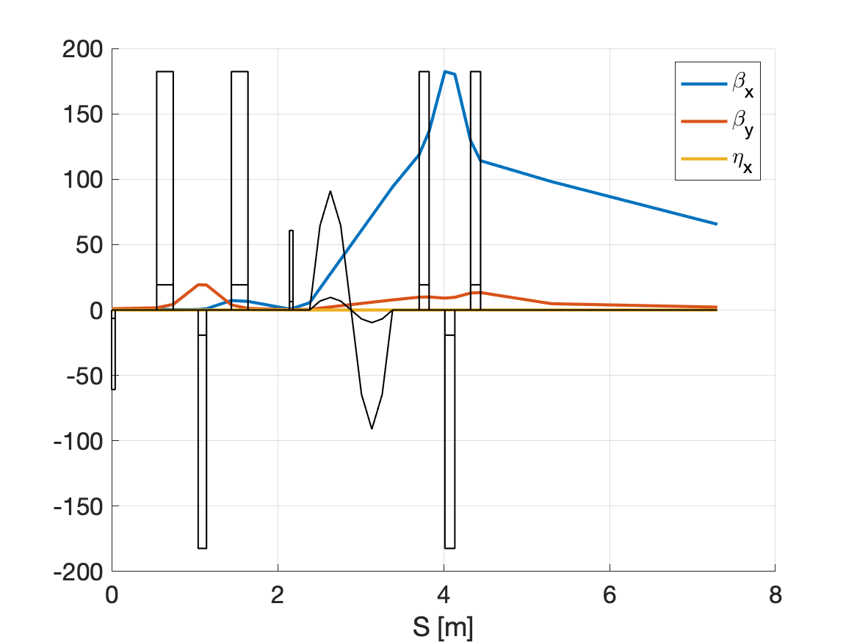
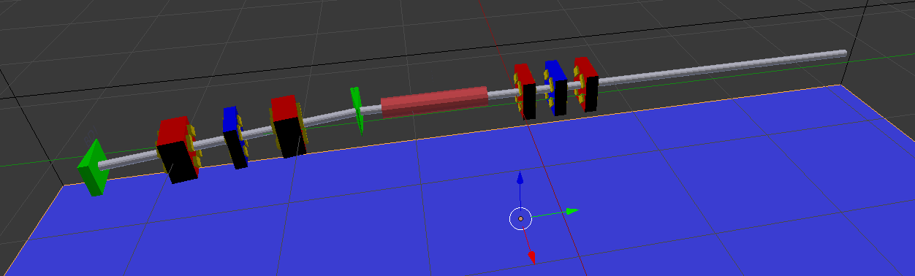

BriXsinO
3 MeV
3 MeV
+ 6~8 MeV
Dump
L=1m;
V=5 MV;
f=1.3 GHz;
CdS- Milano - July 2nd, 2019

Slide 44

Bdw = 5% , Flux = 4.10¹² ph/s
CdS- Milano - July 2nd, 2019

Slide 45



MariX_RAD
Daniele Cipriani
Tommaso Forni
Outline:
Stabilizzazione cavità
Metodo compensazione (per massimizzare la potenza)
Metodo per lo shift del fuoco (per il double color senza spostare il tavolo)
Programma fine anno
Futuro
Edoardo Suerra
Francesco Canella
Dario Giannotti
Stefano Capra
Sanae Samsam
Simone Cialdi
Ferrara 27-6-2019
CdS- Milano - July 2nd, 2019

Slide 46






Cavità a 4 specchi:
Oscillator
100MHz
4 mirrors cavity
7°
Piezo
PM
4F system
CdS- Milano - July 2nd, 2019

Slide 49
conclusioni
MariX/BriXS/BriXsino – una via per la sostenibilità di acceleratori e⁻ (e⁺) ad alta potenza media (MW and multi-MW class)
Una nuova linea genetica negli acceleratori (2-way 2-pass)
Entrambe motivazioni strategiche per INFN (con BriXsino ci proponiamo per colmare questa lacuna italiana, ˜6 M€)
Perchè Milano: overlap unico tra competenze di fisica e tecnologia degli acceleratori e lasers, quali High Brightness Beams/FEL/ICS Physics - SC/RF technology - High QE photocathodes - High Power Optical FP cavities, e una User Community molto qualificata nella Luce di Sincrotrone e Free Electron Lasers, con l’interesse (endorsement in MariX-CDR e BriXS-EoI) delle IRCCS San Raffaele, Niguarda, Istituto Nazionale dei Tumori
CdS- Milano - July 2nd, 2019

Slide 50
MAC Meeting - LASA - June 20, 2019

Slide 51

200 kW underground beam dump @ 3.8 GeV
Centro Brasileiro de Pesquisas Fisicas, Rio de Janeiro, May 2nd, 2019

Slide 52



Infrastrutture di Ricerca Analitiche aperte
all’utenza internazionale che operano in Europa e sedi LERU
Analytical Machines as User Facilities in Europe and League of European Research Universities:
a void around Univ. of Milan
LERU members
MAX-Lab
ESS Neutron
PETRA-III
X-FEL, FLASH
DIAMOND
ISIS - CLF
MYRRHA
SOLARIS
SOLEIL
LLB
ANKA
SLS, SwissFEL
ESRF
ILL, LETI
Elettra FERMI
ALBA
SPARC DAFNE
Da PSE Landscape Analysis ESFRI Roadmap 2016
Courtesy Giorgio Rossi – Chair ESFRI
Centro Brasileiro de Pesquisas Fisicas, Rio de Janeiro, May 2nd, 2019

Slide 53


The beam dynamics
All the beam dynamics simulations have been done with ELEGANT by
Alberto Bacci and Marcello Rossetti Conti
Envelopes
Linac 1 1st pass TL Arc compressor TL Linac 1 2nd pass Linac2
Emittances
MAC Meeting - LASA - June 20, 2019

Slide 54



RF Focusing effective only in Standing Wave RF Cavities
a lesson we learned long time ago

Slide 55
Beam dynamics 1: before the arc, Q=50 pC
here
Beam dynamic study made by A. Bacci
I_{peak}=16 A
σ_{x}=6 μm
σ_{z}=360 μm
<E>=1.5 GeV
ε_{nx,y}=0.2 μm
ΔE/<E>=7 10⁻⁴
Longitudinal phase space
Transverse phase space
MAC Meeting - LASA - June 20, 2019

Slide 56


Source layout 5:
The arc compressor
14 Double Bending Achromats Elettra-like
dipole
One DBA
quad
R₅₆=35 mm
30°
sextupole
R=41 m
Study of the arc compressor done by
M. Rossetti Conti
MAC Meeting - LASA - June 20, 2019

Slide 57
Beam dynamics 2: after the arc, Q=50 pC
here
I_{peak}=1600 A
σ_{x}=52μm
σ_{z}=20 μm
ΔE/<E>=3.6 10⁻⁴
ε_{n,x}=1 μm
σ_{y}=14.5 μm
Longitudinal phase space
Transverse phase space
ε_{n,y}=0.2 μm
Centro Brasileiro de Pesquisas Fisicas, Rio de Janeiro, May 2nd, 2019

Slide 58

Submitted to Phys. Rev. AB
MAC Meeting - LASA - June 20, 2019

Slide 59

Temporal pulse structure
FEL | Pulse per second
LCLS | 120 Hz
SACLA | 30-60 Hz
FERMI | 10-50 Hz
PAL | 30-60 Hz
PSI | 100 Hz
EuXFEL | 27 kHz
LCLS II | 1 MHz
MariX | 1MHz
Room
temperature
linacs
MariX
Superconducting
linacs
MAC Meeting - LASA - June 20, 2019

Slide 60

800 kW
150 kW

Slide 61

Brilliance of Lasers and X-ray sources
ELI
12.4
1.24
0.124
λ (nm)
BELLA
FLASH
Thomson/Compton Sources
Outstanding X/γ photon beams
for Exotic Colliders

