Slide 1


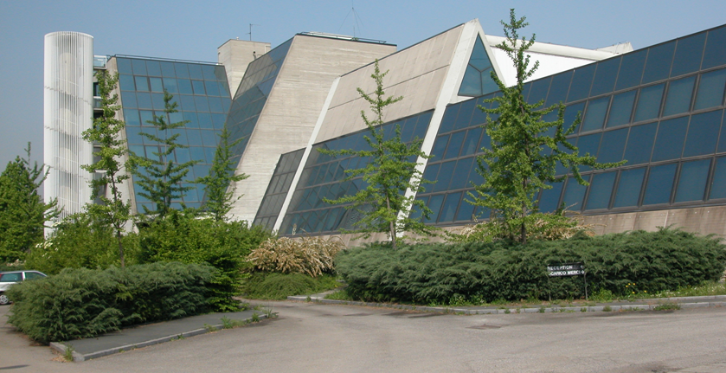
LASA: Laboratorio Acceleratori e Superconduttività Applicata
Superconducting Magnet Group: an update of activity
Massimo Sorbi

Slide 2
Sommario
Piccola panoramica delle infrastrutture del gruppo
Attività attuali
Persone coinvolte
Criticità

Slide 3
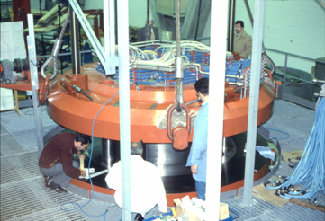
The story in a slide
LASA is hosted by Milano Universita’ degli Studi
Built in the ‘80 to realize a K800 superconducting Cyclotron, the first in Europe
Designed, built and tested in Milano, it is in operation since then at LNS
Since 1986: interest on Superconducting (SC) magnet, SC RF and FEL
ELFA Project: FEL driven by SC RF
LISA/ARES Project from FEL to B-factory
Technology transfer for production of 1/3 LEP-II SC Cavities
Zeus detector
First 15 m LHC dipole
ATLAS magnet system (Barrel Toroid)
SIS300 dipole prototype…

Slide 4
Sommario
Piccola panoramica delle infrastrutture del gruppo
Attività attuali
Persone coinvolte
Criticità

Slide 5
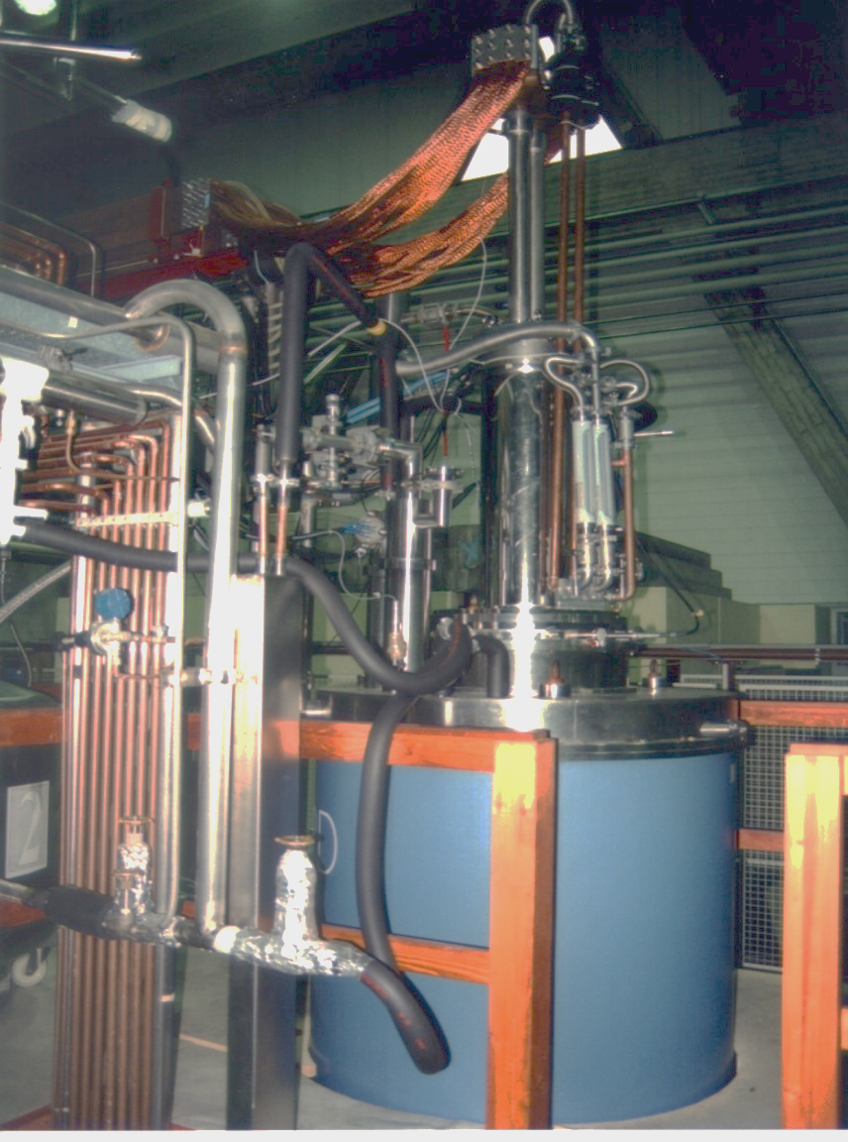
High Magnetic Field Laboratory
The High Magnetic Field Laboratory has the capability to provide magnetic field for research purposes, and to develop and test magnet prototypes
Research Magnets
SOLEMI 1: solenoid NbTi
8 T, 535 mm room temperature bore
SOLEMI 2+3: solenoid Nb₃Sn
15 T, 100 mm cold bore @ 4.2/2.2 K
75 mm cold bore in gas flow 2-300 K
Solenoid NbTi + Nb₃Sn
13.5 T, 50 mm cold bore @ 4.2/2.2 K
Cryocooler-operated magnet
8 T, 75 mm cold bore cryogen-free
Resistive Dipole
1 T, 120 mm room temperature gap
SOLEMI 1

Slide 6
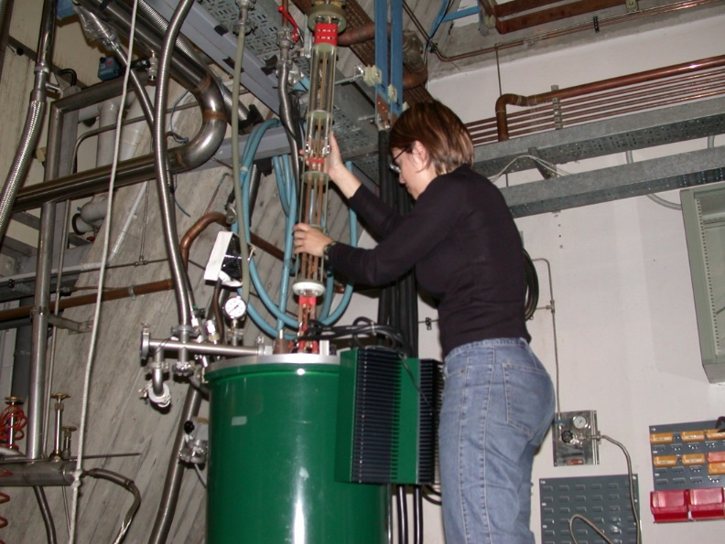
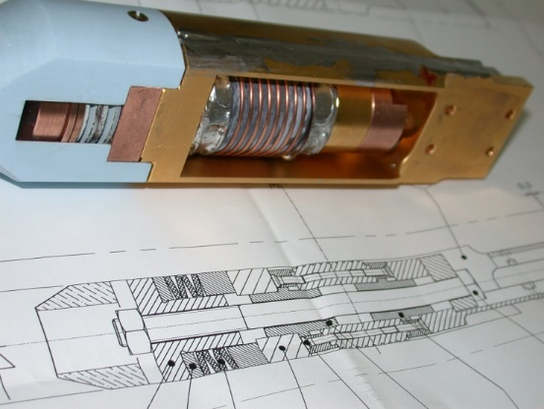
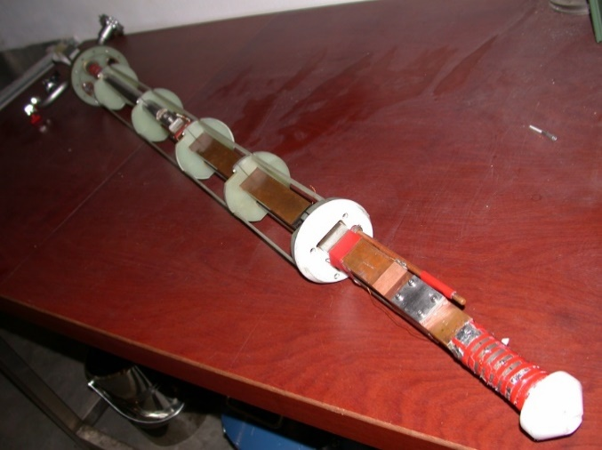
Test Station for Superconducting Cable Characterization
Critical current measurement of S.C. wires
  Facilities to test superconducting wires
  Back-ground magnetic field up 15 T
  Temperature variable from 1.9 K to 50 K
  Iper-stabilized power supply 3000 A, 6 V (battery bank to cancel ripple noise)
  Several supports for many types of conductor.

Slide 7
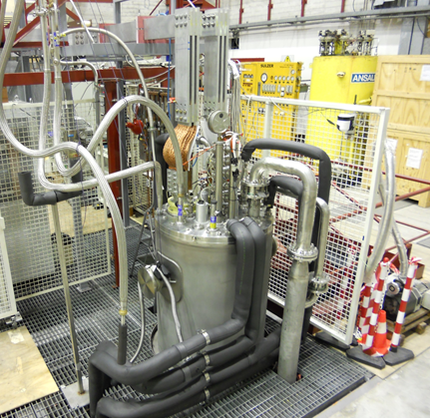
Test Station for long magnets
LHe Cryostats
  φ 690 mm, 6500 mm depth a rather unique feature
  φ 515 mm, 3300 mm depth for medium-size magnets/samples
  φ 480 mm, 1200 mm depth
  other smaller cryostat
Power Supplies
  3 x Power supply up to 10 kA, 6 V
  (series and parallel operation possible)
  2 x Power supply up to 1.2 kA, 36 V
  1 x Power supply up to 500 A, 125 V
  1 x Power supply up to 2 kA, 4 V
  (low noise, battery based)
Magnet Protection System including discharge resistor, switch, Quench Detection Electronics
Fast acquisition system to perform all test necessary to characterize supercond. magnets

Slide 8
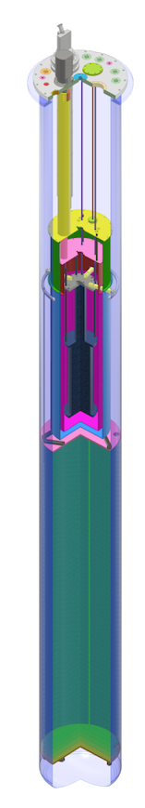
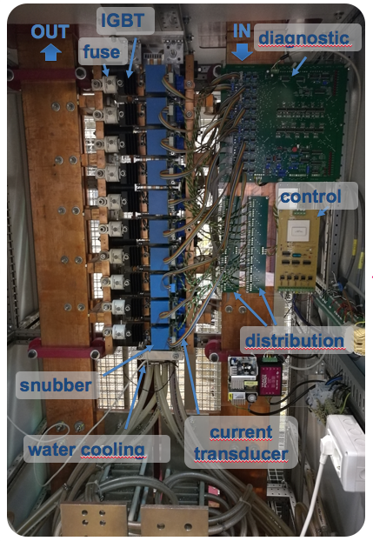
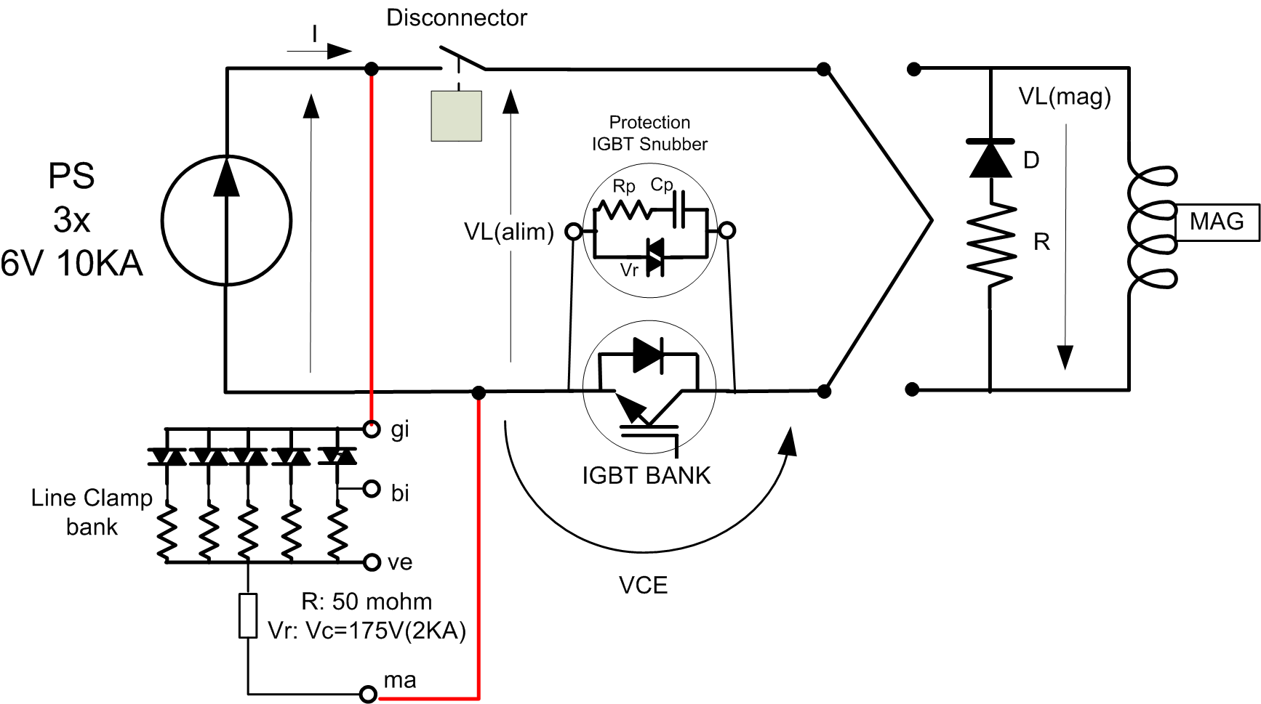
High Current Test Station
IGBT fast switch
1.2 ms to open
220 μs opening time
water cooling 17 kW
10 kA test station
Three 6V 10 kA power supplies
10 kA current leads
7.2 m cryostat
3.4 m
7.2 m
HTS magnet
1.4 m³ ethylene-vinil acetate disks
φ 0.695 m

Slide 9
Sommario
Piccola panoramica delle infrastrutture del gruppo
Attività attuali
Persone coinvolte
Criticità

Slide 10
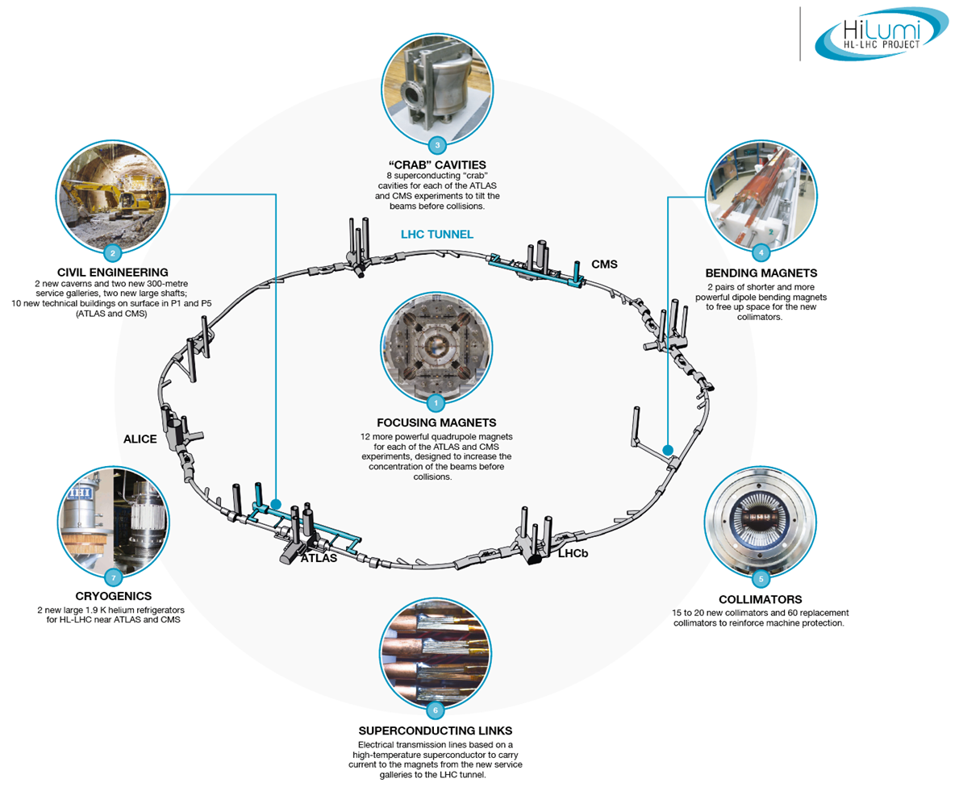
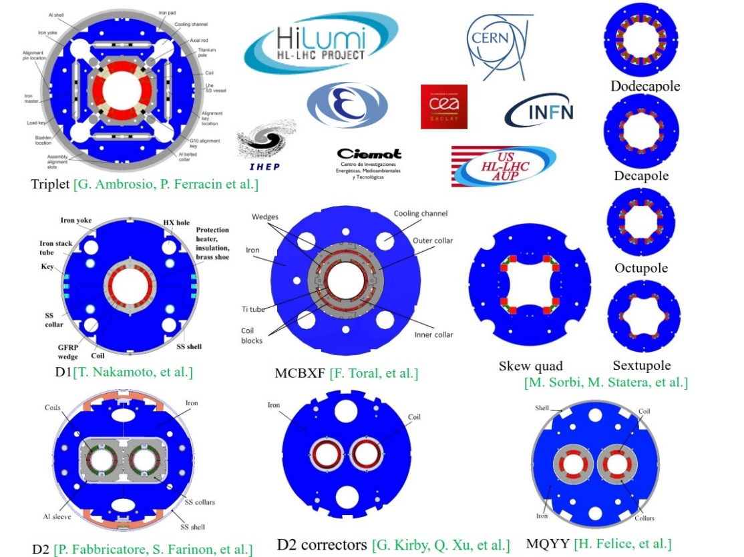
HL-SHOC (CSN-1)
1. Hilumi – LHC activity
Resp. M. Statera
100 magnets of 11 different types, done via 6 collaborations
To be ready by 2024
LASA is focussed on High Order Correctors in the HL-LHC
INFN LASA: 54 HOC

Slide 11
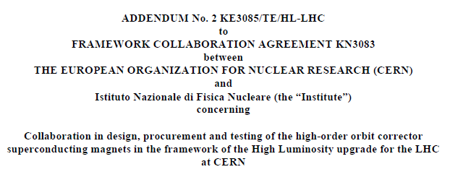
Scope - High Order Correctors
The INFN-LASA follows the design, construction and test of the 5 prototypes of the High Order (HO) corrector magnets for the HL interaction regions of HL-LHC. KE2291
The INFN-LASA will follow the series production of the HO corrector magnets for the interaction regions of HL-LHC. KE3085
Deliverables are the magnets, i.e. active part (coils) with iron yoke and support structure, plus the vertical tests
Integration in the cold mass corrector package is done at CERN
SIGLA: MAGIX (CALL CSN-5, 2015-2019)
30th Nov 2017
54 S.C. High Order Corrector magnets
SIGLA: HL_SHOC (CSN-1)

Slide 12
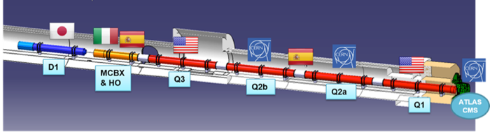
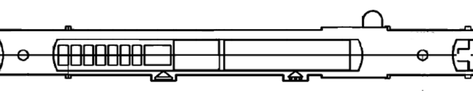
THE LOW BETA SECTION and the High Order Correctors
73.6 m
IP
by P. Fessia
b3
b4
b5
b6
a2
a3
a4
a5
a6

Slide 13
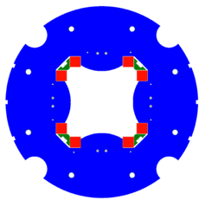
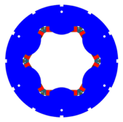
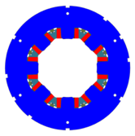
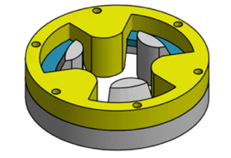
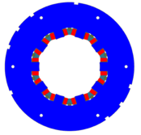
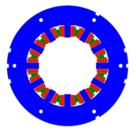
HO Corrector Magnets Zoo
MCSXFP1
MCOXFP1
MgB₂ round coil
OD460
OD320
a2
a3
b3
a4
b4
Tested 2019
Tested 2016
Tested 2017
Tested 2019
MQSXFP1b
MCDXFP1
MCTXFP1
Design
Construction & Test
5 prototypes
54 series magnets
a5
b5
a6
b6
NbTi SuperFerric design
Geometrical lengths:
200 mm - 265 mm
12P, S4P: 540 mm – 580 mm
Tested 2018
Tested 2018

Slide 14
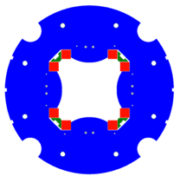
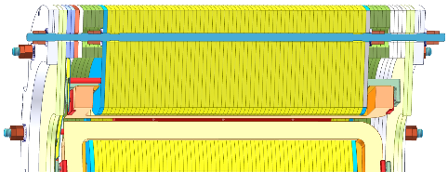
Superferric Design
Longitudinal dimension
Quench protection
Small dimension: 84kN series production (6 magnets)
NbTi superconding coils
Racetrack
Insulation by S2 glass reinforced material
Superferric design
Compact and modular
Strong contribution of the iron poles
Field quality influenced by the shape of the poles
constraints
magnet | Ic @ 4.2 K | Margin @4.2 K | Margin @1.9K
4P S | 315.5 A | 42.3 % | 57.1 %
6P | 225.5 A | 53.4 % | >60 %
8P | 230.2 A | 54.4 % | >60 %
10P | 255.7 A | 58.9 % | >60 %
12P N | 232.6 A | 54.9 % | >60 %
12P S | 230.2 A | 54.4 % | >60 %
coils
CuBe rods
pole
Quench protection
No energy extraction (but 4P)
60% margin @ 1.9 K
ARMCO iron
wedges

Slide 15
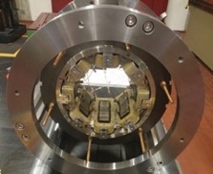
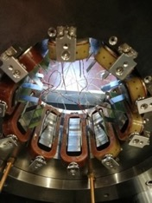
COILS STUDIES
Radiation requirement: 15 MGy
Validated Materials (for coils)
  Duratron
  BTS2 by Arisawa
  Hybrid BTS2/Duratron
8 coils duratron
5 coils BTS2
5 coils hybrid
development at LASA
One technology for all HO correctors coils:
7 or 8 parts BTS2
for different dimensions, form factors, forces

Slide 16
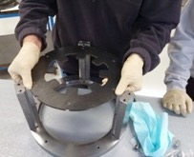
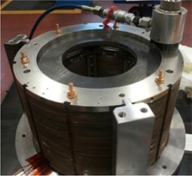
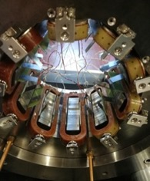
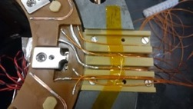
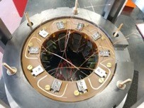
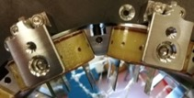
Prototypes Main Results
lamination
Procedure developed at LASA
  6P, 8P, 10P assembled at LASA
  12P and 4P assembled in industry
Documentation
Quality Control
Factory Acceptance Test
✓
alignment frame
ready for series
upper PCB
PCBs fixing
coil
lower PCB
bridge
CuBe rods
wedge

Slide 17
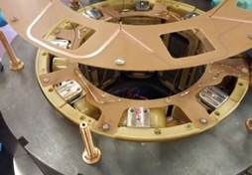
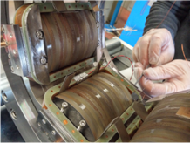
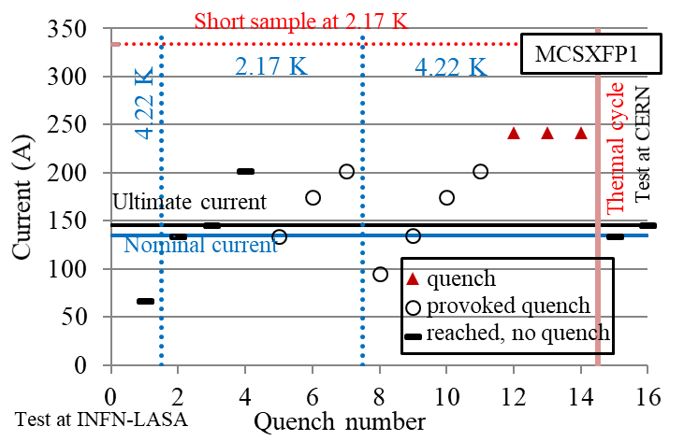
Milestones 1
MCSXFP1 Assembly procedure
MCOXFP1
Electrical connections on PCBs
Tested 2016
Tested in 2017

Slide 18
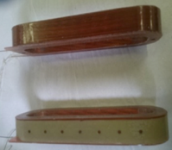
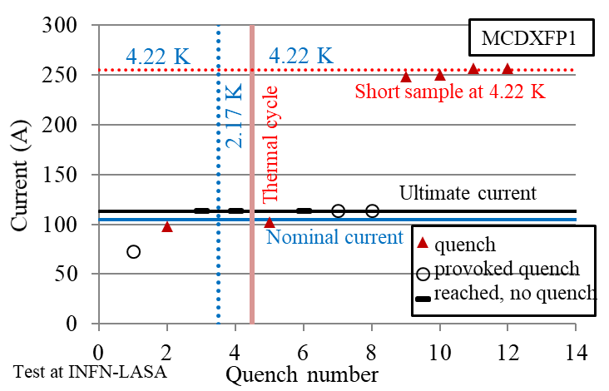
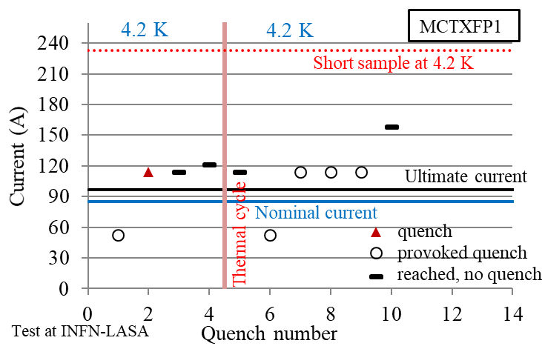
Milestones 2
MCDXFP1
coils technology
MCTXFP1
Construction in industry tested
Tested in 2018
Tested 2018

Slide 19
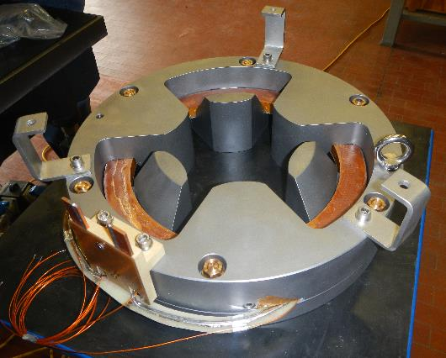
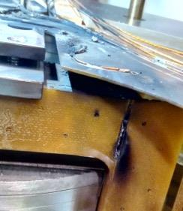
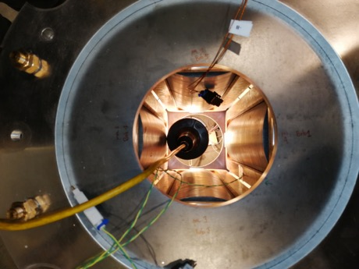
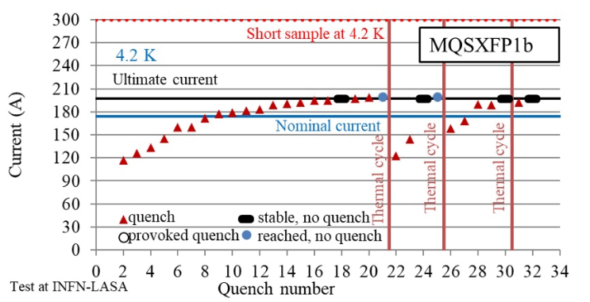
Milestones 3
Round Coil Superconductin Magnet
MQSXFP1b
demonstrator
Tested 2019
Tested 2019

Slide 20
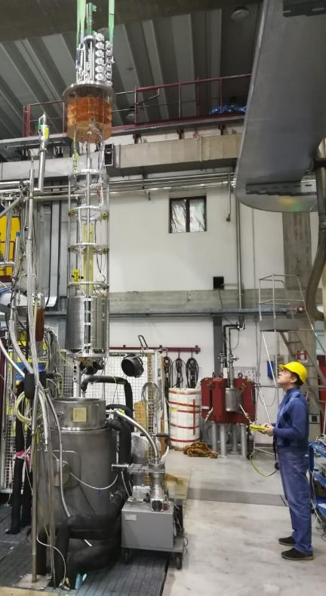
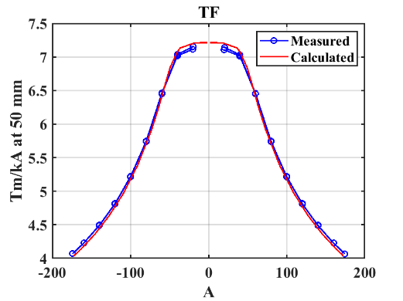
Milestones 4
Magnetic Field Measurement at LASA
MQSXFP1 | Calculated (Measured)
Nominal current I_{nom} Ultimate current I_{ult} | 174 A 197 A
Integrated field @ I_{nom} @ 50 mm | 700 T mm (709 T mm)
Integrated field @ I_{ult} @ 50 mm | 756 T mm (760 T mm)
∆=1.2%
∆=0.5%
Good compatibility with calculated data
Measured Integrated Field higher than calculated about 1%
Different linear behaviour at low current (plateau level in TF)
Curves crossing at 56 A when iron poles starts to saturate
S. Mariotto 11/12/2019

Slide 21
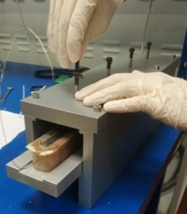
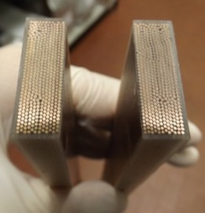
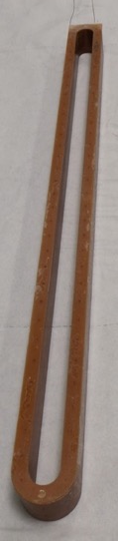
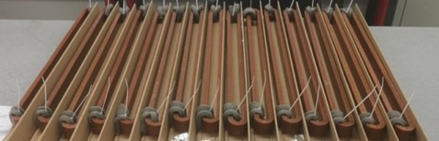
Production in Industry 1
Technology transfer to industry
Winding superconduting coils
first HL-LHC HO coil produced in industry

Slide 22
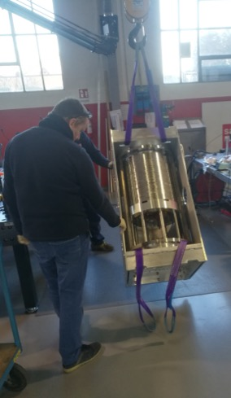
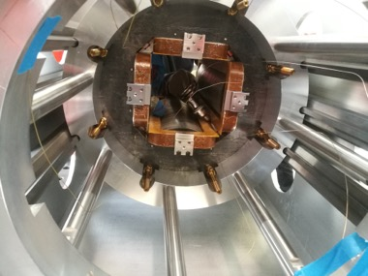
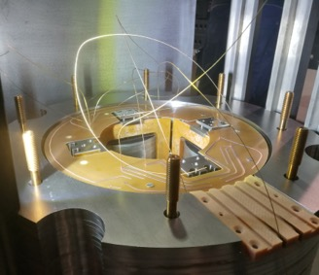

Production in Industry 2
wedge
Assembly
Saes Rial Vacuum
pcb
CuBe rod
frame
frame
bridge to connection box
alignemnt rods
CuBe rod

Slide 23

Series Production – Coils
June 2020
129 coils produced
19 NCs
Series production started
54 Magnets – 5 families
Total length about 17 m
Integrated in 6 cryomodules
456 coils +spares
First half batch: 9 magnets (76 coils)
total
120
80
10P
40
6P
8P
12P-N
scrape
12P-S
4P
2019
2020
June

Slide 24



Series Production - Magnets
4/9 cores installed
2/9 set of coils installed
Next week first magnet is closed MCDXF001
Batch 1a: 8 magnets within Aug 2020, 4P in Sep 2020
MCDXF001
Batch 1a | core | coils | PCB | FAT
M06 | OK | ongoing
 | OK | ongoing
M08 | ongoing
 | ongoing
M10 | OK | OK
 | OK | OK
M12-N
M12-S
M04
First series magnet in costruction
Batch 1a
Coils and standard mechanics produced

Slide 25
HL-LHC HO Correctors Test configurations
Prototypes
Single magnet test
Series production
54 magnet out of 100 for HL-LHC
to be tested in 3 batches 2020-2022
Each batch consists of:
  18 magnets
  5 cooldowns
    (2 x A) + (2 x B) + (1 x C)
Each HO corrector characterized by
1 common CL + bus bar
1 dedicated CL + bus bar
3 voltage taps
Cross check magnet connection before powering by AC signal
signal connections
600
current leads
LHe max
bus bars
2350
A
B
C

Slide 26

Delivery and Test Plan
2020
2021
2022
1a (9 magnets)
1b (9 magnets)
2 (18 magnets)
3 (18 magnets)
Cryogenics Manpower
Power supply Logistic
DAQ
Up to 4 magnets per cooling
Single powering
February 2022

Slide 27




2. New test station for large High Temperature Superconducting Magnets
Resp. F. Broggi, M. Statera
10 kA test station
Three 6V 10 kA power supplies
10 kA current leads
7.2 m cryostat
3.4 m
7.2 m
HTS magnet
DISCORAP cryostat for HTS magnets test
Mechanical interface redesign ongoing
Zero uplift filler delivered
Fast switch commissioned
Electrical connections integration ongoing
Temperature control design ongoing
Cryocooler procurement ongoing
Magnetic field measurement integration designed
1.4 m³ ethylene-vinil acetate disks
φ 0.695 m

Slide 28

Working Principle
Vacuum
AIR
Low helium consuption
Good temperature control
Low temperature gradient (Ghe)
30-100 K
Shell design by R. Pengo
We introduce the cryocooler
10-50 K
GAS He
HEATER
Note
The cryostat is not in vacuum
The vessels have to allow the gas to flow in/out for cleaning
Liquid He
(optional)
Vacuum insulation
+ LN2

Slide 29

Thermal Balance Scheme
Current leads
  Gas He from a 450 l Dewar
  Updated CL design (no UHV welding on Cu)
  1-2 W @ I=0 and 7 W @ 10 kA
Mechanical support
Integration ongoing
CURRENT LEADS
G He
CRYOCOOLER
FIRST STAGE 20W @ 30K and 120 W @100 K
SECOND STAGE 9W @ 10 K

Slide 30


Magnet Temperature
40 K
300 K
Simplified model
Additional L-He consuption 1-10 l/h
Temperature homogeneity 1K
3.4 m
77 K
Magnet screen
LHe
20 K
4 K

Slide 31



3. HTS R&D activities (INFN CSN5)
Resp. M. Statera
INFN Genova
INFN Milano
CNR-SPIN Genova
Univ. Bologna
BISCOTTO
BiSCCO Cosine Theta Tilted Solenoids
Development of CCT in BiSCCO and MgB₂
Past experience with the construction and test of NbTi quadrupoles (50 Tm) for B-factory IR
Tilted Solenoid Dipole

Slide 32



INFN design under coordination of R.Musenich
BiSCCO wire developed by CNR SPIN
(A.Malagoli and A.Leveratto)
PhD A.Traverso
BISCOTTO
Winding tests and 2-layer demonstrator ongoing

Slide 33






3. High field dipole magnets beyond LHC era: Future Circular Collider
Resp. M. Sorbi
INFN (LASA & Genova) has been encharged to design the 16 T Nb₃Sn superconducting dipole
Design completed (2015-2019)
INFN design has been condidered the baseline option in the FCC CDR
800 mm 600 mm
Magnet length 14.3 m
Free physical aperture 50 mm
Field amplitude 16 T
Margin on the load-line @ 1.9K 14 %
Total time margin 40 ms
Critical current density @ 1.9 K, 16T 2300 A/mm²
Conductor fit (Jc/B) EuroCirCol fit
Degradation due to cabling 3%
Minimum Cu/nonCu 0.8
Maximum strand diameter 1.2 mm
Maximum stress on conductor at warm 150 MPa
Maximum stress on conductor at cold 200 MPa
Maximum hot spot temp. (@ 105% I_{nom}) 350 K
Maximum number of strands in a cable 40 - 60
Maximum voltage to ground (magnet) 1.2 kV
Maximum TOTAL voltage to ground 2.5 kV
Conductor cost (performance based) 5 Euro/kAm
Cosinetheta
(INFN)
Block-coils
(CEA-france)
Common-coils
(CIEMAT-spain)
2015 2017
CCT
(PSI with LBNL and CERN)

Slide 34
Critical current density at 4.2 K
10⁴
Nb₃Sn
10³
Critical current density A.mm⁻²
LHC dipole
NbTi
FCC dipole
10²
Conventional iron yoke electromagnets
10
Magnetic field (Tesla)

Slide 35




Nb₃Sn coil cross section
Units (10⁻⁴)
Cold mass cross section
Magnetic and Mechanical study (LASA/Genova)
Field quality
35

Slide 36



Slide 37

From EuroCirCol to short model construction (FalconD project)
(Agreement of co-financing with CERN)
Development in four years of a significant model in collaboration with industry (contract with ASG signed 1/6/2020), simplifying as possible the structure, with the assembling at LASA
Basic choices: single aperture, comparable coil cross section with EuroCirCol design , length 1.5 m max
Magnetic field:
  The minimum target is the first step beyond 11T (as this value is the consolidated state-of-art for accelerator dipoles): 12 T at 1.9K. This is also a reasonable target considering the limited experience of the team in Nb₃Sn technology and the involvement of the industry.
  The ultimate field of about 14 T (short sample 15.8T)
  Under these condition a two layers dipole is feasible
Start with existing wire (HL-LHC)
Plan the construction of a significant number of coils
Future Accelerator post-LHC
Cos-theta Optimised Nb₃Sn Dipole

Slide 38


Reference configuration: cold mass geometry
22.1 mm
Ø 70 mm
5
3
2
9.65 mm
R_{iron} = 275 mm
4
1
y_{iron} = 97 mm
Ø 20 mm
Minimum wedge thickness
d_{block 1-2} = 1.03 mm
d_{block 2-3} = 1.67 mm
d_{block 5-4} = 1.10 mm
Mandrel radii
R_{in}= 25 mm
R_{out}= 46.8 mm
X_{iron} = 97 mm
Courtesy: R. Valente

Slide 39



Winding connection side
Layer 2
Layer 1
block split
wedge jump
layer jump (30°)
Connection side
wedge jump
Courtesy: R. Valente

Slide 40




3D design
18.5 mm
5
4
4
Peak field [T] | Opt. 1 | Opt. 2
Straight section | 12.57 | 12.57
Coil ends | 12.34 | 12.75
ΔB_{peak} | 0.23 | -0.18
3
2
1
50.8 mm
Y-Z section
Length [m] | Opt. 1 | Opt. 2
overall | 1.67 | 1.67
yoke | 1.40 | 1.40
Coil ends | 0.135 | 0.135
Magnetic | 1.36 | 1.54
Conductor | 238.5 | 239
Opposite
connection side
1.4 m
1.67 m
conductor length/pole ≈ 120 m
Courtesy: R. Valente

Slide 41

The program (2020-2022):
Complete TDR beginning 2021
Purchase INFN-LASA furnace for Nb₃Sn heat treatment to be installed in ASG (Genova)
Coil winding, heat treatment and impregnation in ASG
Assembling of cold mass at LASA
Functional test at 4.2 K and operative current 20 kA
Final test at CERN
Challenging for the group:
New technology for assembly
New criostat 4.5 m
Upgrade test station from 10 kA to 20 kA

Slide 42
Annuncio ufficiale del CERN DG
Dear Colleagues,
Today, the CERN Council decided to update the European Strategy for Particle Physics with the enthusiastic support of all Member States. The Strategy sets out the scientific vision for the near and long-term future of our field. Concluding an inclusive process that has taken place over almost two years, the Strategy update represents a major accomplishment for the European high-energy physics community, and provides a basis for Europe to maintain its prominent role in particle physics and the innovative technologies developed by the field.
The Strategy recommendations and the deliberation document can be found here:
Strategy recommendations :
https://indico.cern.ch/event/924500/contributions/3884837/subcontributions/308163/attachments/2060582/3456333/CERN-ESU-013.pdf
Deliberation document :
https://indico.cern.ch/event/924500/contributions/3884837/subcontributions/308163/attachments/2060582/3456338/CERN-ESU-014.pdf
The update of the Strategy rounded off a rich week of discussions and decisions. The Council and its subordinate committees were impressed by, and warmly congratulated CERN and its personnel on, the successful handling of the Covid-19 pandemic and the gradual and safe re-start plan. They also expressed appreciation for the work done in the framework of the “CERN against Covid-19 task force”. The Scientific Policy Committee applauded the wealth of beautiful physics results produced by the LHC experiments that were presented at the LHCP conference at end of May. The draft Medium-Term Plan for the period 2021-2025 was very well received; the final plan will be presented to the Council for approval in September.
The Council approved the Management’s proposal for the items to be included in the five-yearly review of the financial and social conditions of the members of the personnel. The proposal was based on concertation with the Staff Association and represents an important step in the review process.
CERN’s first-ever public environment report was presented to the Council, which agreed to its release into the public domain, and we look forward to sharing it with all of you soon.
As of today, our Member and Associate Member States have paid 88% of their 2020 contributions, which demonstrates their continued strong support for the Organization even during these difficult times for the whole world. We are grateful for their commitment, which enables us to fulfil our mission. Many thanks to all of you for your hard work and dedication, which lies at the heart of their confidence in us.
As we approach the end of the first half of the year, which has presented extraordinary challenges for the life of the Laboratory, we are pleased to invite you to an online meeting at 15.30 on 29 June, where we will provide a more in-depth update on the outcome of this Council session and on the ongoing gradual resumption of on-site activities. We look forward to this opportunity for us all to come together, virtually, to look ahead to an exciting future for CERN.
With our warmest regards,
Fabiola Gianotti, Frédérick Bordry, Eckhard Elsen, Martin Steinacher, Charlotte Warakaulle

Slide 43

European Strategy for Particle Physics
The European Strategy Group (ESG) is set up by the CERN Council approximately every 5 years, with to establish a proposal for the update of the medium-and long-term European Strategy for Particle Physics, submitted to the CERN Council for approval. The ESG takes into account the input submitted by the Physics Preparatory Group
https://europeanstrategyupdate.web.cern.ch/european-strategy-group-esg
The European Vision is to prepare a Higgs factory, followed by a future hadron collider with sensitivity to energy scales an order of magnitude higher than those of the LHC, while addressing the associated technical and environmnental challenges.

Slide 44

Attuale risultato ottenuto: US-Fermilab
84% on the laodline at 1.9 K
92% on the loadline at 4.2 K
60-mm aperture
4-layer graded coil
15 T dipole demonstrator
Staged approach: In first step pre-stressed for 14 T
Second test foreseen in fall 2019 with additional pre-stress for 15 T

Slide 45
5. Partecipation in IFAST (già Aries-2) for Novel sc magnet for Hadron-Therapy
Resp. L. Rossi
The Innovation Fostering in Accelerator Science and Technology (I-FAST) project is a CERN coordinated H2020 project in the submission stage (but pre-approved…)
In our technical program we will develop innovative SC magnets
Description: Construction of a model/prototype of a superconducting HTS magnet for application in innovative accelerator hadron-therapy (both for new sc synchrotrons and sc gantries)
Expected deliverable(s): Design of a sc magnet, and development of innovative component (double function magnet) involving HTS technology and a novel magnetic lay-out (Canted Cosine Theta generating dipole and quadrupole field or other innovative lay-out as toroidal )

Slide 46
The develoment is expected to in collaboration with industry (partner in the H2020 application)
Some models are expected to be developed «in house» at LASA
Installation at LASA of special winding machines and impregnation tools
Synergic activity respect high field dipole development
Starting date: Sept. 2020

Slide 47
Sommario
Piccola panoramica delle infrastrutture del gruppo
Attività attuali
Persone coinvolte
Criticità

Slide 48
Researcher:
Francesco Broggi (Ric.-INFN)
Lucio Rossi (PA-UNIMI) from Sept. 2020
Massimo Sorbi (PA-UNIMI)
Marco Statera (Tecnologo-INFN)
Not permanent:
Ernesto De Matteis (A.R. Senior-INFN)
Marco Prioli (Tecnologo-INFN)
PhD Students:
Samuele Mariotto (III year)
Riccardo Valente (II year)
Master thesis Student:
Andrea Mombelli
Technicians:
Augusto Leone
Antonio Paccalini
Danilo Pedrini
Maurizio Todero
Carlo Uva
Not permanent:
Alessandro Pasini
Recently retired: Mauro Quadrio
Very good group, motivated but…
Criticità:
Necessity to be consolidated and reinforced

