Slide 1
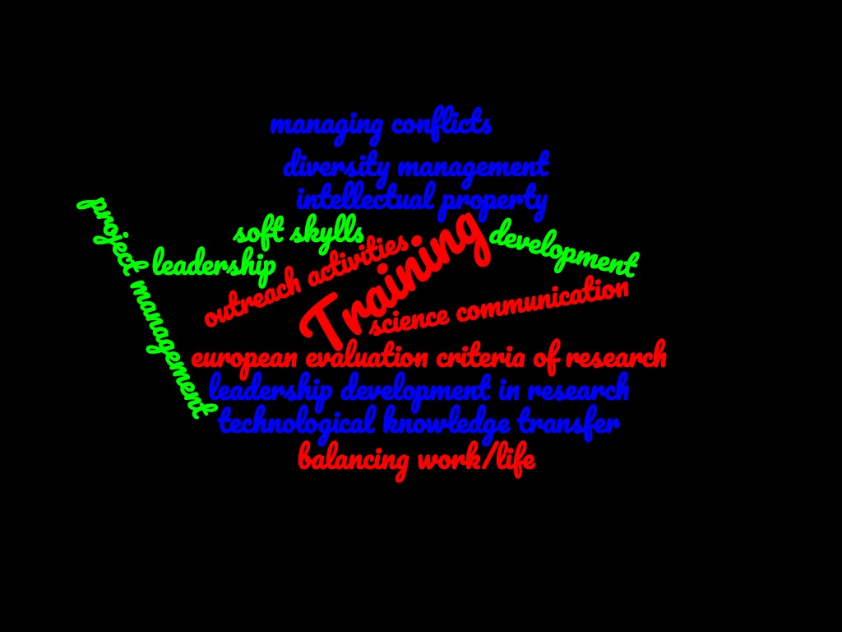
Fellini Training activities
H2020 MSCA COFUND
G.A. 754496
July 3rd 2020
1st Meeting with the second call FELLINI Fellows
Maria Rosaria Masullo (Na unit) Coordination Board
masullo@na.infn.it

Slide 2
Personal Career Development Plans (CDP)
Fellini is not only a research programme, but also « provide all Fellows with an
ideal basis for their future careers, preparing them for a wide range
of career options »
In this context the Personal Career Development Plan (CDP) is an important tool
Fellows are required to define their CDP at beginning of their programme, with input also from supervisors and the CB, according to their needs. CDPs will be formally updated annually (see Antonio Masiero presentation)
The CDP is a tool for researchers to plan, monitor and evaluate their progress in the acquisition of skills, experiences and advancement in their career.
The CDP will comprise fellows’ scientific objectives and training needs, including complementary skills:
primarily on scientific and technological knowledge through research on individual, personalised projects;
management and financing of research projects and programmes;
intellectual property rights;
entrepreneurship, how to create spin-off companies;
science communication, dissemination skills
soft skills
public engagment

Slide 3
The training inside FELLINI
Desirable competences to be developed for being a researcher in Europe:
Communicate with the wider community, and with society generally, about your areas of expertise
Coach PhD researchers, helping them to be more effective and successful in their R&D trajectory
Understand the value of your research work in the context of products and services from industry and other related employment sectors

Slide 4
The training inside FELLINI
Fellows participation to the existing INFN training programme and/or to ad hoc format
Train young researchers in their field of research
Provide opportunities for increasing managerial experience:
Improve the young researcher employment perspective
Enhance the multi-disciplinarity of training, increasing the level and quality of interaction with other excellent research centres and with private companies:
Strengthen the creative and innovative potential of researchers through intersectoral mobility
Training on Intellectual Property and Technology Transfer
Interdisciplinary research training
Improve soft skills of the fellows
Provide the researchers with organizational and soft skills necessary for team-based research work
Work-life balance, time management

Slide 5
Training funds
Available 300 €/month for training
According to fellow needs (see CDP) and to enhance their professional development, the fellow training funds can be used for the participation to:
schools, ad hoc courses directly related to the execution of the scientific project;
workshops or conferences regarding topics not strictly connected to the research project, but useful to develop complementary skills.
In addition to these opportunities, the fellows will have access to the INFN National Training Plan training programme. In these cases all the expenses will be covered directly by the national training funds.

Slide 6
INFN national training programme https://www.ac.infn.it/personale/formazione/
The national programme includes different technical and scientific courses, which change from one year to the other on the base of employees and administration requirements.
Some examples:
National training for Horizon EUROPE
Physics and Communication: Dissemination and Communication of european project
Physics and Communication: the scientist on the stage. The format and the activities
Normally the training language is Italian, but we can ask for English or organize national courses for English speaking people

Slide 7
INFN national training programme
LINKS
https://www.ac.infn.it/personale/formazione/
https://www.ac.infn.it/personale/formazione/pf2020/PIANO_FORMATIVO_NAZIONALE_2020.pdf
To see the list of courses
https://www.ac.infn.it/personale/formazione/piani-formativi.html
Go to DATABASE CORSI
Link on «Lista corsi». You can enter using your AAI id

Slide 8
An example: «Training on European Research Project Design – A focus on ERC » (approved for the Autumn)
Module 1: Orientation- Design – Project Studio
1) Orientation: categories of calls and opportunities (with deeper information on ERC)
2) Design: putting ideas on paper (tips to create a successful project structure)
3) Project studio: how to deal with project tools and instruments (tips to manage the project writing
and execution)
Module 2: Self-Branding - Speech - Stories
4) Self-Branding: writing and customizing an appealing CV (tips to adapt the CV to different
scenarios)
5) Speech: How to “defend” your project, activity and idea (tips to prepare a convincing speech for
different scenarios)
6) Stories: presentation of INFN ERC winners (tips succeed, from starting idea to the daily project
implementation)

Slide 9
An example of Training course: A first training on Public Engagement (approved for September 10-11)
The main aim of this training program is to provide an initial support to the early career researchers in public engagement activities, as outreach, research communication and school interactions.
The webinar course will include a theoretical and a practical part.

Slide 10
An example of Training course on Project Management
Introduction to Project management
organization, communication, documentation and management
Project Quality Management
verification and validation processes
Project Risk Management
risks and uncertainties

Slide 11
INFN Physics Schools
Examples of INFN schools
XXXII INTERNATIONAL SEMINAR of NUCLEAR and SUBNUCLEAR PHYSICS "Francesco Romano"
https://agenda.infn.it/event/21318/
Course on Innovative detector (theory and experiment)
https://agenda.infn.it/event/15095/program
XVII Seminar on Software for Nuclear, Subnuclear and Applied Physics and official Geant4 School
https://agenda.infn.it/event/20606/
https://www.facebook.com/SoftwareandGeant4School/?ref=aymt_homepage_panel

Slide 12
Which kind of useful expertise you can find inside INFN ……….
A national Committee on the «Third Mission» (outreach, dissemination): CC3M ( in each INFN division there is a local contact person)
The primary objective of the Committee is to coordinate local initiatives for the dissemination of scientific culture with an impact on a national level
A National External Funds unit for supporting the INFN researchers (in some INFN division there is a local contact person….work inprogress) :
https://fondiesterni.infn.it/index.php/it/
fondiesterni@lists.infn.it
A National Committe for Technological Transfer (CNTT) and a Central Office in Frascati ( in each INFN division there is a local contact person)
https://web.infn.it/TechTransfer/index.php/en/
Technology licensing, fostering innovation
A central Communication Office that takes care of INFN communication towards the external world and also national outreach events
http://home.infn.it/en/media-outreach
Comunicazione@presid.infn.it

Slide 13
Webinar on * Research Professional an extensive database of funding opportunities and research policy news platform
*Research Professional is an extensive database of funding opportunities and research policy news platform. Following an INFN request, *Research Professional will run two online training sessions with focus on how to use the service effectively to find relevant funding opportunities.
*Research Professional Online Tutorial 1 - Wed 01/07/2020 11:00 - 12:30 (Rome time)
*Research Professional Online Tutorial 2 - Wed 29/07/2020 15:00 - 16:30 (Rome time)
If you do not have a *Research Professional account yet, you can register with the service and create your account clicking the link below and inserting your institutional login details and following the instructions.
https://www.researchprofessional.com/site/infn
To access to the program you will need an INFN-AAI identity, that all INFN employees have.

Slide 14
Webinar on * Research Professional an extensive database of funding opportunities and research policy news platform
During the session attendees will learn how to:
Personalise your profile to receive the most relevant opportunities and news in your field;
Access insider expertise and proven know-how on research funding bodies using Funding Insight;
Interact with content found throughout the website and save your favourites for future review;
Share funding and news content within the platform and externally, using the Email and Download features;
View shared funding resources curated by your subscription administrators.
And will get overview of the global funding landscape within a nuclear physics and related disciplinary domains.

Slide 15
Training at companies
Fellows can opt for the opportunity to develop a part of their research project in the industrial environment through a secondment period they will spend at the companies, working at targeted projects defined such as to allow them to apply to their academic research the acquired experience at the company. The company could help them to find industrial and interdisciplinary applications of their work output.
Companies can provide training on*:
project management, technological processes, quality assurance methodology, product development
product lifecycle management, complex project coordination
financial planning of R&D activities
industrial development of R&D results in the microelectronic field
*Seven private companies have agreed to provide their official support to the FELLINI fellowship programme

Slide 16
A Mentoring Programme (MP)
The word itself was inspired by the character of Mentor in Homer's Odyssey. In ancient Greek (Μέντωρ) he is a character of Greek mythology, son of Alcimo. Though the actual Mentor in the story is a somewhat ineffective old man, the goddess Athena takes on his appearance in order to guide young Telemachus in his time of difficulty.
Mentor is different from a supervisor/tutor
Mentoring is multidimensional and involves more than the academic part of a person the way tutoring does—it concerns a persons’ life. A tutor assists someone with learning a new process or concept, whereas a mentor goes far beyond the role of a tutor.
A mentor intentionally focuses on building quality relationships, sharing life experiences and positive views on making the most out of a person’s future.
A tutor focuses on short term outcomes whereas mentoring improves the young person’s capabilities for life long learning.

Slide 17
A Mentoring Programme (MP)
The main goal of MP is to transfer to young researchers all the expertise needed:
to achieve leadership positions in research management, both in academia and in other public or private research centres
to develop personal skill and potential.
in addition, in an attempt to make a real impact on the careers of researchers, some training courses will be devoted to gender diversity management.
The mentors will belong to Italian and International research community (University and research centres) involved in research field different from the mentee one (transdisciplinary mentoring)
Our idea is to look for mentors among supervisors, among those who want to volunteer
The role of the mentor is:
to provide advice on career paths,
to help navigate organizational politics,
to be a sounding board about office politics,
to prevent isolation at work,
to help create a culture that better supports gender diversity managment
to take into account fellow CDP

Slide 18
A Mentoring Programme (MP)
The MP will last 10/12 months and will be organised in the second year of the fellowship. It will be a transdisciplinary mentoring program aimed to achieve the own professional development goals of the mentee and to develop their career skills.
The programme will be supported by other activities (such as training seminars, contact with SME, etc.) that will contribute to sustain the programme.
The programme is based on 5/6 meetings (face-to-face or via internet connection) that have to last 2hours each.
A model of relationship centered on mentees

Slide 19
A Mentoring Programme (MP)
The objective of MP is to support young researchers in the acquisition of the following skills:
Leadership development in research
Diversity management
National evaluation criteria of research
European evaluation criteria of research
Ability to apply as leader for funding programmes in research
Liaising between the university and private industry
Balancing work/life and leisure
Inclusive communication
Fundamental concepts of diversity and inclusion

Slide 20
QUESTIONS ?
Thanks for the attention

