Slide 1


Fellini funds and rules
Laura Bandiera –INFN FE
Project Manager
Contacts:
bandiera@fe.infn.it
fellini-office@lists.infn.it
H2020 MSCA COFUND
G.A. 754496

Slide 2
Fellini people
Coordination Board:
  Prof. Antonio Masiero (Project Coordinator) – UniPD & INFN PD
  Dr. Laura Bandiera (Project Manager) – INFN FE
  Dr. Alessia D’Orazio – INFN BO
  Dr. Paolo Giacomelli – INFN BO
  Ms. Luisa Iacono (Financial Officer) – INFN PD
  Dr. Maria Rosaria Masullo – INFN NA
  Dr. Chiara Meroni – INFN MI
  Dr. Pier Stanislao Paolucci – INFN Roma
  Dr. Michele Punturo – INFN PG

Slide 3
Fellini people
Fellini Office:
  Dr. Laura Bandiera (Project Manager) – INFN FE
  Ms. Luisa Iacono (Financial Officer) – INFN PD
  Ms. Alessandra Lombardo – INFN PD
  Ms. Giorgia Salvato – INFN PD
  Contacts: fellini-office@lists.infn.it
  N.B. For any request, please contact the Fellini Office!

Slide 4
Original Project Timeline
01/01/2018 - 31/12/2022
Due to the covid travel restrictions, some fellows of the 2° call cannot come to Italy to start their fellowships before the end of June 2020, as previously agreed.

Slide 5
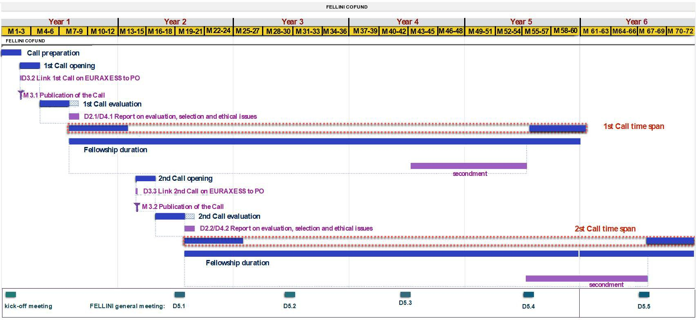
New Project Timeline
01/01/2018 - 31/12/2023
N.B. Each single fellowship lasts 3 years. In the GANTT the extension of fellowship duration is referred to the overall 30 fellowships duration, given the different start date for different fellows
A 1 year extension has been granted by the EU Commission via Amendment.

Slide 6
Budget
Travel refund to INFN work location
______________________
During the Fellini fellowship/partnership and during the secondment a dedicated budget will be avaible at the INFN Unit and for which each of you is responsible
Research funds
Training funds (300 €/month – see M. Masullo talk)

Slide 7

Travel Refund
Refund of the travel tickets to and from INFN work location at the beginning and at the end of the fellowship.
Maximum of € 1.000 (€ 500 per journey supported by evidence of travel and proof of costs).

Slide 8

Research funds
The funds are calculated as follows:
  for fellows in theoretical physics average of 800 euro/month;
  for fellows in experimental physics average of 1.200 euro/month.
At the beginning of each calendar year, the budget is calculated for the entire year. Any leftover budget from the previous year will be reassigned to the project around the end of March, as an INFN internal rule for all European funds.

Slide 9
Research funds
Movements of budget from a cost category to another are possible depending on the specific Project activities. Indeed, one of the aims of the FELLINI programme is to train you in managing funds of your own project.
The research funds can be used for activities, such as purchasing of equipment, participation to conferences/workshop/meeting on topics directly connected to your FELLINI project or inviting guests for scientific collaborations needed to realize the FELLINI Project activity.
Please consider that equipment purchased with Project funds remains property of INFN.

Slide 10
Secondment
The Fellini project includes a period of secondment, that can start from the second year of the fellowship, with a duration between six and twelve months*.
The secondment can also be split in 2 periods (minimum duration of six months) to be spent in the same external research institute or private company, or in 2 different ones.
*Originally the secondment duration was 1 year.

Slide 11
Secondment
The secondment has to meet the requirements of international, cross-sectoral or interdisciplinary mobility and can be spent:
in another institute or laboratory outside of Italy. A possible exception to this rule is the case where the research activity is interdisciplinary;
in a high-tech private company, also in Italy;
for researchers in the medical physics field, the possibility to spend a year in hospitals or hadron-therapy centres is also possible, in Italy or abroad.

Slide 12
What to do before the Secondment
You will submit to the Fellini CB the proposal of secondment, agreed with supervisor, describing the scientific motivation of the proposed choice.
In case of a secondment within a private company it is strongly recommended that the proposal is also discussed and agreed upon with some representatives of the company before the submission.
Once the proposal of secondment has been approved by the Fellini CB, the official activation procedure can start. This procedure typically takes at least three months.

Slide 13
During the Secondment
You will be fully involved in R&D teams of the Institution/company and you will have a local tutor (Senior Researcher/Manager), with a long-standing experience;
INFN supervisors and fellows will frequently meet to review the work done and evaluate the next steps, following the evolution of the research work;
It is expected that you will disseminate what you have learned to the other Fellows of the FELLINI project, through meetings, and to the INFN researchers, via seminars.

Slide 14
During the Secondment
Research and training yearly budget will be available also during the secondment and the research funds can also be used for the travel costs related to the secondment.
Expenses for research training, travel and conferences, will be paid by INFN also during the Fellows’ secondment period.
During the leave you will continue receiving the same salary from INFN.
A subsistence (e.g., additional salary, reimbursement of expenses..) can be provided by the hosting institution/company.
A further mobility allowance of a maximum of 4.980 euro (total gross value) can be provided. Depending on fiscal benefits, the net value could vary between about 2.500 and 3.500 euro. This further mobility allowance could be reduced: a) according to the eventual amount of subsistence provided by the institute/company or b) if the chosen secondment location does not require a home transfer;

Slide 15
Dissemination and Outreach
Dissemination ensures that the results of the research developed in each single FELLINI project are disseminated and exploited through communication and transfer into other research environments. Scientific publications and conference presentations are the major means of foreground dissemination.
Outreach ensures that the results of the research and their broader impacts are communicated to a larger audience involving the general public and the society.
Both aspects are fundamental for the success of the FELLINI Programme and for your career development.
Notes:
Ho aggiunto le scuole

Slide 16
Dissemination:
EU funding Aknowledgment
Remember that the fellow worktime has to be 100% on FELLINI project!
For all the presentations/posters/scientific articles related to the Project, the Commission requires to give appropriate information on EU funding and to the G.A. 754496.
Articles/Proceedings/Preprints: The following text must be included in all scientific papers: “This project has received funding from the European Union’s Horizon 2020 research and innovation programme under the Marie Skłodowska-Curie grant agreement No 754496”.
N.B. The above sentence must be used always if possible. In some cases (e.g., for a publication of the whole scientific collaboration of which the FELLINI project is just a part) the sentence can be modified as follow: [Fellow Name] has received funding….).
N.B. Remember that the fellow worktime should be 100% on FELLINI project!

Slide 17

Dissemination:
EU funding Aknowledgment
Presentations/Posters: The EU emblem must be always shown and the reference to the G.A 754496. Consider that the EU emblem must have an appropriate prominence when displayed with another one (e.g. the Project logo).
As an example see the next slide in which EU emblem, FELLINI logo and reference to G.A. are displayed!!!!
For details regarding the EU rules of ackowledge funding see: https://ec.europa.eu/research/participants/docs/h2020-funding-guide/grants/grant-management/acknowledge-funding_en.htm

Slide 18

Example of FELLINI fellow presentation
Enrico Fermi
H2020 MSCA COFUND
G.A. 754496

Slide 19
Dissemination:
Open Access rules
Open access to all peer-reviewed scientific publications relating to FELLINI results must be ensured. One can freely choose the most appropriate path to open access by following two possibilities:
1. Self-archiving ('green' open access) means that a published article or the final peer-reviewed manuscript is archived (deposited) in an online repository before (such as ArXiv etc..), alongside or after its publication. Repository software usually allows authors to delay access to the article ('embargo period'). If this route is chosen beneficiaries must ensure open access to the publication within a maximum of six months.
Reference: https://ec.europa.eu/research/participants/docs/h2020-funding-guide/cross-cutting-issues/open-access-dissemination_en.htm

Slide 20
Dissemination:
Open Access rules
Open access to all peer-reviewed scientific publications relating to FELLINI results must be ensured. One can freely choose the most appropriate path to open access by following two possibilities:
2. Open access publishing ('gold' open access) means that an article is immediately provided in open access mode (on the publisher/journal website). Publishers sometimes charge so called Article Processing Charges(or APCs) to make articles open. For such a cost one can use the money from FELLINI research budget. Since typically the cost of APCs could be few keuro, we recommend this way only for the main articles related to your FELLINI project (e.g. first/single author papers). In the case of gold open access publishing, open access must be granted at the latest on the date of publication and you also have to deposit a copy in a repository.
Reference: https://ec.europa.eu/research/participants/docs/h2020-funding-guide/cross-cutting-issues/open-access-dissemination_en.htm

Slide 21






Outreach and CC3M @INFN
And much more… ERN, MasterClass, Open Labs, Pint of Science, etc..
https://web.infn.it/CC3M/index.php/it/attivita-e-ricerca

Slide 22
Outreach activities
FELLINI OUTREACH
Participation as Marie Curie Fellows to the European Researchers' Night;
Selected projects for short interviews to be published on Youtube.

Slide 23
Outreach activities
FELLINI OUTREACH
Inside INFN UNIT
Participation as Marie Curie Fellows to the European Researchers' Night;
Selected projects for short interviews to be publised on Youtube;
To support your positive integration in the INFN Unit, you could choose one or more of the outreach actvities already carried out in the INFN Unit.
Please contact the CC3M local responsible to have more information about the outreach activities.

Slide 24
Fellini network
Yearly Workshop/meeting in which all the fellows present their scientific research, discuss and exchange scientific material
Exchange Seminars within INFN Units
Fellini training programme -> see Masullo talk
Fellini website - https://web.infn.it/fellini/ - where to collect the main news (e.g. important papers, prizes, interviews)
Notes:
Ho aggiunto le scuole

Slide 25
Thank you for the attention!

