Slide 1
Particle experiment on the Moon
Is Gravity involved in particle Physics?
Can Gravity give contribution to CPV?
Can Antimatter have a repulsive gravitational interaction?
Nanni Piacentino

Slide 2
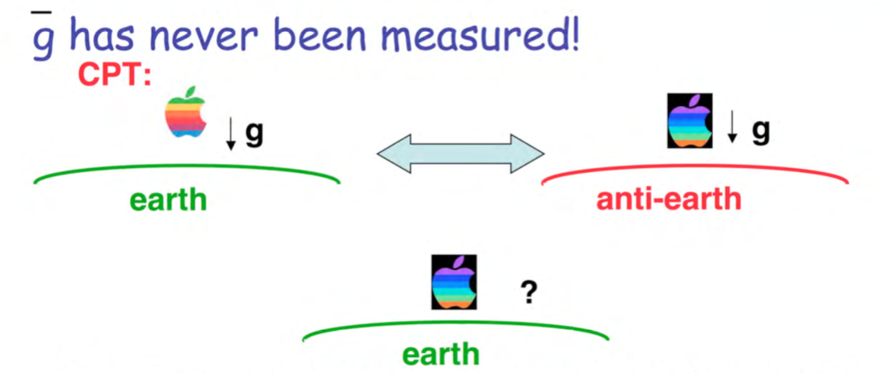
Gravitational Repulsion?
Antimatter particles correspond to negative energy solution;
Could this correspond to a negative gravitational mass and to a consequent gravitational repulsion between matter and antimatter?

Slide 3
This could be an opportunity
Antigravity can mimic the CP violation in the Kaon system:
The reason that the weak force sees the kaon as a linear superposition of K and anti-K is that they ‘mix’
W W
d
s

Slide 4
Opportunity
Tha Neutral Kaons Physics is extremely complex. Let us consider just the decay of the long lived one : and the short lived one , They are also different CP eigenstates, , decades in 9 x 10⁻¹¹ seconds conserving CP, infact π⁻ π⁺ has CP = +1
CP = +1 CP = +1 conserved
π⁻
π⁺

Slide 5
Opportunity
decays in π⁻ π⁺ π⁰ (in 5 x 10⁻⁸ secondi).
conserving CP, because π⁻ π⁺ π⁰ has CP = -1.
CP = -1 CP = -1 conserved
π⁺
π⁰
π⁻

Slide 6
Opportunity
This is what should appen:
CP conserved
But (once in 500 times):
(CP = +1)
(CP = -1)
CP violated

Slide 7
This could be an opportunity
Antigravity can mimic the CP violation in the Kaon system:
The reason that the weak force sees the kaon as a linear superposition of K and anti-K is that they ‘mix’
W W
d
s

Slide 8
The gravitational field is described by the acceleration g so the components of antimatter and matter of a meson are divided by a distance growing with the time that can be written as:

Slide 9
The time useful for the phenomenon is a fraction Ω^{-½} of the mixing time Δτ where:
Where τ_{s} is the life time of K_{s}

Slide 10
The dimension of a K meson is about 0.5 fm or:
The ratio:
Is the adimensional constant that characterizes the phenomenon

Slide 11
The answer could antigravity

Slide 12
And obtain the CPV parameter as:

Slide 13
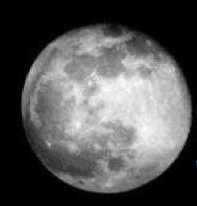
But on the Moon
g_{Moon}=1,62m/s² =16,53% g _{Earth}
So that we expect a huge effect on

Slide 14
Cosmic Protons on the Moon surface
﻿A direct measurement of the flux of protons on the lunar surface has not yet been made, but Ackermann 3et al. [20] fit the data of the gamma albedo from the Moon surface due to the incoming proton flux finding it to be equal, within a 10% uncertainty, to the proton flux measured by AMS-02 [21] and PAMELA [22]. We can considered the proton flux as determined by AMS-02. ﻿The rate of incoming protons when integrated on the permitted entrance to the detector can reach as many as 2.2⇥10⁴ protons per second. The energy of the cosmic protons ranges from a few MeV to ⇠200 GeV with the maximum flux around 1 GeV and several smaller local maxima at 5, 13, and 31 GeV.
So the incident proton spectrum is energetic enough for the production of KL allowing for a measurement of R

Slide 15
Active Target
Distance for the
Decay of the
produced K _{S}
Permanent
Magnet
Or solenoid
based on solar
cells power
supply
Tracker Layers
RICH
ECAL

Slide 16
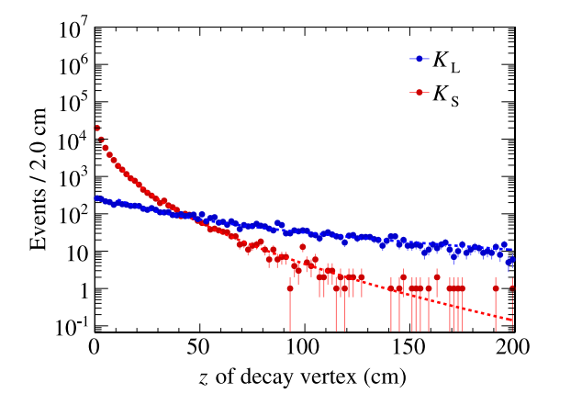
K_{L}➔cτ=15,34 m K_{s}➔cτ=2,6844 cm

Slide 17
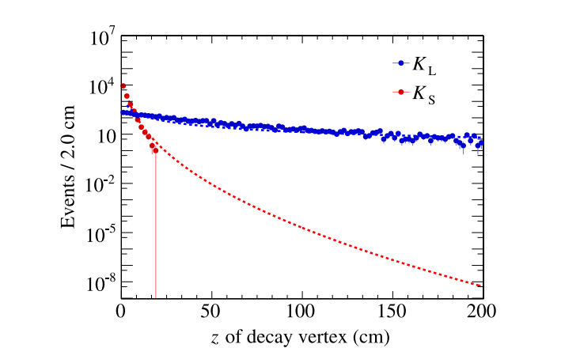

Slide 18
The Moon Village Program

Slide 19
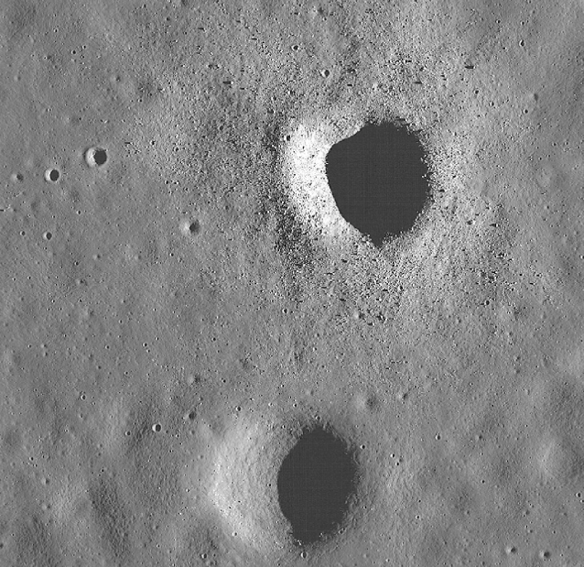
Small Craters could be a good solution for holding the detector

Slide 20
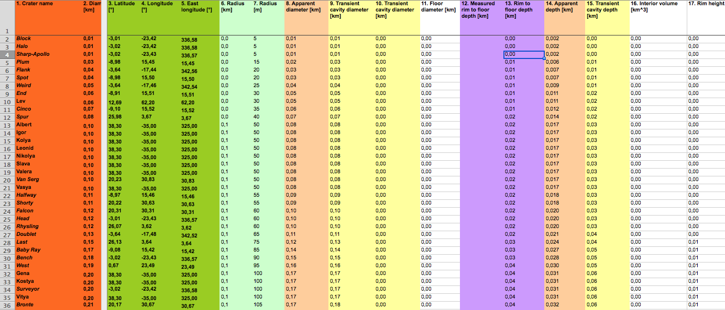
A few small Craters

Slide 21
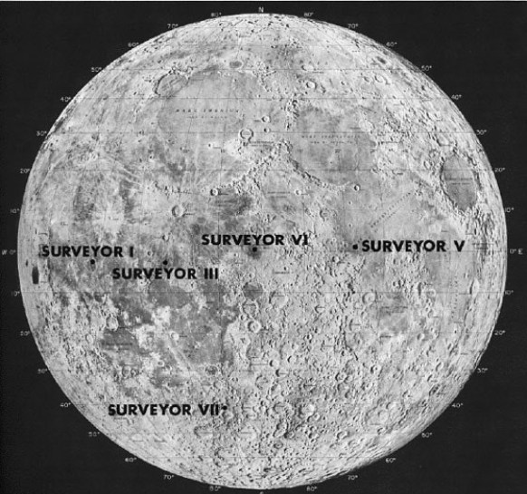
Optimum Equatorial position

Slide 22
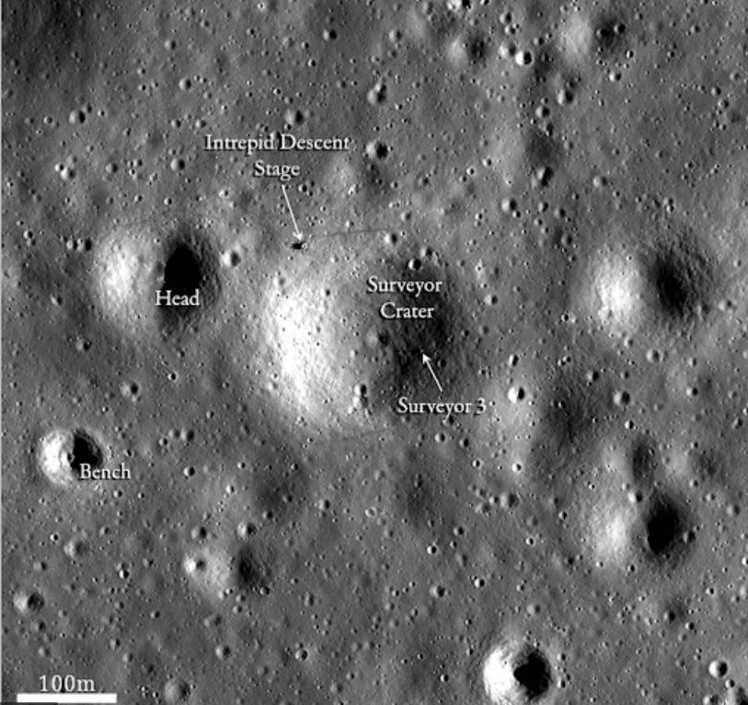
Interesting Craters
20 metri
31 metri
30 metri

Slide 23
State of the studies
Anthony simulated the production on aLEO orbit:
Antonio and Francesco (Trento) simulated the production on AMS2, We d have event files
We started a study for a trigger on Klong in AMS2 by learning machines

Slide 24
Thanks

Slide 25
The third point; the Good argument
Myron Good observed that if the gravitational potential is explicitly assumed to have absolute meaning the difference of energy between ne neutral kaons ,

Slide 26
The third one; the Good argument
This would induce a time evolution of the components
Of the kind:
So to a K_{s} regeneration

Slide 27
The third one; the Good argument
Similar arguments are possible also for non absolute potentials.
At the time of the Good argument, CP violation was still unknown.
Even if we now know that CPV is connected to KMC Matrix we will take advantage from the Good argument in the following

Slide 28
Experimental Tests to weigh the antimatter
• Weigh an antiproton and a positron: huge problem of residual electric fields
• Gravity ≈ 10-7 V / m for antiproton, 10-11 V / m for an electron ...
• Can be possible for cold antiprotons using quantum electronics (Single Electron Transistor): V. Bouchiat, G. Chardin, M.H. Devoret and D. Esteve, Hyperfine Interactions 109 (1997) 345
• Weigh the positronium e + e-through cooled source: AP Mills, M. Leventhal, NIM B 192 (2002) 102
• Weigh the AD to antihydrogen at CERN J. Walzl and T.W. Hänsch, Gen. Relat. and Grav. 36 (2004) 561

Slide 29
opportunity
the argument is symmetrical:
we can estimate the typical energy of a photon produced by the virtual creation/annihilation of a particle of mass m in a gravitational field g. From Heisenberg we can probe the space at the length scale:

Slide 30
opportunity
so the typical photon energy should be:
that is an approximate expression
of the Unruh Hawking temperature

Slide 31
opportunity
so the typical photon energy should be:
that is an approximate expression
of the Unruh Hawking temperature

