Slide 1
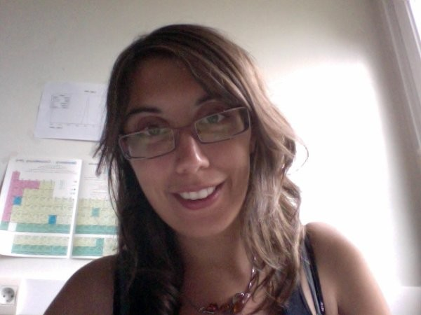
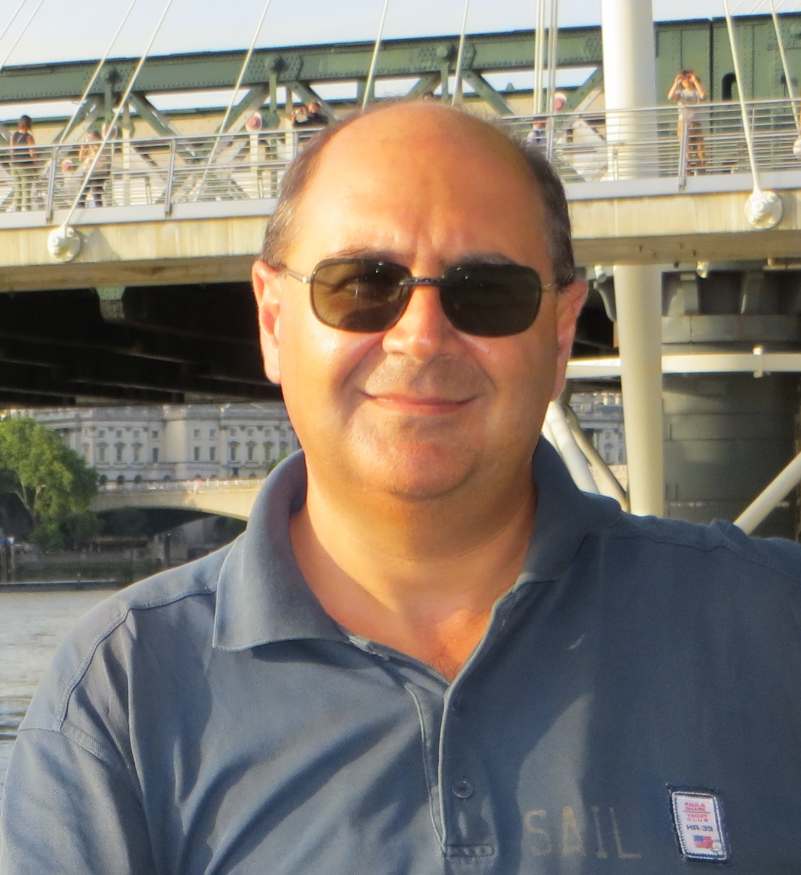
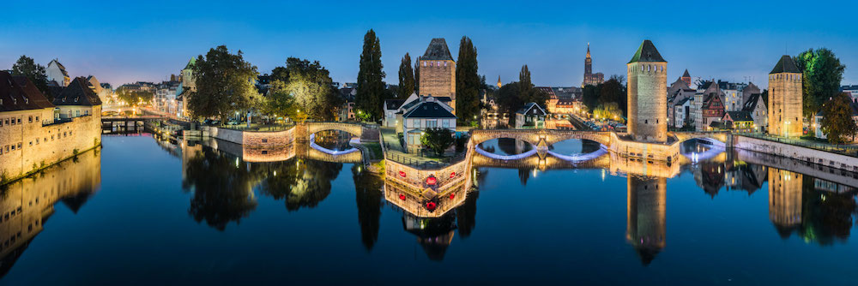
Editorial Board Report
Chiara la Tessa, Marie Vanstalle, Mauro Villa
III Virtual Strasbourg meeting 24/05/2021
1

Slide 2
Outline
EB Meetings and internal working
Papers
Published, submitted, writing, to be started….
Authorship
Conferences
Talks given, proceedings, ….
Forthcoming conferences

Slide 3
EB Meetings and internal working
Meetings every 4 weeks continue… but short: 1h
Repository of relevant information on Google docs
Effective work sharing:
Papers/proceedings are reviewed by all EB members
Conference searches by all
Conference advertisements is done by all EB members
Every interesting conference is assigned to one EB member
She/he will follow the candidate speakers or poster presenters in all phases
Abstract submission/presentation reharsal/proceeding writing and submission

Slide 4
Papers – published since 2020
I. Mattei et al, Measurements of ¹²C fragmentation cross sections on C, O and H in the energy range of interest for particle therapy applications, IEEE TRPMS. 4
L. Galli et al, Fragment charge identification technique with a plastic scintillator detector using clinical carbon beams, NIM A 953
Y. Dong et al, The Drift Chamber detector of the FOOT experiment: Performance analysis and external calibration, NIM A 986 (2021) 164786
M. Morrocchi et al, Performance Evaluation of the TOF-Wall Detector of the FOOT Experiment, IEEE Trans. Nucl. Sci. (doi:10.1109/TNS.2020.3041433)
G. Battistoni et al, Measuring the impact of Nuclear Interaction in Particle Therapy and in Radio Protection in Space: the FOOT experiment, Front. Phys. 8 (2021) 568242
A. C. Kraan et al, Charge identification of nuclear fragments with the FOOT Time-Of-Flight system, NIM A 1001 (2021) 165206
G. Galati et al, Charge identiﬁcation of fragments with the emulsion spectrometer of the FOOT experiment, Open Physics (2021) accepted

Slide 5
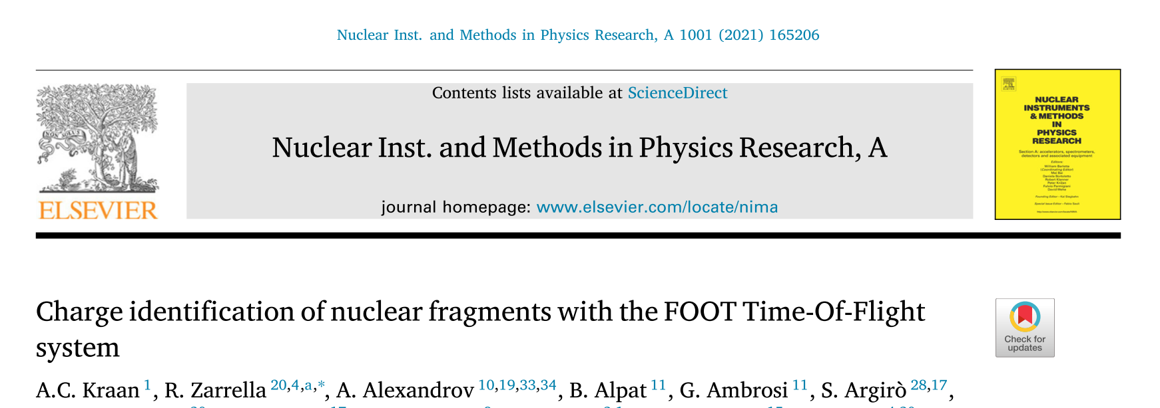
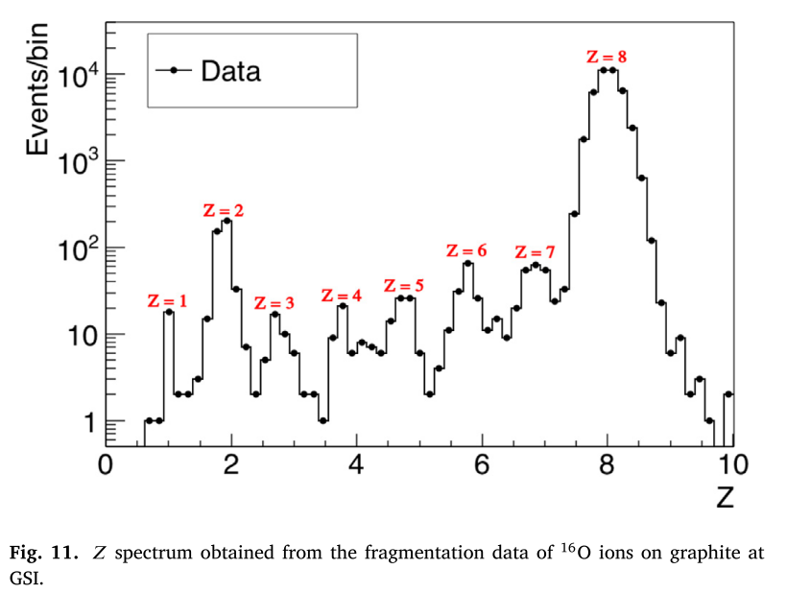
p
¹⁶O
¹²C

Slide 6
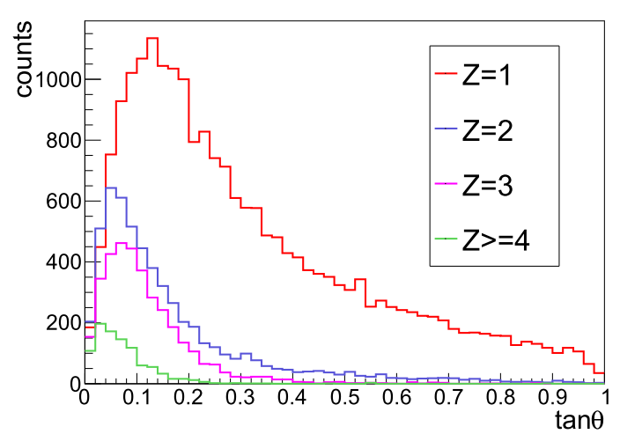
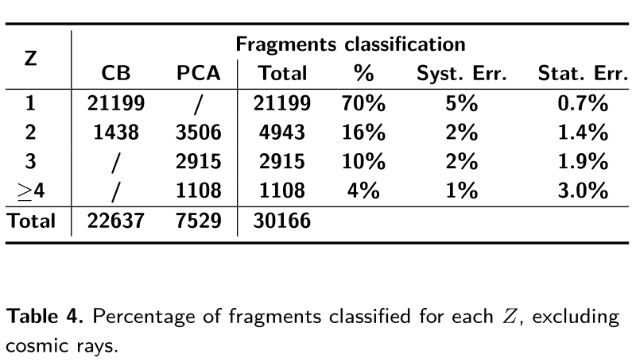
………..

Slide 7
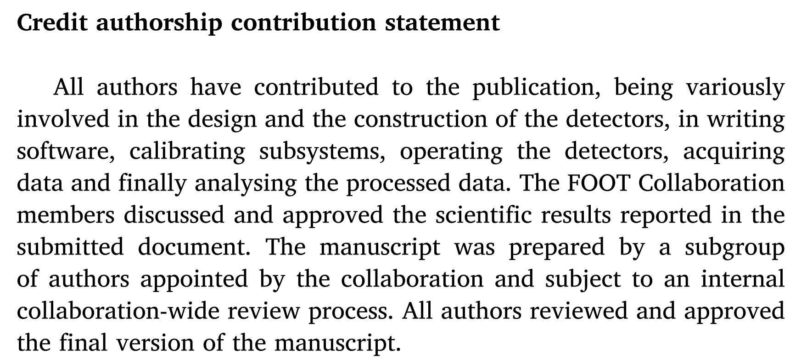
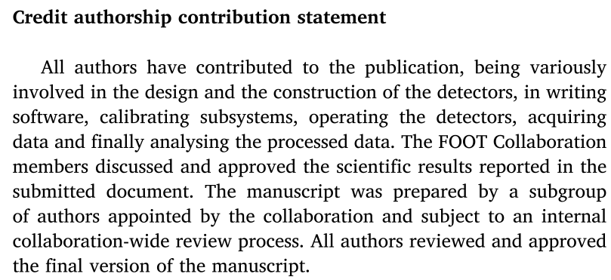
Papers – credit authorship

Slide 8
Papers – submitted

Slide 9
Papers in the writing stage (we know of)
1. P. Cerello et al, Performance of the Calorimeter Module for the FOOT experiment
it describes:
- the design of the FOOT Calorimeter,
- the lab tests
- the beam test results (GSI & CNAO)
Status: at the first round of comments in the EB
2. P. Cerello et al, Simulation of the optical photon propagation in the
FOOT calorimeter module
It describes:
- the optical transport of photons inside a calorimeter cell
- comparison between Monte Carlo and Data
Status: just received by the EB: feedback within a week from now
Target journals: NIM, Journal of Instrumentation

Slide 10
Forthcoming papers - physics papers
GSI 2019 – Emulsion runs – ¹⁶O @200 MeV/n on C, H targets
Cross sections for proton, helium and litium production in fragmentation processes
A paper on GSI 2020 data will follow
GSI 2019 / CNAO -
Nuclear fragments production in ¹⁶O @200 MeV/n on C, H targets, 2 < Z < 8.
Based on Z identification on ΔE and TOF measurements
CNAO
Production cross section at 32° and 50°

Slide 11
Forthcoming papers - technical papers
Technical paper on MSD
On beam data taken at Trento in 2021
Technical paper on DAQ performance
On beam data taken at GSI in 2021
Other technical papers could be foreseen:
On VTX performance (GSI 2021)
On the global reconstruction (GSI 2021)
Currently the lack of data is the major showstopper!

Slide 12
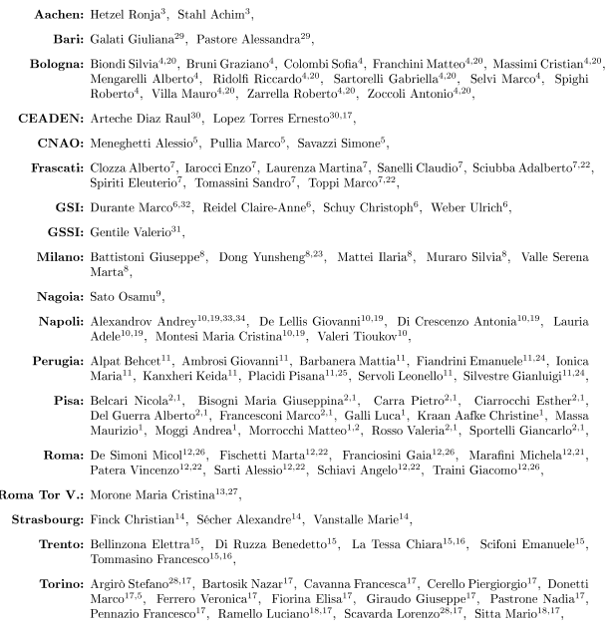
Authorship 2021
99 Authors
34 Institutions
Italy, France, Germany, Japan, Russia, Cuba
3 Continents (Europe, Asia, America)
List here for you to check!

Slide 13
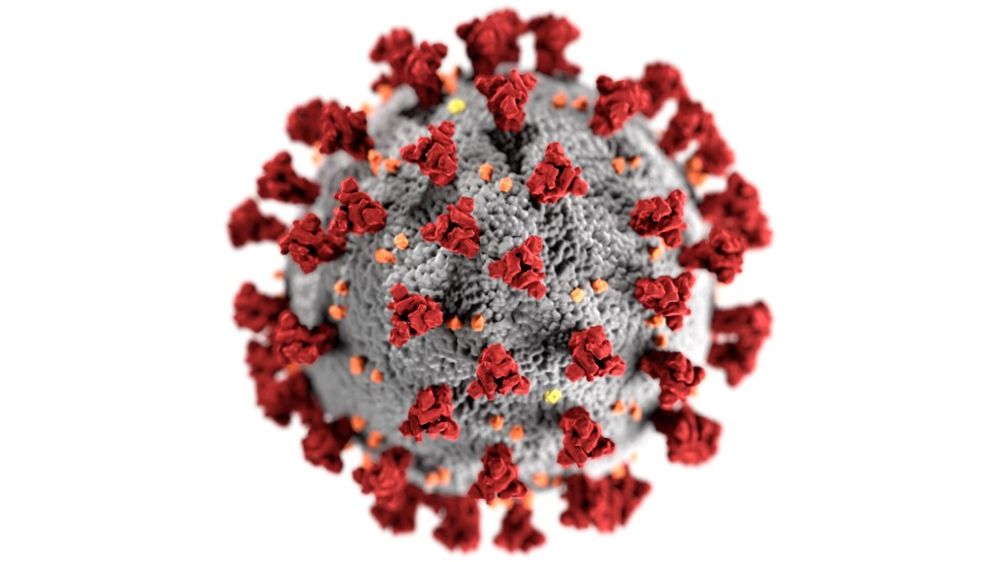
Conferences (survival stories)
2016
Talk 1
2017
Talks: 4
2018
Talks: 12
Posters: 7
2019
Talks: 20
Posters: 2
2020
Talks: 13
Posters: 3
2021
Talks: 10
Posters: 3
and counting
All conferences of 2020 were either postponed to next year or held online. Some 2021 conferences have been postponed to 2022. However, the FOOT-print is still strong.
?

Slide 14
Name | Abstract dead line | where | when | Talk or poster | Person
BTTBW |  | Online | 9-12/2 | Talk | R. Ridolfi
BTTBW |  | Online | 9-12/2 | Talk | B. Di Ruzzo
PTCOG59 | 28/02/21 | Online | 4-7/6 | Poster | G. Franciosini
RAD2021 | 28/02/21 | Herceg Novi | 14-18/6 | talk | M. Franchini
ANCP 2021 | 31/05/21 | Online/Praga | 12-17/9 | Talk | S. Colombi
IWORID | 31/3/21 | Ghent | 27/6-1/7 | Talk | G. Franciosini
TIPP2021 | 7/2/21 | online | 24-29/5 | Talk | B. Di Ruzzo
TIPP2021 | 7/2/21 | online | 24-29/5 | Poster | G. Silvestre
TIPP2021 | 7/2/21 | online | 24-29/5 | Poster | N. Bartosik
SIF2021 | 7/5/21 | online | 13-17/9 | Talk | F. Peverini
SIF2021 | 7/5/21 | online | 13-17/9 | Talk | R. Zarrella
SIF2021 | 7/5/21 | online | 13-17/9 | Talk | A.De Gregorio
SIF2021 | 7/5/21 | online | 13-17/9 | Talk | M. Montefiore
Twepp |  | Bergen (No) | 20-24/9 |  | K. Kanxheri
NSSMIC 2021 | 6/5/21 | Online | 16-23/10 |  | L. Scavarda
NSSMIC 2021 | 6/5/21 | Online | 16-23/10 |  | M. Barbanera
PANIC 2021 | 20/6/21 | Lisbon | 30/8-3/9 |  | A. Trigilio (AM)
PANIC 2021 | 20/6/21 | Lisbon | 30/8-3/9 |  | A. Lauria (AM)

Slide 15
Should we participate to online-only conferences?
The scientific community is all in the same boat
Cont:
Capturing attendee attention
is difficult
Social interaction is difficult
No new friends, no new experiences
No city visiting
Pro:
Make YOUR work known
Make FOOT work known
Have proceedings!
ZOOM MEETING

Slide 16
Proceedings from 2020 online conferences
RT2020, S. Biondi, The FragmentatiOn Of Target Experiment (FOOT) and its DAQ system, TNS
SIF2020, M.C. Montesi, The FOOT experiment, NC
SIF2020, R. Zarrella, Calibration and performances of the full scale ΔE-TOF prototype of the FOOT experiment, NC
SIF2020, Y. Dong, The FOOT drift chamber performance, NC
SIF2020, R. Ridolfi, The magnetic spectrometer of the FOOT experiment, NC
NUCLEUS2020, S. Biondi, The FragmentatiOn Of Target (FOOT) experiment
ICNFP, S. Colombi, Enhancing the understanding of fragmentation processes in hadrontherapy and radioprotection in space with the FOOT experiment
7 proceedings; 5 in indexed journals

Slide 17
Forthcoming conferences
(PANIC2020, online, 5-10/9) (ANPC, Prague, 12-17/9)
Ganil Colloquia, Vercours France, 27/9-1/10/22
Radiation Research Society meeting, Portorico, 3-6/10
IBIC2021, online, 13-16/9
Bormio Meeting, Bormio, Winter 2022
Vienna Conference on Istrumentation, feb 2022
Calor 2020 moved to 2022, Brighton, UK, 16-20/5/2022
and several others ….
LOOKING FOR
S
Don’t be shy!

Slide 18
Summary
Despite the difficult times, we are well alive in the scientific community!
Papers, presentations and proceedings have been produced!
New data will give us new opportunities for papers and presentations to conferences.
Be ready to be a part of this effort!
From the Editorial board, thank you for your help and collaboration!

